Slide 1
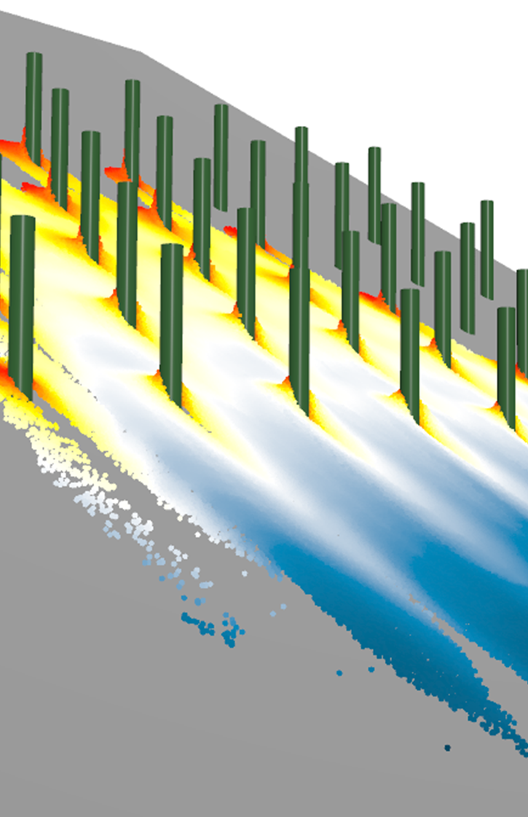



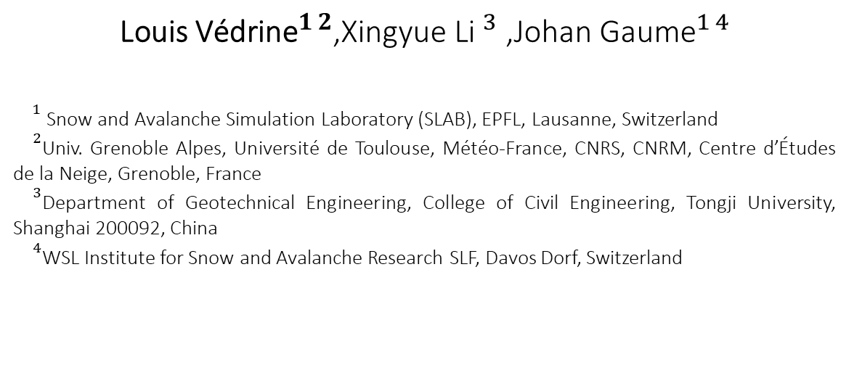
Detrainment and braking of small to medium snow avalanches interacting with forests
${\text{Louis} \text{V}\text{é}\text{drine}}^{1 2}$,${\text{Xingyue} \text{Li} }^{3}$ ,${\text{Johan} \text{Gaume}}^{1 4}$
${}^{1}$Snow and Avalanche Simulation Laboratory (SLAB), EPFL, Lausanne, Switzerland
${}^{2}$Univ. Grenoble Alpes, Université de Toulouse, Météo-France, CNRS, CNRM, Centre d’Études de la Neige, Grenoble, France
${}^{3}$Department of Geotechnical Engineering, College of Civil Engineering, Tongji University, Shanghai 200092, China
${}^{4}$WSL Institute for Snow and Avalanche Research SLF, Davos Dorf, Switzerland
EGU 2022, VIENNA, 25 May 2022

Slide 2
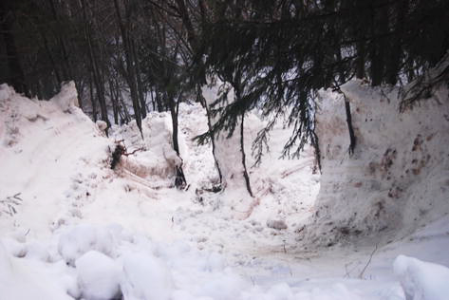
Introduction
Observations :
the presence of trees tends to reduce the run-out distance of the avalanches, this protective effect depends on :
the snow properties
the forest density
the type of trees and their arrangement ...
Detrainment of avalanche snow by trees.
Photo: F. Perzl, 2008.
How to model the forest-avalanche interaction ?
Detrainment approach (Feistl et al., 2015)
Based on snow mass stopped in the forest
Frictional approach
Increase of the two friction coefficients of the Voellmy model
2

Slide 3
Introduction
Observations :
the presence of trees tends to reduce the run-out distance of the avalanches, this protective effect depends on :
the snow properties
the forest density
the type of trees and their arrangement ...
Detrainment of avalanche snow by trees.
Photo: F. Perzl, 2008.
How to model the forest-avalanche interaction ?
Detrainment approach (Feistl et al., 2015)
Based on snow mass stopped in the forest
Frictional approach
Increase of the two friction coefficients of the Voellmy model
Need to quantify the mass stopped per unit of area $M_{d}$
3

Slide 4
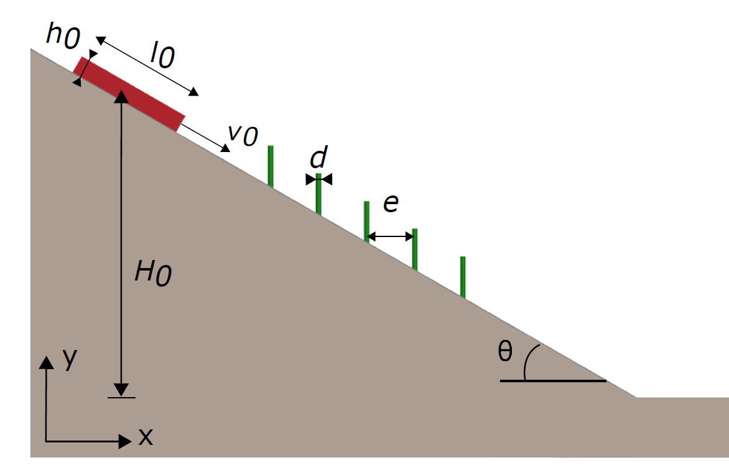
Methodology
Model setup hypothesis:
trees not destroyed (rigid obstacles) for small & medium avalanches
Side view of the model setup of MPM simulations of snow avalanches impacting trees
How to model the forest-avalanche interaction ?
Detrainment approach (Feistl et al., 2015)
Based on snow mass stopped in the forest
Frictional approach
Increase of the two friction coefficients of the Voellmy model
Need to quantify the mass stopped per unit of area $M_{d}$

Slide 5
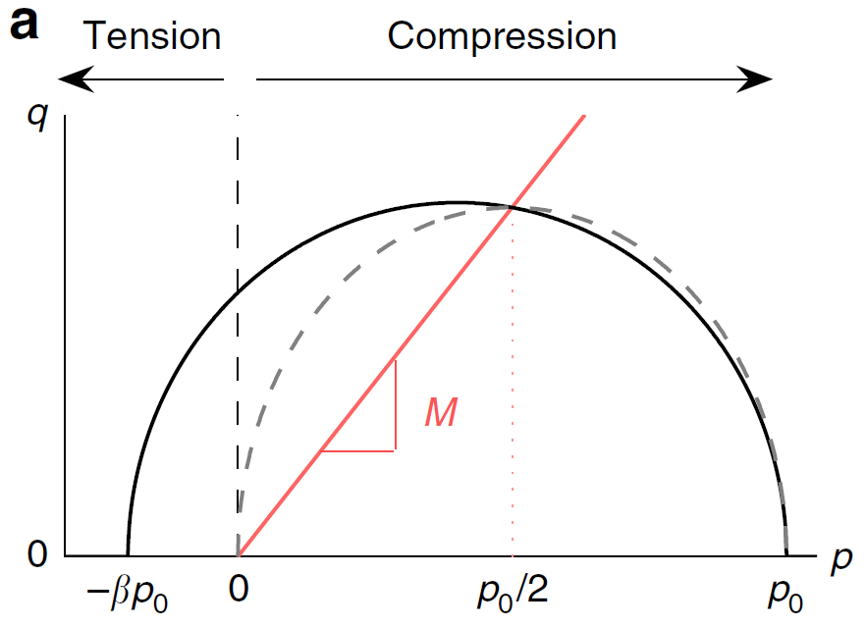
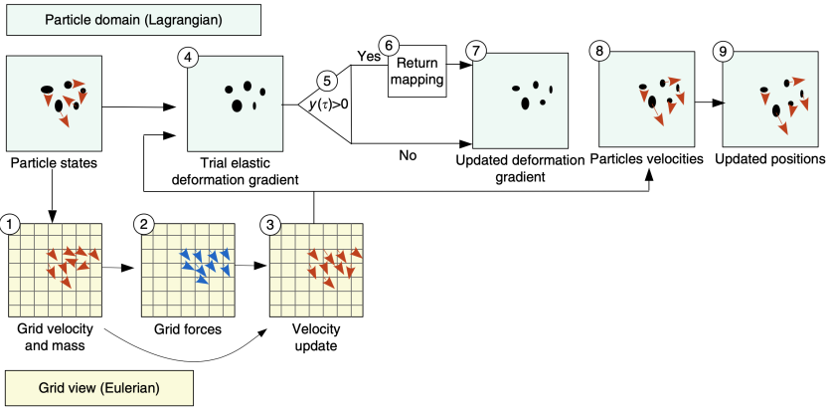
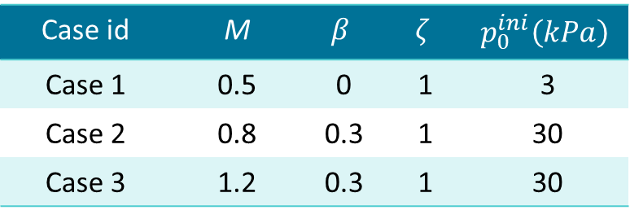
Methodology
Consitutive relation: modified Cam Clay model (from Gaume et al., 2018)
Case id | M | $$β$$ | $$ζ$$ | $$p_{0}^{ini}\left(kPa\right)$$
Case 1 | 0.5 | 0 | 1 | 3
Case 2 | 0.8 | 0.3 | 1 | 30
Case 3 | 1.2 | 0.3 | 1 | 30
Overview of the MPM method (from Gaume et al., 2018)
Snow properties adopted in the MPM modelling of the flows for three typical flow regimes

Slide 6
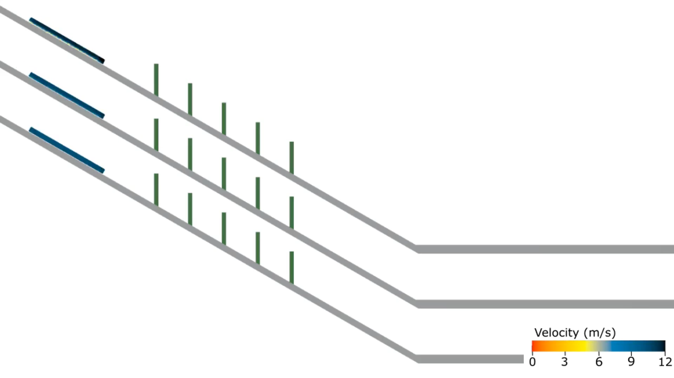
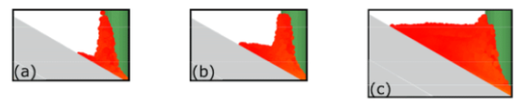
Results : influence of snow properties
(a)
(b)
(c)
Snow more cohesive and frictional
Profile of accumulated snow for different flow regimes: (a) Case 1, (b) Case 2, and (c) Case 3, e=8 m, d=1 m, and v₀=10 m s⁻¹

Slide 7
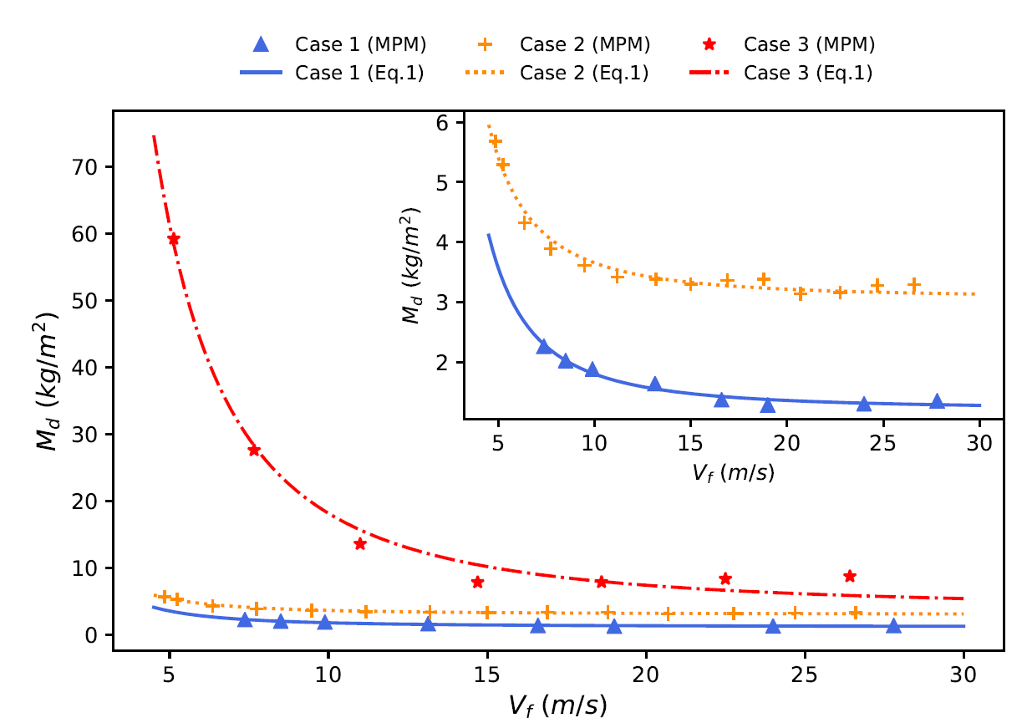
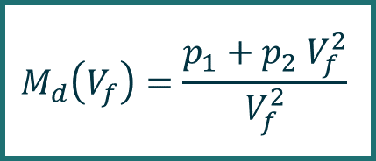
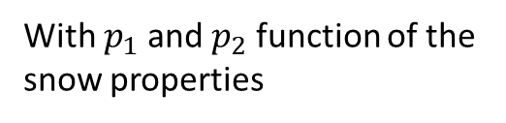
Results : influence of the avalanche velocity
$$M_{d}\left(V_{f}\right)=\frac{p_{1}+p_{2} V_{f}^{2}}{V_{f}^{2}}$$
With $p_{1}$ and $p_{2}$ function of the snow properties
Evolution of the detrainment mass per unit of area of snow with the velocity (regular staggered forest, e=8 m).

Slide 8
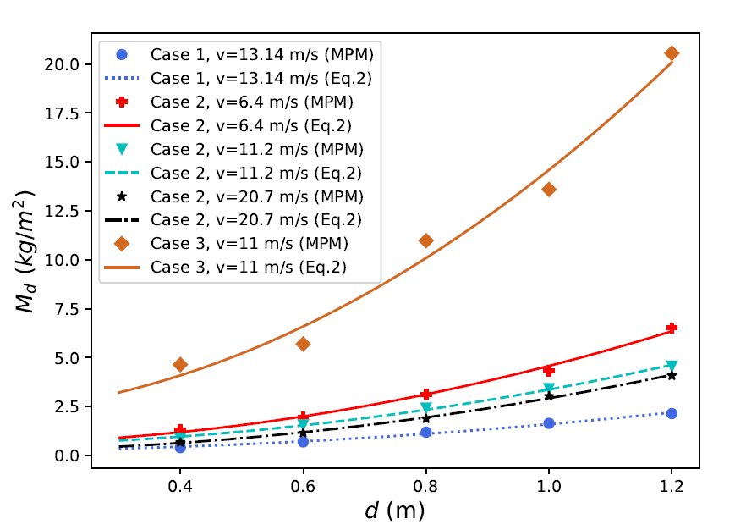
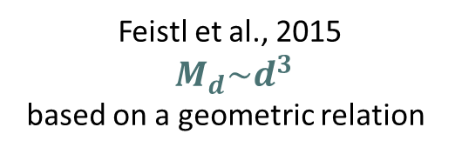
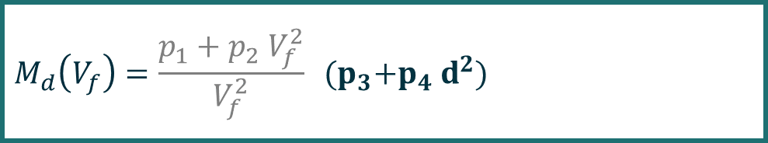
Results : influence of forest parameters
Feistl et al., 2015
$M_{d}\sim d^{3}$
based on a geometric relation )
Evolution of the detrainment mass per unit of area with the tree diameter for different types of snow and front velocity
$$M_{d}\left(V_{f}\right)=\frac{p_{1}+p_{2} V_{f}^{2}}{V_{f}^{2}} {(p}_{3}+p_{4}{ d}^{2})$$

Slide 9
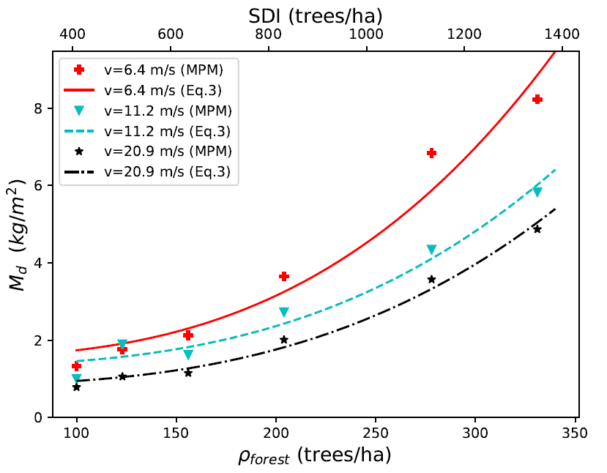
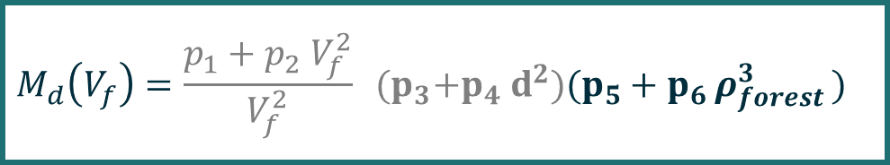

Results : influence of forest parameters
$SDI=ρ_{forest}{\left(\frac{d}{0.25}\right)}^{1,605}$
Evolution of the detrainment mass per unit of area with the tree diameter for different types of snow and front velocity
Evolution of the detrainment mass per unit of area with the forest density for different front velocities (snow properties: Case 2, d=0.6 m)
$$M_{d}\left(V_{f}\right)=\frac{p_{1}+p_{2} V_{f}^{2}}{V_{f}^{2}} {(p}_{3}+p_{4}{ d}^{2})(p_{5}+p_{6 }ρ_{forest }^{3})$$

Slide 10
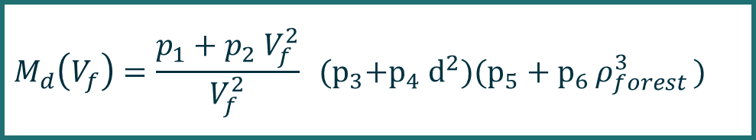
Results : influence of forest parameters
Evolution of the detrainment mass per unit of area with the tree diameter for different types of snow and front velocity
Evolution of the detrainment mass per unit of area with the forest density for different front velocities (snow properties: Case 2, d=0.6 m)
$$M_{d}\left(V_{f}\right)=\frac{p_{1}+p_{2} V_{f}^{2}}{V_{f}^{2}} {(p}_{3}+p_{4}{ d}^{2})(p_{5}+p_{6 }ρ_{forest }^{3})$$

Slide 11
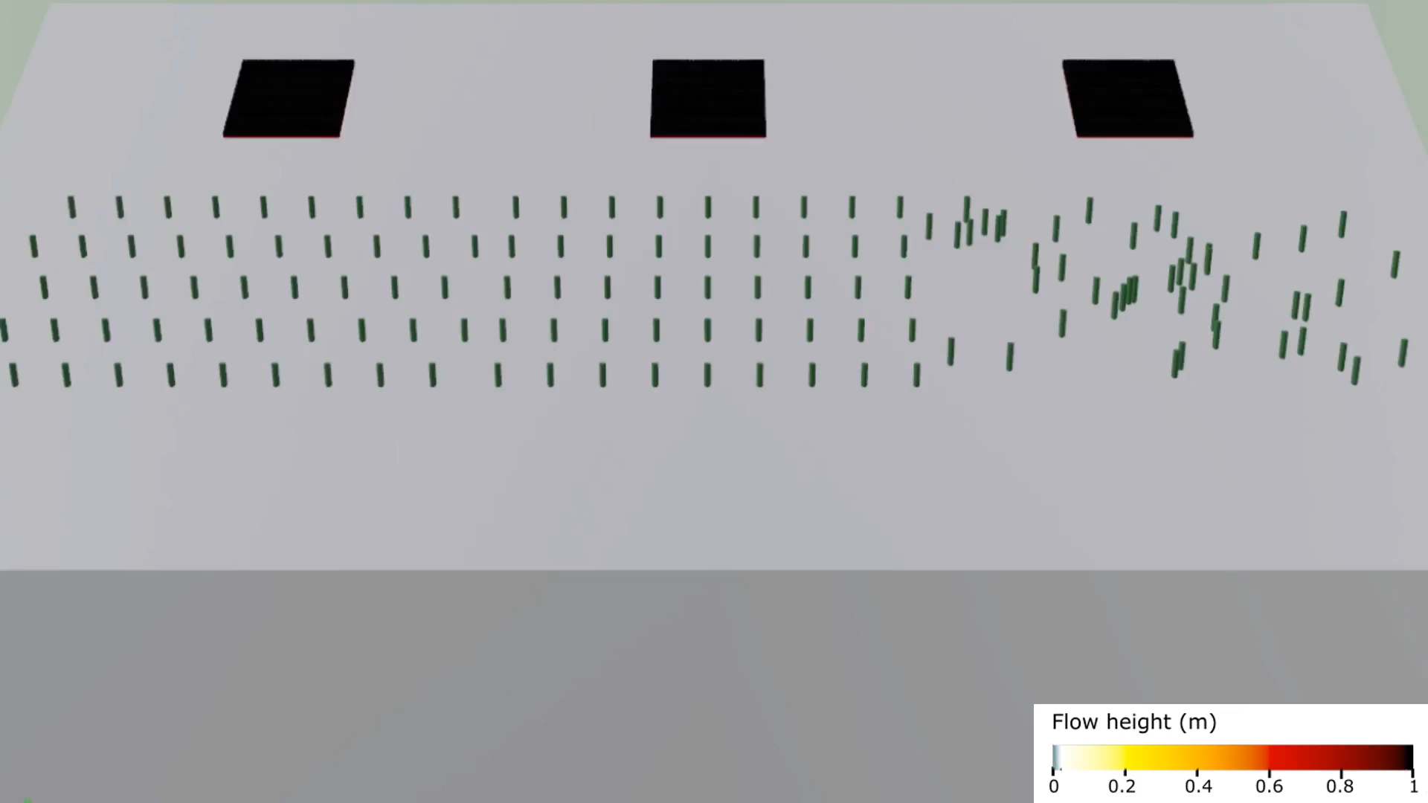

Outlooks
(a) (b) (c)
Investigate the influence of the tree arrangements
Study the release process in forested area
Improvement of the avalanche-forest interaction models in operational simulation tools
Flow height of the avalanche in a forest with (a) staggered arrangement,
(b) aligned arrangement, (c) random arrangement, (Case 2,${ v}_{0}=6 m/s$)
Contact :
If any questions or enquiries, I am available by e-mail :
Louis Védrine <louis.vedrine@ens-paris-saclay.fr> or <louis.vedrine@meteo.fr>

