Slide 1



Identification and quantification of sources and sinks of carbonyl sulfide
Grant N°742798
Alessandro Zanchetta, Linda M.J. Kooijmans, Steven van Heuven, Andrea Scifo, Bert Scheeren, Jin Ma,
Ivan Mammarella, Ute Karstens, Harro A.J. Meijer, Maarten Krol, and Huilin Chen
EGU22 – BG2.2, May 24th, 2022
Alessandro Zanchetta – a.zanchetta@rug.nl
ESRIG – CIO, University of Groningen – Nijenborgh 6, Groningen (NL)

Slide 2

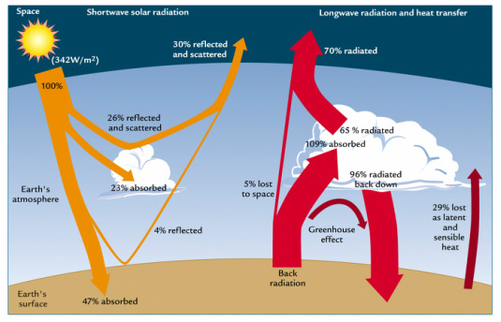
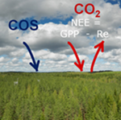
Introduction
Carbonyl sulfide (COS): a gas species involved in C and S cycles.
Currently associated to a slightly negative net radiative forcing.
Absorbed by plants similarly to CO₂: potential tracer for GPP.
But there are many uncertainties: estimated missing source is 230-800 GgS/year.

Slide 3
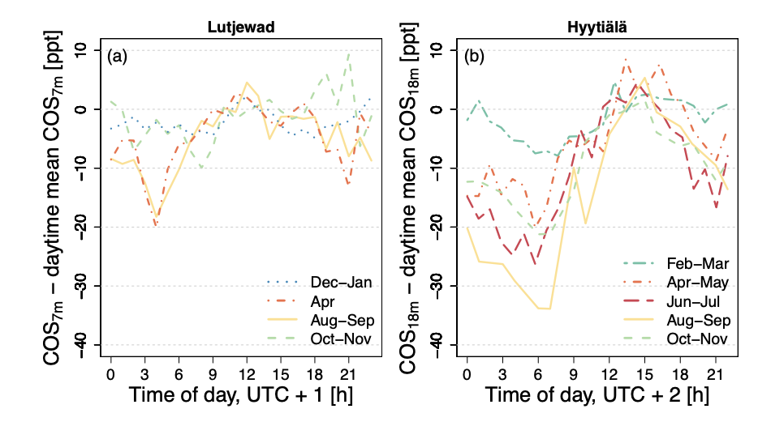
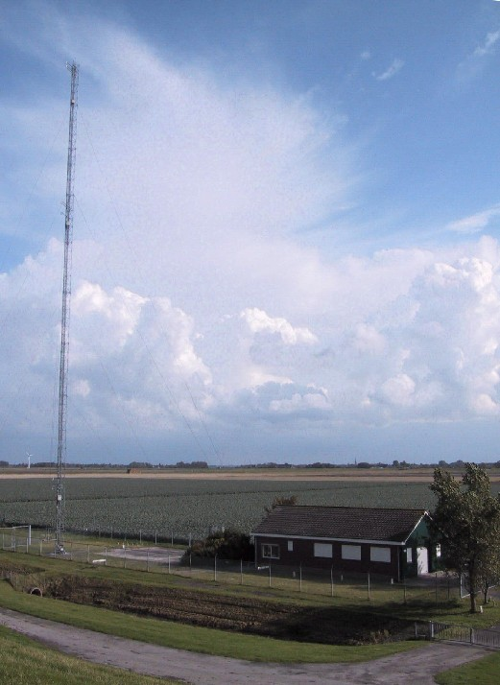
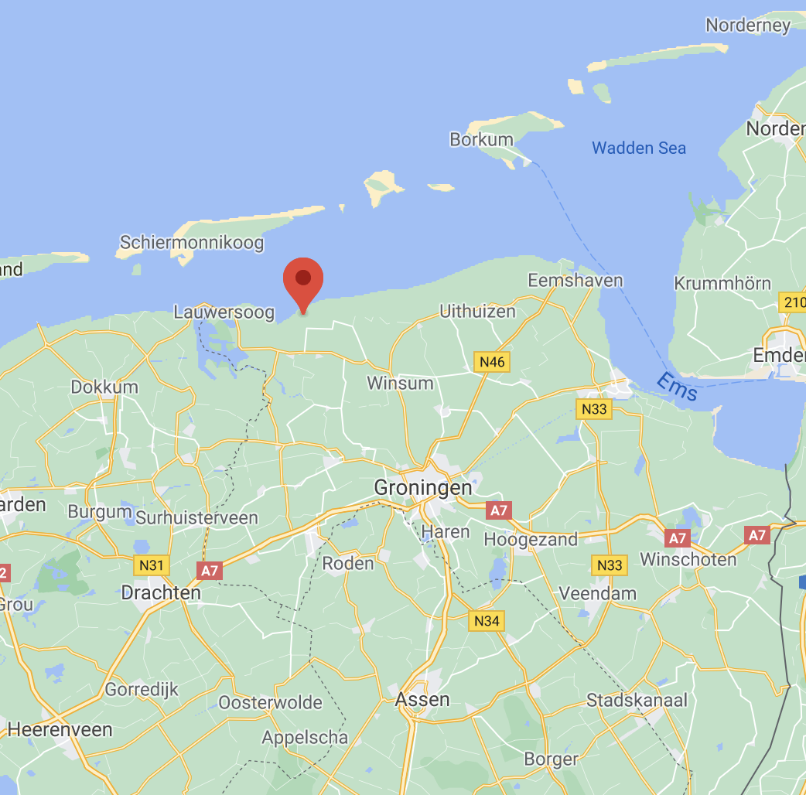
Introduction
Nighttime sinks related to sites rich in vegetation
Median nighttime F(COS) = -3.0 ± 2.6 pmol m⁻² s⁻¹
-2.9 ± 2.2 pmol m⁻² s⁻¹ from August to November 2015
-7.2 ± 2.8 pmol m⁻² s⁻¹ in April 2015
A few positive F(COS) were measured during
nighttime in the ploughing season
(Kooijmans, 2018)
(Kooijmans, 2018)
Lutjewad
Kooijmans (2018): Monthly average diurnal cycle of COS mole fractions minus the mean daytime mole fractions to indicate the seasonal variation of the diurnal cycle amplitude.
Lutjewad, ICOS measurement station

Slide 4
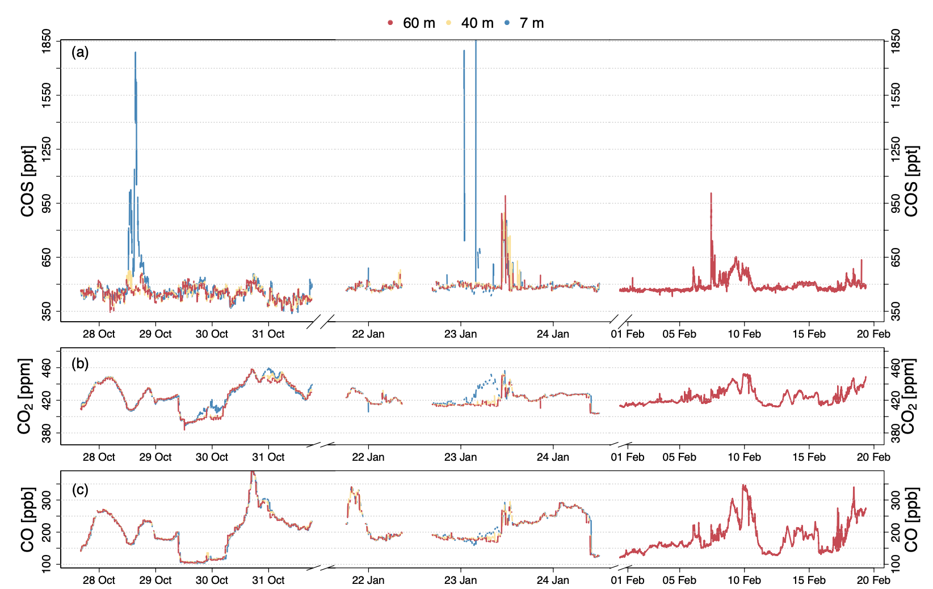
Research questions
COS plumes observed in Lutjewad.
Are there known and/or unaccounted anthropogenic COS sources in the province of Groningen?
Could they explain the enhancements
that have been observed in Lutjewad?
(Kooijmans, 2018)

Slide 5
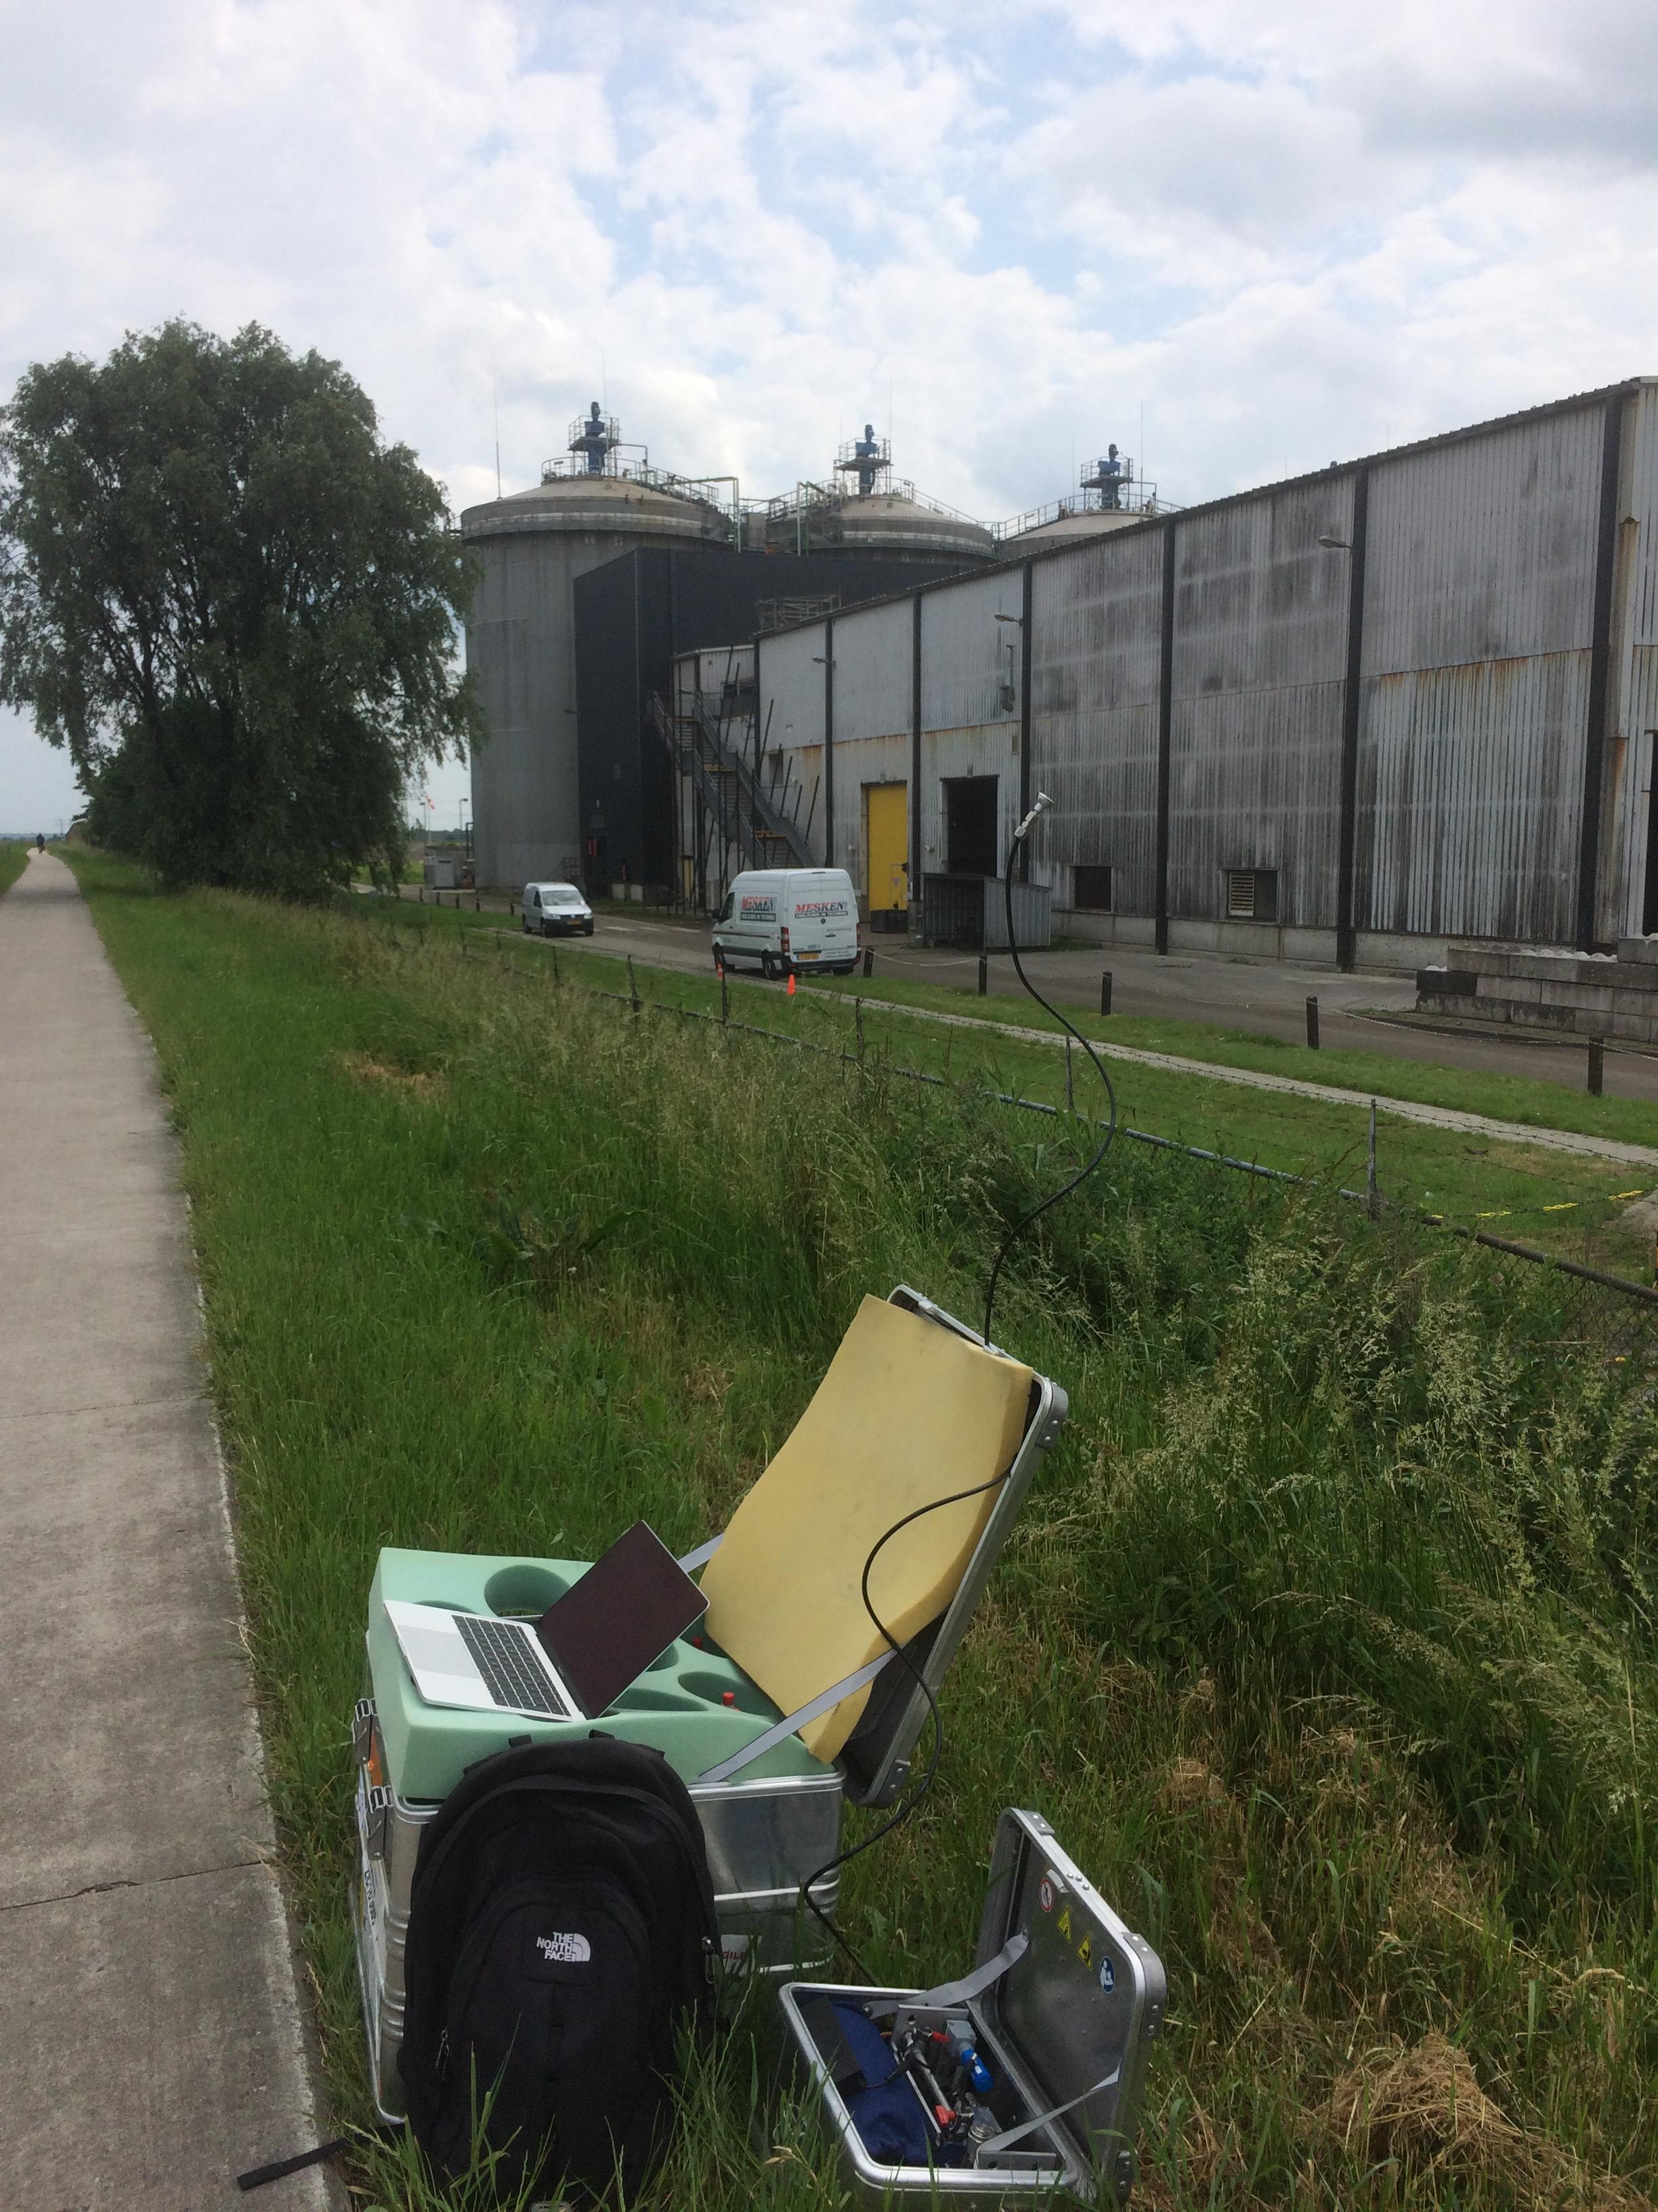
Methodology
Identification of local anthropogenic sources
  Sampling activities
  Known sources from literature (e.g. industries, power plants)
  Potential sources (mobile sampling)
Quantification of COS emissions
Implementation of COS data in available models and databases
  Stocastic Time-Inverted Lagrangian Transport (STILT)
  F(COS) – biospheric and anthropogenic databases, plus the new sources
Inlet
Pump and flask
Discrete sampling of waste treatment plant and biodigesters (June 2019)

Slide 6
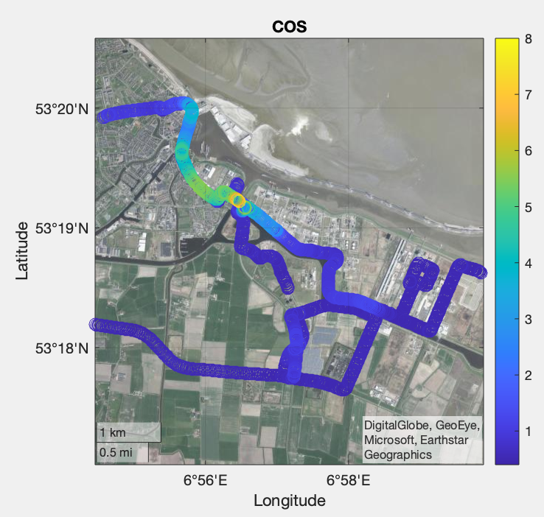
First step: sampling activities
In-situ mobile sampling and
flasks measurements:
COS emissions at biodigesters and at (bio)gas- and coal-related industries.
Highest estimated COS flux: 31.4 µmol/s.
Correlation with CO emissions
(2-10 pptCOS/ppbCO), occasional correlations with CH₄ and CO₂
Somewhat similar to the emissions
measured in Lutjewad…
Ploughing was not proven as a COS source.
ppb
Delfzijl
Wind direction
Farmsum

Slide 7
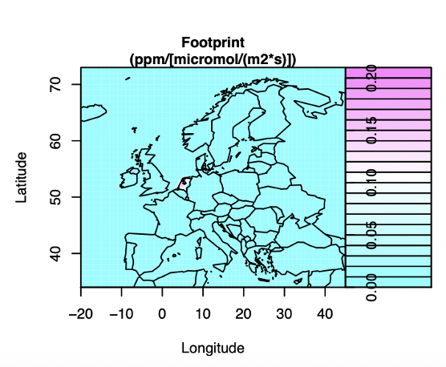
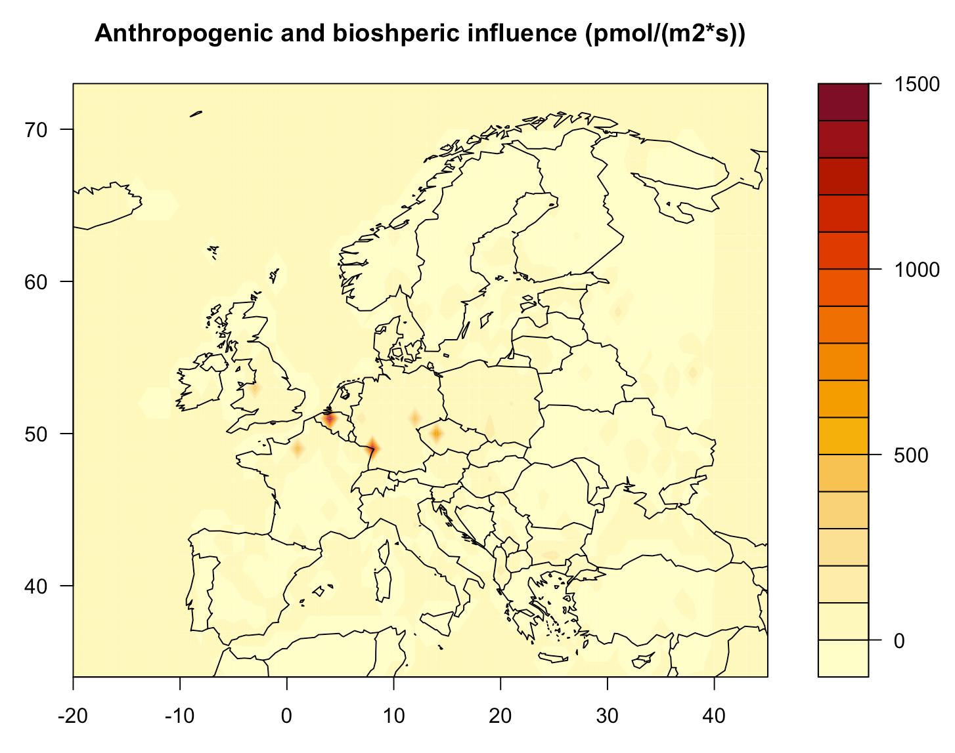
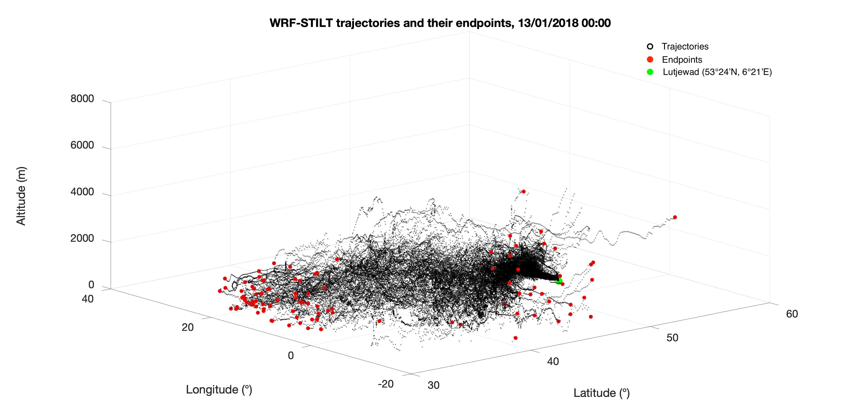

Second step: implementation in models
Background $(ppt)$ + (Footprint $(\frac{ppm}{µmol/(m^{2}∗s)})$* Flux $(\frac{pmol}{\left(m^{2}∗s\right)})$) = COS $(ppt)$
TM5-4DVAR
STILT
Biospheric + Anthropogenic
Ma et al. (2021)
(ICOS carbon portal)
(SiB4, Kooijmans)
Zumkehr et al. (2018)
and local sources
Latitude
Longitude

Slide 8
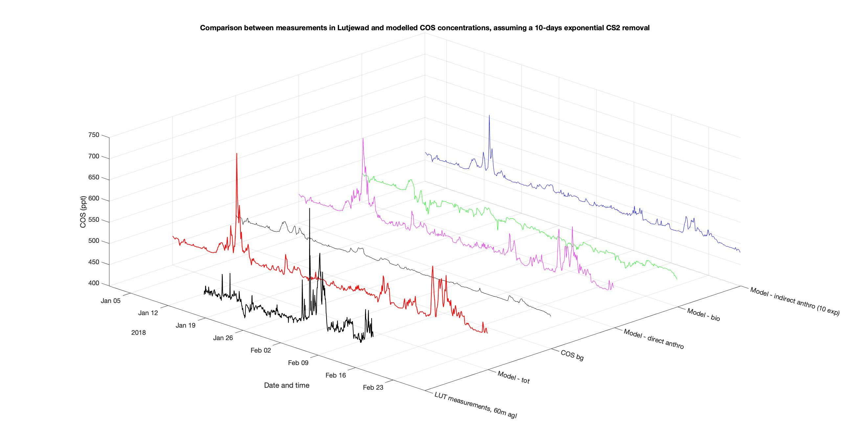
Results: models
Indirect anthro
Direct bio
Direct anthro
COS background
Model - total
Measurements

Slide 9
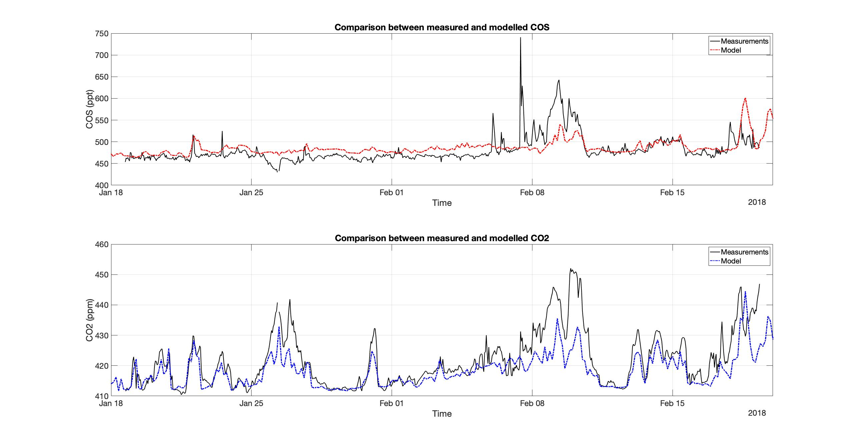
Results: models and measurements

Slide 10
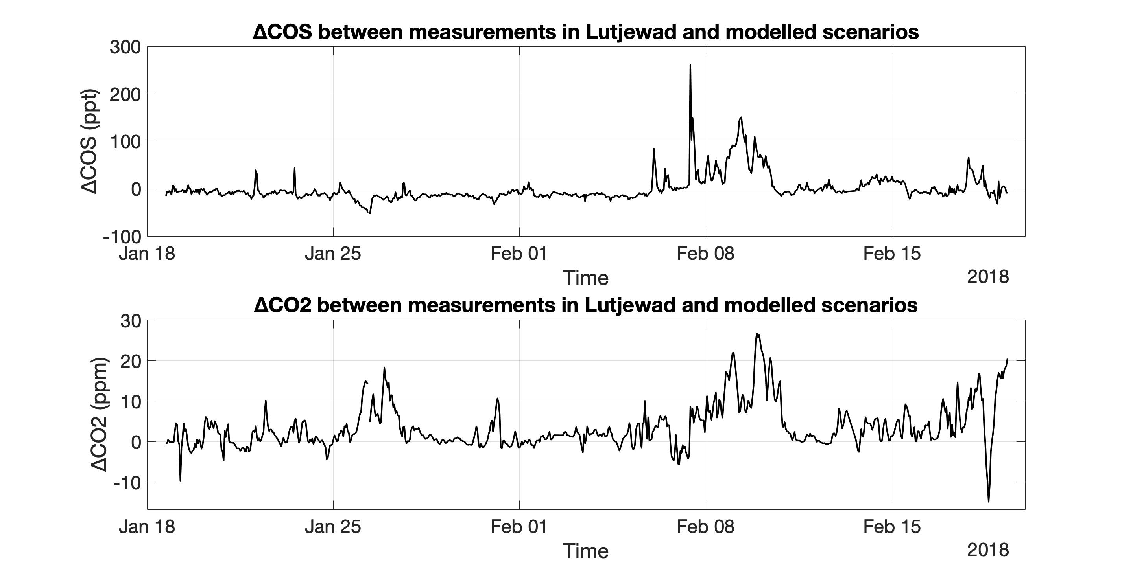
Results: models and measurements
∆COS = Measured COS – Modelled COS
∆CO2 = Measured CO2 – Modelled CO2

Slide 11
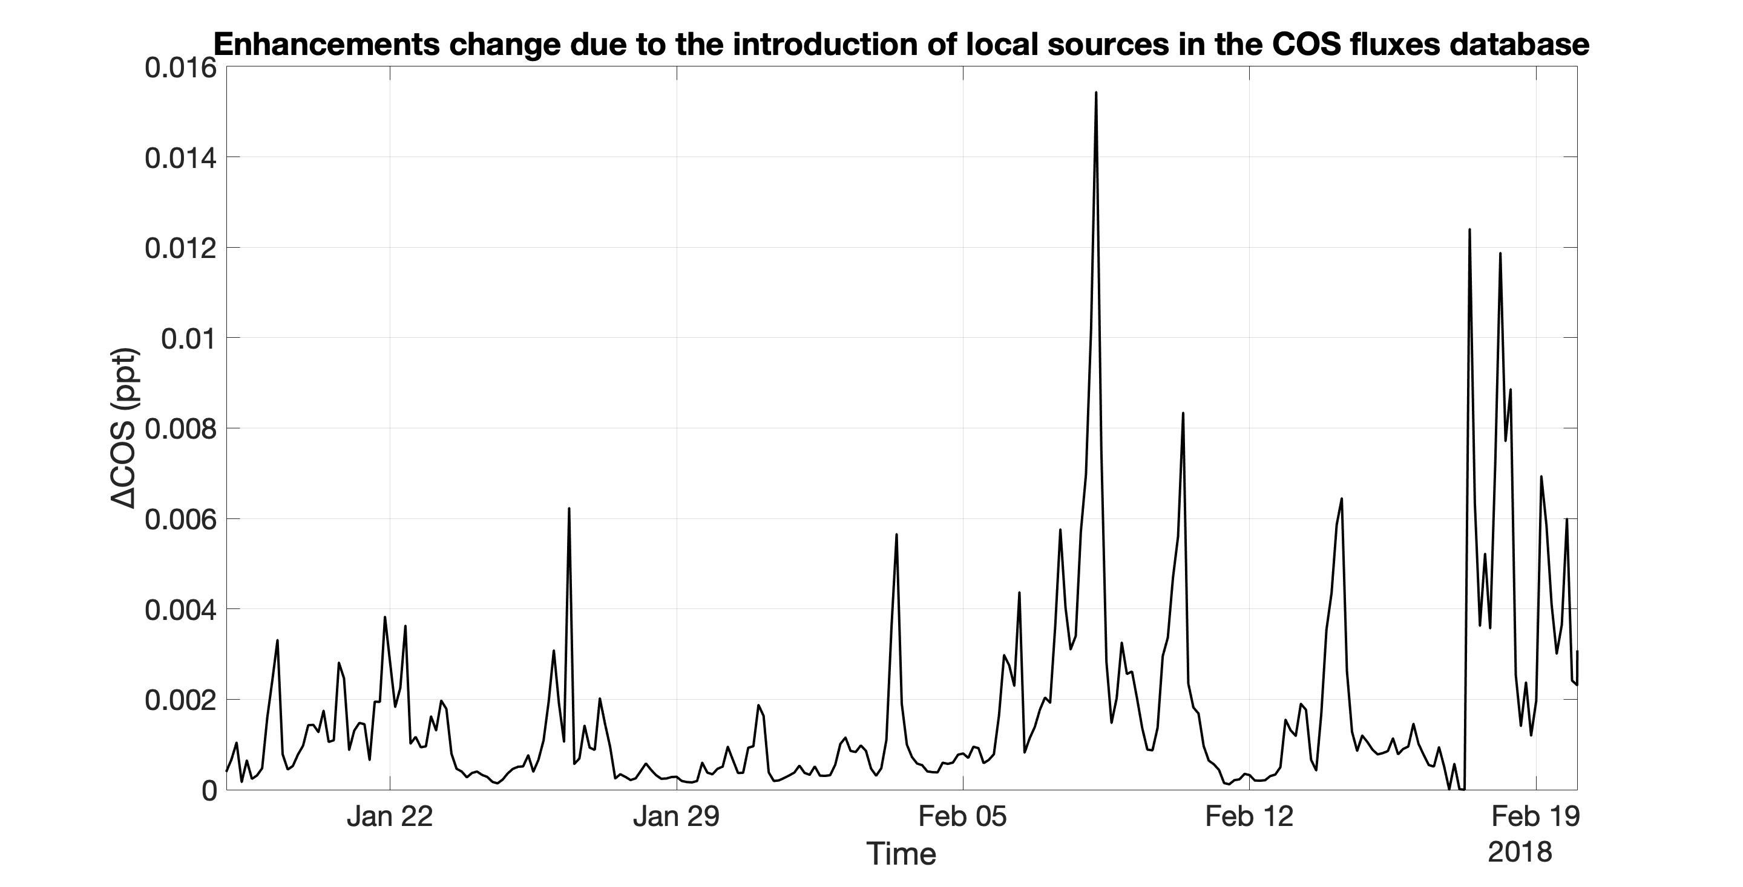
Results: models and measurements
∆COS = Model with local sources – Model without local sources

Slide 12
Discussion: localization of sources
Highest peaks can be partially justified by known industrial sources in Europe.
Lutjewad’s surroundings show potentially high influence with footprints, but very limited COS fluxes with current databases.
Latitude
Longitude

Slide 13
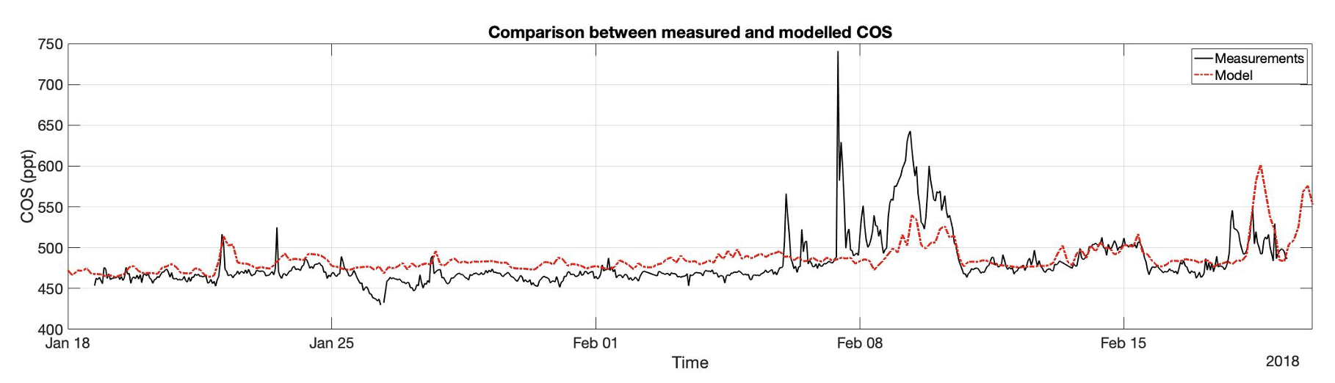
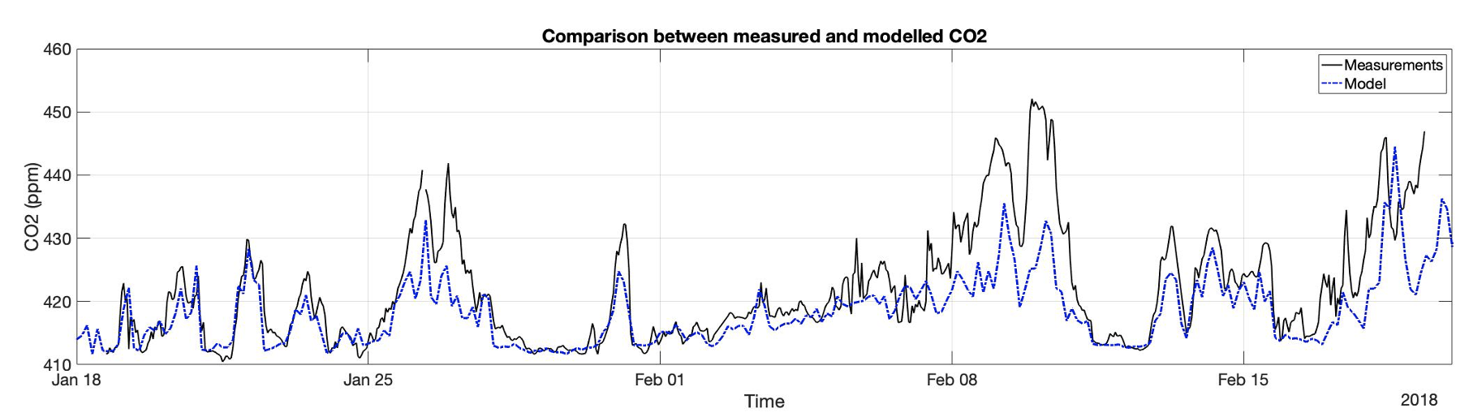
Discussion: models and measurements
The model follows the general trend in the measurements rather well.
The mismatch is consistent in time for both CO₂ and COS,
suggesting possibly unknown
(or imprecisely assessed) industrial sources.
The introduction of the measured local sources
had only marginal effects on the final modelled results.

Slide 14
Conclusion
Local sources of COS were identified in the province of Groningen
  Biodigesters are not included in current databases
European industrial areas have influenced the measurements in Lutjewad
Local sources could not explain the remaining gap
  Need for further measurements (single samples)
  Considering also time variability or specific events as a cause of the plumes
Further measurements and/or modelling is needed to understand what could close the ‘gap’.

Slide 15
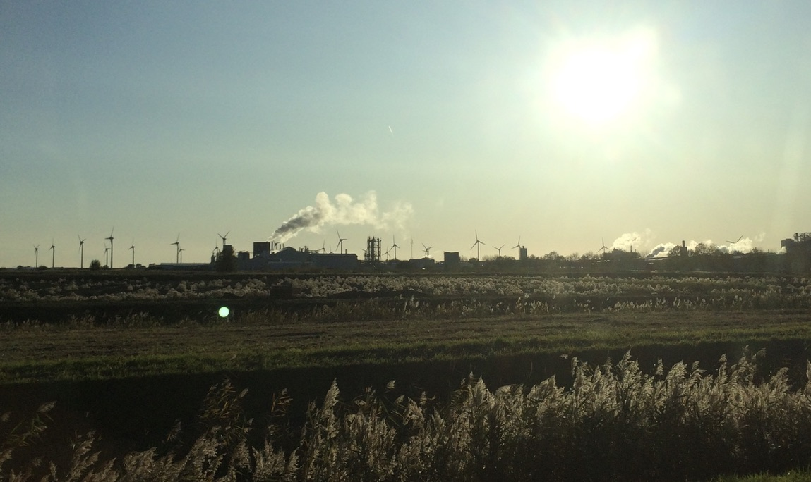

Thank you! Questions?
Grant N°742798

