Slide 1




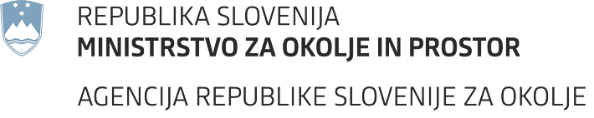
Stable isotopes of the River Sava as a tool for transit time investigations: a case study Ljubljansko polje, Slovenia
Klara Nagode, Aljaž Pavšek, Urška Pavlič, Polona Vreča
HS2.3.3 - Isotope and tracer methods: flow paths characterization, catchment response and transformation processes
Notes:
Hello, I am Klara and my PhD studies in the field of isotope hydrology specifically its application in the urban isotope hydrology. But first things first, before we can apply this isotope hydrology principle to the analysis of water supply system we need to know how our urban water cycle is influenced by natural water cycle.

Slide 2

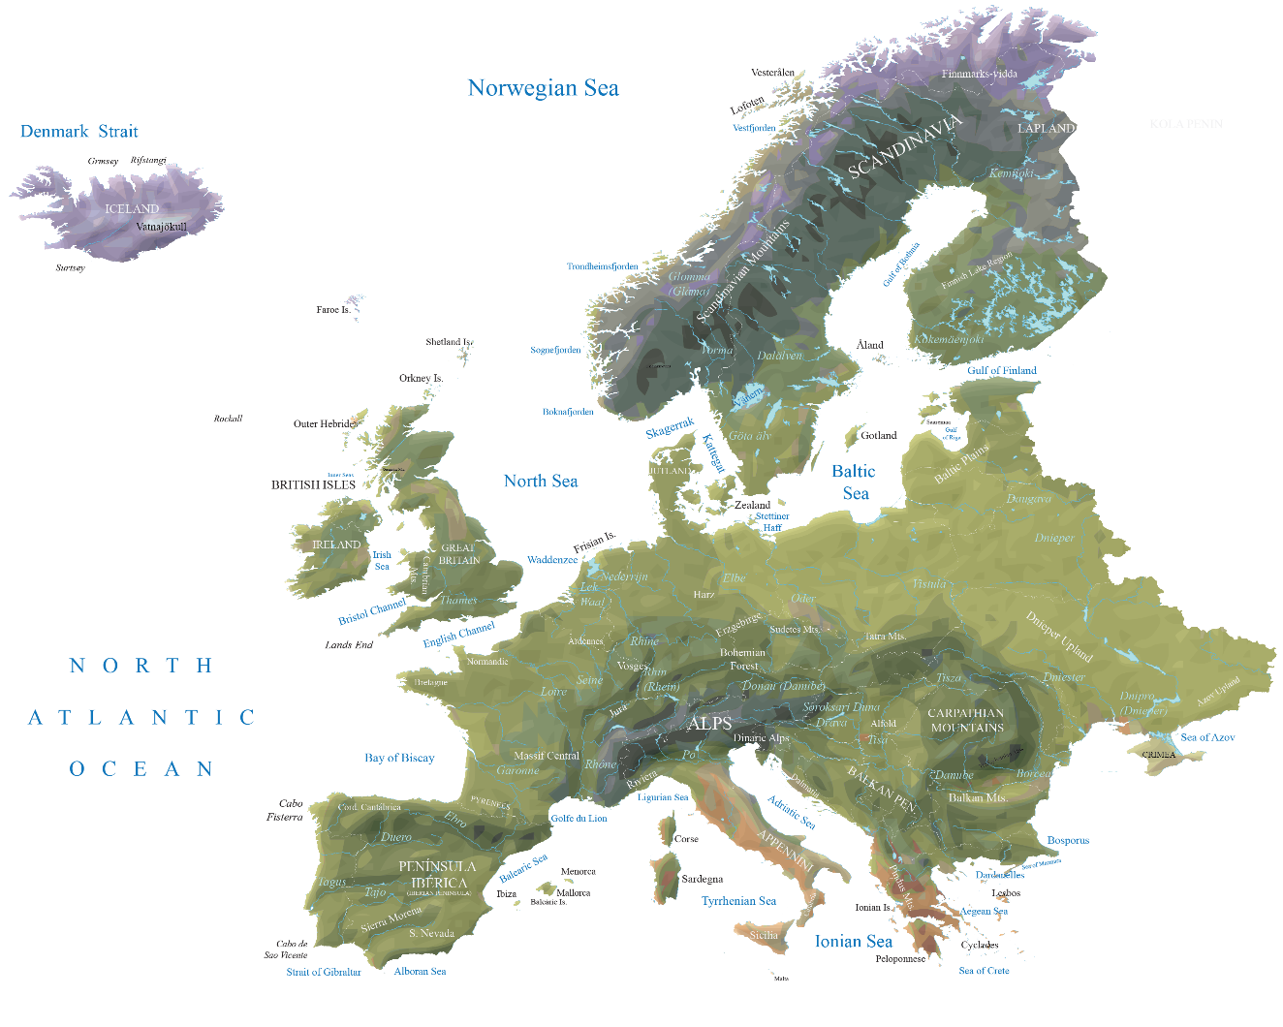

Challenges
Climate change affect water resources
SLOVENIA
WHERE?
Ljubljana
Source: gisgeography.com
Notes:
It has been also observed that impact of climate change directly affects the natural water cycle that in consequence also affect our water sources. We need to protect our water sources and ensure the sustainable abstraction.
This is all also applicable to my country Slovenia. Analyses of the hydrological state in Slovenia indicate that the available quantities of water are diminishing, and that the distribution of precipitation is changing. Therefore, there is a need to better understand our sources and how they are changing in time and space.
We conducted our study in Ljubljana, capital city of Slovenia where we collected

Slide 3
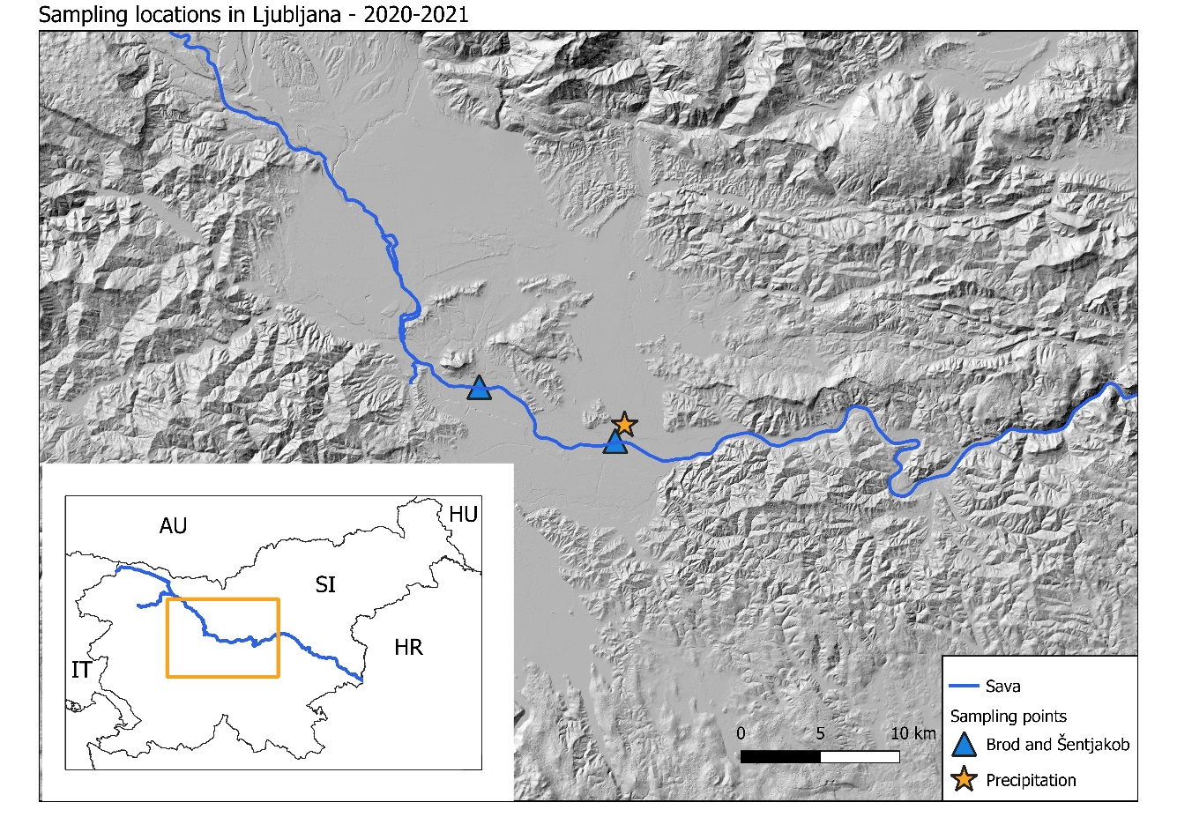
Methodology
Precipitation data
River Sava – two sample locations
Climatological data
River data
Archive precipitation data
Water lines
Lump parameter model
Source: ARSO (meteo.si), IJS (slonip.ijs.si)
Notes:
Sampling for the precipitation has been performed since 1981 in Ljubljana, while the systematic investigation of river Sava has been performed since January 2020 at two locations. For the evaluation we also used our data climatological and river data.
We used the precipitation data to derive the water meteoric lines, while the surface water data was used for the estimation of the residence times.

Slide 4
Objectives
Characterisation of water sources
Changes in the residence times
Notes:
Our objectives was to characterise the water source and estimeate the residence time and compare this to the previous investigations.

Slide 5
What did we found out?
Temperature and precipitation
Statistical increase in temperature
Increase in precipitation amount in colder months, decrease in warmer months
Source: ARSO (meteo.si; arso.gov.si/vode)
Notes:
Since 1981 we are observing the increase in temperature and changes in the precipitation patterns. The established climatic characteristics are also reflected in the isotopic composition of precipitation in the Ljubljana area

Slide 6
What did we found out?
ONGOING RESEARCH
Seasonality
Highly damped signal in river
Notes:
In the same time period, also the temperature at the sampling location changed. During our study period we can observe the seasonality in the precipitation data, while almost no seasonality can be observed in the river. Also, the amplitude is highly damped.

Slide 7
What did we found out?
Long term LMWL (1981-2021)
Smaller error for slope and intercept
Lines similar to GMWL
ONGOING RESEARCH
Short term LMWL (2020-2021)
Big error for slope and intercept
Lower value of slope and intercept
Changes in precipitation sources
Condensation temperature
Re-evaporation
Notes:
The long-period PWGMW is plotted close to the GMWL, while lines for the period 2020-2021 have a lower intercept and slope and also higher error for both parameters. Changes in the slope can be attributed to the changes in the precipitation sources, condensation temperatures and reevaporating of precipitation.

Slide 8
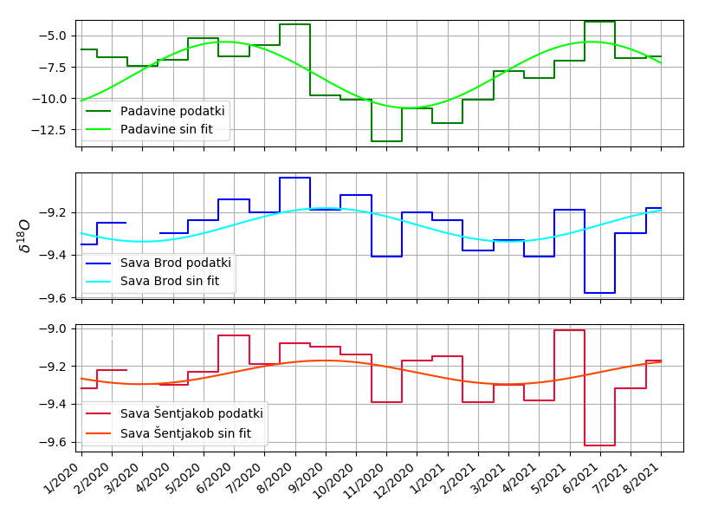
What did we found out?
Damped amplitude in the Sava River
Changes when compared with previous studies
ONGOING RESEARCH
 | Sava Brod | Sava Šentjakob
MRT/year | 4.2 | 3.1
Notes:
In the surface water we are observing quite damp signal, therefore also the estimated amplitude was is very low. The exponential flow model produced mean stream water transit times of 4.2 and 3.1 years at Sava Brod and Sava Šentjakob, respectively. This estimated transit times were longer compared to the results of previous investigations. Although the identified results are hydrologically plausible, the limitation of this and previous studies are presented as uncertainties resulting from a short sampling period and low sampling frequencies.

Slide 9
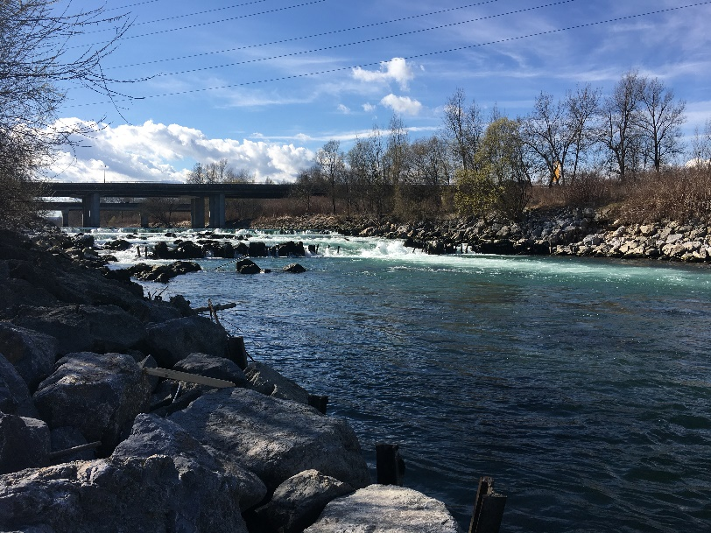
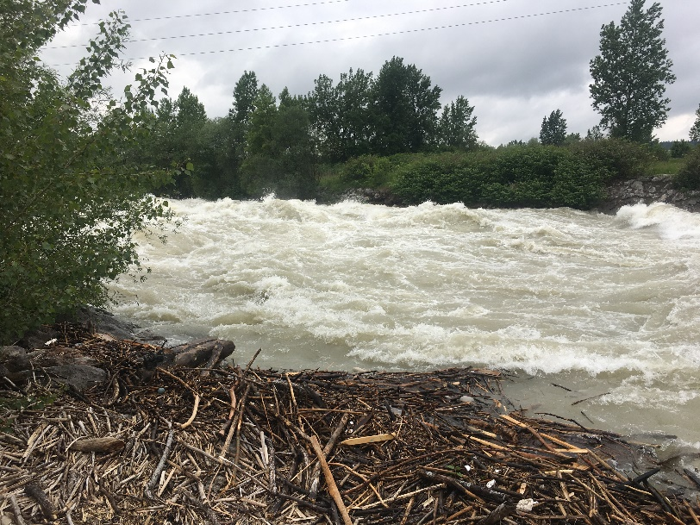

What is left to do?
Longer sampling time period
Estimation of the uncertainties

Slide 10

Thank you for attention!
Klara.nagode@ijs.si
Acknowledgments:
Slovenian Research Agency−ARRS Programme (P1−0143), Young research program (PR−09780)
IAEA
CRP−Use of Isotope Techniques for the Evaluation of Water Sources for Domestic Sup-ply in Urban Areas (F33024, No. 22843).
RER 7013 - Evaluating Groundwater Resources and Groundwater-Surface-Water Interactions in the Context of Adapting to Climate Change (Case study Sava)
Slovenian Environment Agency

