Slide 1



Urban water neutrality at different scales: CityPlan design and evaluation framework
Presenting Author: Pepe Puchol-Salort,
Co-Authors: Jiaying Lu, Dr Stanislava Boskovic, Dr Barnaby Dobson,
Dr Maarten van Reeuwijk, Dr Ana Mijic
Department of Civil and Environmental Engineering
ESPRC CDT Sustainable Civil Engineering
Imperial College London

Slide 2
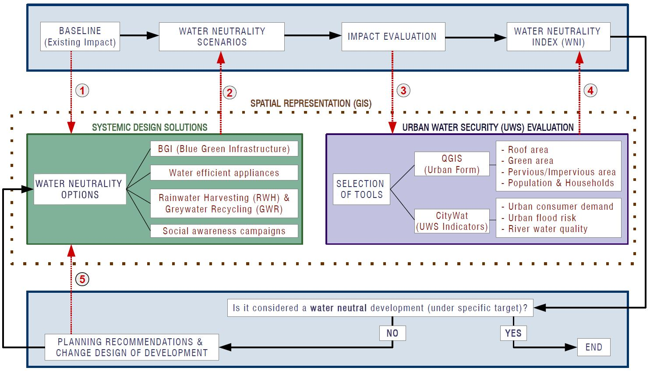
CityPlan
1

Slide 3
CityPlan
1

Slide 4
CityPlan
1

Slide 5
CityPlan
1

Slide 6
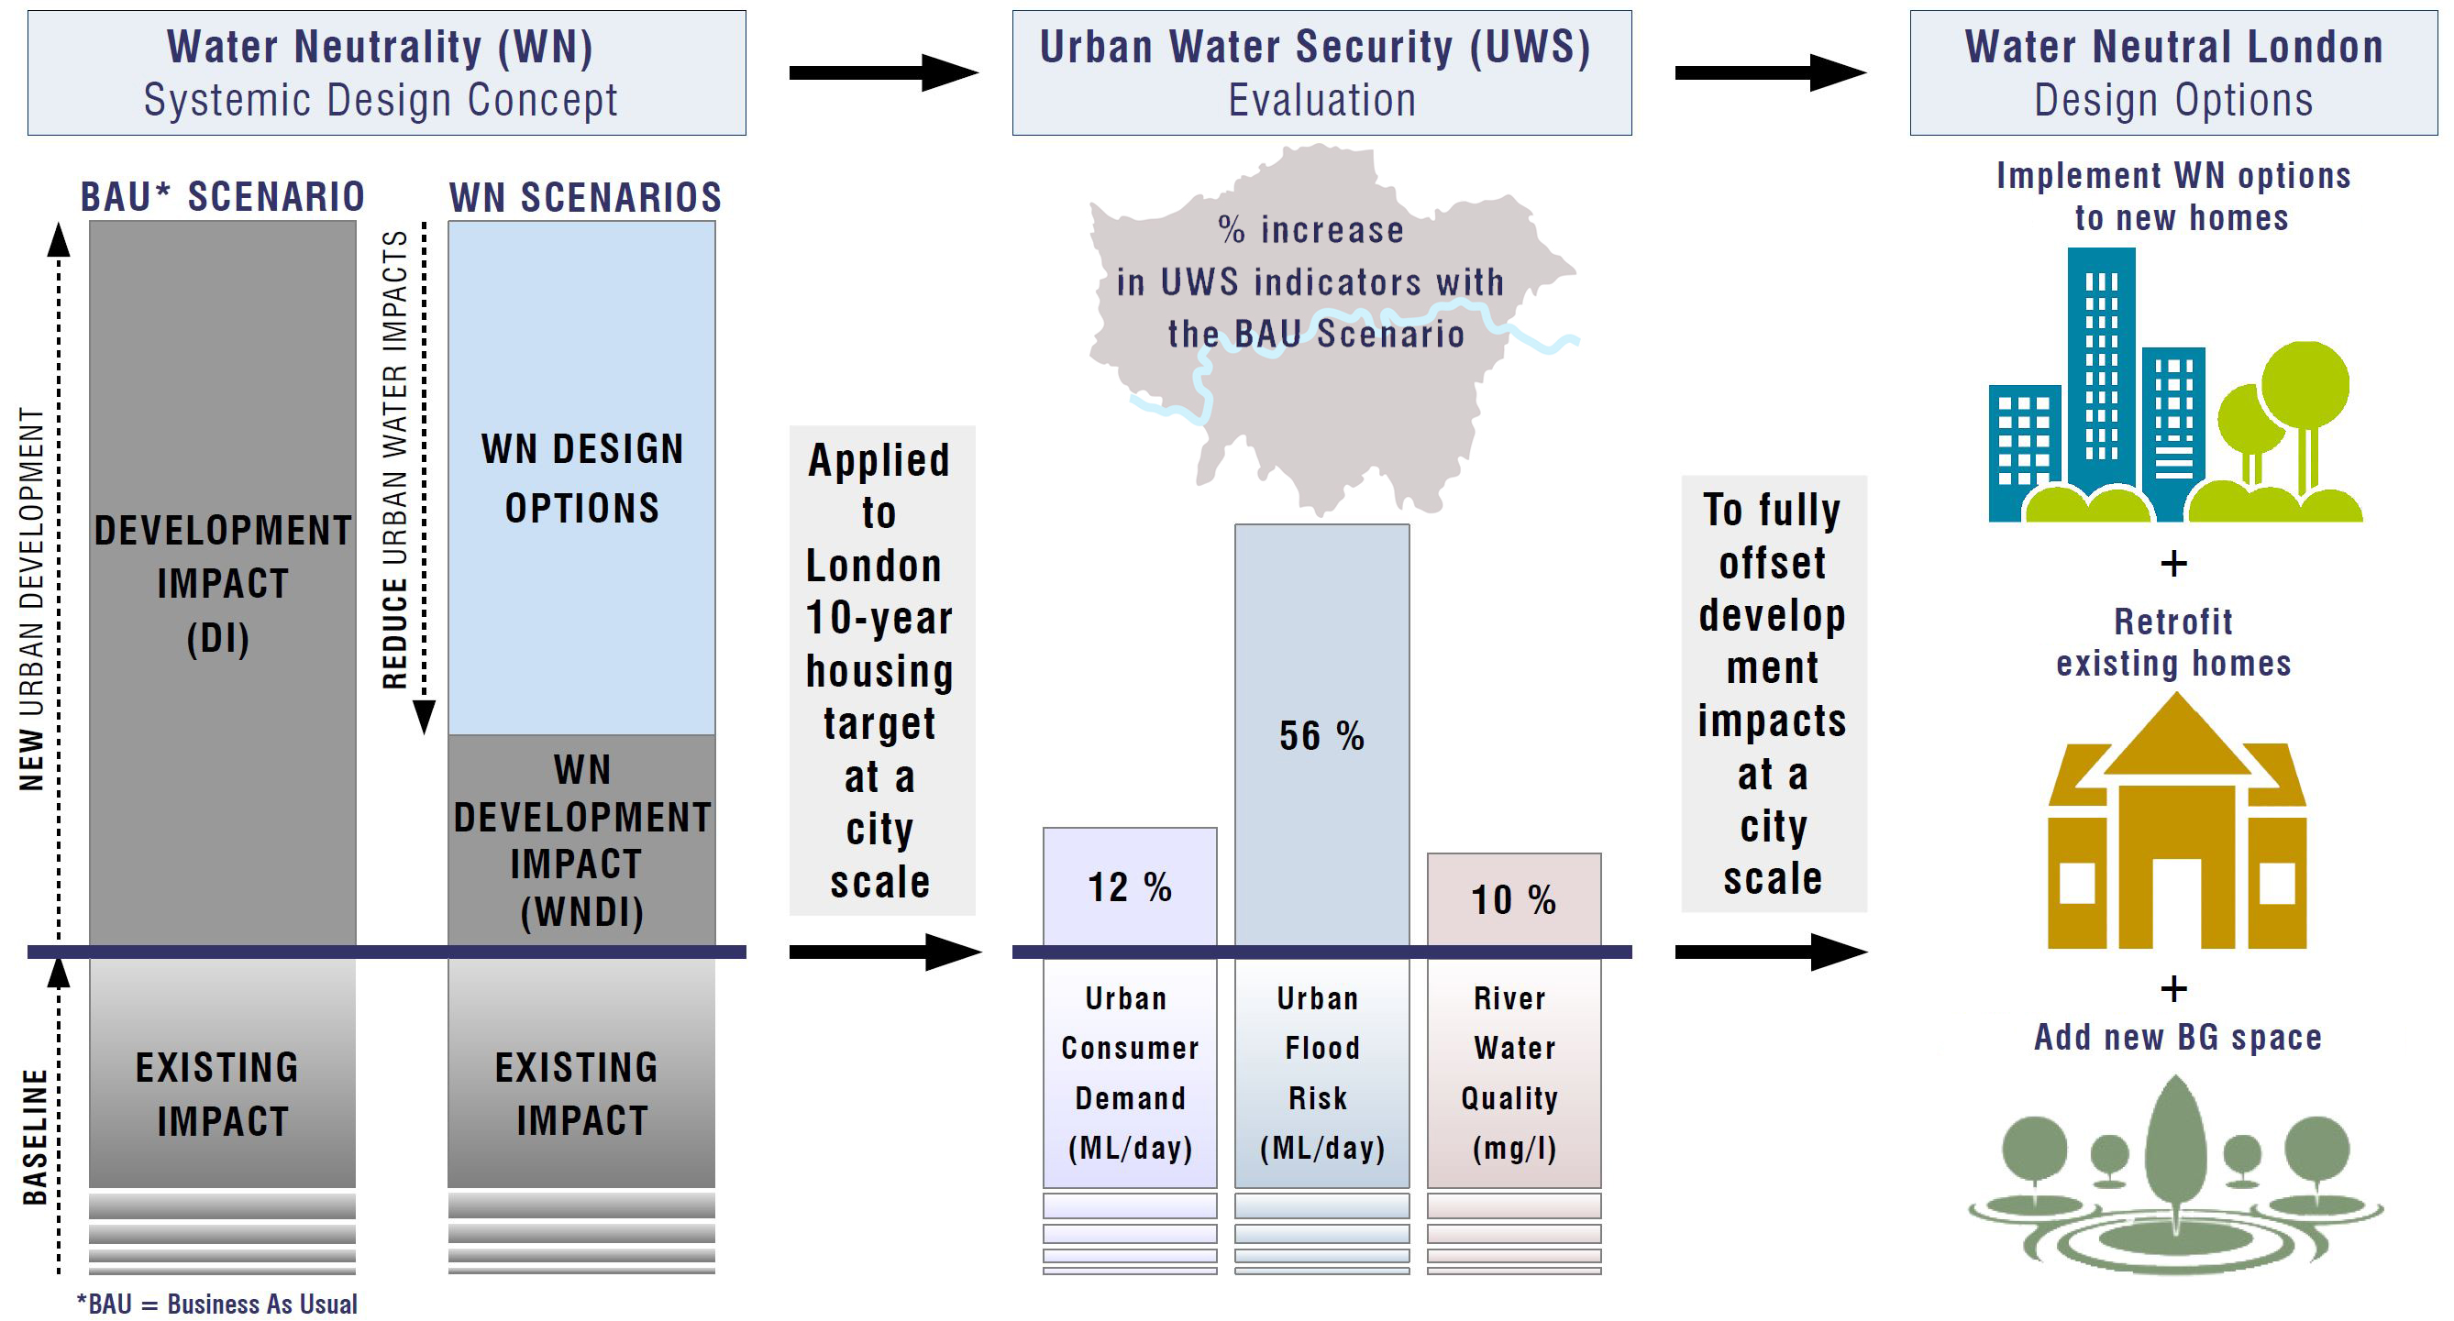
Water Neutrality concept
2

Slide 7
Water Neutrality concept
2

Slide 8
Water Neutrality concept
2

Slide 9
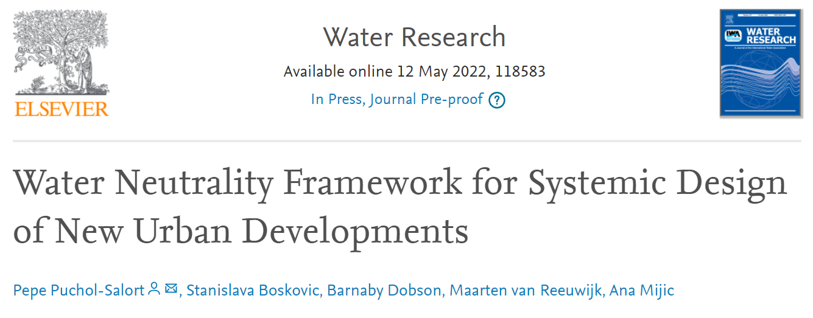
CityPlan-Water
3

Slide 10
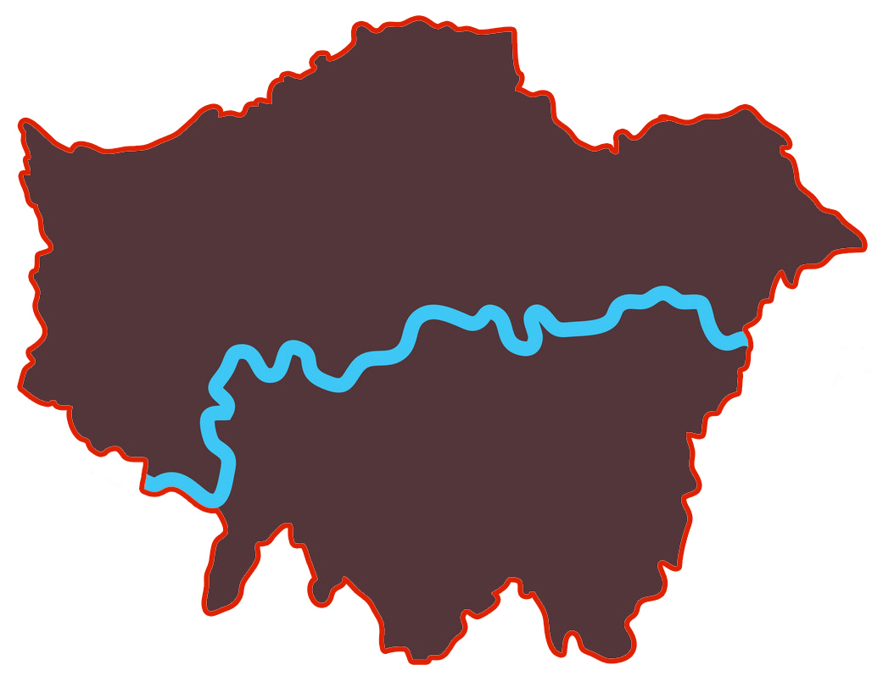
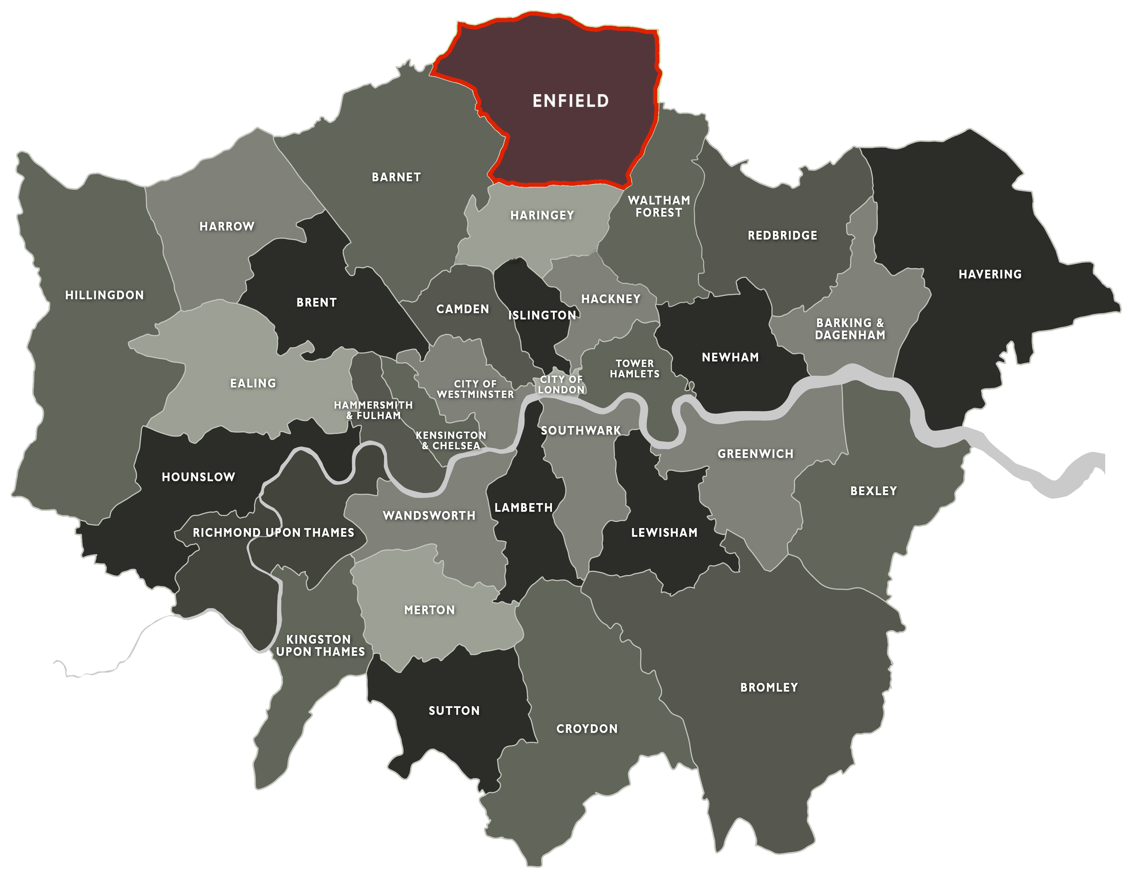
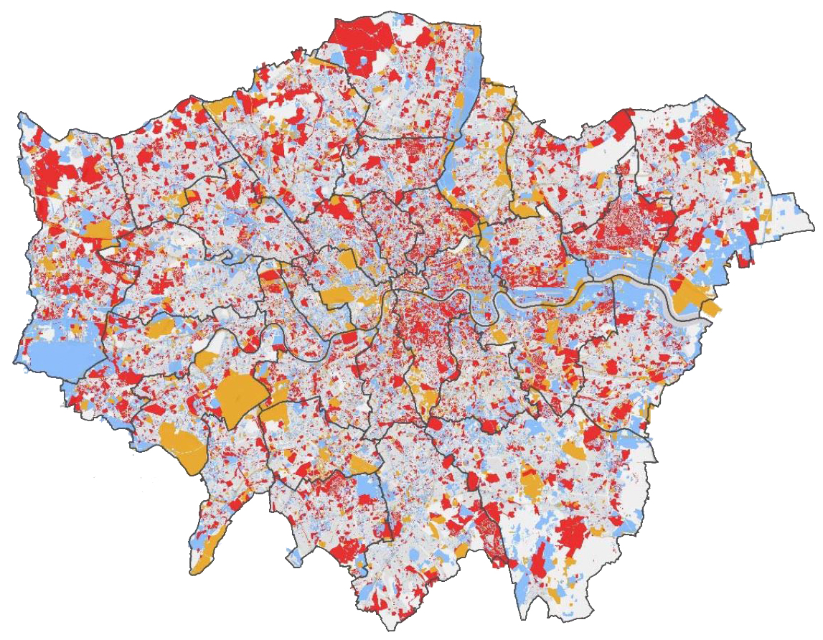
Working across scales
City Scale
Borough Scale
How do we move our WN results and targets
across scales?
Urban Development Scale
4
Notes:
▪ Integrated & adaptive urban planning → Systemic Design concept
▪ CityPlan → applied to different sustainability areas & scales

Slide 11
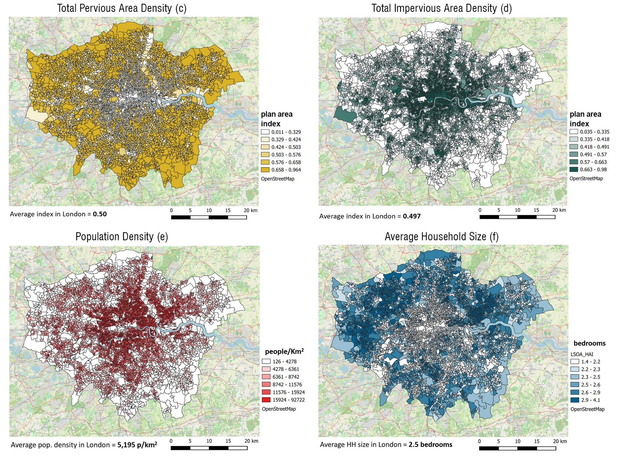
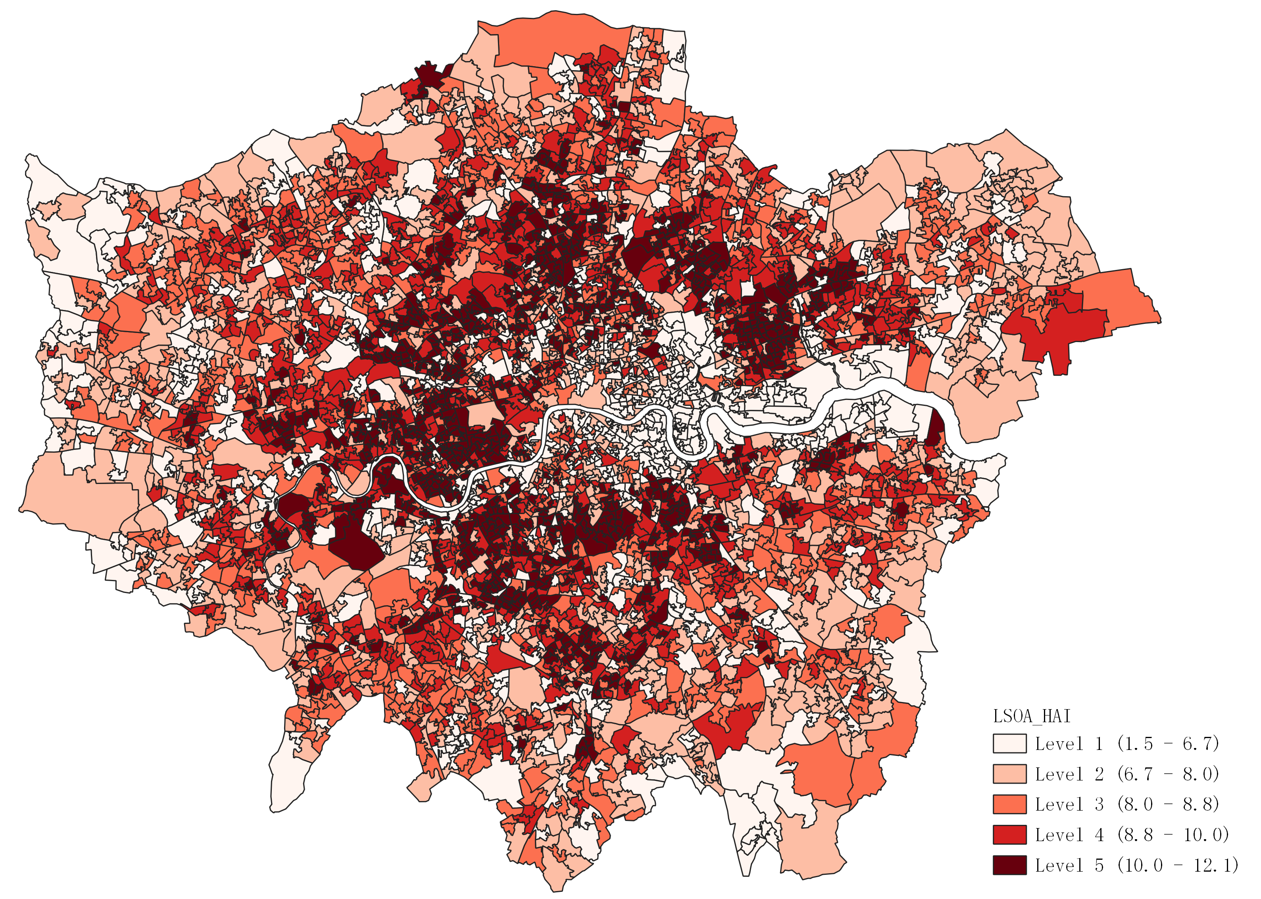
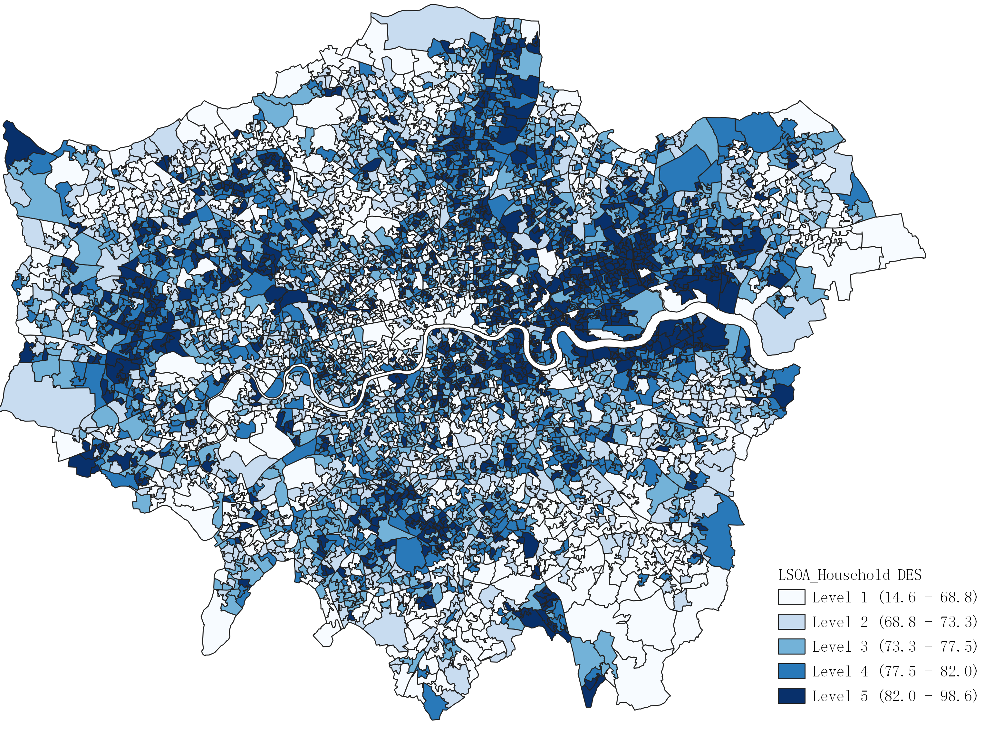
Urban form properties & data-driven indicators
Urban form properties
Data-driven indicators
Housing Age Indicator (HAI)
Device Efficiency Score (DES)
5

Slide 12
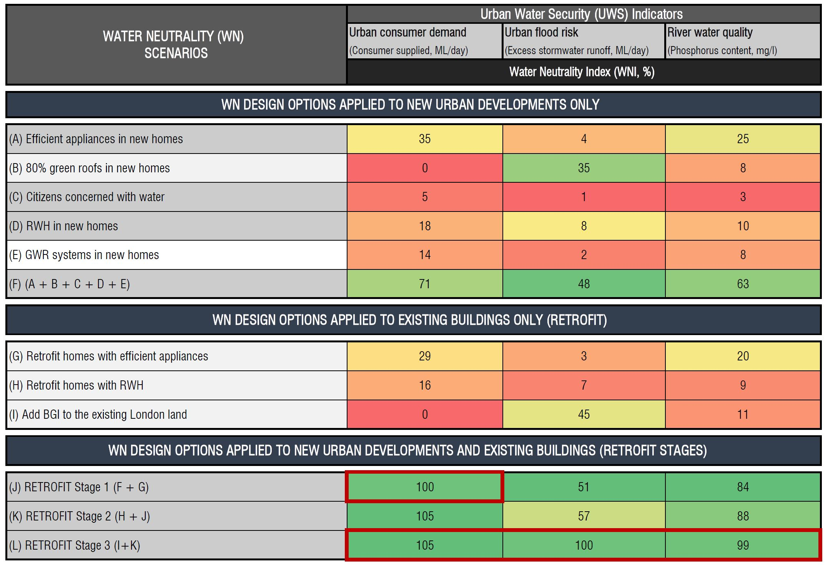
Urban Water Security (UWS) evaluation at city scale
WN options in 522,870 new homes achieves Water Neutrality in the range between WNI=50-70%
Retrofitting 432,500 existing homes adds additional WNI=20-45%
WN across all UWS indicators requires WN in new homes, retrofitting existing homes and adding 19 km² of BG spaces
6

Slide 13
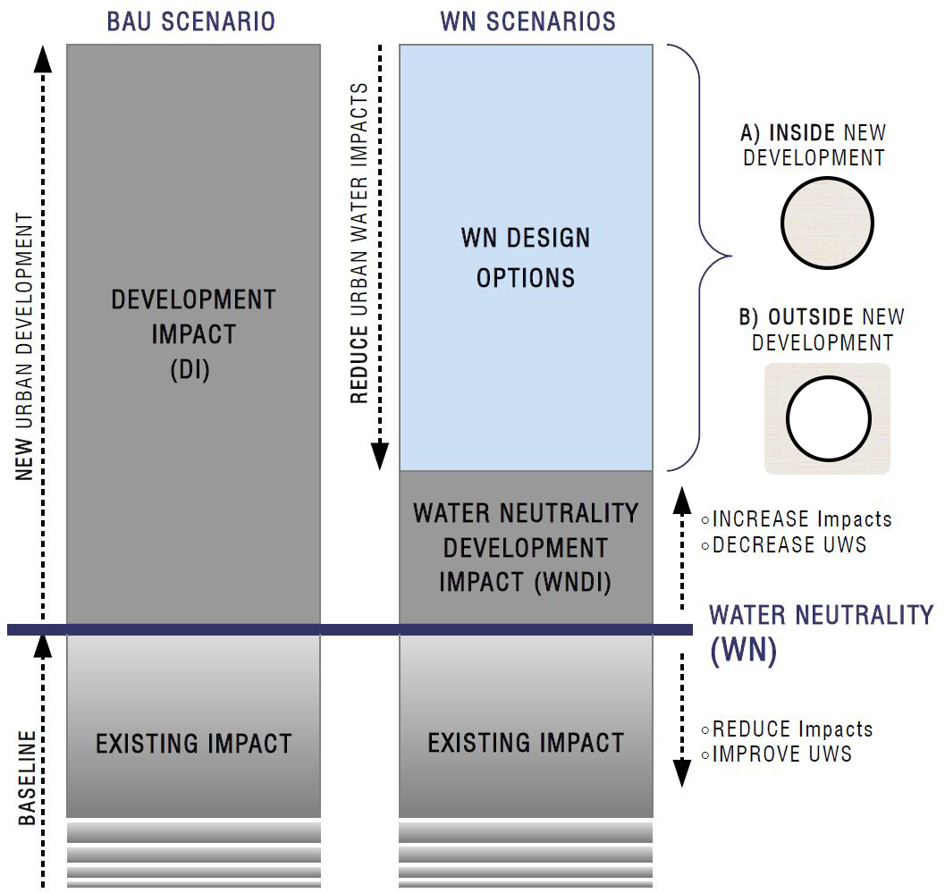
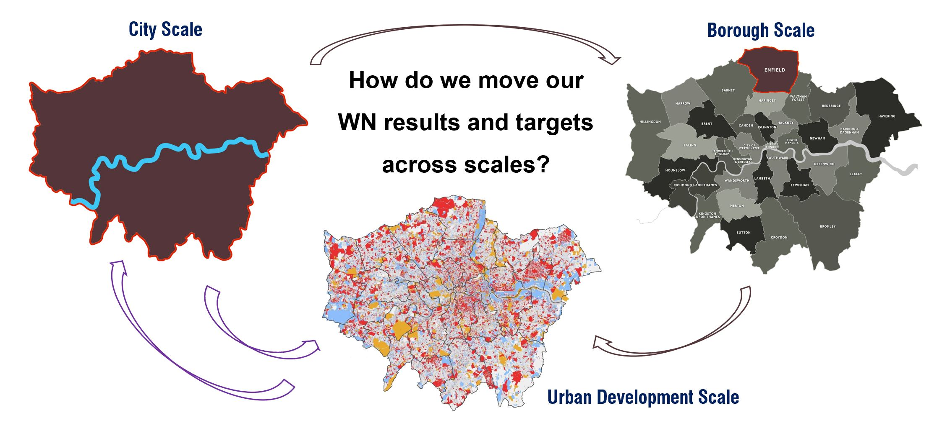
Conclusions and future scope
CityPlan framework
Water Neutrality concept
Spatial data & indicators
+
Next steps
VDR with a scoring system at different scales
WNI results at city scale
UWS evaluation
7

Slide 14
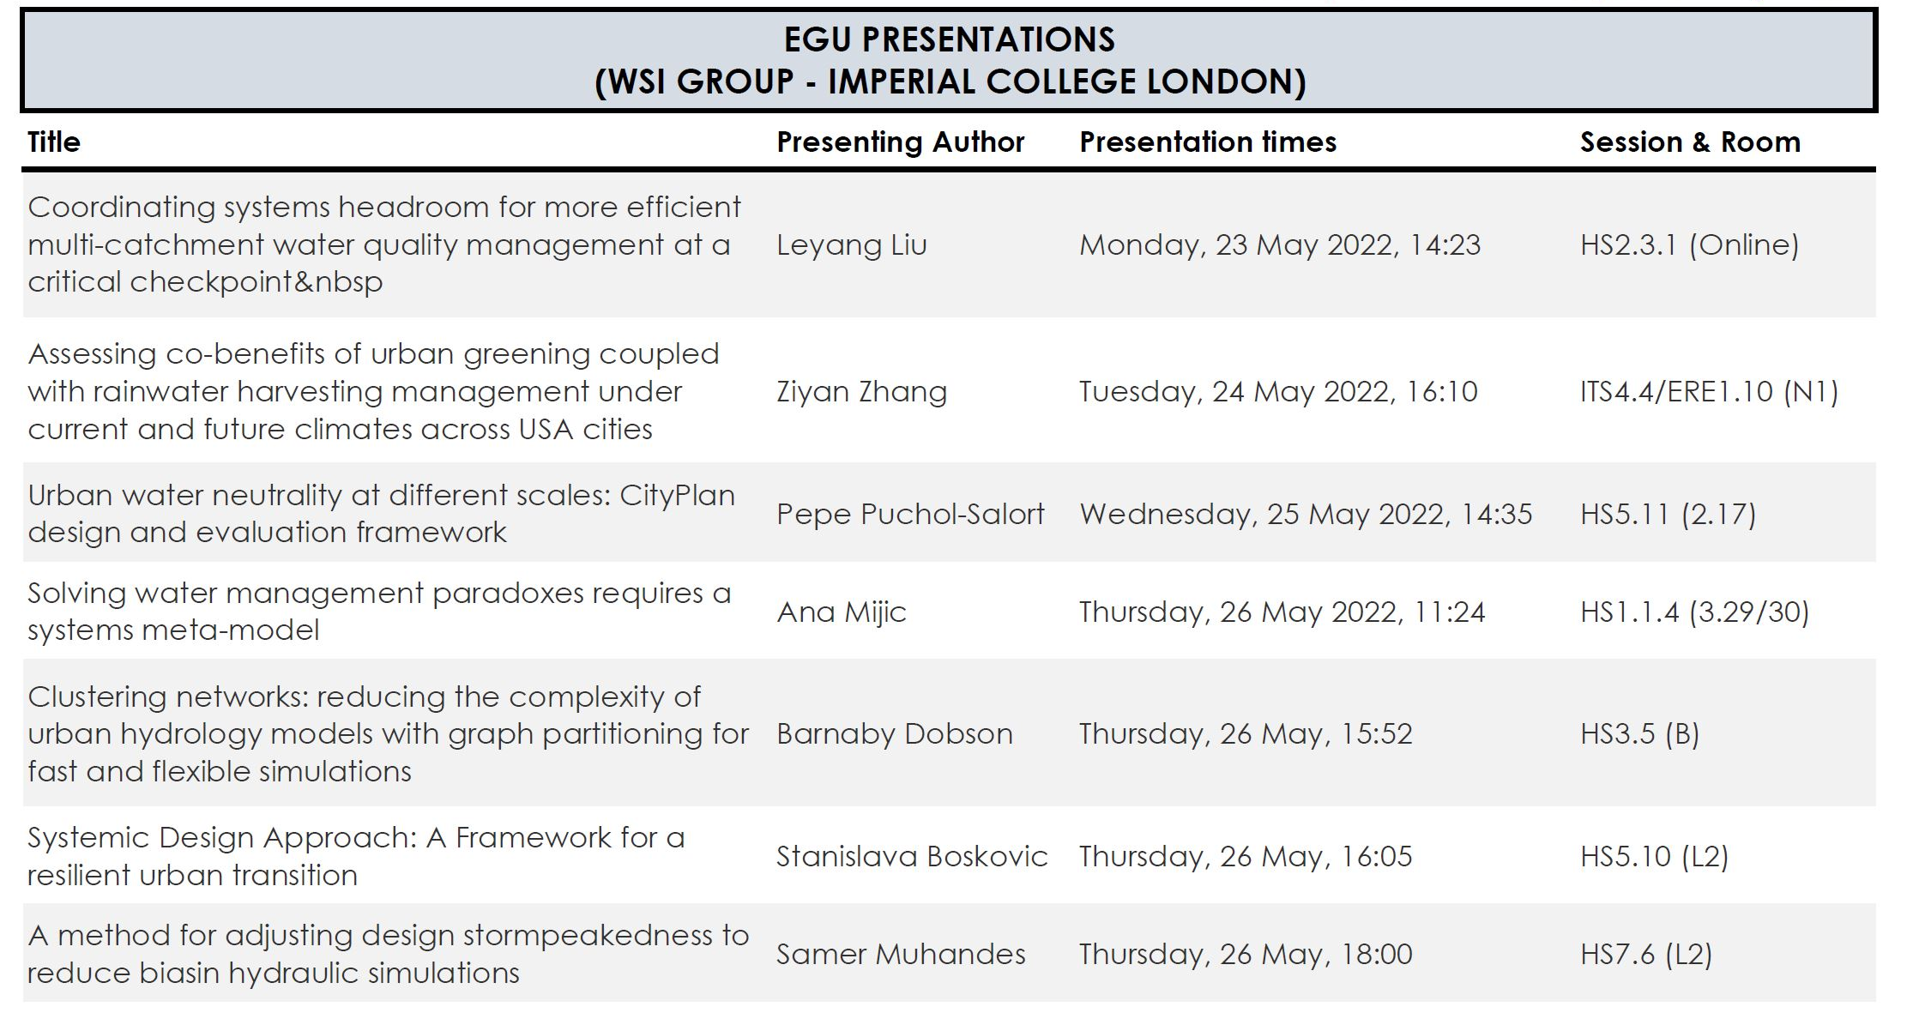


THANK YOU!
Q & A TIME
Pepe Puchol-Salort
jp1218@ic.ac.uk
Twitter: @Pepepuchol
Department of Civil and Environmental Engineering
ESPRC CDT Sustainable Civil Engineering

