Slide 1
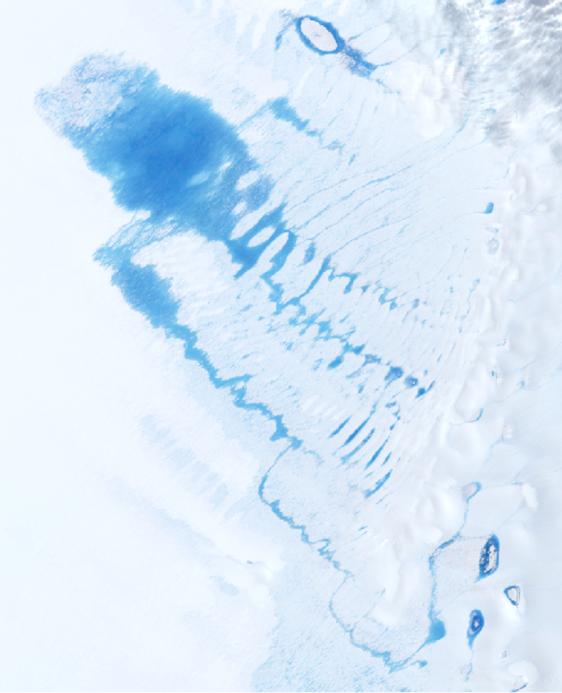
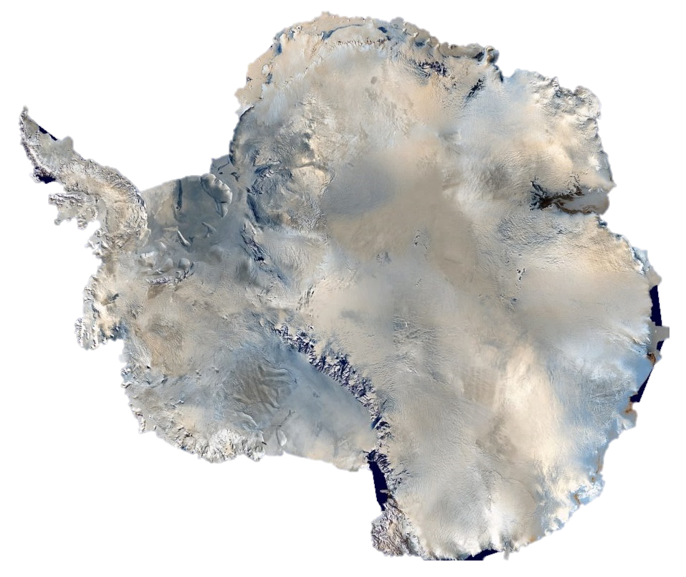






Large inter-annual variability in supraglacial lakes around the East Antarctic Ice Sheet
Jennifer Arthur
(Durham University)
Chris Stokes¹, Stewart Jamieson¹,
Rachel Carr², Amber Leeson³, Vincent Verjans⁴

Slide 2
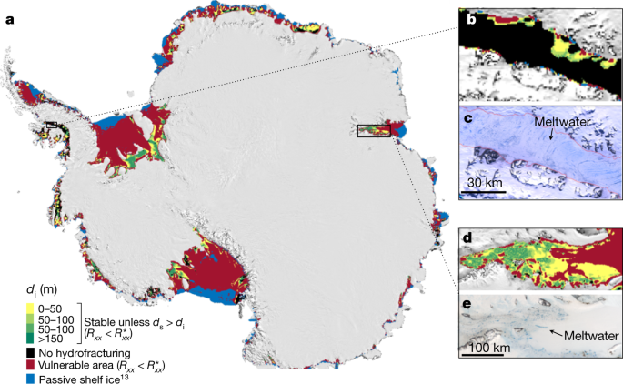
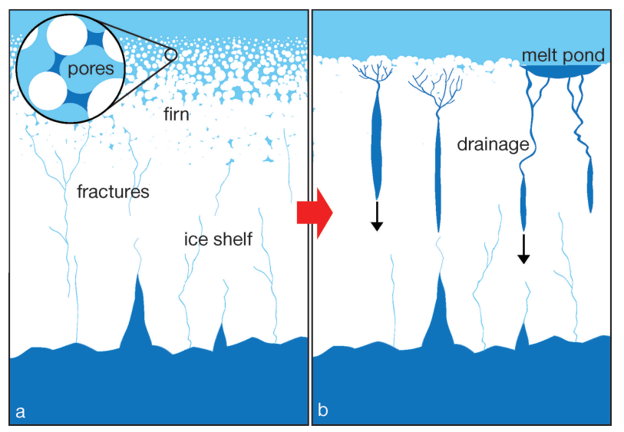
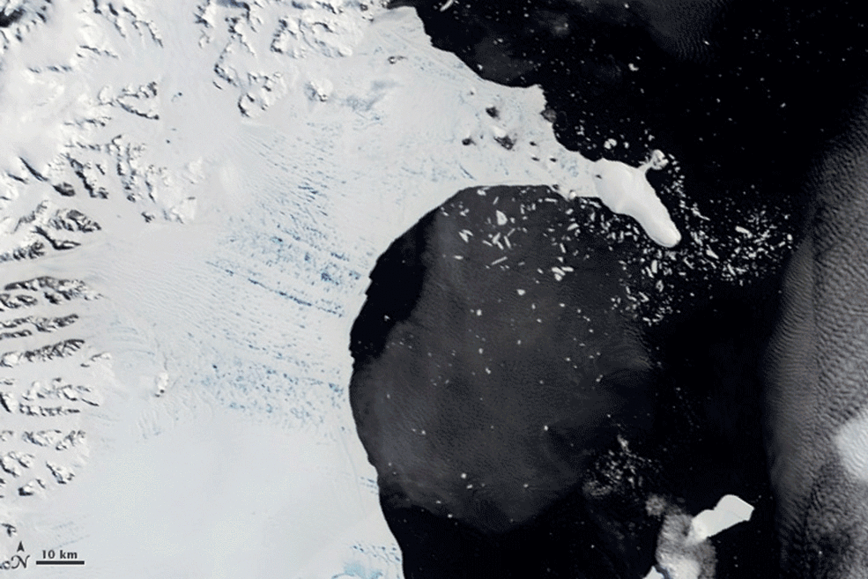

Importance of surface meltwater
Vulnerable to hydrofracture
Some Antarctic ice shelves are already vulnerable to meltwater-driven hydrofracture:
Unconfined (high tensile stress)
High surface melt rates
Widespread, low-porosity firn
Extensive surface melt ponding
Lai et al. (2020) Nature
Kuipers Munneke et al. (2014) J. Glac.
NASA
• • • • • •
Jennifer Arthur

Slide 3
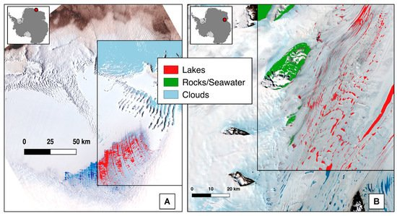
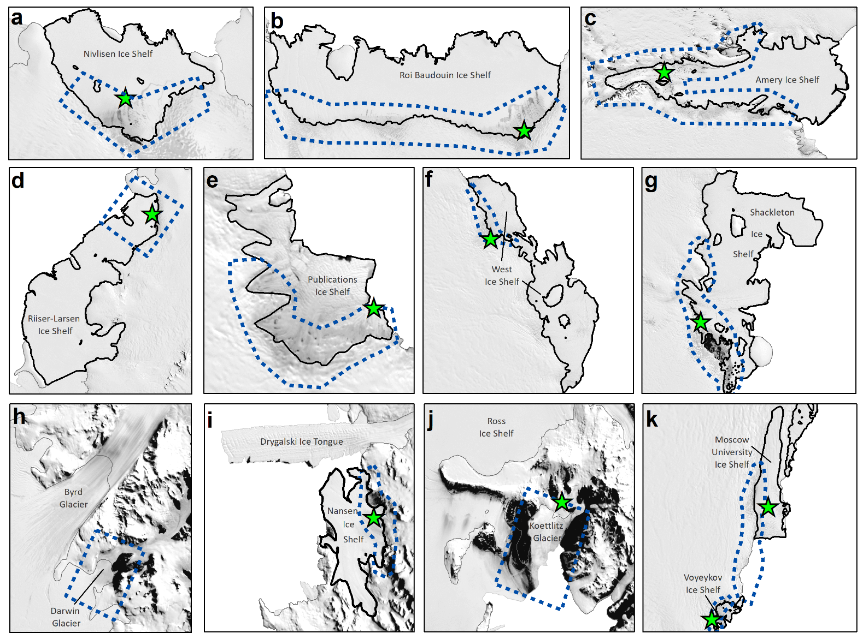
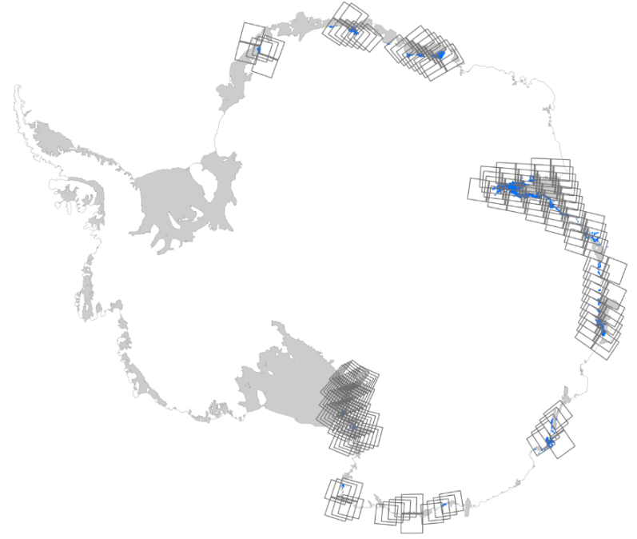
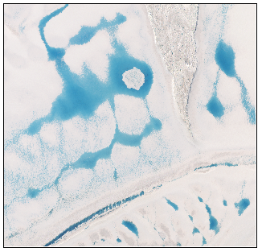
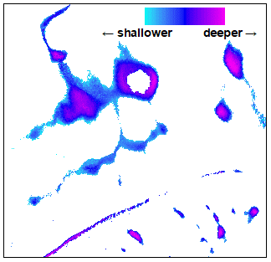

Methods
January 2014 – January 2020
Reanalysis (ERA5)
Regional climate model (MAR)
Community Firn Model
Lake areas and volumes
(Landsat 8)
Surface melt
Threshold-based classification:
2-m air temperature
Surface net solar radiation
Snowfall
Firn air content
Surface runoff
Minimum ice lens depth
~31 km
35 km
Moussavi et al. (2020) Rem. Sens.
Lake depth retrieval:
• • • • • •
Jennifer Arthur

Slide 4
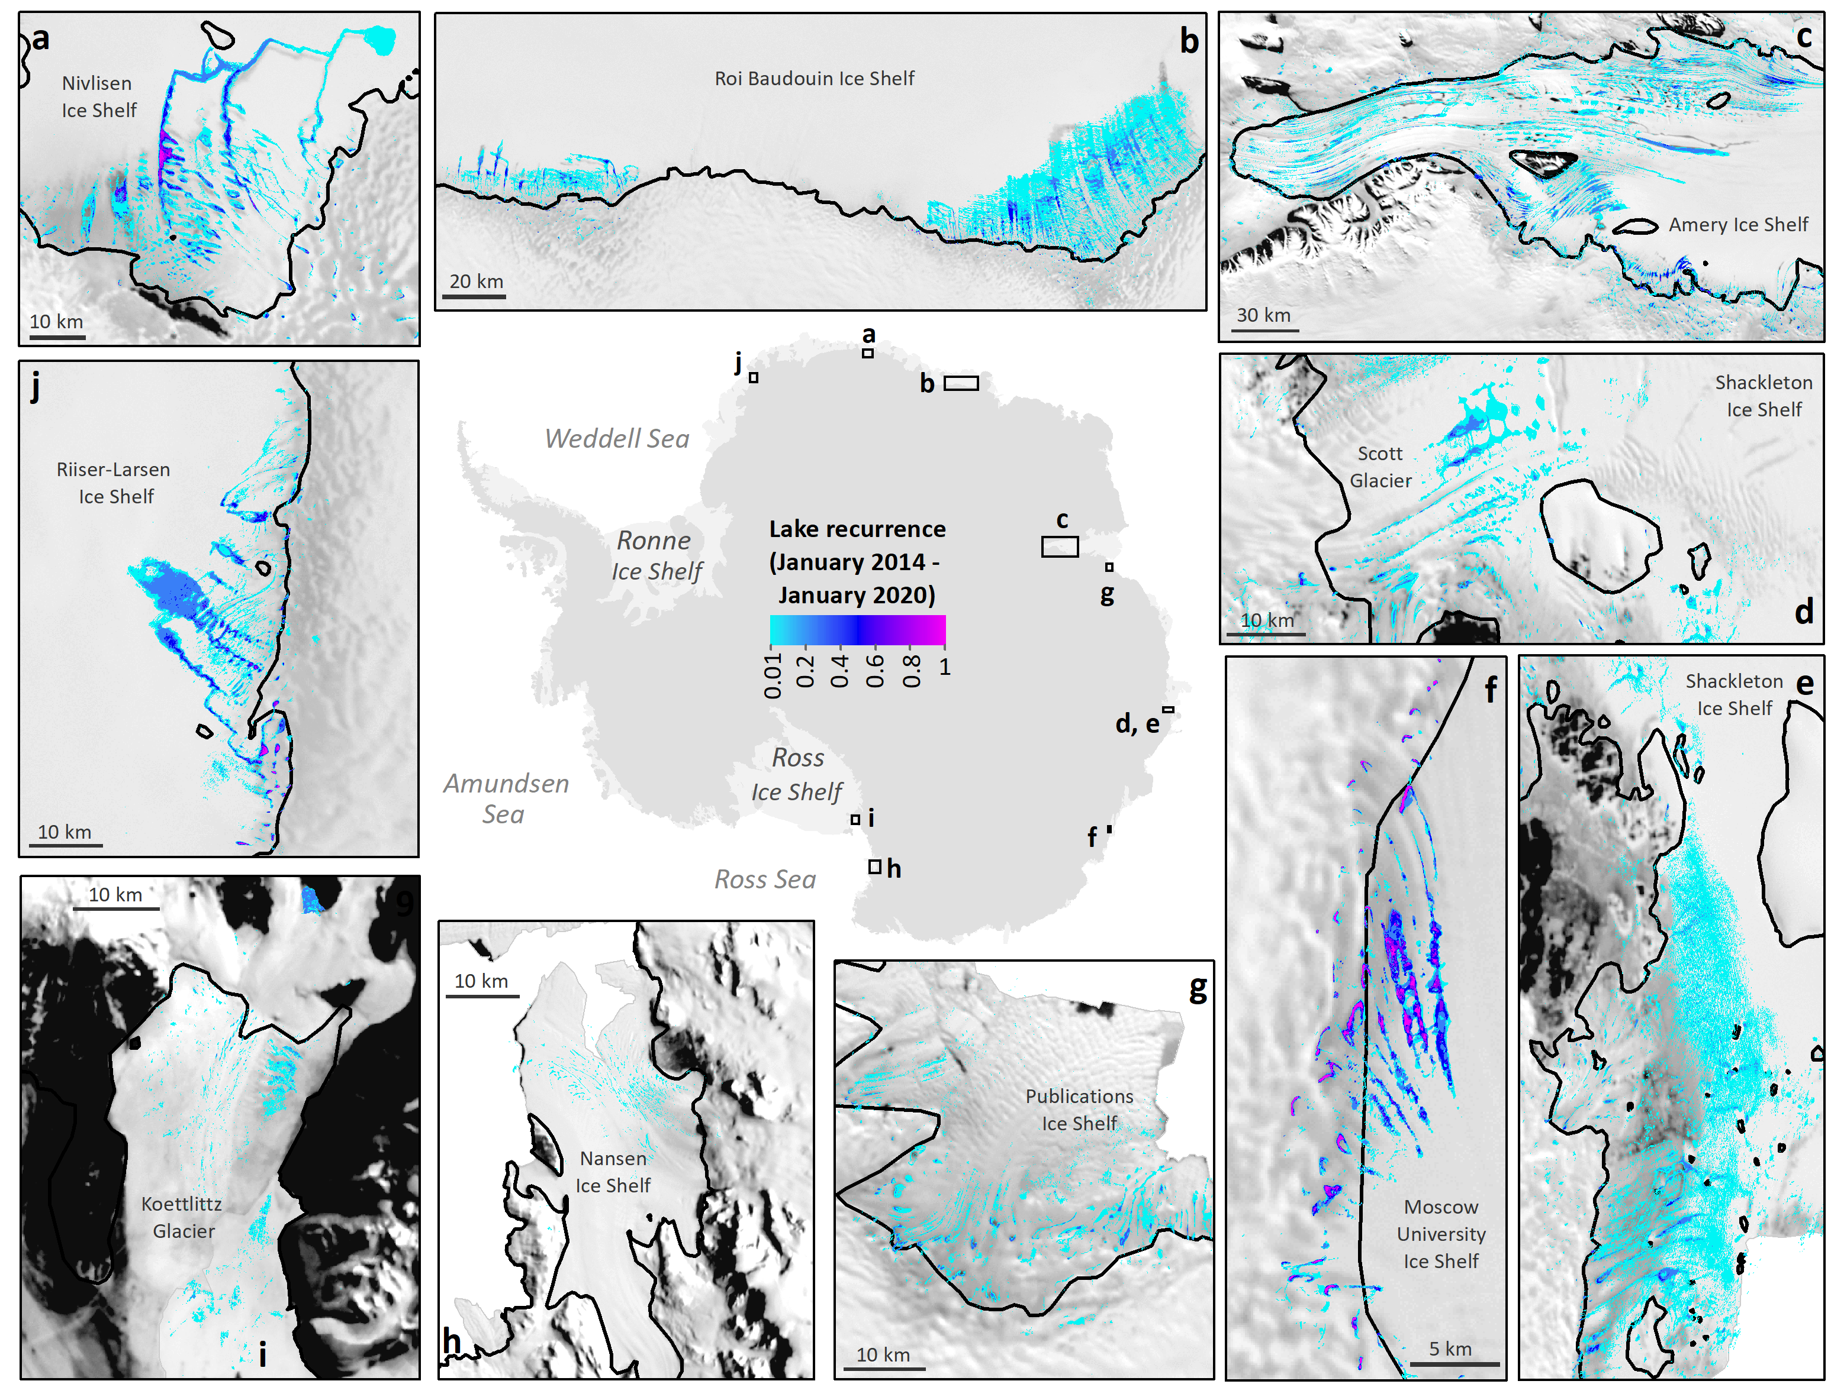
Interannual recurrence of surface meltwater
Arthur et al. (2022) Nat. Comms.
• • • • • •
Jennifer Arthur

Slide 5
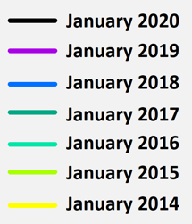
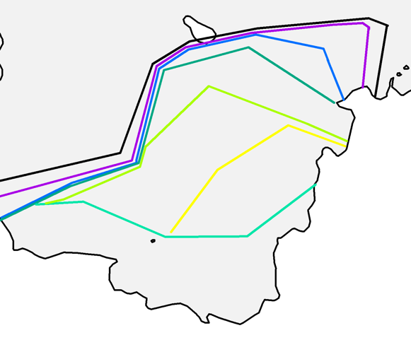
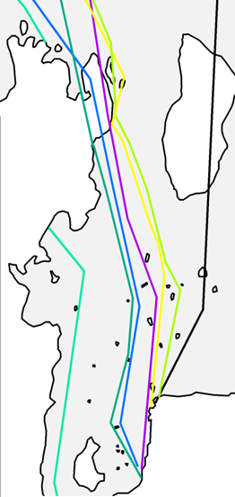
Interannual recurrence of surface meltwater
Arthur et al. (2022) Nat. Comms.
• • • • • •
Jennifer Arthur

Slide 6
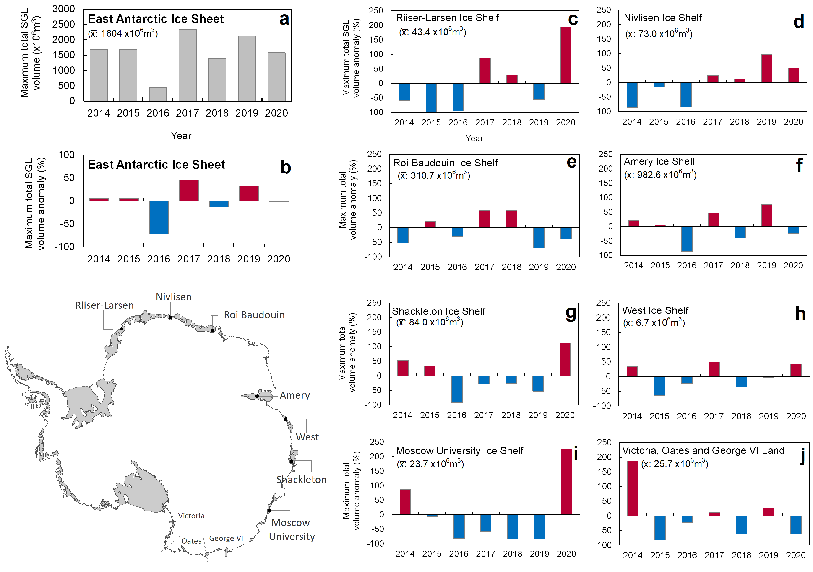
Lake volume interannual variability
Arthur et al. (2022) Nat. Comms.
• • • • • •
Jennifer Arthur

Slide 7
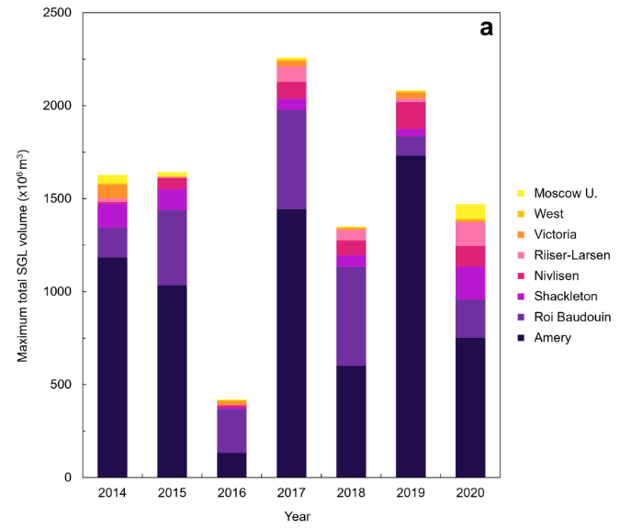
Lake volume interannual variability
Arthur et al. (2022) Nat. Comms.
• • • • • •
Jennifer Arthur

Slide 8
Lake volume interannual variability
Arthur et al. (2022) Nat. Comms.
• • • • • •
Jennifer Arthur

Slide 9
Lake volume interannual variability
Arthur et al. (2022) Nat. Comms.
• • • • • •
Jennifer Arthur

Slide 10
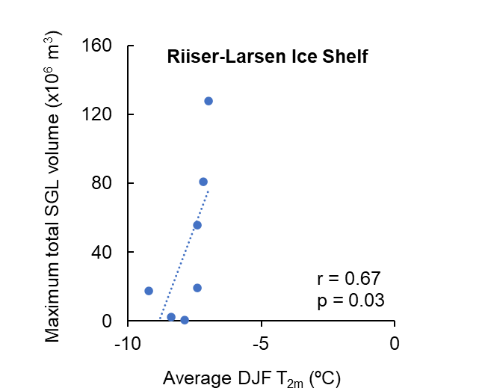
Controls on lake area and volume interannual variability
Positive correlations between lake area, lake volume and mean summer air temperatures →
• • • • • •
Jennifer Arthur

Slide 11
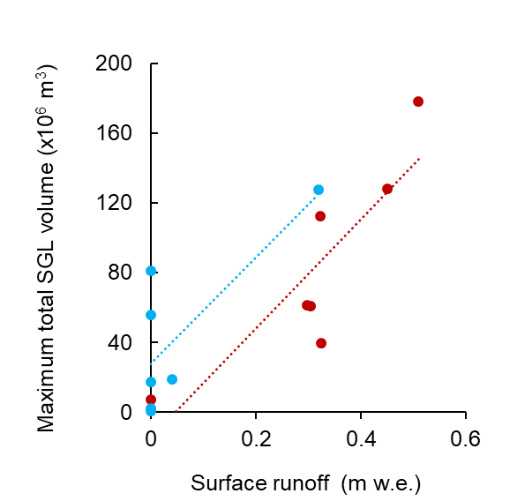
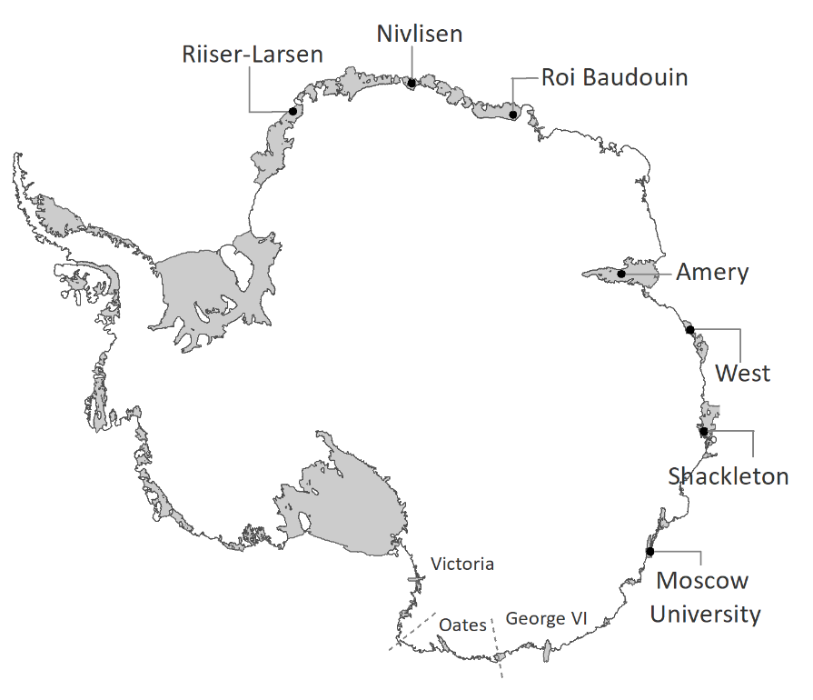
Controls on lake area and volume interannual variability
Positive correlations between lake area, lake volume and mean summer air temperatures →
r = 0.76
p = 0.04
r = 0.86
p = 0.01
Mean January surface runoff is significantly positively correlated on two ice shelves:
Shackleton and Riiser-Larsen.
Higher lake volumes correlate with higher surface melt
and a lower ratio of November firn air content to summer melt.
• • • • • •
Jennifer Arthur

Slide 12
Controls on lake area and volume interannual variability
Positive correlations between lake area, lake volume and mean summer air temperatures →
r = 0.76
p = 0.04
r = 0.86
p = 0.01
Mean January modelled surface runoff on all other ice shelves is very low or zero.. despite large recorded lake volumes.
Suggests MAR is overestimating snow accumulation → underestimating surface runoff?
• • • • • •
Jennifer Arthur

Slide 13
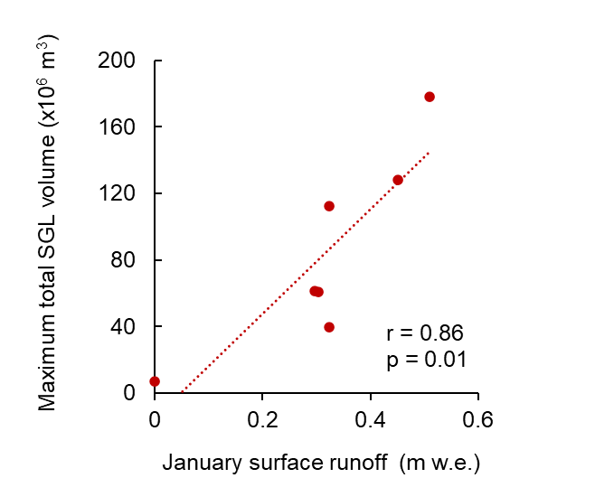
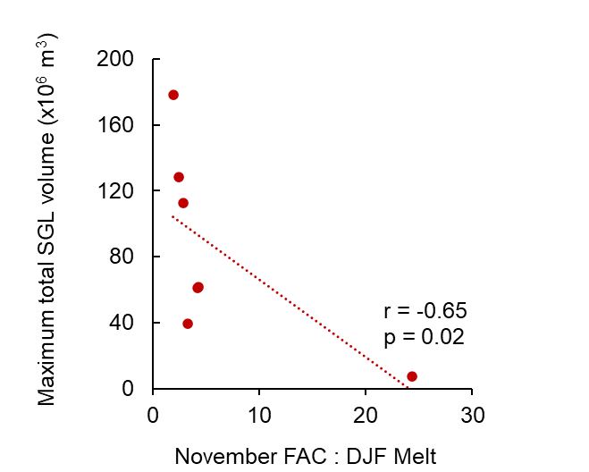
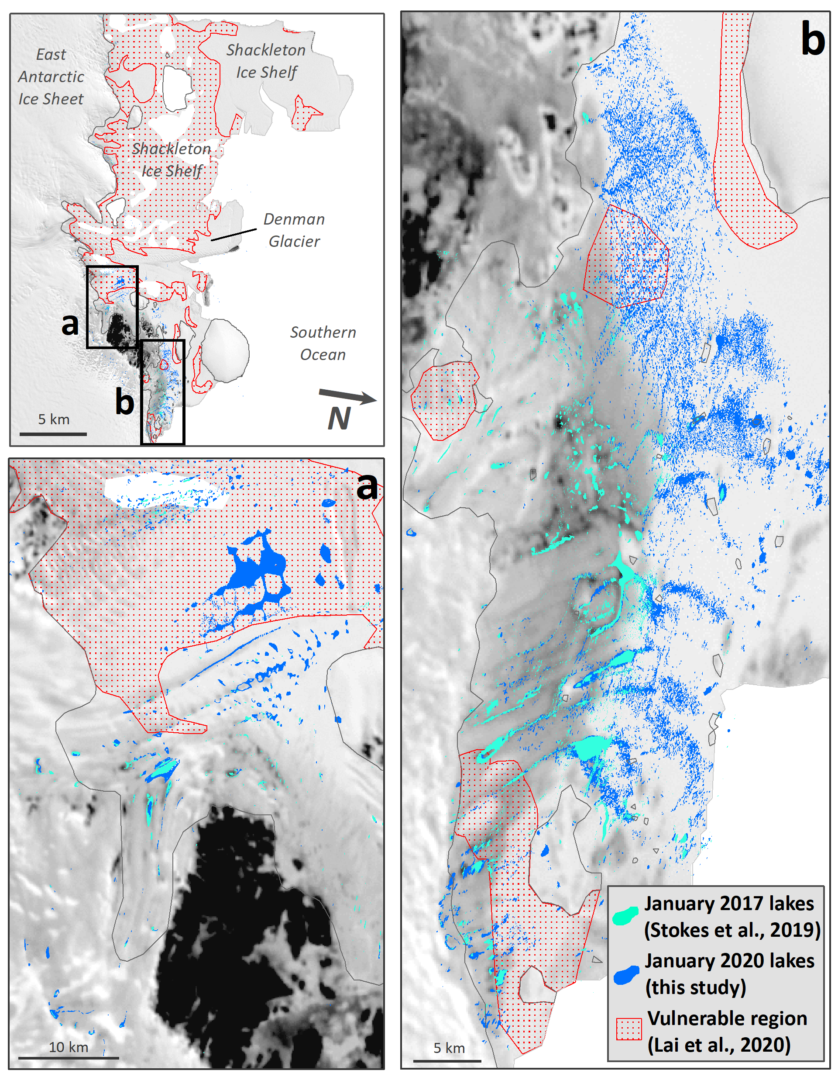
Shackleton Ice Shelf: vulnerable in future?
Arthur et al. (2022) Nat. Comms.
Lakes are beginning to intersect regions vulnerable to hydrofracture
(i.e. high tensile regions that provide buttressing¹).
Intense surface melt: most mean annual melt days outside AP^{2,3}.
Simulated future runoff is one of the highest in Antarctica⁴.
(¹Lai et al., 2020; ²Kittel et al., 2021; ³Johnson et al., 2021; ⁴Gilbert and Kittel, 2021).
• • • • • •
Jennifer Arthur

Slide 14

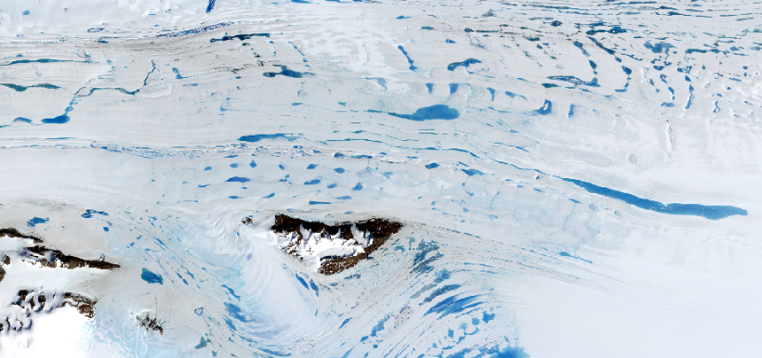
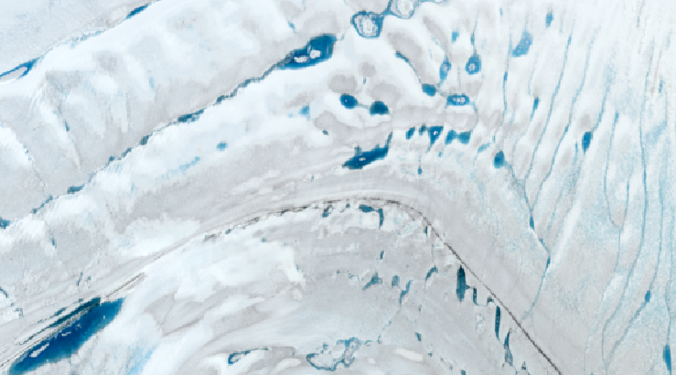
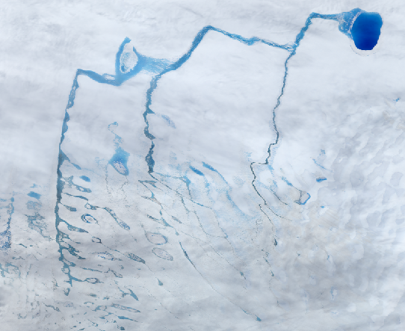
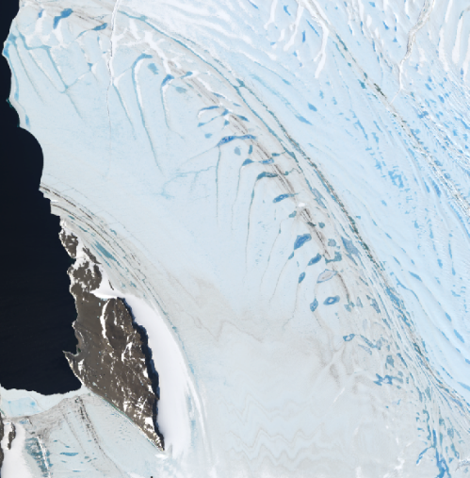
Conclusions and future work
Supraglacial lake volume varies interannually by as much as 200% on individual ice shelves and by up to ~72% across the East Antarctic Ice Sheet.
Lake areas and volumes are strongly positively correlated with mean summer air temperature.
On ice shelves where lake volume is significantly correlated with modelled runoff, January surface melt and the ratio of November firn air content to summer (DJF) melt are important predictors of lake volume.
Drifting snow, local melt-albedo feedbacks, melt refreezing in firn still need better resolving in models.
Validation of modelled surface melt, runoff and firn air content over full melt season (November – February).
• • • • • •
Jennifer Arthur

Slide 15




Thank you for listening!
Questions?
Community Firn Model: https://github.com/UWGlaciology/CommunityFirnModel
Modèle Atmosphérique Régionale:
^{https://gitlab.com/Mar-Group}
Lake detection algorithm:
https://github.com/mmoussavi/Lake_Detection_Satellite_ Imagery/tree/master/Landsat_8
Lai, C. Y., et al. Nature, 584, 574–578 (2020).
Kittel, C. et al. Cryosphere, 15, 1215-1236 (2021).
Gilbert E. and Kittel C. Geophysical Research Letters, 48 (2021).
Johnson, A. et al. Journal of Glaciology, 1-14 (2021).
Arthur, J.F et al. (2022) Large interannual variability in supraglacial lakes around East Antarctica. Nature Comms. 13, 1711.
jennifer.arthur@durham.ac.uk
@AntarcticJenny

