Slide 1


Presentation On
EGU22-7328
Seismically induced Landslide hazard assessment based on the spatial distribution of the slope strength demand in the Western Himalayas
Presented By

Slide 2
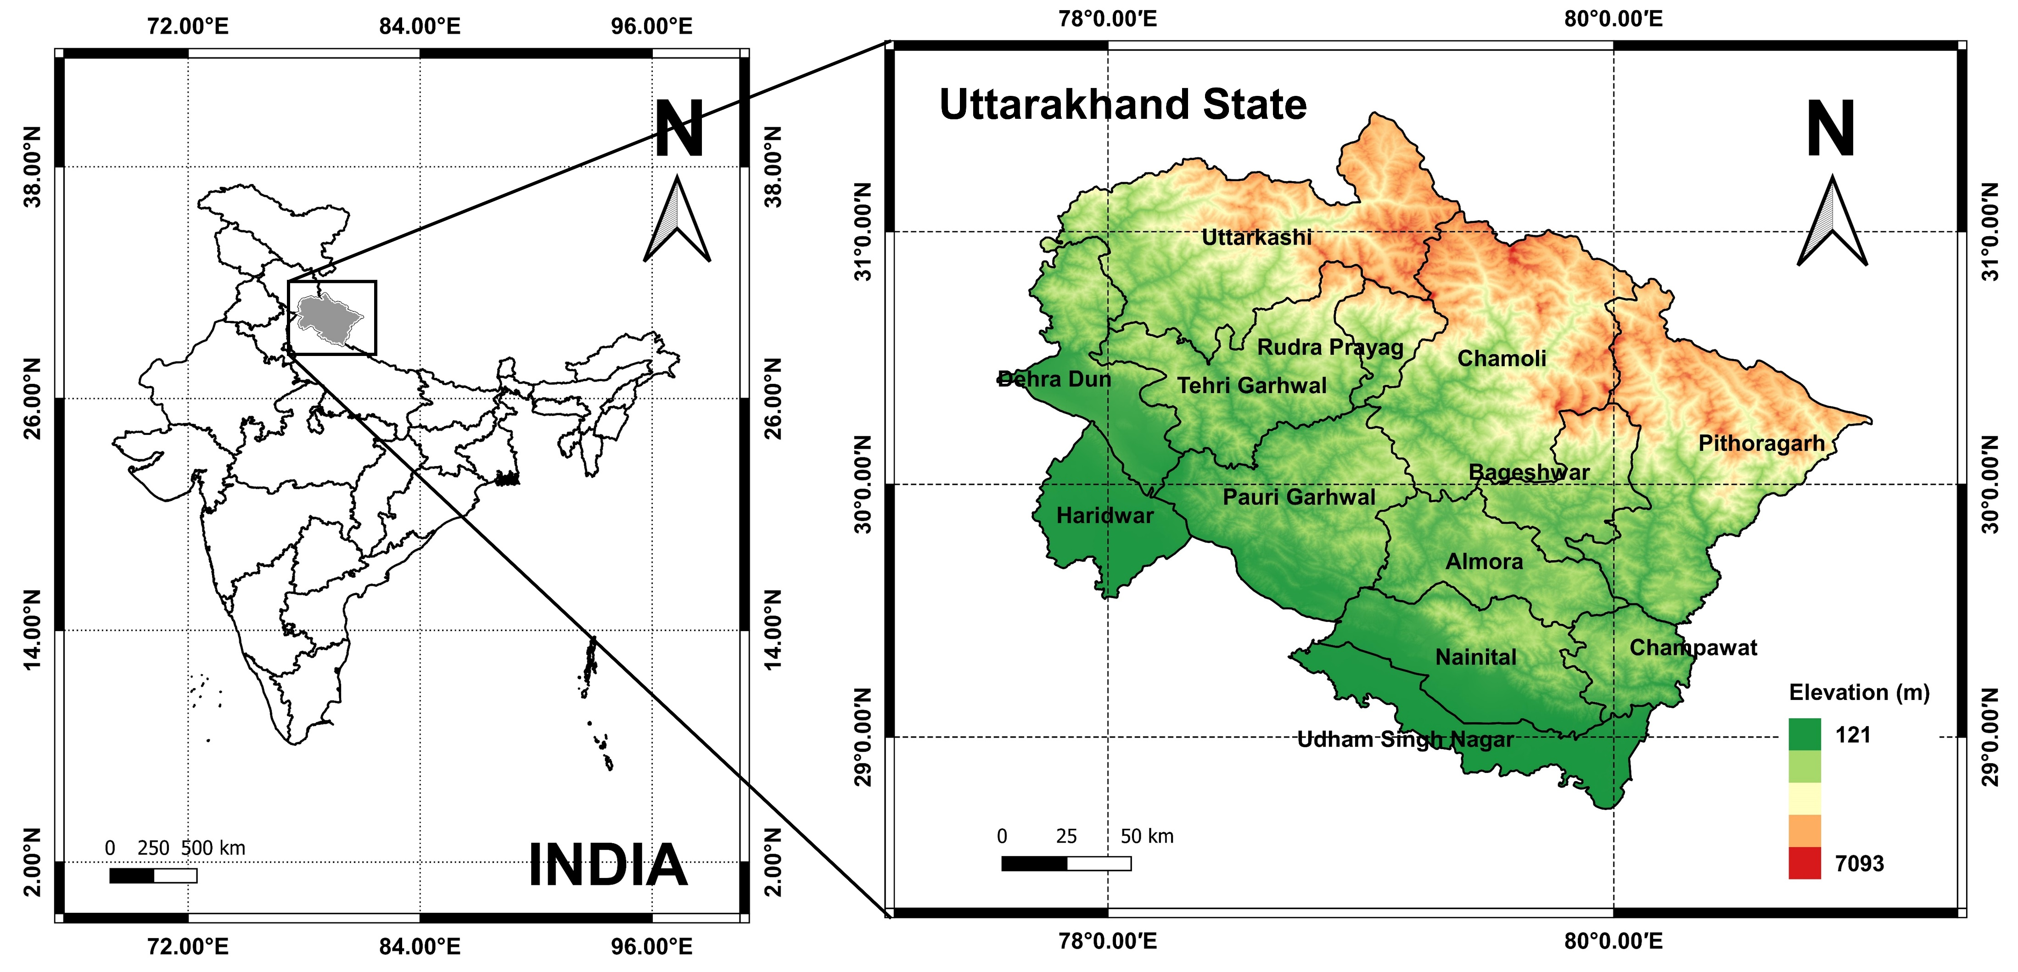
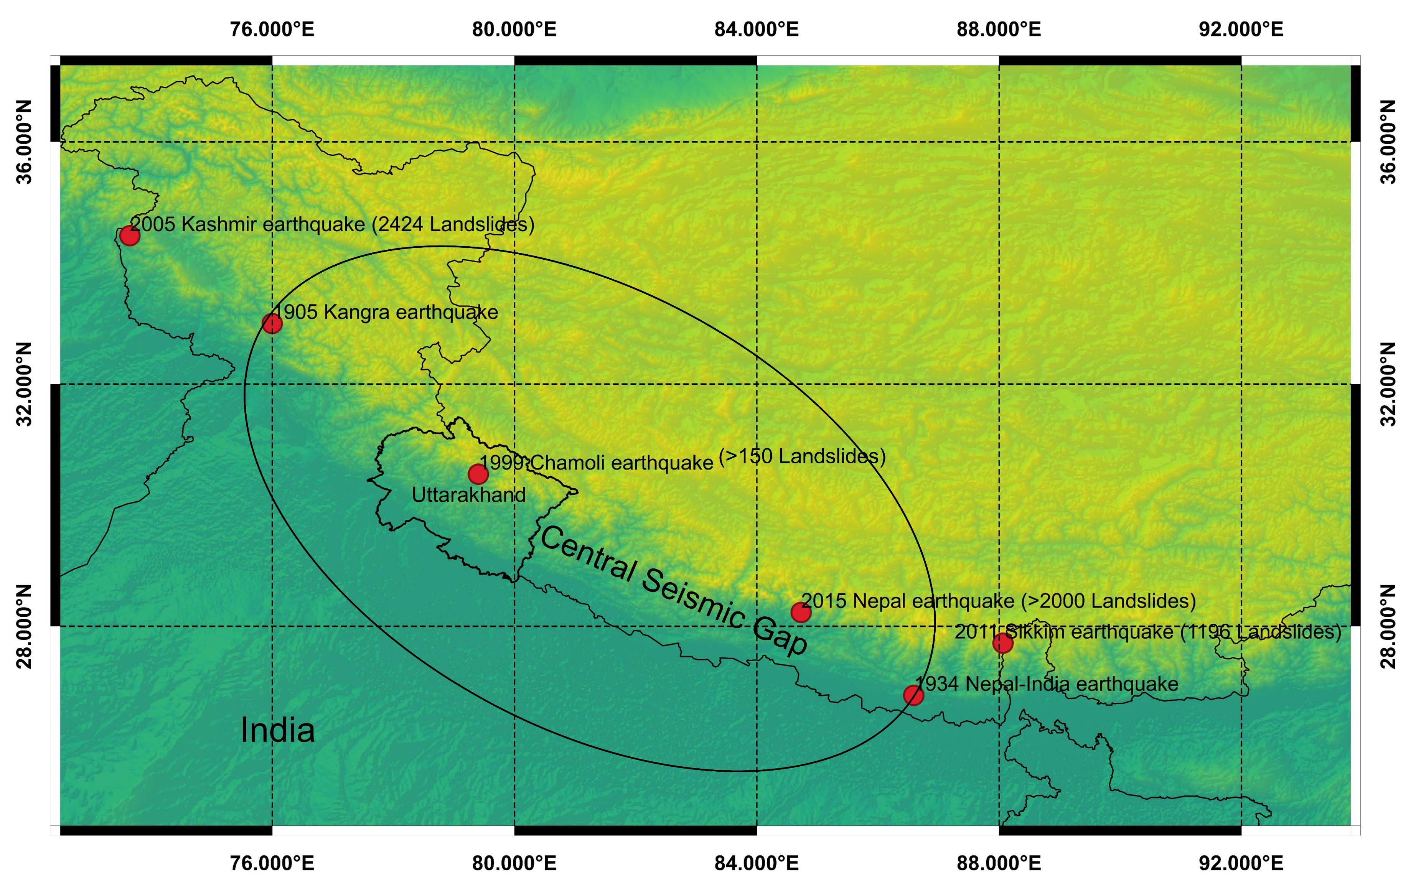
Himalayan Region
Among the most seismically active regions in the world.
Earthquake-induced landslides are very common in the Himalayas and its surrounding regions.
Uttarakhand (Western Himalayas), a state in the northern part of the Indian subcontinent.
It falls in zones IV (severe) and V (very severe) as per IS:1893 2002.
It lies in the center seismic gap.
Fig. 1 Location details of study area
Notes:
Uttarakhand is a part of western Himalayas. Himalayas are considered as the most seismically active region of the word. Earthquake induced landslide are very common in this region due to the fractured geology and tectonic framework. As we can see the Figure 2 that the number of landslides caused by different earthquakes. Uttarakhand also lies in the central seismic gap which is the region between two major earthquakes which are 1905 Kangra earthquake and 1934 Nepal-India Earthquake. It is reported the central seismic gap has very high strain energy accumulation and this energy will cause great earthquakes in the future. As Uttarakhand has the highest vulnerability among all Himalayan states as per the Landslide susceptibility map of India and due to its high seismicity, it was selected for co-seismic landslide hazard studies.

Slide 3
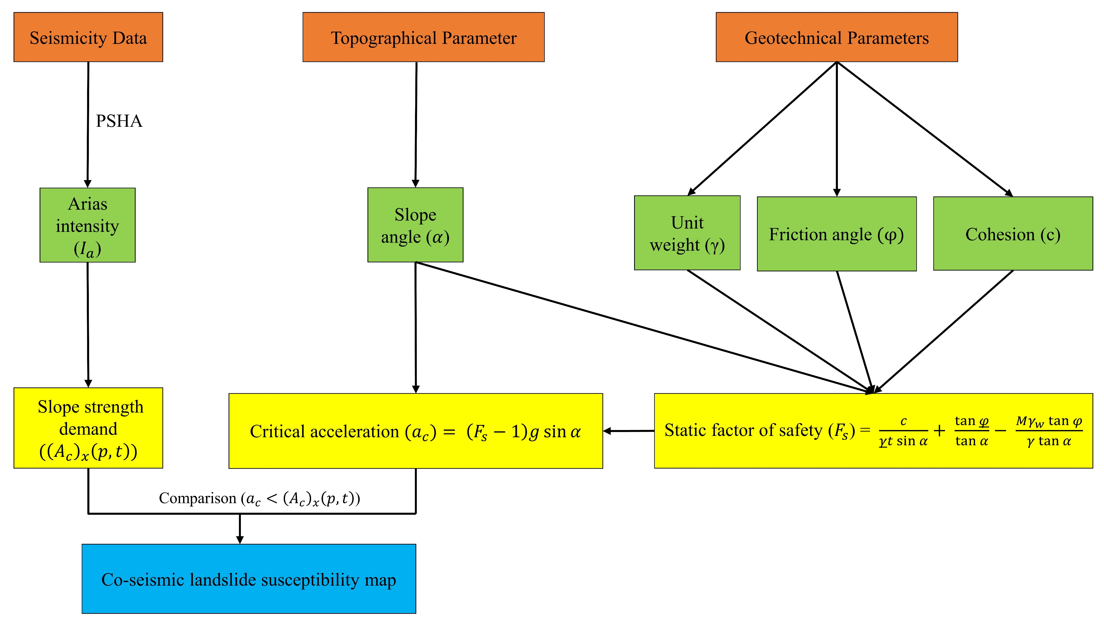
Fig. 4 Flow chart showing the methodology followed in the present study

Slide 4
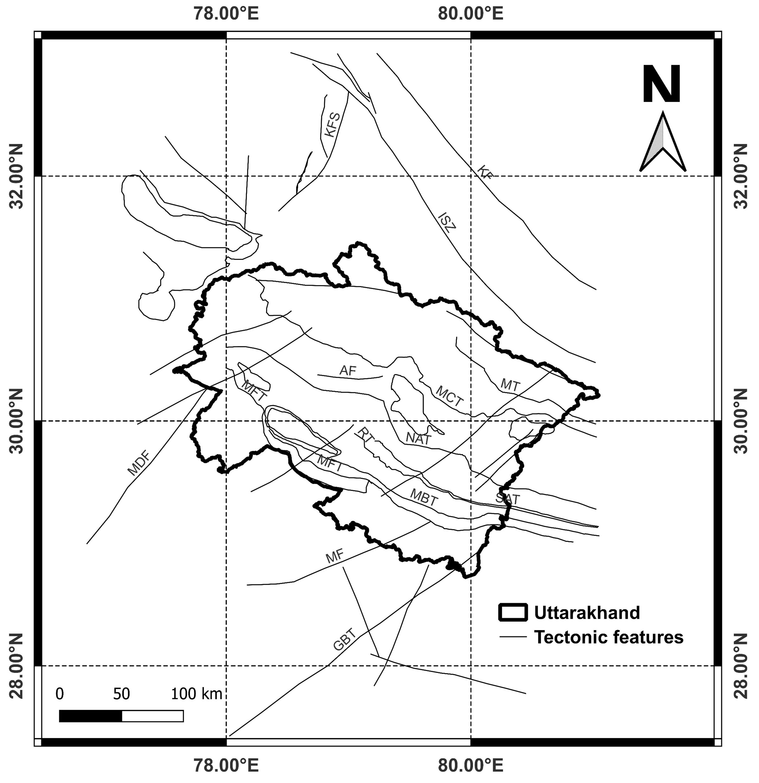
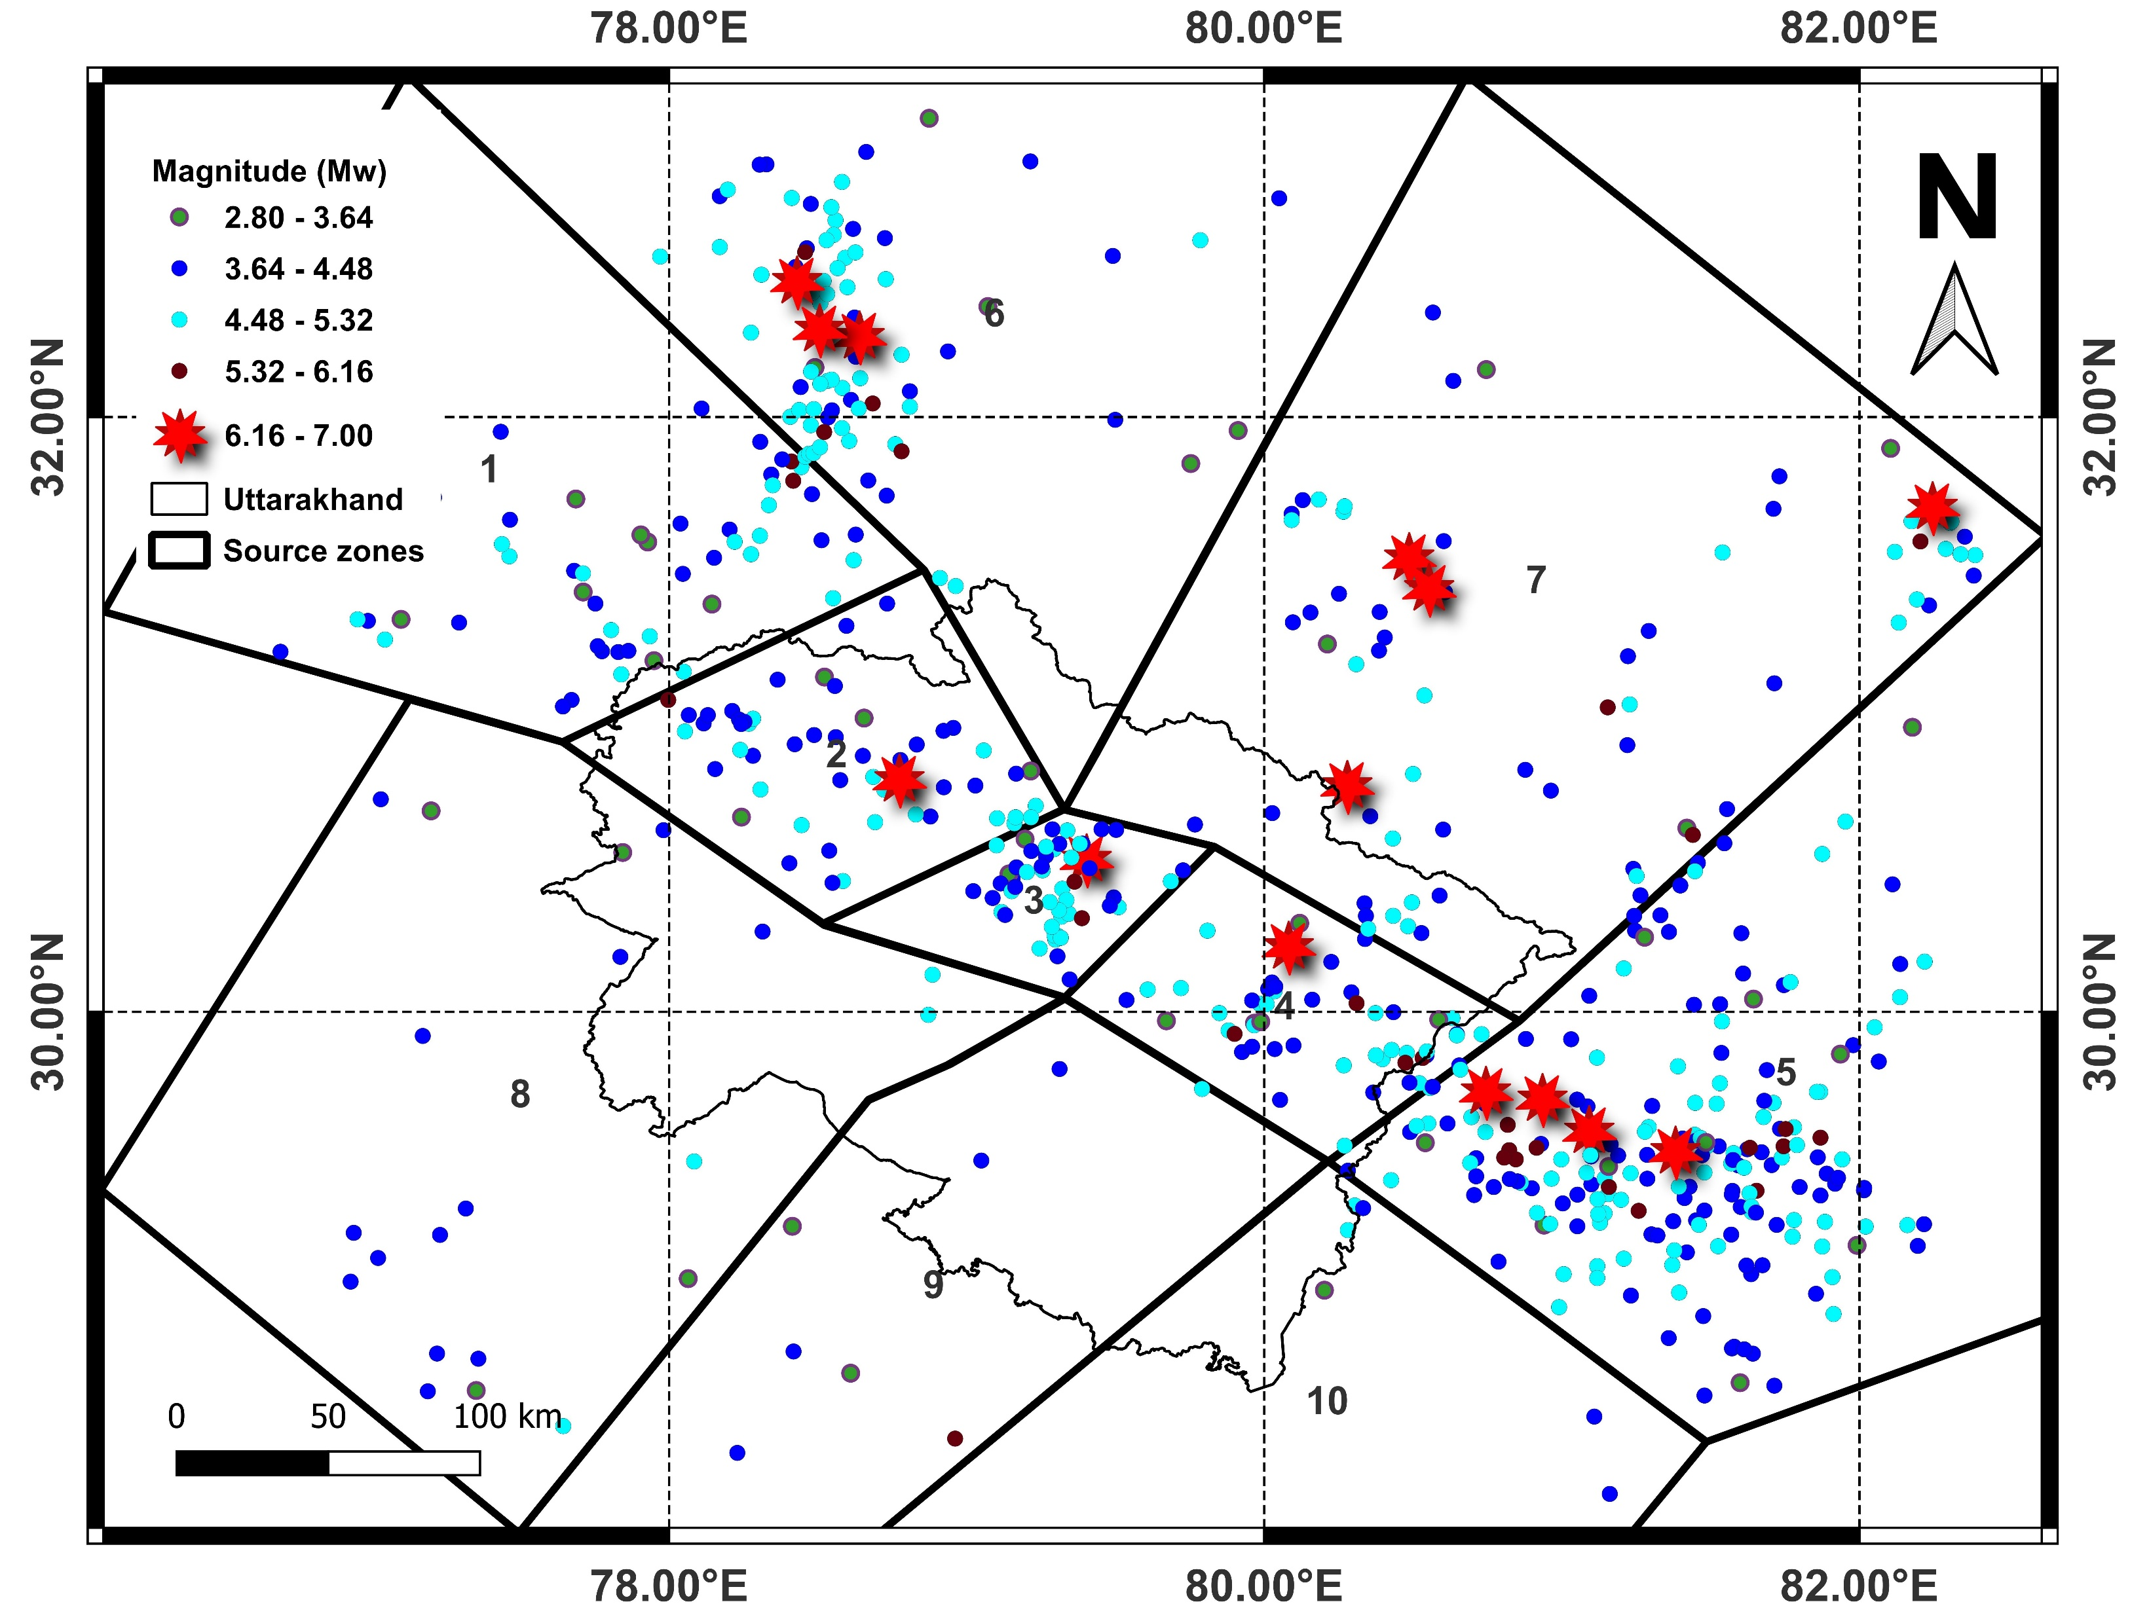
Fig. 2 Major tectonic features of the study area; South Almora Thrust (SAT), Indus Suture Zone (ISZ), Moradabad Fault (MF), Karakorum fault (KF), Kaurik Fault System (KFS), North Almora Thrust (NAT), Munsiyari Thrust (MT), Ramgarh Thrust (RT), Mahendragarh Dehradun Fault (MDF), Great Boundary Thrust (GBT), Alakananda Fault (AF) (modified after Gupta and Satyam, 2022 and GSI, 2021)
Fig. 3 Seismic source zones delineated in and around the Uttarakhand state (modified after Gupta and Satyam, 2022)

Slide 5
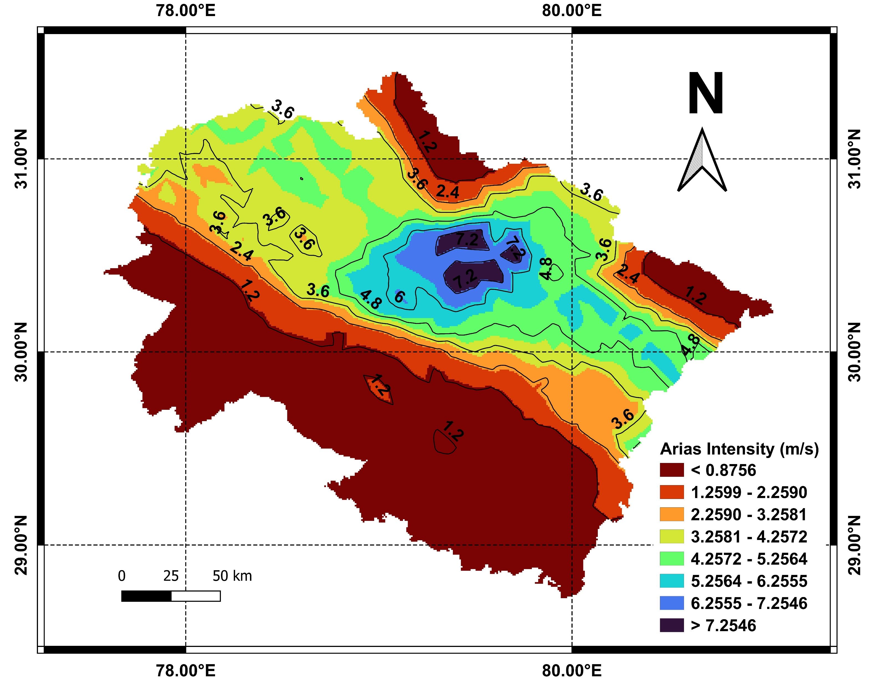
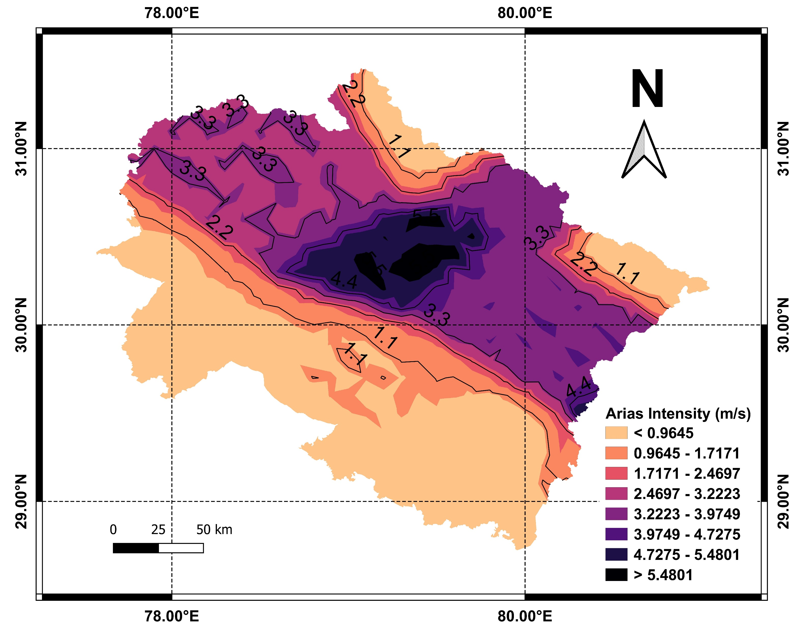
(a)
(b)
Fig. 5 The map showing the Arias intensity ${(I}_{a})$ distribution for 475 years return period; (a) For soil slopes (b) For rock slopes

Slide 6
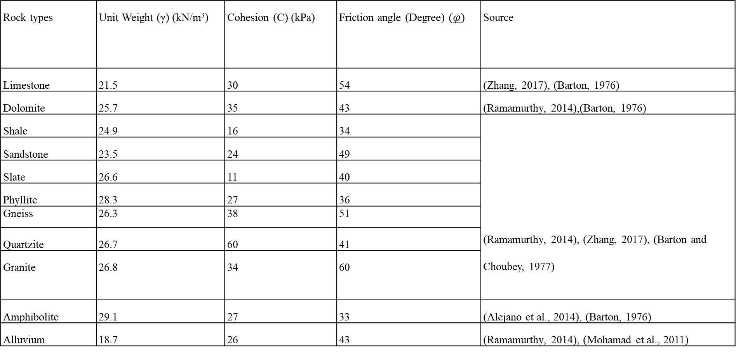
Table 1 Geological and geotechnical parameters assigned to different rock types for the present study
Rock types | Unit Weight (γ) (kN/m³) | Cohesion (C) (kPa) | Friction angle (Degree) $(φ)$ | Source
Limestone | 21.5 | 30 | 54 | (Zhang, 2017), (Barton, 1976)
Dolomite | 25.7 | 35 | 43 | (Ramamurthy, 2014),(Barton, 1976)
Shale | 24.9 | 16 | 34 | (Ramamurthy, 2014), (Zhang, 2017), (Barton and Choubey, 1977)
Sandstone | 23.5 | 24 | 49
Slate | 26.6 | 11 | 40
Phyllite | 28.3 | 27 | 36
Gneiss | 26.3 | 38 | 51
Quartzite | 26.7 | 60 | 41
Granite | 26.8 | 34 | 60
Amphibolite | 29.1 | 27 | 33 | (Alejano et al., 2014), (Barton, 1976)
Alluvium | 18.7 | 26 | 43 | (Ramamurthy, 2014), (Mohamad et al., 2011)

Slide 7
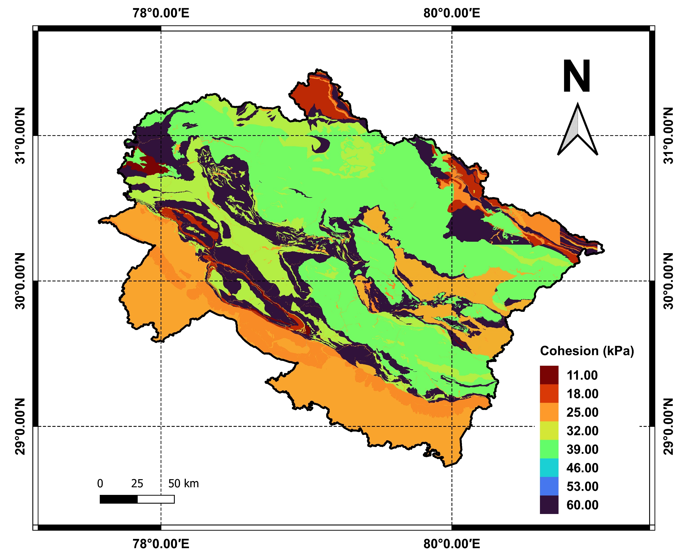
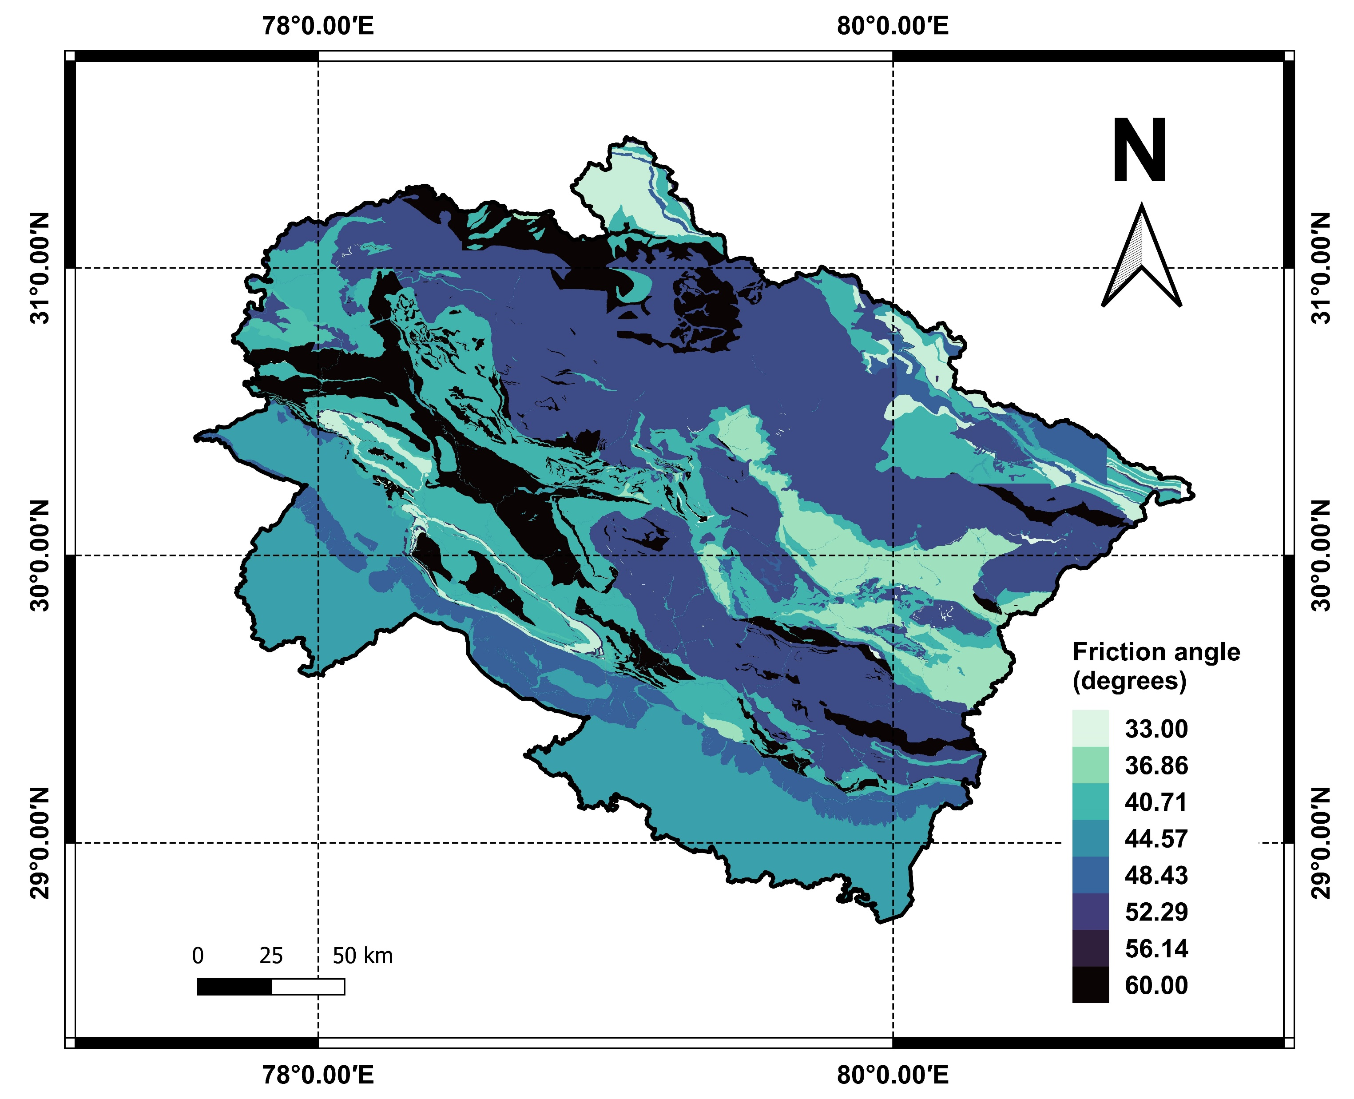
(a)
(b)
Fig. 6 The maps showing the variation in the geotechnical properties of different geological units of the study area; (a) Cohesion, (b) Friction angle

Slide 8
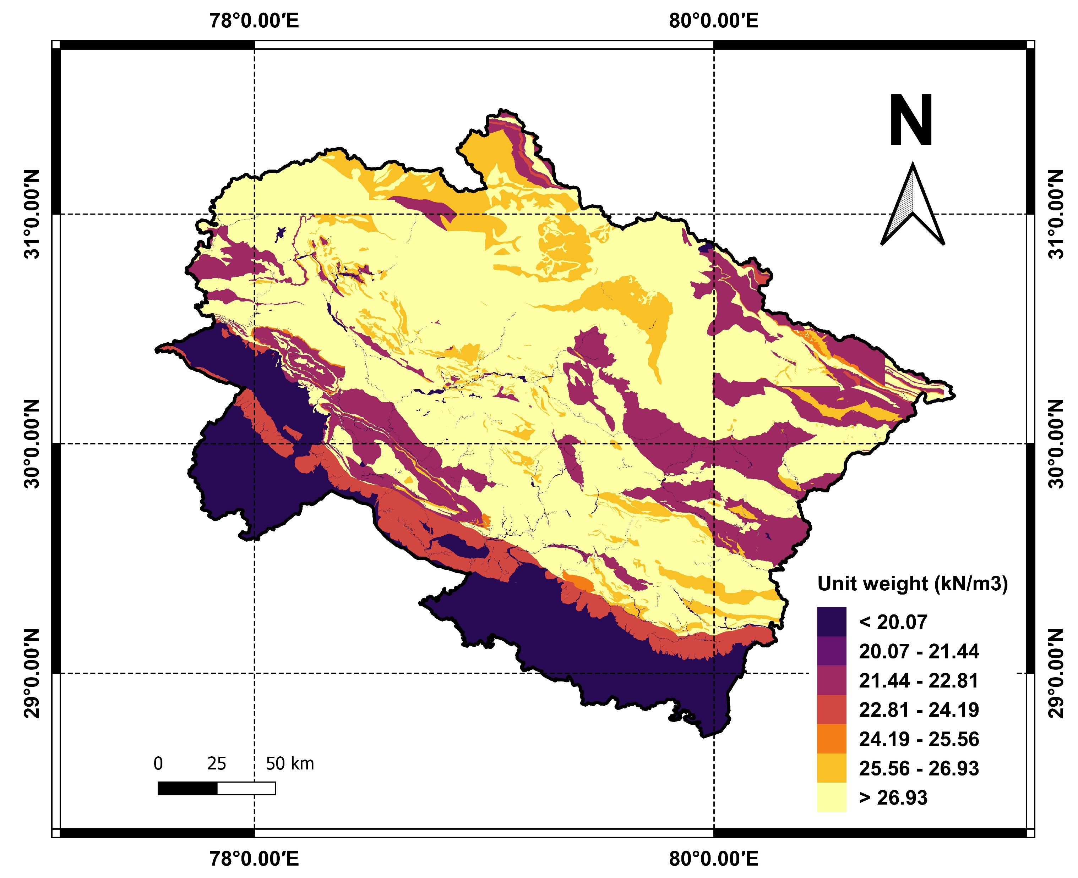
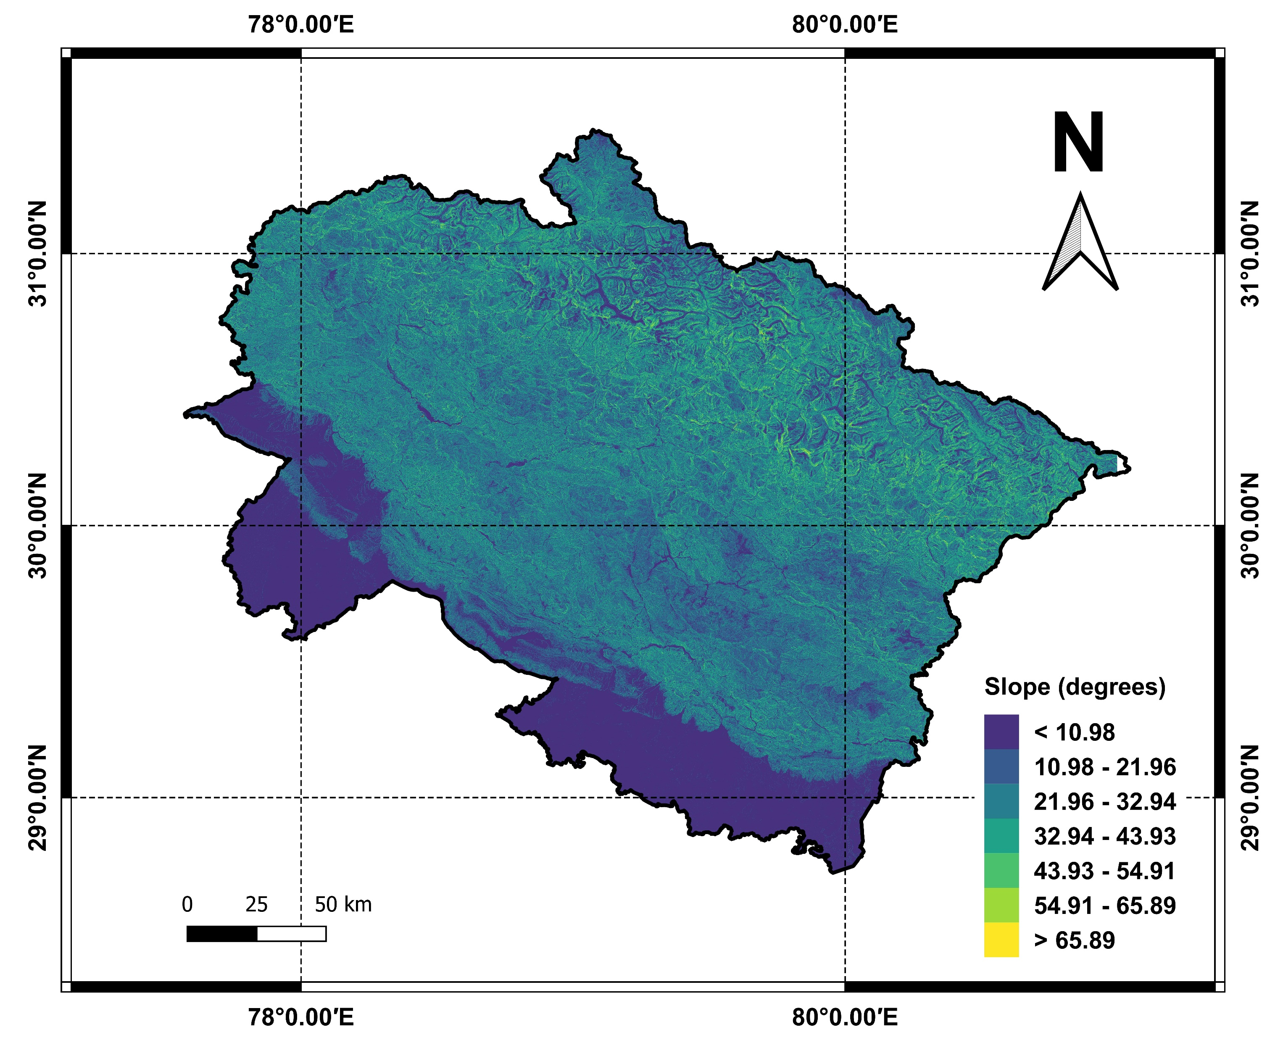
(a)
(b)
Fig. 7 The maps showing the variation in the geotechnical and topographical properties of different geological units of the study area; (a) Unit weight, (b) Slope angle

Slide 9
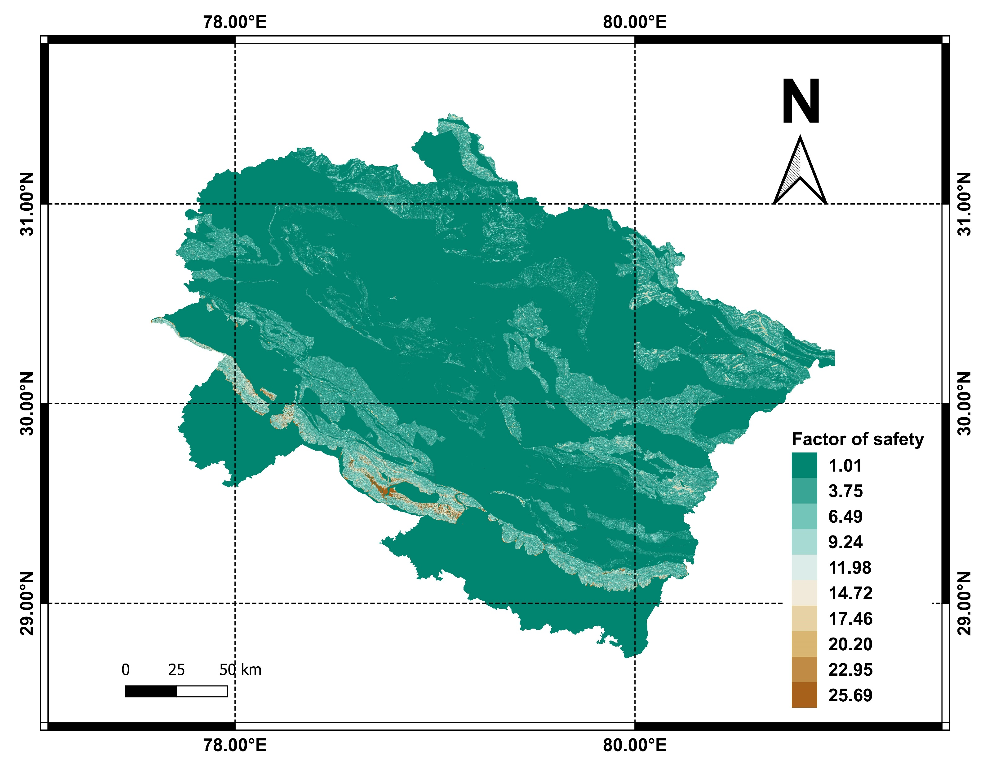
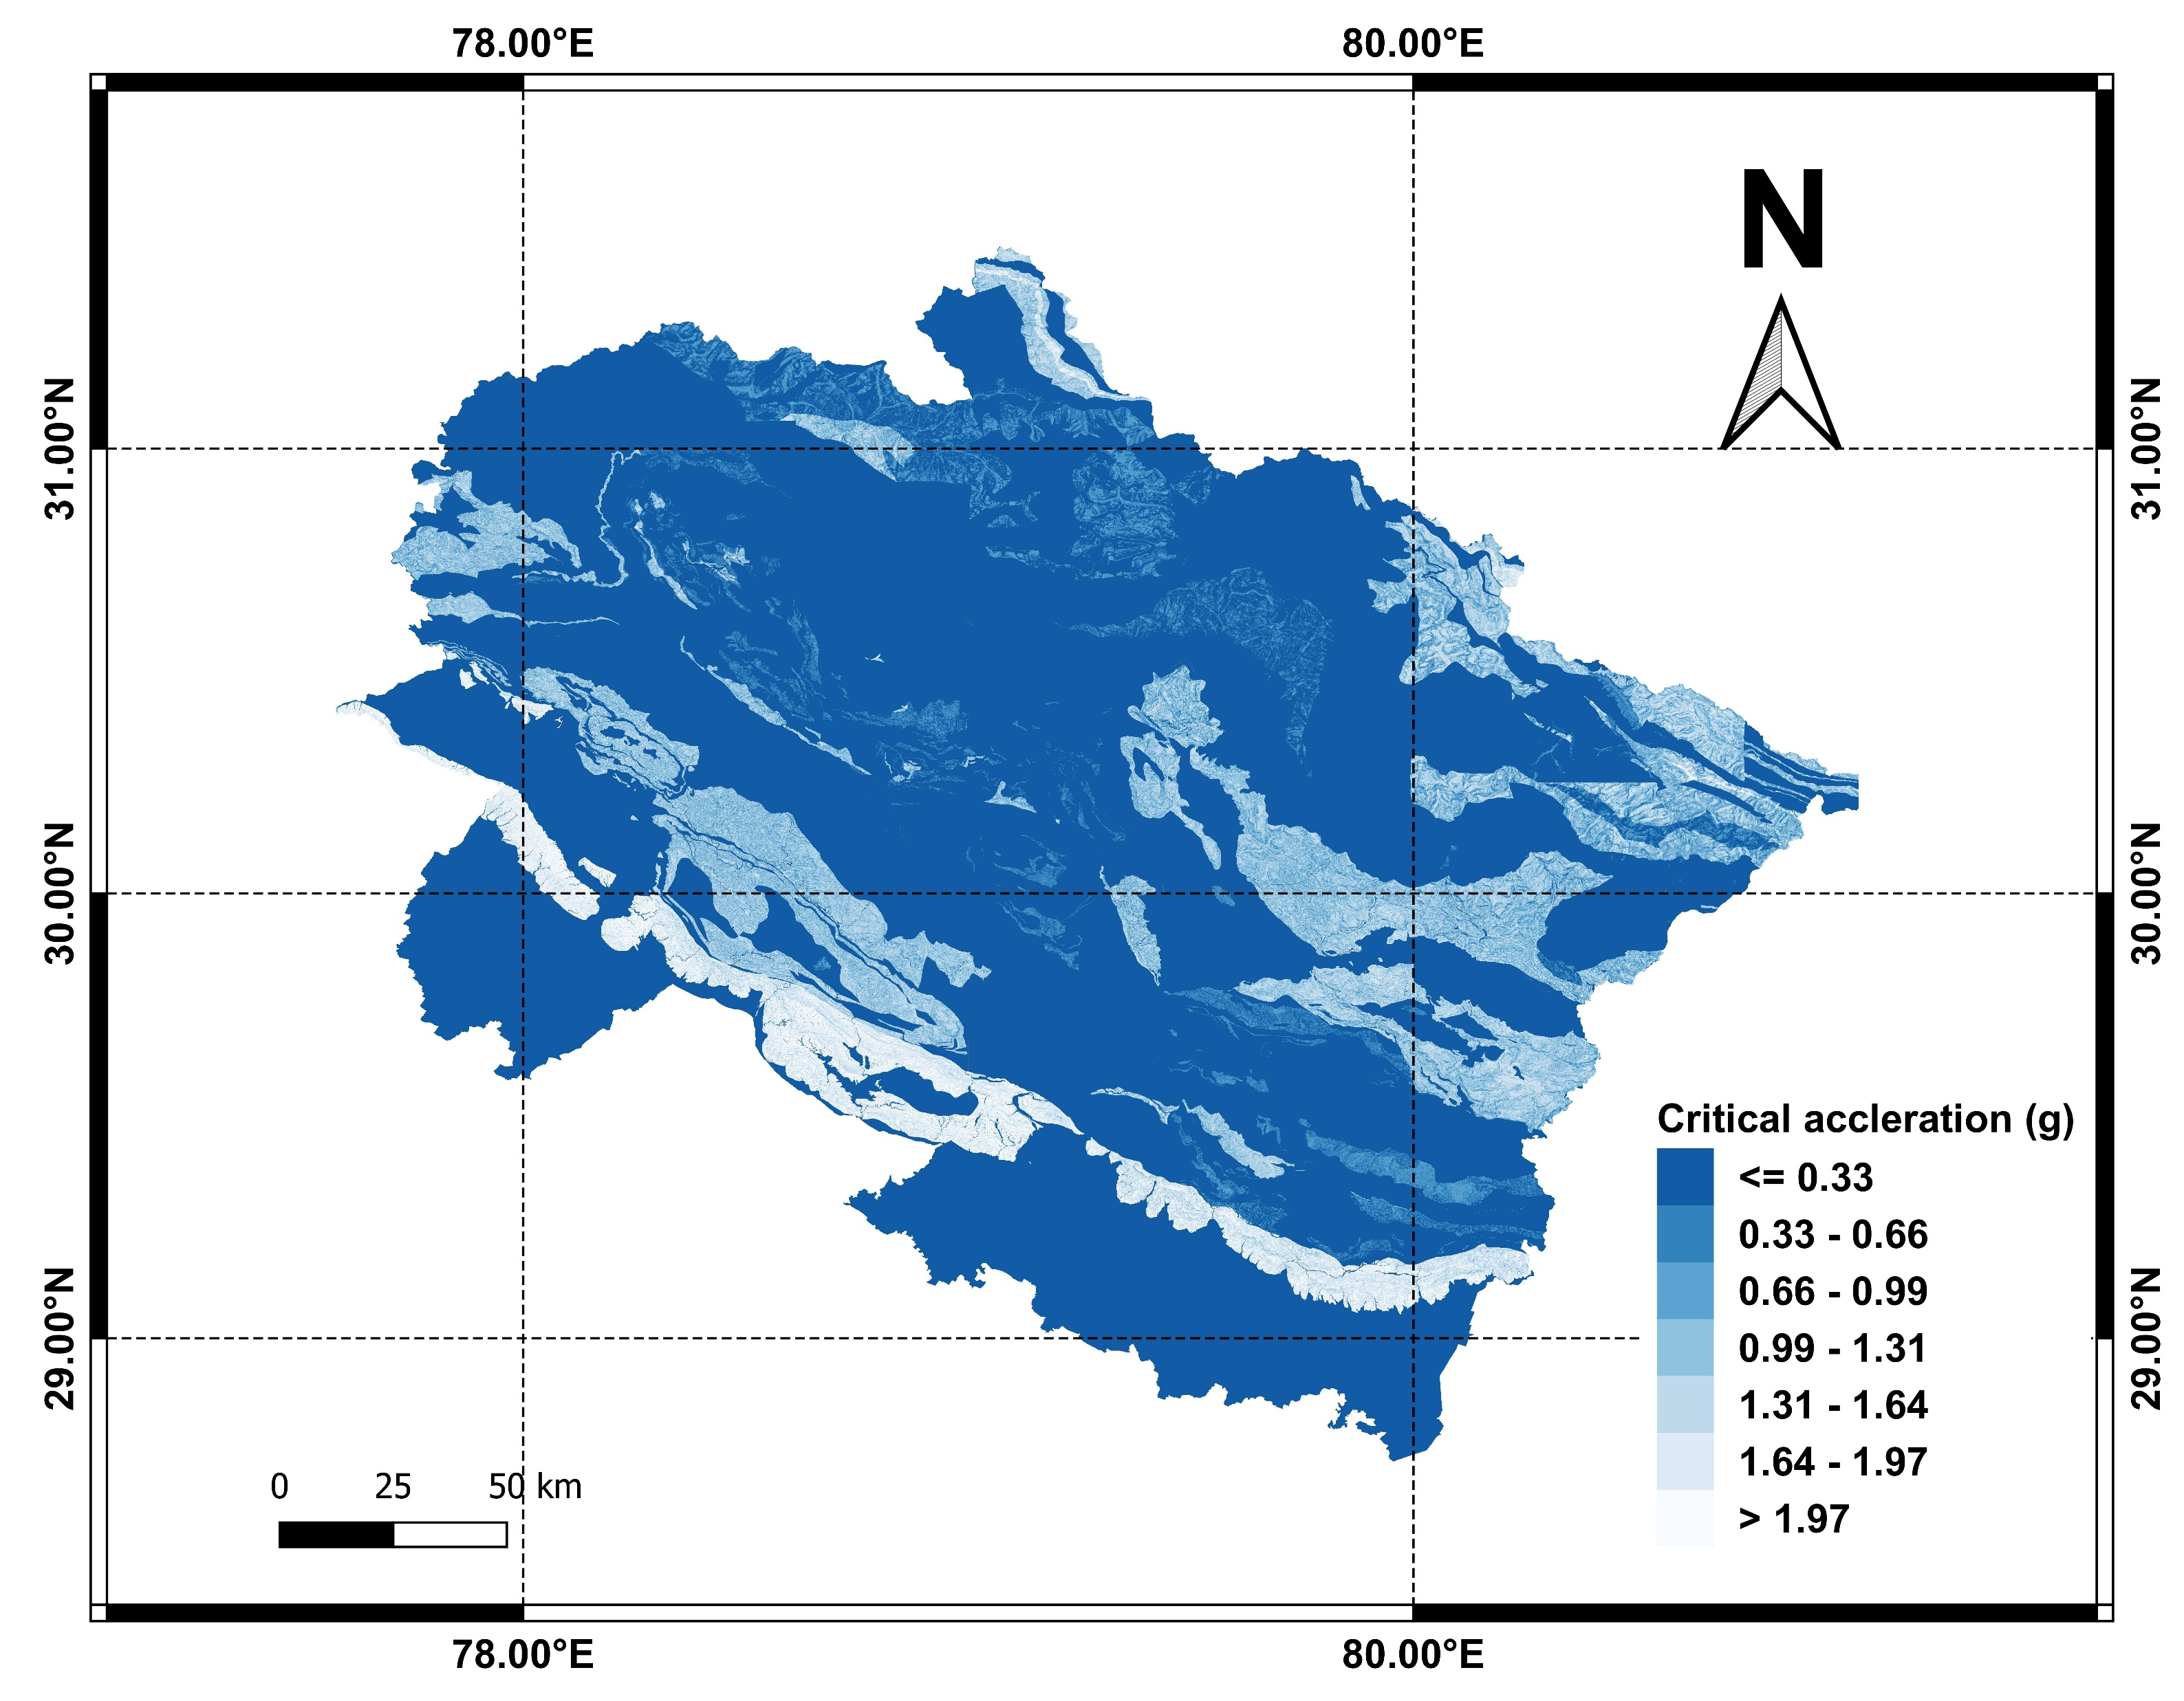
Fig. 8 The map showing the distribution of static factor of safety for the study area
Fig. 9 The in-situ critical acceleration ($a_{c}$) map for the study area

Slide 10
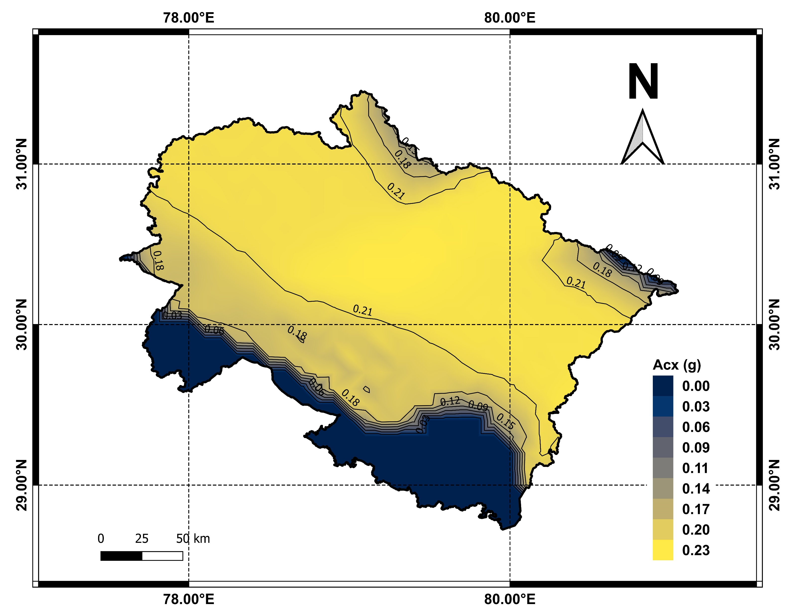
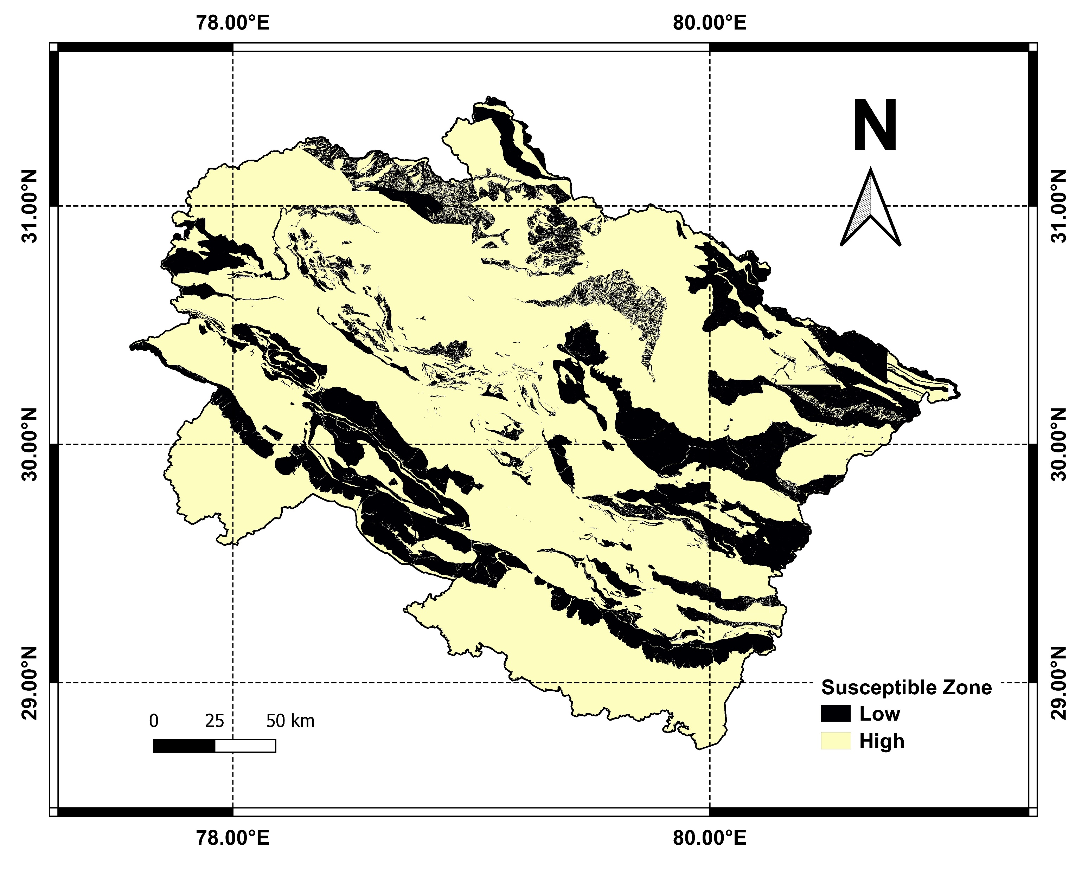
Fig. 10 The map showing the spatial distribution of slope strength demand for the study area
Fig. 11 The co-seismic landslide susceptibility map for the study area

Slide 11
References
Gupta K, Satyam N. Estimation of Arias intensity and peak ground acceleration (PGA) using probabilistic seismic hazard assessment of Uttarakhand state (India). Arab J Geosci 2022;15:437. https://doi.org/10.1007/s12517-022-09733-9.
GSI. Bhukosh-the spatial data portal and a geophysical data repository.
Zhang L. Engineering Properties of Rocks. Second Edi. Elsevier Ltd.; 2017.
Barton N. The shear strength of rock and rock joints. Int J Rock Mech Min Sci 1976;13:255–79. https://doi.org/10.1016/0148-9062(76)90003-6.
Ramamurthy T. Engineering in Rocks for Slopes, Foundations and Tunnels. Third Edit. PHI Learning Private Limited; 2014.
Barton N, Choubey V. The shear strength of rock joints in theory and practice. Rock Mech Felsmechanik Mécanique Des Roches 1977;10:1–54. https://doi.org/10.1007/BF01261801.
Alejano LR, Perucho Á, Olalla C, Jimenez R. Rock Engineering and Rock Mechanics: Structures in and on Rock Masses. London: 2014.
Mohamad ET, Alshameri BA, Kassim KA, Saad R. Shear strength behaviour for older alluvium under different moisture content. Electron J Geotech Eng 2011;16 F:605–17.

Slide 12
Thank you

