Slide 1




Conceptualising the management of climate extreme events through a GIS-based digital twin system
Khurram Riaz, Marion McAfee, Iulia Anton, and Salem Gharbia

Slide 2

What is Digital twin technology?
A digital twin is a virtual representation of a physical object, with a continuous flow of data that enable convergence between the physical and virtual state.
NASA introduced the digital twin concept to develop physical models and simulations of spacecraft for the first time in 2010
More recently, digital twins have been employed in structures and buildings, energy flow, and in manufacturing
Currently, digital twin technology is being explored for developing the smart cities
A representation of a physical asset that has a level of accuracy that allows the user to understand and predict its performance.

Slide 3







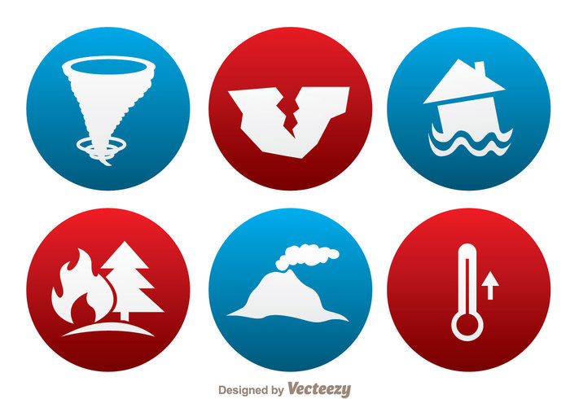


Digital Twin for A Smart City
Reality Capture
2D and 3D models
Interfaced with real-time data
Physical Asset
Digital twin
Two-way integration
Accurate prediction of the effect of mitigations
Data Access
Topographic base maps
Environmental Management
Urban planning
Disaster management
Land
Records
Source: ATKINS (2019). “Digital Twin for the Built Environment”

Slide 4
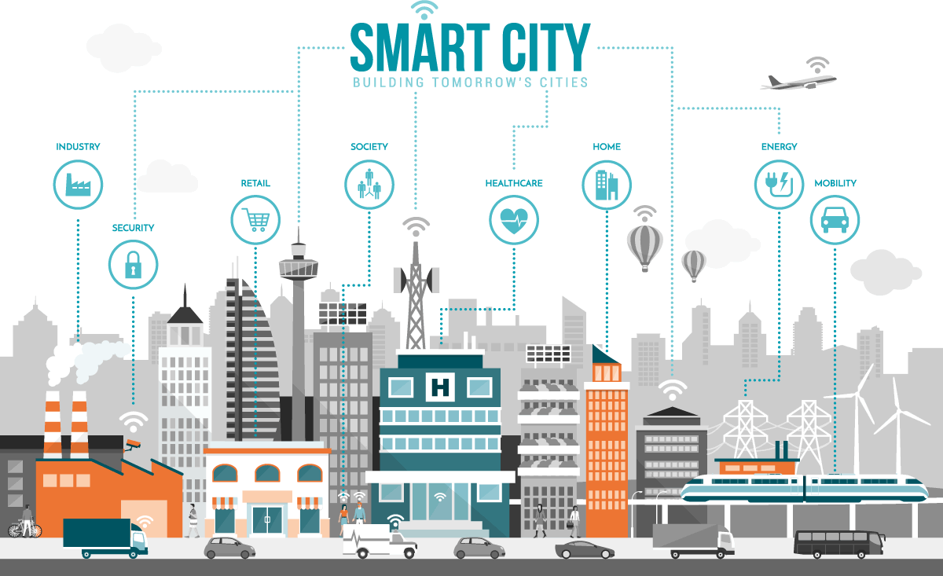

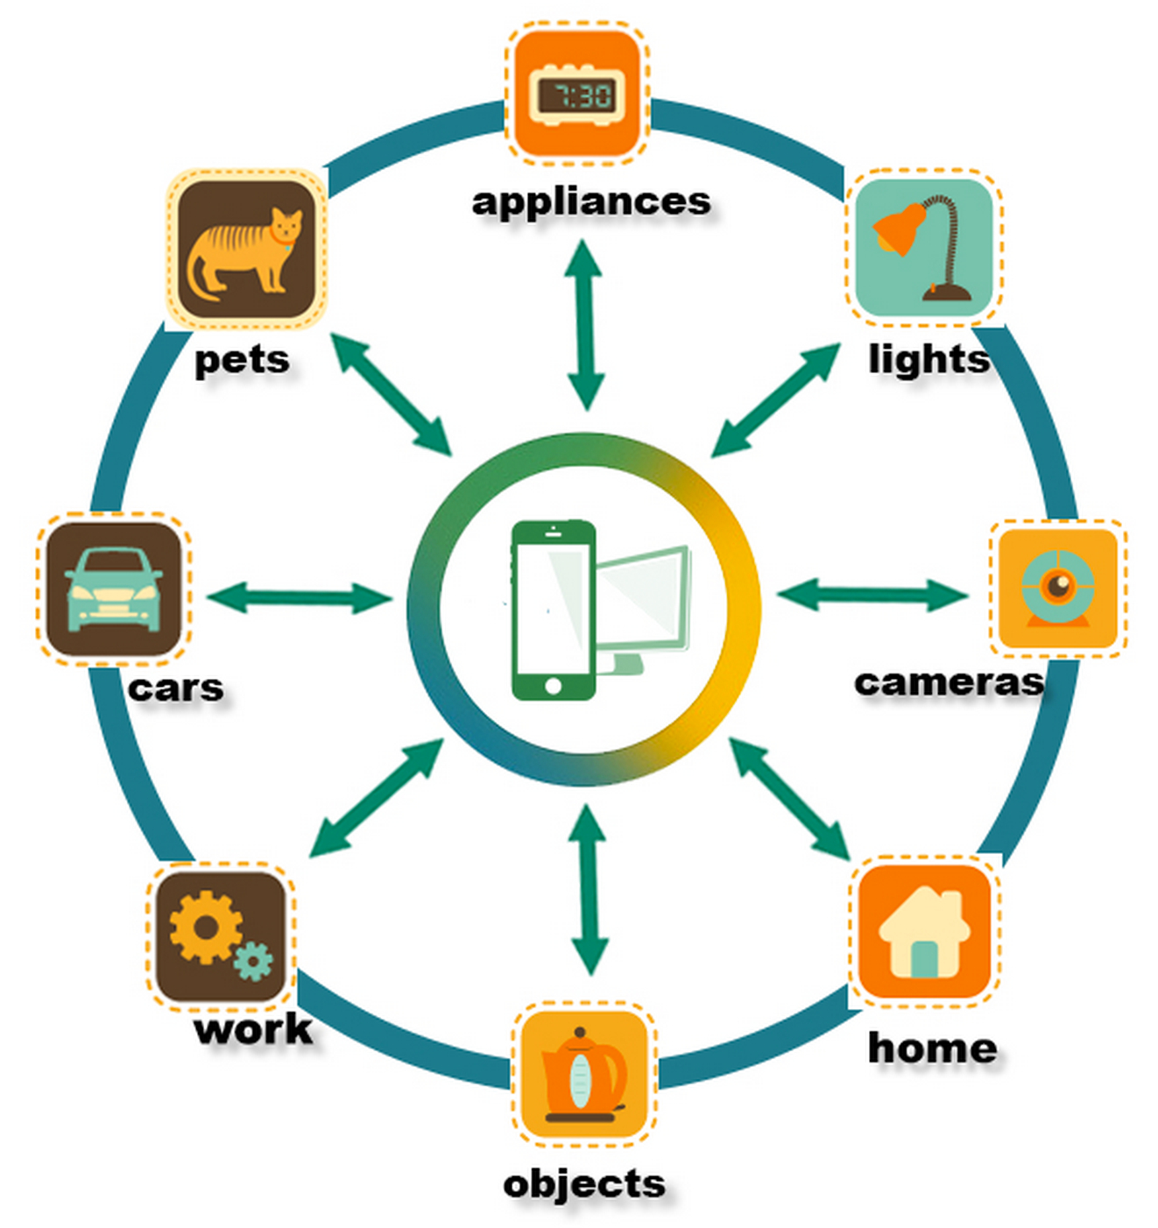
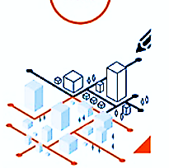
Major Components for developing Smart cities
Major Component of Digital twin technology for smart cities
3D city model
Real-Time Sensor Data
Digital twin

Slide 5
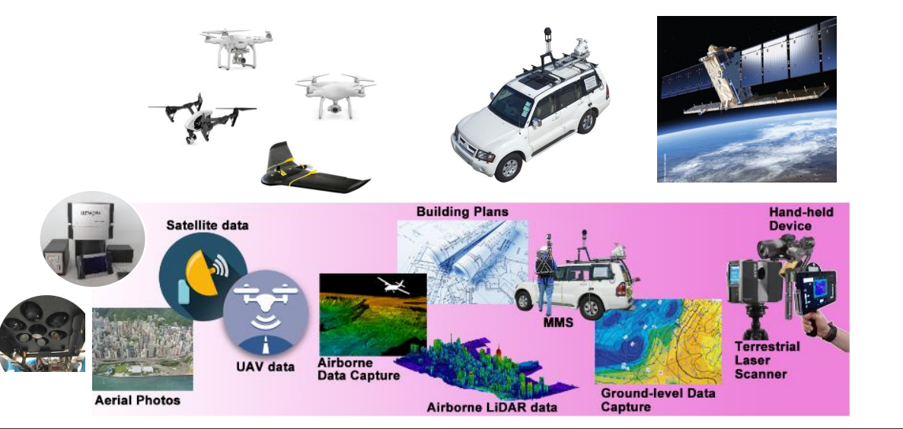
Technologies and sensors used for real-time data

Slide 6
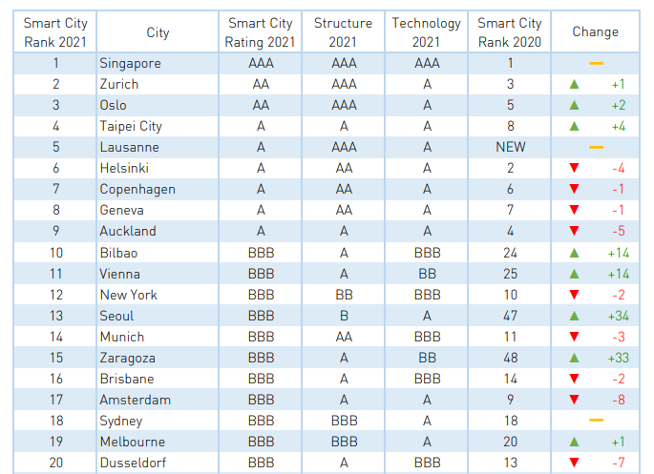

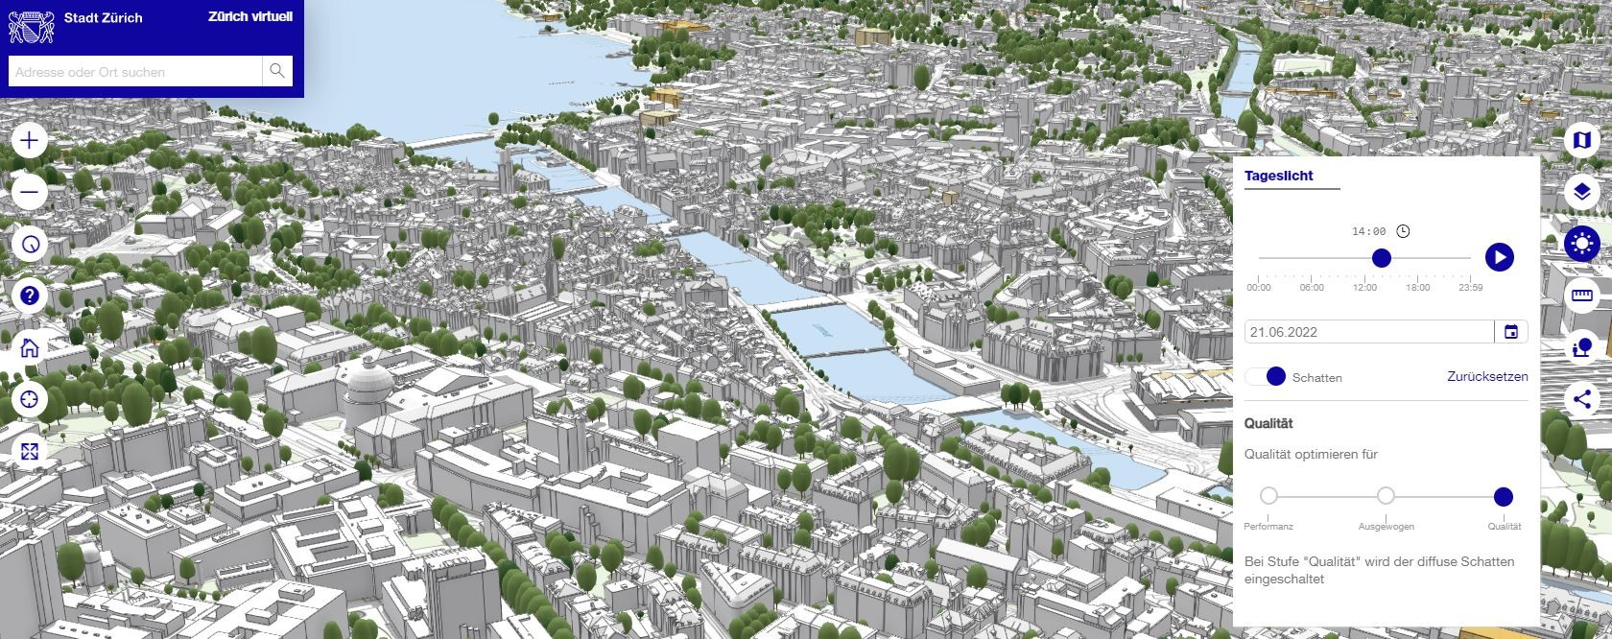
Smart City Index 2021
World-leading smart cities
https://www.smartnation.gov.sg/
https://www.stadt-zuerich.ch/ted/de/index/geoz/Zuerich_Virtuell.html
Source: Institute for Management Development (IMD) World Competitiveness Center – Smart City Index 2021

Slide 7



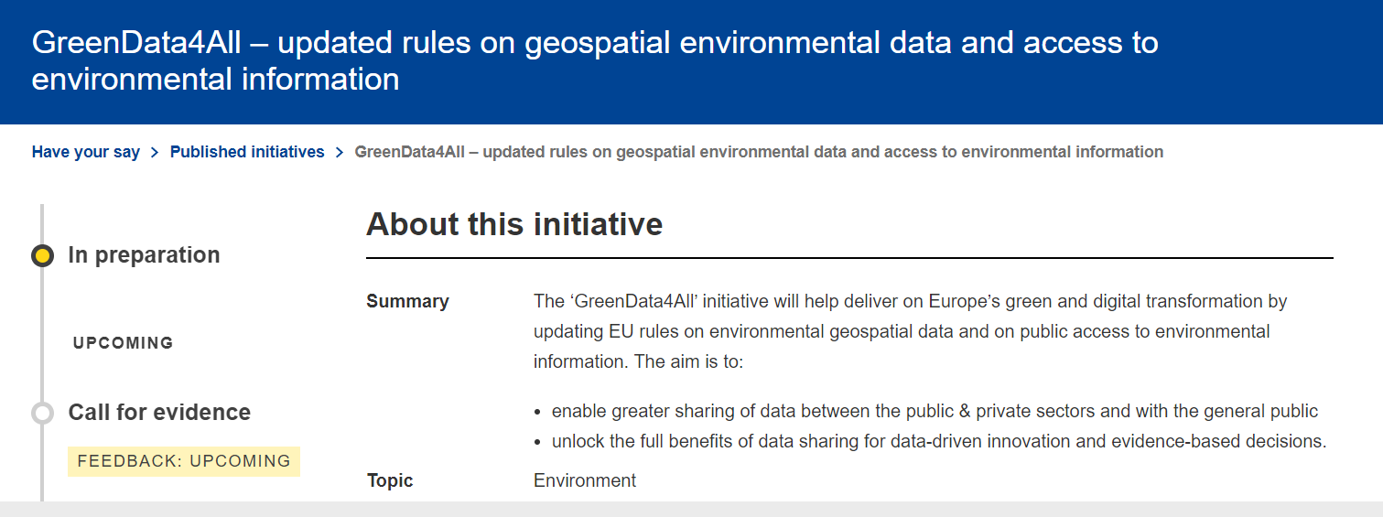
EU Projects on Digital twin solutions for climate-resilient smart cities

Slide 8




SCORE Digital twin for coastal city climate resilience
Study Area
Data Collection
Nowcast
Digital twin
Early warning system
Hydraulic model
Meto updates
Atmosphere Data
City models
Early warning support system
Downscaling
&
Nowcasting
Local updates
10 Coastal city labs
Local Sensor Data
Digital twin
Maps
https://score-eu-project.eu/

Slide 9

A systematic review on the development of climate-resilient smart cities through digital twin technology
Findings:
limited amount of research conducted on digital twin technology in the process of climate resilience
In terms of climate resilience and smart cities, it is a very new phrase, resulting in a small number of relevant articles for this study. However, Due to the rapidly increasing interest of the European Union and other financial agencies in digital twin technology, the number of publications focusing on climate-resilient smart cities is projected to increase dramatically in the near future.

Slide 10




Dr. Salem Gharbia BEng (Hons), M.Sc. (Distinction), MIEI, PG.D., PD Ed, Ph.D.
Lecturer in Water Science
Department of Environmental Science,
ATU, Sligo. Ireland
F91 YW50
E: gharbia.salem@itsligo.ie
Dr. Marion McAfee, MEng, PGCHET, PhD, FHEA, SMIEEE
Senior Lecturer in Systems and Control Engineering
ATU Sligo, Ireland
F91 YW50
E: mcafee.marion@itsligo.ie
Khurram Riaz
Ph.D. Student
Department of Environmental Science,
Atlantic Technological University
ATU Sligo, Ash Lane, Sligo, F91 YW50, Ireland
E: khurram.riaz@mail.itsligo.ie
Dr Iulia Anton (PhD MechEng, MS CompSCi, BS Eng, BS Math, HDip DataAnalyst)
Project Manager
Atlantic Technological University
ATU Sligo, Ash Lane, Sligo, F91 YW50
E: anton.iulia@itsligo.ie

