Slide 1


Estimation of Non-Linear Water Uptake Parameter using Genetic Algorithm for Sodic Soils
European Geosciences Union, General Assembly 2022
Gaurav Goet¹, Ickkshaanshu Sonkar², and Kotnoor Hari Prasad³
¹Research Scholar, Indian Institute of Technology Roorkee, India (ggoet1@ce.iitr.ac.in)
²Assistant Professor, Indian Institute of Technology Ropar, India (ickkshaanshu@iitrpr.ac.in)
³Professor, Indian Institute of Technology Roorkee, India (suryafce@ce.iitr.ac.in)

Slide 2

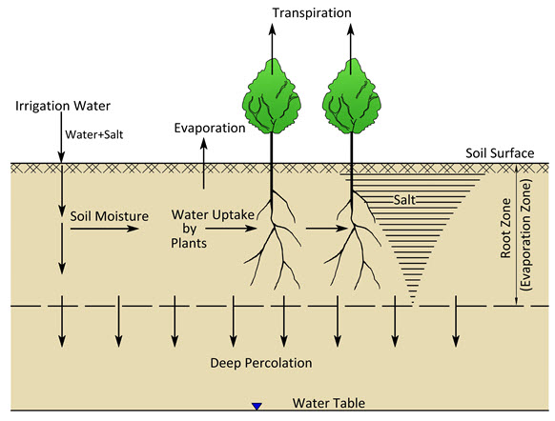
Introduction
Long-term irrigation with WW impacts soil physical and hydraulic properties like hydraulic conductivity, soil-water retention (SWR), infiltration, gravity drainage etc.
Most importantly, affects root water uptake (RWU) thence, altering the:
  Water budget
  Irrigation scheduling
  Crop yield
RWU is affected due to development of matric stress (limited water condition) and osmotic stress (due to salinity) in the root zone.
Fig: Smedema and Rycroft (1983)

Slide 3
Objective
A numerical model is developed for the solution of Richard’s equation with root water uptake as a sink term.
For accurate prediction of root zone soil moisture, the root water uptake parameter β and soil hydraulic parameters K_{sat}, α_{v}, n_{v}, θ_{s}, and θ_{r} have to be estimated accurately.
Directly measured soil hydraulic properties on soil samples do not represent exactly the field conditions (Vereecken et al., 2010).
To accurately estimate these parameters is by applying inverse estimation.
The objective of the present study is estimation of root water uptake parameter using observed percentage soil moisture and deep percolation and the effect of saline water irrigation on water uptake parameter.
Efficient irrigation scheduling

Slide 4
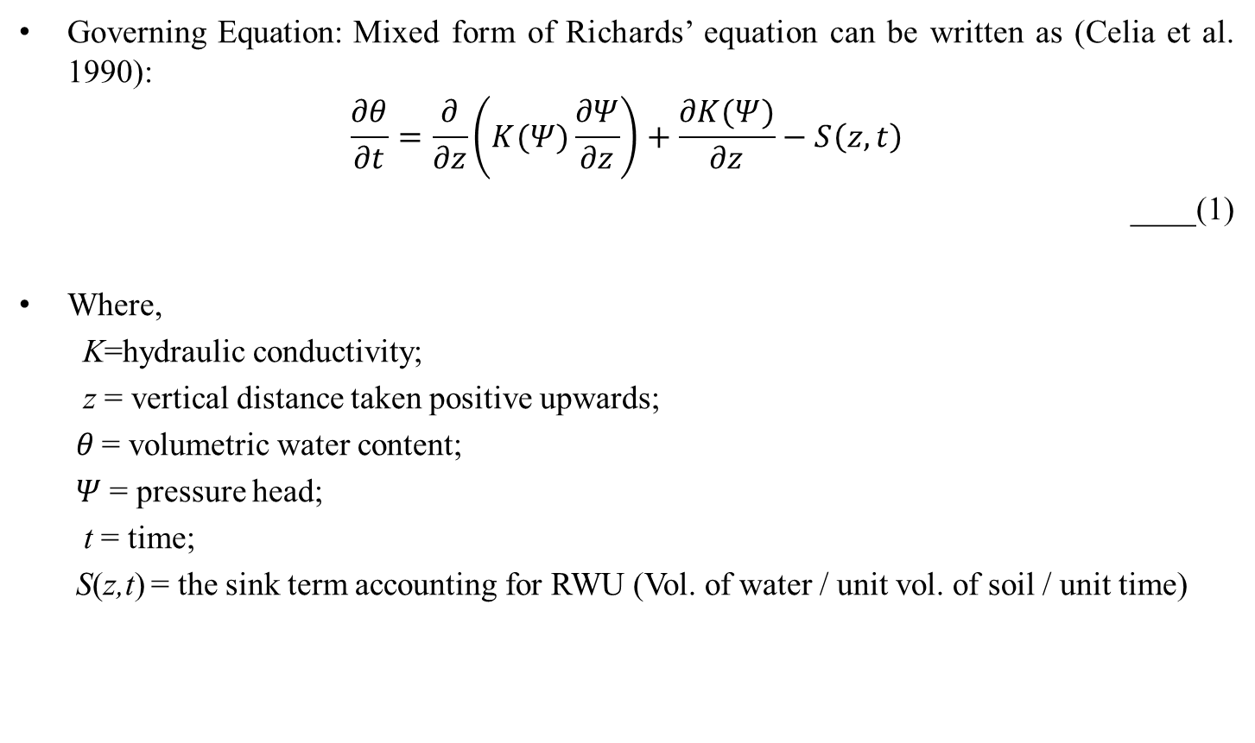
Methodology
Governing Equation: Mixed form of Richards’ equation can be written as (Celia et al. 1990):
$$\frac{∂θ}{∂t}=\frac{∂}{∂z}\left(K(Ψ)\frac{∂Ψ}{∂z}\right)+\frac{∂K(Ψ)}{∂z}−S\left(z,t\right)$$
____(1)
Where,
  K=hydraulic conductivity;
  z = vertical distance taken positive upwards;
  𝜃 = volumetric water content;
  $Ψ$ = pressure head;
  t = time;
  S(z,t) = the sink term accounting for RWU (Vol. of water / unit vol. of soil / unit time)

Slide 5
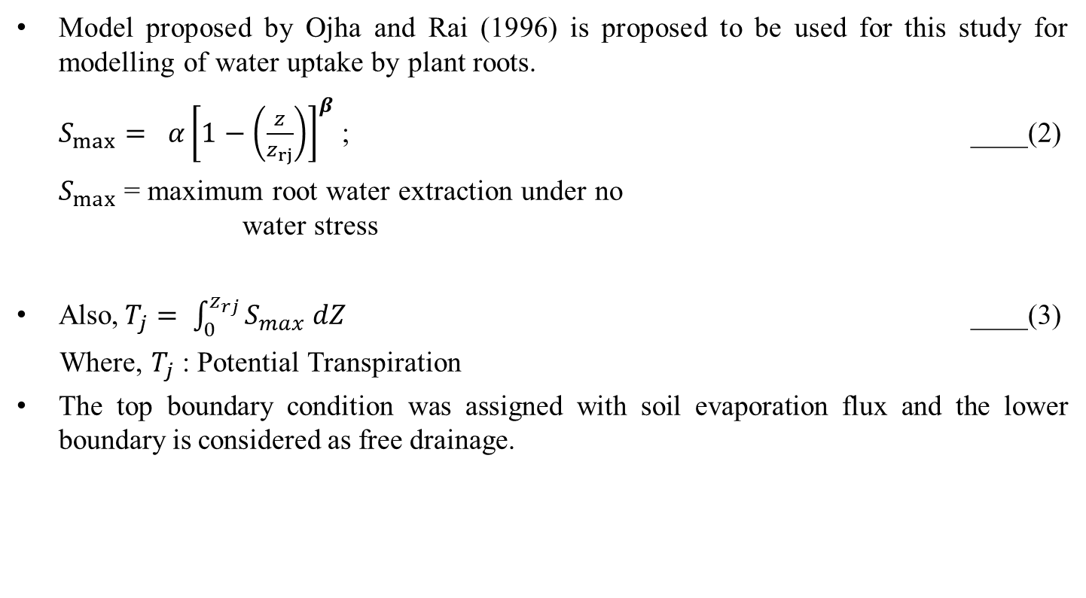
RWU Model
Model proposed by Ojha and Rai (1996) is proposed to be used for this study for modelling of water uptake by plant roots.
  $S_{max}= α{\left[1−\left(\frac{z}{z_{rj}}\right)\right]}^{β}$ ; ____(2)
  $S_{max}$ = maximum root water extraction under no water stress
Also,$T_{j}= \int_{0}^{z_{rj}}{S_{max} dZ}$ ____(3)
Where, $T_{j}$ : Potential Transpiration
The top boundary condition was assigned with soil evaporation flux and the lower boundary is considered as free drainage.

Slide 6
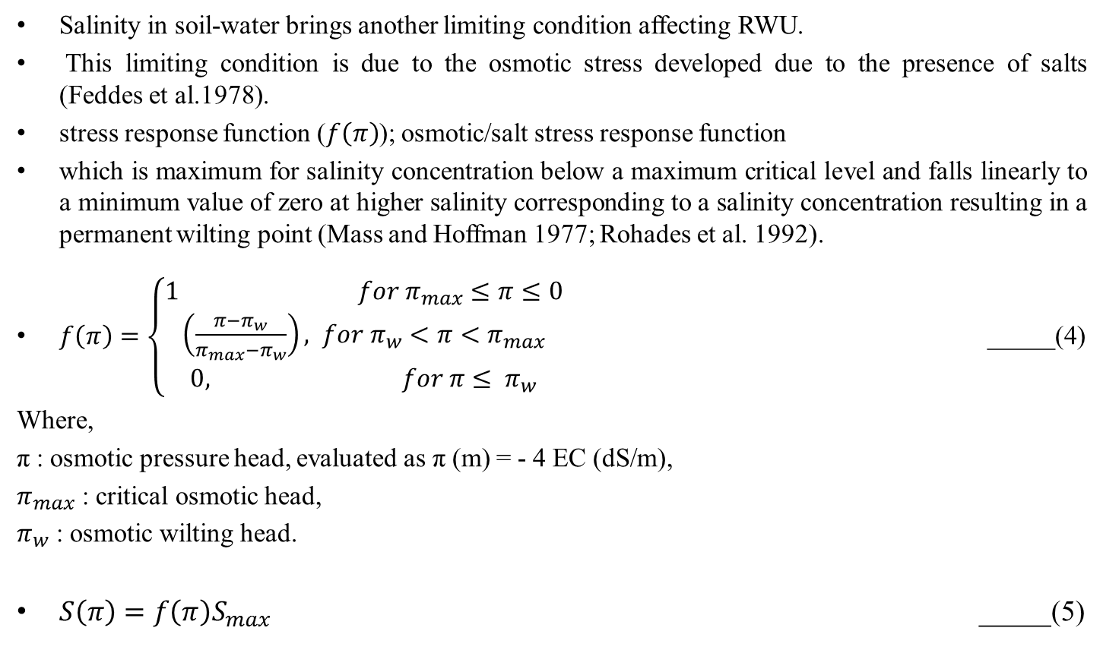
RWU Under Limiting Condition
Salinity in soil-water brings another limiting condition affecting RWU.
This limiting condition is due to the osmotic stress developed due to the presence of salts (Feddes et al.1978).
stress response function ($f\left(π\right)$); osmotic/salt stress response function
which is maximum for salinity concentration below a maximum critical level and falls linearly to a minimum value of zero at higher salinity corresponding to a salinity concentration resulting in a permanent wilting point (Mass and Hoffman 1977; Rohades et al. 1992).
$f\left(π\right)=\left\{\begin{aligned}1 for π_{max}≤π≤0 \\ \left(\frac{π−π_{w}}{π_{max}−π_{w}}\right), for π_{w}<π<π_{max} \\ 0, for π≤ π_{w}\end{aligned}\right.$ _____(4)
Where,
π : osmotic pressure head, evaluated as π (m) = - 4 EC (dS/m),
$π_{max}$ : critical osmotic head,
$π_{w}$ : osmotic wilting head.
$S\left(π\right)=f\left(π\right)S_{max}$ _____(5)

Slide 7
Methodology
Schematic Representation of Linked Simulation Optimization Model
Meteorological Inputs (Temp , R.H. etc.)
Runs several times with sequentially modified β
Observed M₀ / D₀
Observed Crop Parameters (R_{d} , LAI)
RWU
MODEL
GA BASED
OPTIMIZER
β
M_{c} / D_{c}
β_{optimal}
Observed Soil Parameters (K_{sat} , θ_{s} , etc.)
M₀ = Observed moisture content
M_{c} = Simulated moisture content
D₀ = Observed deep percolation
D_{c}= Simulated deep percolation

Slide 8
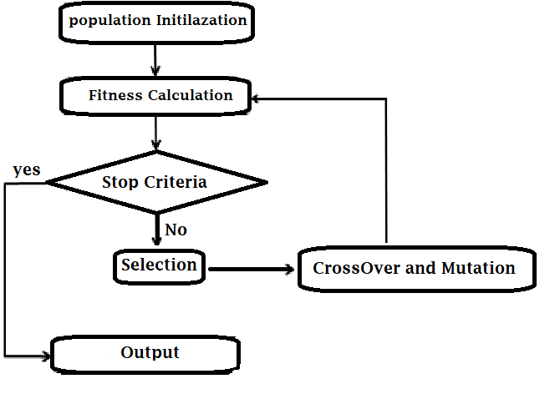
Genetic Algorithm (GA) optimization technique
Computerized search and optimization algorithm
Based on natural selection and natural genetics
Components:
  Genetic representation
  Reproduction
  Mating or cross-over
  Mutation
  Termination criteria (stop condition)

Slide 9
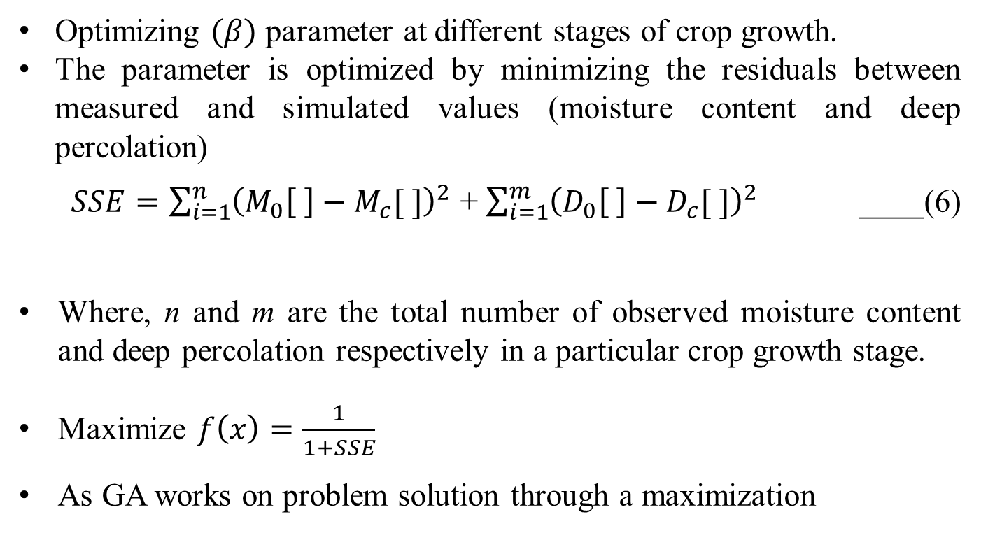
Optimization using Genetic Algorithm (GA)
Optimizing $(β)$ parameter at different stages of crop growth.
The parameter is optimized by minimizing the residuals between measured and simulated values (moisture content and deep percolation)
  $SSE=\sum_{i=1}^{n}{{\left(M_{0}\left[ \right]−M_{c}[ ]\right)}^{2}}$ + $\sum_{i=1}^{m}{{\left(D_{0}\left[ \right]−D_{c}[ ]\right)}^{2}}$ ____(6)
Where, n and m are the total number of observed moisture content and deep percolation respectively in a particular crop growth stage.
Maximize $f\left(x\right)=\frac{1}{1+SSE}$
As GA works on problem solution through a maximization

Slide 10
Code Verification
(Single Parameter Optimization)
For verification, single parameter optimization problem was formulated.
Parameter β was optimized using three 𝜃_{gen} [ ] and DP_{gen} [ ] sets A1, B1, and C1.
The soil hydraulic parameters (i.e. K_{s}, α_{v}, n_{v}, θ_{s}, and θ_{r}) in all sets are the average values reported in Carsel and Parrish (1988) for sandy clay, sandy clay loam, and loamy sand soils, respectively.
The parameter β in sets is considered greater than one to reflect non-linearity in the root water uptake mechanism.
Set | K_{s} (m hr⁻¹) (10⁻²) | α_{v}(m⁻¹) | n_{v} | ϴ_{s} (m³m⁻³) | ϴ_{r} (m³m⁻³) | β
A1 | 0.12 | 2.7 | 1.23 | 0.38 | 0.1 | 3.5
B1 | 1.31 | 5.9 | 1.48 | 0.39 | 0.1 | 2.5
C1 | 14.6 | 12.4 | 2.28 | 0.41 | 0.057 | 1.5
Table 1: soil hydraulic reported in Carsel and Parrish (1988)

Slide 11
Estimation of parameter β
(soil moisture and deep percolation)
The developed code is verified by estimating water uptake parameter β, keeping soil hydraulic parameters constant.
For the optimization, synthetically generated percentage soil moisture depletion and deep percolation data sets were used in the Objective function [Eq. (6)] by treating them as observed data.
Table below presents the optimized value of β and their corresponding minimized objective function (SSE) and fitness function f(x) values.
In all the three sets, the optimized β values are found to be very close to their corresponding true values.
Set | True value of β | Estimated value of β | SSE | f(x) | Number of Generations
A1 | 3.5 | 3.50013 | 1.4 x 10⁻⁴ | 0.99986 | 16
B1 | 2.5 | 2.50008 | 0.7 x 10⁻⁴ | 0.99993 | 9
C1 | 1.5 | 1.50011 | 2.1 x 10⁻⁴ | 0.99979 | 11
Table 2: Optimized value of water uptake parameter β

Slide 12
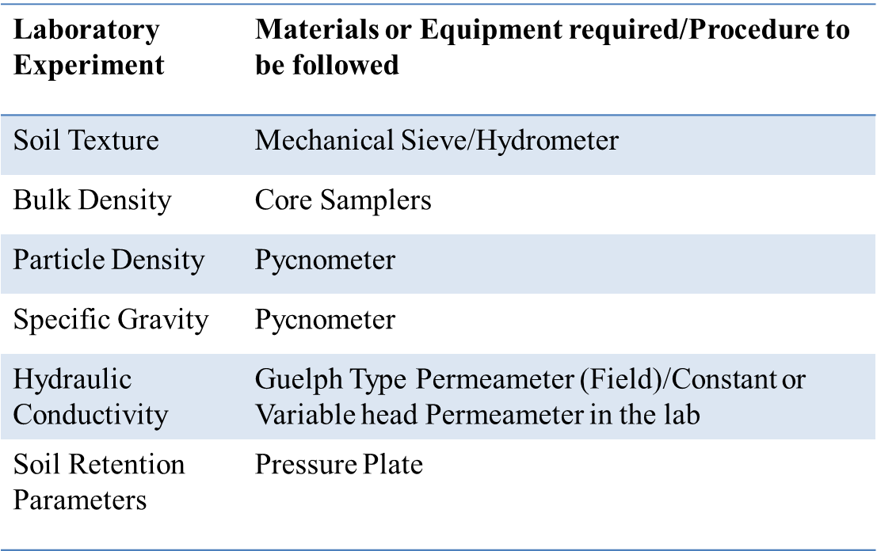
Experiments

Slide 13
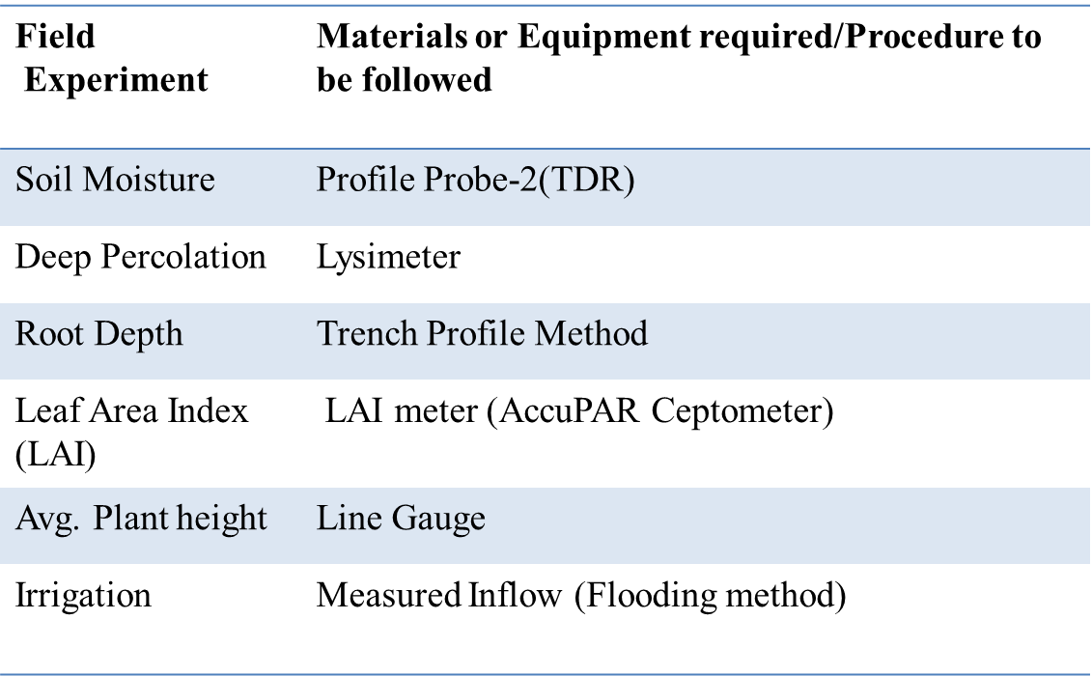
Experiments

Slide 14
ROOT WATER UPTAKE PARAMETER (β) ESTIMATION USING OBSERVED DATA
.
Salinity | β (unit less) | K_{sat} (cmday⁻¹) | α_{v} (m⁻¹) | n_{v} (unit less) | 𝑓(x)
0.5 | 1.72 | 183.21 | 1.862 | 1.466 | 0.8713
7.9 | 1.53 | 190.84 | 1.814 | 1.496 | 0.8549
14.7 | 1.49 | 199.10 | 1.764 | 1.529 | 0.8519
21.2 | 1.43 | 221.92 | 1.618 | 1.644 | 0.8441
Table 3: Value of β parameter with change in salinity level for Wheat crop.
Non-linear parameter (β) decreases with increasing salinity level
Ksat increases with increasing salinity level in case of sandy loam soil
α_{v} increases whereas, n_{v} decreases with increasing salinity level.

Slide 15
CONCLUSION

Slide 16
CONCLUSION

Slide 17
CONCLUSION

Slide 18
CONCLUSION

Slide 19
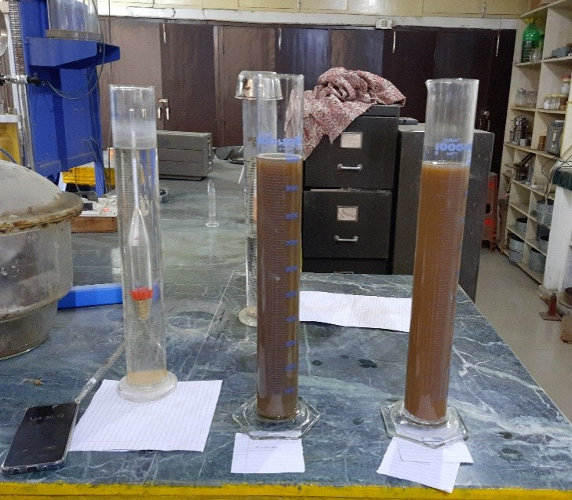
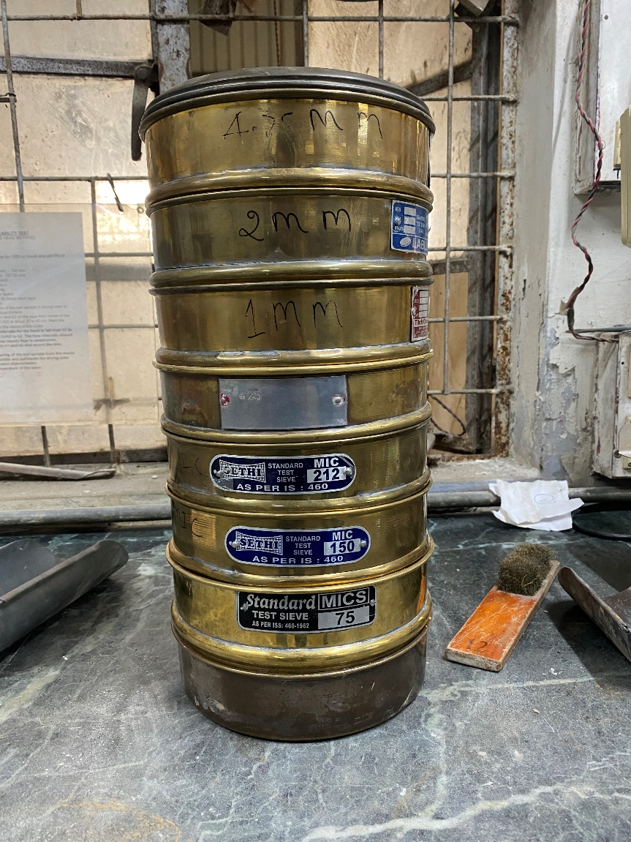
Experiments

Slide 20
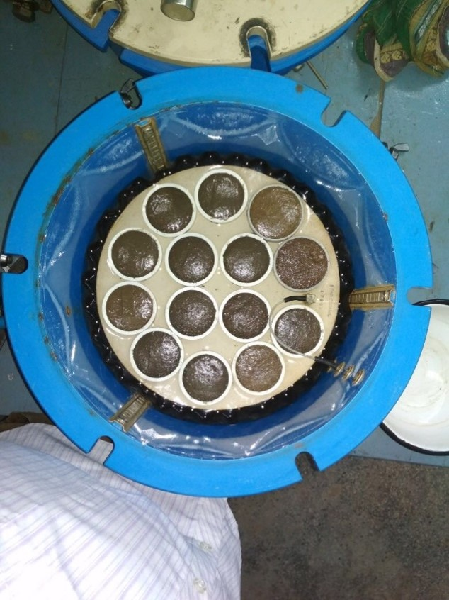
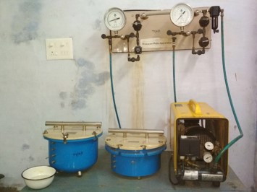
Experiments

Slide 21
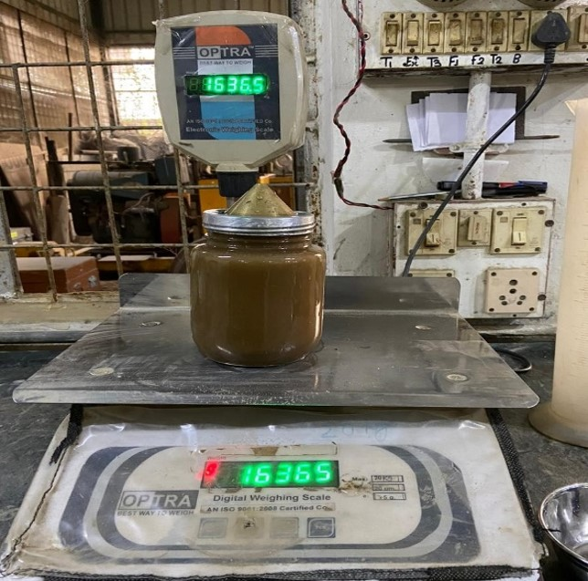
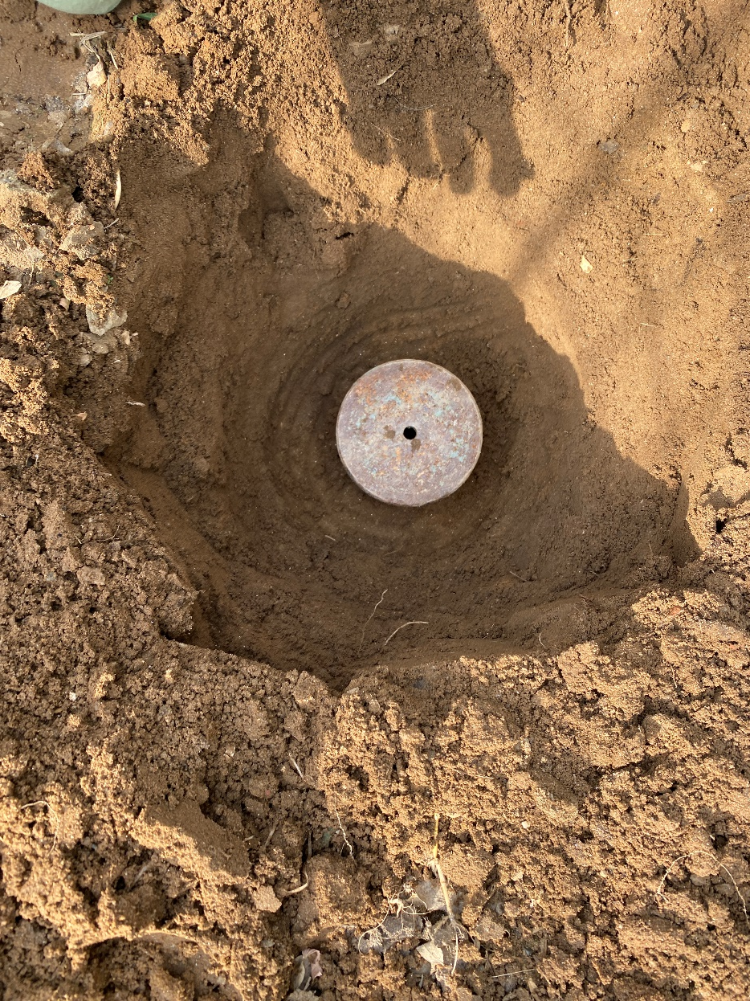
Experiments

Slide 22
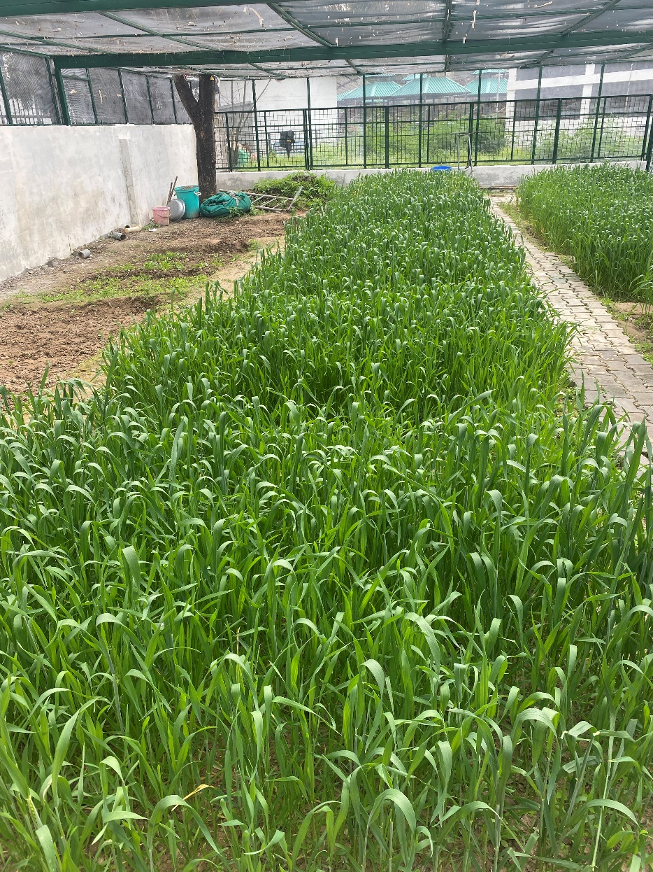
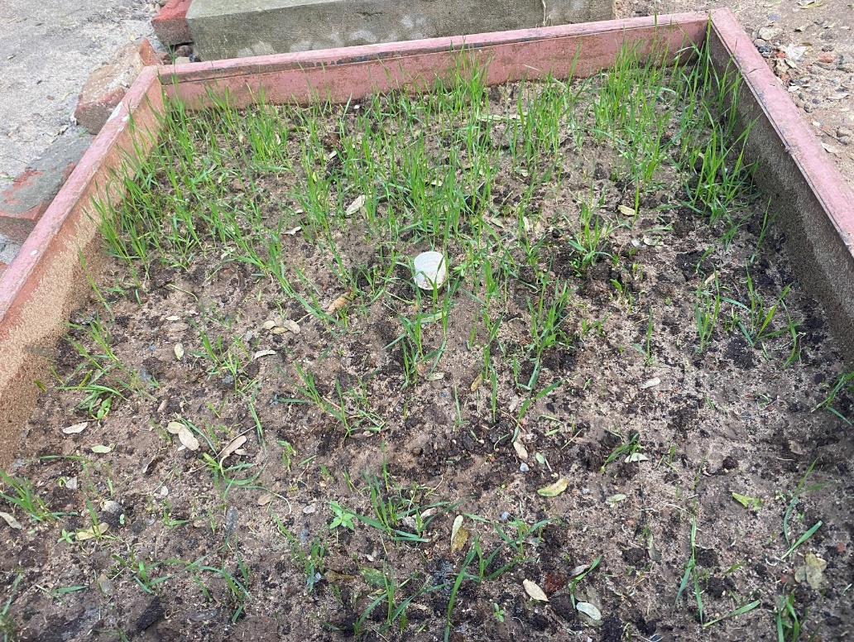
Field Experiments

Slide 23
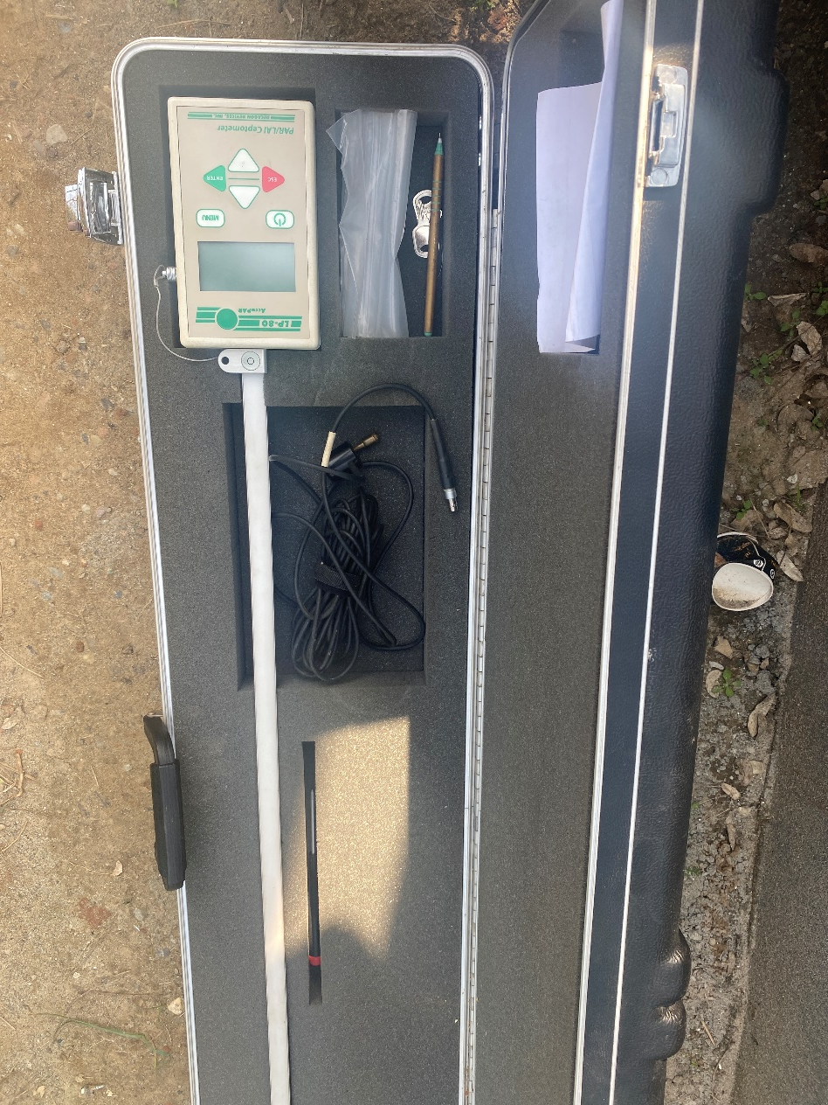
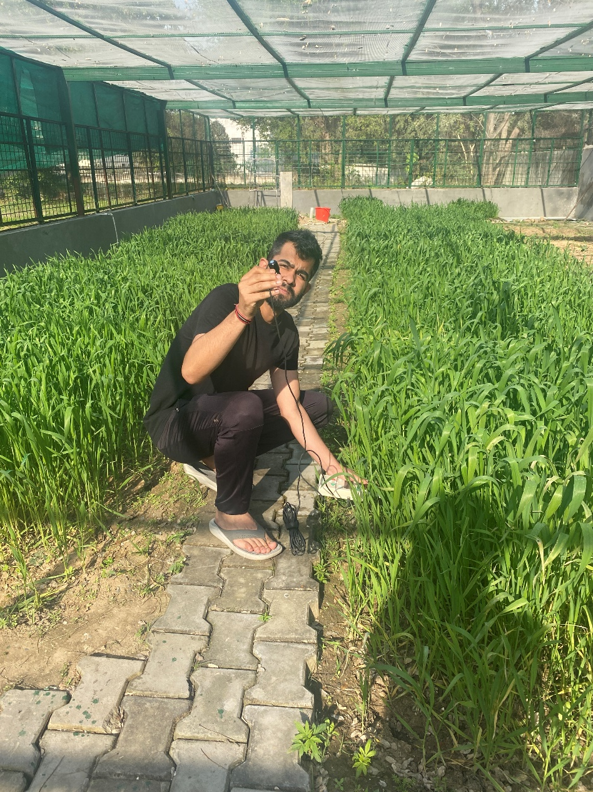
Field Experiments

Slide 24
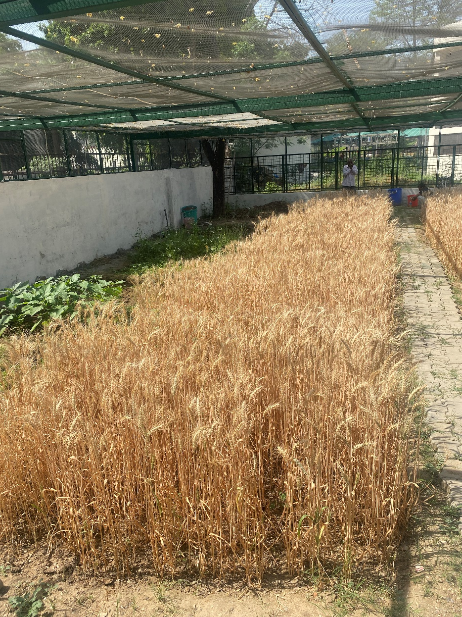
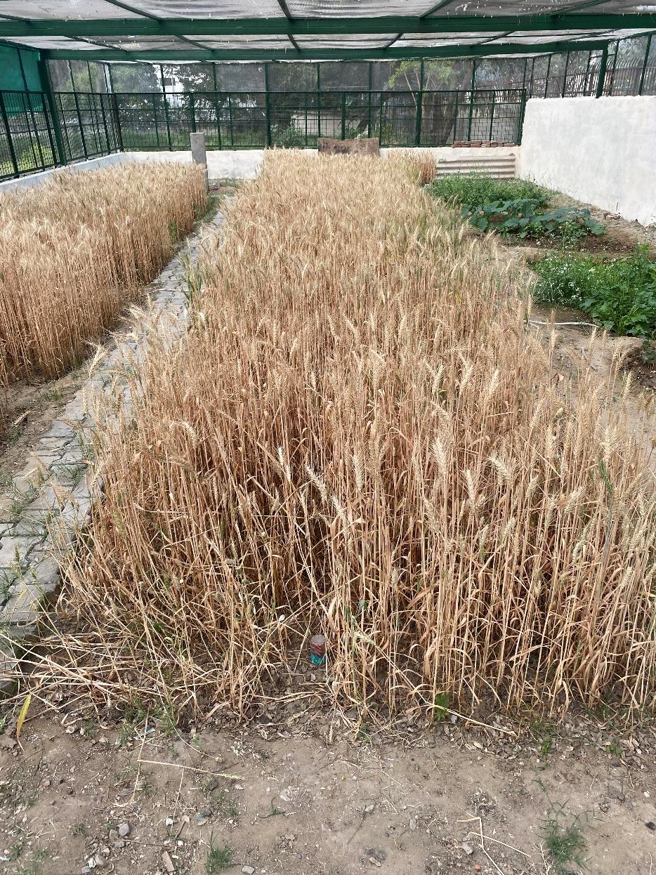
Field Experiments

Slide 25
Thank you
Special thanks to Dean of Relations and Alumni Affairs, IIT Roorkee for providing the financial assistance to attend EGU, General Assembly 2022.

Slide 26
Soil Moisture profile

Slide 27
Soil Moisture profile

Slide 28
Soil Moisture profile

