Slide 1



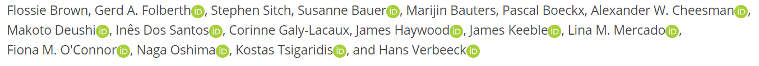
The ozone-climate penalty in South America and Africa by 2100
Leave OSPP feedback
Flossie Brown (fb428@exeter.ac.uk)

Slide 2
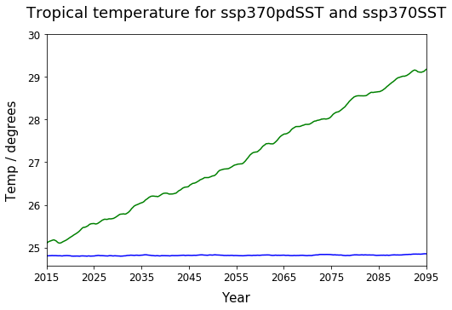
Surface O₃ change due to climate change
Land surface temperature in the tropics
Scenarios used:
ssp370SST − ssp370pdSST
Models used:
MRI-ESM2-0
UKESM1-0-LL
GISS-E2-1-G
Future emissions and future climate
Future emissions and present-day climate

Slide 3
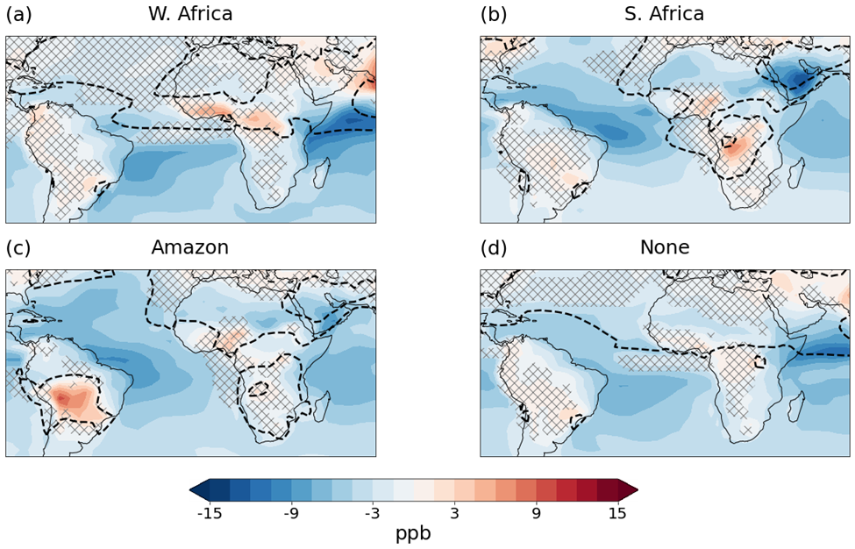
Climate change increases O₃ in areas where O₃ is already high due to emissions.
DJF
MAM
Climate-driven changes in surface O₃ grouped by biomass burning season
JJ
ASO
Ozone above 40 ppb without climate change
Hatched areas are where models predict different directions of change

Slide 4
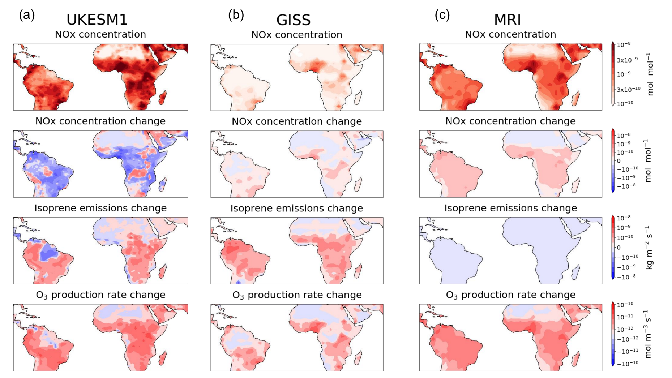

NOx is a key driver of surface O₃ changes
In urban areas and biomass burning areas:
High NOx concentration due to emissions
Increase in NOx due to climate change
Increase in surface ozone production due to climate change

Slide 5

Climate change may increase surface O₃ concentrations in areas that already have high O₃ due to NOx emissions.
Risk to tropical trees, crops and human health!
Surface ozone is likely to decrease in other areas.
See my preprint:
Leave OSPP feedback:
https://egusphere.copernicus.org/preprints/2022/egusphere-2022-218/

