Slide 1

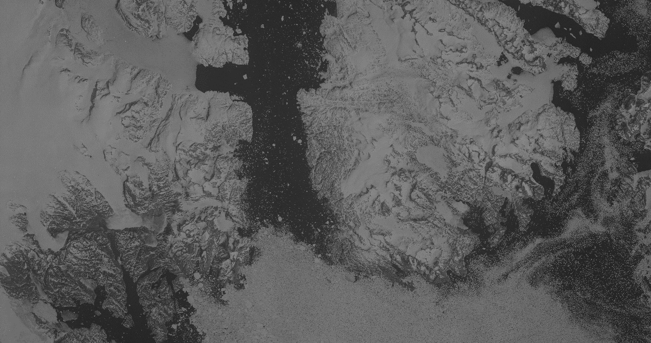



Expanding glacier time series of Antarctica and Greenland using Soviet Era KFA-1000 satellite images
(1974-1994)
Flora Huiban – University Of Copenhagen (fsh@ign.ku.dk)
Supervised By – Anders Ankers bjørk
In The Project – AIR – Antarctic imagery Resurfaced
Flora Huiban, Mads Dømgaard, Luc Girod, Amaury Dehecq, Romain Millan, Jeremie Mouginot, Anders Schomacker, Eric Rignot, and Anders Bjørk
24-05-2022

Slide 2
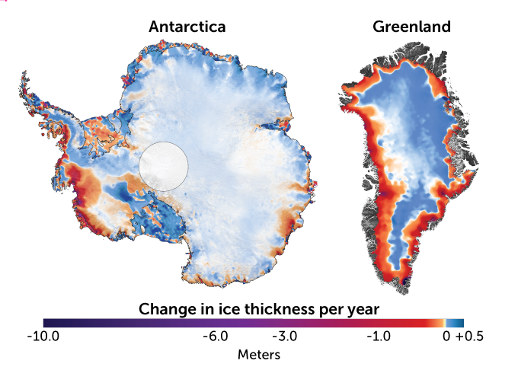
Why is it important?
Greenland
Antarctica
East Antarctica
West Antarctica
(2003 to 2019)
Change in ice thickness per year in meters
-10.0 -6.0 -3.0 -1.0 0 +0.5
Smith et al., Science, (2020)

Slide 3
Why is it important?
Greenland
Antarctica
East Antarctica
West Antarctica
~ 7m
~ 60m
(2003 to 2019)
Change in ice thickness per year in meters
Sea Level rise equivalent
-10.0 -6.0 -3.0 -1.0 0 +0.5
Smith et al., Science, (2020)

Slide 4
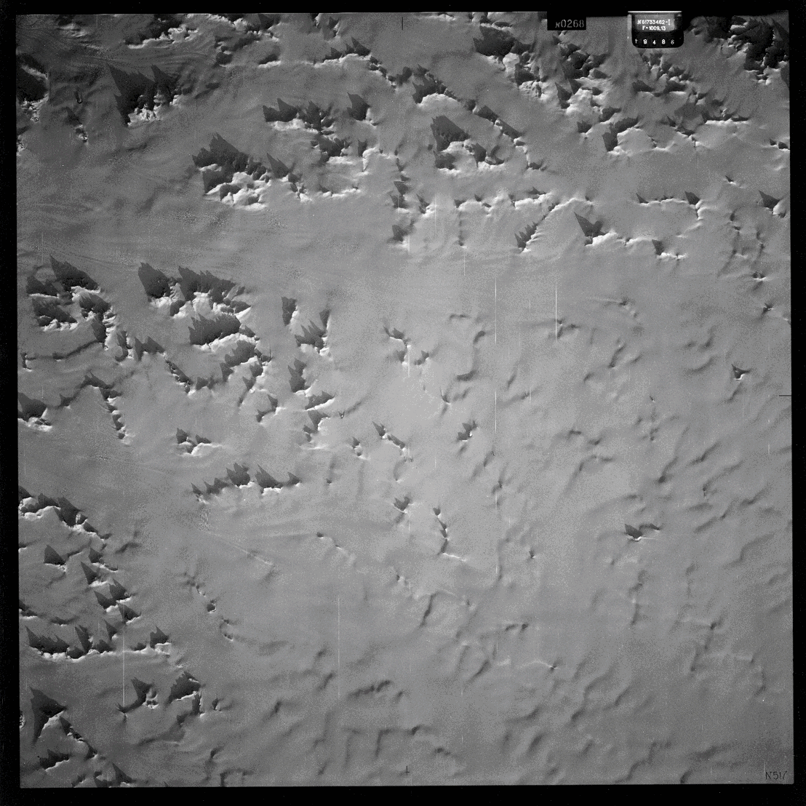
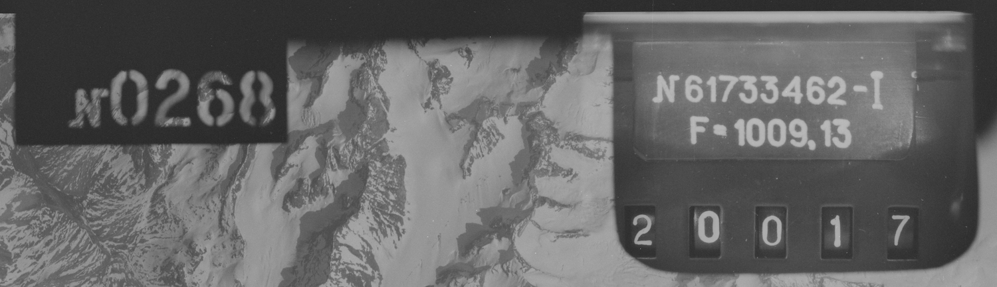
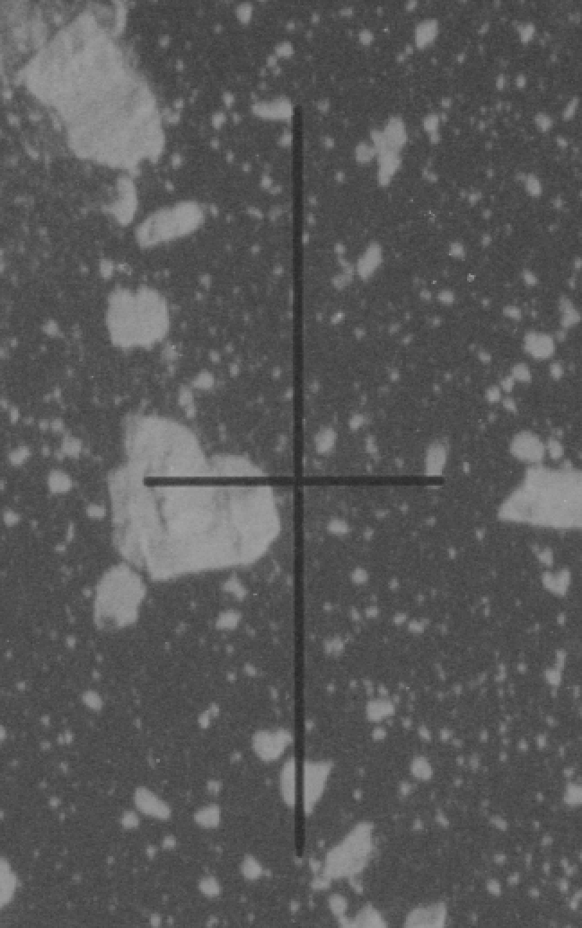
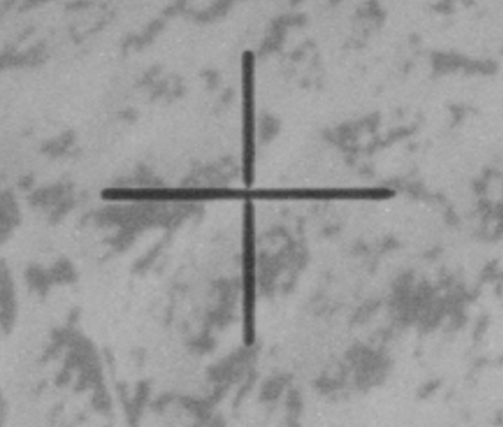
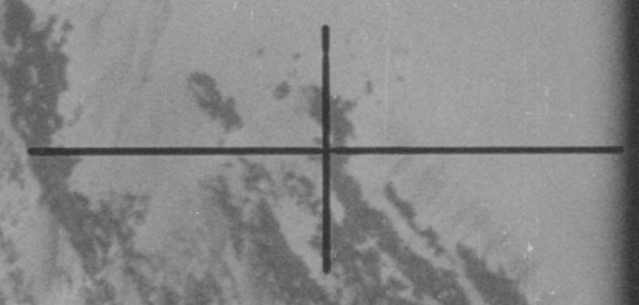
KFA-1000 satellite images
Resolution | 5 m
Focal length | ~1000mm
Footprint | ~80km * 80km
Size | ~30 cm * 30 cm
Approximate location of the images
Low altitude satellite flight: ~ 250 km
Stereoscopic imagery: along-track overlap (20% to 80%)

Slide 5
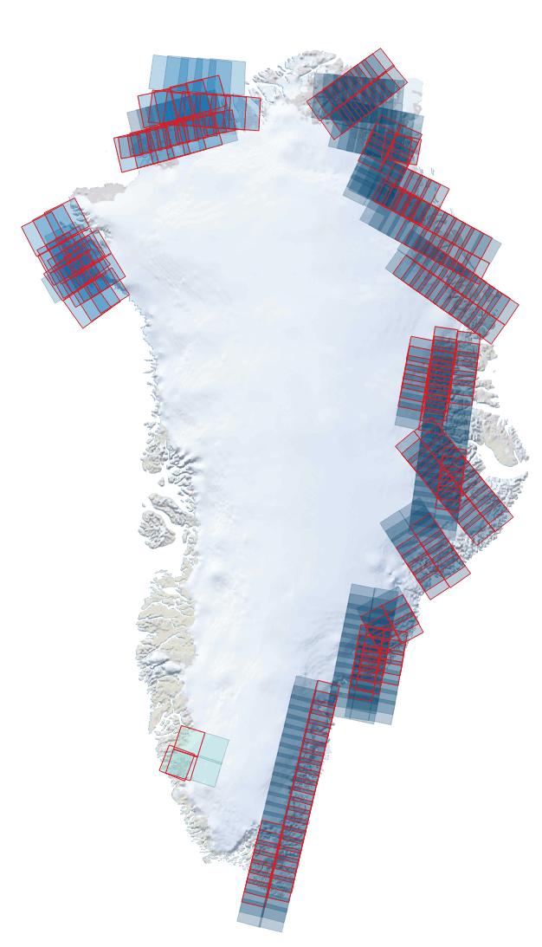
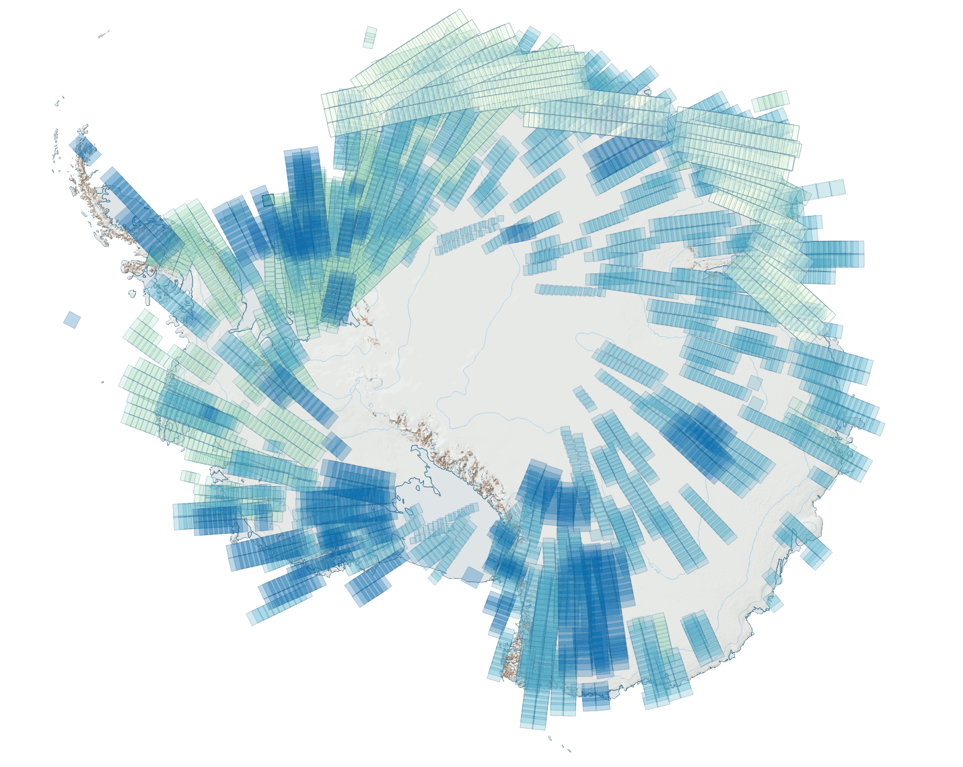
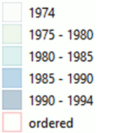
Data availability from Soviet KFA-1000 Spy Satellite for Greenland and Antarctica
5m
1980-1995
(300 scenes)
5 m
1974-1995
(11,000 scenes)
Resolution | 5 m
Focal length | ~1000m
Footprint | ~80km * 80km
Size | ~30 cm * 30 cm
Approximate location of the images
Low altitude satellite flight: ~ 250 km
Stereoscopic imagery: along-track overlap (20% to 80%)

Slide 6
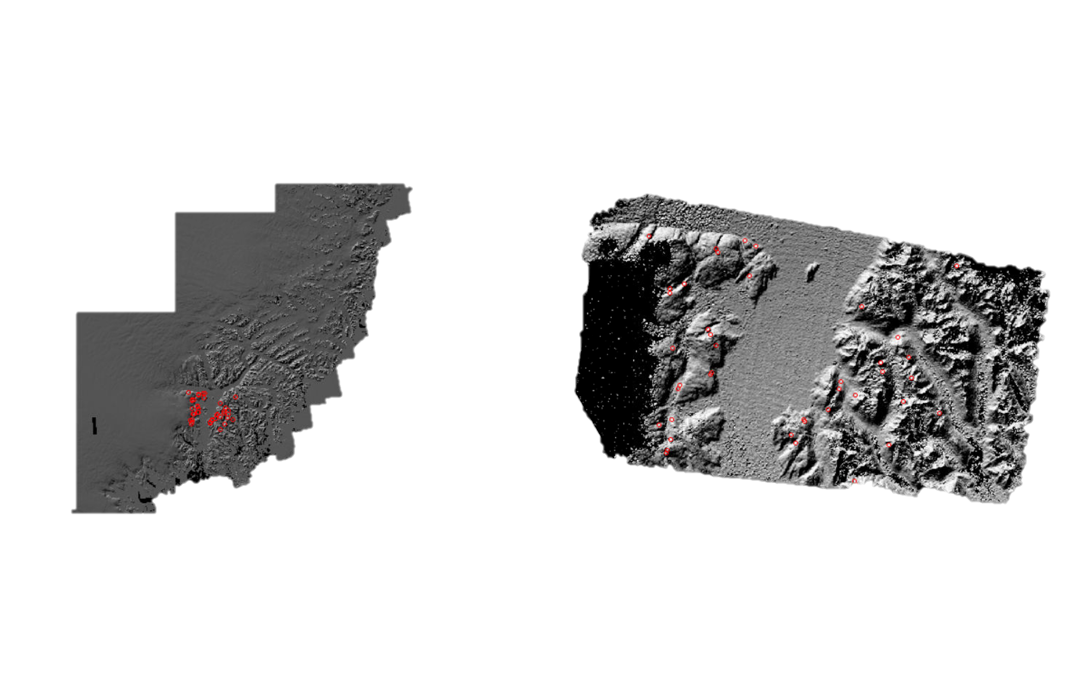
Image Processing – NASA Ames Stereo Pipeline
Preliminary DEM (KFA-1000)
Reference DEM (ArcticDEM)
ASP: a suite of free and open-source automated stereogrammetry tools to process stereo images
image matching method to georeference (RANSAC)

Slide 7
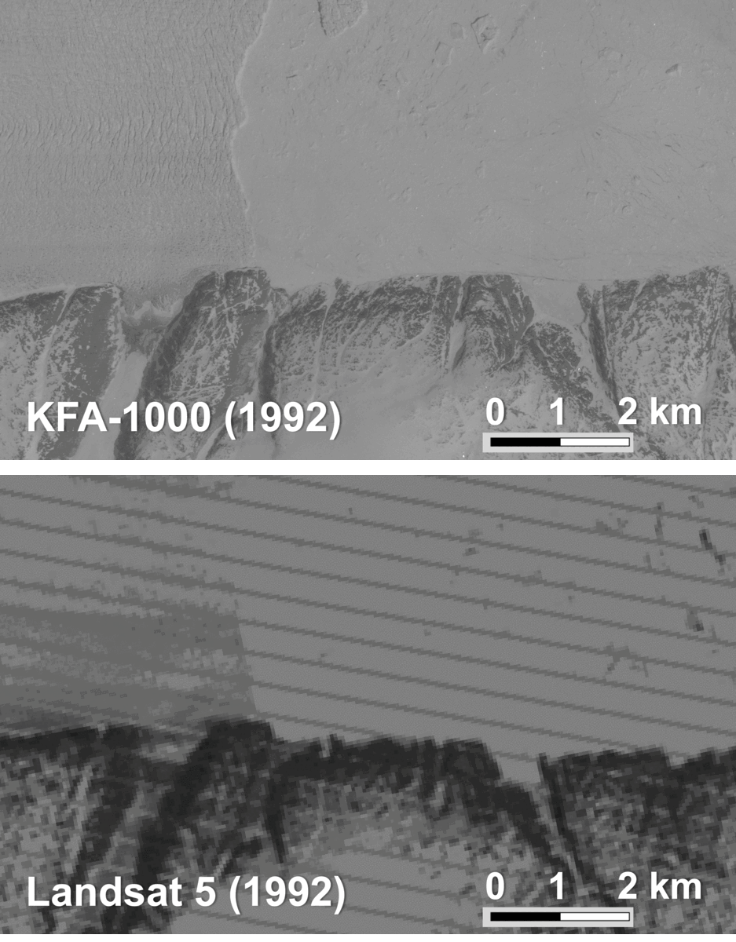
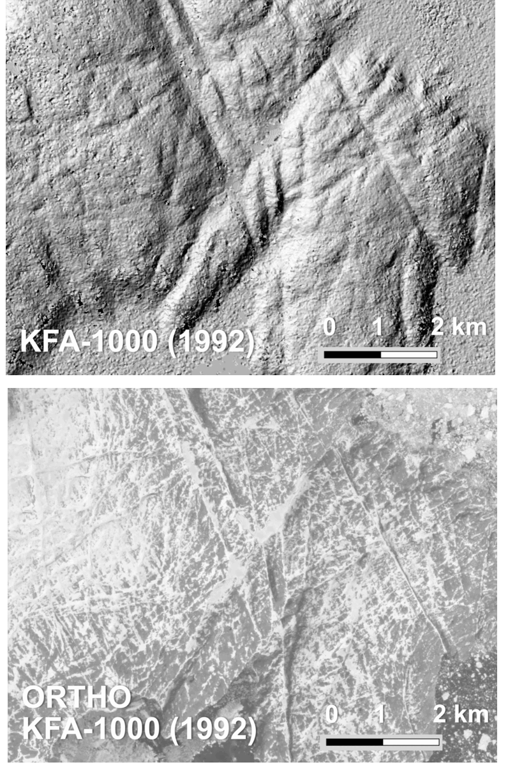
Orthophoto
DEM

Slide 8
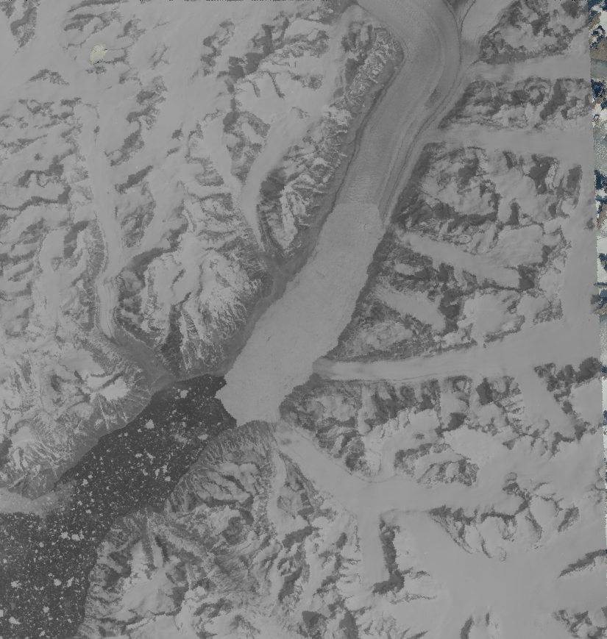
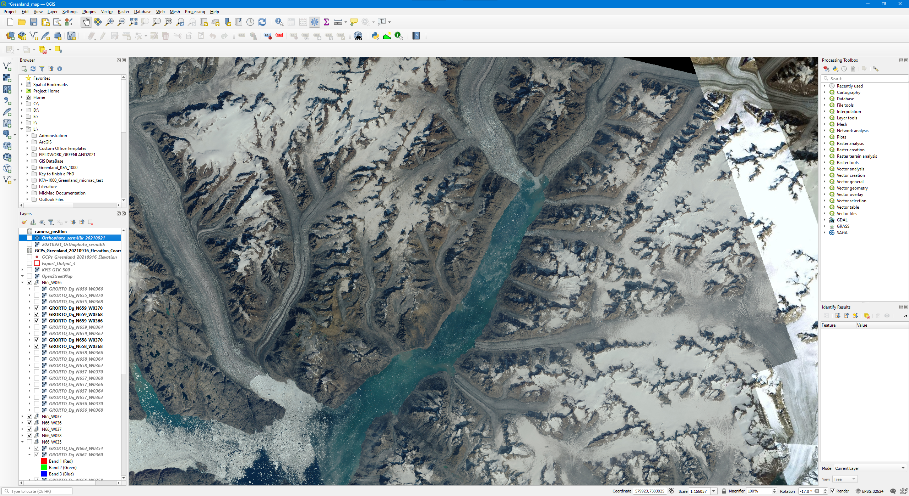
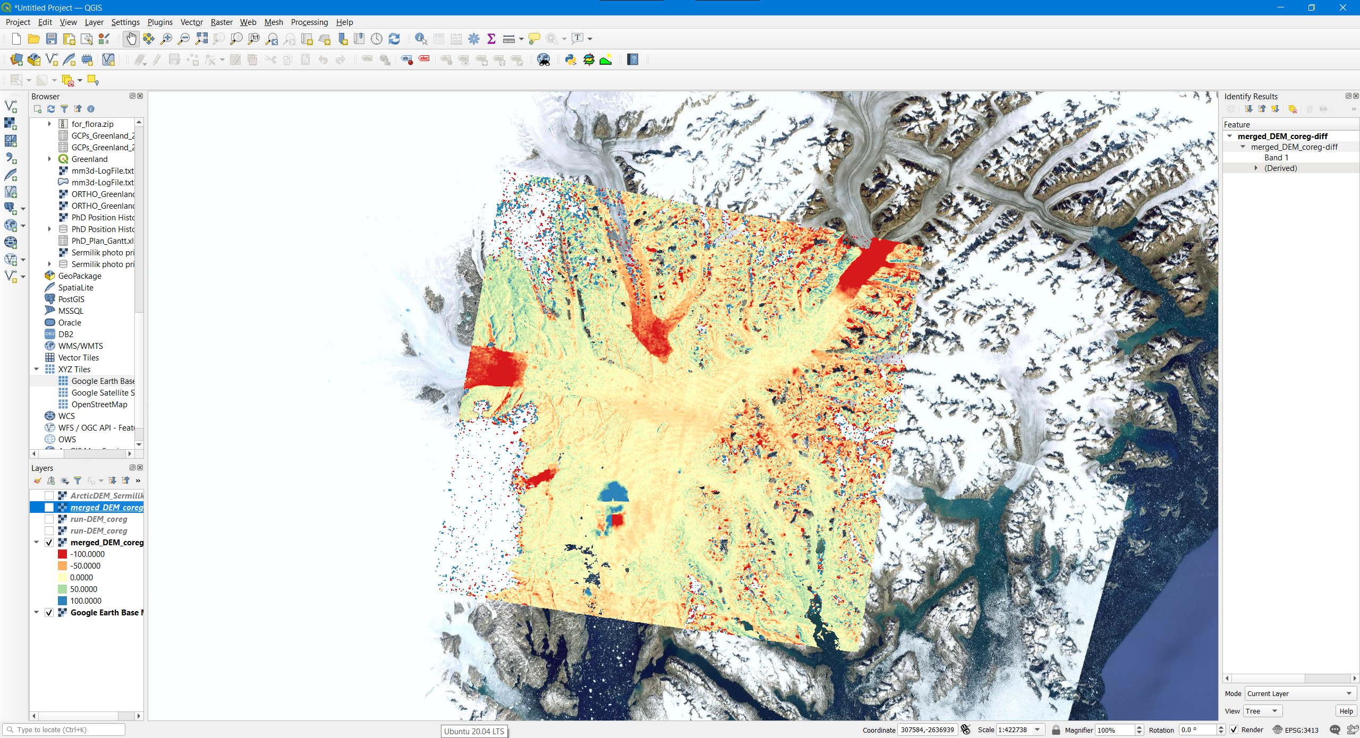
Take Away
Flora Huiban
University Of Copenhagen
(fsh@ign.ku.dk)
~10km
~10km
KFA-1000 satellite images:
unique and underused dataset
stereo images
high-resolution orthophoto and DEM
better than what we have for the same period
excellent coverage
Promising automated and efficient way of processing: ASP
opportunity of large scale computing
better, stronger, faster
Potential to improve understanding of past glaciers dynamics:
frontal position
flow-velocity
surface elevation
grounding line
KFA-1000
1992 - 2016
SDFE
-100 m
-50 m
0 m
50 m
100 m
Dod between ArcticDEM and KFA-1000 using ASP

