Slide 1
MIdAS
MultI-scale bias AdjuStment
P. Berg, T. Bosshard, W. Yang, and K. Zimmermann
EGU GA-2022, CL5.1.5

Slide 2
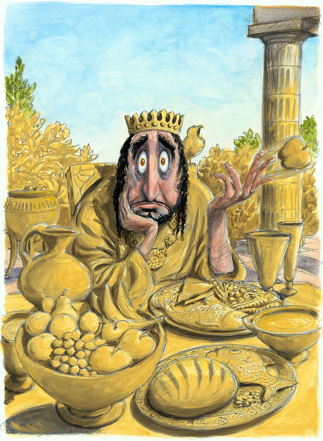
The origins of bias adjustment:
King Midas
Gold! glorious gold! I am made up of gold!
I pluck a rose, a silly, fading rose,
Its soft, pink petals change to yellow gold;
Its stem, its leaves are gold–and what before
Was fit for a poor peasant’s festal dress
May now adorn a Queen.
...this meat
which by its scent quickened my appetite
Has lost its scent, its taste,–’tis useless gold.
Alas! my fate! ’tis gold! this peach is gold
This bread, these grapes & all I touch! this meat
Which by its scent quickened my appetite
Has lost its scent, its taste,–’tis useless gold
– M. Shelley (1922)
Image source: https://anentrepreneurswords.com/2014/06/08/who-needs-king-midas/

Slide 3

What is MIdAS?
A modern python implementation of quantile mapping – solving many practical issues for operational production
  Parallellization (DASK)
  Standards (IRIS)
  Flexible layout – allowing exchange of components
Cascade quantile mapping
  Temporal cascades (Haerter et al., 2011) – reducing negative interference between scales
  Spatial cascades – TBA
Day-of-year + running mean instead of calendar month
Read more here:
  https://doi.org/10.5194/gmd-2022-6
  Paper including links to code in the Zenodo repository

Slide 4
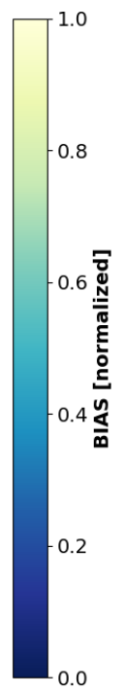
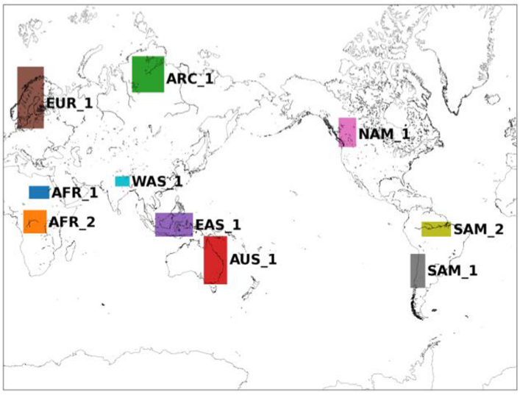
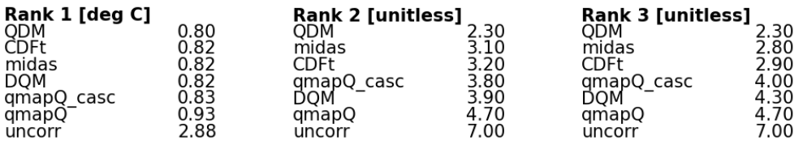
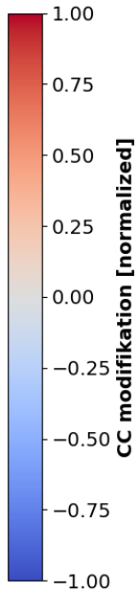
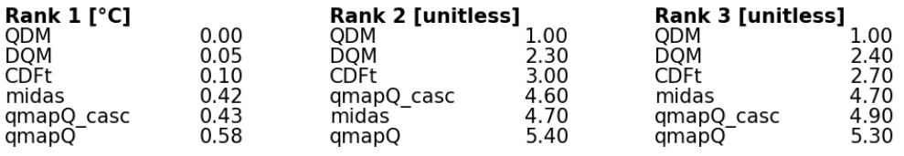
GMD - paper
  https://doi.org/10.5194/gmd-2022-6
Performance on bias removal – mean temperature
P1 = 1971-2000
P2 = 2011-2040
P3 = 2041-2070
P4 = 2071-2100
Impact on climate signal – mean temperature

Slide 5
What comes next?
This year
Extend to several variables:
  relative humidity
  wind speed
  radiation
  cloudiness
  min & max temperature (with consistency)
Evaluation for use with convection permitting models and sub-daily resolution
Upcoming
Multi-variate adjustment technique
Spatial cascades

