Slide 1
Developing Novel Geophysical Tools to Investigate the Influence of Vegetation on Slope Stability
N. I.J. Thaman, R. Stirling, J. Chambers, P. Wilkinson, P. Meldrum
EGU22 – European Geoscience Union General Assembly
Session NH1.6

Slide 2
Research Objectives
To better understand the influence of vegetation on soil water dynamics in slopes
To determine the impact of vegetation on the hydrological behaviour of a high plasticity clay using 4-D Electrical Resistivity Tomography (ERT)
Highlight how soil-water-plant interactions change over time and respond to extreme weather conditions (drought/inundation) to better predict, manage, and mitigate the occurrence of slope failure
Improve understanding of vegetation-driven soil moisture movement in the near-surface to better assess seasonal and longer-term slope stability to inform asset management strategies

Slide 3
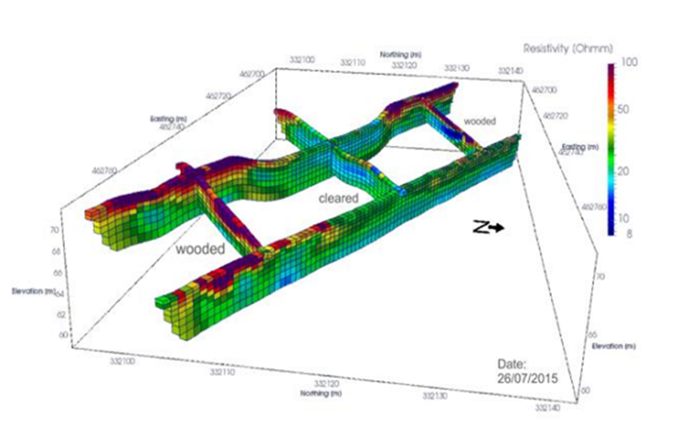
PRIME: Electrical Resistivity Tomography (ERT)
Non-invasive ground imaging tool sensitive to subsurface soil moisture dynamics
Provides long-term data highlighting the evolution of moisture content
Understand how vegetation influences soil moisture content over time
Assess the effectiveness of vegetation in managing slope hydrology and excess surface water in the built environment
Resistivity image depicting enhanced subsurface moisture abstraction (red) in heavily wooded areas (image courtesy of the BGS).
Notes:
PRIME is a low-cost system specifically designed to remotely monitor ‘at risk’ geotechnical assets (e.g. embankments; cuttings; dams).
Using PRIME, it is possible to monitor the internal condition of infrastructure assets in near real-time, with high temporal and spatial resolution. It monitors the moisture content of the asset and can track ground movement, whilst its interface with point sensors allows it to respond to changes in conditions.

Slide 4
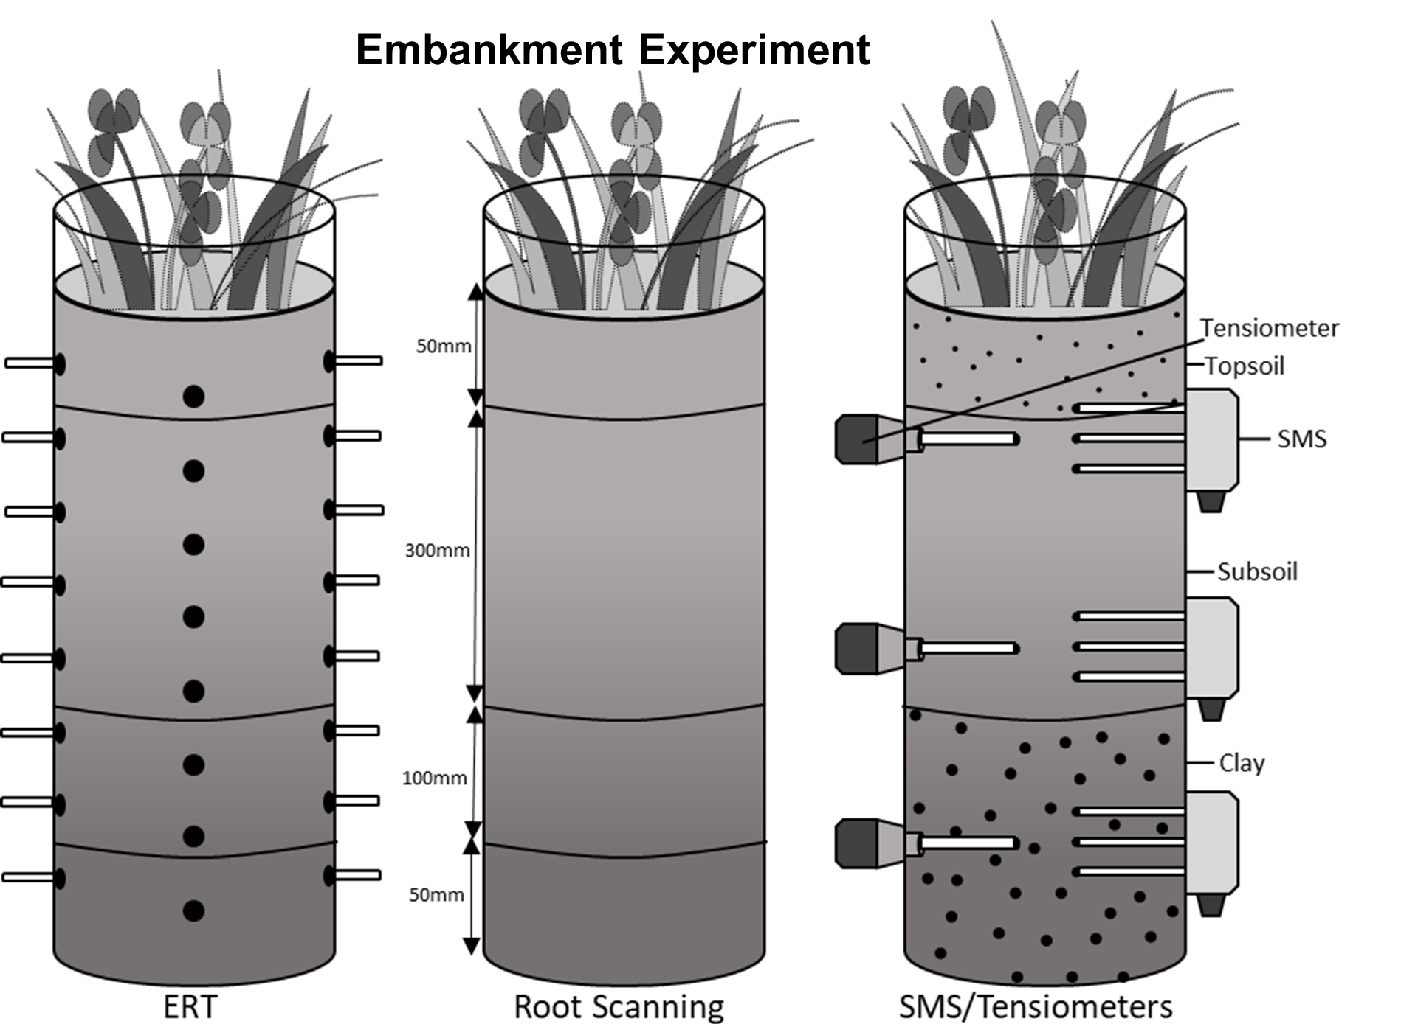
Methodology – Soil Column Experiments
Planted with vegetation, False Oat Grass and Common Bent
Ampthill Clay used as test material
Environmental conditions controlled using environment chamber
3D ERT electrode array and point sensors for measurement of volumetric water content, matric suction, and electrical conductivity
Soil column experiment using Ampthill Clay, featuring ERT, SMS and Tensiometers
Notes:
Planted with vegetation, False Oat Grass and Common Bent
Ampthill Clay used as test material (Ampthill Clay is used in the construction of linear infrastructure networks in southern England).
Environmental conditions controlled using environment chamber
3D ERT electrode array and point sensors for measurement of volumetric water content, matric suction, and electrical conductivity

Slide 5
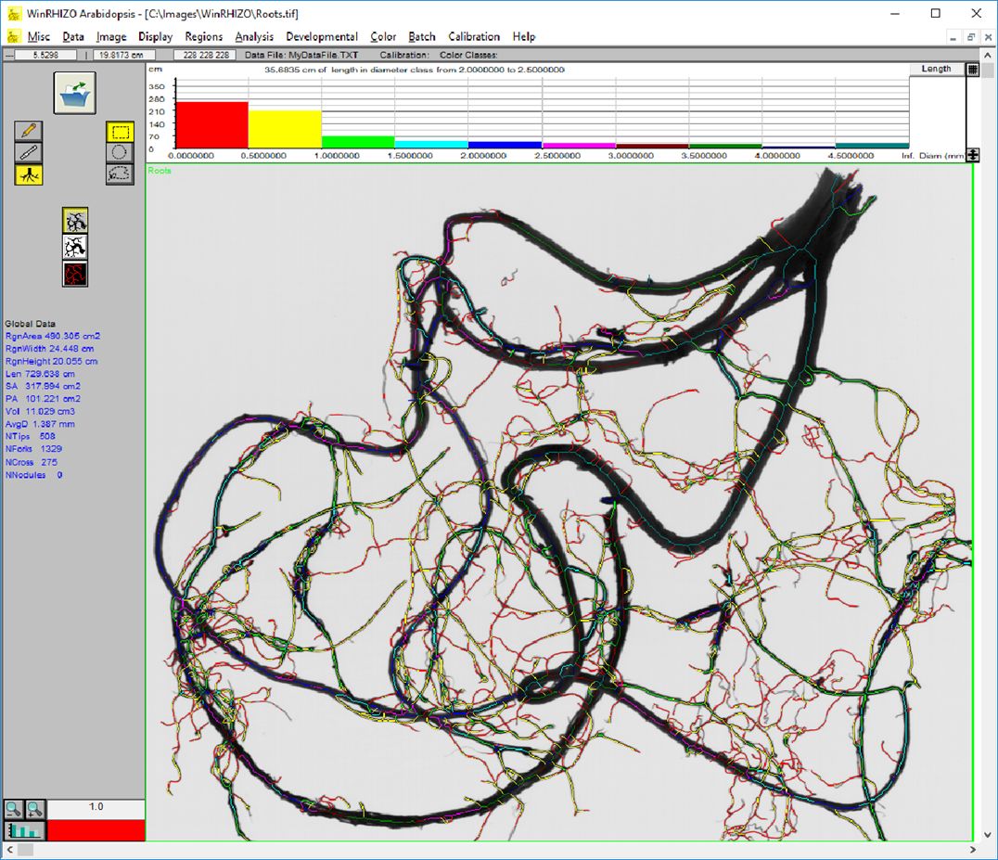
Root Scanning Equipment - WinRhizo
Image analysis system designed for root measurement
Morphology (length, area, volume...), topology, architecture and colour analyses
Root diameter distribution graphic (Regent Instruments Inc., 2021)

Slide 6
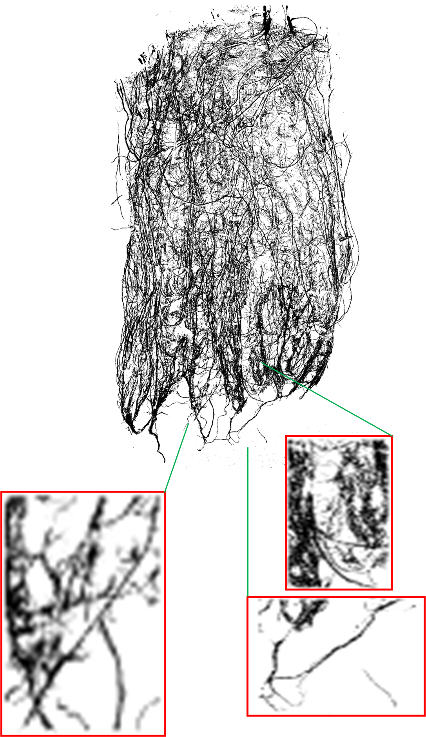
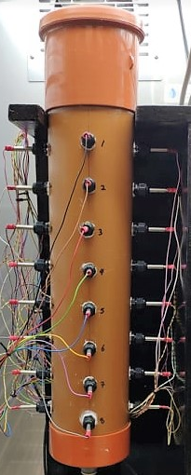
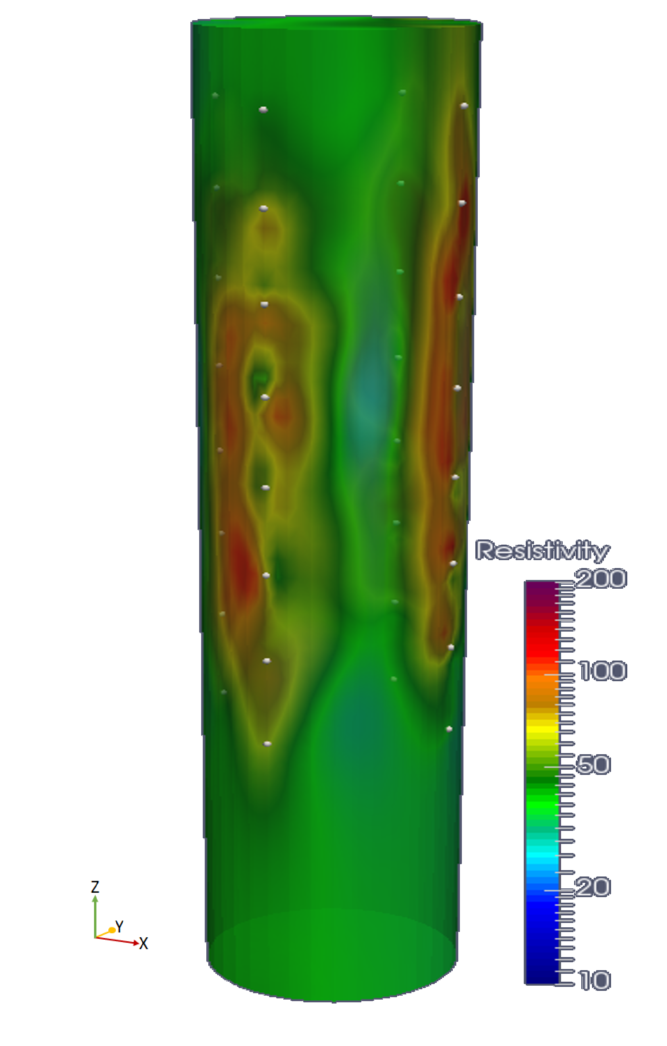
Discussion and Results
Monitor volumetric water content, matric suction, electrical conductivity
The internal condition of soil column assets in near real-time
3D modelling of moisture conditions over time in different climatic conditions
Changes in root architecture with depth and changing env. conditions
Root scans using WinRhizo
ERT soil column resistivity modelling
Notes:
Provides a snapshot of the types of outputs achievable using ERT and shows the resistivity profile of a soil column. Frequent imaging of soil-water-plant interactions using ERT, and point sensors, capture transient changes in soil moisture conditions over time in extreme weather conditions in clay, demonstrating how plant roots respond to changes in their environment and how these changes to root architecture influence the soil moisture dynamics of vegetated soils.

Slide 7
References
BGS, UKRI . (2020). Proactive Infrastructure Monitoring and Evaluation system: PRIME. Available: https://www.bgs.ac.uk/geology-projects/geophysical-tomography/technologies/prime/. Last accessed 11/11/2020.
WinRHIZO. Available: https://regent.qc.ca/WinRHIZOAbout.html. Last accessed 28/02/2022.

Slide 8
Developing Novel Geophysical Tools to Investigate the Influence of Vegetation on Slope Stability
Narryn Thaman
Newcastle University
N.Thaman2@newcastle.ac.uk
EGU22 – European Geoscience Union General Assembly
Session NH1.6

