Slide 1


Emerging trends in global forest above-ground biomass derived from a decadal time record of high-resolution satellite observations
M. Santoro, O. Cartus, S. Quegan, H. Kay, P. Bunting, R. Lucas, A. Araza, S. de Bruin, M. Herold, N. Labrière, J. Chave, T. Le Toan, H. Balzter, P. Rodríguez-Veiga, P. Defourny, J. Kellndorfer, Å. Rosenqvist, M. Hayashi, K. Kobayashi, O. Ochiai, T. Tadono, F.M. Seifert
Work undertaken as part of the European Space Agency Climate Change Initiative (ESA CCI) Biomass activity

Slide 2
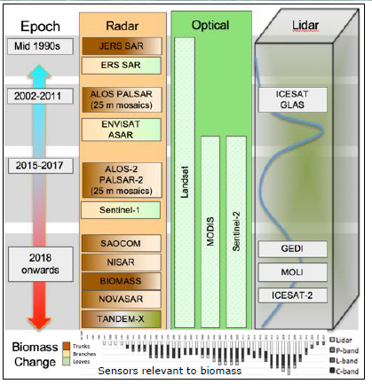
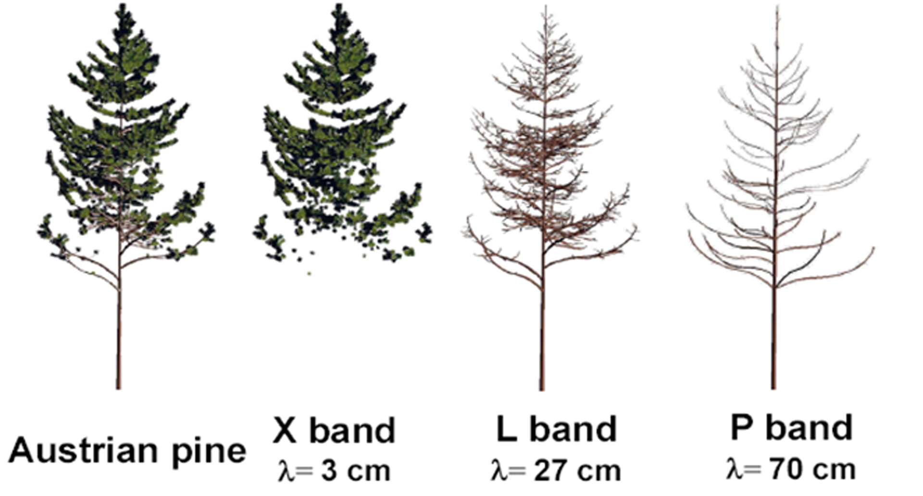
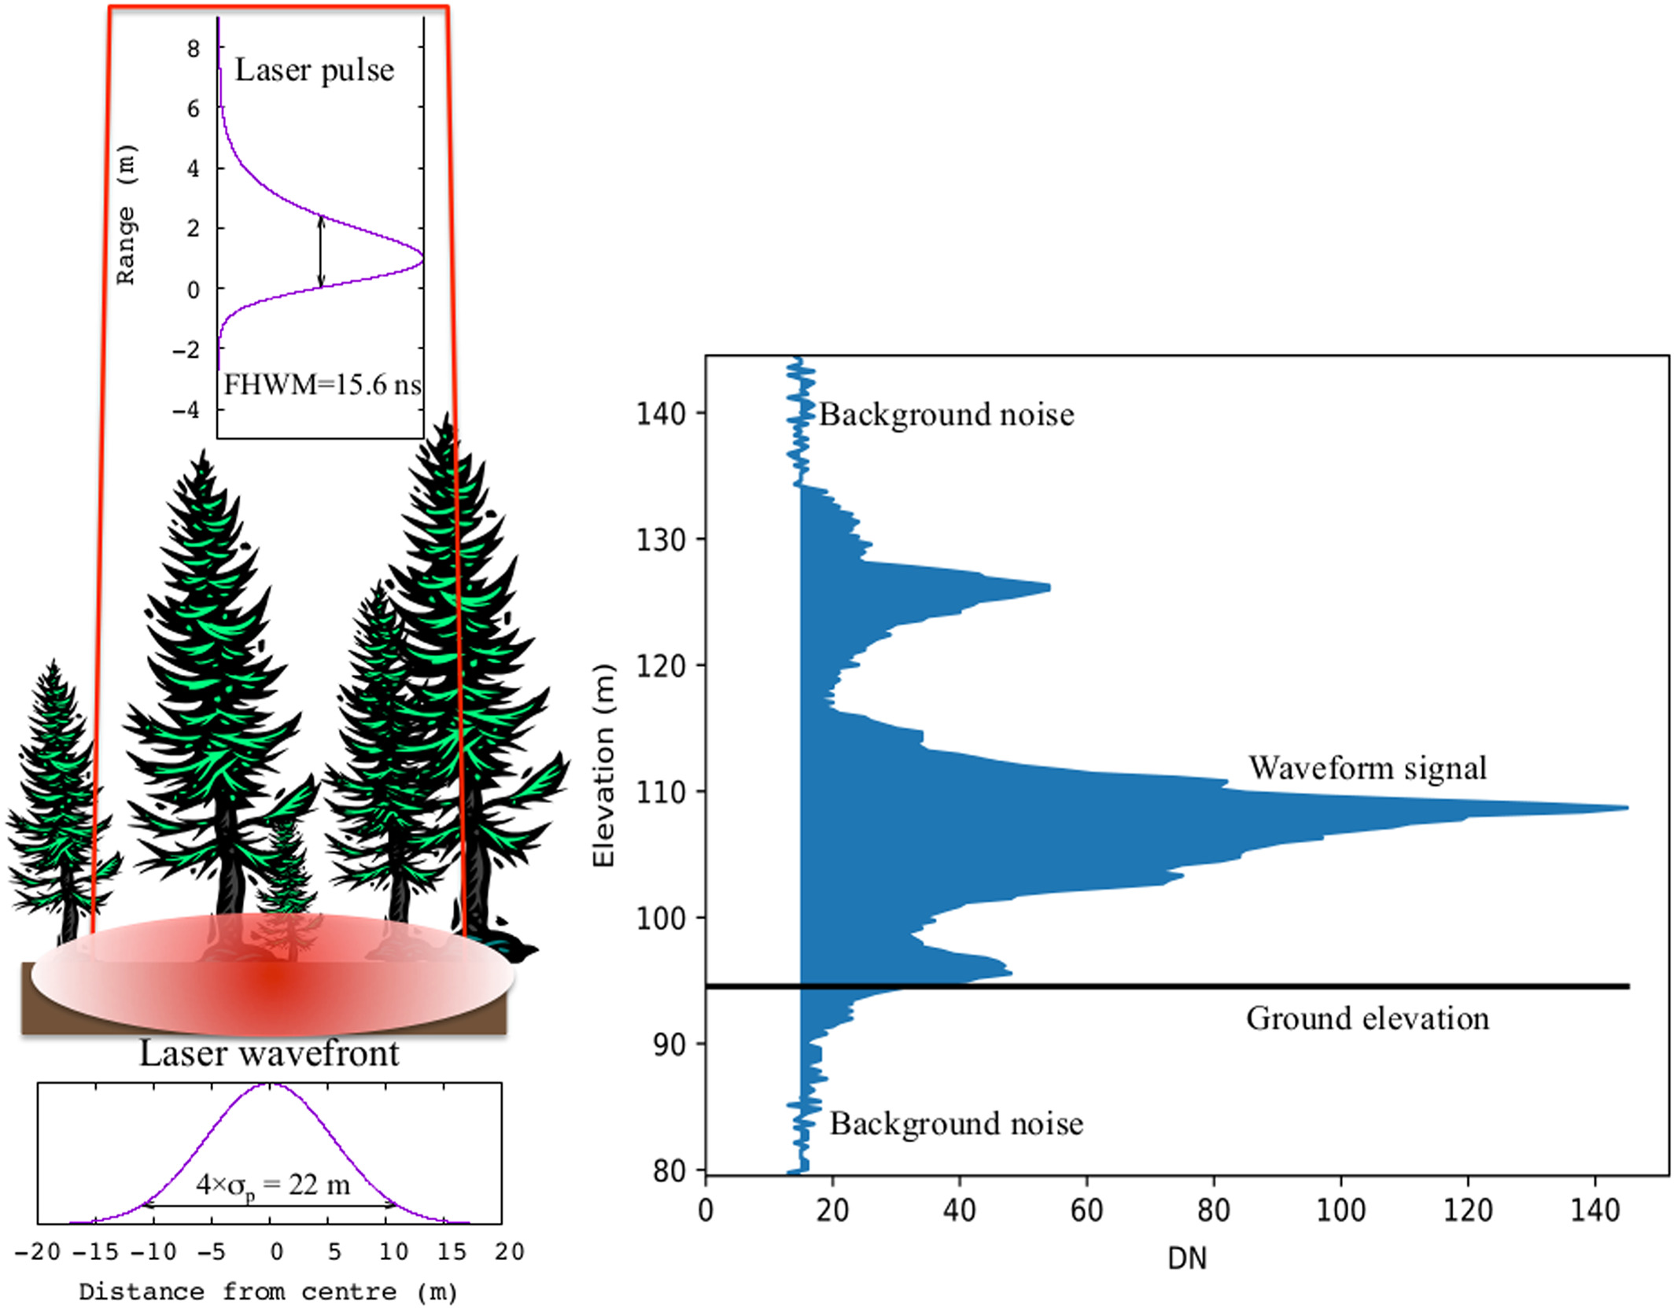
Spaceborne EO relevant to biomass estimation
SAR
(Courtesy T. Le Toan)
(Hancock et al., 2019)
LiDAR
Lots of data sources but different instrumentation, i.e., data quality variable in time

Slide 3
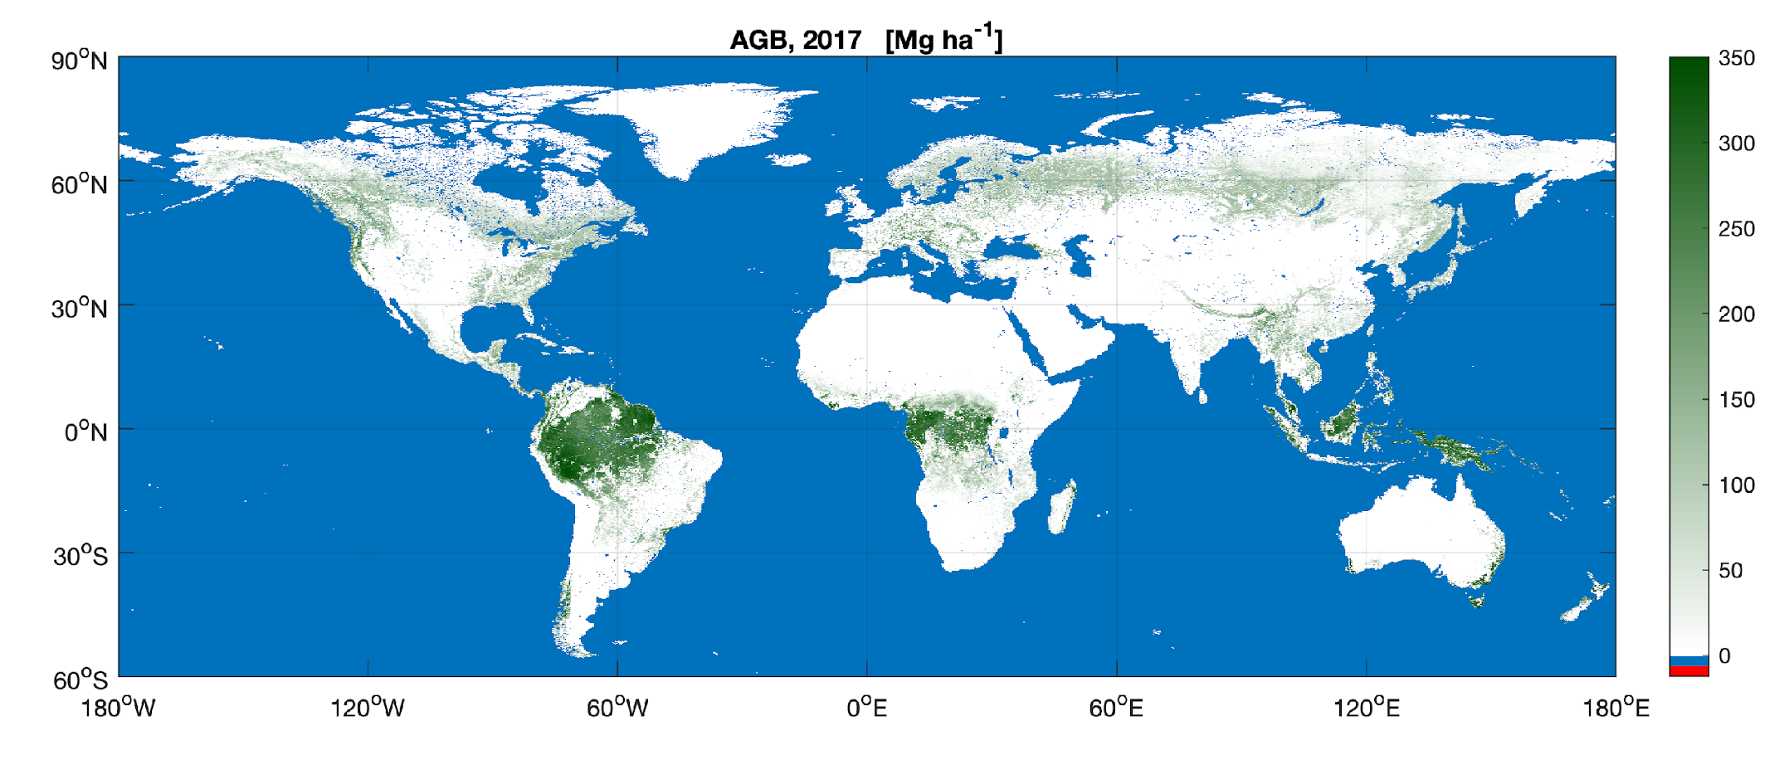
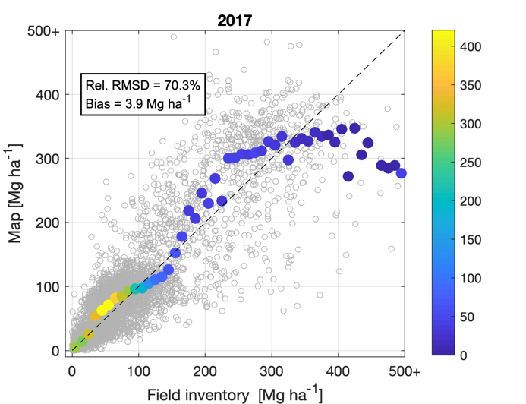
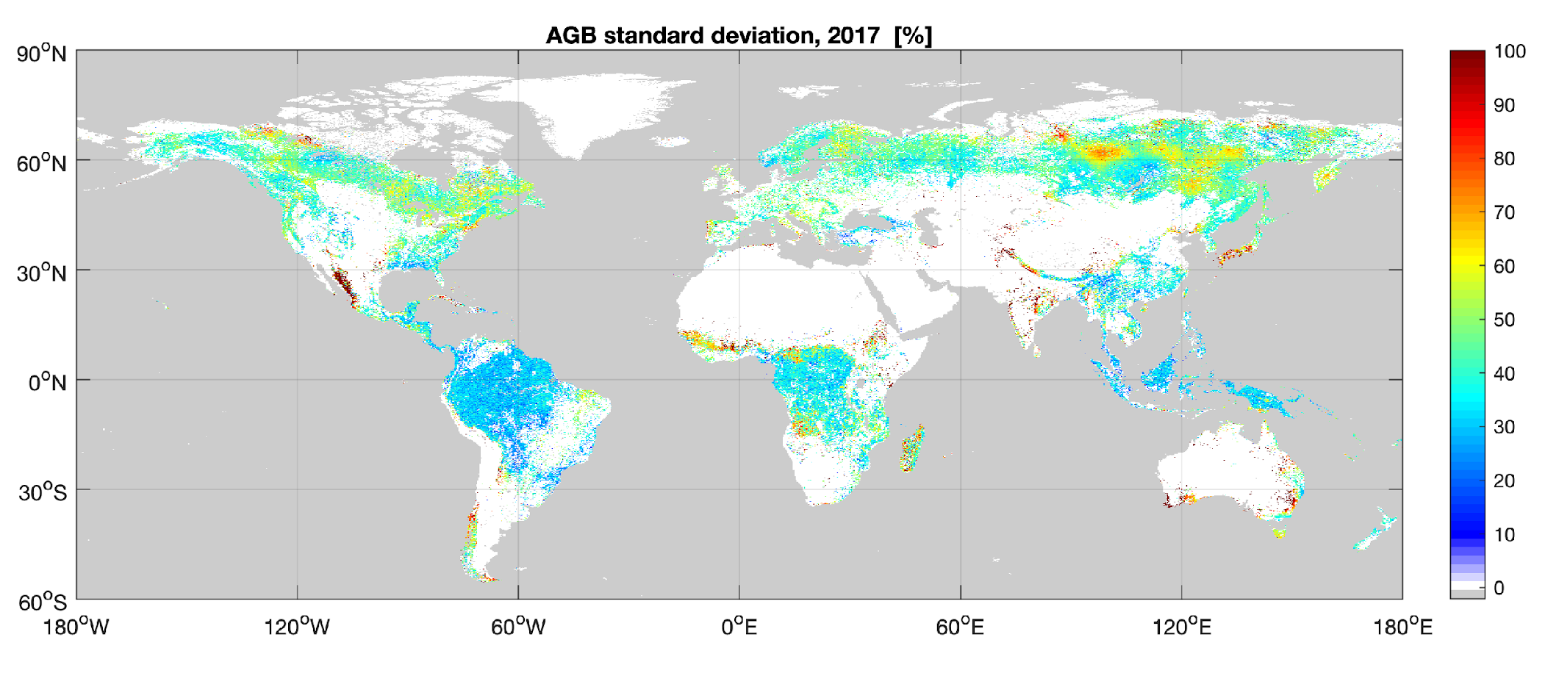
The CCI Biomass AGB datasets
The CCI Biomass AGB datasets
Global AGB maps @ 100 m for 2010, 2017 and 2018 and related standard deviation (SD) (version 3)
Version 4, including 2019 and 2020, will be released in late autumn 2022.
+
+
Take-home message
Reliable representation of the AGB distribution
Local biases and imprecision

Slide 4
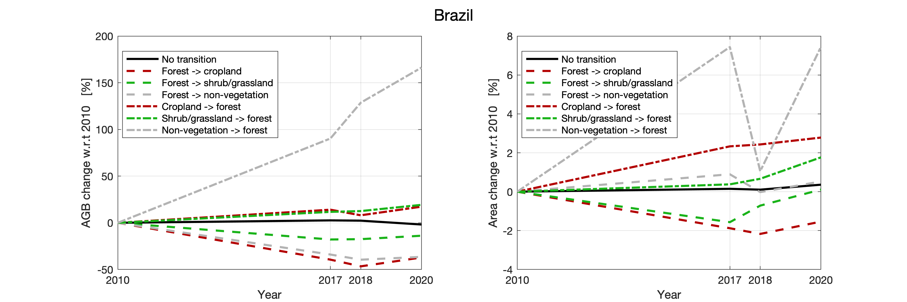
Coupling biomass and land cover to identify transitions
The CCI Biomass AGB datasets
We look at land cover transitions and related AGB trends using the map datasets of 2010, 2017, 2018 and 2020.
Transitions are defined as one-way conversion from forest to cropland OR shrubland/grassland OR non-vegetated areas and vice versa. For each category, the conversion occurred any time between 2010 and 2020.

Slide 5
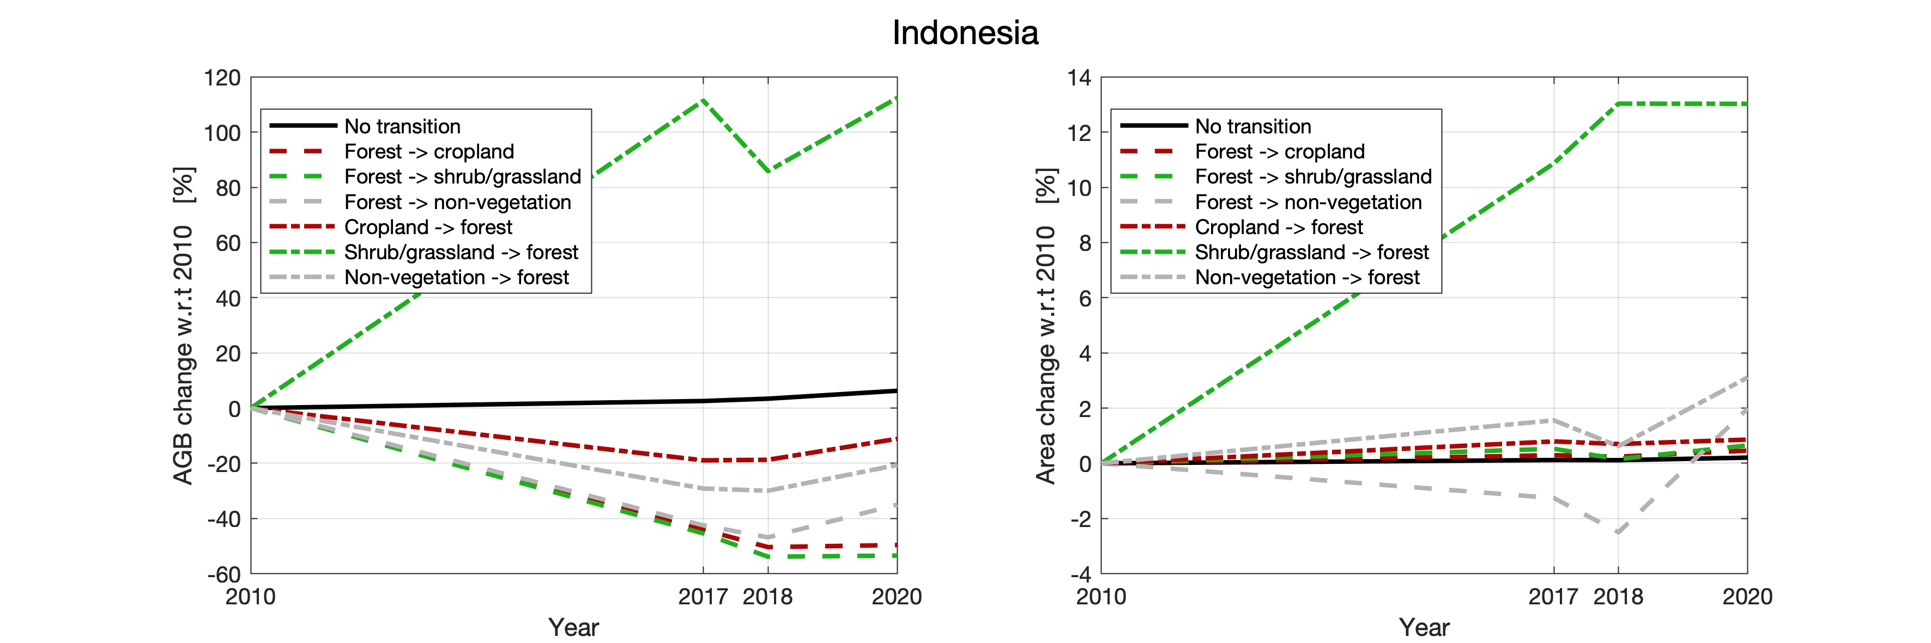
Emerging AGB trends in Southeast Asia

Slide 6
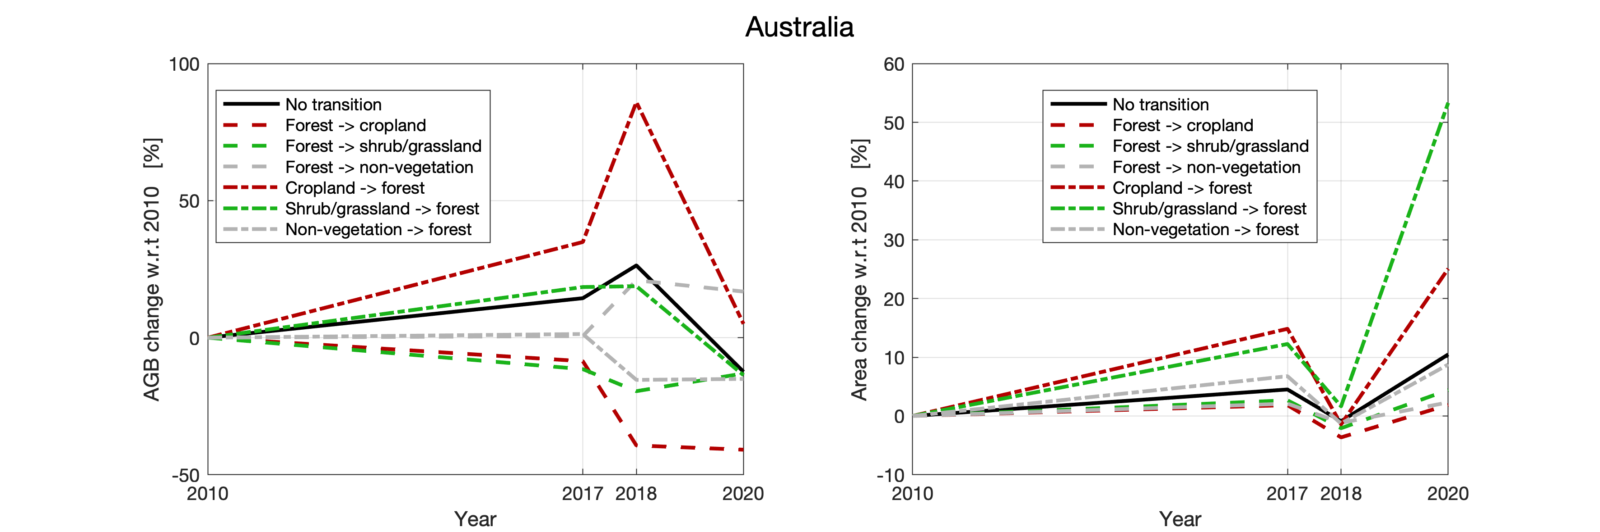
Emerging trends in Australia

Slide 7
Summary on emerging trends globally
The CCI Biomass AGB datasets
The terrestrial AGB pool in forests fluctuated between 550 Pg and 560 Pg while the global forest area increased by 1%.
AGB changes were particularly evident in areas associated with persistent forest land, with areas such as western Canada and northeast Europe losing biomass whilst others (e.g., central and southeast Asia) experienced net gains.
Differentiation between natural and plantation forests was not achieved and so the relative contribution of losses and gains associated with each was not able to be discerned.
Conversion of forest to cropland and grassland resulted in a loss of approximately 0.8 Pg of AGB whilst conversion of these non-forest landscapes to forest increased the global AGB pool by 0.2 Pg.

Slide 8
Conclusions
The suite of CCI Biomass data products has been introduced
Pixel level estimates of AGB and AGB change are not reliable; large-scale averages in contrast can be interpreted and related to land cover trends. A few trends have been presented here but deeper understanding of the impact of the maps’ uncertainties is needed.
The future suite of ESA CCI Biomass data products will foresee a more regular temporal sampling and an extended time interval (2005 / 2010 / yearly between 2015 and 2022). In addition, AGB bias and precision will also be improved by furthermore including a wider range of recent satellite observations (e.g., by spaceborne LiDAR) and re-processed satellite data products with the overall aim of consolidating these preliminary results

Slide 9
CCI Biomass, summary slide
About the CCI Biomass project
https://climate.esa.int/en/projects/biomass/
Link to CCI Biomass data products (version 3, November 2021)
https://catalogue.ceda.ac.uk/uuid/5f331c418e9f4935b8eb1b836f8a91b8
For queries and technical support
Maurizio Santoro, Gamma Remote Sensing, santoro@gamma-rs.ch

