Slide 1

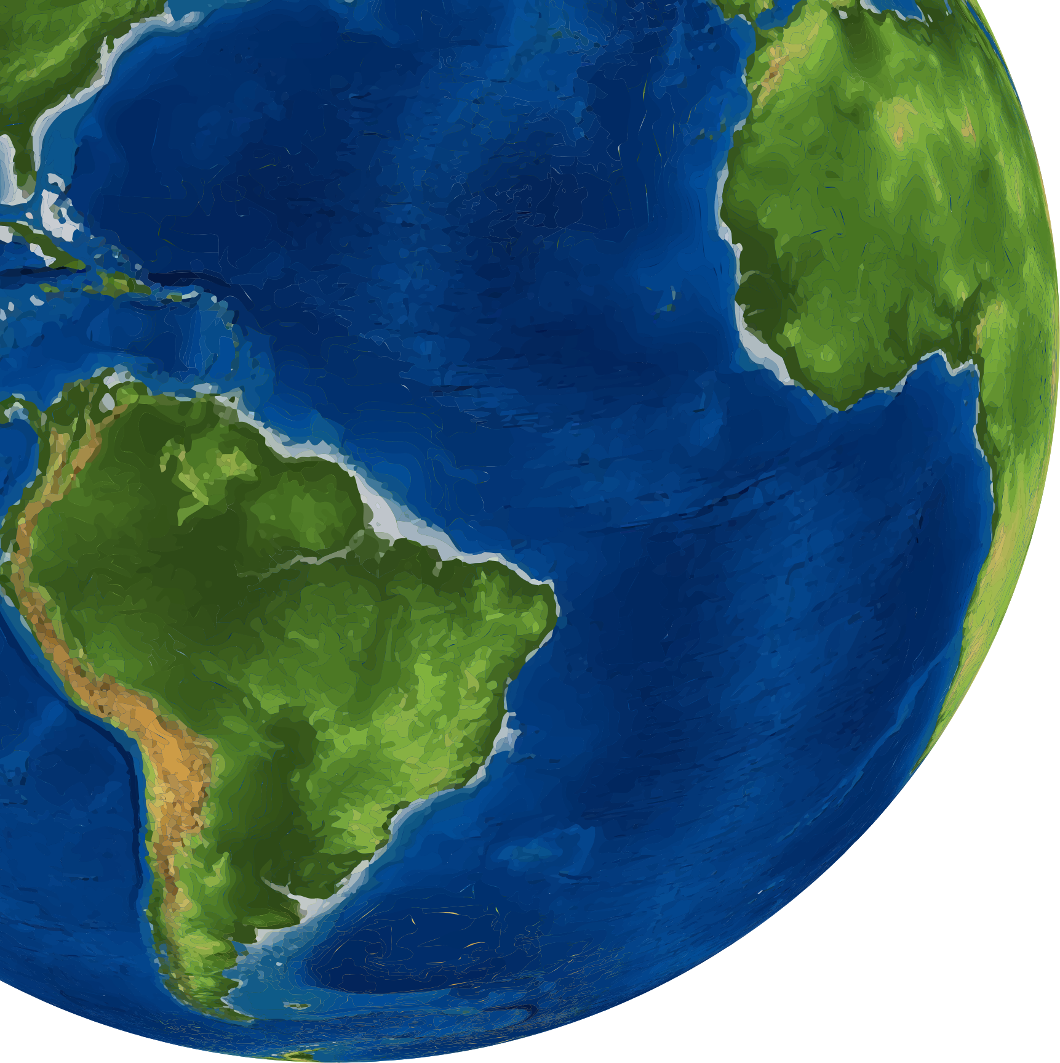
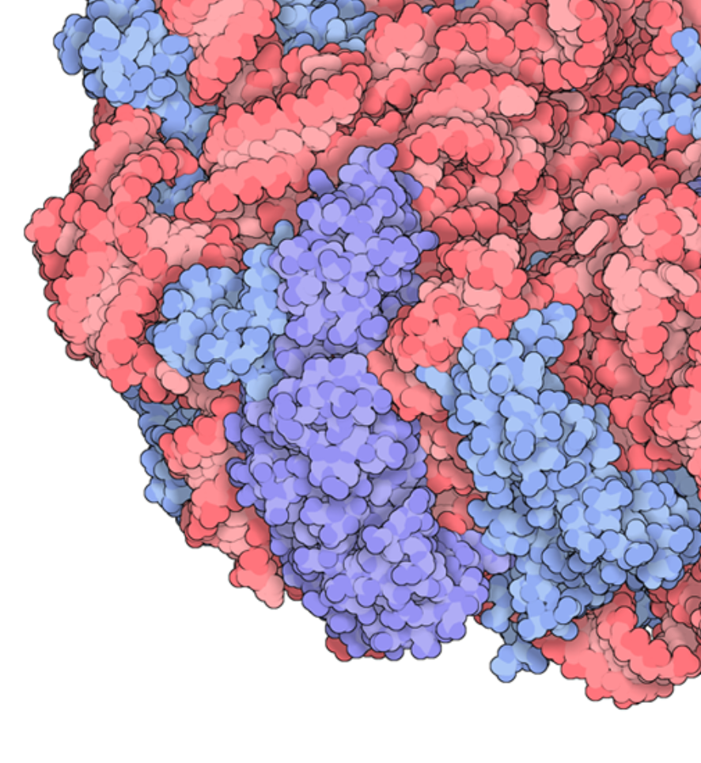

The global mass and average rate of rubisco
EGU 2022
Yinon Bar-On
Weizmann Institute of Science
Notes:
I'm going to talk about the "…"
This is work I did with my advisor Ron Milo and in collaboration with Rob Phillips from Caltech

Slide 2
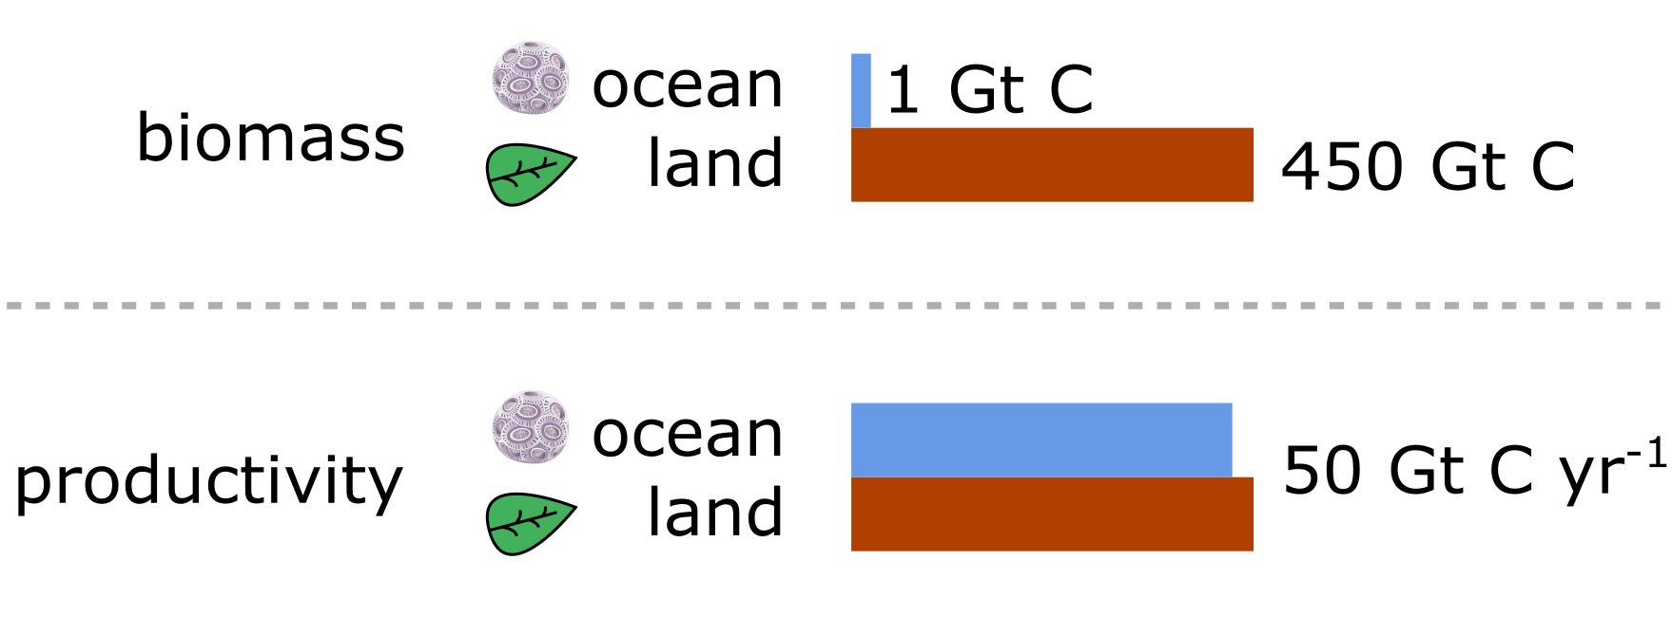
land has ≈500-fold more producer mass but the ocean is as productive
Bar-On & Milo PNAS (2019)

Slide 3
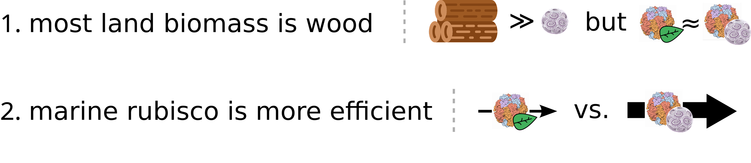
Why is marine biomass more efficient?
Alternative hypotheses:
  Most land biomass is inactive - the amount of key enzymes (rubisco) is the same
  Marine enzymes (rubisco) are more efficient
Bar-On & Milo PNAS (2019)

Slide 4
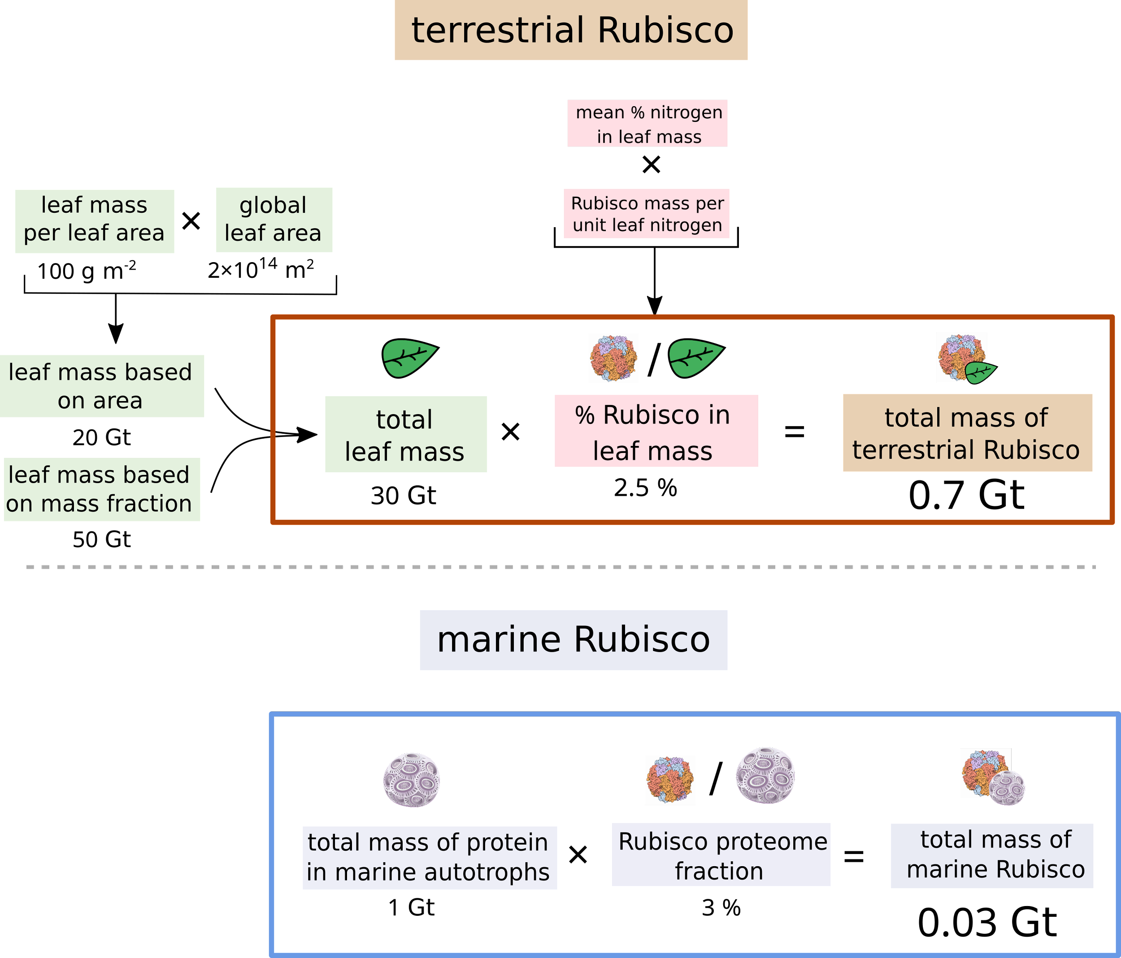
Different efficiencies of rubisco on land vs. ocean
Bar-On & Milo PNAS (2019)

Slide 5
Different efficiencies of rubisco on land vs. ocean
Bar-On & Milo PNAS (2019)

Slide 6

Why is marine biomass more efficient?
Alternative hypotheses:
  Most land biomass is inactive - the amount of key enzymes (rubisco) is the same
  Marine enzymes (rubisco) are more efficient
Bar-On & Milo PNAS (2019)

Slide 7
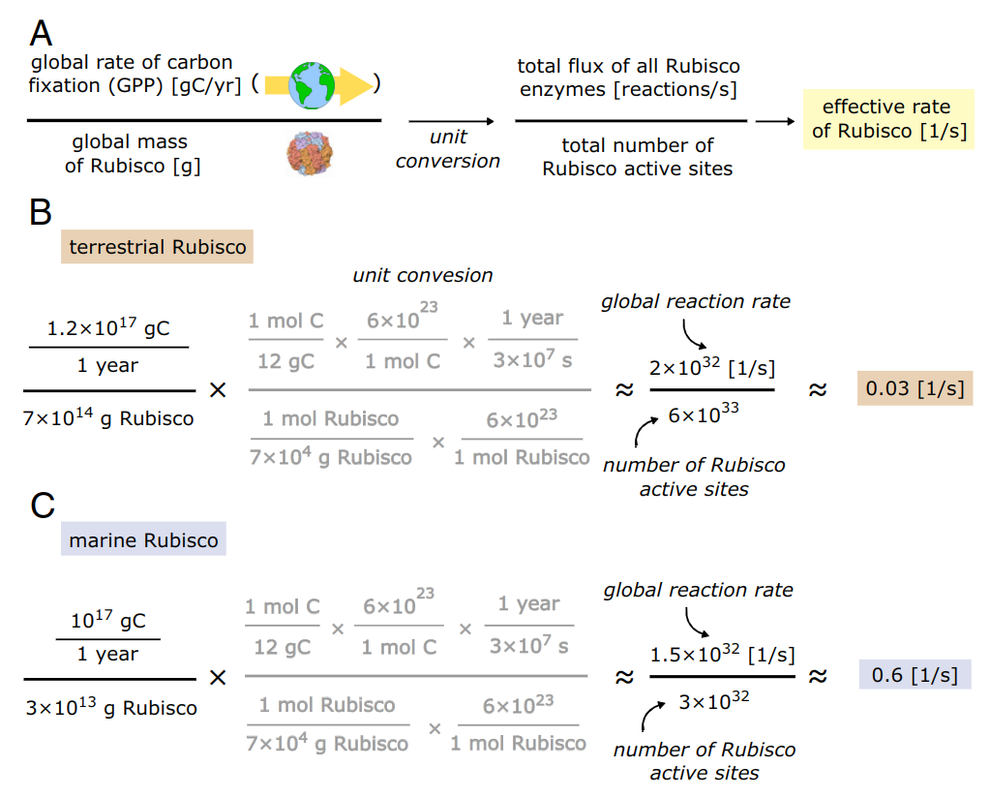
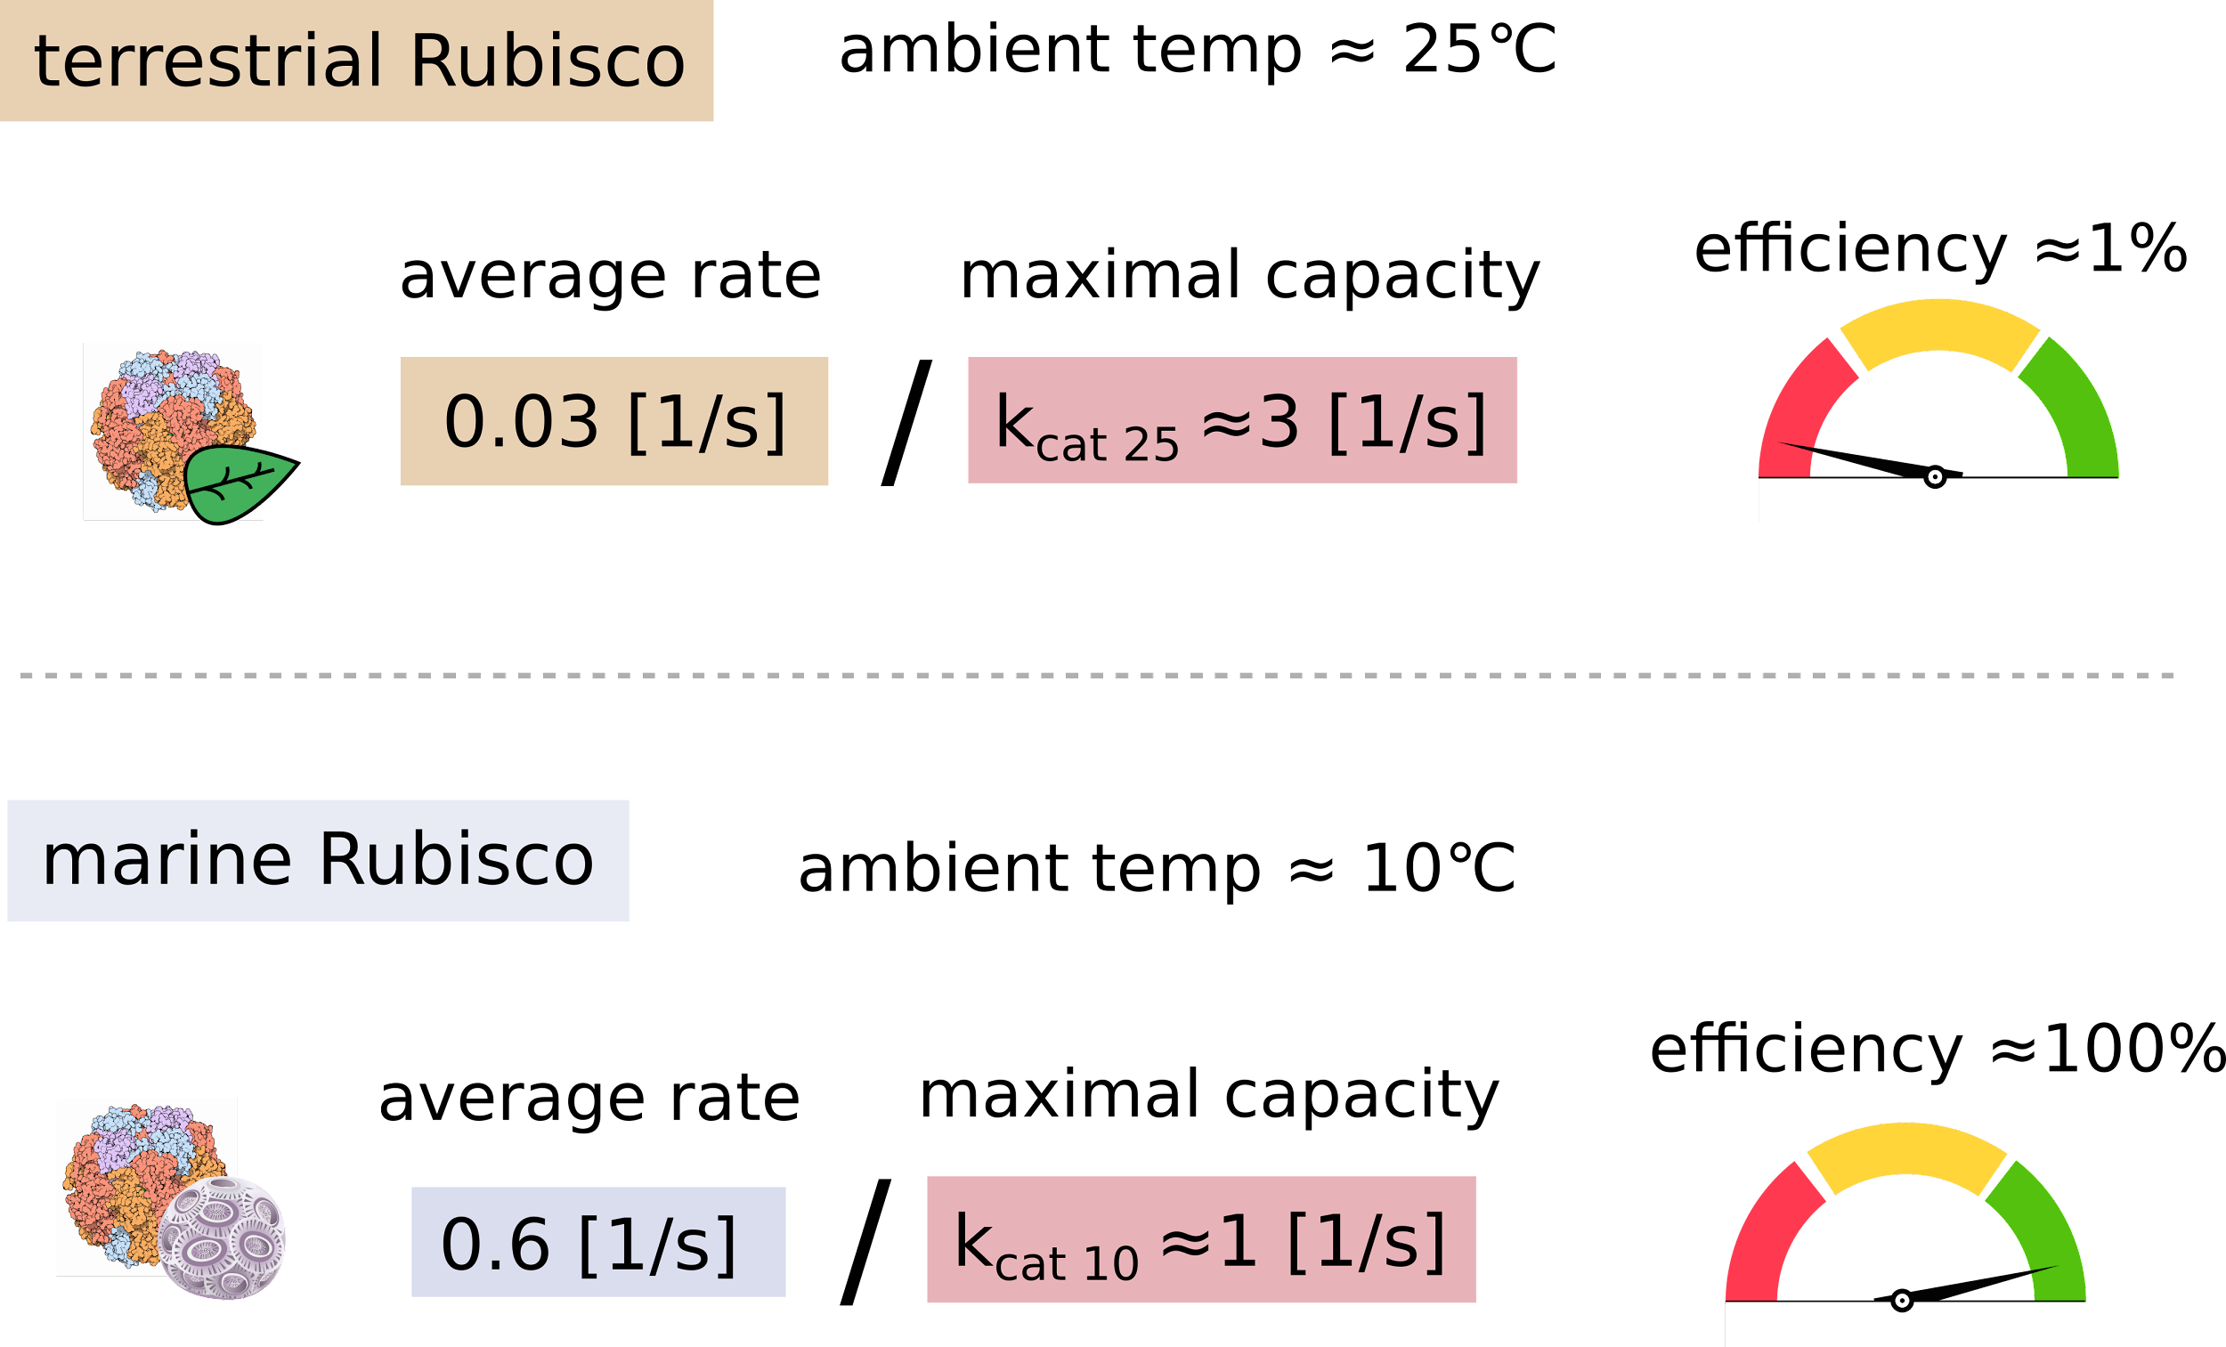
The average rate of rubisco on land vs. ocean
rate
protein
GPP ≈ 120 Gt C yr⁻¹
rubisco ≈ 0.7 Gt
GPP ≈100 Gt C yr⁻¹
rubisco ≈ 0.03 Gt
Bar-On & Milo PNAS (2019)

Slide 8
Different efficiencies of rubisco on land vs. ocean
rubisco k_{cat} ≈ 3 s⁻¹ (in 25°C)
Bar-On & Milo PNAS (2019)

Slide 9
Different efficiencies of rubisco on land vs. ocean
rubisco k_{cat} ≈ 3 s⁻¹ (in 25°C)
ambient T ≈ 10°C
Bar-On & Milo PNAS (2019)

Slide 10
Different efficiencies of rubisco on land vs. ocean
rubisco k_{cat} ≈ 3 s⁻¹ (in 25°C)
0.6 s⁻¹
≈
ambient T ≈ 10°C
1 s⁻¹
maximal rate at ambient T
Bar-On & Milo PNAS (2019)

Slide 11
Different efficiencies of rubisco on land vs. ocean
rubisco k_{cat} ≈ 3 s⁻¹ (in 25°C)
0.6 s⁻¹
≈
ambient T ≈ 10°C
1 s⁻¹
maximal rate at ambient T
0.03 s⁻¹
≈
ambient T ≈ 25°C
3 s⁻¹
Bar-On & Milo PNAS (2019)

Slide 12
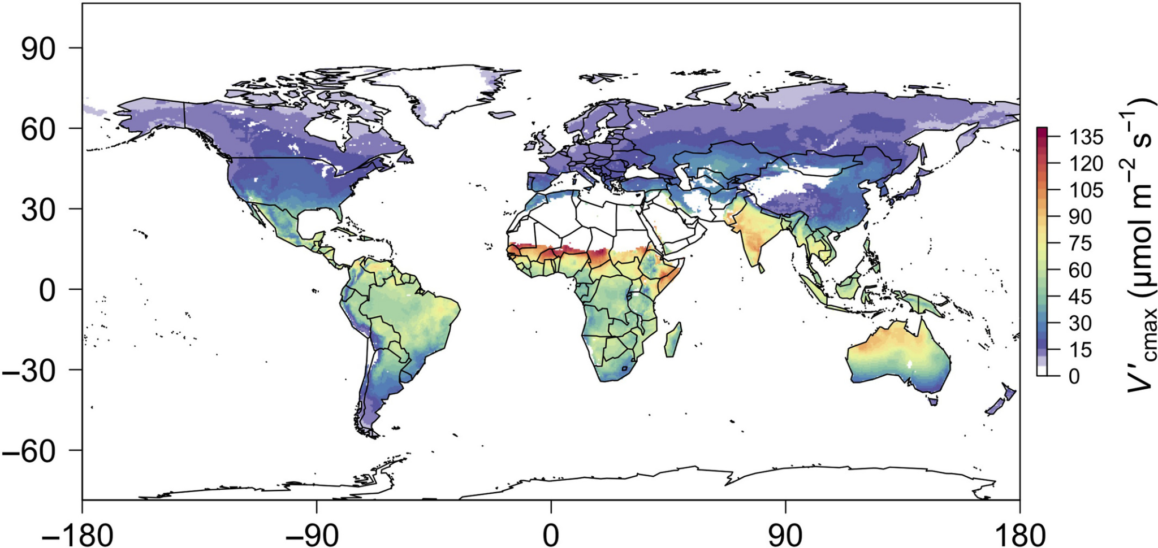
Why is rubisco working so slowly on land?
Likely factors: CO₂, Light, water etc.
We can use new models that validate our global estimate to study the effects of different environmental factors
Smith et al. Ecol. Lett. (2019); Dong et al. New Phyt. (2022)

Slide 13
Thanks!

