Slide 1




Safeguarding heritage sites from hydrometeorological extremes: the Santa Croce district
in Florence
Tamagnone P.¹, Caporali E.¹, Sidoti A.²
¹ University of Florence
² Opificio delle Pietre Dure conservation workshops
NH1.4
Extreme meteorological and hydrological events induced by severe weather and climate change
EGU22-7449

Slide 2
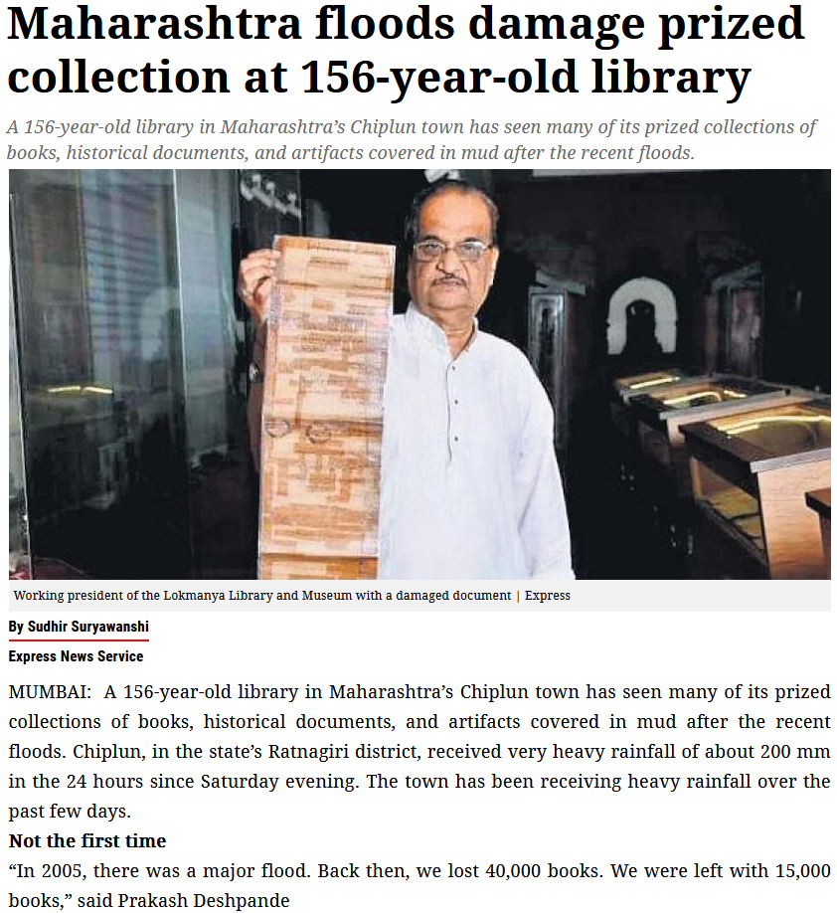
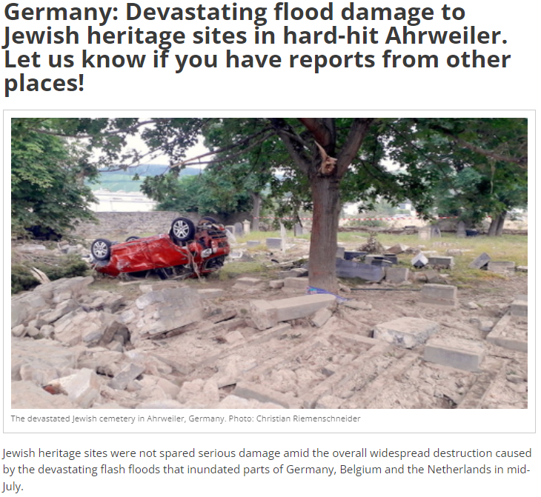
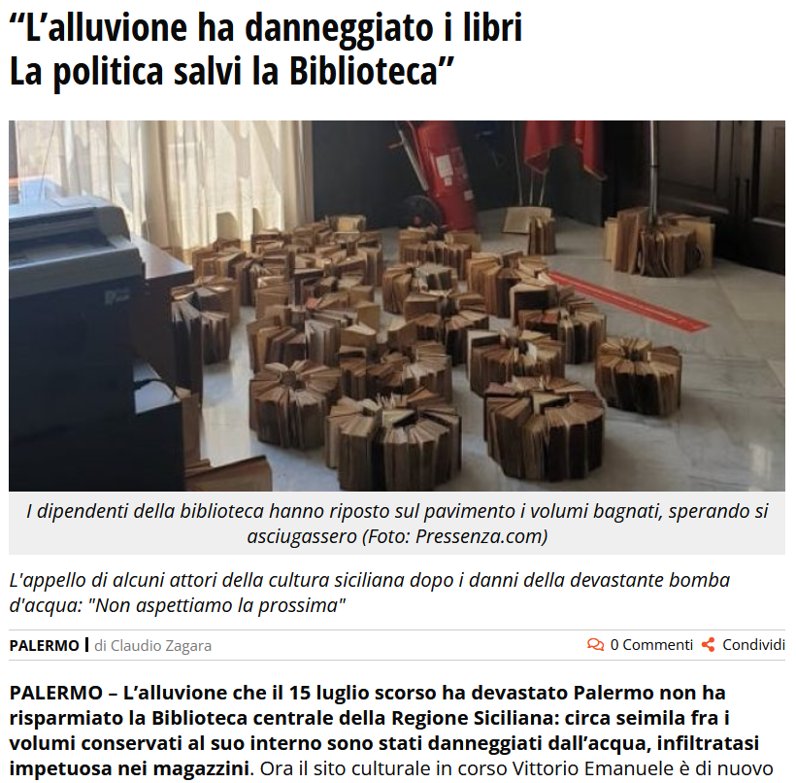
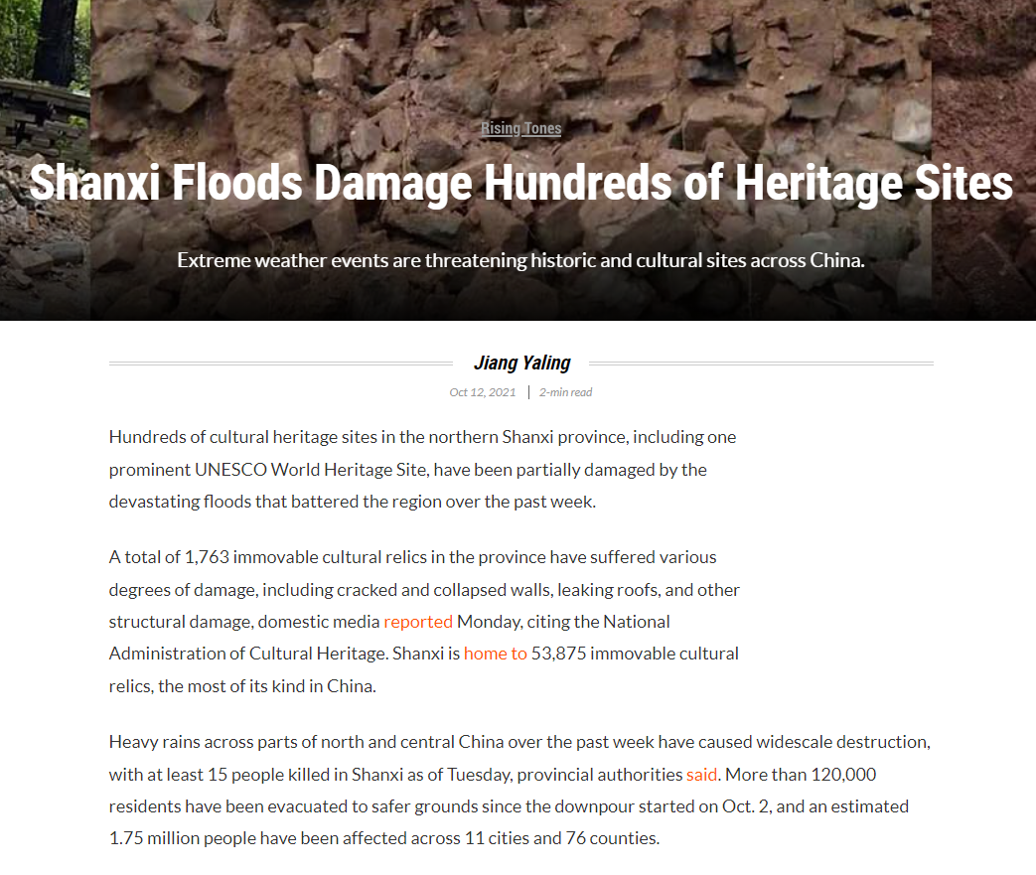
Pluvial flood risk
in city environment
Pluvial floods may threat the safety of people and important assets.
www.jewish-heritage-europe.eu, 2021
www.newindianexpress.com, 2021
Furthermore, they can cause incalculable damages to historical buildings and the inestimable cultural heritage preserved
inside.
www.sixthtone.com, 2021
Intro
Project
R.P. 1
R.P. 2
R.P. 3
www.livesicilia.it, 2020

Slide 3






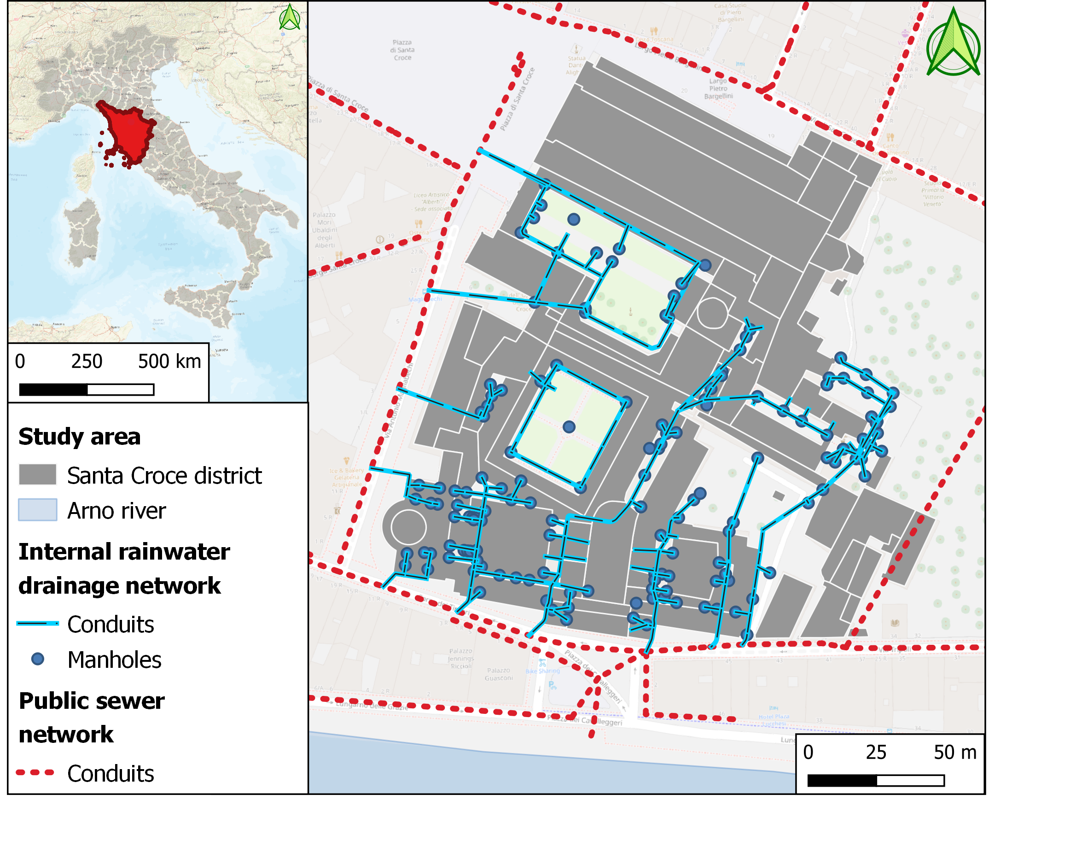
TALETE project
Protecting the cultural heritage from pluvial floods:
the Santa Croce district in Florence
The study area is dangerously exposed to multiple sources of flood hazard:
1. river flooding due to the proximity to the Arno River
2. flooding by sewage since that the internal drainage network is linked with the main sewer conduits of the city
Intro
Project
R.P. 1
R.P. 2
R.P. 3
Tamagnone P., Caporali E., Sidoti A. Facing climate extremes to protect the heritage: the Santa Croce District In Florence, 2022, Climate.Culture.Peace

Slide 4
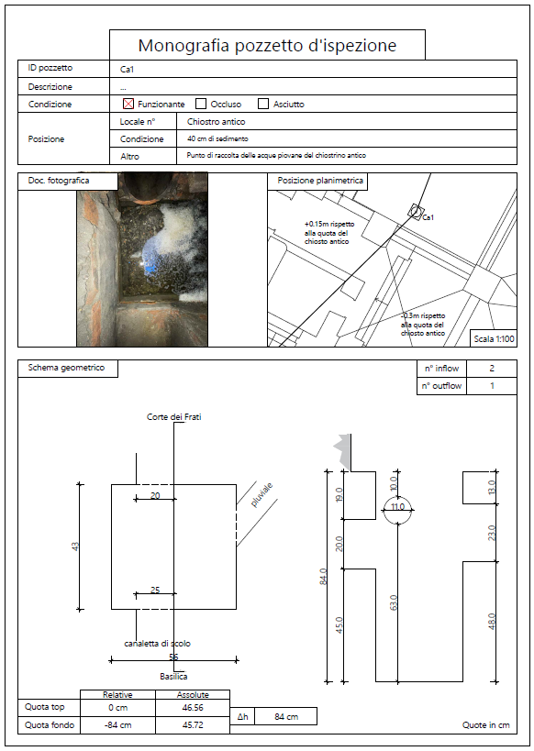
TALETE project : research phases
Research, survey, digitalization: reconstruction of the drainage network of historic buildings and detection of connections with the urban sewer network
Opera di Santa Croce
Monographs of manholes
National Central Library of Florence
Intro
Project
R.P. 1
R.P. 2
R.P. 3
Retrieving geometrical features and technical specifications of the drainage network

Slide 5
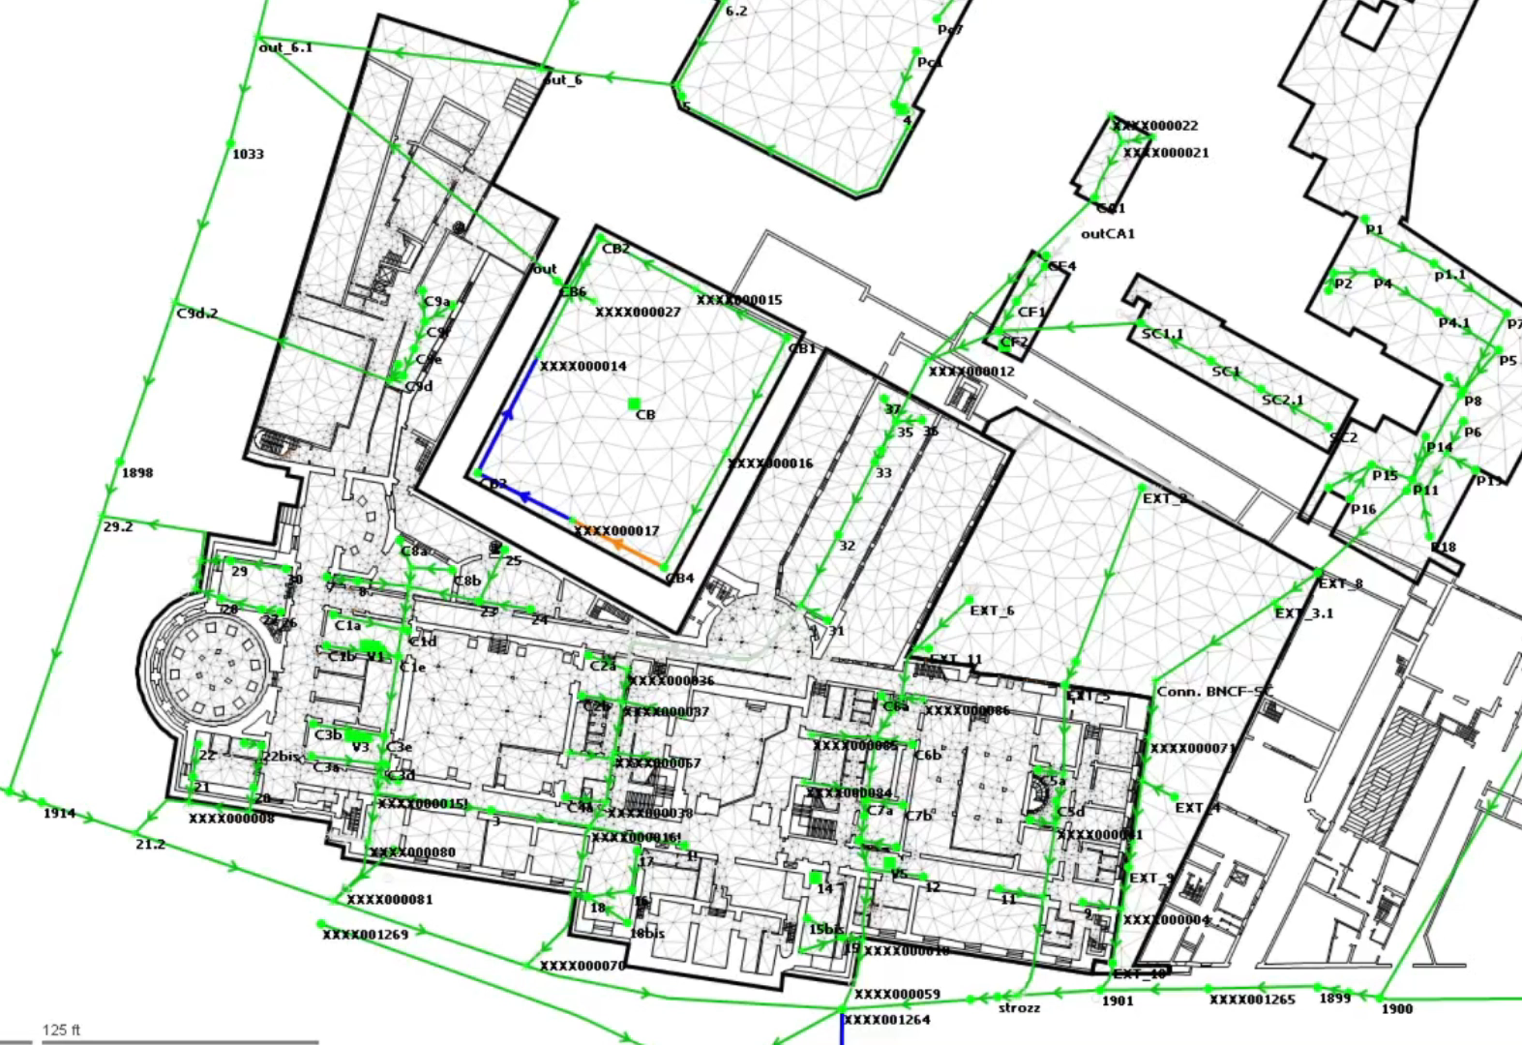
TALETE project : research phases
Hydrological and hydraulic modelling: evaluation of the interactions between the internal drainage network, the urban sewer system and surface runoff processes
1D/2D dual drainage model implemented to simulate all hydraulic phenomena occurring both on the surface and through the sewer network (software: InfoWorks ICM)
Intro
Project
R.P. 1
R.P. 2
R.P. 3

Slide 6
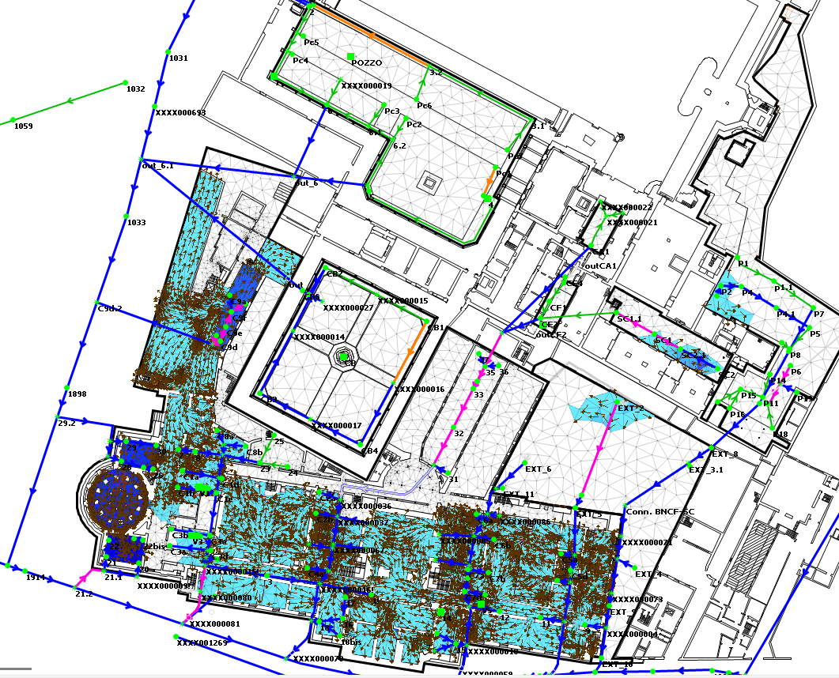
TALETE project : research phases
Hydrological and hydraulic modelling: evaluation of the interactions between the internal drainage network, the urban sewer system and surface runoff processes
Intro
Project
R.P. 1
R.P. 2
R.P. 3
Simulation of multiple extreme hydrometeorological events
Tamagnone P., Caporali E., Sidoti A. Protecting heritage cities from pluvial flooding: the Santa Croce district in Florence, 2022, 39th IAHR World Congress, Granada, Spain (accepted)

Slide 7
TALETE project : research phases
Hydrological and hydraulic modelling: evaluation of the interactions between the internal drainage network, the urban sewer system and surface runoff processes
Intro
Project
R.P. 1
R.P. 2
R.P. 3
Simulation of multiple extreme hydrometeorological events
Tamagnone P., Caporali E., Sidoti A. Protecting heritage cities from pluvial flooding: the Santa Croce district in Florence, 2022, 39th IAHR World Congress, Granada, Spain (accepted)

Slide 8
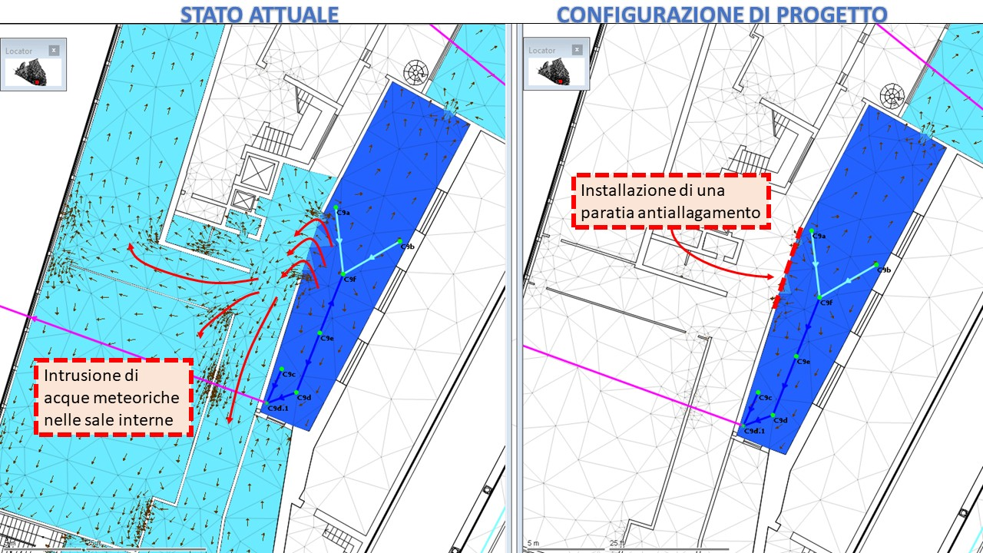
TALETE project : research phases
Prevention and mitigation strategies: identification of critical issues and development of structural and non-structural strategies for the management of hydraulic risk induced by pluvial floods
Anti-flooding
barrier
Proposal of
structural strategy
Sewer overflow and flooding of interior rooms
Intro
Project
R.P. 1
R.P. 2
R.P. 3
Actual
Proposal

Slide 9
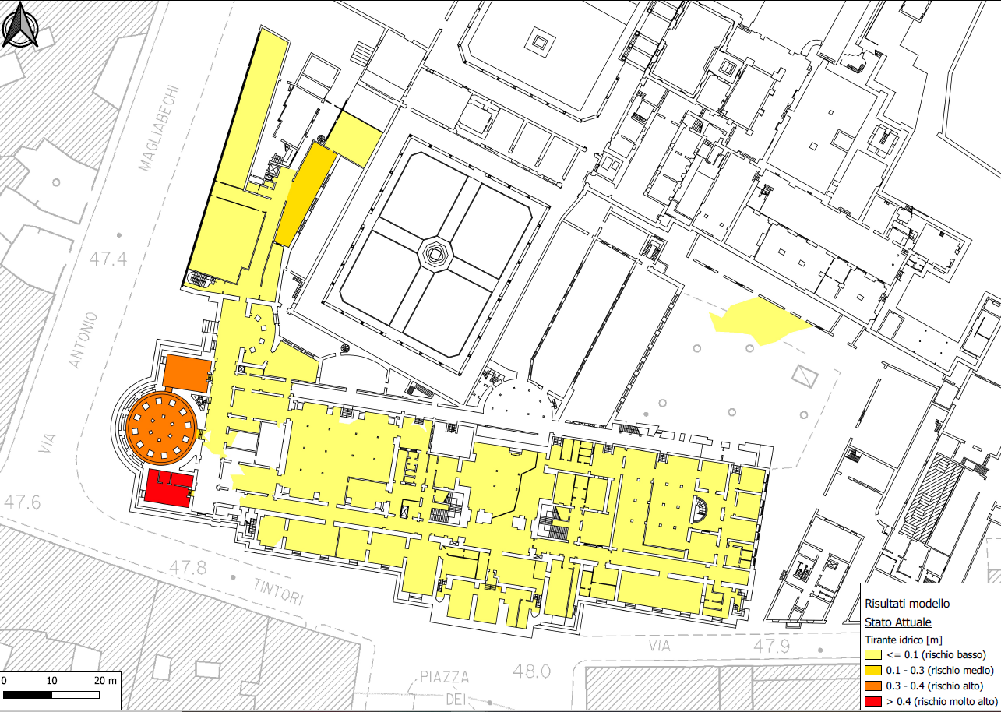
TALETE project : research phases
Prevention and mitigation strategies: identification of critical issues and development of structural and non-structural strategies for the management of hydraulic risk induced by pluvial floods
Flood risk map
Proposal of
non-structural strategy
Intro
Project
R.P. 1
R.P. 2
R.P. 3

Slide 10
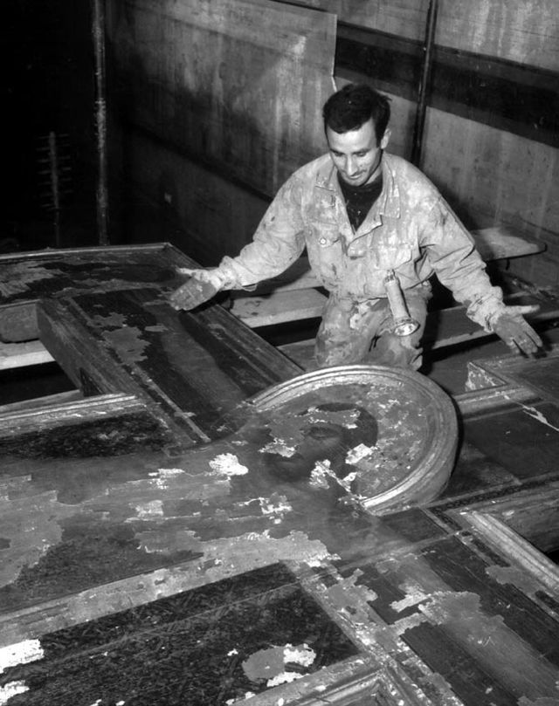
Ivo Bazzechi Cimabue Flood, marked as public domain -Wikimedia Commons
THANK YOU FOR YOUR ATTENTION
Tamagnone Paolo
paolo.tamagnone@unifi.it
Caporali Enrica
enrica.caporali@unifi.it
Sidoti Alessandro
alessandro.sidoti@opificiodellepietredure.com
Let’s
protect
our heritage
NH1.4
Extreme meteorological and hydrological events induced by severe weather and climate change
EGU22-7449

