Slide 1


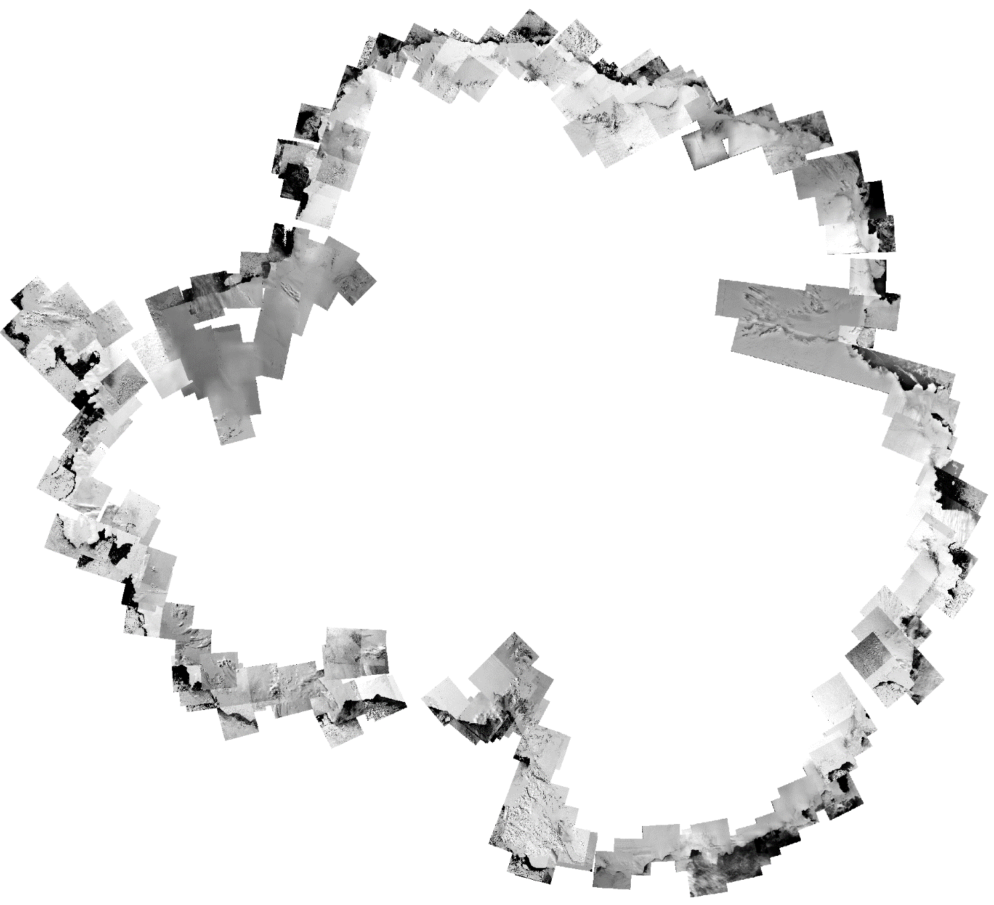
Landsat-1 mosaic of Antarctica
Bertie Miles* and Rob Bingham
School of Geosciences, University of Edinburgh
*Bertie.Miles@ed.ac.uk

Slide 2
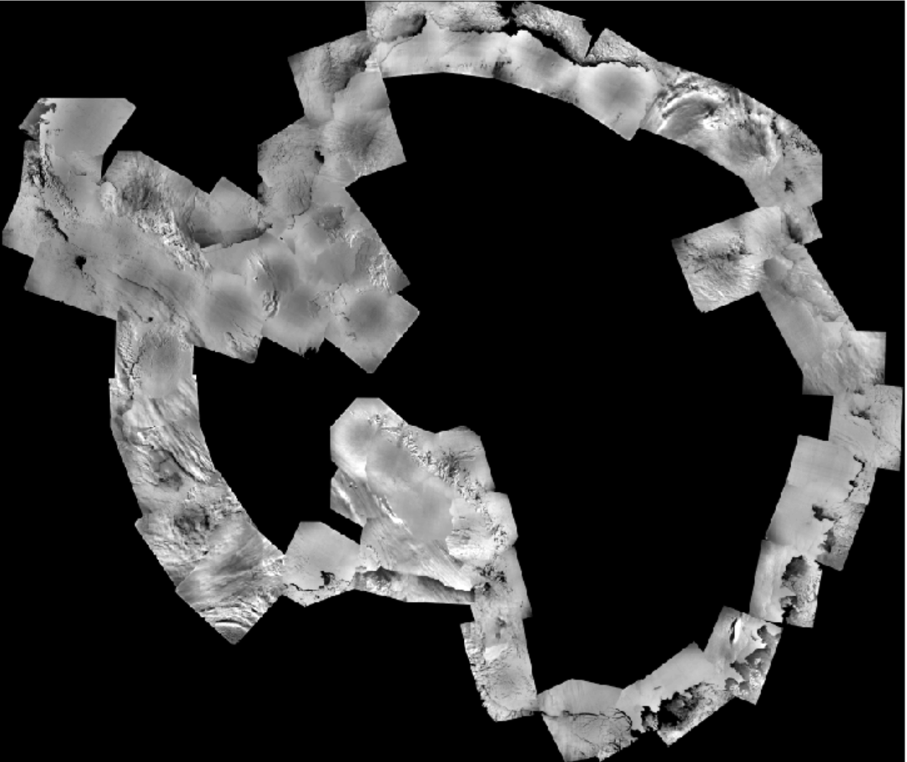
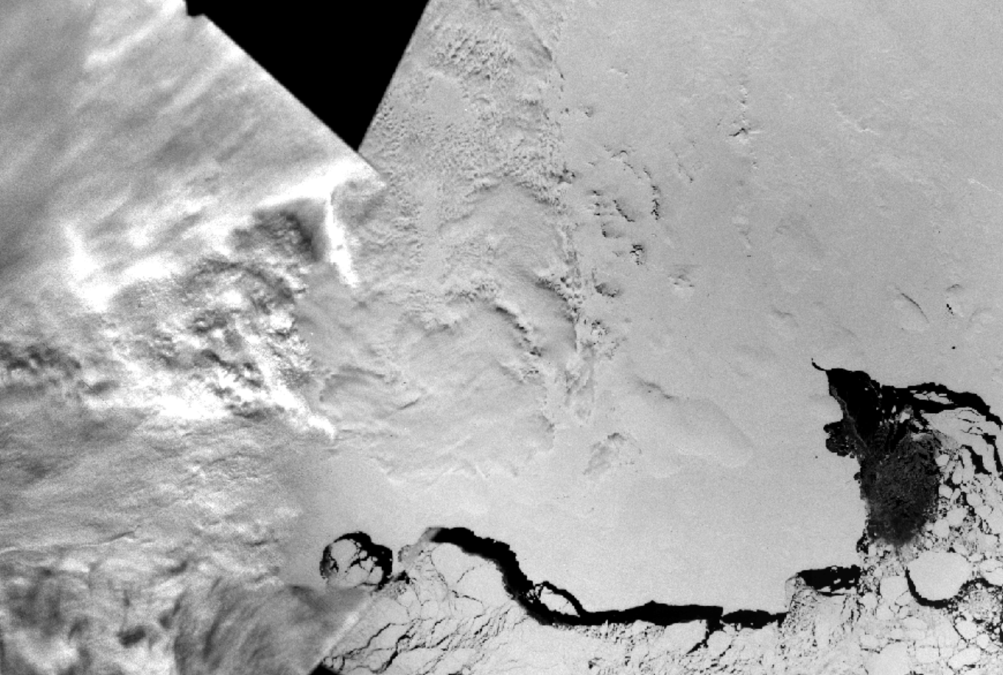
Satellite observations limited to post 1990s
Most observations are concentrated in the 2000s, with a few studies stretching back to the early 1990s
The earliest mosaic of Antarctica is from 1963, but cloudy, grainy and difficult to distinguish features. In practice earliest mosaic is from 1997.
Important to extend the observational record
DISP mosaic 1963; Kim et al., 2007

Slide 3
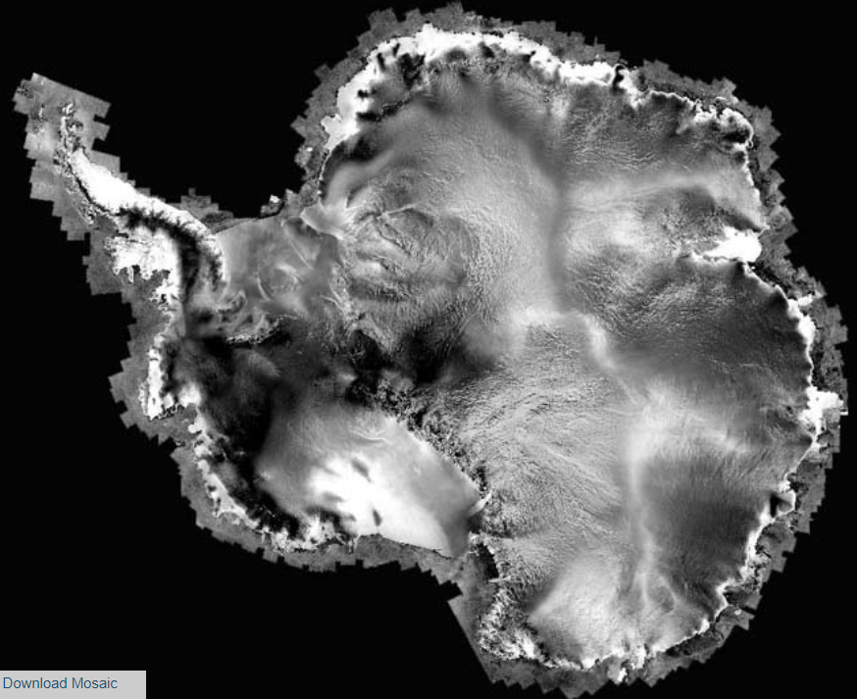
Satellite observations limited to post 1990s
Most observations are concentrated in the 2000s, with a few studies stretching back to the early 1990s
The earliest mosaic of Antarctica is from 1963, but cloudy, grainy and difficult to distinguish features. In practice earliest mosaic is from 1997.
Important to extend the observational record
RAMP mosaic 1997; Byrd Polar Research Centre

Slide 4
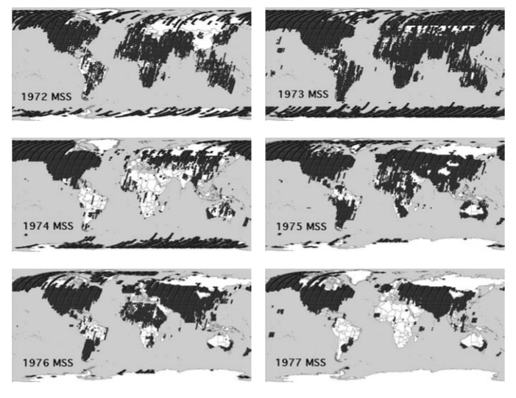
Landsat-1 imagery: an untapped archive
Nearly complete coverage of Antarctic coastline between 1972 and 1976
Reasonable quality, spatial resolution around 60 m. But poor geolocation and lots of cloud.
Imagery has previously not been processed in a systematic ice sheet wide analysis, presumably because of these time consuming issues
Landsat -1 scene archive; USGS

Slide 5
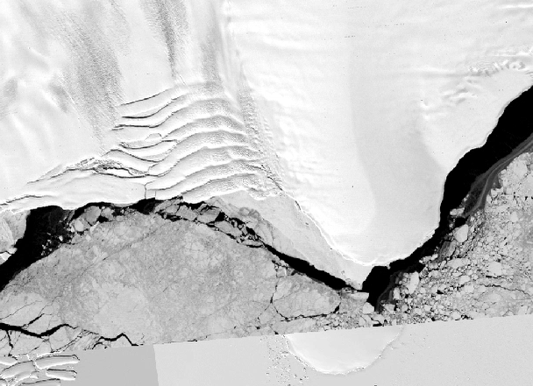
Landsat-1 imagery: an untapped archive
Nearly complete coverage of Antarctic coastline between 1972 and 1976
Reasonable quality, spatial resolution around 60 m. But poor geolocation and lots of cloud.
Imagery has previously not been processed in a systematic ice sheet wide analysis, presumably because of these time consuming issues
Landsat -1 scene archive; USGS

Slide 6
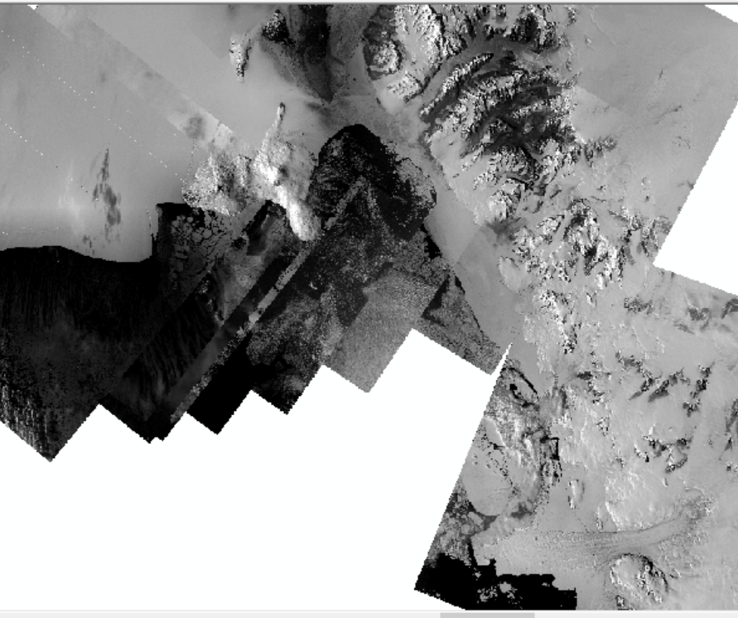
A near cloud free mosaic of Antarctica’s ice shelves
Near complete cloud-free coverage of Antarctica’s ice shelves
>300 Landsat-1 images manually co-registered to Landsat-8 images
Imagery can be used for coastline mapping, ice shelf damage, basal melt channels, change in flow direction and pinning points
Victoria Land and Ross Ice Shelf 1972-74

Slide 7
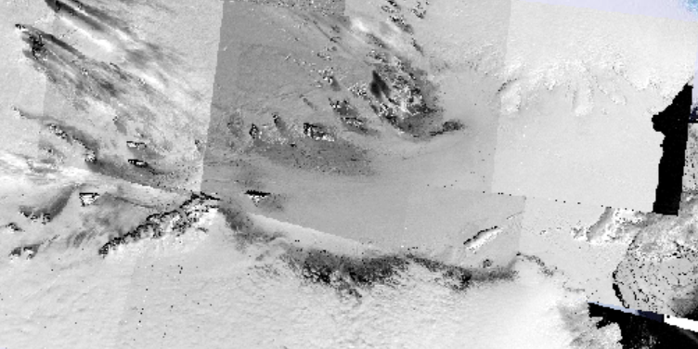
A near cloud free mosaic of Antarctica’s ice shelves
Near complete cloud-free coverage of Antarctica’s ice shelves
>300 Landsat-1 images manually co-registered to Landsat-8 images
Imagery can be used for coastline mapping, ice shelf damage, basal melt channels, change in flow direction and pinning points
Amery Ice Shelf 1972-74

Slide 8
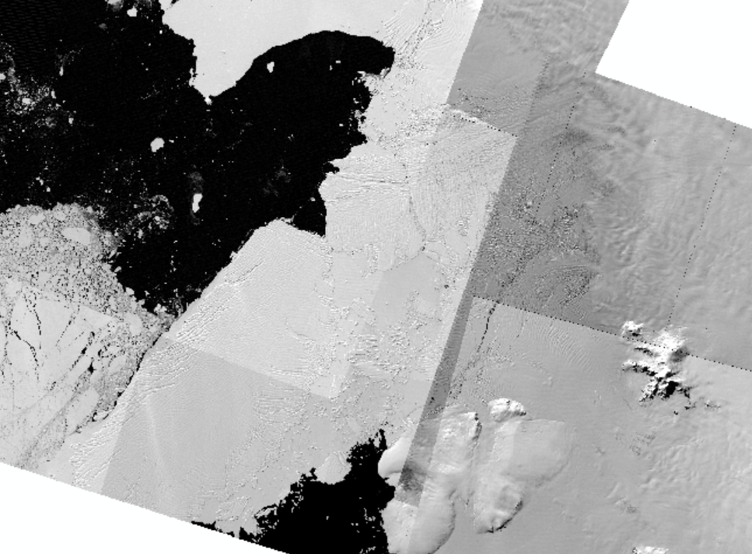
A near cloud free mosaic of Antarctica’s ice shelves
Near complete cloud-free coverage of Antarctica’s ice shelves
>300 Landsat-1 images manually co-registered to Landsat-8 images
Imagery can be used for coastline mapping, ice shelf damage, basal melt channels, pinning points
Thwaites 1972-74

Slide 9
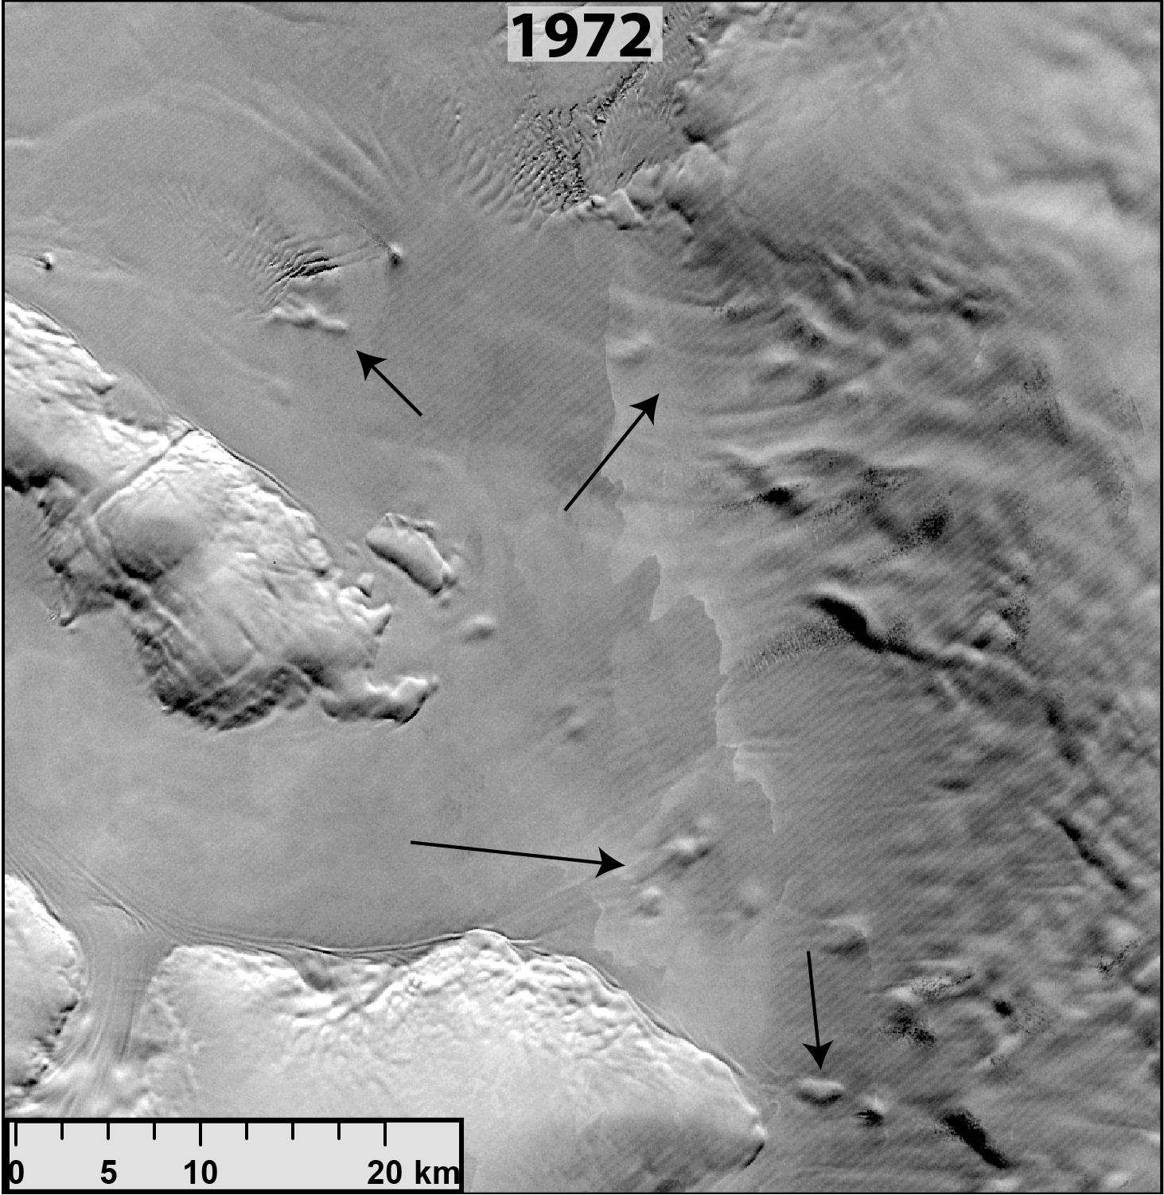
Pinning points
Proxy for ice shelf thickness change, potential to extend our knowledge of ice shelf thickness change back to the 1970s
Disappearance or weaker imprint on ice shelf surface is indicative of ice shelf thinning
A firmer imprint or new visible bumps on the surface indicative of ice shelf thickening
Aiming for pan-ice sheet mapping of pinning point change over past 50 years
George VI Ice Shelf 1972 - 2022

Slide 10
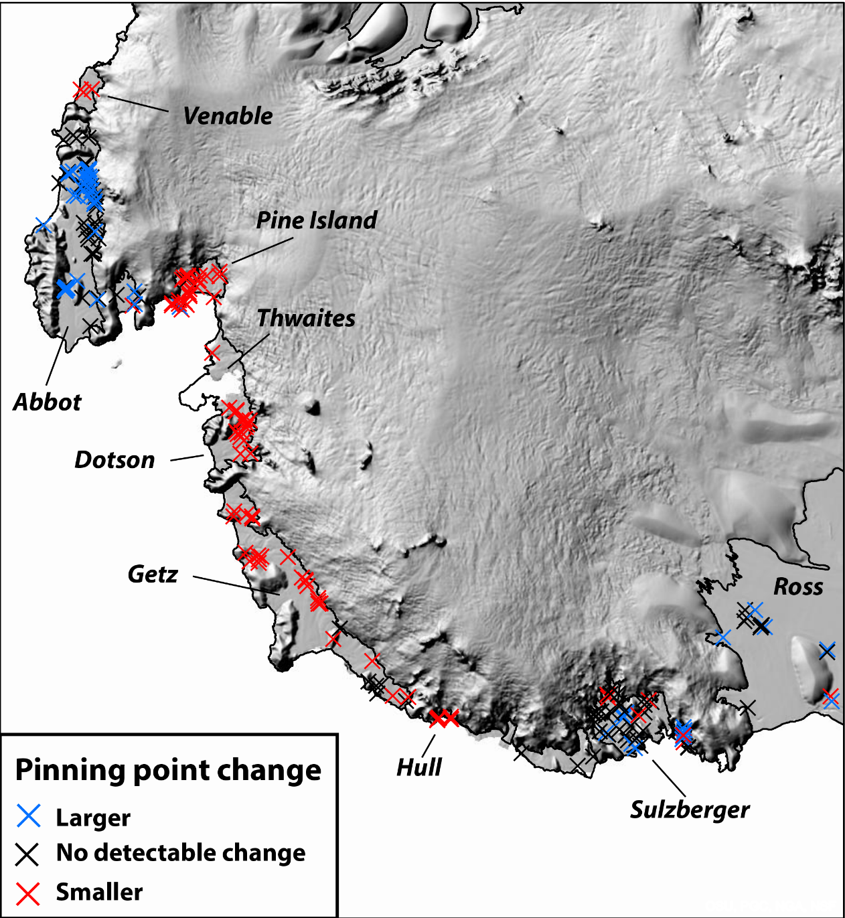
Pinning points – results so far (1972/74 – 2021/22)
Widespread disappearance of visible pinning points in West Antarctica
Increase in visible pinning points on Abbott Ice Shelf – thickening?
Pan-ice sheet analysis in progress
Decadal change: Were ice shelves already thinning in 1970s/80s?
1972-1990
1990-2000 (LIMA mosaic)
2000 (LIMA mosaic-2022)
(Thickening)
(Thinning)

Slide 11
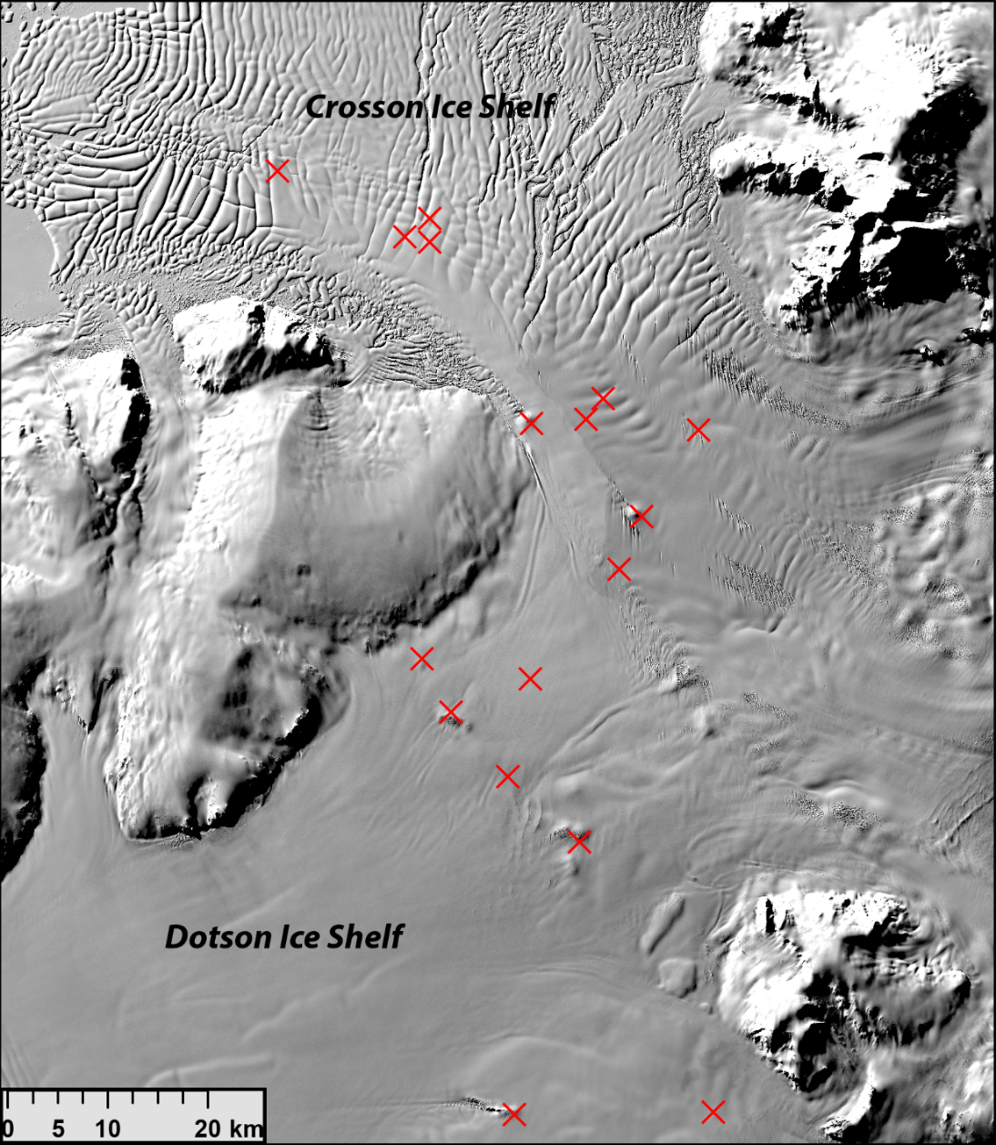
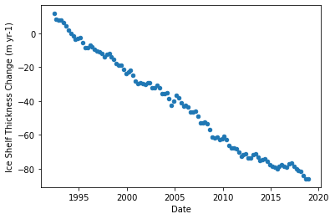
Pinning points – example Crosson/Dotson Ice Shelf
Comparison to altimetry 1992-2018 (averaged over same area as image on left)
Data from Adusumilli et al. (2020)
Disappearance of pinning points consistent with a very strong thinning signal.

Slide 12
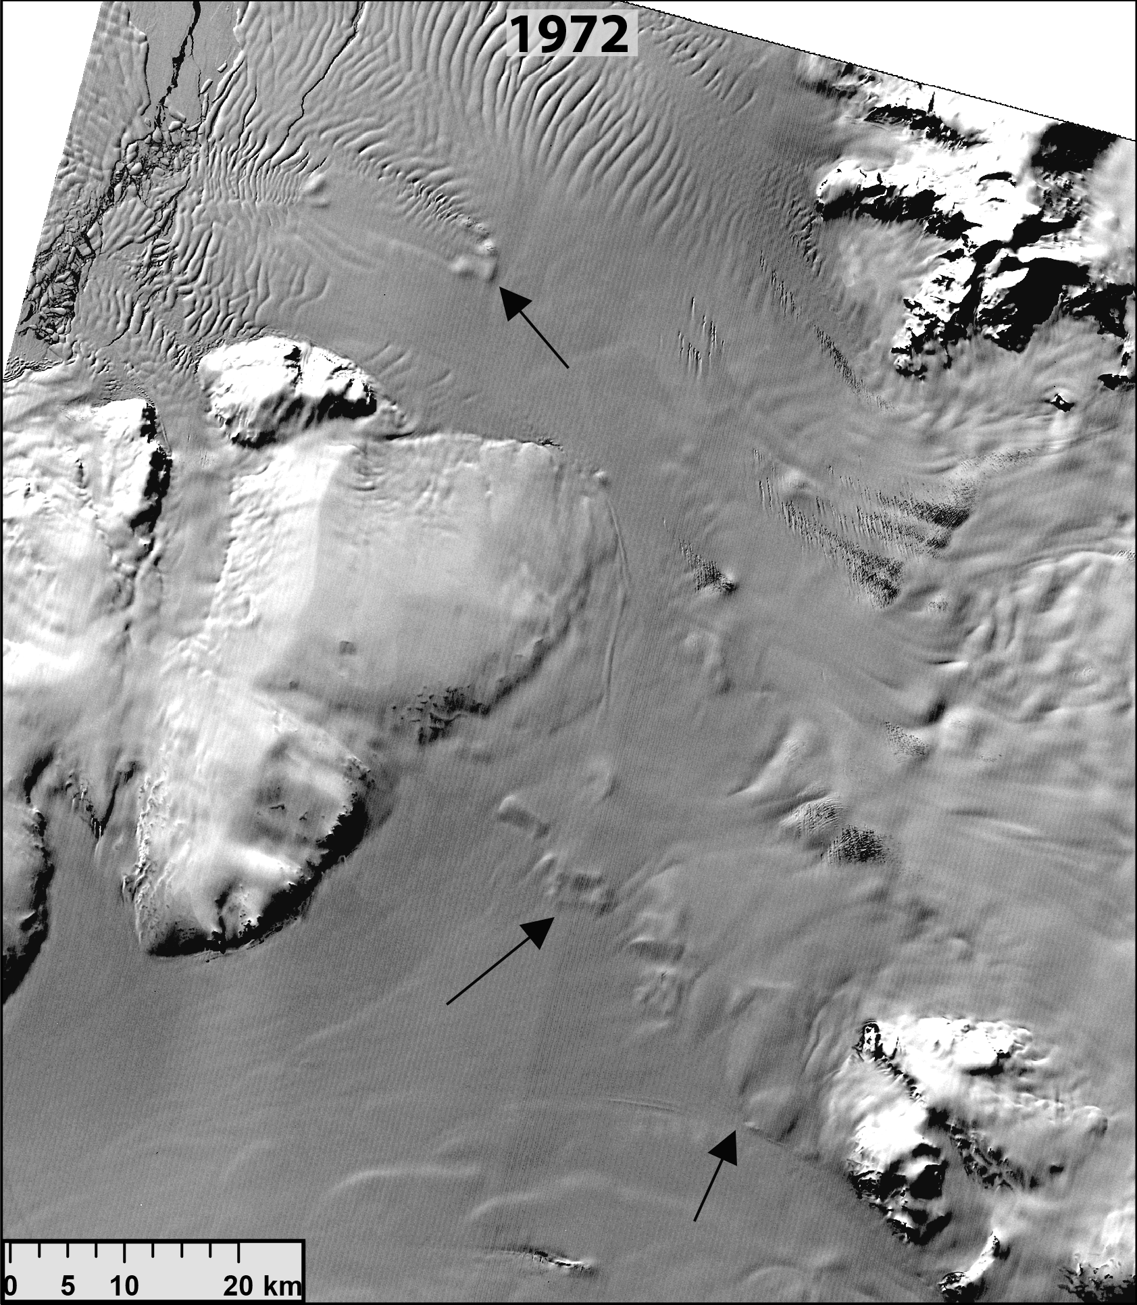
Pinning points – example Crosson/Dotson Ice Shelf

Slide 13
Pinning points – results so far
Widespread disappearance of visible pinning points in West Antarctica
Increase in visible pinning points on Abbott Ice Shelf – thickening?
Pan-ice sheet analysis in progress
Decadal change: Were ice shelves already thinning in 1970s/80s?
1972-1990
1990-2000 (LIMA mosaic)
2000-2022

Slide 14
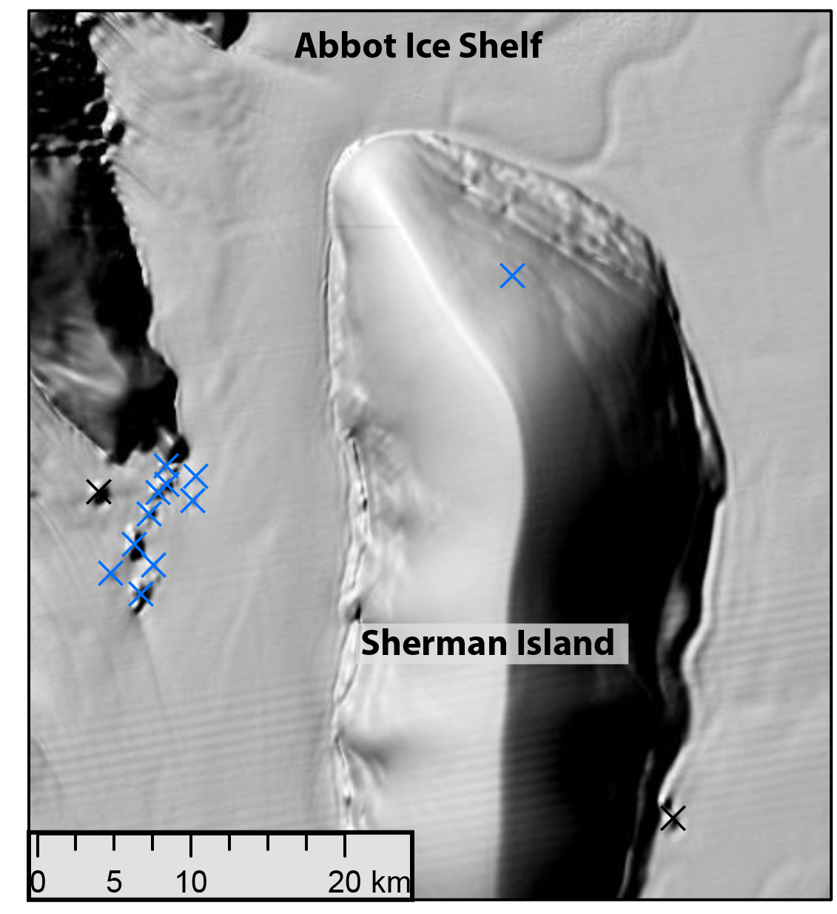
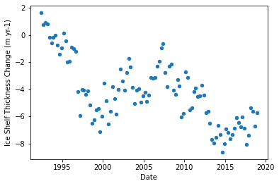
Pinning points – example Abbott Ice Shelf
Comparison to altimetry 1992-2018 (averaged over same area as image on left)
Data from Adusumilli et al. (2020)
Increase in footprint of pinning points not consistent with a weak thinning signal.

Slide 15
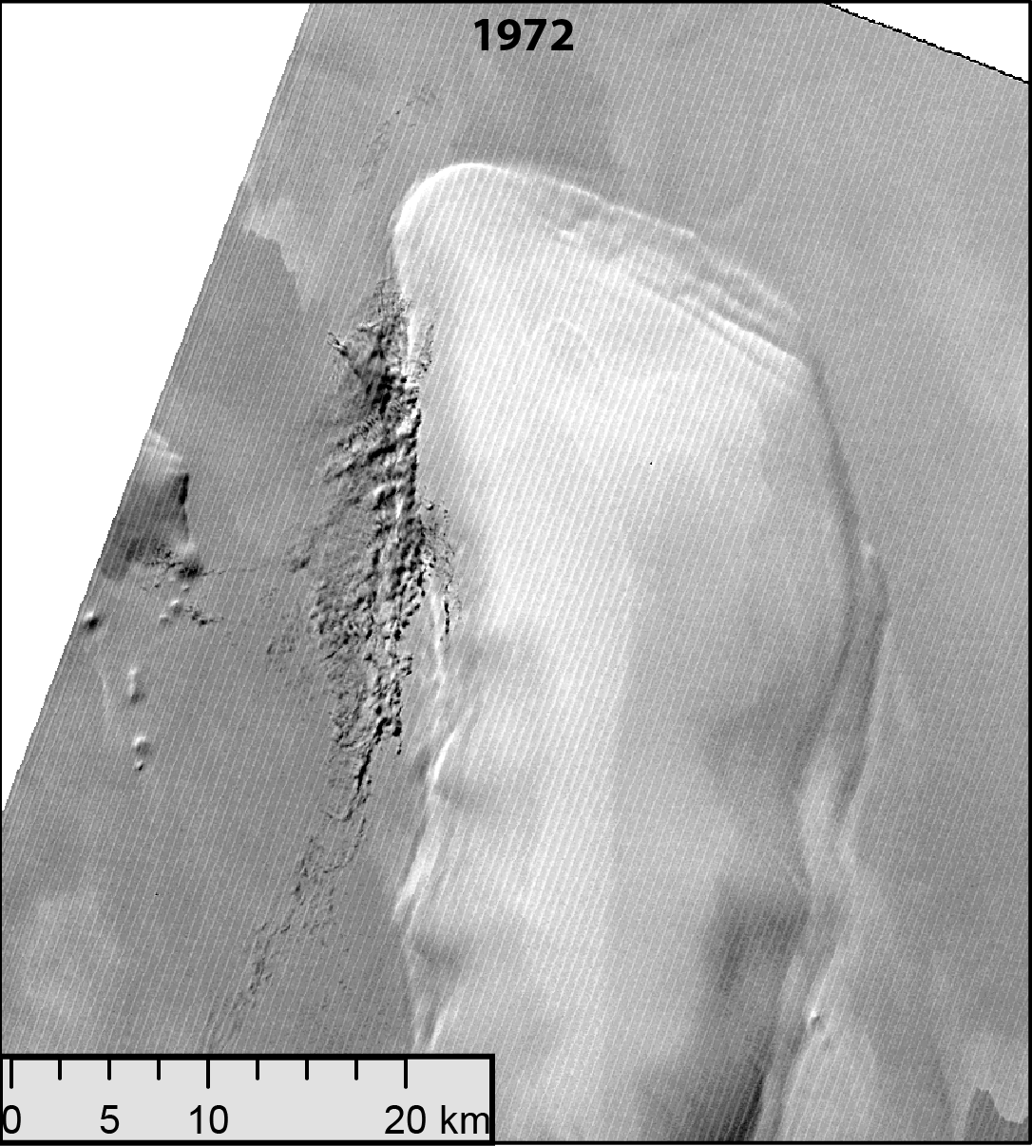
Pinning points – example Abbott Ice Shelf

Slide 16
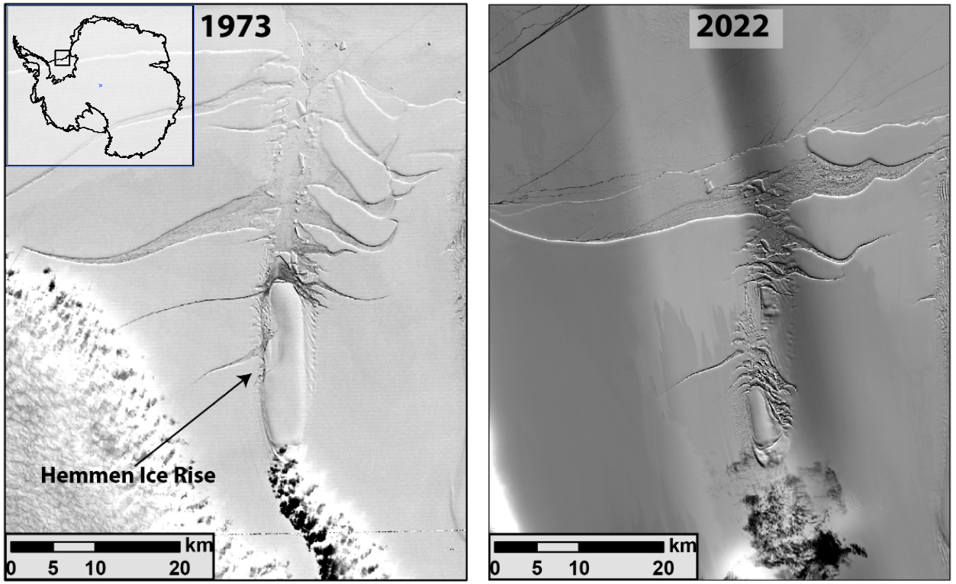
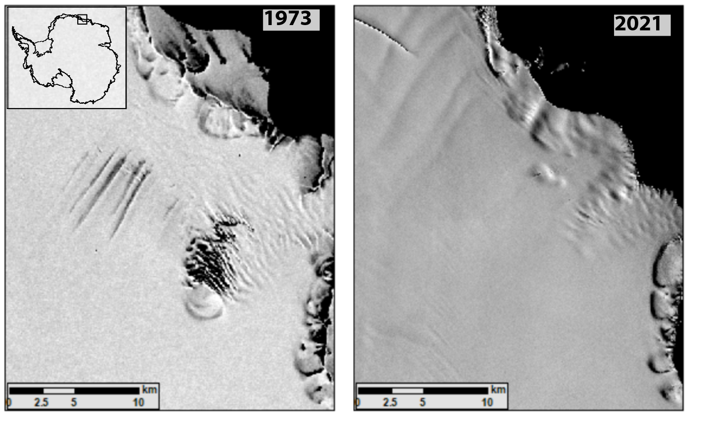
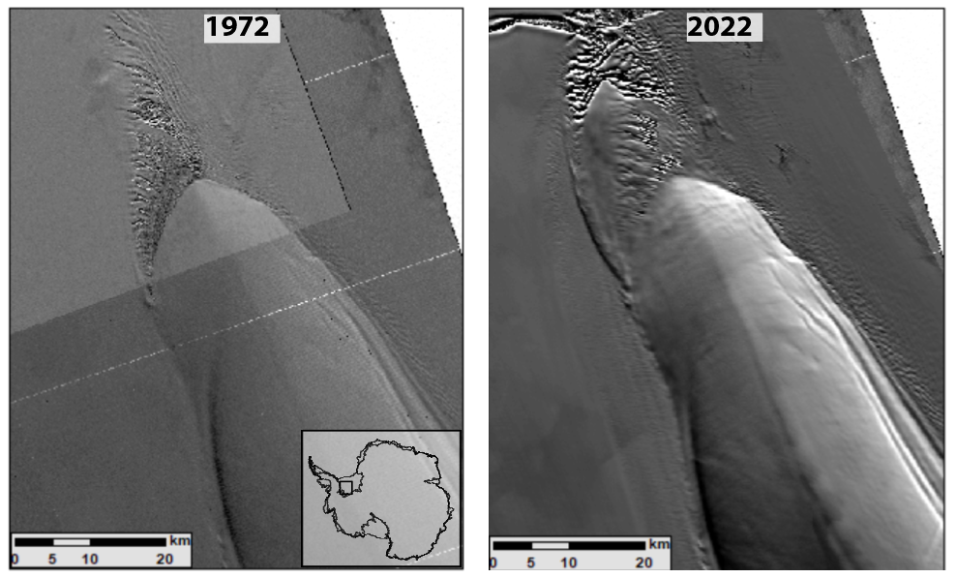
Many more interesting examples across the ice sheet
Shrinkage of Hemman Ice Rise, Ronne Ice Shelf
Loss of major pinning point, Borchgrevink Ice Shelf, Dronning Maud Land
Thanks for your attention
Growth of Korff Ice Rise, Ronne Ice Shelf

