Slide 1


Characterising reanalysis representation of winds at the interface between Antarctica and the Southern Ocean
Thomas Caton Harrison¹, Tom Bracegirdle¹, John King¹ and Stavroula Biri²
1. British Antarctic Survey, Cambridge, UK
2. National Oceanography Centre, Southampton, UK

Slide 2

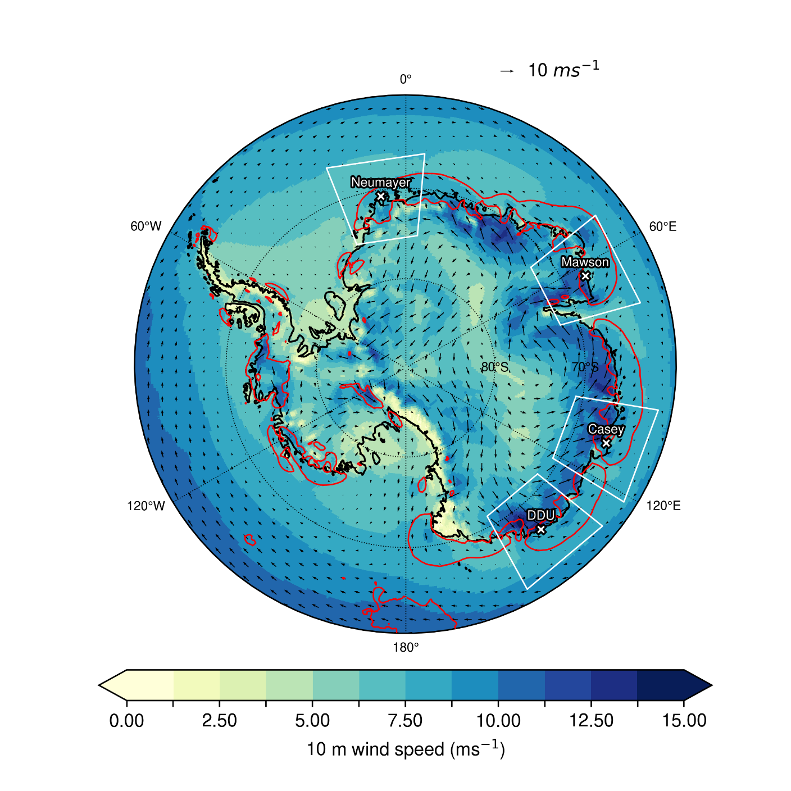
Coastal winds of Antarctica
Polar easterlies: mean wind speeds peak onshore, but 12-hourly variability peaks offshore
Important for regulating ocean heat transport towards ice shelves, sea ice production and distribution
Poor observational coverage means reanalyses are critical
How well do recent reanalyses compare with marine scatterometer obs?
Do reanalyses capture short-term variability observed at coastal stations?
Figure 1: Mean ERA5 10 m wind field vectors 2010-2017 with 10 m wind speed (ms⁻¹) shaded. Stations used in this analysis are labeled. The 4 ms⁻¹ standard deviation of 12-hourly 10 m wind speed is contoured in red.

Slide 3
Part 1: Reanalysis comparison with ASCAT

Slide 4
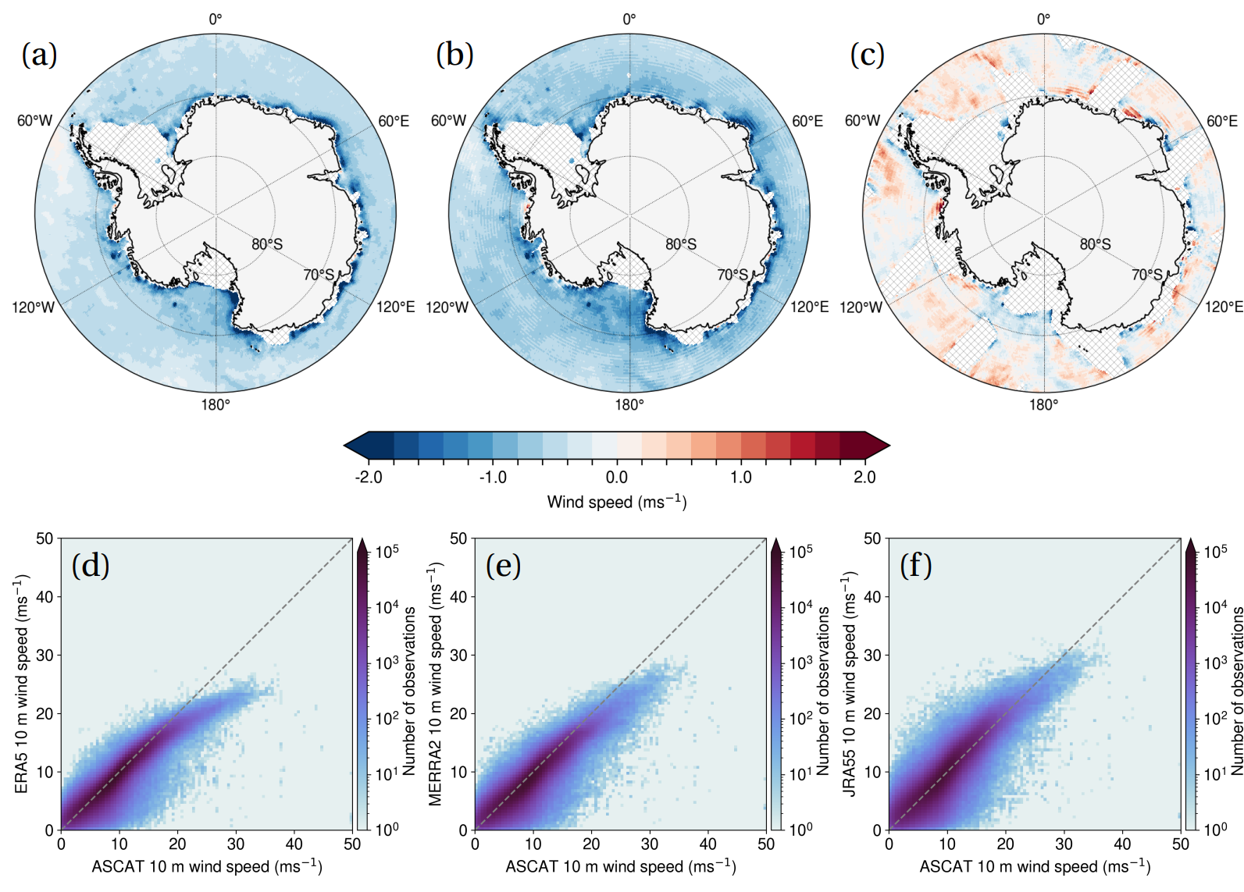
Overall results
Figure 2: Mean reanalysis minus ASCAT 10 m wind speed (ms⁻¹) for the period 2010-2017 for (a) ERA5, (b) MERRA-2 and (c) JRA-55. Heat map scatterplots of collocated data points south of 65°S are shown for (d) ERA5, (e) MERRA-2 and (f) JRA-55, shaded by the density of observations. Data points which are rain flagged or have a GMF-matchup flag value over 2 are not included and pixels with fewer than 50 ASCAT-reanalysis collocations are masked from (a-c).
r = 0.92
r = 0.90
r = 0.88

Slide 5
Uncertainties in comparing scatterometer and reanalysis winds
Sampling: ASCAT is processed on a 12.5 km grid with varying observation times along the swath whereas the reanalyses are on standard timesteps on a grid which is coarser but has comprehensive coverage.
Atmospheric stability: ASCAT winds are measured at the sea surface and scaled to 10 m assuming neutral stability. JRA-55 10 m winds are calculated assuming neutral stability, while ERA5 and MERRA-2 are stability-dependent (Torralba et al., 2017).
Ocean currents: ASCAT measures wind stress so wind speeds derived are surface-relative.
Air density: The scaling of wind stress to winds at 10 m is density-dependent (hence temperature-dependent). Based on De Kloe et al. (2017) accounting for this could increase reanalysis winds over the near coastal region by about 0.1 m/s.
Sea ice: Reanalyses and ASCAT may have different designation of sea ice, marginal or open ocean.
Independence: ASCAT is assimilated into all three reanalyses from 2008, but the exact assimilation procedure likely varies. At ECMWF ASCAT is assimilated into the neutral wind (Chiara et al., 2016).
Notes:
Torralba, V., Doblas-Reyes, F. J., & Gonzalez-Reviriego, N. (2017). Uncertainty in recent near-surface wind speed trends: a global reanalysis intercomparison. Environmental Research Letters, 12 (11), 114019.
Chiara, G. D., English, S., Janssen, P. A. E. M., & Bidlot, J.-R. (2016). Ascat ocean surface wind assessment. (776). Retrieved from https://www.ecmwf.int/node/16513 doi: 10.21957/6wqfjq02c
de Kloe, J., Stoffelen, A. and Verhoef, A., 2017. Improved use of scatterometer measurements by using stress-equivalent reference winds. IEEE Journal of Selected Topics in Applied Earth Observations and Remote Sensing, 10(5), pp.2340-2347.

Slide 6
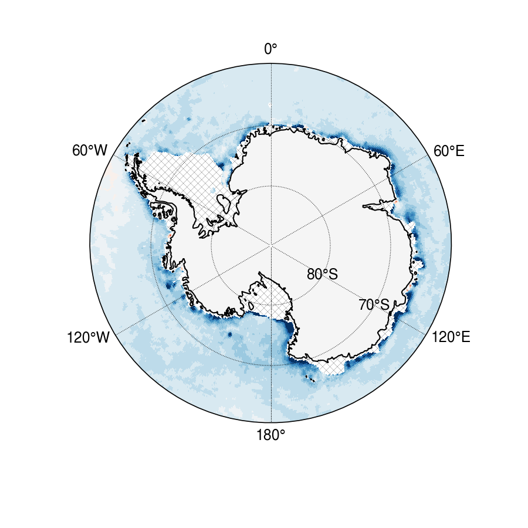
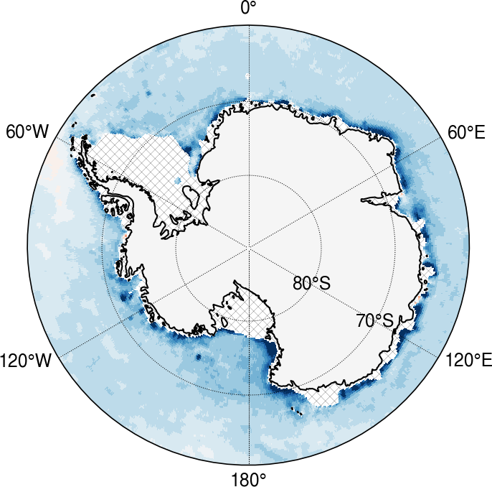
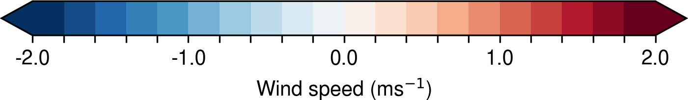
Effect of accounting for atmospheric stability
ERA5 minus ASCAT 10 m winds
ERA5 minus ASCAT 10 m neutral winds

Slide 7
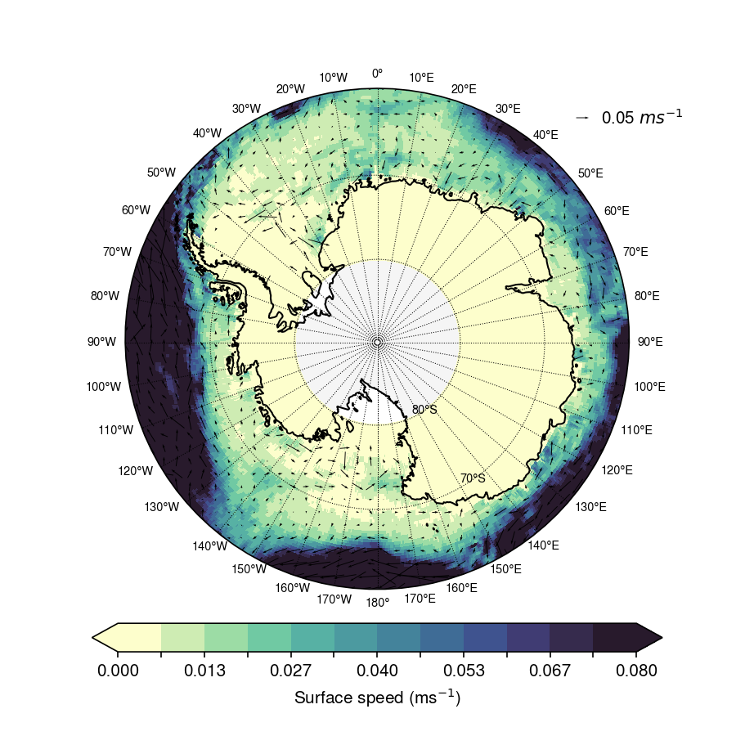
Ocean currents
ASCAT measures wind stress on a moving ocean surface
Reanalysis winds are Earth-relative
Accounting for ocean surface currents relieves much of an apparent positive zonal wind bias (i.e. too strong westerlies) in ERA5 relative to ASCAT (Rivas and Stoffelen, 2019)
Much weaker surface currents are present in the region of the coastal easterlies
South of 65°S the mean OSCAR surface speed is 0.08m/s for the 2010-2017 period
Given high uncertainties in ocean current estimates in the coastal region (the driving wind in OSCAR is itself ERA5), no correction is made but doing so may be expected to increase ASCAT winds overall
Figure 2: Mean surface speed (shaded) with motion vectors overlain from the OSCAR dataset
Notes:
Belmonte Rivas, Maria, and Ad Stoffelen. "Characterizing ERA-Interim and ERA5 surface wind biases using ASCAT." Ocean Science 15, no. 3 (2019): 831-852.

Slide 8
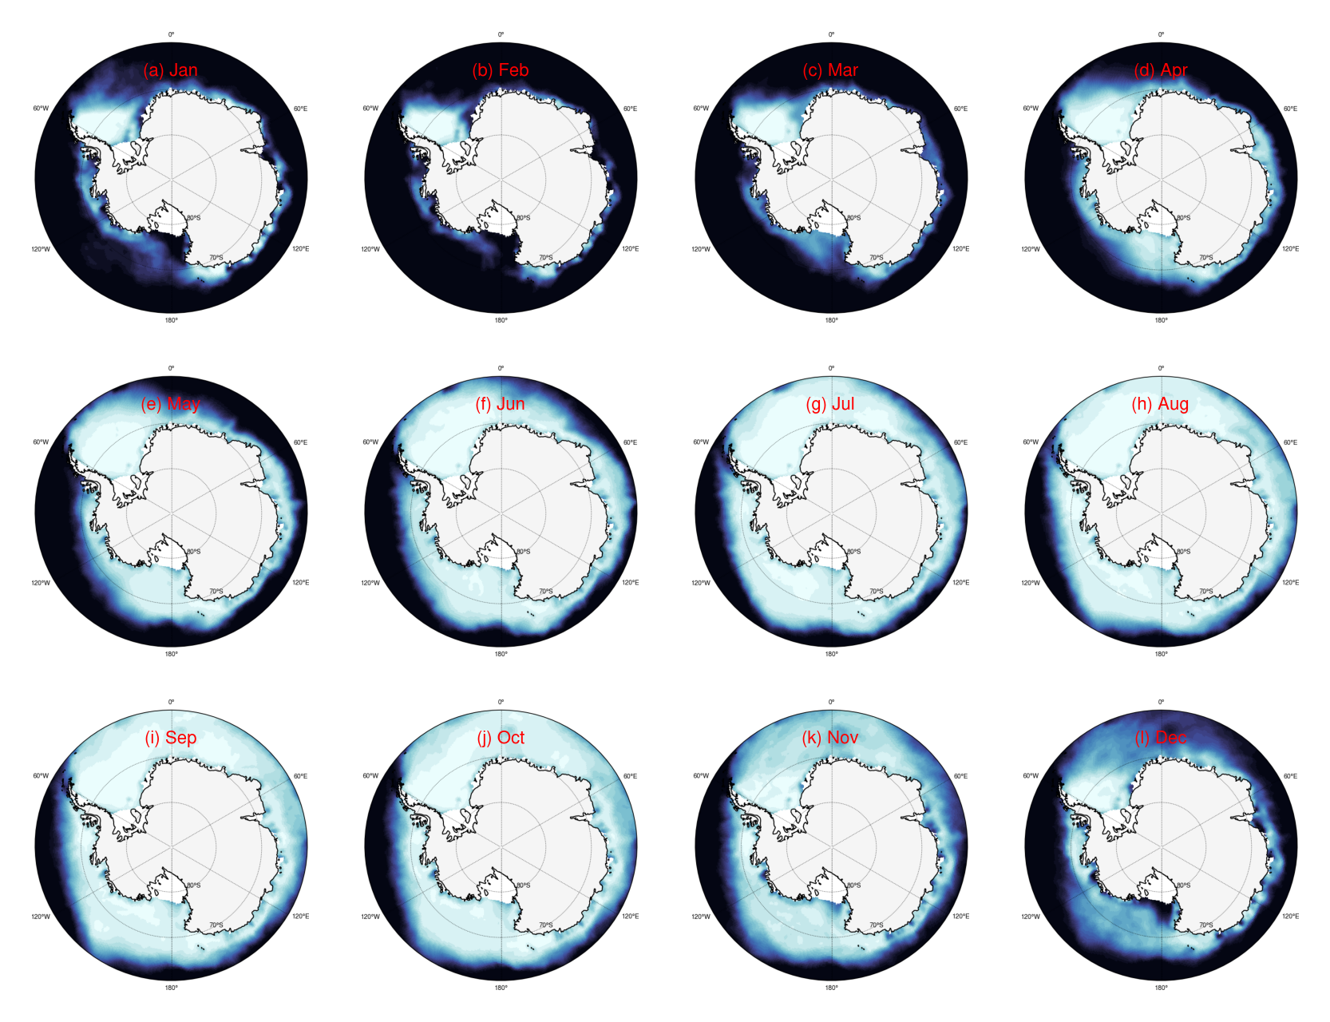
Sea ice

Slide 9
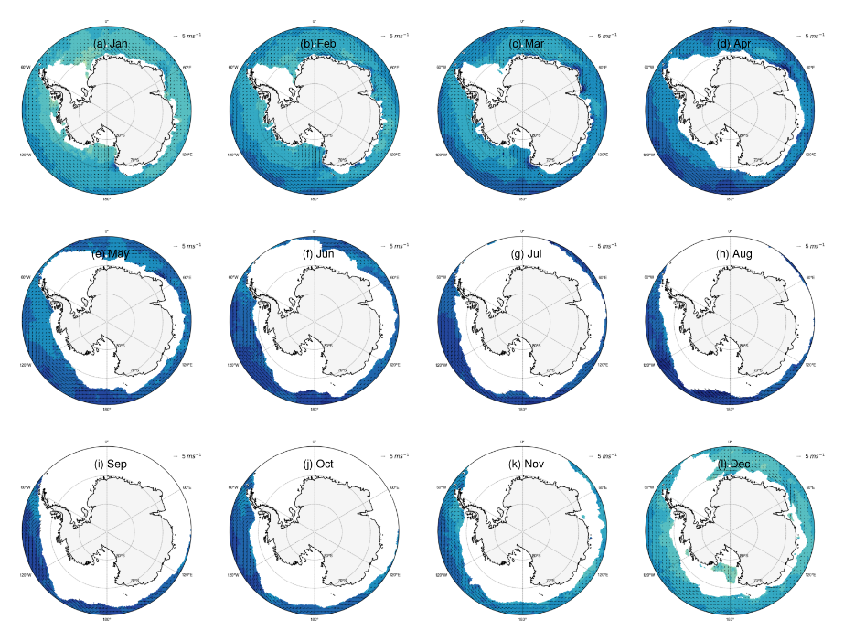
Sea ice

Slide 10
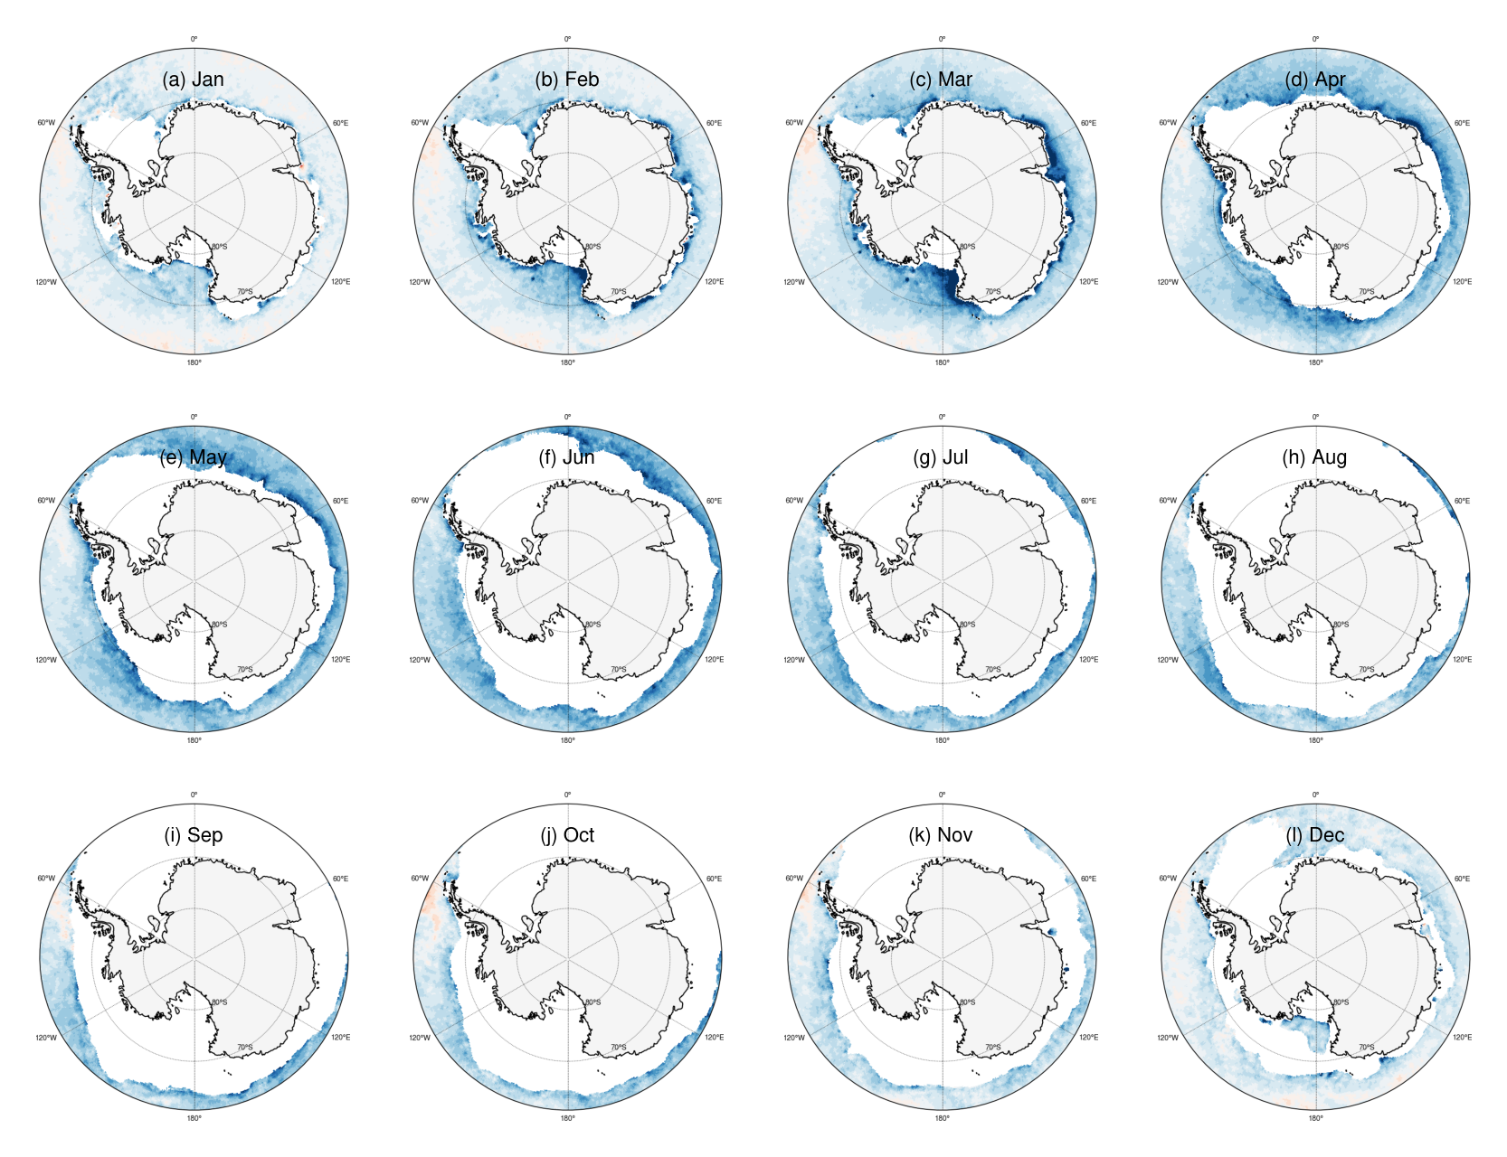
Monthly ERA5 minus ASCAT

Slide 11
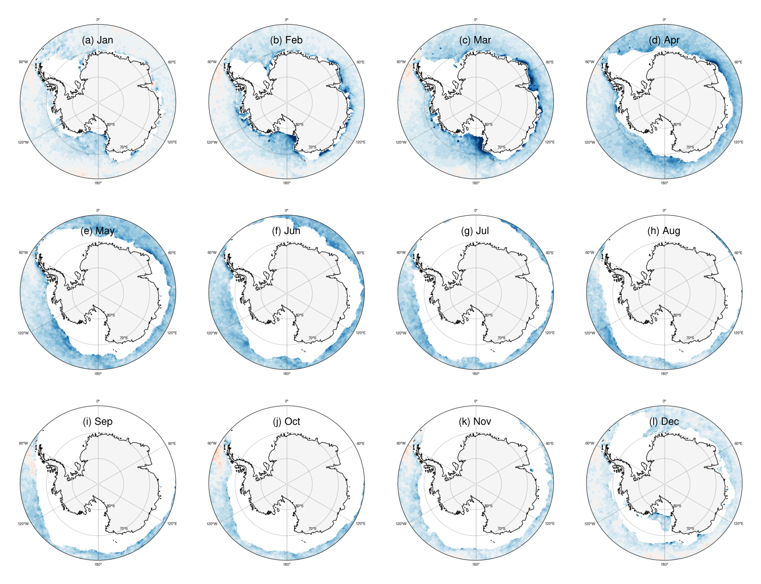
Effect of removing winds over ERA5 marginal ice

Slide 12
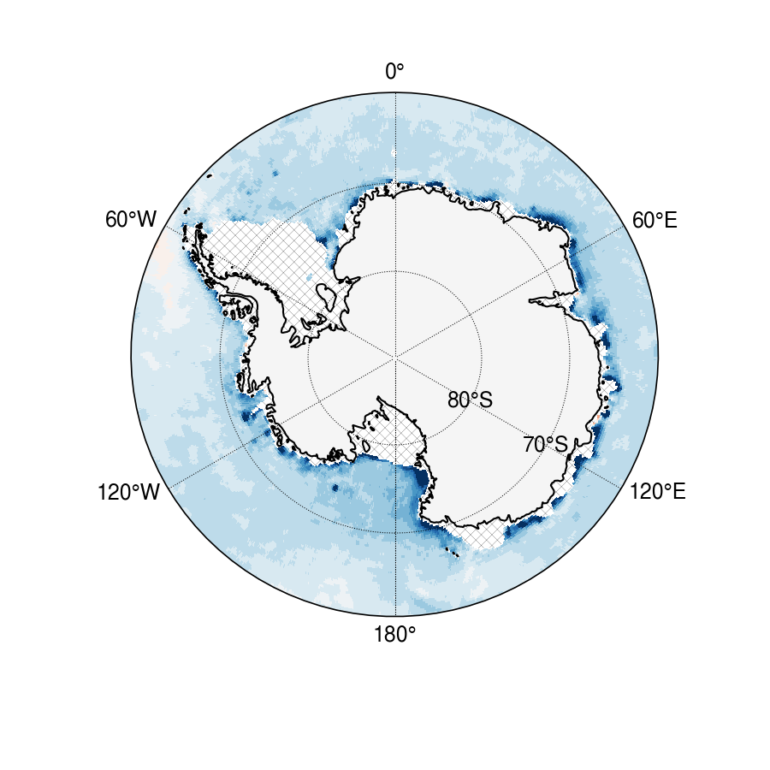
Effect of removing winds over ERA5 marginal ice
ERA5 minus ASCAT 10 m winds
ERA5 minus ASCAT 10 m winds with no marginal ice winds

Slide 13
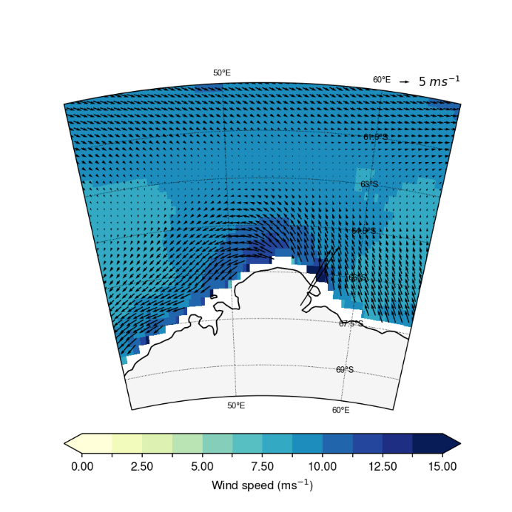
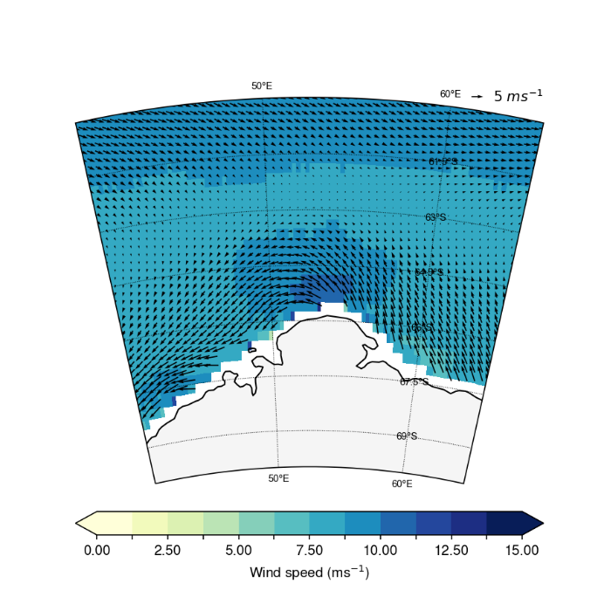
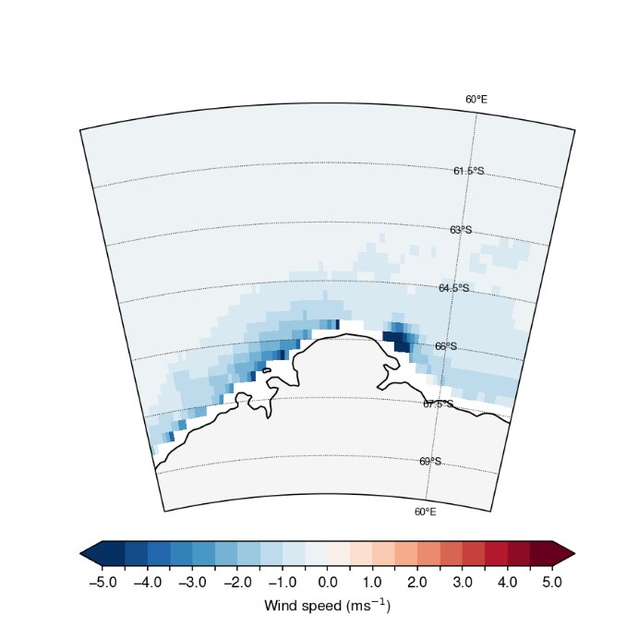
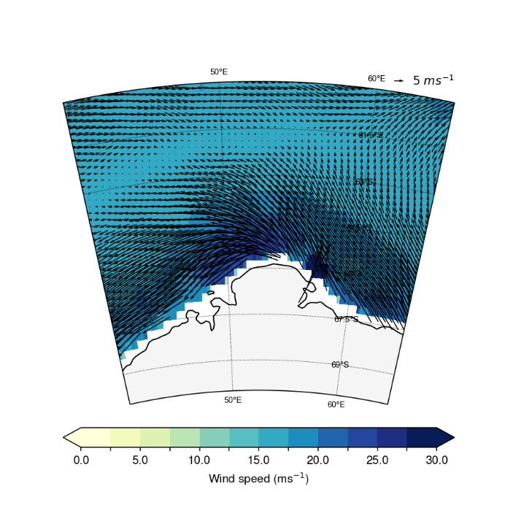
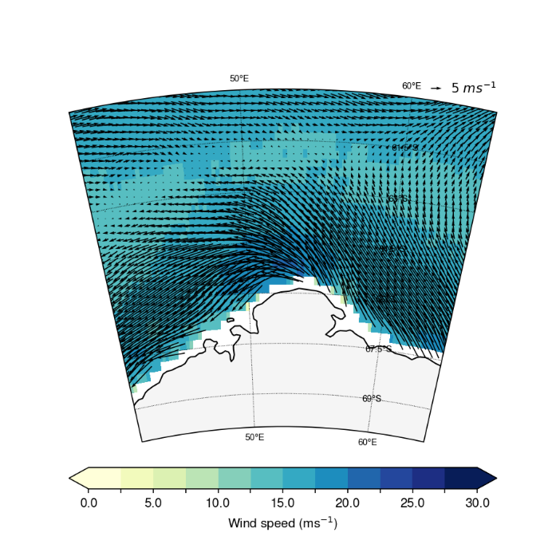
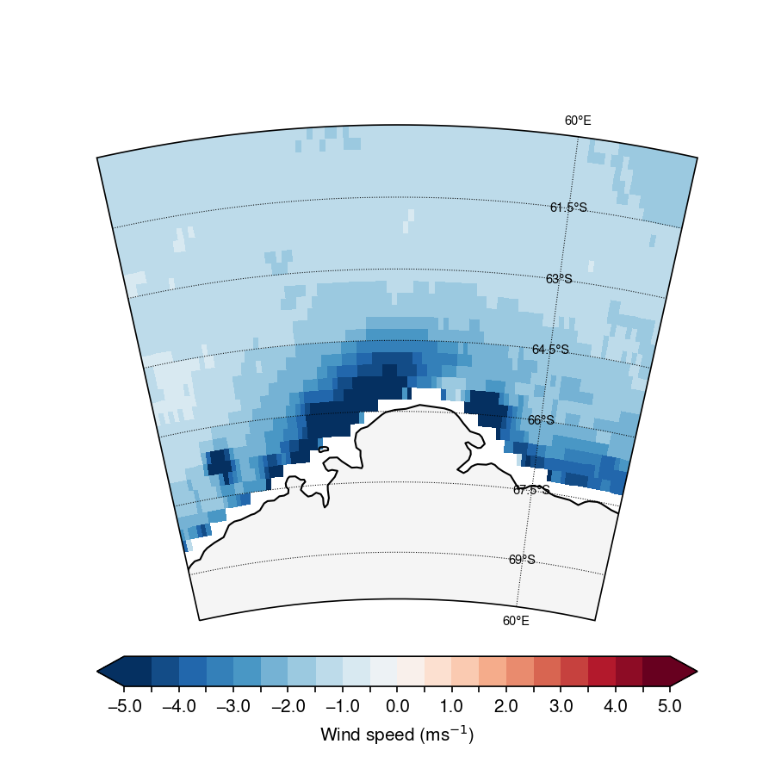
ASCAT high wind case study: Scott Mountains
ASCAT
ERA5
ERA5 minus ASCAT
Mean
Upper 10th percentile

Slide 14
Part 2: Self-organising map analysis at coastal stations

Slide 15
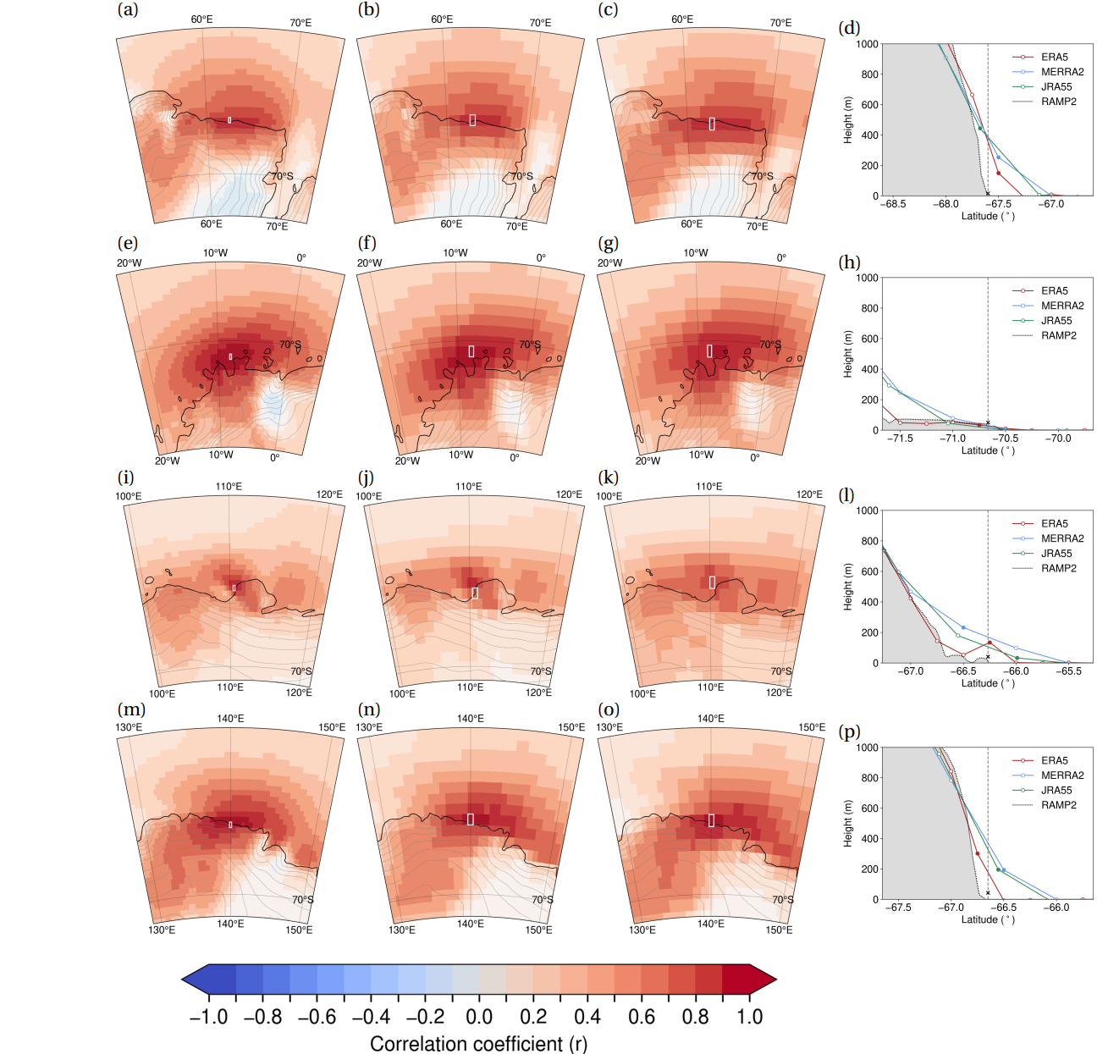
Collocating station data with reanalysis
Correlation coefficients between station data and reanalysis are highest over the collocated gridpoint in each reanalysis
Stations also appear to be representative of a large nearby region, except for Casey
At Casey, the Law Dome has a major impact on the flow
Smoothed orography generates a height offset between true station height and collocated reanalysis
Figure 2: Three left columns (ERA5 leftmost, MERRA-2 in the centre and JRA-55 the rightmost) show correlations between 10 m wind speed measured at surface stations with the local 10 m reanalysis wind field, with the selected nearest neighbour reanalysis gridpoint outlined in white. Rightmost column shows south-north cross sections through the location of the station, with orography from the RAMP2 dataset shaded in grey and reanalysis orography from ERA5 (red), MERRA-2 (blue) and JRA-55 (green) indicated as a line. Filled markers on the lines mark the respective nearest neighbour reanalysis gridpoint. Shown are Mawson (a-d), Neumayer (e-h), Casey (i-l) and DDU (m-p).

Slide 16
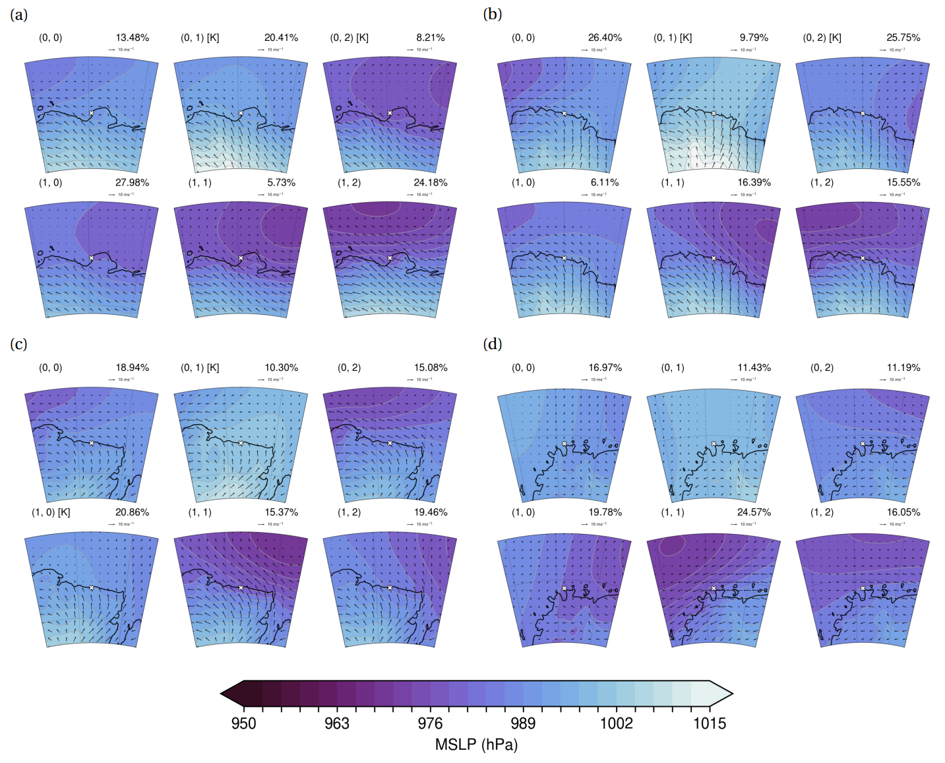
Figure 2: Composited ERA5 mean sea-level pressure (MSLP) with 10 m wind vectors for each node at (a) Casey, (b) DDU, (c) Mawson and (d) Neumayer from SOMs calculated for the period 2010-2017. Station locations are marked as a white cross. Katabatic-dominated nodes are labeled with a [K].

Slide 17
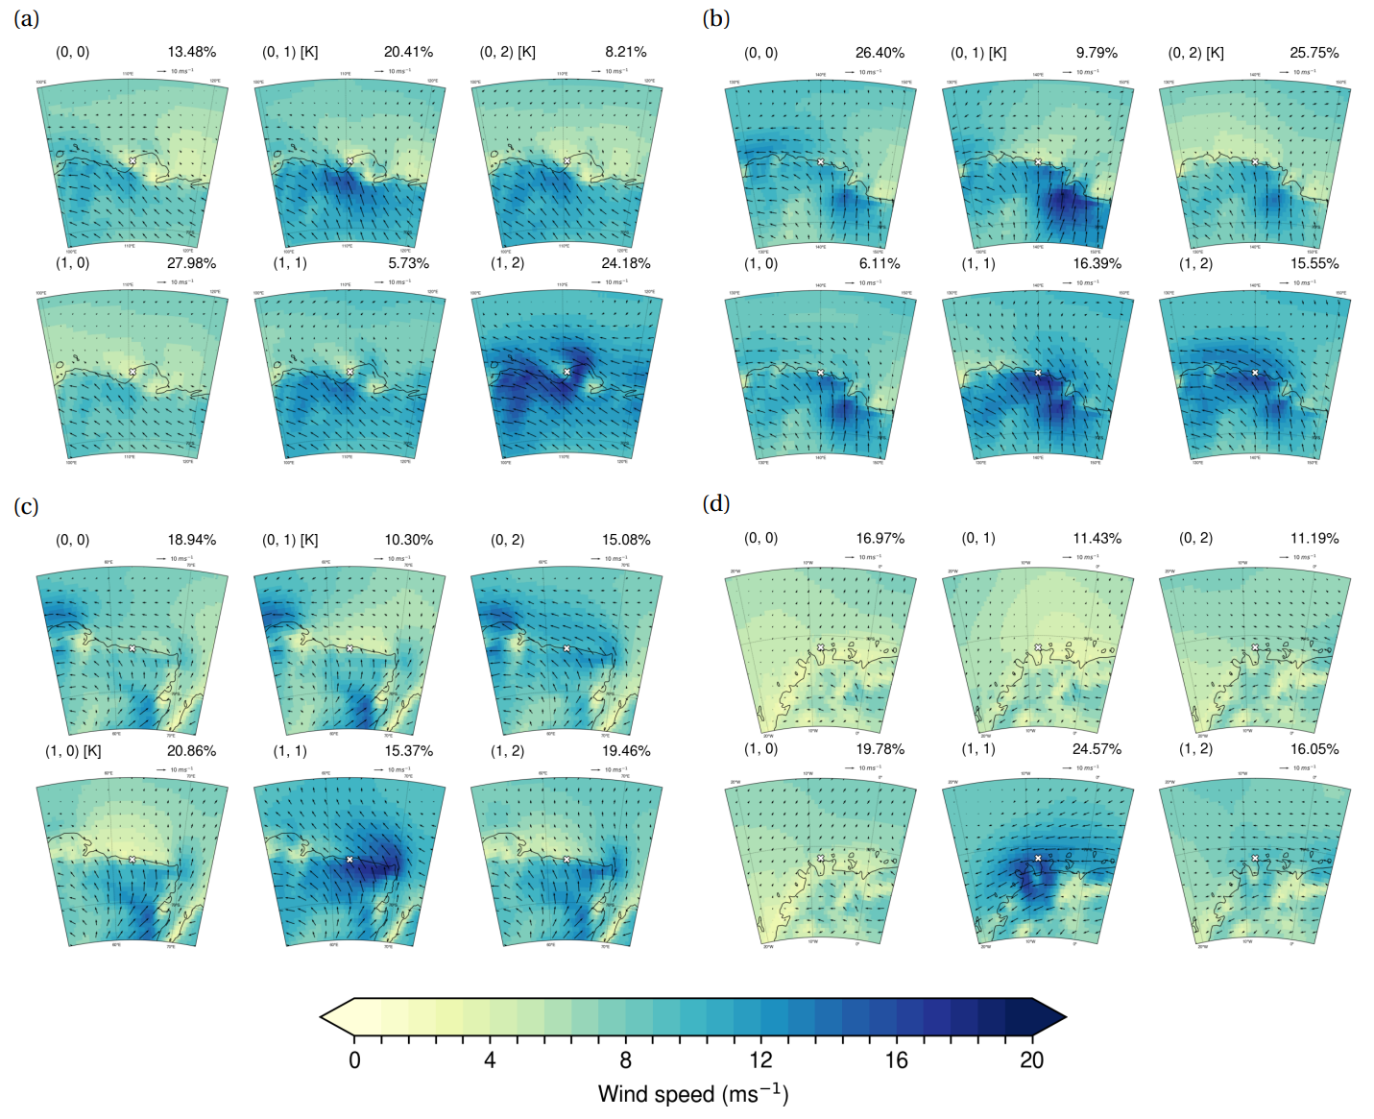
Figure 2: Composited ERA5 10 m wind speed with 10 m wind vectors overlain for each node at (a) Casey, (b) DDU, (c) Mawson and (d) Neumayer from SOMs calculated for the period 2010-2017. Station locations are marked as a white cross. Katabatic-dominated nodes are labeled with a [K].

Slide 18
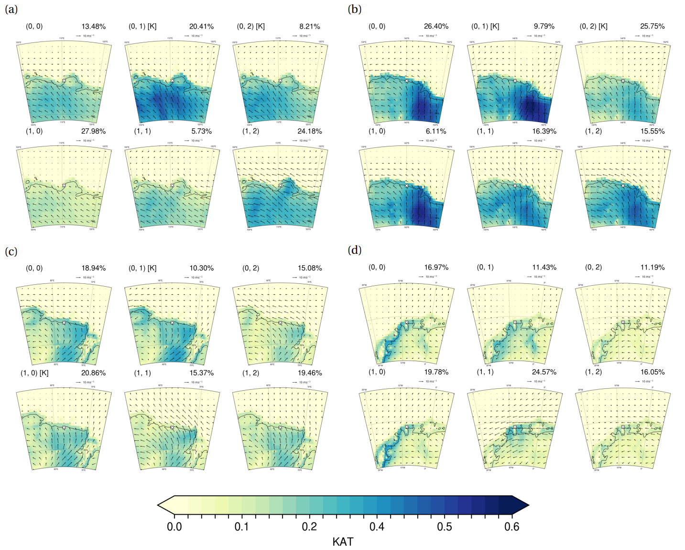
Figure 2: Composited ERA5 katabatic acceleration term with 10 m wind vectors overlain for each node at (a) Casey, (b) DDU, (c) Mawson and (d) Neumayer from SOMs calculated for the period 2010-2017. Station locations are marked as a white cross. Katabatic-dominated nodes are labeled with a [K].

Slide 19
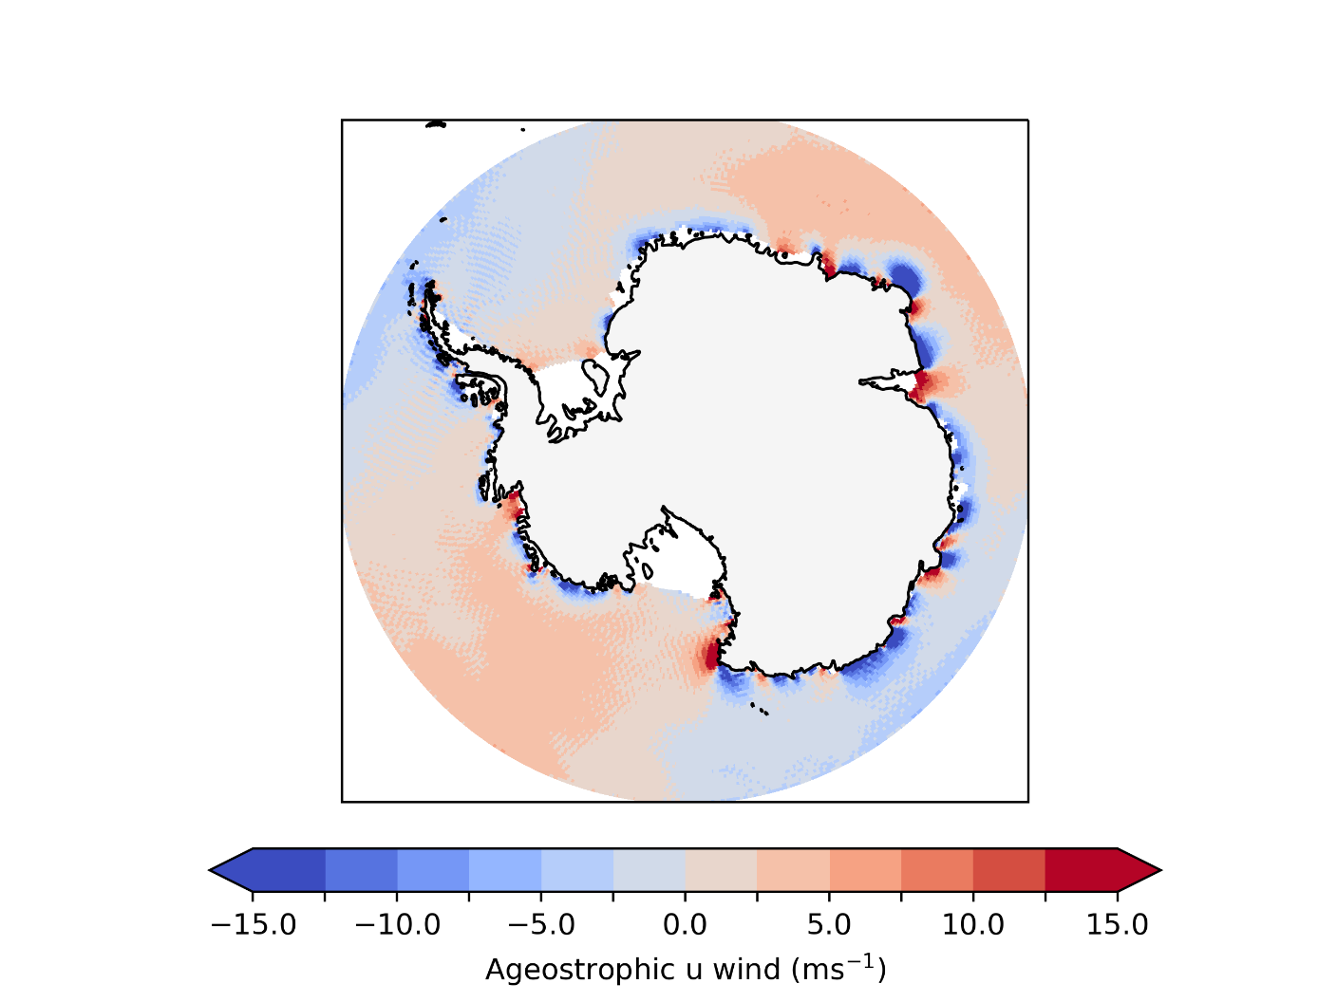
Ageostrophic coastal winds in ERA5
Figure 2: ERA5 900 hPa ageostrophic u wind mean for the period 2010-2017
Blue indicates the 900 hPa u-wind is more negative (i.e. stronger easterlies) relative to the geostrophic wind
The East Antarctic coastal margins include many regions of supergeostrophic and subgeostrophic flow induced by blocking, barrier flow and tip jets
Enderby land (black box region) identified in Sampe and Xie (2007) as the second most frequent marine high wind region in the world based on multiyear QuickSCAT observations
Notes:
Sampe, T. and Xie, S.P., 2007. Mapping high sea winds from space: A global climatology. Bulletin of the American Meteorological Society, 88(12), pp.1965-1978.

Slide 20
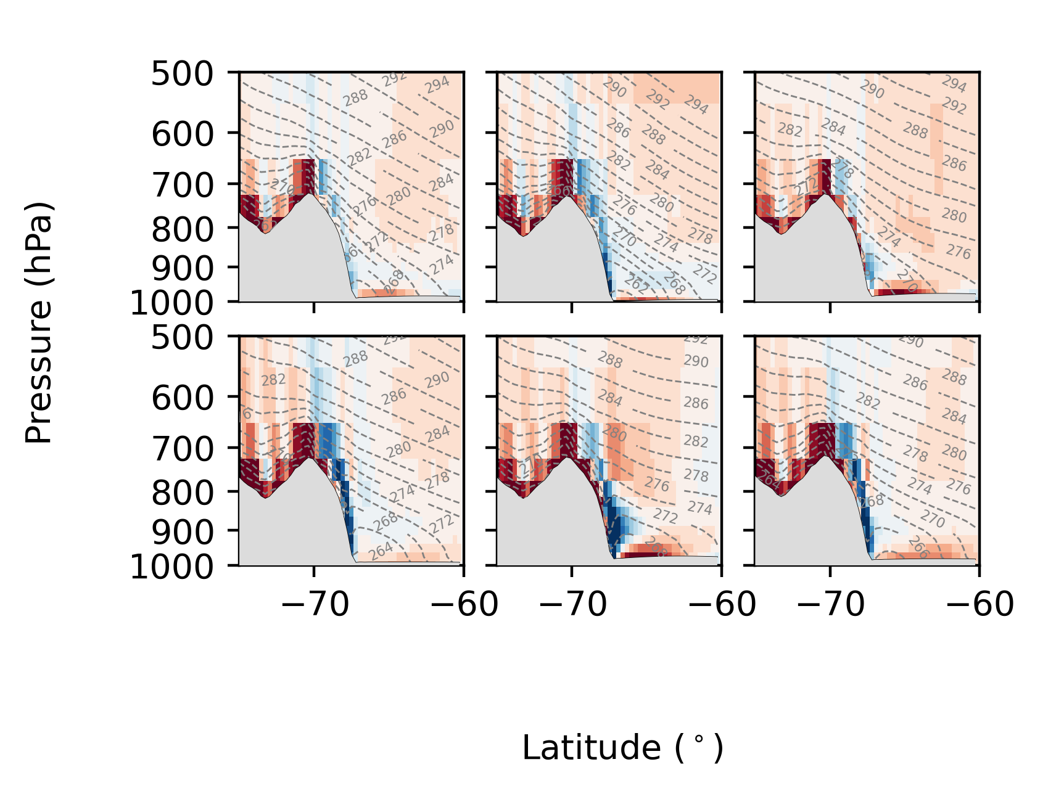
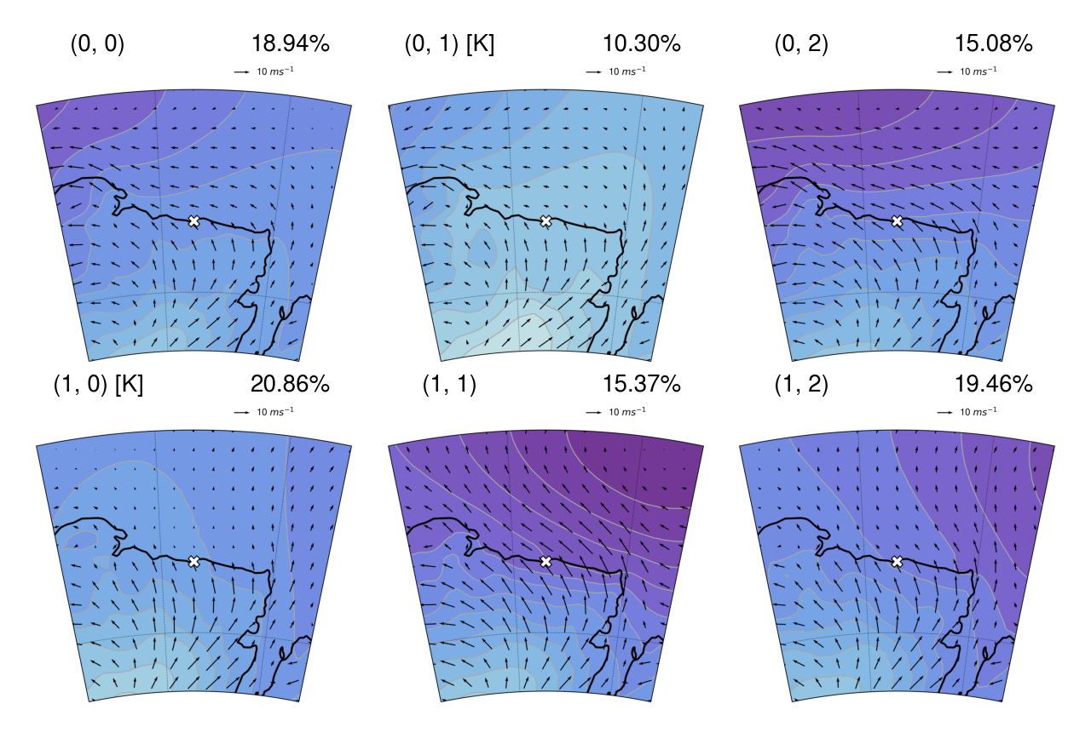

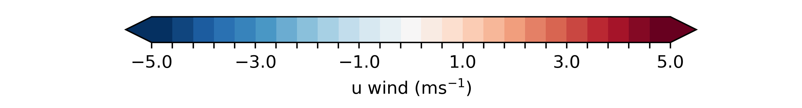
Ageostrophic coastal winds in ERA5 at Mawson

Slide 21
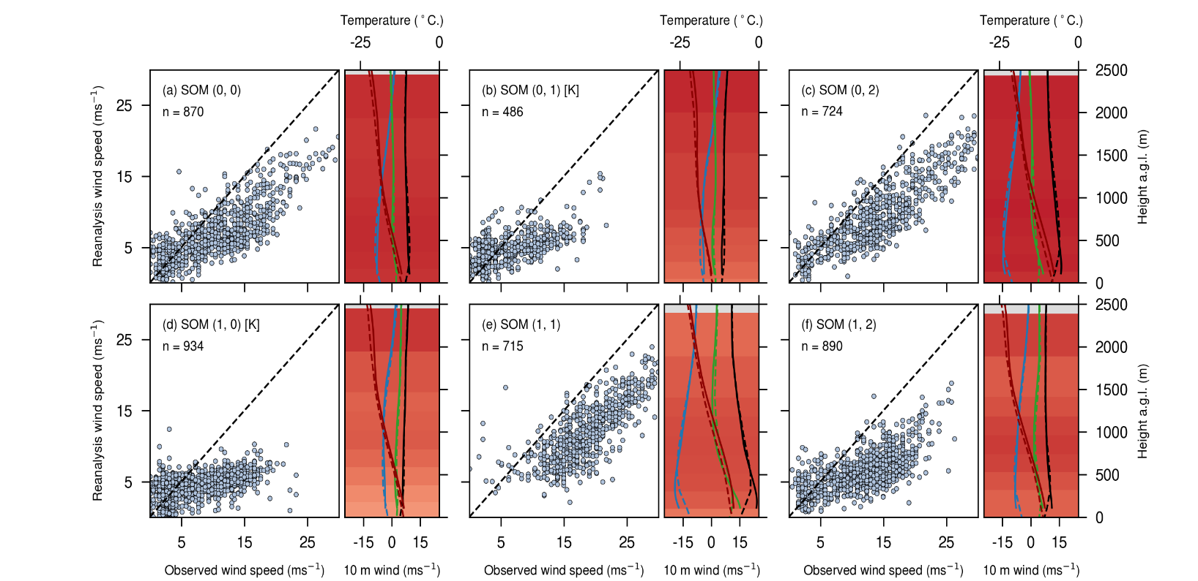
Variability: self-organising map states at coastal stations Mawson
Figure 3: Composited ERA5 mean sea-level pressure (MSLP) with 10 m wind vectors for each node at Mawson from SOMs calculated for the period 2010-2017. Station locations are marked as a white cross. Katabatic-dominated nodes are labeled with a [K].
Figure 4: ERA5-observation wind intercomparison by SOM node for the period 2010-2017. For each node, left panels are scatterplots of observed vs reanalysis 10 m wind speeds. The right panels are vertical profiles of mean wind speed (black), u wind (blue), v wind (green) and temperature (red) from observations (solid) and reanalysis (dashed) for that node. Shading in the background of each profile indicates the correlation coefficient between observed and reanalysis wind speed at that level. Katabatic-dominated nodes are labeled with a [K].

Slide 22
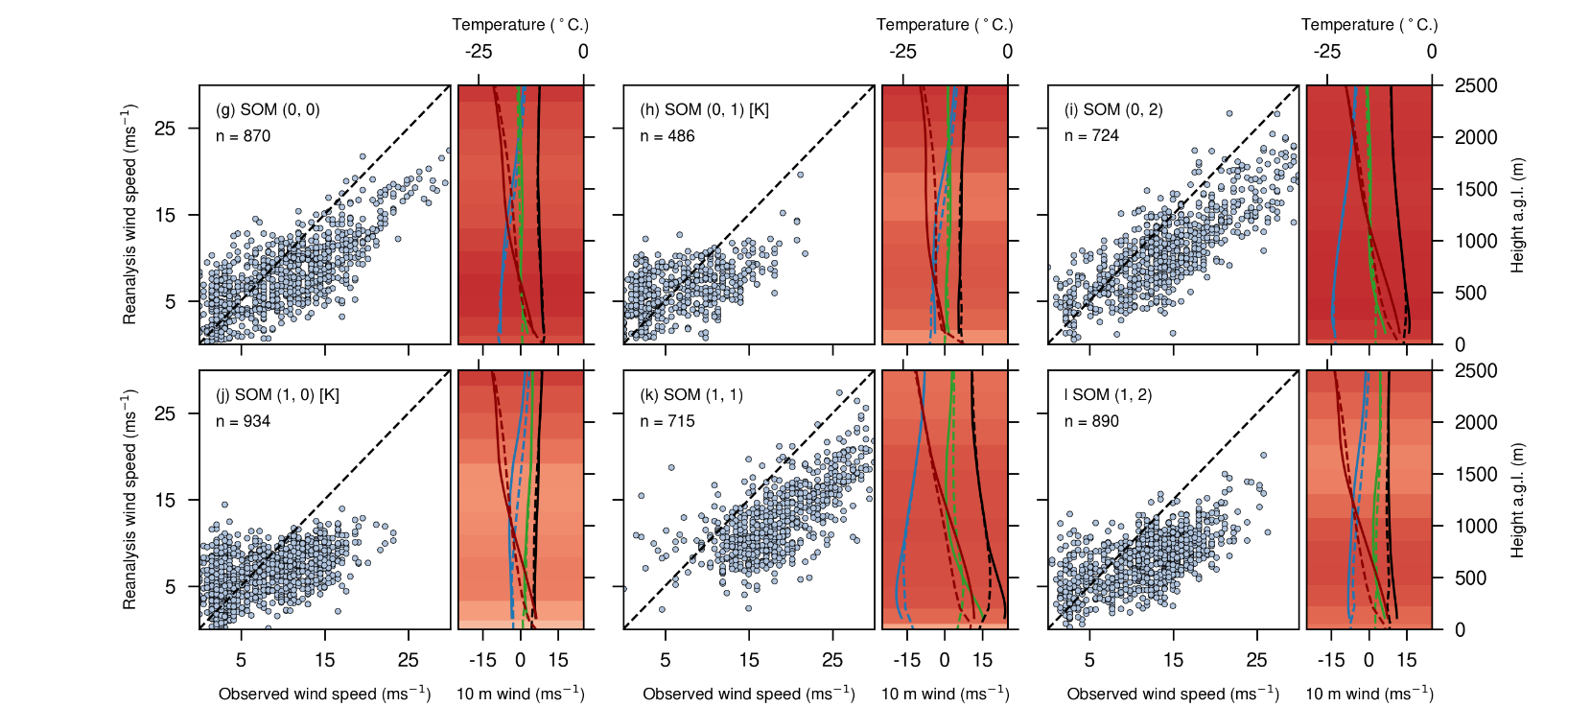
Variability: self-organising map states at coastal stations Mawson
Figure 3: Composited ERA5 mean sea-level pressure (MSLP) with 10 m wind vectors for each node at Mawson from SOMs calculated for the period 2010-2017. Station locations are marked as a white cross. Katabatic-dominated nodes are labeled with a [K].
Figure 4: MERRA-2-observation wind intercomparison by SOM node for the period 2010-2017. For each node, left panels are scatterplots of observed vs reanalysis 10 m wind speeds. The right panels are vertical profiles of mean wind speed (black), u wind (blue), v wind (green) and temperature (red) from observations (solid) and reanalysis (dashed) for that node. Shading in the background of each profile indicates the correlation coefficient between observed and reanalysis wind speed at that level. Katabatic-dominated nodes are labeled with a [K].

Slide 23
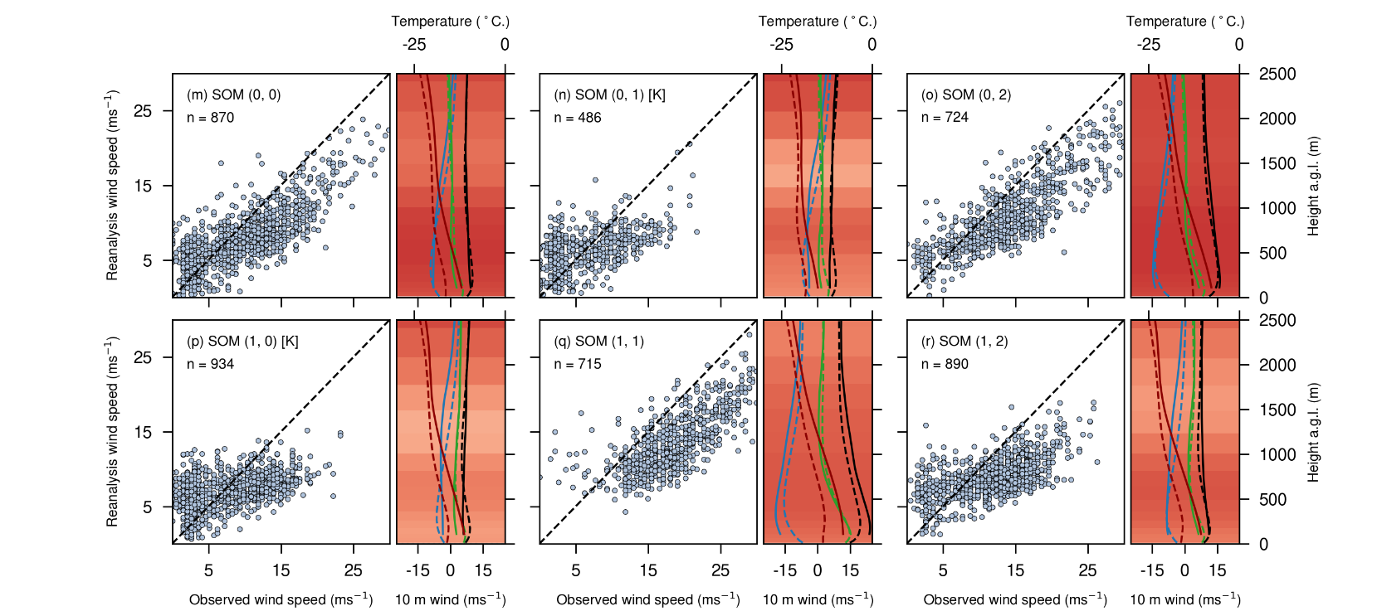
Variability: self-organising map states at coastal stations Mawson
Figure 3: Composited ERA5 mean sea-level pressure (MSLP) with 10 m wind vectors for each node at Mawson from SOMs calculated for the period 2010-2017. Station locations are marked as a white cross. Katabatic-dominated nodes are labeled with a [K].
Figure 4: JRA-55-observation wind intercomparison by SOM node for the period 2010-2017. For each node, left panels are scatterplots of observed vs reanalysis 10 m wind speeds. The right panels are vertical profiles of mean wind speed (black), u wind (blue), v wind (green) and temperature (red) from observations (solid) and reanalysis (dashed) for that node. Shading in the background of each profile indicates the correlation coefficient between observed and reanalysis wind speed at that level. Katabatic-dominated nodes are labeled with a [K].

Slide 24
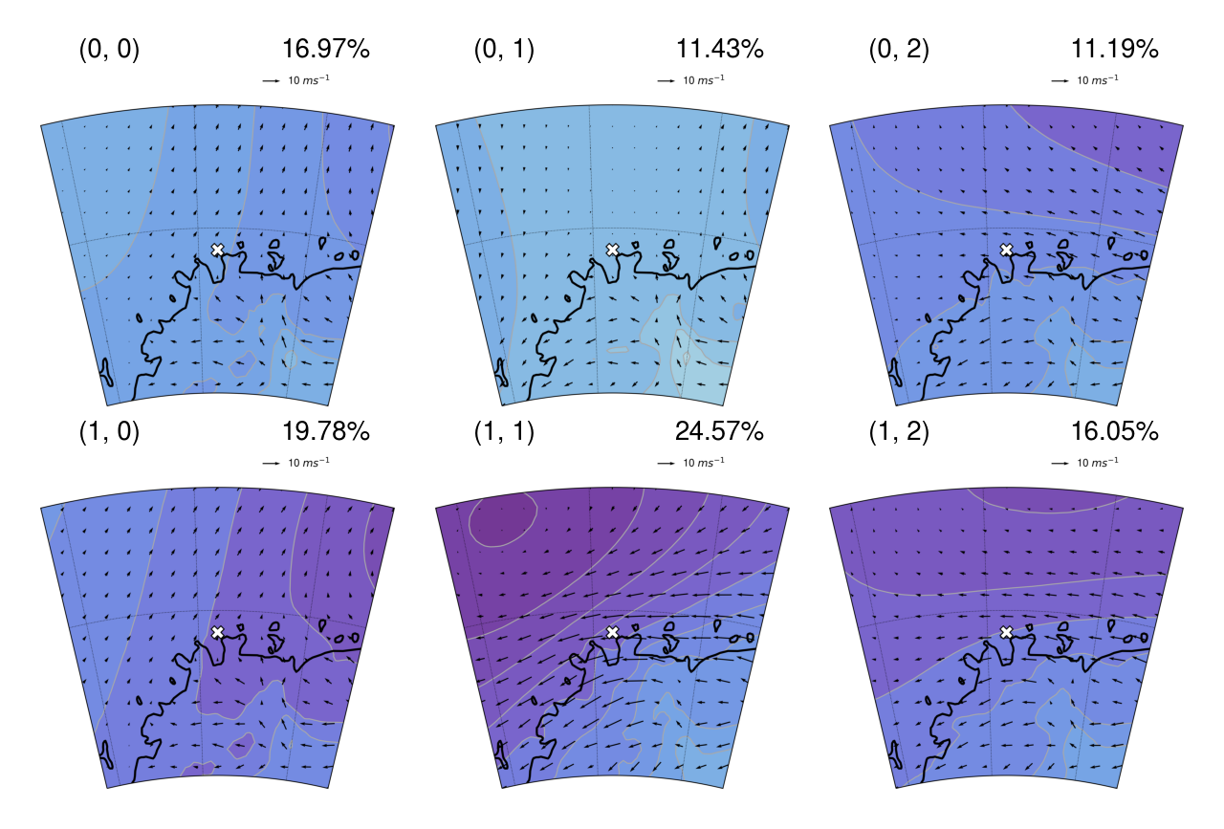
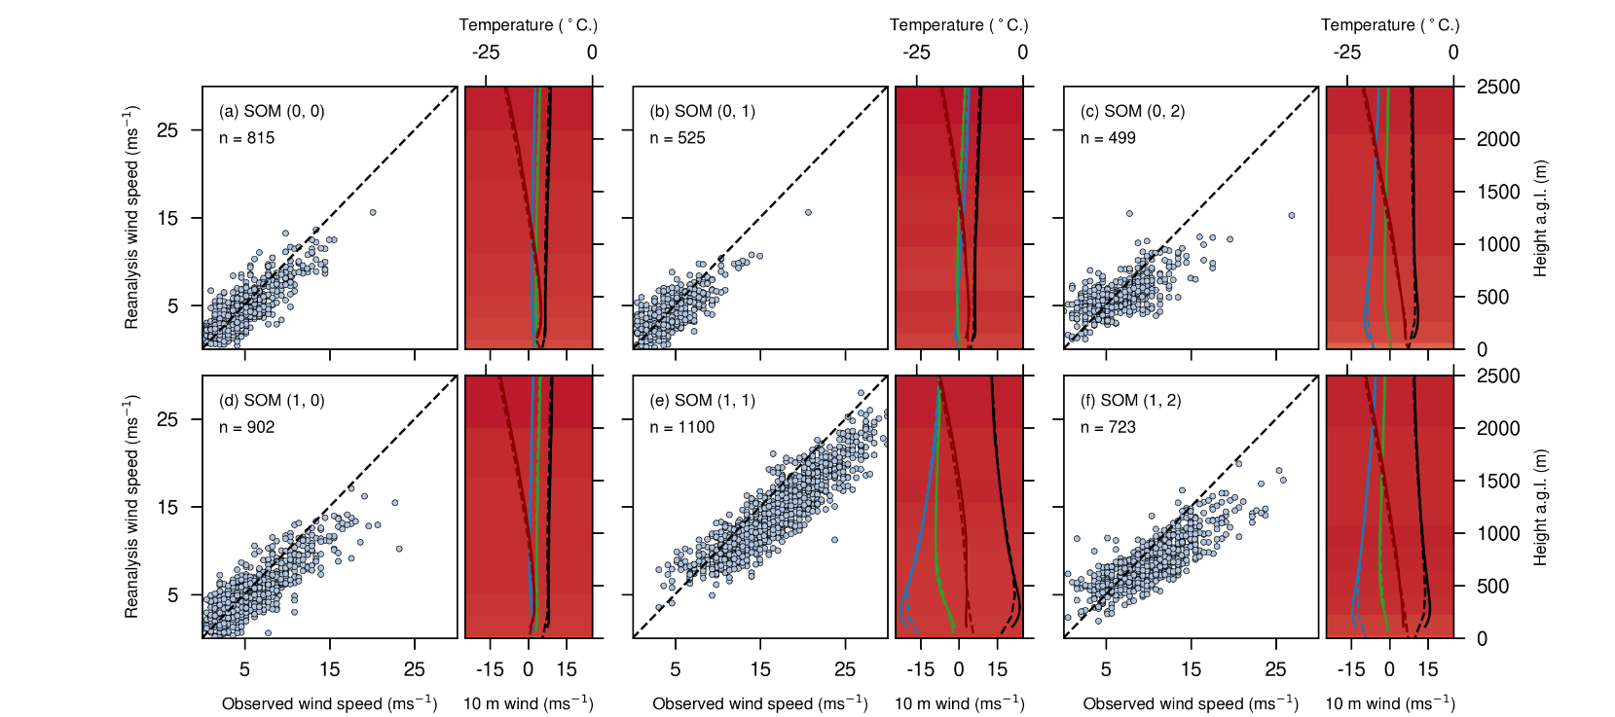
Variability: self-organising map states at coastal stations Neumayer
Figure 3: Composited ERA5 mean sea-level pressure (MSLP) with 10 m wind vectors for each node at Neumayer from SOMs calculated for the period 2010-2017. Station locations are marked as a white cross. Katabatic-dominated nodes are labeled with a [K].
Figure 4: ERA5-observation wind intercomparison by SOM node for the period 2010-2017. For each node, left panels are scatterplots of observed vs reanalysis 10 m wind speeds. The right panels are vertical profiles of mean wind speed (black), u wind (blue), v wind (green) and temperature (red) from observations (solid) and reanalysis (dashed) for that node. Shading in the background of each profile indicates the correlation coefficient between observed and reanalysis wind speed at that level. Katabatic-dominated nodes are labeled with a [K].

Slide 25
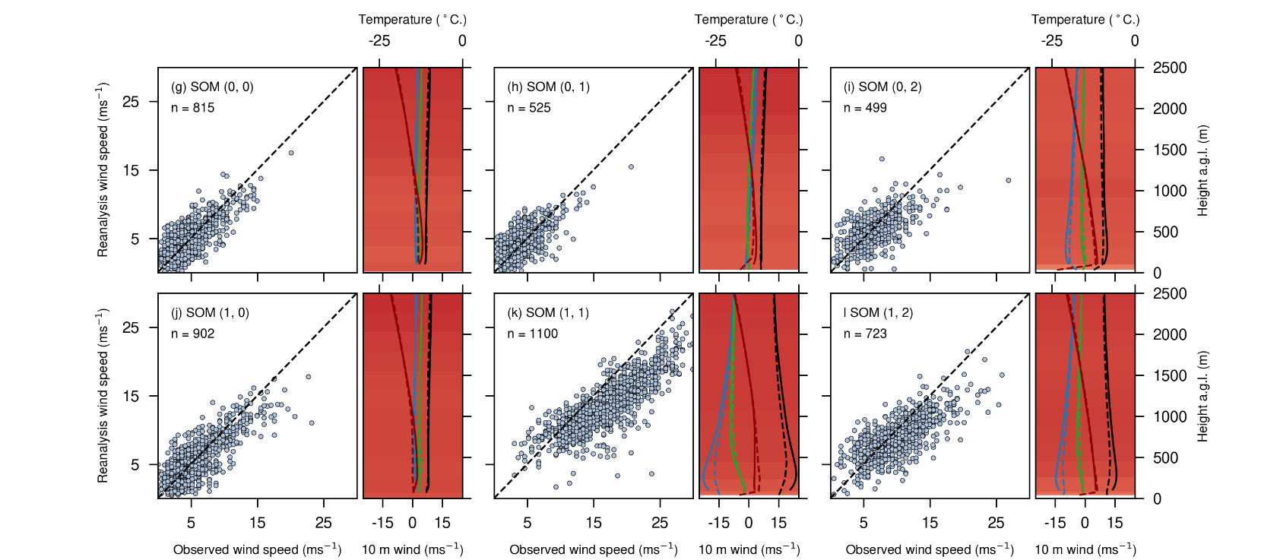
Variability: self-organising map states at coastal stations Neumayer
Figure 3: Composited ERA5 mean sea-level pressure (MSLP) with 10 m wind vectors for each node at Neumayer from SOMs calculated for the period 2010-2017. Station locations are marked as a white cross. Katabatic-dominated nodes are labeled with a [K].
Figure 4: MERRA-2-observation wind intercomparison by SOM node for the period 2010-2017. For each node, left panels are scatterplots of observed vs reanalysis 10 m wind speeds. The right panels are vertical profiles of mean wind speed (black), u wind (blue), v wind (green) and temperature (red) from observations (solid) and reanalysis (dashed) for that node. Shading in the background of each profile indicates the correlation coefficient between observed and reanalysis wind speed at that level. Katabatic-dominated nodes are labeled with a [K].

Slide 26
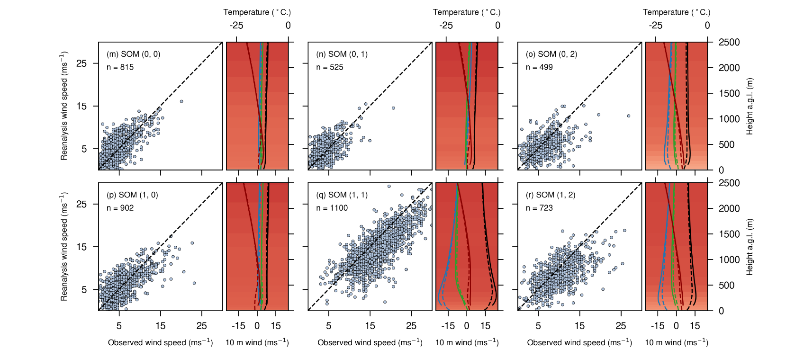
Variability: self-organising map states at coastal stations Neumayer
Figure 3: Composited ERA5 mean sea-level pressure (MSLP) with 10 m wind vectors for each node at Neumayer from SOMs calculated for the period 2010-2017. Station locations are marked as a white cross. Katabatic-dominated nodes are labeled with a [K].
Figure 4: JRA-55-observation wind intercomparison by SOM node for the period 2010-2017. For each node, left panels are scatterplots of observed vs reanalysis 10 m wind speeds. The right panels are vertical profiles of mean wind speed (black), u wind (blue), v wind (green) and temperature (red) from observations (solid) and reanalysis (dashed) for that node. Shading in the background of each profile indicates the correlation coefficient between observed and reanalysis wind speed at that level. Katabatic-dominated nodes are labeled with a [K].

Slide 27
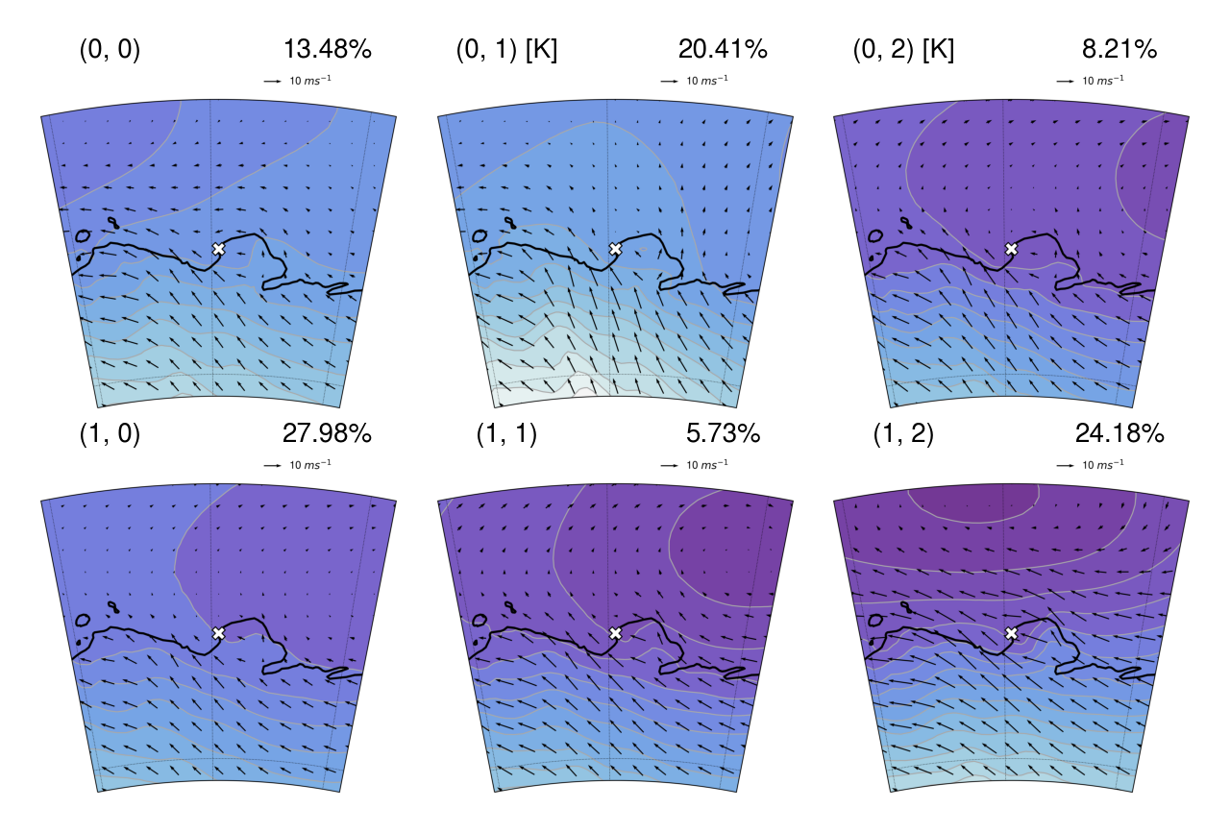
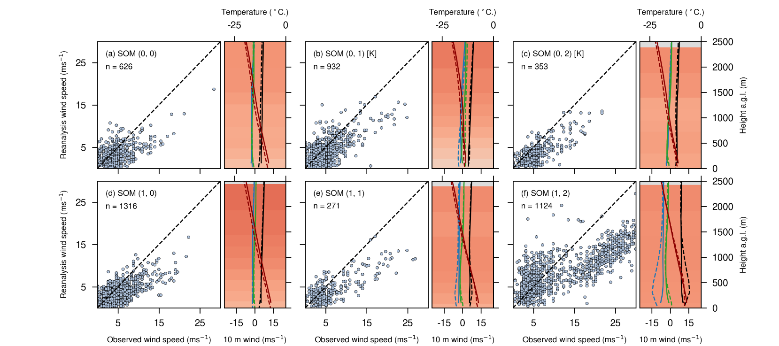
Variability: self-organising map states at coastal stations Casey
Figure 3: Composited ERA5 mean sea-level pressure (MSLP) with 10 m wind vectors for each node at Casey from SOMs calculated for the period 2010-2017. Station locations are marked as a white cross. Katabatic-dominated nodes are labeled with a [K].
Figure 4: ERA5-observation wind intercomparison by SOM node for the period 2010-2017. For each node, left panels are scatterplots of observed vs reanalysis 10 m wind speeds. The right panels are vertical profiles of mean wind speed (black), u wind (blue), v wind (green) and temperature (red) from observations (solid) and reanalysis (dashed) for that node. Shading in the background of each profile indicates the correlation coefficient between observed and reanalysis wind speed at that level. Katabatic-dominated nodes are labeled with a [K].

Slide 28
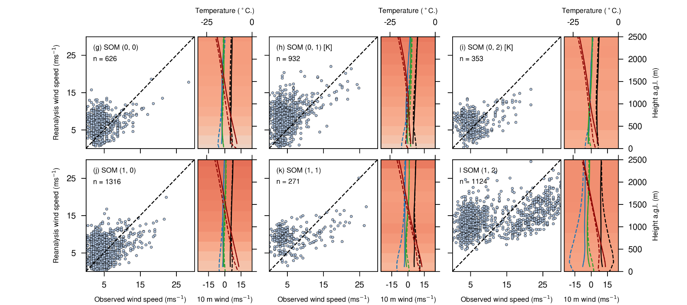
Variability: self-organising map states at coastal stations Casey
Figure 3: Composited ERA5 mean sea-level pressure (MSLP) with 10 m wind vectors for each node at Casey from SOMs calculated for the period 2010-2017. Station locations are marked as a white cross. Katabatic-dominated nodes are labeled with a [K].
Figure 4: MERRA-2-observation wind intercomparison by SOM node for the period 2010-2017. For each node, left panels are scatterplots of observed vs reanalysis 10 m wind speeds. The right panels are vertical profiles of mean wind speed (black), u wind (blue), v wind (green) and temperature (red) from observations (solid) and reanalysis (dashed) for that node. Shading in the background of each profile indicates the correlation coefficient between observed and reanalysis wind speed at that level. Katabatic-dominated nodes are labeled with a [K].

Slide 29
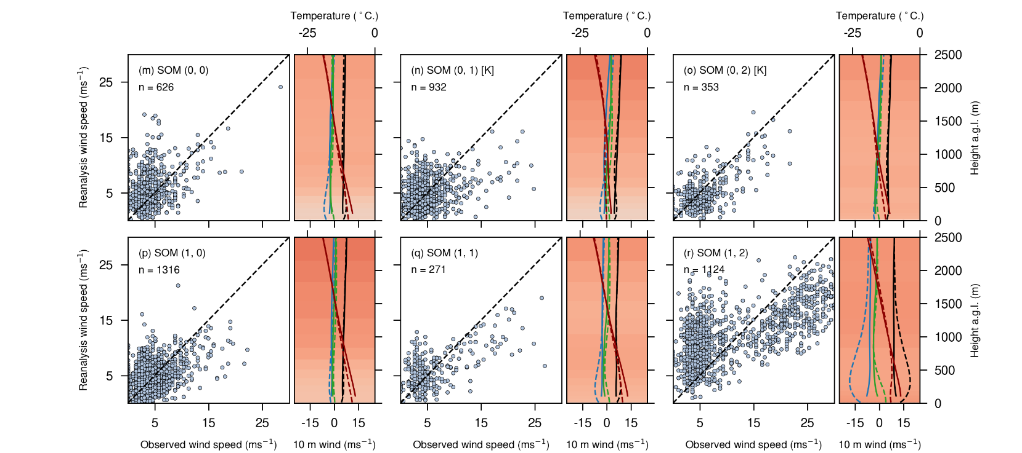
Variability: self-organising map states at coastal stations Casey
Figure 3: Composited ERA5 mean sea-level pressure (MSLP) with 10 m wind vectors for each node at Casey from SOMs calculated for the period 2010-2017. Station locations are marked as a white cross. Katabatic-dominated nodes are labeled with a [K].
Figure 4: JRA-55-observation wind intercomparison by SOM node for the period 2010-2017. For each node, left panels are scatterplots of observed vs reanalysis 10 m wind speeds. The right panels are vertical profiles of mean wind speed (black), u wind (blue), v wind (green) and temperature (red) from observations (solid) and reanalysis (dashed) for that node. Shading in the background of each profile indicates the correlation coefficient between observed and reanalysis wind speed at that level. Katabatic-dominated nodes are labeled with a [K].

Slide 30
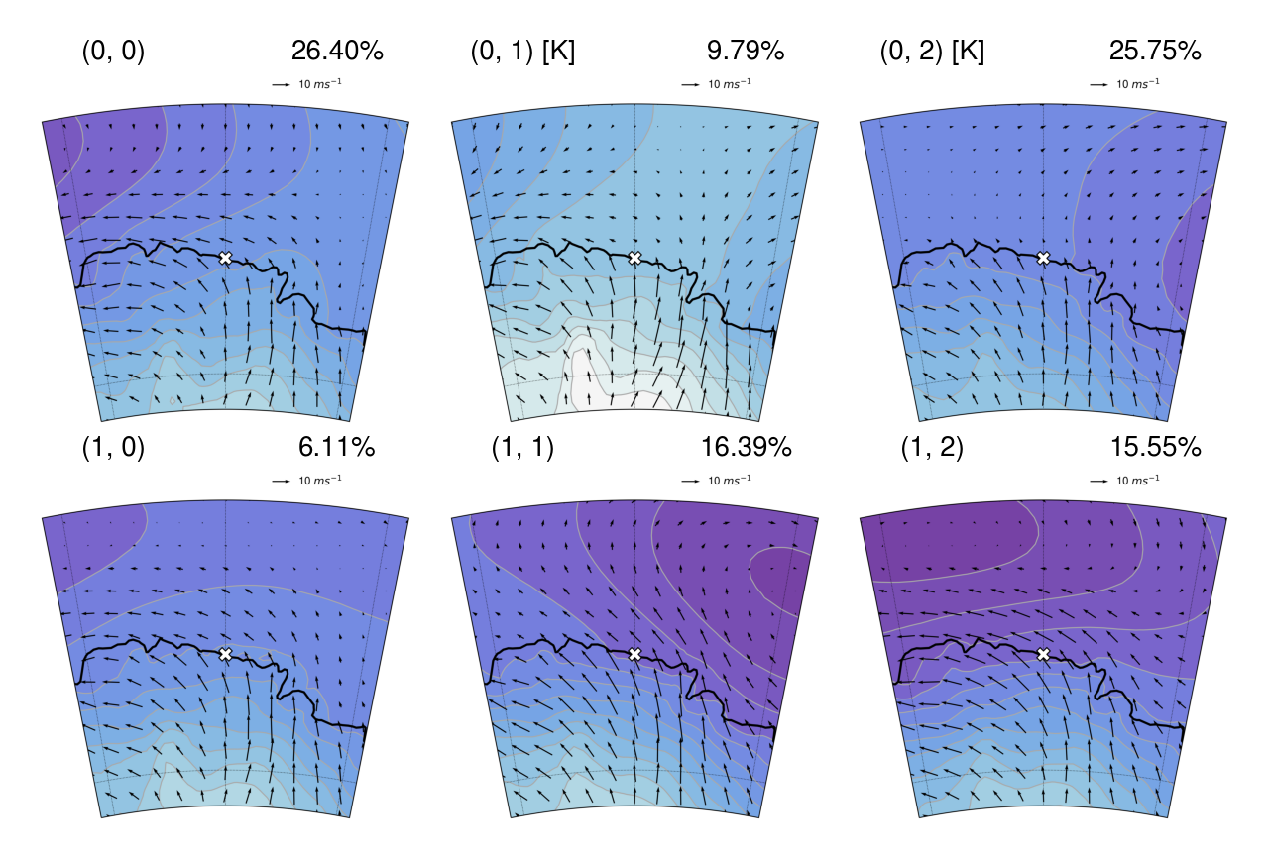
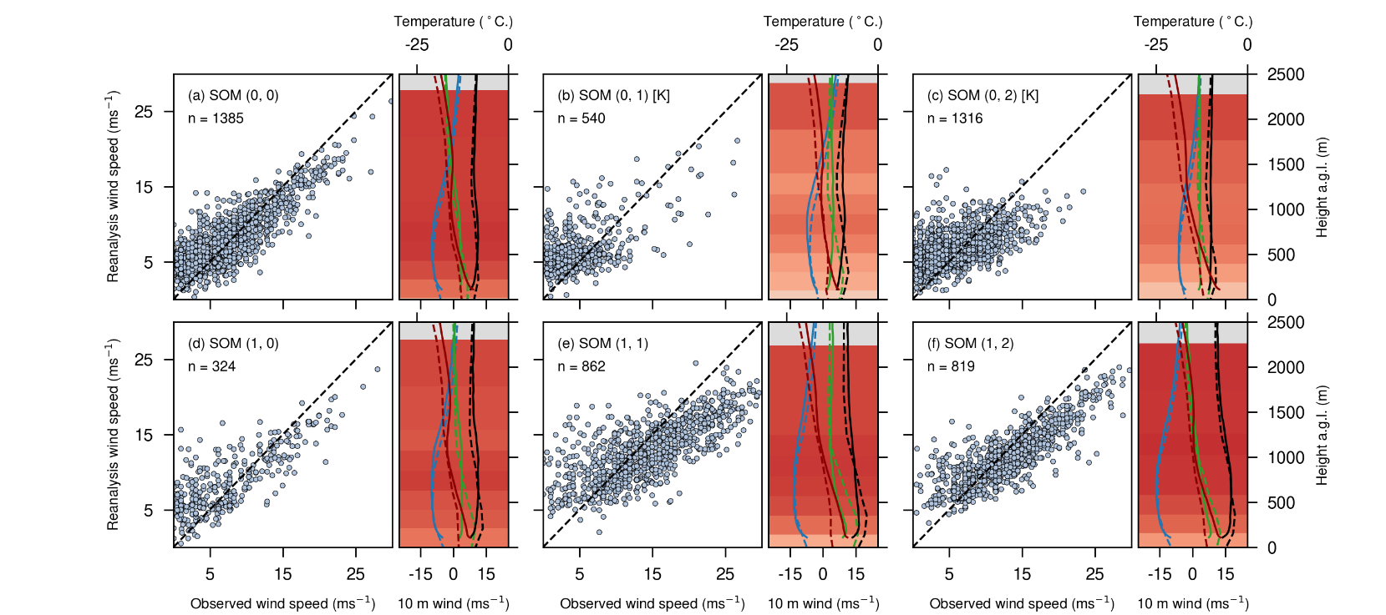
Variability: self-organising map states at coastal stations Dumont D’Urville
Figure 3: Composited ERA5 mean sea-level pressure (MSLP) with 10 m wind vectors for each node at DDU from SOMs calculated for the period 2010-2017. Station locations are marked as a white cross. Katabatic-dominated nodes are labeled with a [K].
Figure 4: ERA5-observation wind intercomparison by SOM node for the period 2010-2017. For each node, left panels are scatterplots of observed vs reanalysis 10 m wind speeds. The right panels are vertical profiles of mean wind speed (black), u wind (blue), v wind (green) and temperature (red) from observations (solid) and reanalysis (dashed) for that node. Shading in the background of each profile indicates the correlation coefficient between observed and reanalysis wind speed at that level. Katabatic-dominated nodes are labeled with a [K].

Slide 31
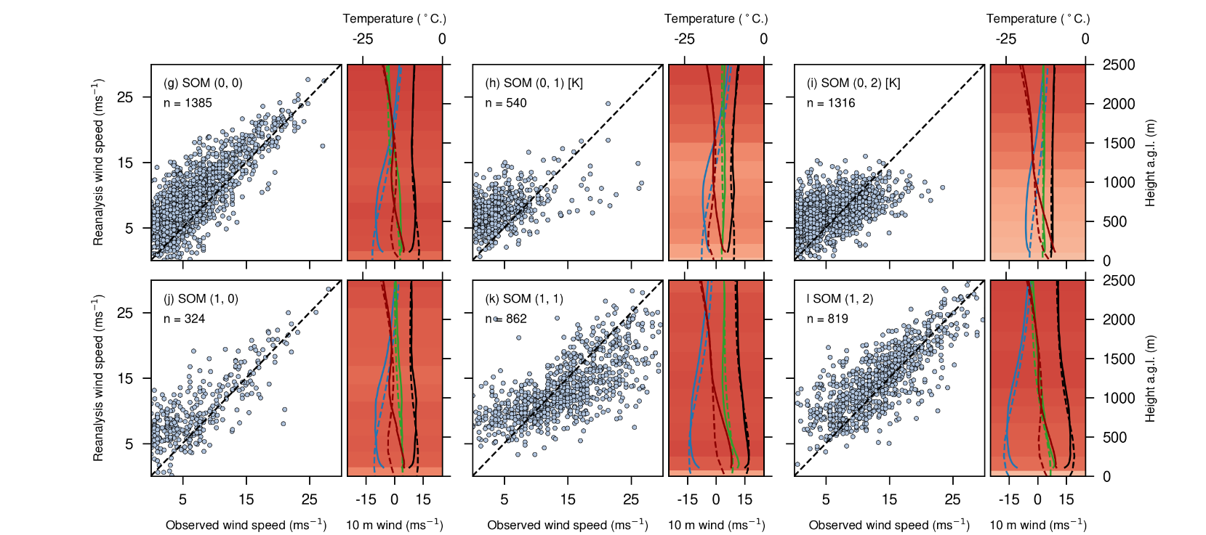
Variability: self-organising map states at coastal stations Dumont D’Urville
Figure 3: Composited ERA5 mean sea-level pressure (MSLP) with 10 m wind vectors for each node at DDU from SOMs calculated for the period 2010-2017. Station locations are marked as a white cross. Katabatic-dominated nodes are labeled with a [K].
Figure 4: MERRA-2-observation wind intercomparison by SOM node for the period 2010-2017. For each node, left panels are scatterplots of observed vs reanalysis 10 m wind speeds. The right panels are vertical profiles of mean wind speed (black), u wind (blue), v wind (green) and temperature (red) from observations (solid) and reanalysis (dashed) for that node. Shading in the background of each profile indicates the correlation coefficient between observed and reanalysis wind speed at that level. Katabatic-dominated nodes are labeled with a [K].

Slide 32
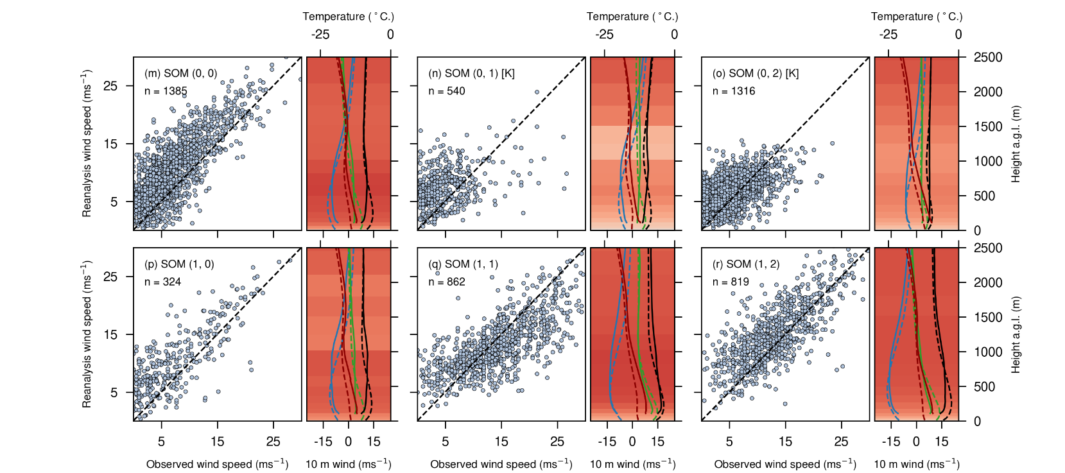
Variability: self-organising map states at coastal stations Dumont D’Urville
Figure 3: Composited ERA5 mean sea-level pressure (MSLP) with 10 m wind vectors for each node at DDU from SOMs calculated for the period 2010-2017. Station locations are marked as a white cross. Katabatic-dominated nodes are labeled with a [K].
Figure 4: JRA-55-observation wind intercomparison by SOM node for the period 2010-2017. For each node, left panels are scatterplots of observed vs reanalysis 10 m wind speeds. The right panels are vertical profiles of mean wind speed (black), u wind (blue), v wind (green) and temperature (red) from observations (solid) and reanalysis (dashed) for that node. Shading in the background of each profile indicates the correlation coefficient between observed and reanalysis wind speed at that level. Katabatic-dominated nodes are labeled with a [K].

Slide 33
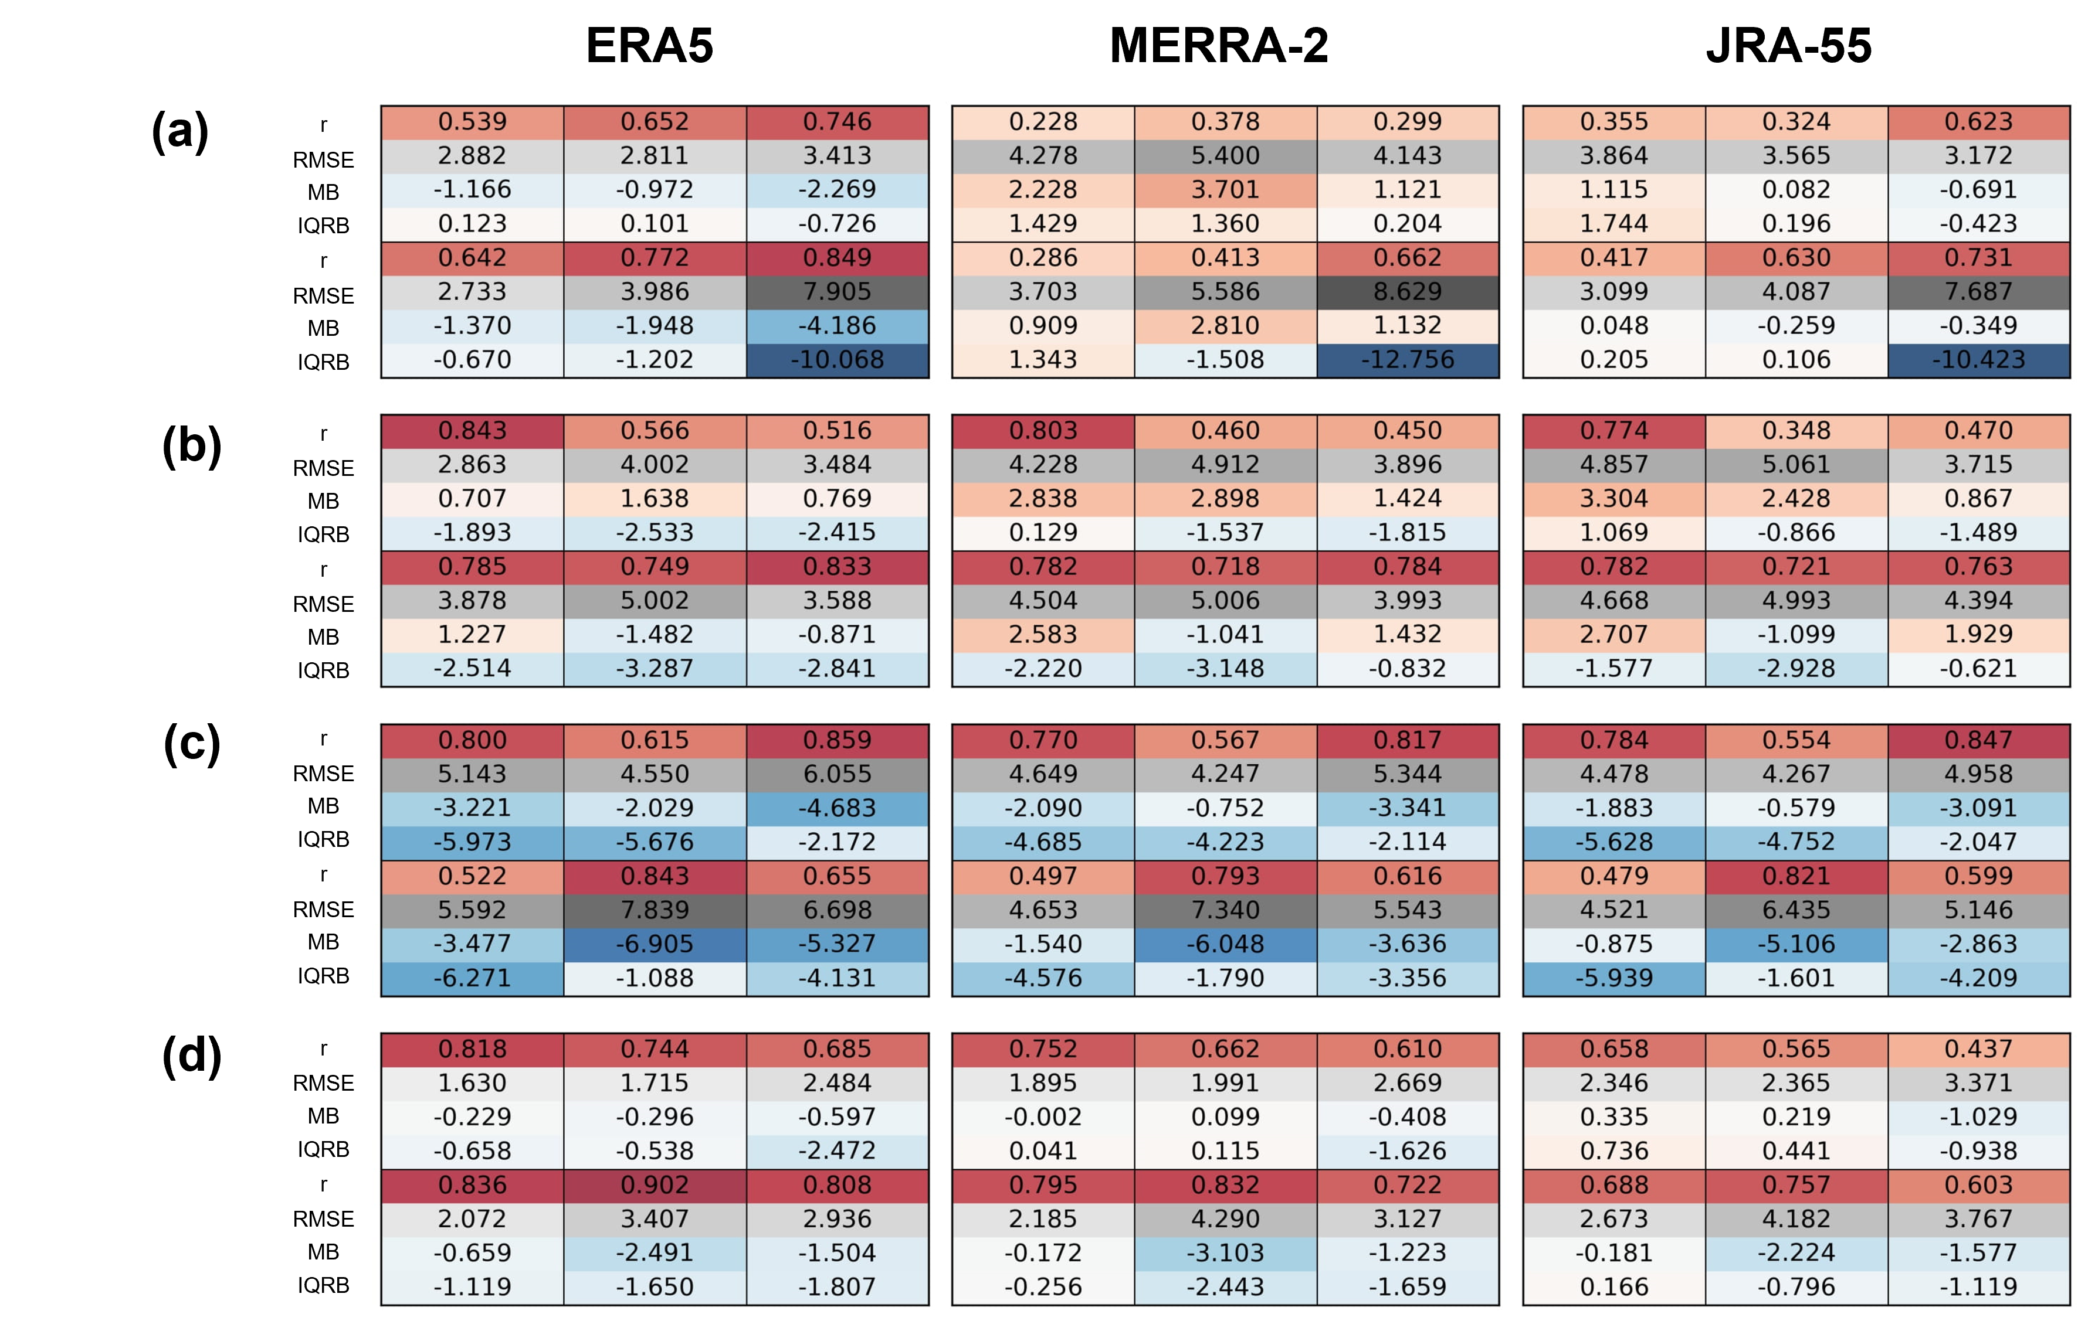
Performance statistics by SOM node
Casey
Dumont D’Urville
Mawson
Neumayer

Slide 34
Key results
Wind speed correlation coefficients against ASCAT and station data are highest in ERA5
However, ERA5 is systematically biased low at high wind speeds
Wind speed biases against ASCAT increase close to the Antarctic coast in all reanalyses
Reanalyses underestimate the variability in surface winds measured at coastal stations when katabatic forcing dominates
Conversely, variability is better captured when synoptic forcing is strong but surface winds are (mostly) underestimated
Representation of orography is important
Caton Harrison, T., Biri, Stavroula, Bracegirdle, Thomas J., King, John C., Kent, Elizabeth C. and Vignon, Étienne. 2022. Reanalysis representation of low-level winds in the Antarctic near-coastal region. In prep.

Slide 35
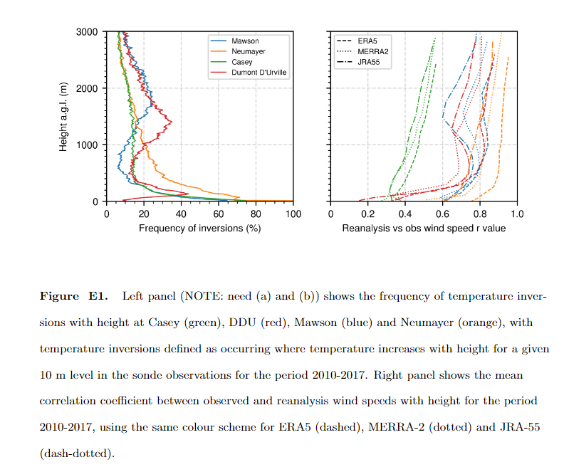
Supplementary: role of temperature inversions

