Slide 1






Future Scenarios of the African Rice System: Climatic and Socio-economic Pathways
K. De Vos , C. Janssens, L. Jacobs, B. Campforts, E. Boere, P. Havlík, M. Maertens, G. Govers
Contact : koen.devos@kuleuven.be

Slide 2
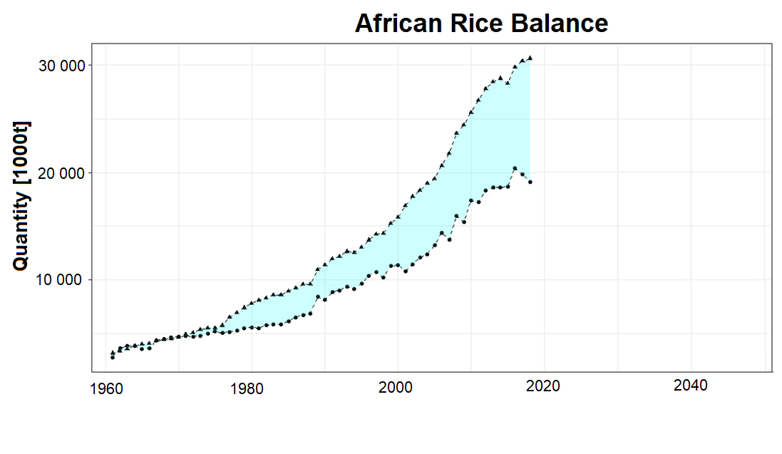
koen.devos@kuleuven.be
Why?
Consumption
Trade
Production
Source: FAOSTAT

Slide 3
koen.devos@kuleuven.be
Why?
Consumption
Trade
Production
FUTURE ?
Source: FAOSTAT

Slide 4

Objective
Understand future trajectories of the African Rice System under plausible socio-economic and climatic scenarios for 2050
Will Climate Change set African rice production back?
And/or what role will socio-economics have?
Distinction between Long-term and Year-to-Year effects

Slide 5
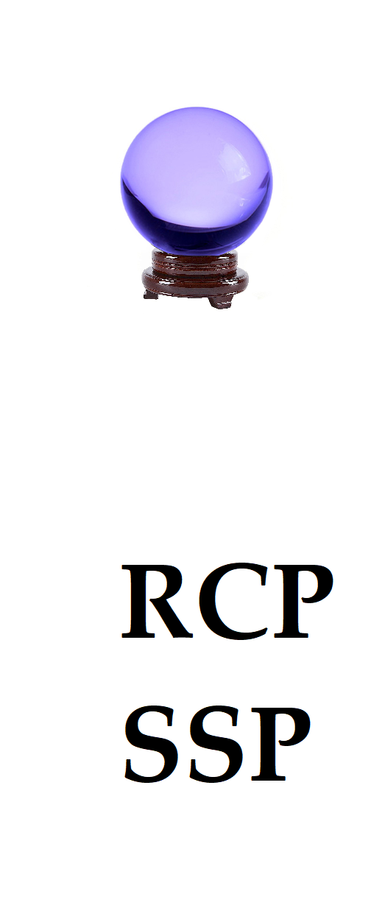

Predicting the Future
→ Accurate Estimations of the Future
→ Representative Concentration Pathways (RCP)
→ Shared Socioeconomic Pathways (SSP)
NOT
YES

Slide 6
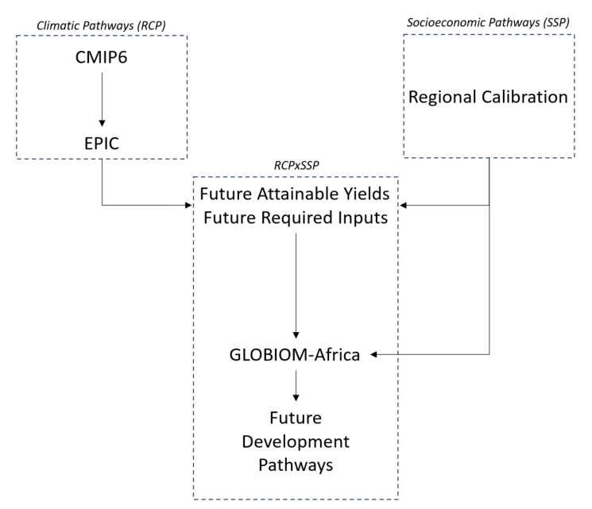
Workflow
NoCC
RCP2.6
RCP7.0
SSP1
SSP2
SSP3
CROP MODEL
ECONOMIC + LAND USE CHANGE MODEL

Slide 7
First, the Overall Picture

Slide 8

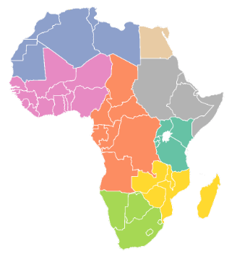
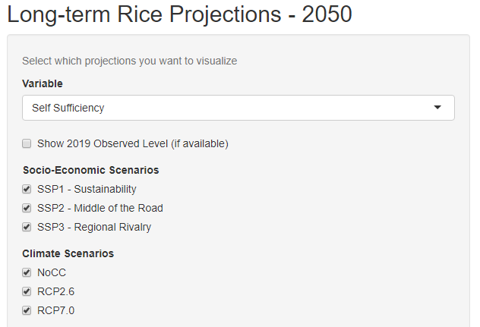
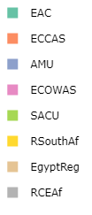
Long-Term Effects
Interactive Content

Slide 9
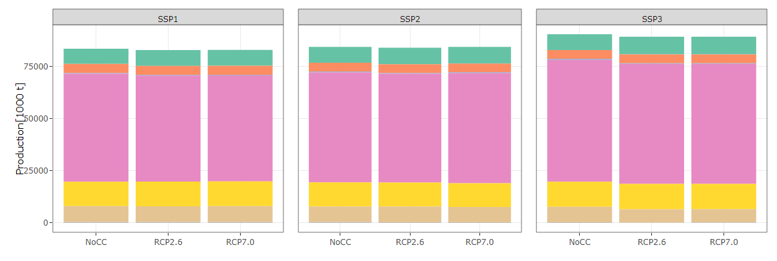
Long-Term Effects
Interactive Content
Low Population + High Economic Development
High Population + Low Economic Development
SSP1 - Sustainability
SSP2 – Middle of the Road
SSP3 – Regional Rivalry
75 000
2050 Rice Production [1000 t]
50 000
25 000
0
NoCC
RCP2.6
RCP7.0
NoCC
RCP2.6
RCP7.0
NoCC
RCP2.6
RCP7.0
Clear effect of Socio-Economics

Slide 10
Long-Term Effects
Interactive Content
Low Population + High Economic Development
High Population + Low Economic Development
SSP1 - Sustainability
SSP2 – Middle of the Road
SSP3 – Regional Rivalry
75 000
2050 Rice Production [1000 t]
50 000
25 000
0
NoCC
RCP2.6
RCP7.0
NoCC
RCP2.6
RCP7.0
NoCC
RCP2.6
RCP7.0
Clear effect of Socio-Economics
→ Population Growth

Slide 11
Long-Term Effects
Interactive Content
Low Population + High Economic Development
High Population + Low Economic Development
SSP1 - Sustainability
SSP2 – Middle of the Road
SSP3 – Regional Rivalry
75 000
2050 Rice Production [1000 t]
50 000
25 000
0
NoCC
RCP2.6
RCP7.0
NoCC
RCP2.6
RCP7.0
NoCC
RCP2.6
RCP7.0
Clear effect of Socio-Economics
→ Population Growth
Minor effects of Climate Change

Slide 12
Now, Year-to-Year Variations…

Slide 13
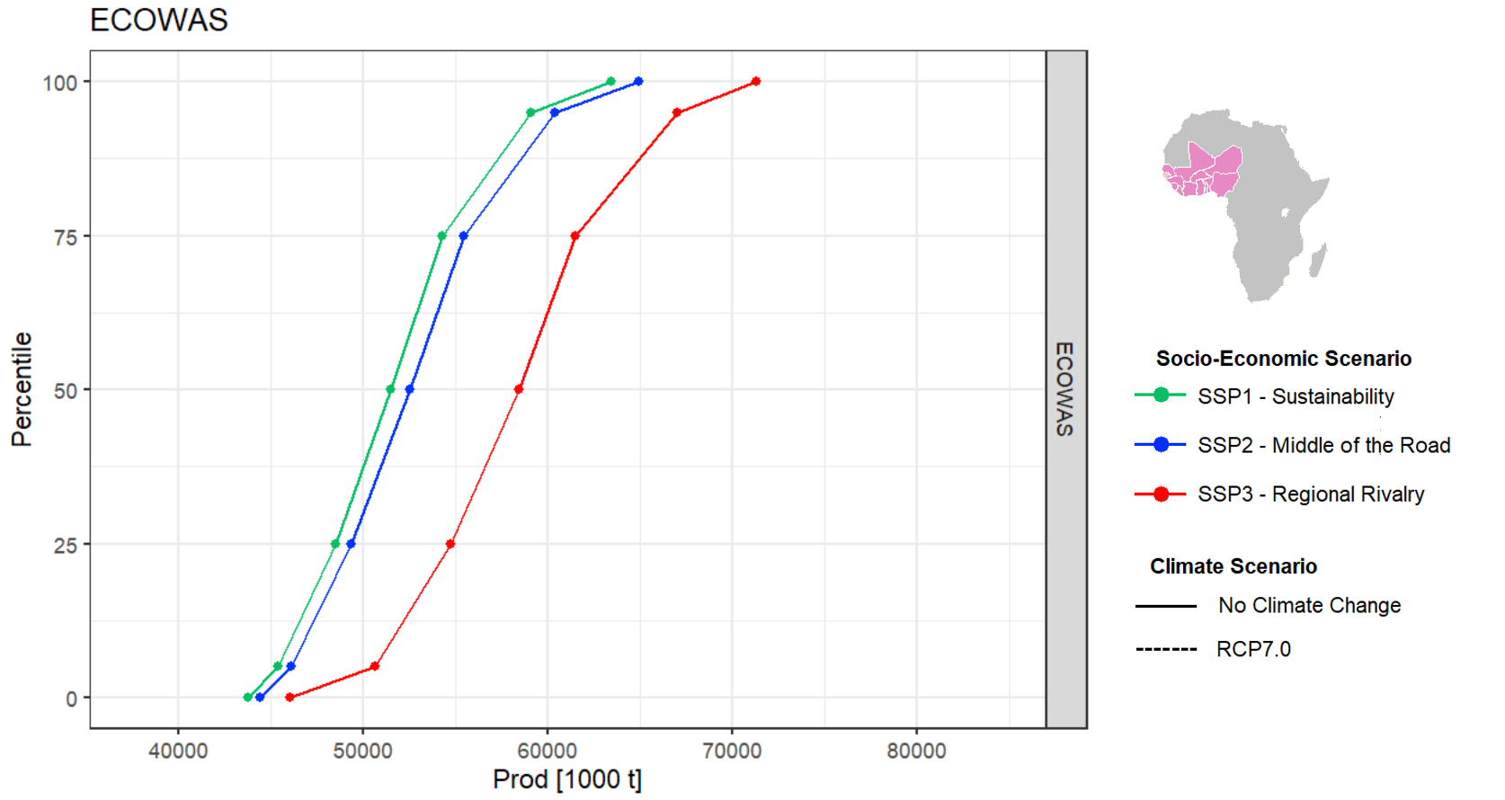
Year-to-Year
p100
p75
Percentile Value
p50
p25
p00
40 000
50 000
60 000
70 000
80 000
ECOWAS 2050 Rice Production [1000 t]

Slide 14
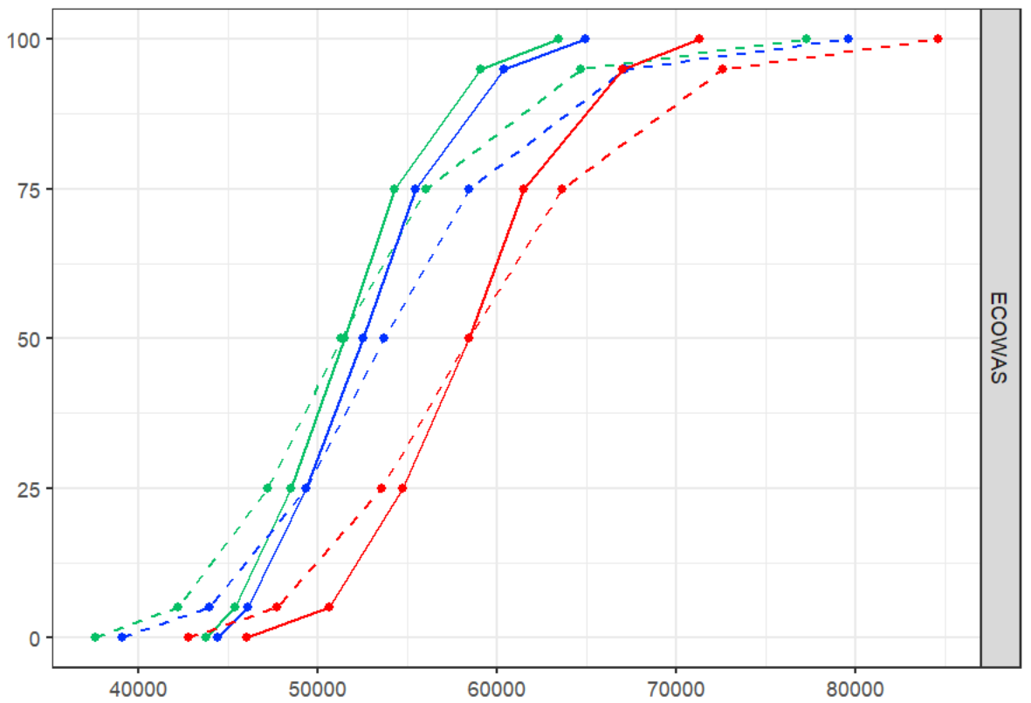
Year-to-Year
p100
p75
Percentile Value
p50
p25
p00
40 000
50 000
60 000
70 000
80 000
ECOWAS 2050 Rice Production [1000 t]

Slide 15
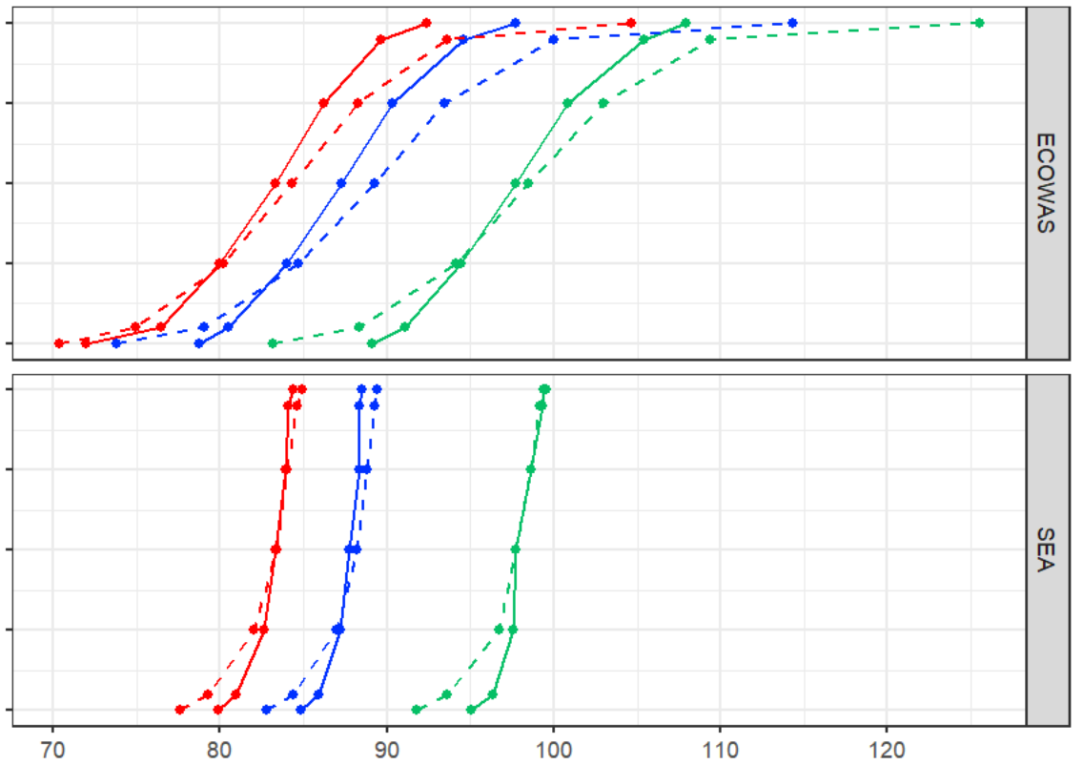
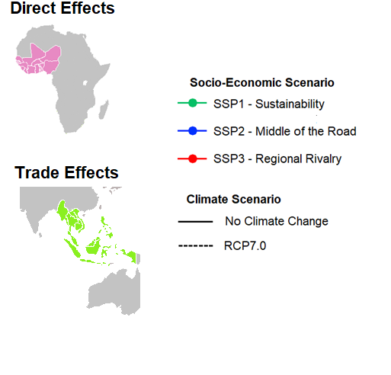
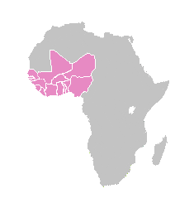
1
Year-to-Year
p100
p75
Percentile Value
p50
p25
p00
p100
70
80
90
100
110
120
p75
ECOWAS 2050 Rice Consumption per Capita [kg/pers]
p50
p25
p00

Slide 16
1
Year-to-Year
p100
p75
p50
p25
p00
Percentile Value
p100
p75
p50
p25
p00
70
80
90
100
110
120
ECOWAS 2050 Rice Consumption per Capita [kg/pers]

Slide 17
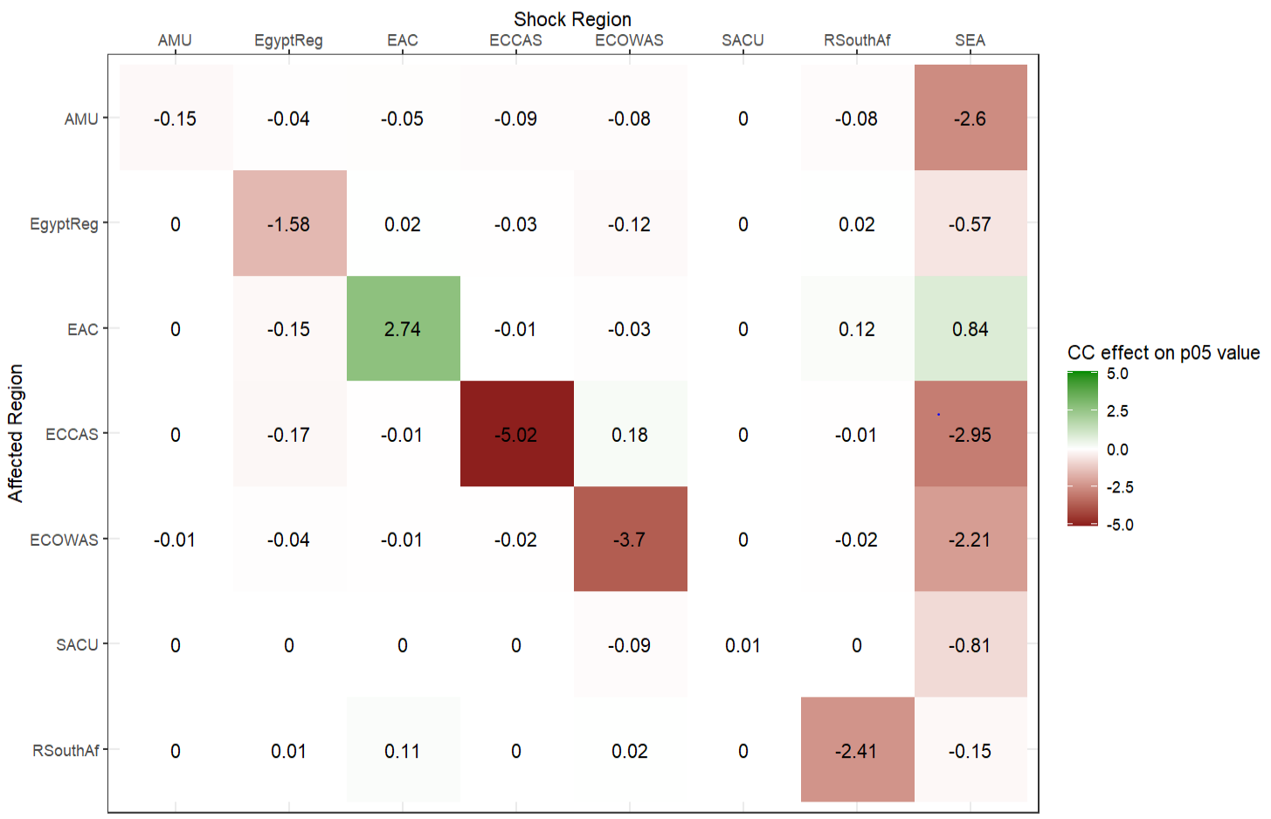
1
CC Effect Matrix
Shock Region
CC Effect on p05
Consumption [%]
Affected Region

Slide 18
1
CC Effect Matrix
Shock Region
Dominantly Negative Effects
CC Effect on p05
Consumption [%]
Affected Region

Slide 19
1
CC Effect Matrix
Shock Region
Dominantly Negative Effects
Low Intracontinental Trade Effects
CC Effect on p05
Consumption [%]
Dominantly Negative Effects
Affected Region

Slide 20
1
CC Effect Matrix
Shock Region
Dominantly Negative Effects
Low Intracontinental Trade Effects
Rainfed vs. Irrigated Regions
CC Effect on p05
Consumption [%]
Affected Region

Slide 21
1
CC Effect Matrix
Shock Region
Dominantly Negative Effects
Low Intracontinental Trade Effects
Rainfed vs. Irrigated Regions
Import-Dependent vs. Self-Sufficient
CC Effect on p05
Consumption [%]
Affected Region

Slide 22
1
CC Effect Matrix
Shock Region
Dominantly Negative Effects
Low Intracontinental Trade Effects
Rainfed vs. Irrigated Regions
Import-Dependent vs. Self-Sufficient
Bilateral Trade Dependency
CC Effect on p05
Consumption [%]
Affected Region

Slide 23

The Road Ahead
On the Long-Term, Socioeconomic Changes are more important than Climate Changes, in particular Population Changes
The African Rice System will become more volatile under Climate Change
Climate Change not only increases the year-to-year variability of Direct Climate Effects, but also of Ripple Effects through Trade.

Slide 24
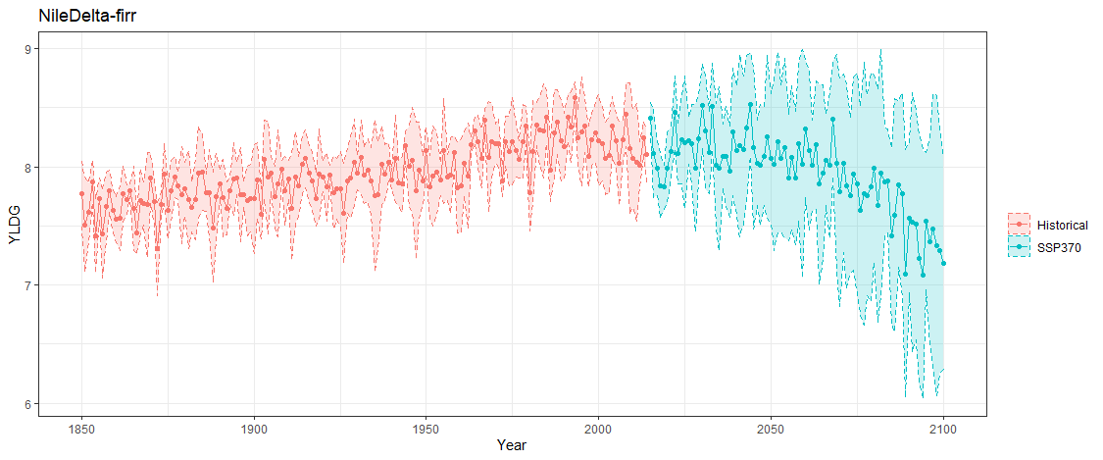
But what after 2050?
Nile Delta Attainable Yields
Attainable Yield [t/ha]

Slide 25


Thank you!
Contact : koen.devos@kuleuven.be

Slide 26
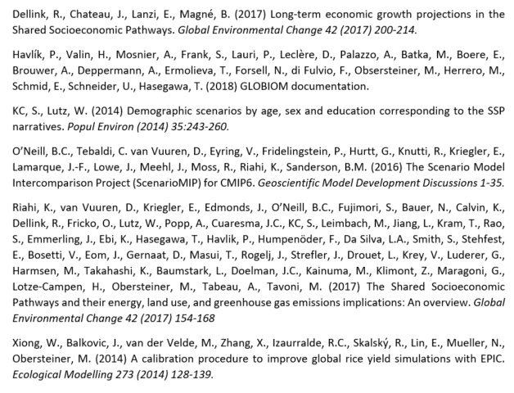
References

Slide 27
Supplementary Slides
These slides are not an integral part of the presentation, but are available through the online display material for background information
Contact : koen.devos@kuleuven.be

Slide 28

Historical Development
Production
Region | Area - 1961 | Area - 2020 | Area Relative Growth | Yield – 1961 | Yield - 2020 | Yield Relative Growth
Northern Africa | 0.2 E6 ha | 0.6 E6 ha | + 200 % | 4.98 t/ha | 8.70 t/ha | + 75 %
Sub-Saharan Africa | 2.5 E6 ha | 16.6 E6 ha | + 564 % | 1.26 t/ha | 1.98 t/ha | + 57 %
Africa Total | 2.7 E6 ha | 17.2 E6 ha | + 537 % | 1.55 t/ha | 2.20 t/ha | + 42 %
Extension processes dominated over Intensification processes

Slide 29
Historical Development
Consumption
Region | Population - 1961 | Population - 2013 | Population Relative Growth | Consumption per capita - 1961 | Consumption per capita – 2013 | Consumption per capita relative growth
Northern Africa | 68 E6 pers. | 203 E6 pers | + 199 % | 9.73 kg/cap | 17.11 kg/cap | + 76 %
Sub-Saharan Africa | 203 E6 pers. | 792 E6 pers. | + 290 % | 11.7 kg/cap | 30.85 kg/cap | + 164 %
Africa Total | 271 E6 pers. | 995 E5 pers. | + 267 % | 9.33 kg/cap | 23.81 kg/cap | + 155 %
Population Changes dominated over Dietary Shifts

Slide 30
Historical Development
Trade
Top 5 Countries Exporting Rice to Africa 1986
Top 5 Countries Exporting Rice to Africa 2020
Country | Amount [tonnes] | Import %
Thailand | 113 010 | 31 %
Italy | 48 556 | 13 %
Pakistan | 45 940 | 13 %
China | 41 333 | 11 %
USA | 26 141 | 7 %
Total | 364 724 | 100%
Country | Amount [tonnes] | Import %
India | 4 127 729 | 36 %
Thailand | 2 119 386 | 18 %
Pakistan | 1 230 706 | 11 %
China | 1 160 907 | 10 %
Viet Nam | 1 077 199 | 9 %
Total | 11 514 107 | 100 %
Self-Sufficiency = 70 %
Self-Sufficiency = 70 %

Slide 31
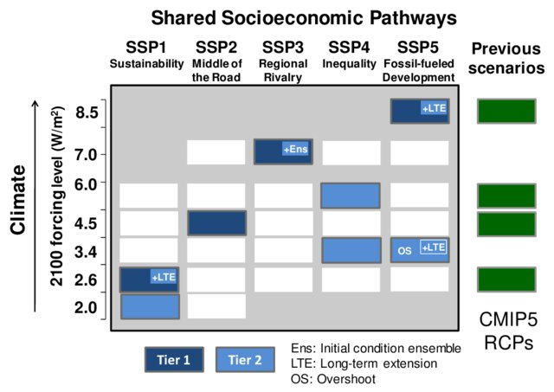
Workflow
GCM
UKESM-1-0-LL
IPSL-CM6A-LR
GFDL-ESM4
MRI-ESM2-0
MPI-ESM1-2-HR
O’Neill et al. 2016

Slide 32
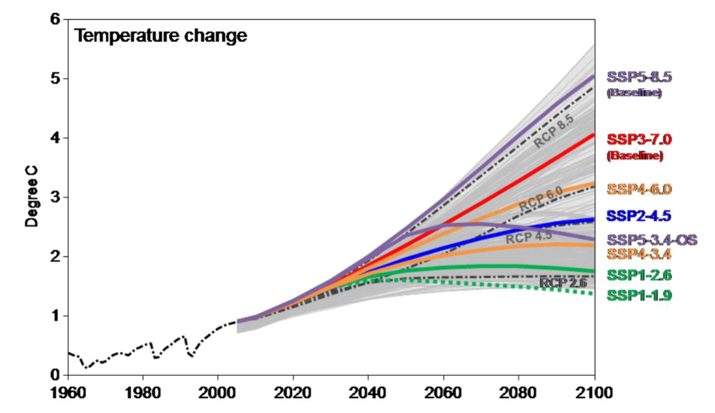
Workflow
O’Neill et al. 2016

Slide 33
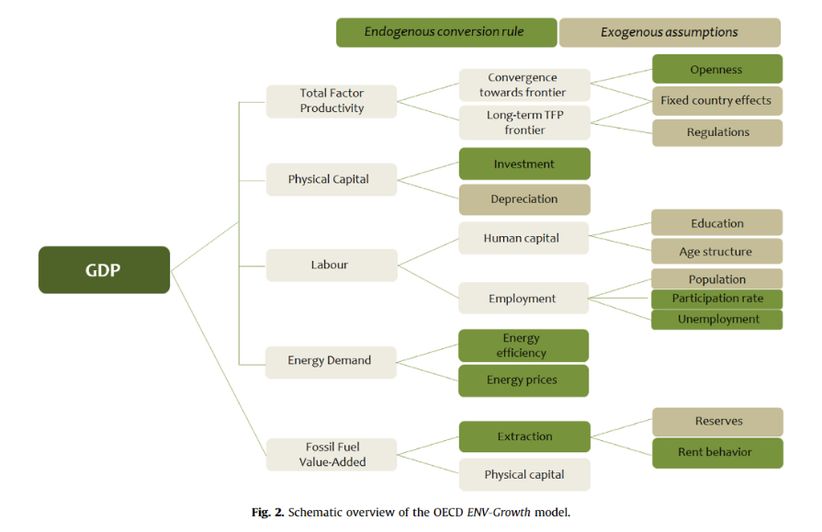
Workflow
Dellink et al. 2017

Slide 34
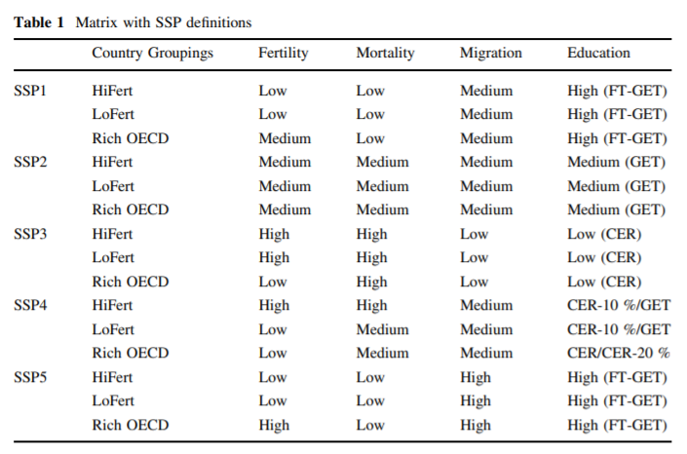
Workflow
KC & Lutz, 2014

Slide 35
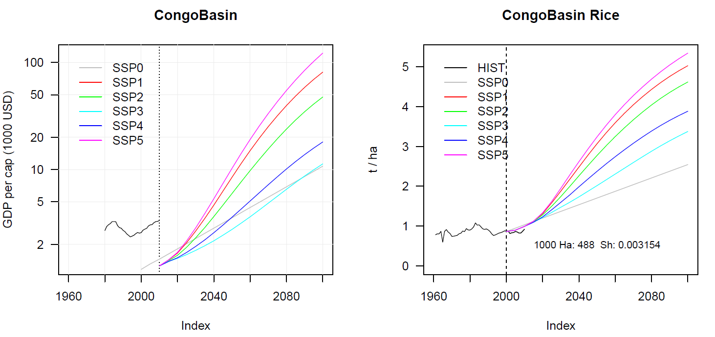
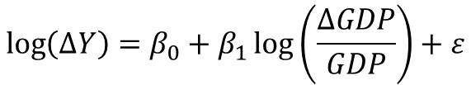
Workflow
$$\log\left(∆Y\right)=β_{0}+β_{1}\log\left(\frac{∆GDP}{GDP}\right)+ε$$

Slide 36
Workflow
EPIC: e.g. attainable yield under CC = 2.5 t/ha
Historical Yield (1980-2015) = 3.5 t/ha
Climate Shifter = 0.71
SSP: e.g. attainable yield under SSP = 4 t/ha
Base Yield (1985 – 2015) = 3 t/ha
Technological Shifter = 1.33
GLOBIOM: Base Yield = 3 t/ha
Total Shifter = 0.71 * 1.33 = 0.94
Expected Yield = 2.82 t/ha
Assumptions/Drawbacks:
Climate and Technological Shifter are independent
Strongly Depends on the Base Year Value (1985-2015 average)
EPIC historical = Potential Yield
SSP/GLOBIOM historical = Actual Yield
Changes in Actual Yield are correlated with changes in Potential Yield

Slide 37
Workflow
Nile Delta Attainable Yields
Attainable Yield [t/ha]

Slide 38
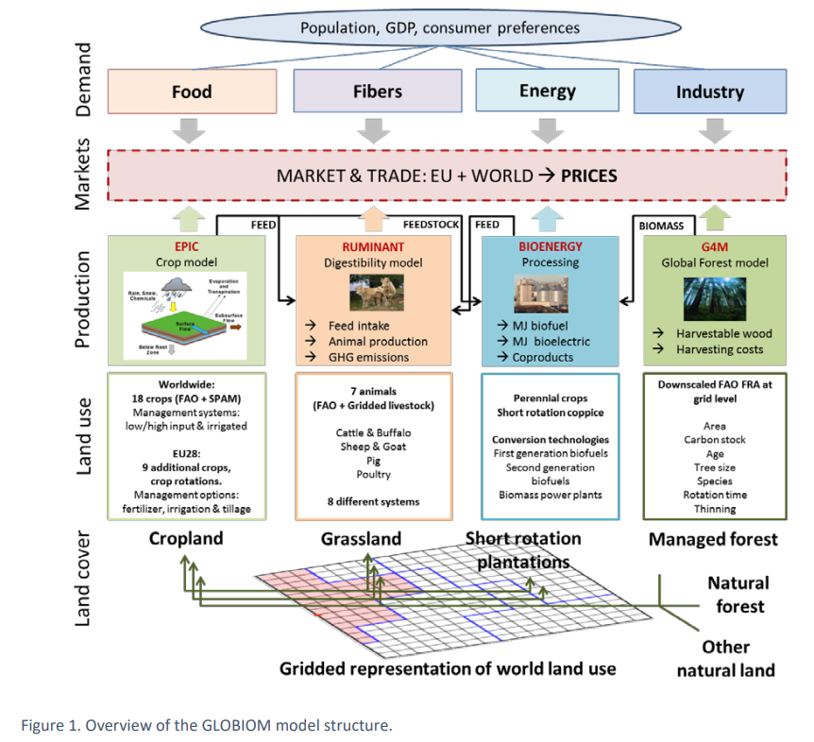
Workflow
Havlík et al. 2018

Slide 39
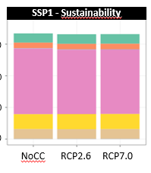
Long-Term Effects
Region | With CO2-fertilization effect | Without CO2-fertilization effect | CO2-fertilization effect
Production [1000 t] | 84 654 | 83 641 | + 1.2 %
Area [1000 ha] | 22 604 | 25 242 | - 10.5 %
Yield [t/ha] | 3.75 t/ha | 3.31 t/ha | + 13.3 %
Consumption [1000 t] | 97 139 t | 96 338 t | + 0.8 %
CO2-fertilization has little effect on long-term trend of production and consumption → Socio-Economically driven
It does have an important impact on Yield and Area → Sustainability of the system!

Slide 40
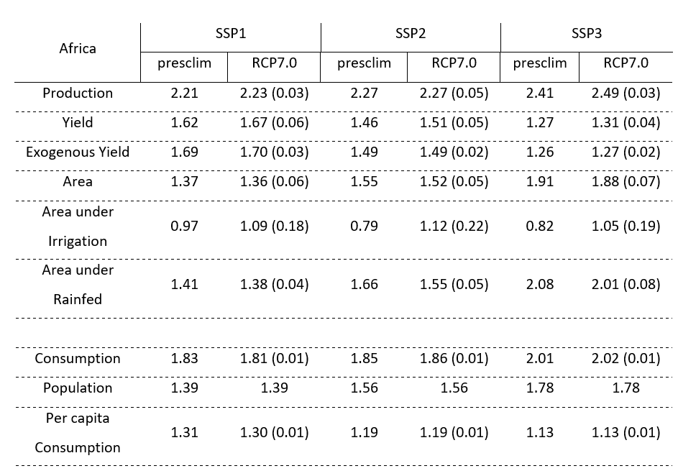
Long-Term Effects
Table 1: Relative change in 2050 to 2020 for the different SSP and RCP scenarios

Slide 41
Year-to-Year
RCP x SSP
Standard GLOBIOM run (2000 → 2050)
Area + Demand = Constant
Yield = Percentile value (for 1 region)
2050 levels
Yield Percentile is introduced in only 1 region
Look to the differences with the standard 2050 level
Domestical differences = Robustness of the region itself to internal shocks
International differences = Ripple Effects
African Regions → ECOWAS
Providing Regions → Southeast-Asia
Which Regions???

Slide 42
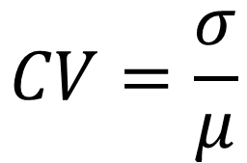
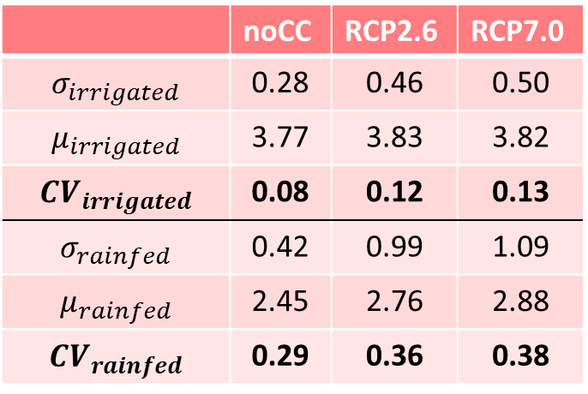
Year-to-Year
 | noCC | RCP2.6 | RCP7.0
$$σ_{irrigated}$$ | 0.28 | 0.46 | 0.50
$$μ_{irrigated}$$ | 3.77 | 3.83 | 3.82
$$CV_{irrigated}$$ | 0.08 | 0.12 | 0.13
$$σ_{rainfed}$$ | 0.42 | 0.99 | 1.09
$$μ_{rainfed}$$ | 2.45 | 2.76 | 2.88
$$CV_{rainfed}$$ | 0.29 | 0.36 | 0.38
$$CV=\frac{σ}{μ}$$

Slide 43

Year-to-Year
Does CC increase the interannual fluctuations of the system compared to natural variability?
→ Through Coefficient of Variation (CV)
$$∆CV=CV_{CC}−CV_{hist}$$
ΔCV – Africa (2050) | RCP2.6 | RCP7.0
Irrigated Systems | + 0.04 | + 0.05
Rainfed Systems | + 0.07 | + 0.09

Slide 44
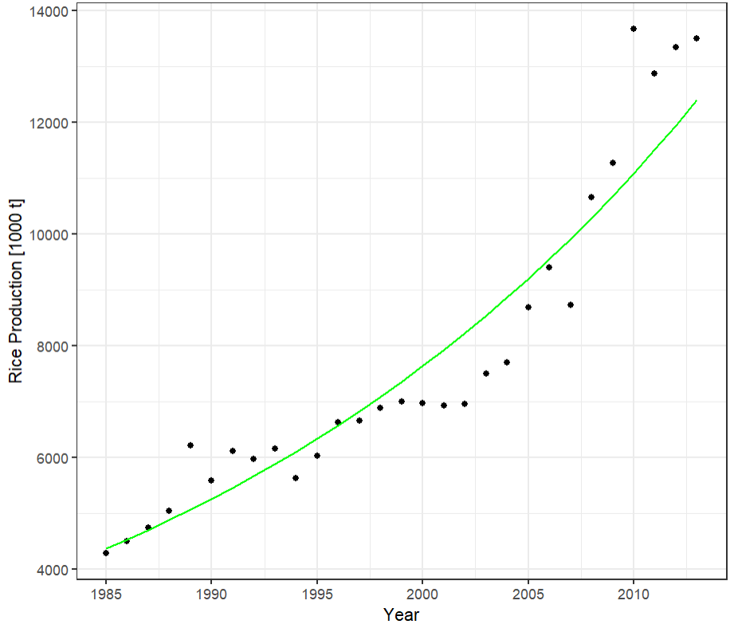
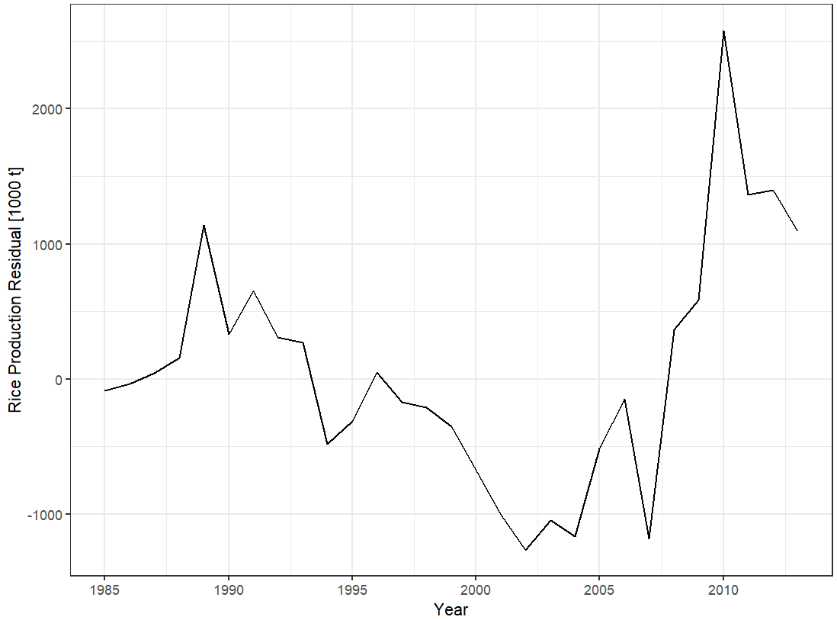
Year-to-Year
How realistic is the modeled production distribution?
We have used the historical variability of modeled yields from EPIC, but we have no indication of how well GLOBIOM-X is able to reproduce a realistic production/consumption/… distribution
African Rice Production
Detrended African Rice Production
R² = 0.90
Source: FAOSTAT

Slide 45
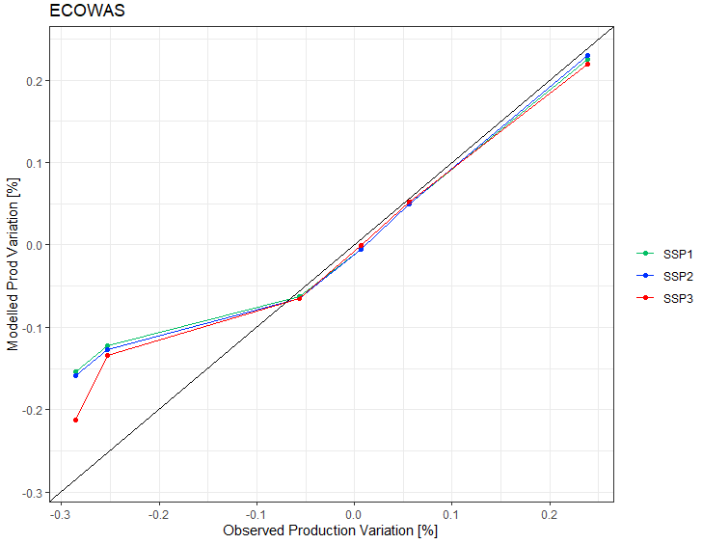
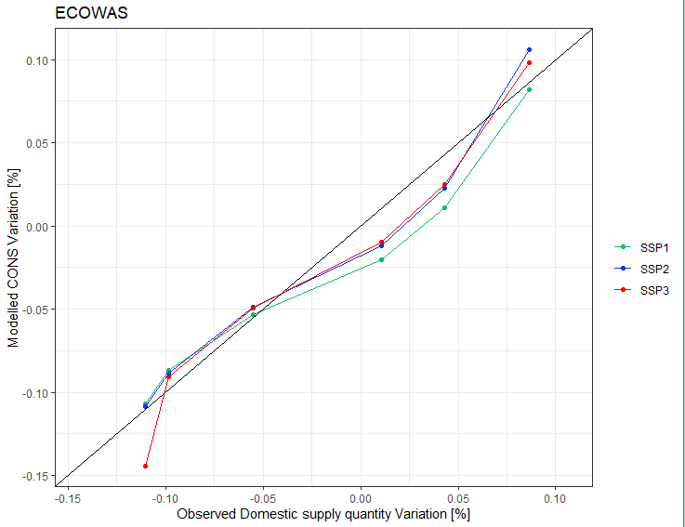
Year-to-Year

Slide 46
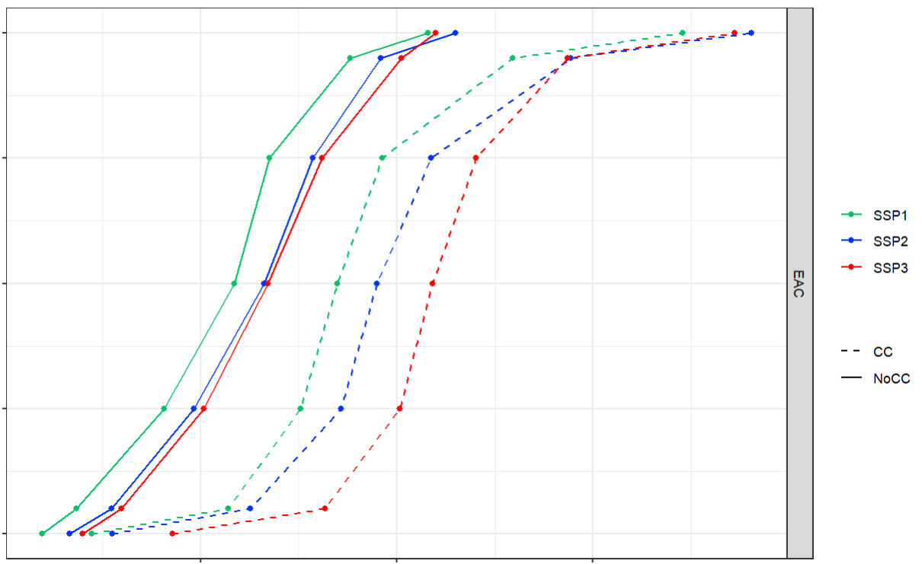
CC Effect Matrix
p100
p75
Percentile Value
p50
p25
p00
7000
9000
11000
EAC Rice Production [1000 t]

Slide 47

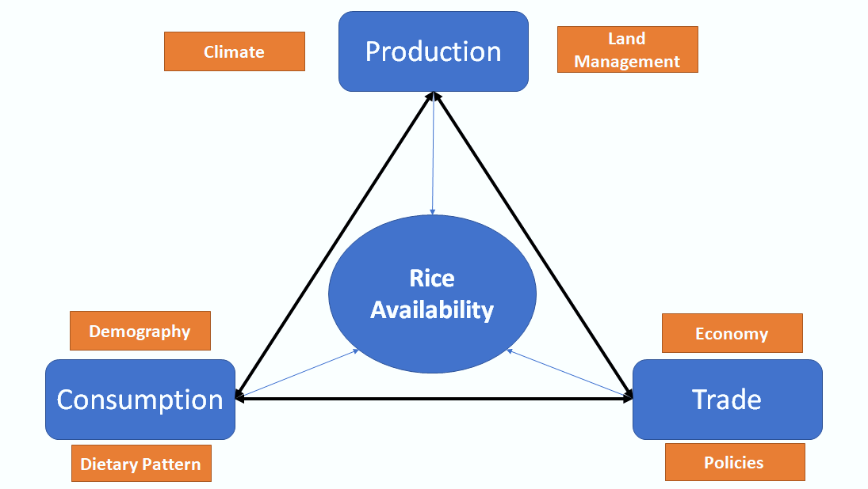


The Road Ahead

Slide 48
Thank you!
Contact : koen.devos@kuleuven.be

