Slide 1

The Spatial Weather
Generator SPAGETTA:
Hard Times of its Adolescence
Martin Dubrovsky^{1,2}, Ondrej Lhotka^{1,2},
Jiri Miksovsky^{2,3}, Petr Stepanek², Jan Meitner²
Institute of Atmospheric Physics CAS, Prague, Czechia;
(2) Global Change Research Institute CAS, Brno, Czechia;
(3) Charles Univ., Faculty Mathematics & Physics, Prague, Czechia
This presentation (~ GRIMASA project funded by GACR):
  Introduction to SPAGETTA generator
  brief History of its development (…~ list of “experiments”)
  Many experiments have been done, the generator was validated during its development… … now it’s time to apply the generator in climate change impact projects…
  … but the problems came …
Notes:
Based on:
20210921-23~CMES~Louny~Dubrovsky.pptx

Slide 2
weather generators
= models, which produce synthetic weather data statistically similar to real-world weather data
are based on statistical approaches (AR models, Markov chain models, …), in which model of the generator is calibrated using observed data, then it may produce synthetic data similar to the calibration data
are used to produce: Inputs to models, which use weather data to simulate various weather-dependent processes, e.g.: - Crop modelling
                - Hydrological modelling
advantages:
  Very fast (compared to RCM, e.g.)
  arbitrarily long series may be produced
  may produce data even for ungauged sites (via WG interpolation)
  may be easily linked with GCM or RCM-based CC scenarios and produce synthetic series representing future climate… (optionally, only selected characteristics / AVGs, STDs, CORs/ may be modified and sensitivity analysis may be made)
Notes:
standardised deviations from their mean annual cycle are modelled using

Slide 3
GRIMASA project (2018-2022)
Main Aim: Development of the spatial weather generator, which will be able to produced “realistic” synthetic weather series for use in various applications
Requirements on SPAGETTA generator:
  Multivariate
  Multisite (gidded or irregularly distributed sites)
  Various temporal and spatial scales
    Temporal scale: annual / monthly / daily / hourly
    Spatial scale: local (~ 1km) to continental scale
Notes:
1. First of all, I would like to introduce myself… What I am doing, why I am here, and what is the topic of my presentation.
And compound events? I heard of them first time sometimes some 16 months ago, when Jakob invited me to writing DAMOCLES ??
2. My main topic are Weather generators are my main topic for last 25 years… While developing WGs, I have to validate them, abnd for this I use various validation indices, for xample hot days, …, I also employed drought indices, crop yealds (crop models outputs) , river streamflows (outputs from hydrological models) …
Now, since 2016 I am developing a multiste (gridded) weather generator SPAGETTA and in validation it, I gave s treass on spatial characteristics, such as spatial hot days and spatial hot spells… this was main main task in 2017… Well, and after getting into contact with Jakob, I got idea to define some compound indices… Anyway, my so-called compoujd indices were defined very simly byt I did not care about it, as my main aim is to devoelpop WGs, ahich are good in reproducing important climatic characteristics and I just put the compound indices on the list…
Though, I am a climatologist by education, I feel to be rather statistician and programmer while developing WGs… …. Sure, when I talk with a proffesioanl progaramers or statistician, I say I am climatologist…
My motivation: I am now involved in DAMOCLES, but I was not in Prague kickoff meeting… So , I got idea to prpae a presentation which will help my better involvement… As aI do not know much about compound events, I decided that I will introduce my gnerators, and then I will ask you some questions….

Slide 4
SPAGETTA = parametric multi-variate spatial daily WG
multivariate AR(1) model:
  X*(t) = AX*(t) + Be
  where
X*_{i} = vector of standardized weather variables)
  e = white noise
  A, B = [k x k] matrices derived from COV(X) and LagCOV(X)
  • Dimension: k = n(vars) X n(grid-points) (< 1500; → 2 mil.numbers in matrices!)
  • Time step = mostly 1 day (may be also 1 month or 1 year)
  • Conditioned on precipitation occurrence modelled using spatially correlated Gaussian stream transformed into binaries
  • SPAGETTA is based on spatializing (using D. Wilks’ approach) single site M&Rfi generator
Notes:
having n-th term, X(n), (n+1)-th term is selected:
- K nearest neighbors of X(n) (using Mahalanobis distance to measure between-terms distance) are found in the learning series. These neighbours must satisfy conditions: (a) |JD-JD(n)|≤ ΔD days), (b) (optionally) the neighbours must be with the same precipitation category as X(n)
- X(n+1) is generated from this set. Several algorithms were considered, X(n+1) =

Slide 5
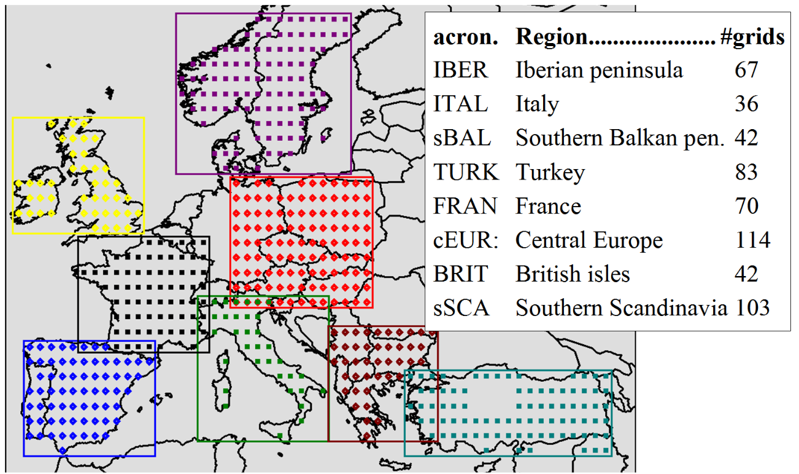
Step 1: Multi-site single-variate generator
Experiment: X = Temperature
8 EU areas
E-OBS vs. WG vs 19 RCMs validation in terms of: spatial hot Days/Spells;
& future vs. now
Notes:
standardised deviations from their mean annual cycle are modelled using

Slide 6
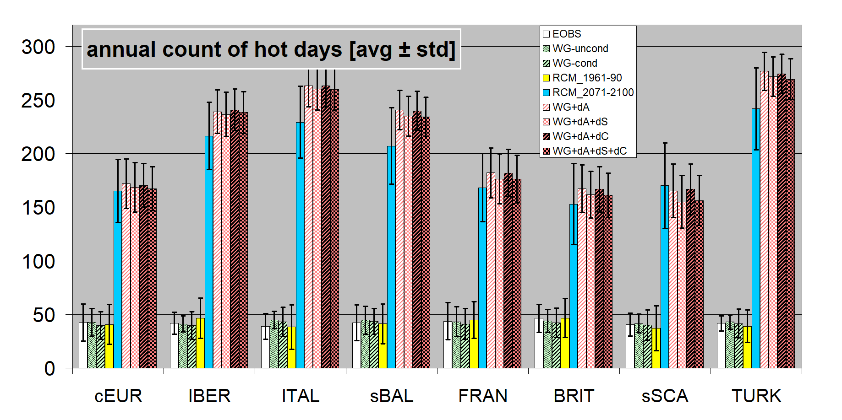
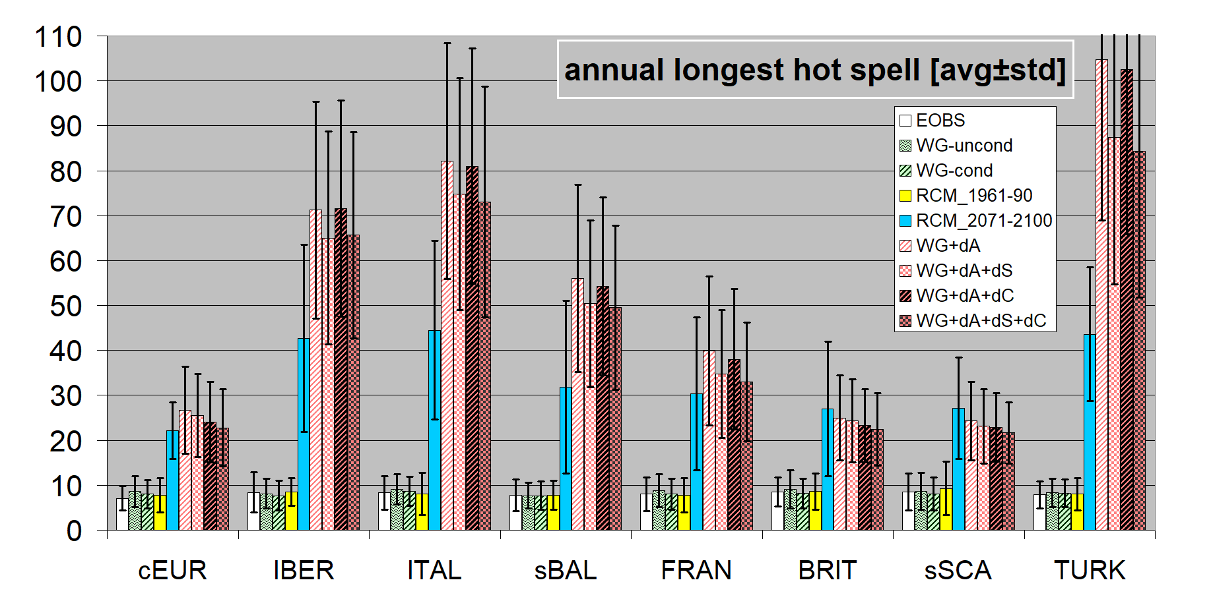
Spatial
Hot Days
Spatial
Hot spells
graphs show:
- 8 EU regions
- WG vs. 19RCMs
- Now vs. Future
Notes:
!!!!!! To je BLBOST!!!! Values for COLD must be values for WET (compare with next Slide!!!!!) [taken from EGU2019?]]

Slide 7
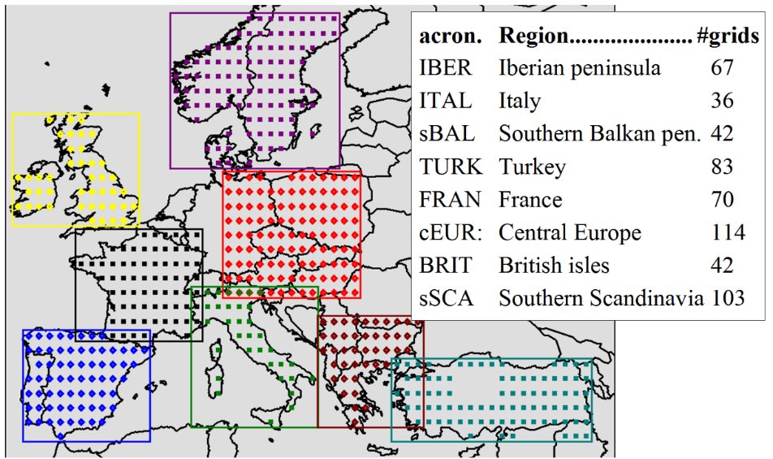
Step 2: adding precipitation
Precipitation ~ separate multivariate Gaussian stream generated by AR(1) model and converted into PREC occurences & PREC amounts (gamma distributed)
Experiment: similar as previous (8 EU areas, same data) but: X = TEMP & PREC validation indices: spatial compound
TEMP-PREC Days/Spells (e.g. hot-dry spells)
DATA:
calibration of WG: EOBS-13.1
(TAVG & PREC; 0.5º version regridded into 1º resolution); calibration period = 1961-90.
19 RCM simulations from CORDEX EUR-44 regridded into double resolution
Notes:
standardised deviations from their mean annual cycle are modelled using

Slide 8
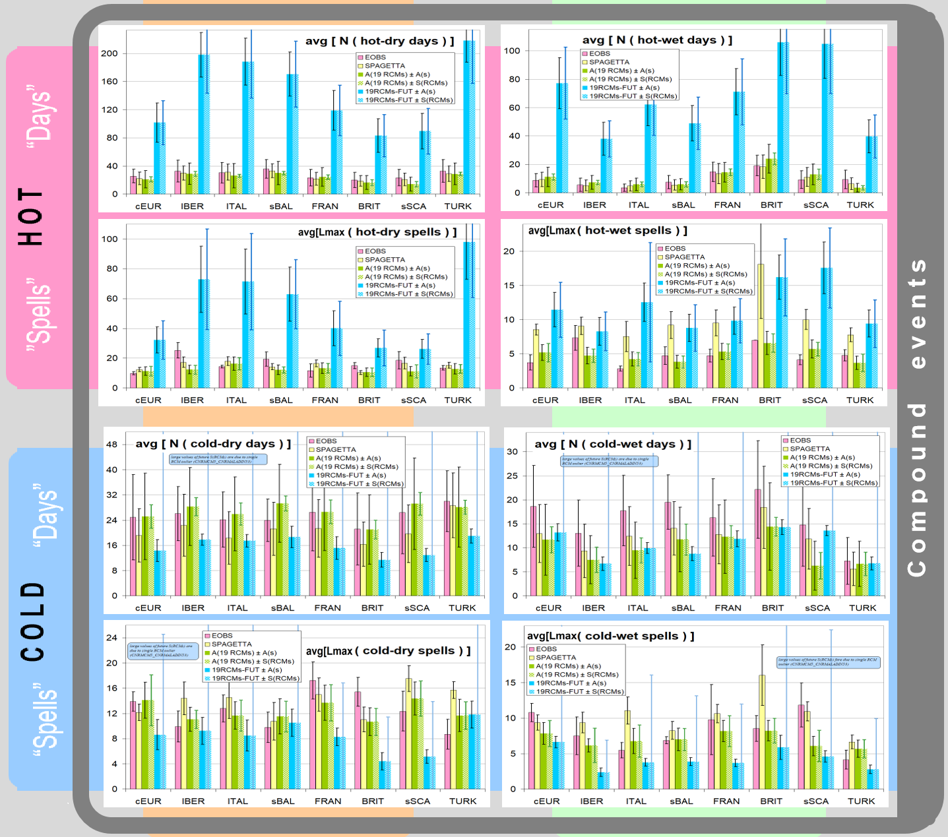
OBS – WG - RCMs: T-P compound events NOW & FUTURE
D R Y
W E T
Notes:
[from EGU2019, asi]

Slide 9
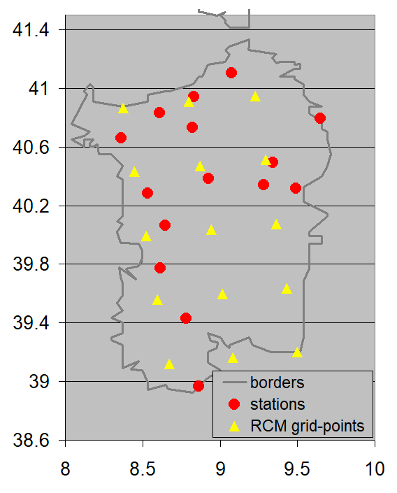
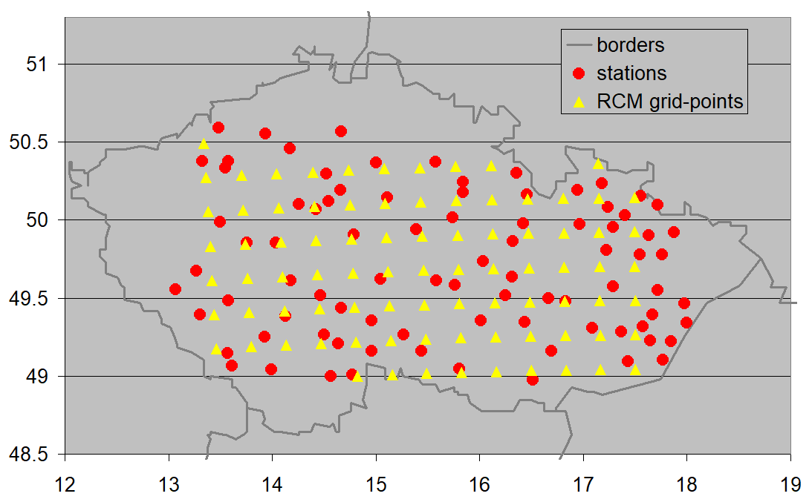
Step 3: Adding more variables
Experiment: modelling Fire Weather Index time series 2 regions
● FWI = f(T,P,Hum,Wind)
● OBS vs. WG vs. RCM
● 2 regions
!!! Quantile mapping transformations implemented to allow for significantly non-Gaussian variables (wind, humidity)
OBS (observations): 85 stations representing Czechia + 15 stations representing Sardinia
RCMs: 8 RCM simulations (historical & RCP85, EUR-11 domain; CORDEX database; conditioned on availability of the four variables: Tmax, Prec, RelHum, Wind). BASELINE = 1971-2000; FUTURE = 2070-99. For Czechia, both raw and bias-corrected versions of RCMs were available.
To allow more conclusive comparisons, we made adjustments to the density of RCM grid-points (in Sardinia) and cropped original target region (Czechia), so that number of grid-points is not so large (SPAGETTA tends to crash when number of grid-pints exceeded ~100), and number of RCM grid-points is about the same as number of available weather stations.
Czechia
Sardinia
Notes:
standardised deviations from their mean annual cycle are modelled using

Slide 10
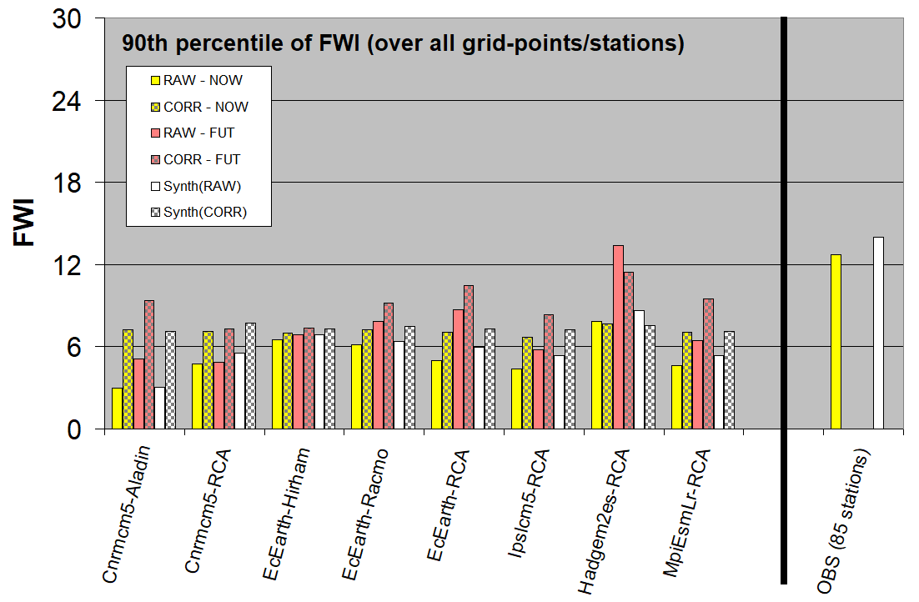
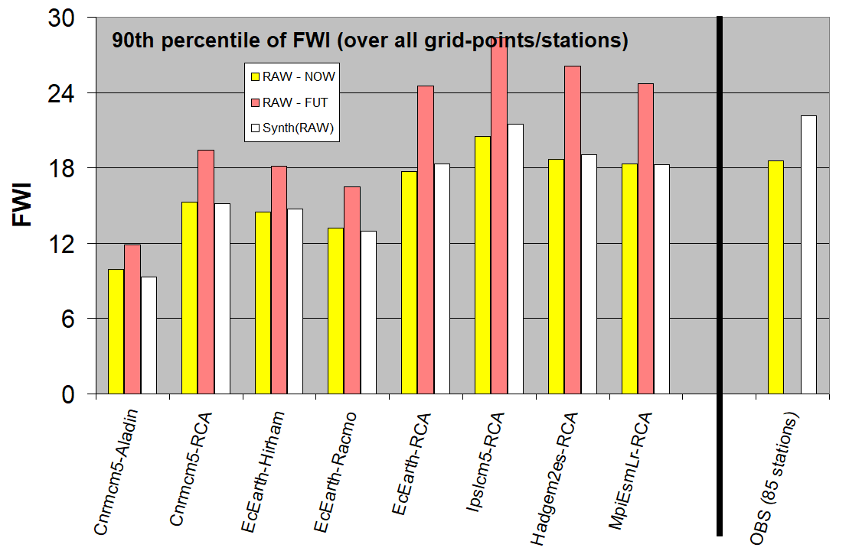
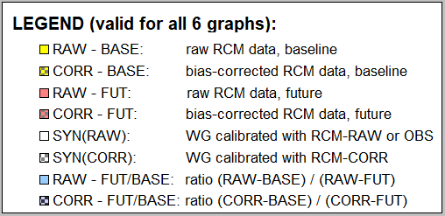
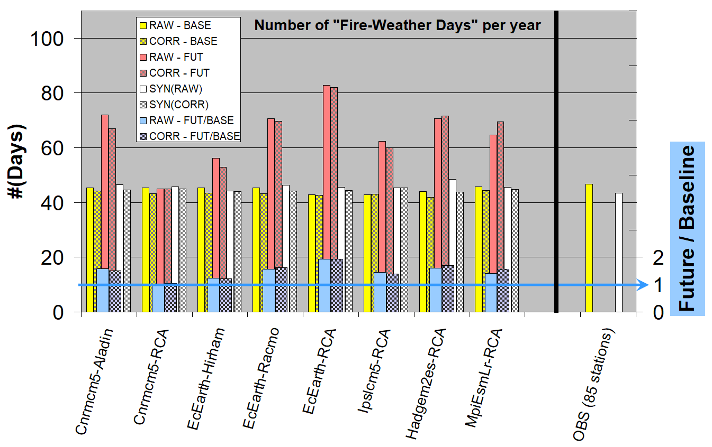
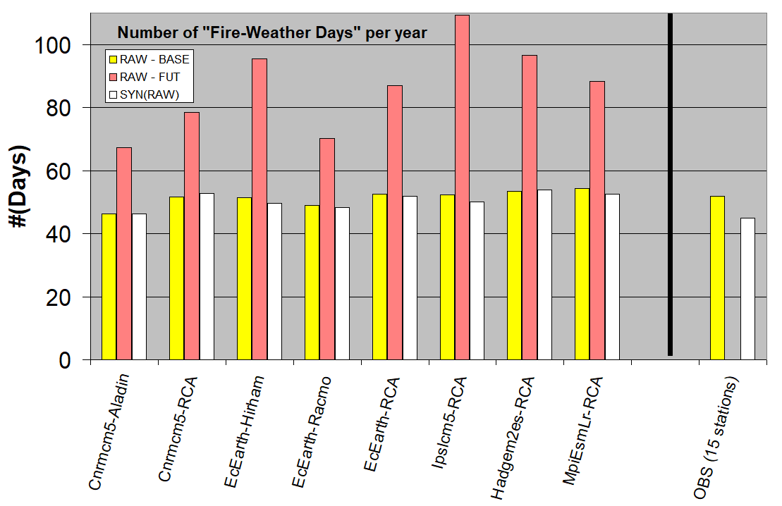
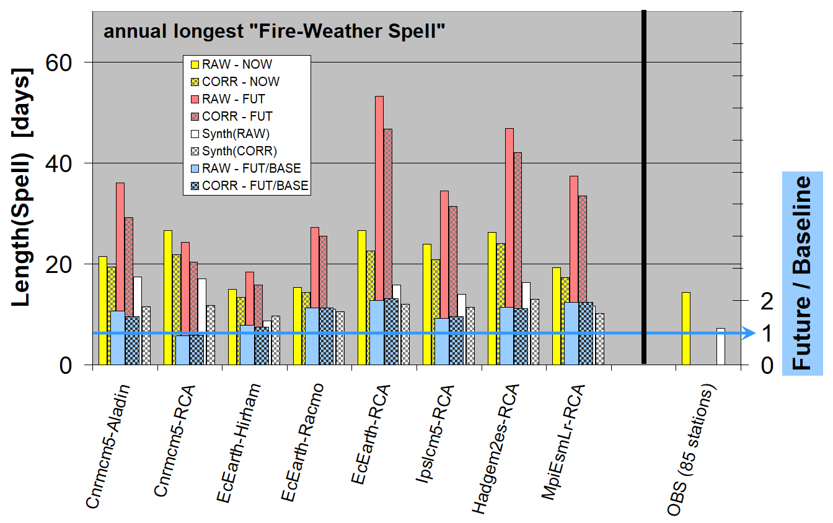
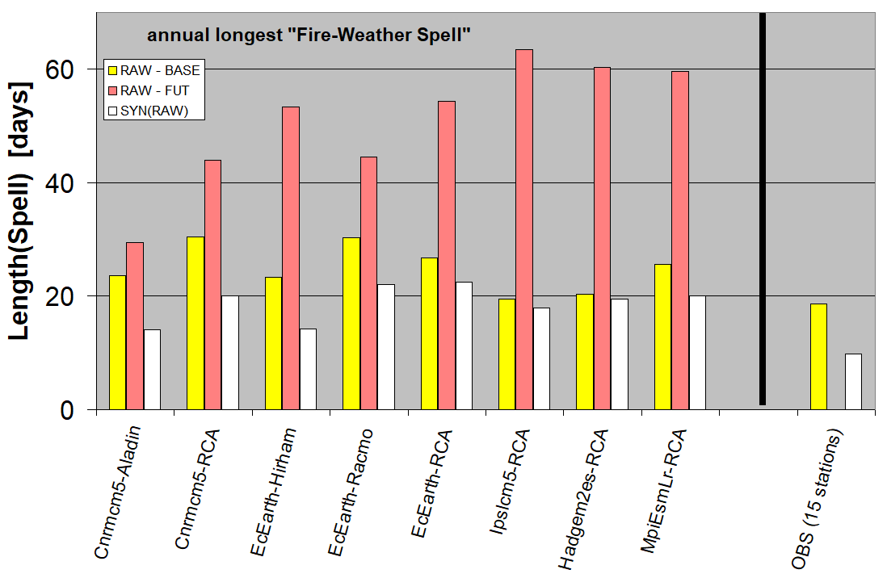
FWI-90p
N(sFWdays)/year
4. Present experiment
(i) Deriving FWI characteristics from OBS & RCMs:
FWI-90p = 90th percentile of FWI (across all months and stations/grid-points)
sFWdays = “Spatial FireWeather Days” (= day when FWI exceeds FWI-90p at more than 30% of stations/gridpoints in the region)
sFWspell = “Spatial FireWeather Spell” (= uninterrupted sequence of FireWeather Days).
(ii) Calibration of SPAGETTA with both observed & RCM-simulated series
(iii) Generation of 100-year synthetic series (SYNTH) representing both OBS and RCM weather
(iv) Deriving FWI characteristics from SYNTH
Graphs show FWI-90p , frequency of sFWdays and means of annual longest sFWspell.
5. Results
Czechia
Sardinia
Lmax(sFWspell)
6. Conclusions
a) RCMs:
- large inter-RCMs variability in FWI-90p as well as in climate change signal
- RCMs imply smaller FWI-90p, even if bias-corrected
- if RCM-based FWI-90p is used, RCMs imply frequency of spatial FW days similar to observations.
- RCMs overerestimate length of annual longest spatial FW spells
- RAW and CORR versions of RCMs imply similar magnitudes of climate change signal
b) WG:
- slightly overestimate FWI-90p from calibration data
- perfectly fits frequency of sFW days in calibr. data
- significanly underestimate length of annual longest WF spells → improvements in model or code of the generator are desirable
Characteristics were derived from:
a) RCMs & WG calibrated with RCM outputs
b) Observed weather data & WG calibrated with them
Brief summary : WG performation is not bad, but might be better…

Slide 11
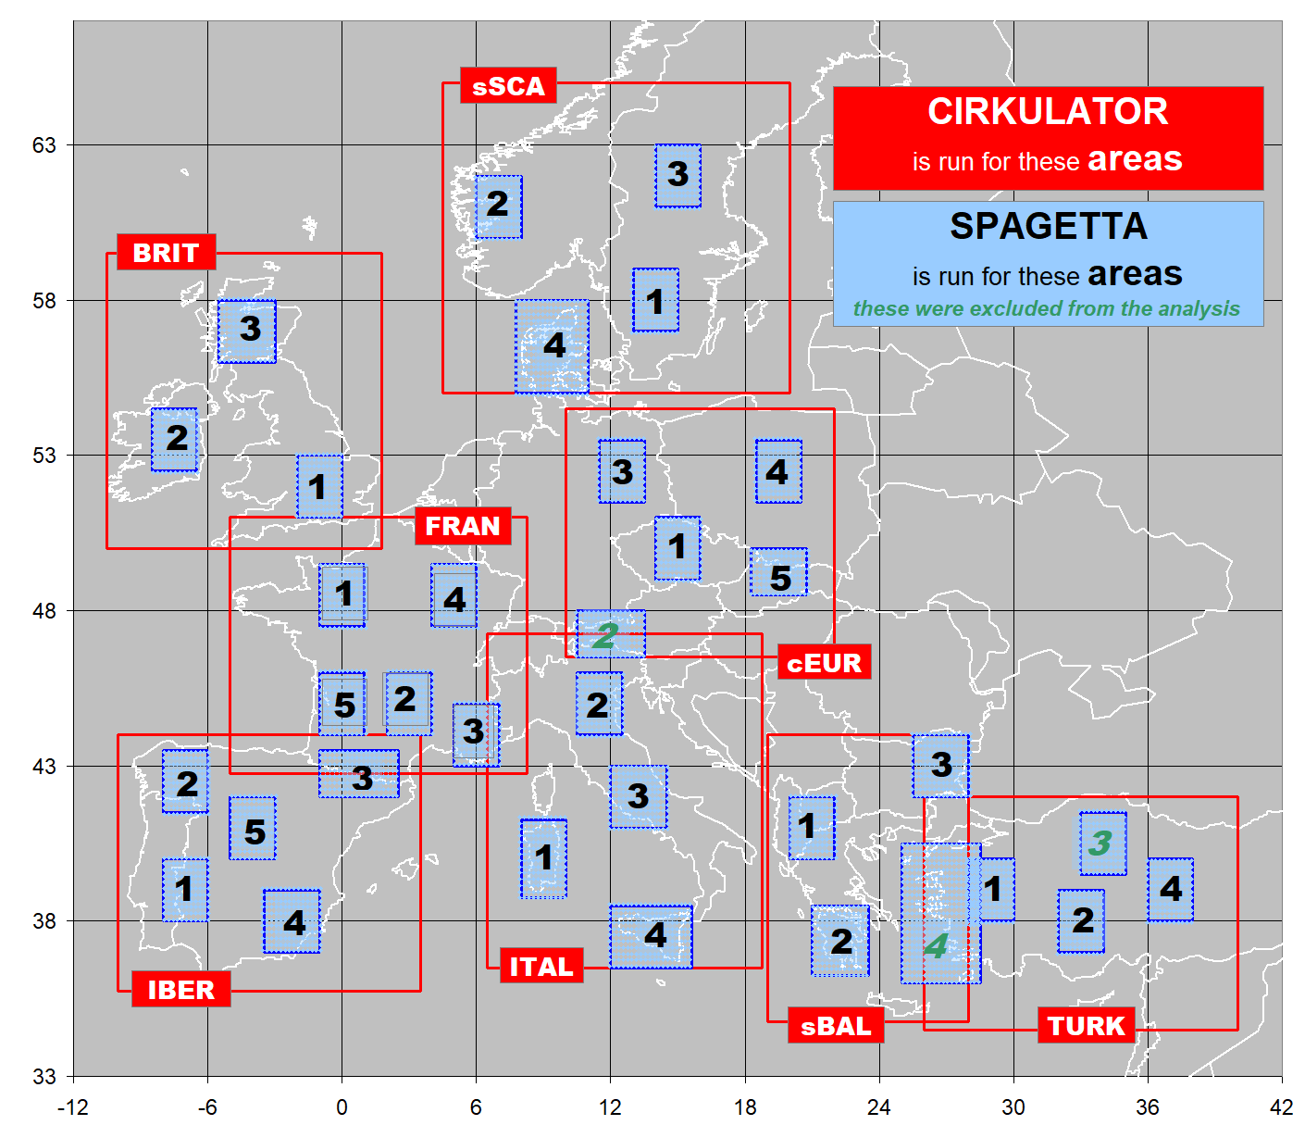
Step 4: Towards improving variability due to larger-scale circulation
Experiment: SPAGETTA (run on smaller areas) is driven by new CIRKULATOR generator run on larger area
CIRCULATOR run on red areas:
grid = 2.5º (NCEP-NCAR reanal.)
variables =
vorticity and (x,y) wind components from MSLP
T,P characteristics
model = AR(1) (~SPAGETTA)
SPAGETTA:
- Temp & Prec from EOBS (EUR11)
calibration period = 1961-90.
Target Regions
Notes:
standardised deviations from their mean annual cycle are modelled using

Slide 12
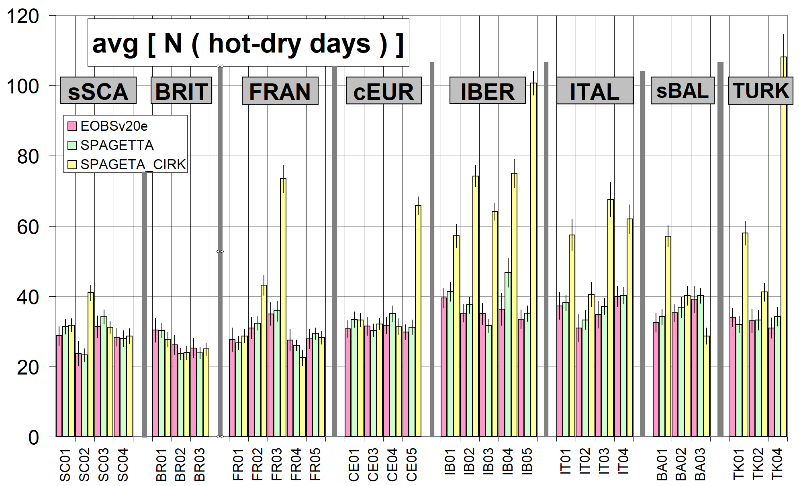
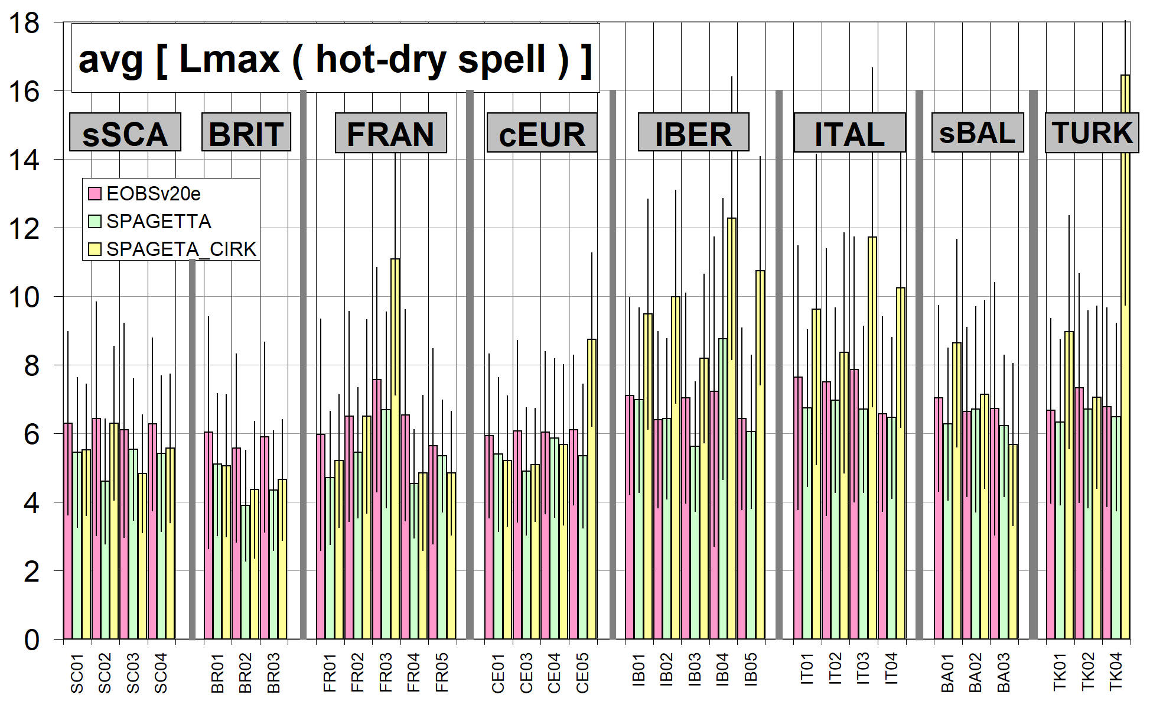
RESULTS: spatial hot-dry days/spells
!!!!
quality of time series generated by SPAGETTA driven by CIRKULATOR is not satisfactory!

Slide 13
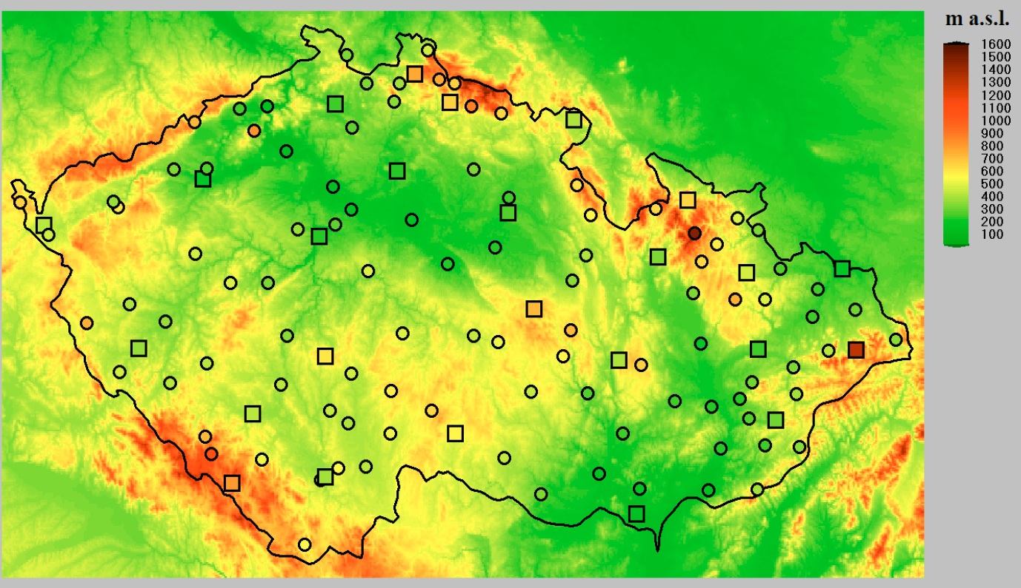
Step 5: Interpolating SPAGETTA
(stations → grid)
Experiment:
125 stations
in Czechia
- results available but not yet properly processed (because some major problems found… )
Notes:
The map was taken from 2006-grenoble-cost719.pdf

Slide 14
… and NOW, SPAGETTA is requested to provide realistic synthetic weather data for CC impacts projects…
… but, quality of synthetic weather series is not satisfactory …
… what are the main problems and how to solve them?
Notes:
standardised deviations from their mean annual cycle are modelled using

Slide 15
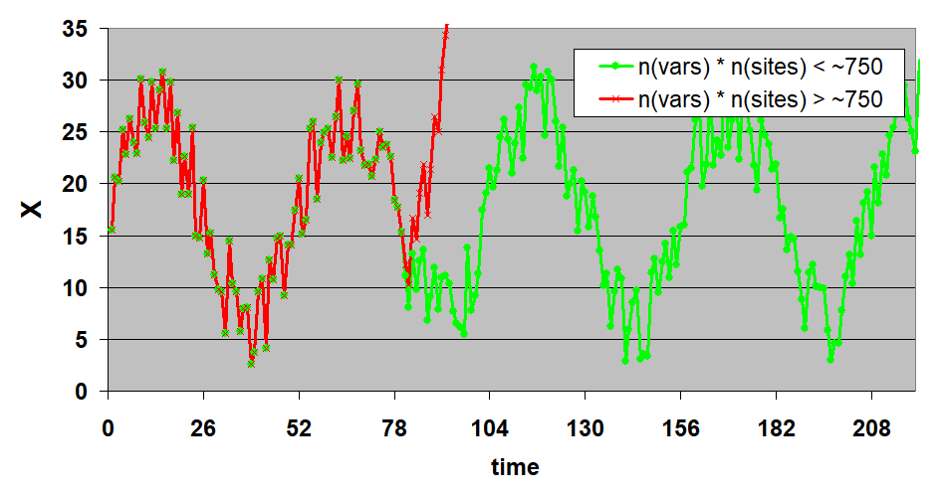
SPAGETTA in Adolescence: Problem #1
1. Matrices of AR model: When applied to time series of 6 variables for too many stations (N>150), the fitted AR model is unstable and the synthetic time series quickly diverges (red line)
Cause of the problem? (probably) when deriving matrices of AR model from extremely large covariance matrices (consisting of even more than 1 million numbers) numerical errors due to finite decimal representation of the real numbers imply unrealistic resulting matrices of AR model.
Solution? Several approaches were designed to simplify or “smooth” the covariance matrices. Though none of the approaches provides perfect solution, 1 approach works.
(similar problem emerges when interpolating AR matrices for interpolated WG)

Slide 16
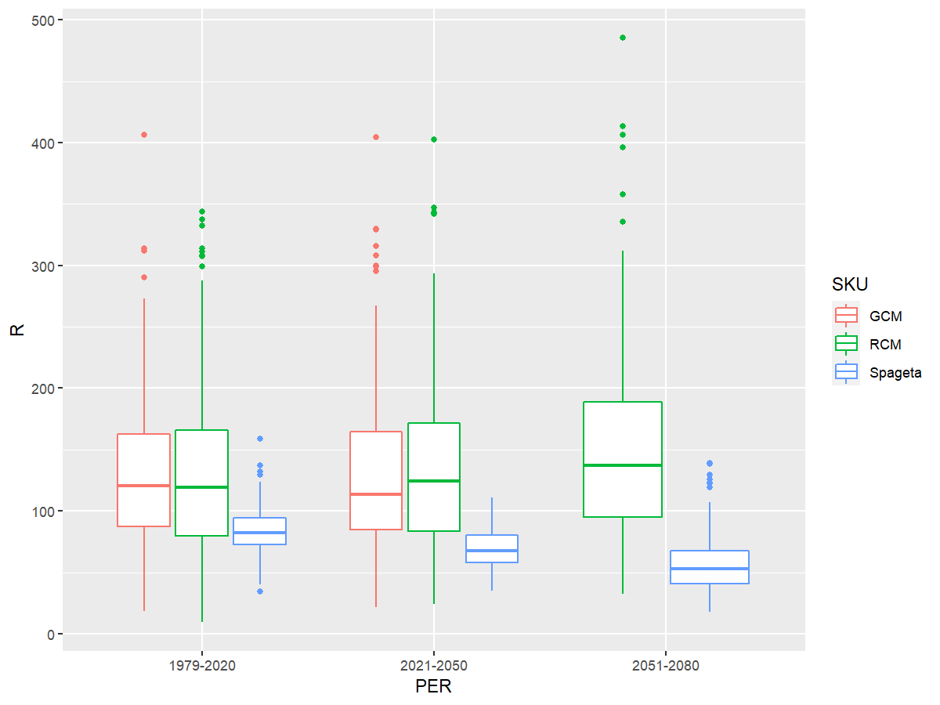
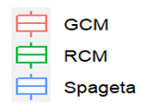
SPAGETTA in Adolescence: Problem #2
2. Underestimated interannual variability
Figure: Outputs from the hydrological model fed by synthetic weather series show significantly biased means and too low interannual variability.
Cause of the problem? present version of the SPAGETTA generator does not explicitely account for the low-frequency weather variability.
Solution? New monthly WG, which focuses on a proper representation of the low-frequency variability is now being developed and will be used to drive the SPAGETTA generator (similarly to GCM being used to drive RCMs).

Slide 17
END
END
The links to individual papers and conference contributions will be added in a couple of days☺
Notes:
having n-th term, X(n), (n+1)-th term is selected:
- K nearest neighbors of X(n) (using Mahalanobis distance to measure between-terms distance) are found in the learning series. These neighbours must satisfy conditions: (a) |JD-JD(n)|≤ ΔD days), (b) (optionally) the neighbours must be with the same precipitation category as X(n)
- X(n+1) is generated from this set. Several algorithms were considered, X(n+1) =

Slide 18
List of papers and conference presentation related to SPAGETTA
a) papers:
[P1] Dubrovský M, Huth R, Dabhi H, Rotach MW (2020) Parametric gridded weather generator for use in present and future climates: focus on spatial temperature characteristics, Theoretical and Applied Climatology, 139, 3-4 (doi:10.1007/s00704-019-03027-z)
[P2] Huth R, Dubrovský M (2021) Testing for Trends on a Regional Scale: Beyond Local Significance. Journal of Climate, 34, 13, 5349-5365 (doi: 10.1175/JCLI-D-19-0960.1)
b) Selected conference presentations
[C1] Dubrovsky M, Dabhi H, Huth R and Rotach MW: Simulation of Temperature-Precipitation Compound Events by a Spatial Weather Generator vs. Regional Climate Models. In: EGU General Assembly 2018, Vienna, 8-13.4.2018 (https://www.egu2018.eu/) [poster]
[C2] Dubrovsky M, Stepanek P, Lhotka O and Miksovsky J: Spatial Compound Event Spells in Present and Future Climates – Weather Generator vs Regional Climate Models. In: EMS Annual Meeting: European Conference for Applied Meteorology and Climatology 2018, Budapest, 2-7. 9.2018 (https://www.ems2018.eu/) [poster]
[C3] Lhotka O and Dubrovsky M: Conditioning stochastic weather generator on atmospheric circulation – preliminary assessment. In: EMS Annual Meeting: European Conference for Applied Meteorology and Climatology 2018, Budapest, 2-7. 9.2018 (https://www.ems2018.eu/) [poster]
[C5] Dubrovsky M, Lhotka O, Stepanek P and Miksovsky J: Simulation of Present and Future Spatial Compound Events in Mediterranean (and elsewhere) – Weather Generator vs. Regional Climate Models. In: Medclivar 2018 Conference. Belgrade, 17-21. 9. 2018 (http://www.medclivar2018conf.eu) [poster]
[C7] Dubrovsky M, Stepanek P, Miksovsky J, Lhotka O, Meitner J and Skalak P: Spatial Temperature-Precipitation Compound Events in Europe: Weather Generator vs. Regional Climate Models, Future vs. Present Climate. In: AGU Fall Meeting, Washington, 10-14.12.2018. (https://fallmeeting.agu.org/2018/) [poster]
[C8] Dubrovsky M, Lhotka O, Stepanek P, Miksovsky J, Meitner J: Involvement of Stochastic Weather Generators within the DAMOCLES project. In: EGU General Assembly 2019, Vienna (Austria), 7-12.4.2019 (https://www.egu2019.eu/). [oral: www.ufa.cas.cz/dub/prasce/2019-egu-wg&compoundevents~mad.pdf]
[C9] Dubrovsky M, Salis M, Mozny M, Duce P, Stepanek P, Jan Meitner: Modelling Present and Future Wildfire Risk: Weather Generator vs. Regional Climate Models. in: The 6th Fire Behavior and Fuels Conference, Marseille (France), 29.4.-3.5.2019 (http://marseilles.firebehaviorandfuelsconference.com/). [poster: http://www.ufa.cas.cz/dub/prasce/2019-marseille-spagetta~mad.pdf]
[C10] Lhotka O, Dubrovský M, Trnka M, Balek J, Kyselý J, Možný M: Links between increasing drought severity and atmospheric circulation over Central Europe. In: EMS Annual Meeting, Copenhagen (Hungary), 9-13.9.2019 (https://www.ems2019.eu/) [poster]
[C11] Dubrovsky M, Huth R, Lhotka O, Miksovsky J, Stepanek P, Meitner J, Trnka M: Stochastic Weather Generators in Czechia: 25 Years of Their Development and Applications. In: 6th International conference on Time Series and Forecasting, Granada (Spain), 25-27.9.2019 (http://itise.ugr.es/) [oral: http://www.ufa.cas.cz/dub/prasce/2019-itise-wgenerators~mad.pdf]
[C12] Dubrovsky M, Lhotka O, Miksovsky J, Salis M, Stepanek P, Skalák P, Meitner J: Employment of Compound Events in Developing and Validating the Stochastic Spatial Weather Generator. In: AGU Fall Meeting, San Francisco, 9-13.12.2019. (https://fallmeeting.agu.org/2019/) [poster: www.ufa.cas.cz/dub/prasce/2019-agu-spagetta~mad.pdf]
[C16] Dubrovsky M, Lhotka O, Miksovsky J: Simulation of Spatial Temperature-Precipitation Compound Events with Circulation-Conditioned Weather Generator. In: EGU General Assembly 2020, online, 4.-8.5.2020 (https://www.egu2020.eu/). [poster]
[C18] Dubrovský M., Lhotka O., Štěpánek P., Mikšovský J., Meitner J.: Vývoj prostorového meteorologického generátoru s vysokým rozlišením pro použití v současném i změněném klimatu. in: Seminar of the Czech Meteorological Society (21-23.9.2021; Louny, Czechia) [oral]
Notes:
standardised deviations from their mean annual cycle are modelled using

