Slide 1
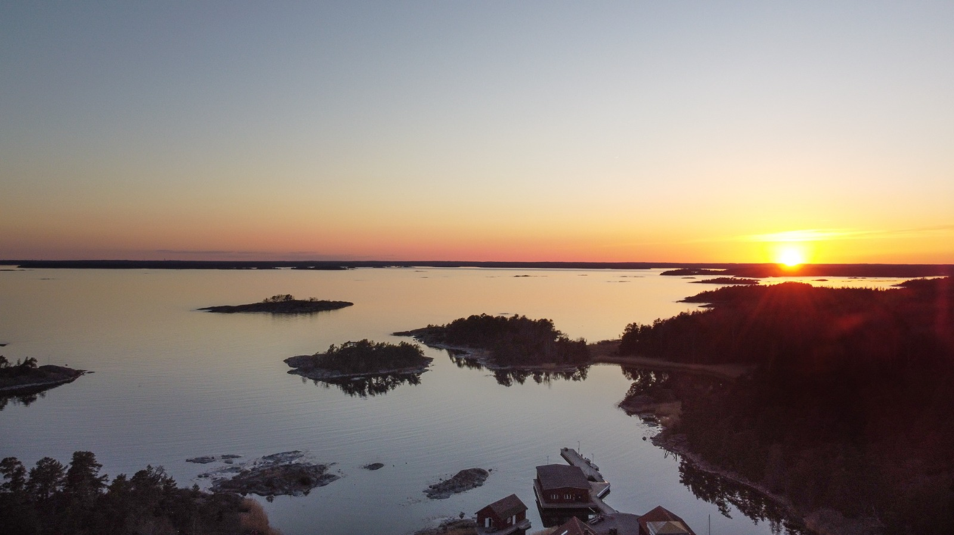

Hidden Hypoxia in Coastal Waters
Presenter: Jonas Fredriksson
Co-authors: Karl Attard, Christian Stranne, and Volker Brüchert
Photo: Petter Hällberg

Slide 2
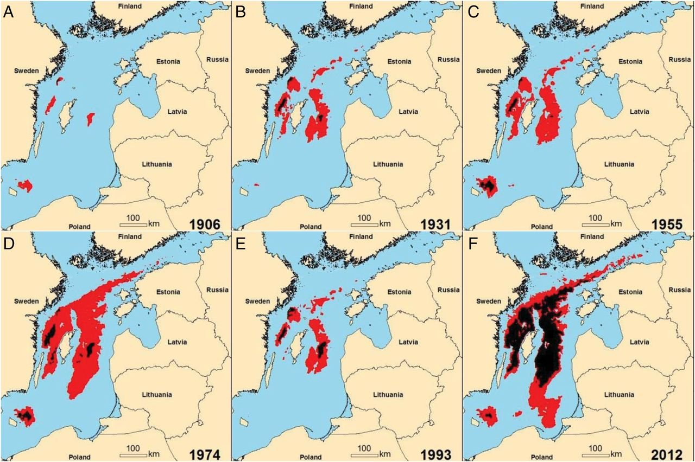
Oxygen deficient areas have increased in the Baltic Sea during the last century
Jacob Carstensen, Jesper H. Andersen, Bo G. Gustafsson, and Daniel J. Conley (PNAS, 2014) https://doi.org/10.1073/pnas.1323156111

Slide 3
What do we mean with ”Hidden hypoxia”?
Many measurements taken from a ship will overestimate benthic oxygen availability. Sometimes grossly. And can not be ”seen” through conventional monitoring.
Transient short time low oxygen events that occur within a few centimeters of the sediment surface.

Slide 4
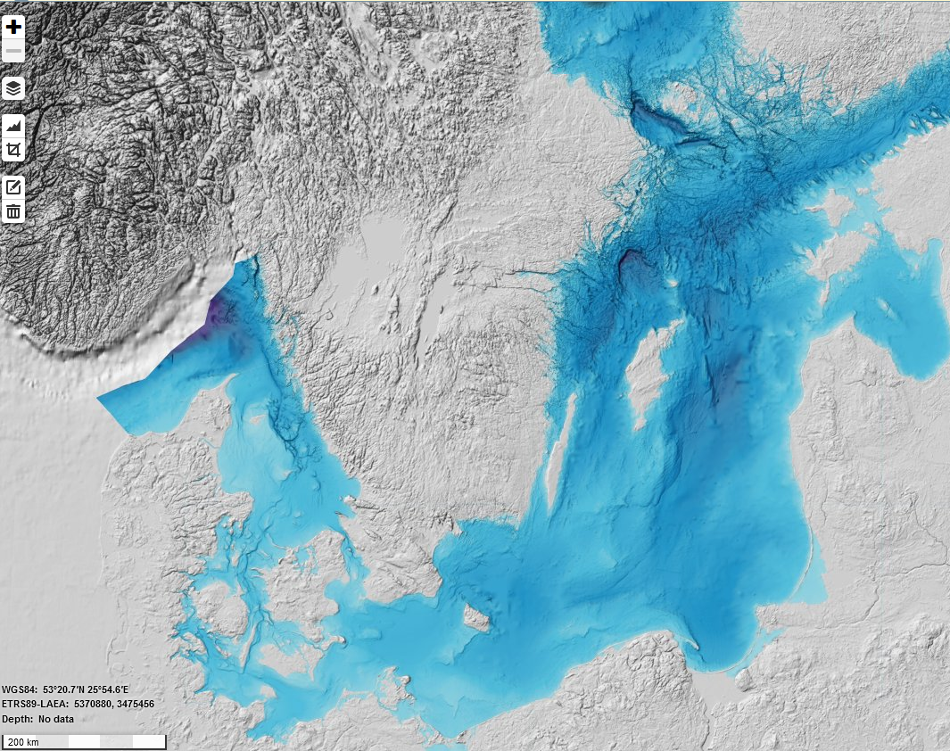
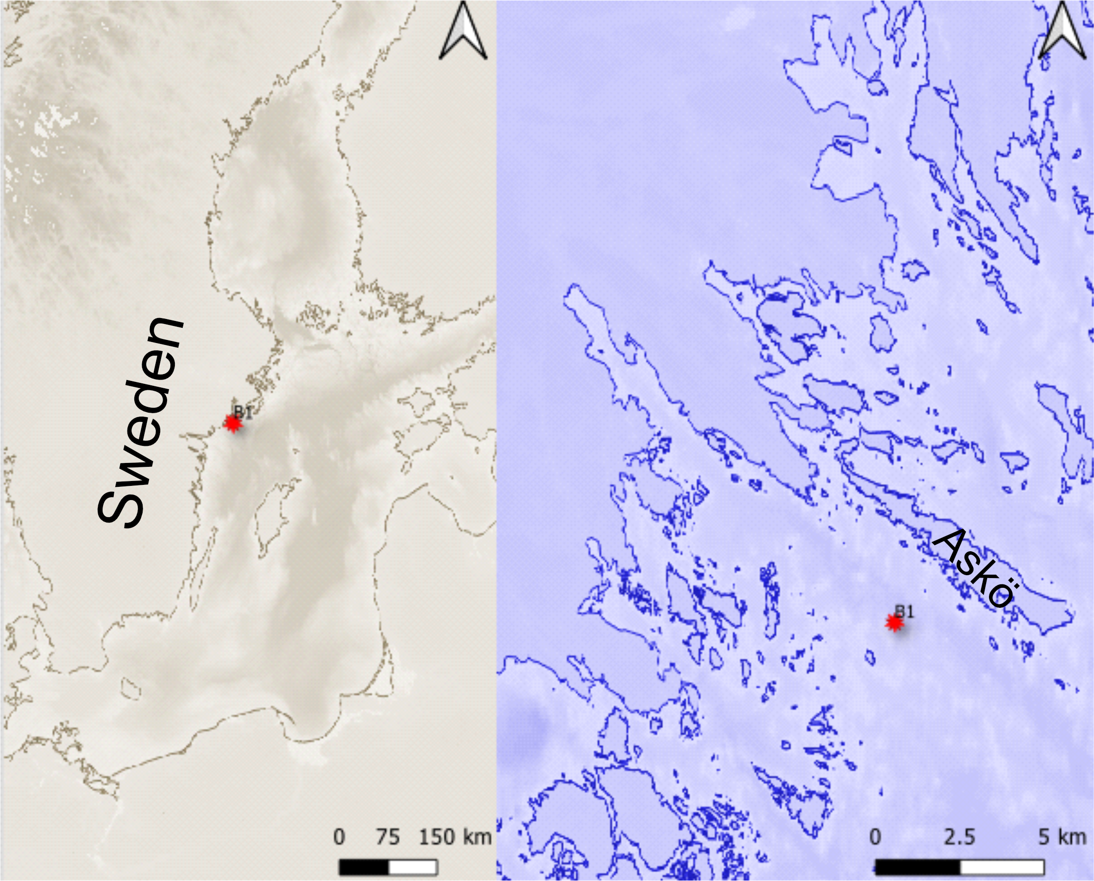
Location
Finland
Sweden
Estonia
Latvia
Lithuania
Poland

Slide 5
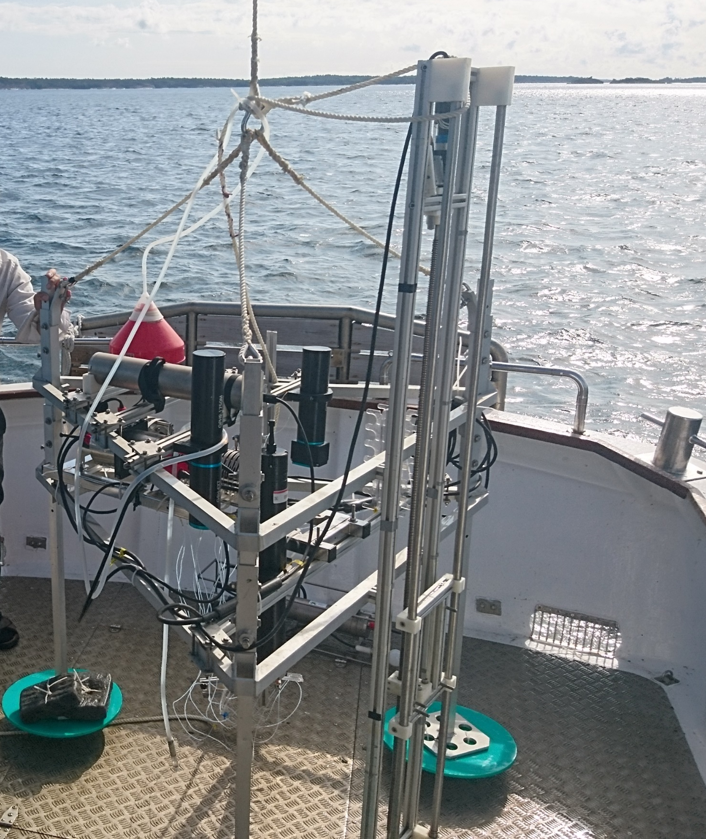
Lander instrument load
Lander 1
Eddy correlation system
Lander 2
Downlooking high frequency ADCP, 2 MHz
CTD, Profiling 0-40 cm above the seafloor
2 Aandera oxygen optodes
12-channel peristaltic pump
Slider for vertical profiling
ADCP
Peristaltic pump

Slide 6
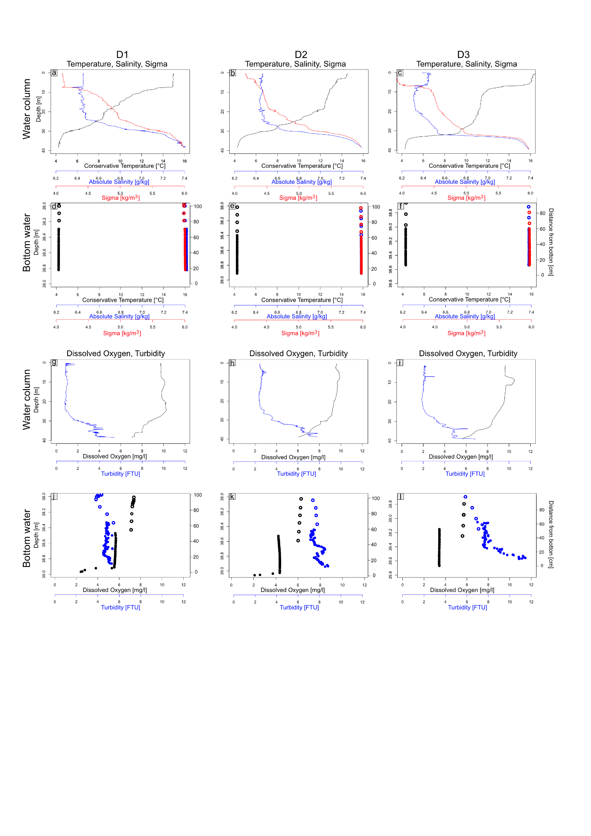
Regular Water column and ”benthic-lander” CTD casts

Slide 7
Regular Water column and ”benthic-lander” CTD casts

Slide 8
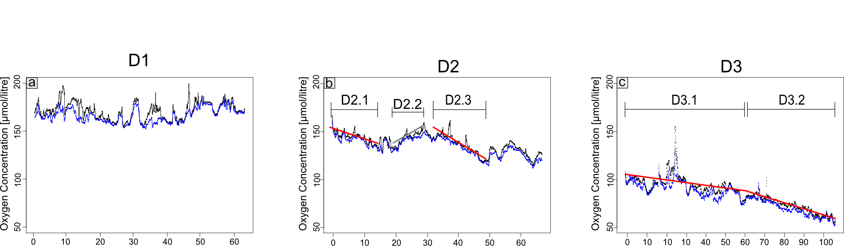
Benthic oxygen concentrations
measured 6 and 26 cm’s above the sea floor
For 3 deployments
Limit for hypoxia
Time [hours]
Notes:
Zooma in

Slide 9
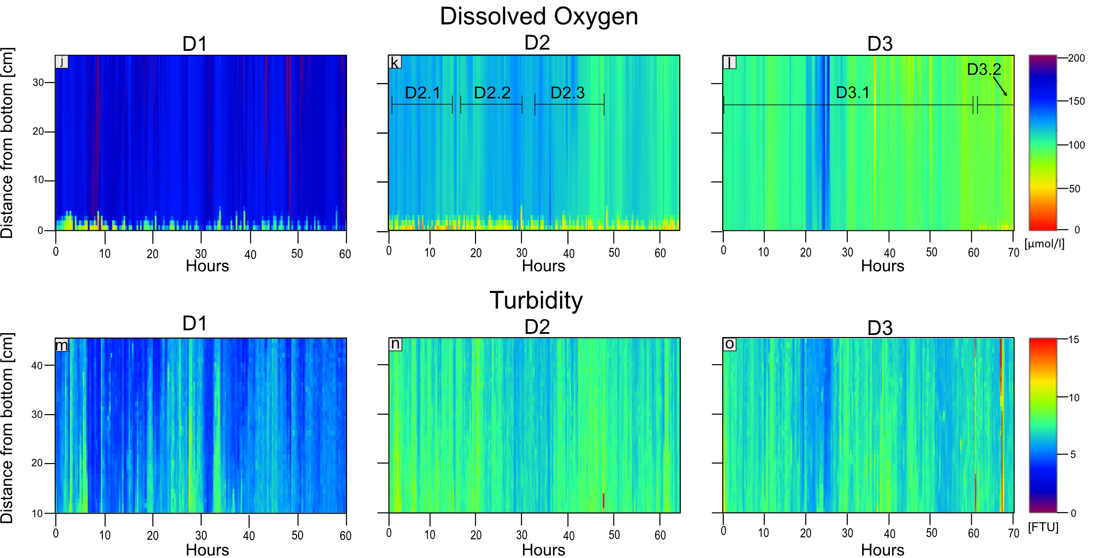
Benthic CTD profiles
Oxygen and Turbidity
Very well mixed
Oxygen gradients only develop close to the sediment surface
Intermittent anoxia within ~3cm of the sediment surface
Strong transient resuspension event

Slide 10

Benthic Oxygen Dynamics
Stationary optodes.
Measuring ~every 2 minutes
Located 6 and 26 cm from the seafloor
Convergece/Divergence
of bottom waters when
the currents change direction
Due to changes in lateral transport
Resuspension event
Time [hours]

Slide 11
Take Home Message
Transient bottom water hypoxia can occur virtually undetected by conventional methods.
The extent of coastal hypoxia is underestimated.
Short time scale hypoxic events occur ubiquitously near the sediment water interface.
Changes are mainly due to physical drivers. However, short term resuspension events can leave long lasting effect on oxygen uptake rates.
This dynamic is not captured by in vitro nor benthic box experiments.
Thank You
Questions?

Slide 12
Bonus slides for the intrepid downloader.

Slide 13
Future work
We are currently working on correlating oceanographic drivers and how they correlate with changes in benthic oxygen.
Expanded collection of field data encompassing spring to fall.
Further:
Modelling of costal currents can help identify areas with low effective water transport.

Slide 14
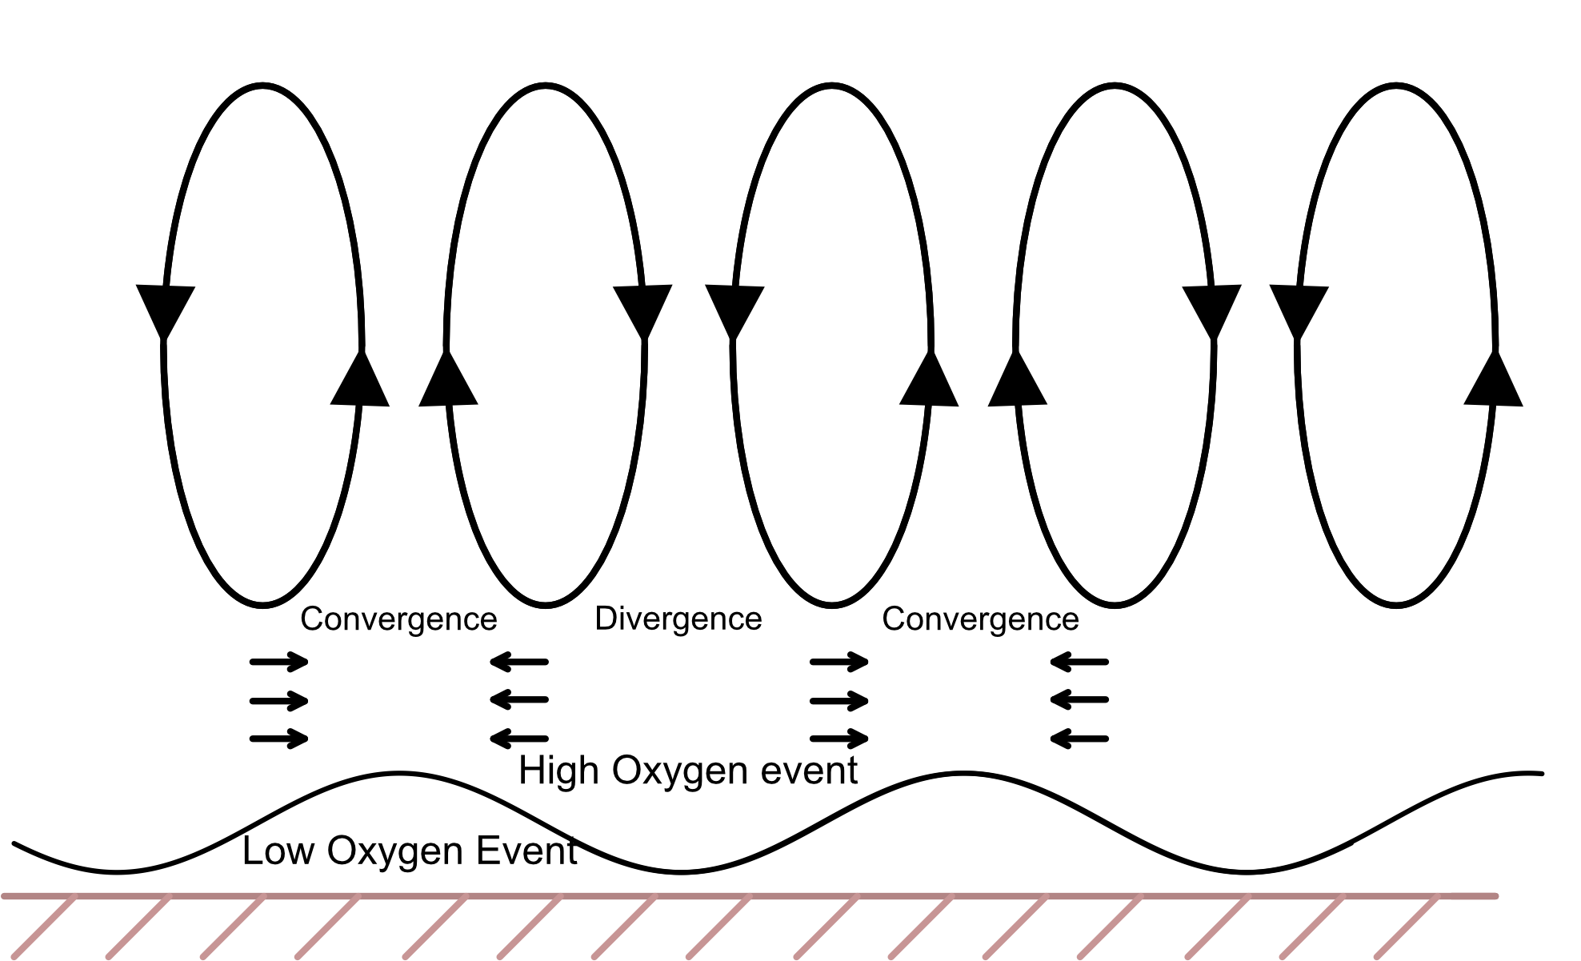
Low O2

Slide 15
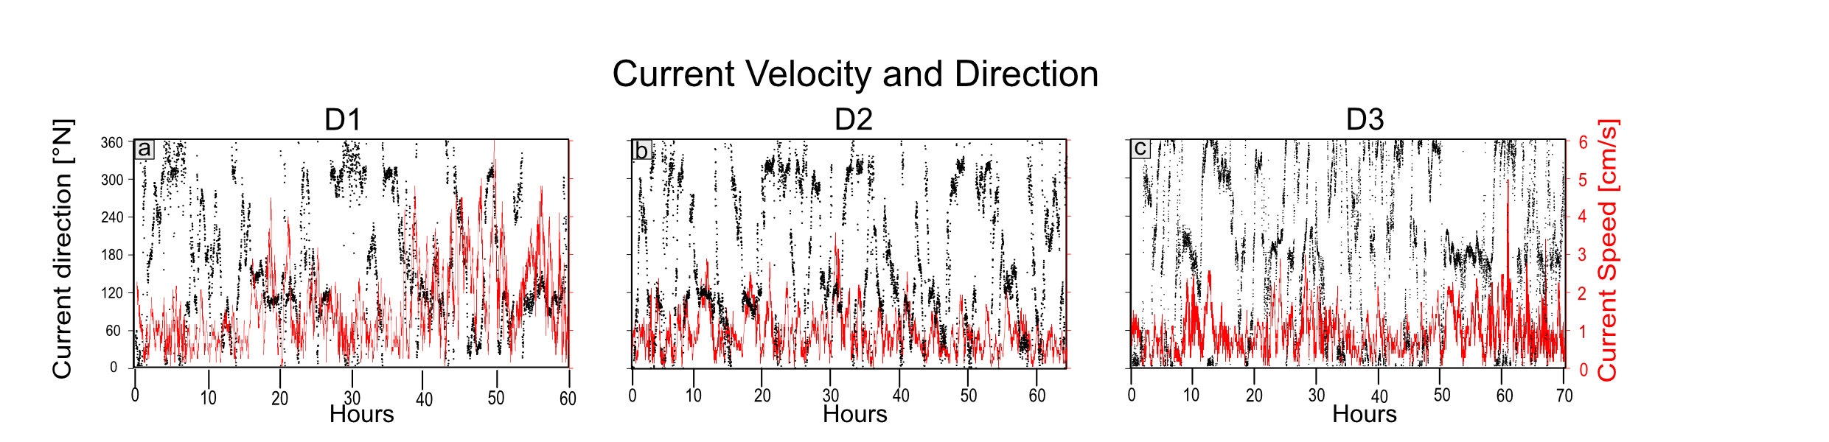

Notes:
Zooma in

Slide 16

