Slide 1














Effects of sudden stratospheric warmings on the observed near-surface wind speed in the northern hemisphere, 1961-2021
Eduardo Utrabo-Carazo^{1,2}, Cesar Azorin-Molina¹, Robert J. H. Dunn³, Enric Aguilar⁴, Manola Brunet⁴
¹
²
³
⁴
eduardo.utrabo@ext.uv.es
We acknowledge support from the FPI grant (PRE2019-090148), the IBER-STILLING project RTI2018-095749-A-100 (MCIU/AEI/FEDER,UE), the VENTS project AICO/2021/023 (GVA), the CSIC Interdisciplinary Thematic Platform PTI-CLIMA and Lorenzo Minola for the Scandinavia data.
@ClimatocLab

Slide 2

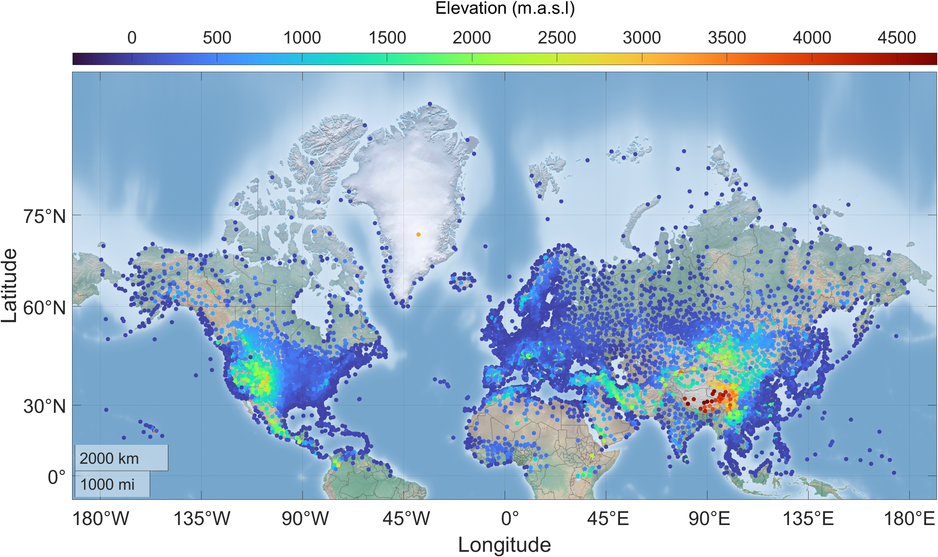
How does near-surface wind speed change under a sudden stratospheric warming (SSW) event?
Are there significant differences in wind speed between a SSW and a strong polar vortex situation?
OBJECTIVES
* Initially, the purpose was to present results for the entire Northern Hemisphere from the HadISD database. However, the quality control and homogenization protocol is very time-consuming and has not been completed in time. This process is essential to be able to analyse the observed wind series.

Slide 3


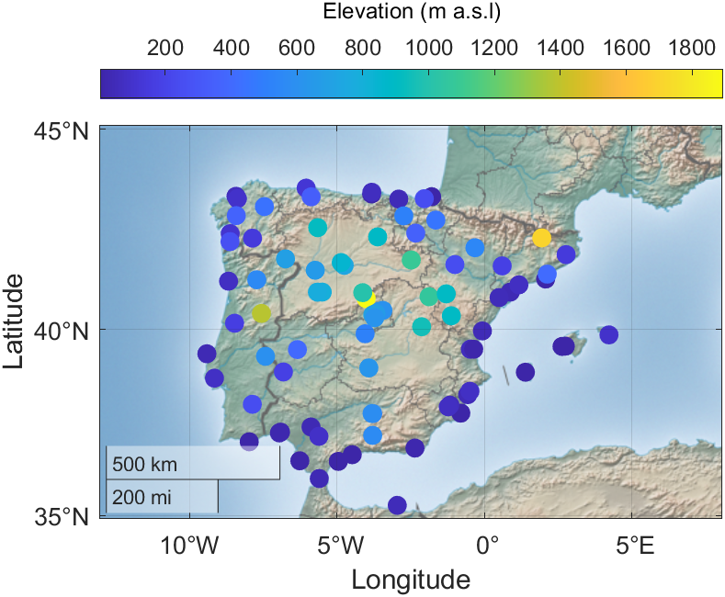
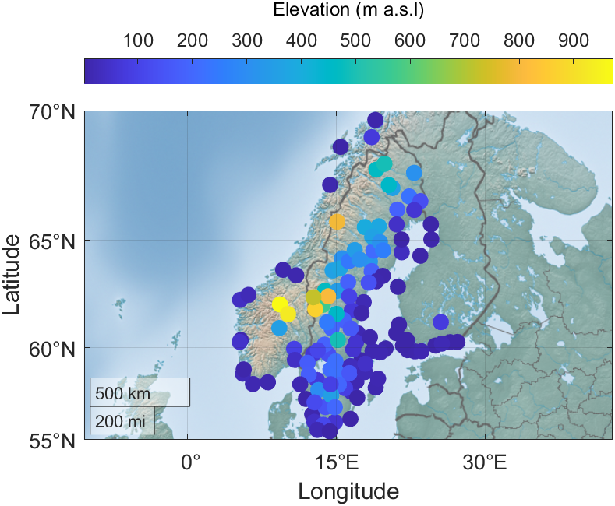
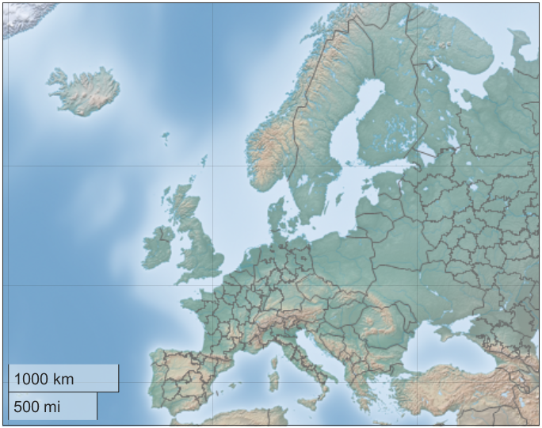
DATA
Daily Peak Wind Gust (DPWG):
87 stations across the Iberian Peninsula (Spain and Portugal), from 1961-2019 (long period)
127 stations across Scandinavia (Norway, Sweden and Finland), from 1996-2016 (short period)
We calculate the DPWG anomalies as the difference of the value minus the climatology of the month to which the particular day belongs. This climatology will be 1981-2010 for the long period and 1996-2016 for the short period.
(Utrabo-Carazo et al. 2022)
STUDY AREA
(Minola et al. 2021)

Slide 4

METHODS
SSW with tropospheric signal (SWS) | SSW (tropospheric signal) | SSW without tropospheric signal (SSWno) | Strong polar vortex, > 60 m/s (PolarVortex)
January 28, 1963 | December 16, 1965 | February 23, 1966 | January 19, 1974
January 7, 1968 | November 28, 1968 | March 13, 1969 | January 11, 1976
March 20, 1971 | January 9, 1977 | January 2, 1970 | December 28, 1980
February 22 1979 | February 29, 1980 | January 18, 1971 | January 10, 1983
March 4 1981 | December 4 1981 | January 31, 1973 | December 20, 1985
February 24 1984 | January 1, 1985 | January 23, 1987 | December 26, 1990
March 14, 1988 |  | December 8, 1987 | January 15, 1991
 |  | February 21, 1989 | -
December 15, 1998 |  | December 30, 2001 | January 11, 2000
February 26, 1999 | March 20, 2000
February 11, 2001 | January 5, 2004 | January 18, 2003 | January 18, 2005
January 21, 2006 | February 22, 2008
January 24, 2009 | February 9, 2010 | February 24, 2007 | Januay 22, 2016
March 24, 2010 | January 6 2013
February 12, 2018 |  | January 2, 2019 | -
Hall et al. 2021 describes the methodology followed to determined and classify these events.
We calculate the mean of DPWG anomalies between days 10 and 60 after the dates shown here, and we will average over each set of events.
We determine the difference between the means of these events, and the statistical significance of that difference via Student's t test at a 99% significance level.
Since we are going to average over a considerable number of events whose characteristics may vary, part of the signal will be lost during the analysis. In future work, we will try to analyse each case individually according to its particularities, such as whether it is a split or a displacement event.

Slide 5

RESULTS
(Iberian Peninsula, long period)
Positive DPWG anomalies in the whole region following a SSW with tropospheric signal, and a majority of negative anomalies for the strong polar vortex events and SSW without tropospheric signal.
During a SSW with tropospheric signal, the DPWG anomalies are higher than during a strong polar vortex or a SSW without tropospheric signal in almost all the region, being this difference statistically significant (p<0.01) in most of the stations. The ones that do not comply with this are located over the Ebro valley to the northeast of the peninsula.
North-south pattern in the significant differences between strong polar vortex events and SSW without tropospheric signal, these differences could indicate that this kind of SSW do have a signal in the troposphere although not large enough to produce a change in the North Atlantic Oscillation.

Slide 6
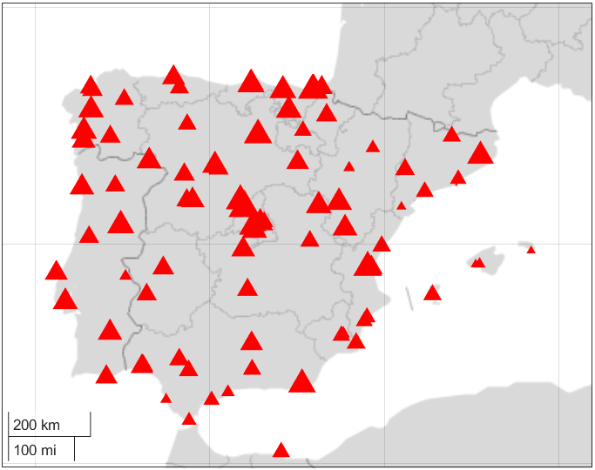
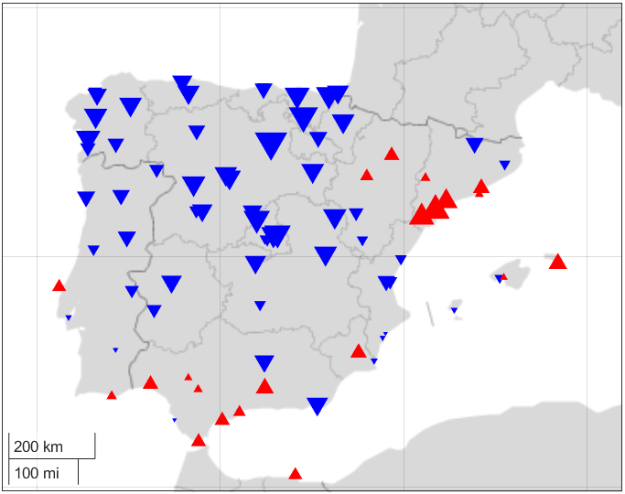
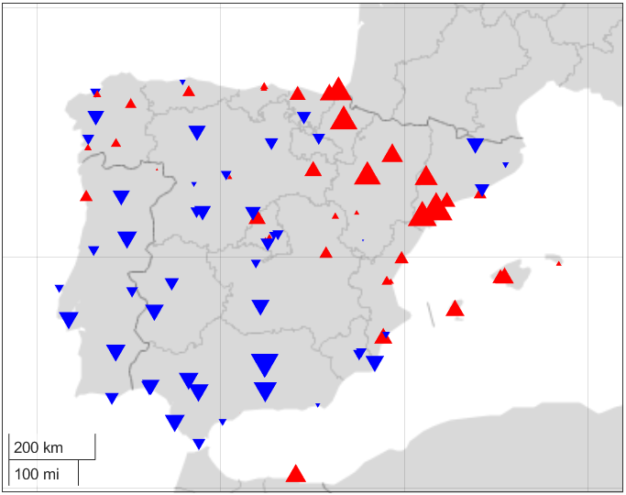




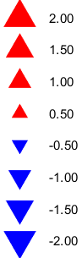
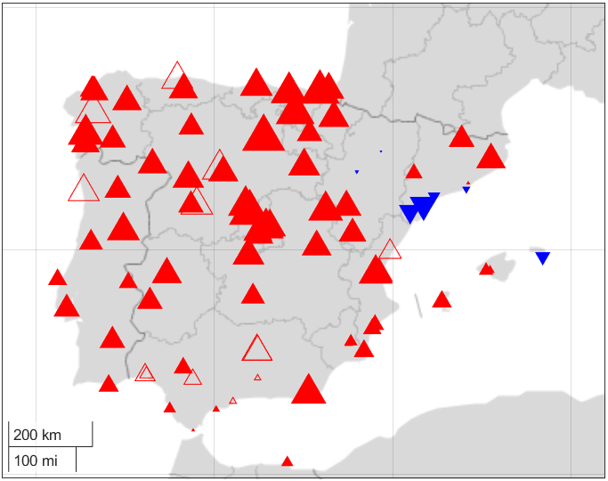
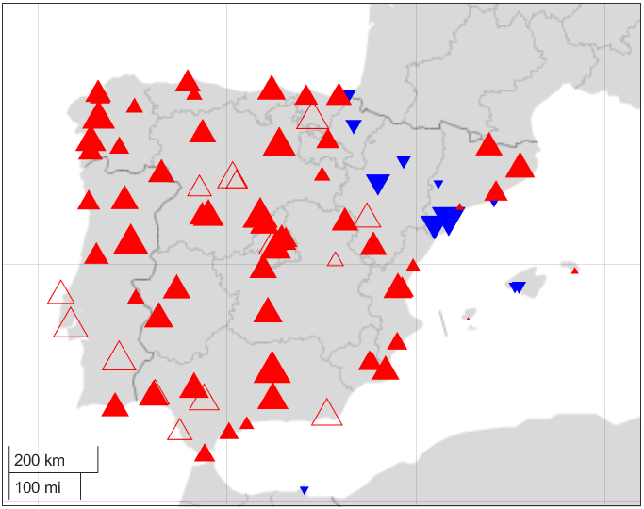
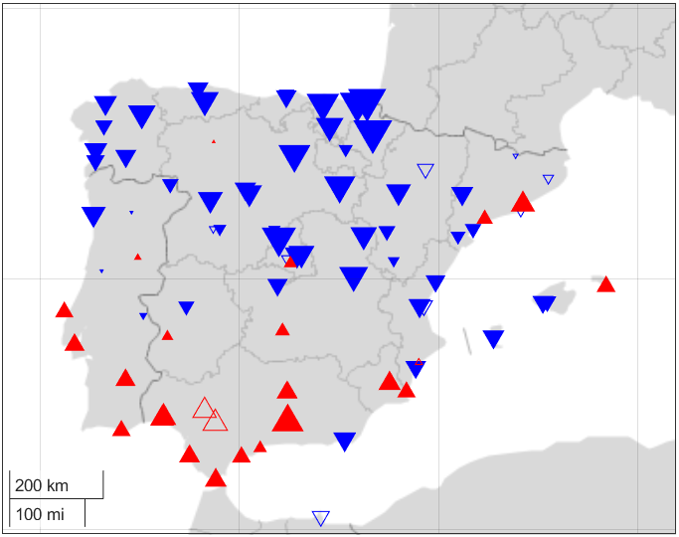
DPWG anomalies after SSW
DPWG anomalies after PolarVortex
DPWG anomalies after SSWno
Non-significant
Significant
m s⁻¹
Difference SSW - PolarVortex
Difference SSW - SSWno
Difference PolarVortex - SSWno

Slide 7
RESULTS
(Scandinavia, short period)
Widespread negative DPWG anomalies across the whole region after a SSW with tropospheric signal and a majority of positive anomalies after a strong polar vortex event and SSW without tropospheric signal.
During a SSW with tropospheric signal, the DPWG anomalies are lower than during a strong polar vortex or a SSW without tropospheric signal in almost all the region, being this difference statistically significant (p<0.01) in most of the stations.
There is no clear pattern in the DPWG anomaly differences between strong polar vortex events and SSW without tropospheric signal, most of them being non-significant.

Slide 8
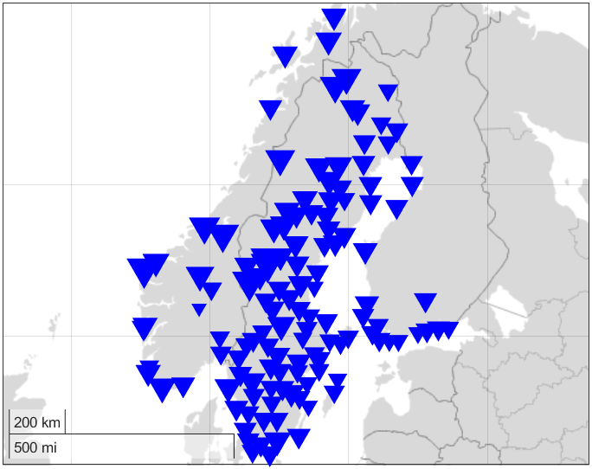
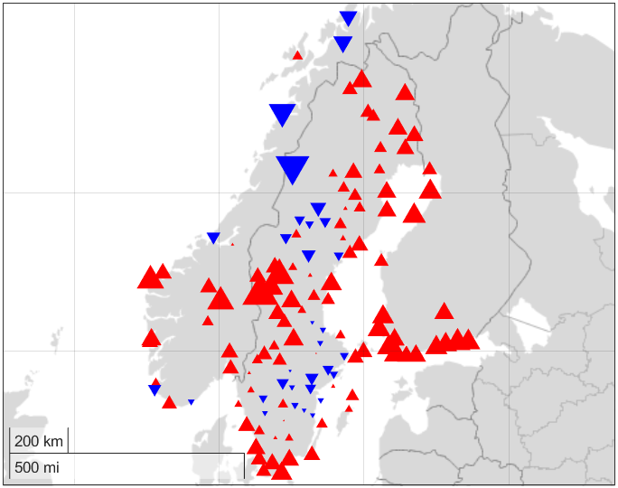
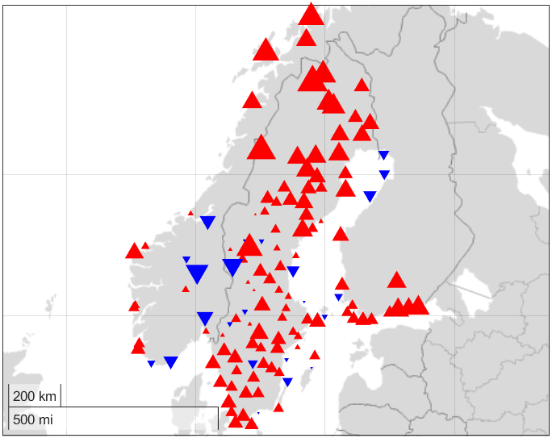

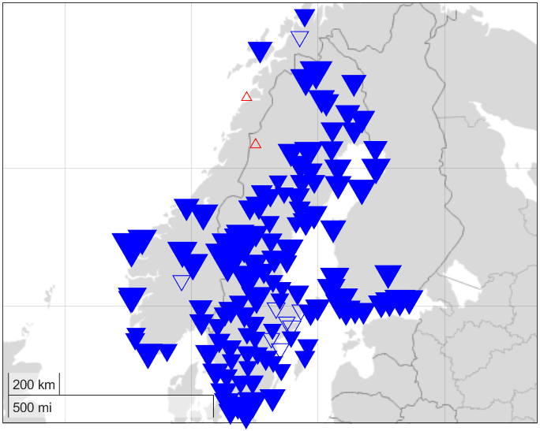
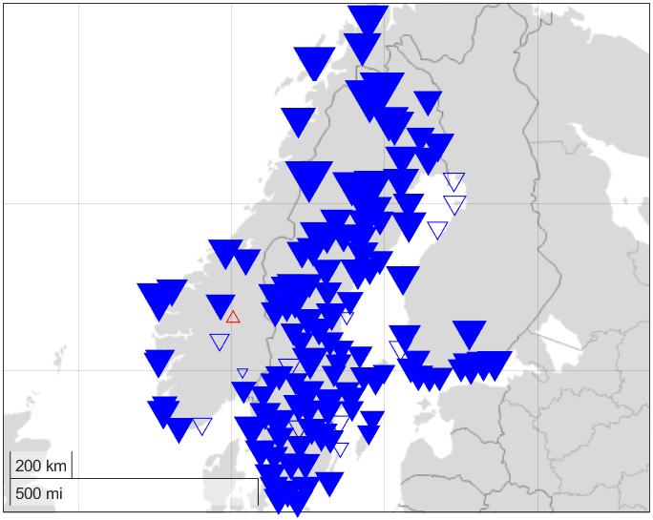
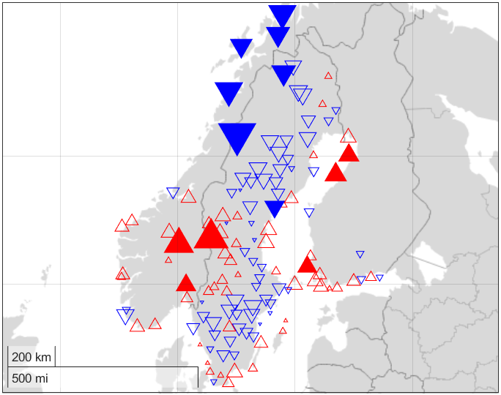
DPWG anomalies after SSW
DPWG anomalies after PolarVortex
DPWG anomalies after SSWno
Non-significant
Significant
m s⁻¹
Difference SSW - PolarVortex
Difference SSW - SSWno
Difference PolarVortex - SSWno

Slide 9
RESULTS
(Iberian Peninsula, short period)
The results are inverse to those obtained in Scandinavia, which is consistent with a negative North Atlantic Oscillation pattern following a SSW with a tropospheric signal.
In general, the anomalies and differences in the Iberian Peninsula are of lower magnitude than those obtained in Scandinavia.
For this period, the north-south pattern, which we obtained in the longer period, does not appear. This would reinforce the idea of the need to analyze all these events individually, since the previous state of the troposphere could influence the results.

Slide 10
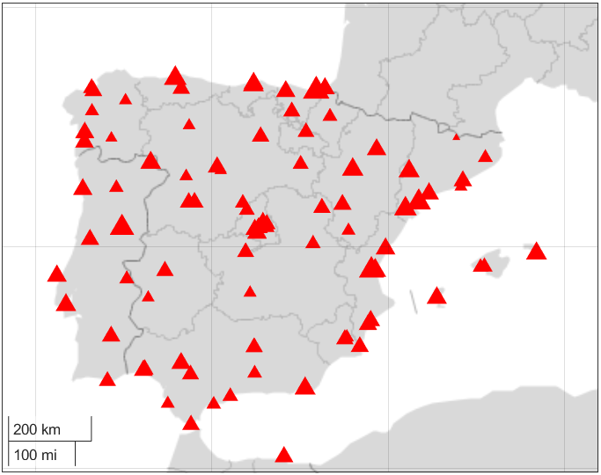
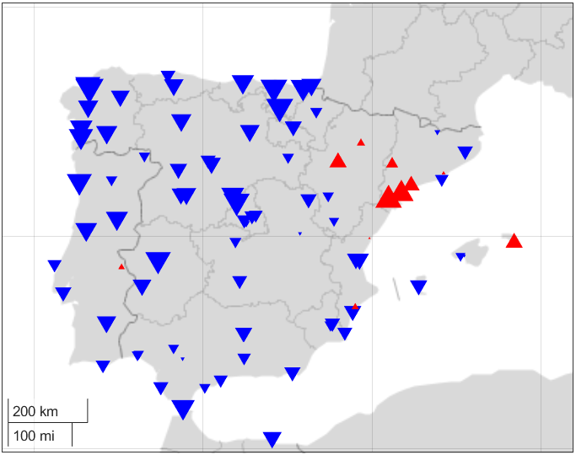
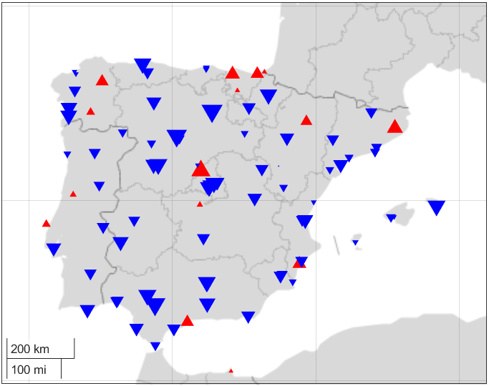
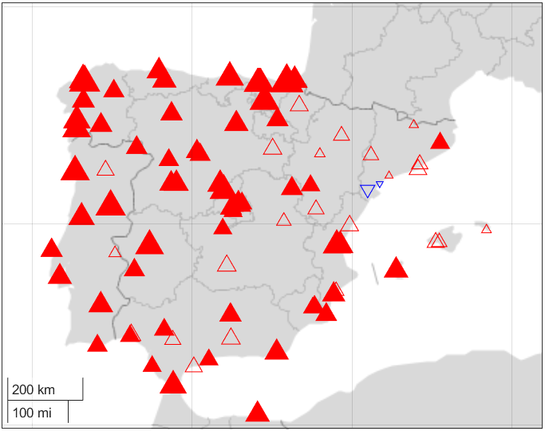
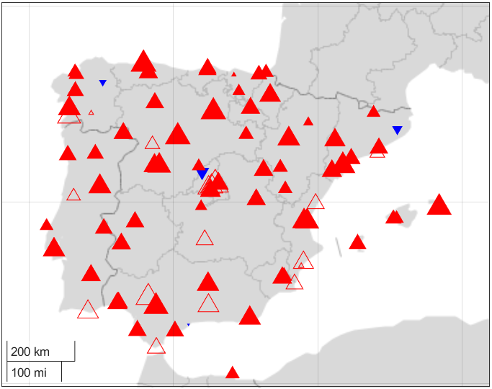
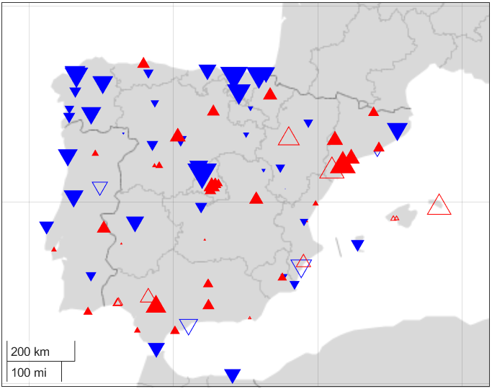
DPWG anomalies after SSW
DPWG anomalies after PolarVortex
DPWG anomalies after SSWno
Non-significant
Significant
m s⁻¹
Difference SSW - PolarVortex
Difference SSW - SSWno
Difference PolarVortex - SSWno

Slide 11

REFERENCES
Hall, R. J., Mitchell, D. M., Seviour, W. J. M., & Wright, C. J. (2021). Tracking the stratosphere-to surface impact of Sudden Stratospheric Warmings. Journal of Geophysical Research: Atmospheres, 126, e2020JD033881. https://doi.org/10.1029/2020JD033881
Minola, L., Azorin-Molina, C., Guijarro, J. A., Zhang, G., Son, S.-W., & Chen, D. (2021). Climatology of near-surface daily peak wind gusts across Scandinavia: Observations and model simulations. Journal of Geophysical Research: Atmospheres, 126, e2020JD033534. https://doi.org/10.1029/2020JD033534
Utrabo-Carazo, E., Azorin-Molina, C., Serrano, E., Aguilar, E., Brunet, M., and Guijarro, J.A. (2022). Wind stilling ceased in the Iberian Peninsula since the 2000s. Atmospheric Research, 272, 106153. https://doi.org/10.1016/j.atmosres.2022.106153

