Slide 1







NEW INSIGHTS INTO THE LAST GLACIAL CYCLE IN THE SOUTH-EASTERN EUROPEAN ALPS FROM THE GLACIAL GEOMORPHOLOGICAL RECORD OF THE MONTE CAVALLO (NE ITALY)
Lukas Rettig¹, Irka Hajdas², Giovanni Monegato³, Paolo Mozzi¹, and Matteo Spagnolo⁴
(lukas.rettig@phd.unipd.it)
¹Department of Geosciences, University of Padua, Padua, Italy
²Institute of Particle Physics, ETH Zurich, Zurich, Switzerland
³CNR-IGG Padova, Italy
⁴School of Geosciences, University of Aberdeen, Aberdeen, United Kingdom

Slide 2
1) ICE EXTENT DURING THE LAST GLACIAL MAXIMUM IN THE SOUTH-EASTERN ALPS

Slide 3
Monte Cavallo
1) ICE EXTENT DURING THE LAST GLACIAL MAXIMUM IN THE SOUTH-EASTERN ALPS

Slide 4
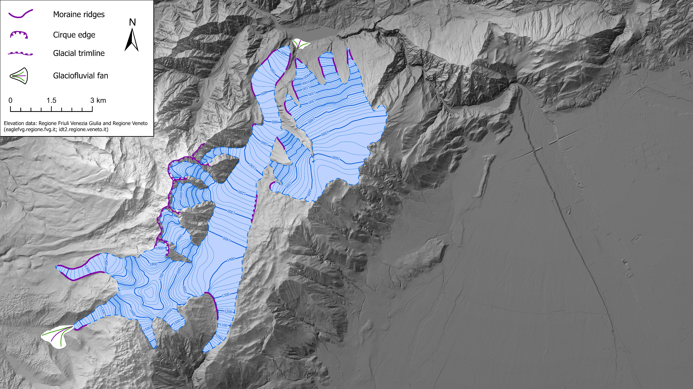
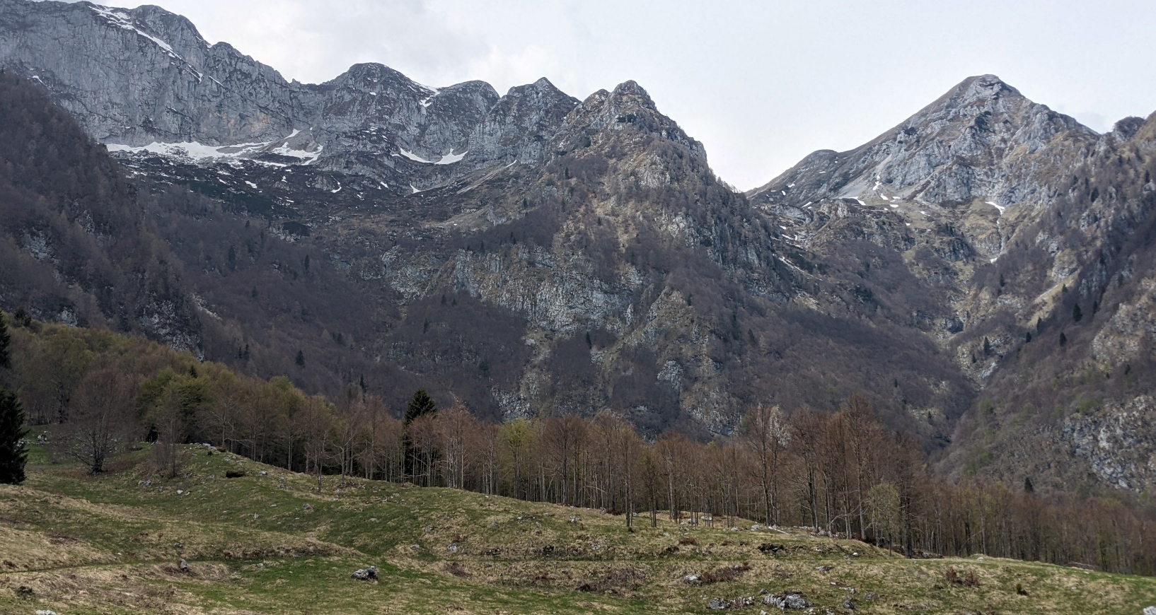
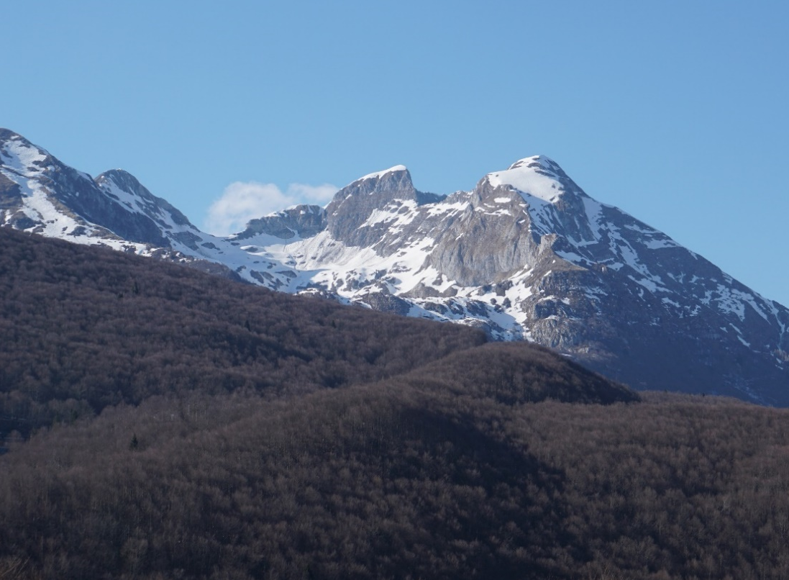
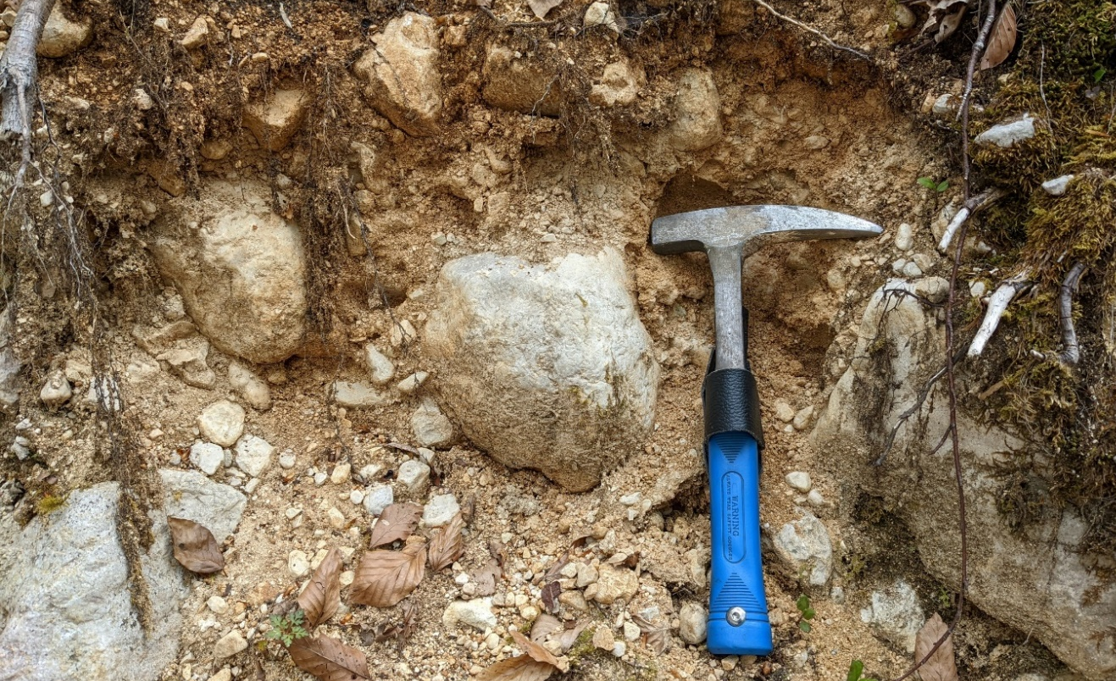
2) THE GLACIAL GEOMORPHOLOGICAL RECORD OF THE MONTE CAVALLO GROUP

Slide 5
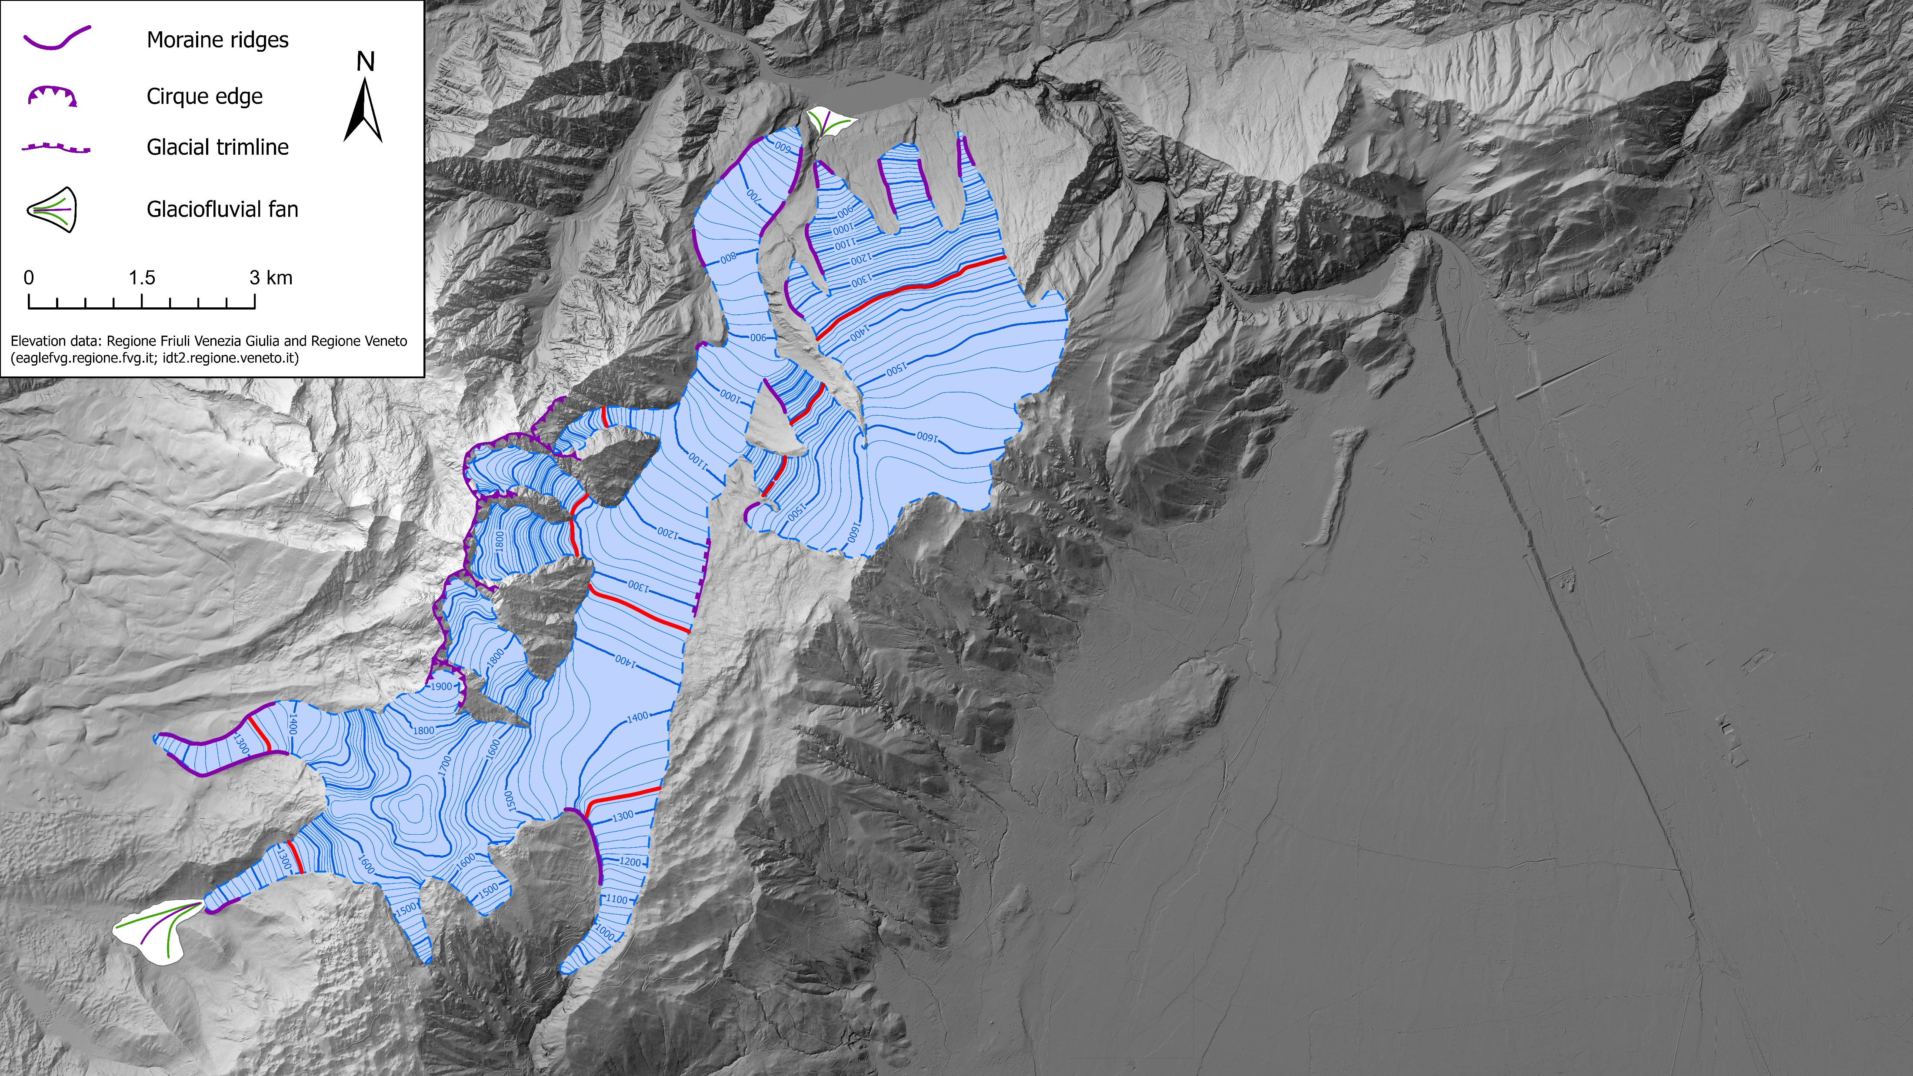
3) Reconstructing paleoglaciers and their Equilibrium Line Altitudes (ELAs) based on geomorphological evidence and numerical models
(Pellitero et al. 2015; 2016)
Castellat plateau glacier
ELA (AABR = 1.56): 1317 m
Monte Cavallo glacier network
ELA (AABR = 1.56): 1328 m
Assuming a summer temperature drop of ca. 9°C (Sanmartin et al., 2014) and applying P = 487*T + 1015 (Ohmura & Boettcher, 2018), this transfers to an LGM precipitation of 3430 mm (cf. modern 2880 mm)

Slide 6
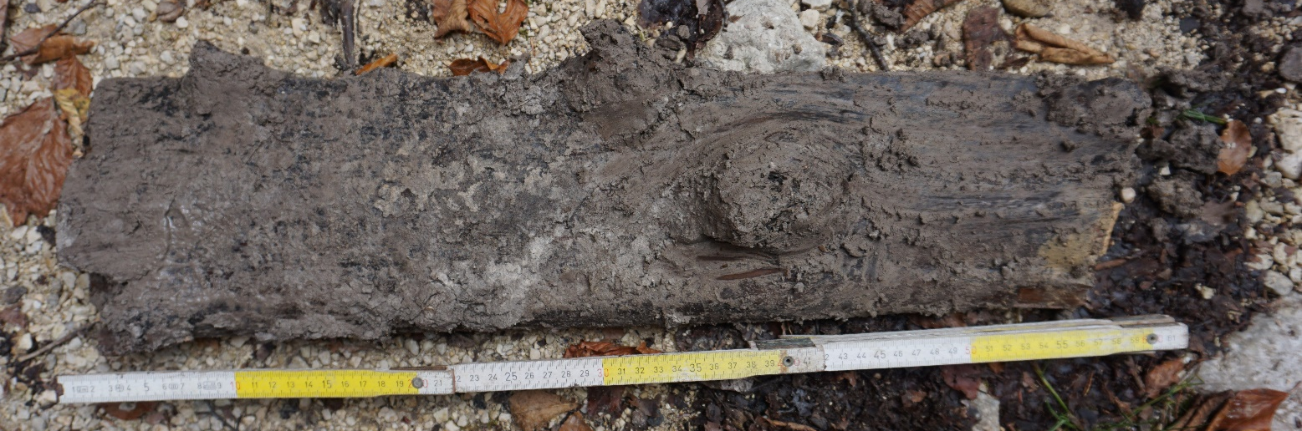
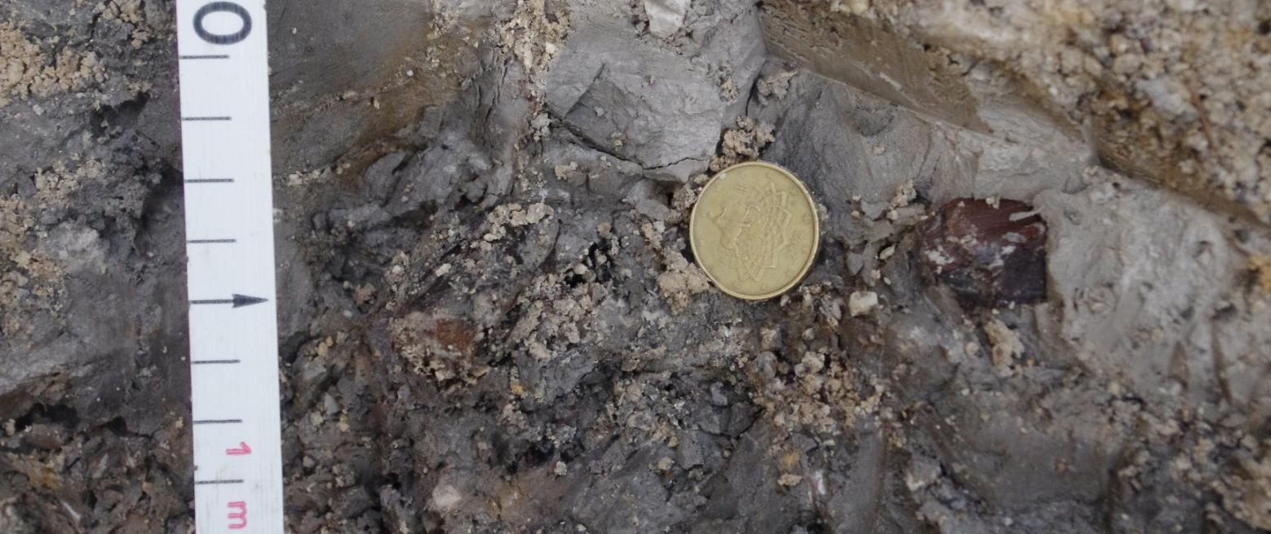
4) Chronological constrains – radiocarbon dating of a lacustrine succession in Val Caltea overlain by till from the LGM advance
Infinite radiocarbon ages! Section related to a previous interglacial (possibly MIS 5)

Slide 7
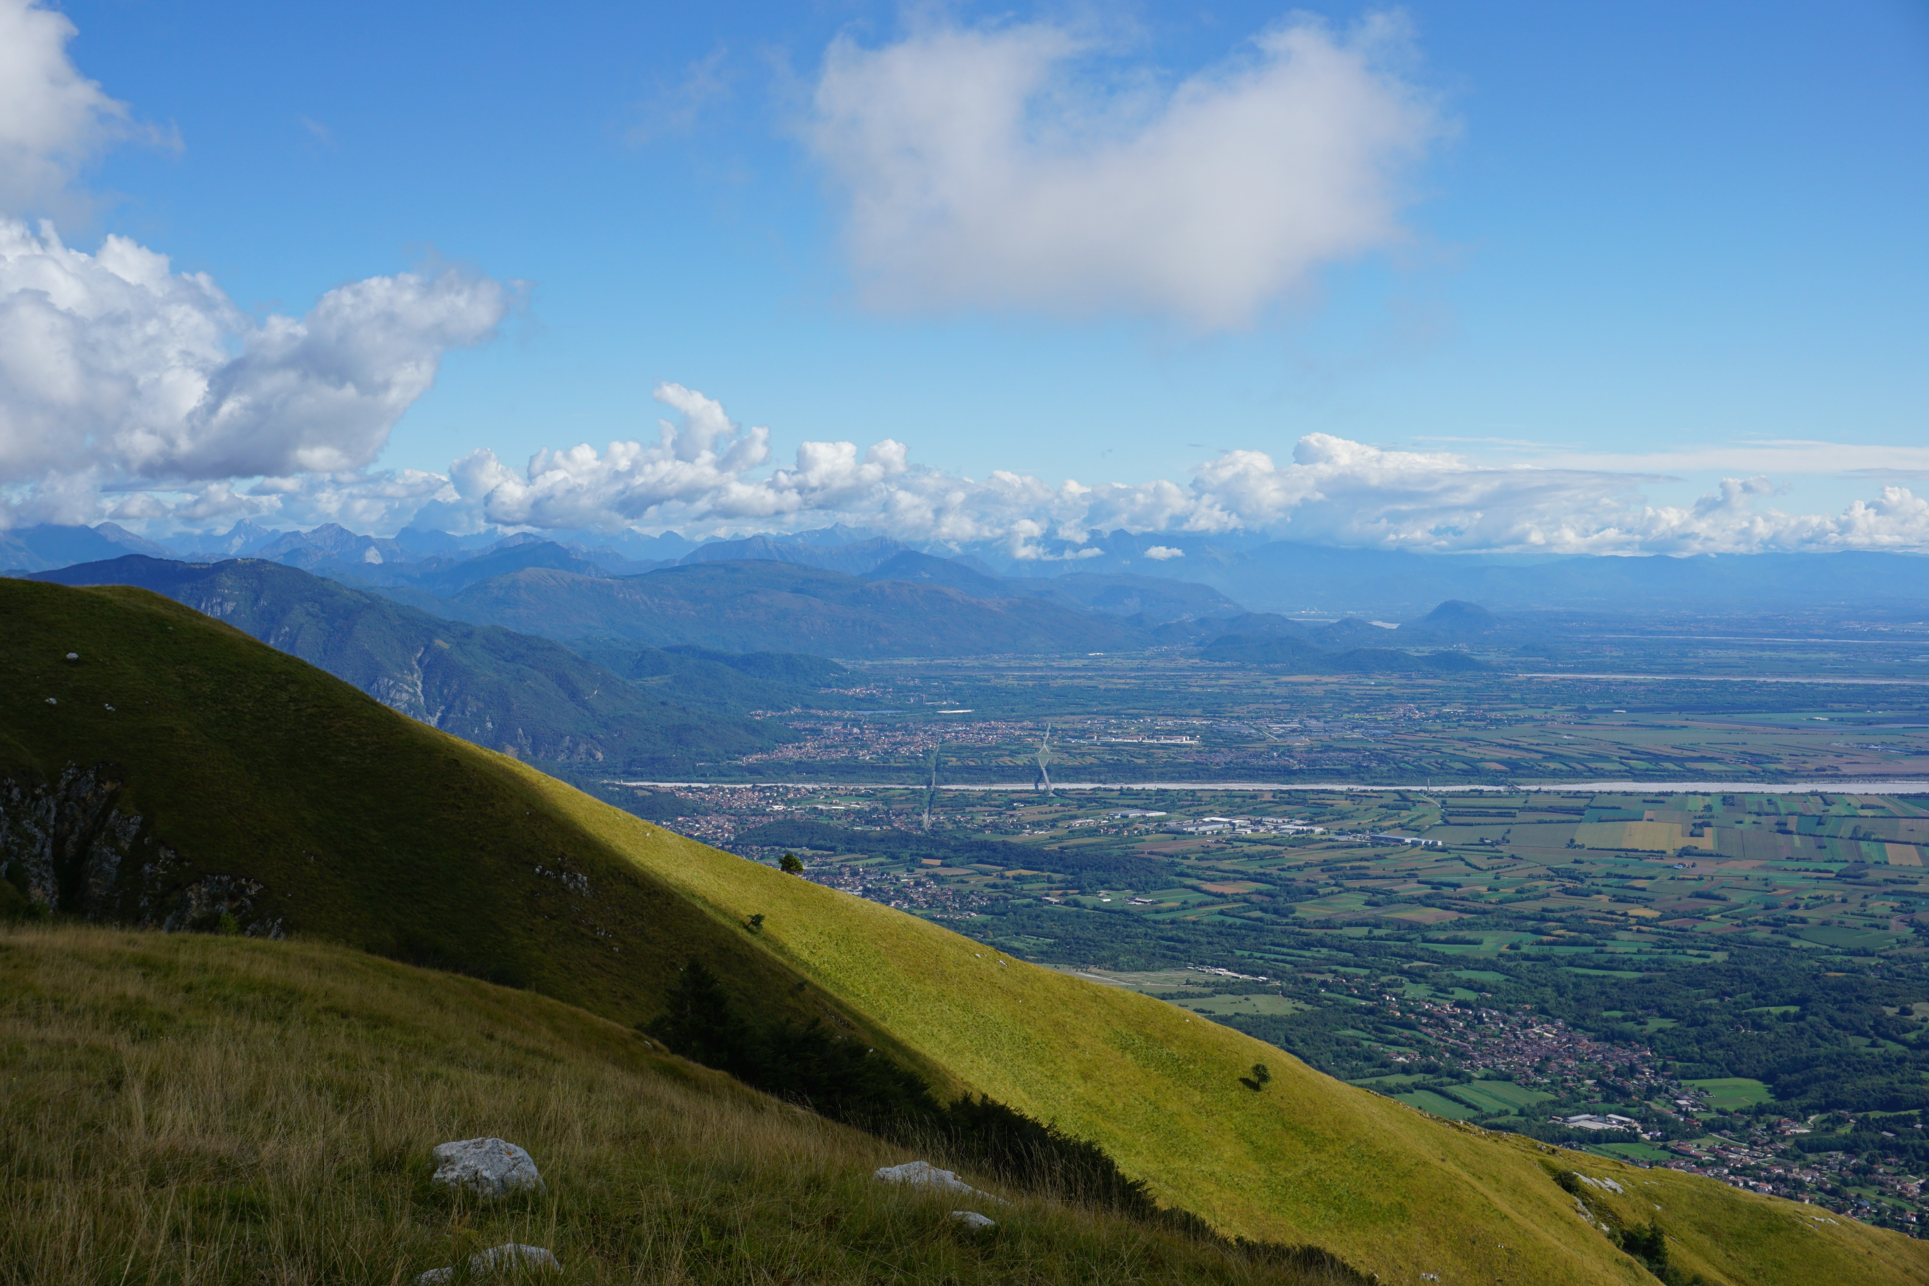
Thank you for you attention!
View from the Castellat Plateau towards the Cellina Fan and the Friulian Plain

