Slide 1




Biosynthesis and n-alkane δ¹³C: influence of elevated CO₂
Bridget Warren, James Bendle, Kweku Afrifa Yamoah, Yvette Eley
Department of Earth Sciences, University of Birmingham
baw888@student.bham.ac.uk
EGU 2022
@squidtrees
Notes:
If you’re reading this, congratulations! You found my notes section. Please send me more geochem puns so I can add them for the next talk.
Why should you never catch a train with algae? They’re dinoflage-late!
Observations suggest tropical grasslands contain more plants than temperate forests. I C 4 plants there, in forests I C 3. Deserts don’t have many but I might see more with a CAMera.
What’s the most promising source of proxy environmental data in the Forgotten Realms? Illiphid biomarkers (nobody? Darn)
What CO2 proxy do pigs use? Oikenones. Unless they’re using boaron. Or palaeosows.
What’s an organic geochemist’s favourite drink? GDGTea!
What biomarkers are produced by kangaroos? Hop-anes!

Slide 2
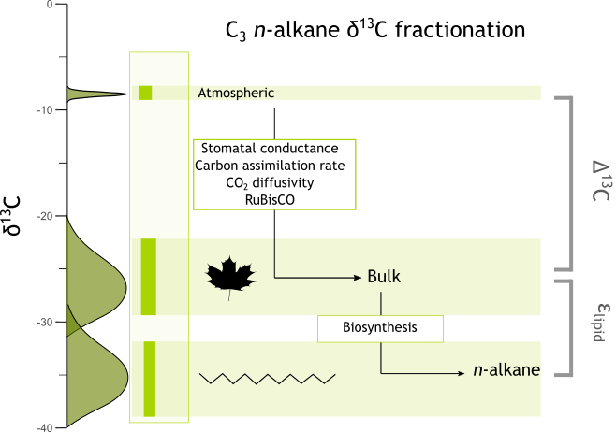
Plant n-alkane δ¹³C
Δ¹³C_{leaf} : difference between atmosphere and bulk plant tissue
Palaeohydrology proxy
n-Alkane synthesis: applies additional fractionation
ε_{lipid}: biosynthetic fractionation
Varies between species, plant functional types
Limited data on impact of environment
Limited data of impact of pCO₂
Data from Tipple and Pagani, 2010

Slide 3
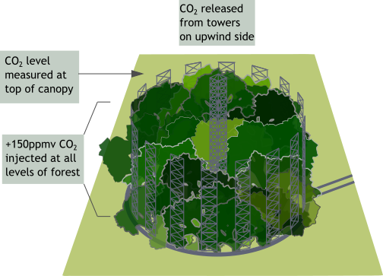
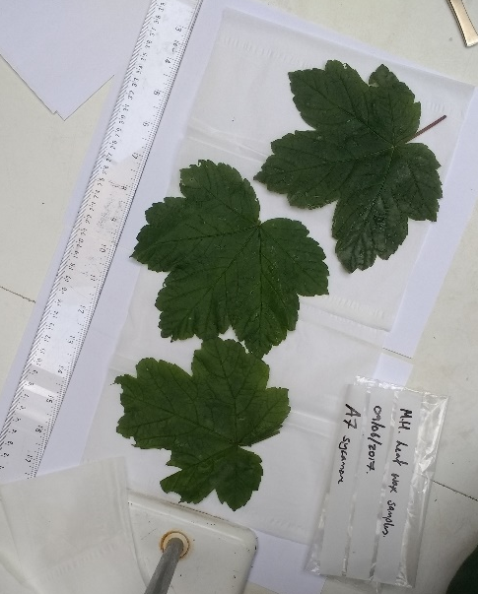
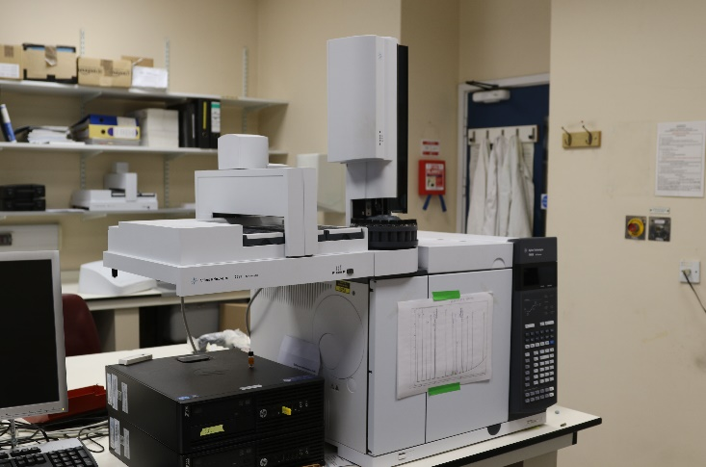
Methods
Birmingham Institute of Forest Research’s Free Air CO₂ Enrichment experiment
(BIFoR FACE)
Semi-natural oak woodland, +150ppmv elevated CO₂
Switched on 2017
2 species collected monthly, 2018-2021
Data generated: bulk and n-alkane δ¹³C

Slide 4
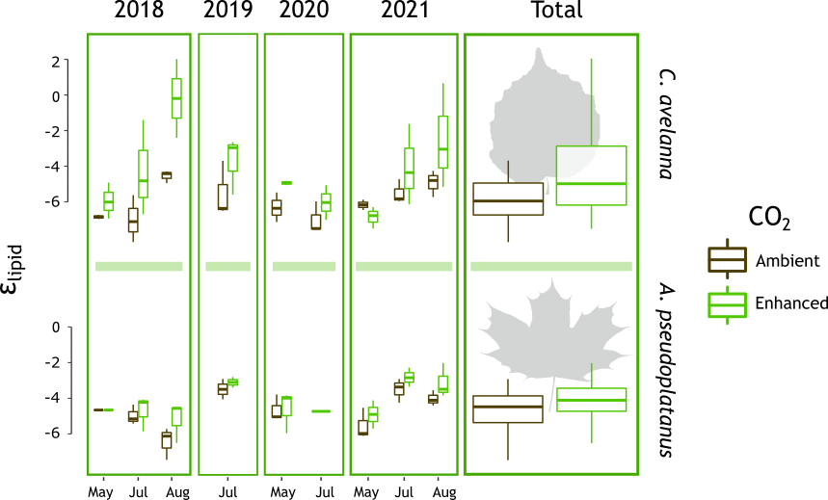
Results: ε_{lipid}
Slight decrease in fractionation under elevated CO₂ in both species
Effect partially obscured by monthly variation
Could relate to shift in carbon pools within plants
Could relate to shifts in seasonality

Slide 5
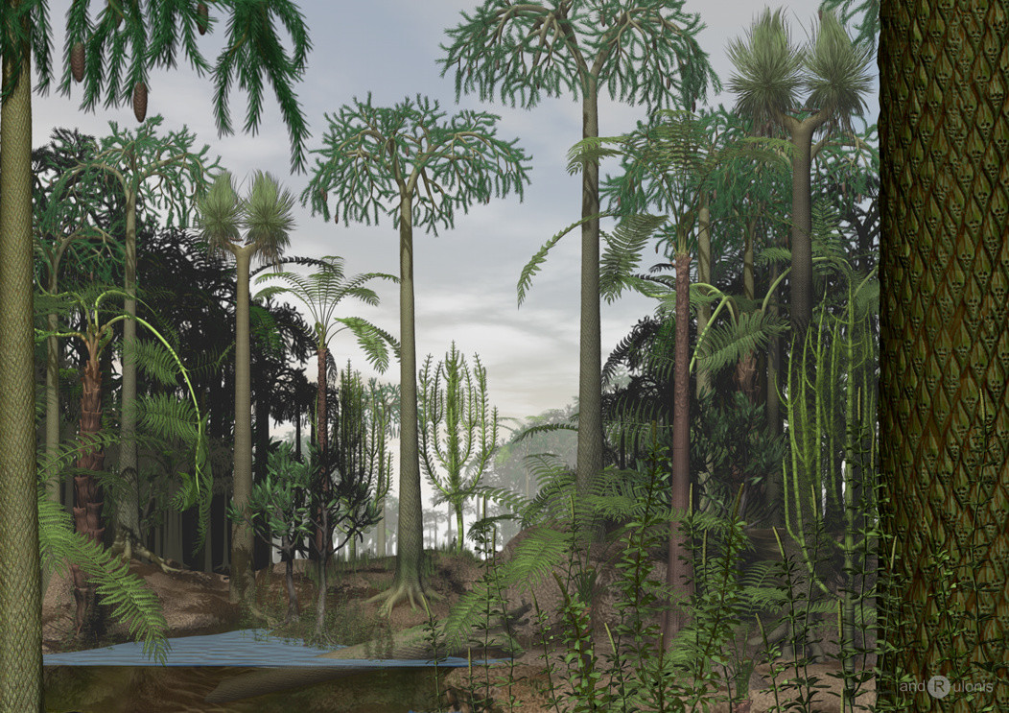
Implications
Short-term experiment: cannot be directly applied to geology
Observed effect is small, may be undetectable in geologic record
Proof environment can influence ε_{lipid}
May explain n-alkane CO₂ correlations in geology without an influence on bulk tissue δ¹³C
Image: Dariusz Andrulonis

Slide 6
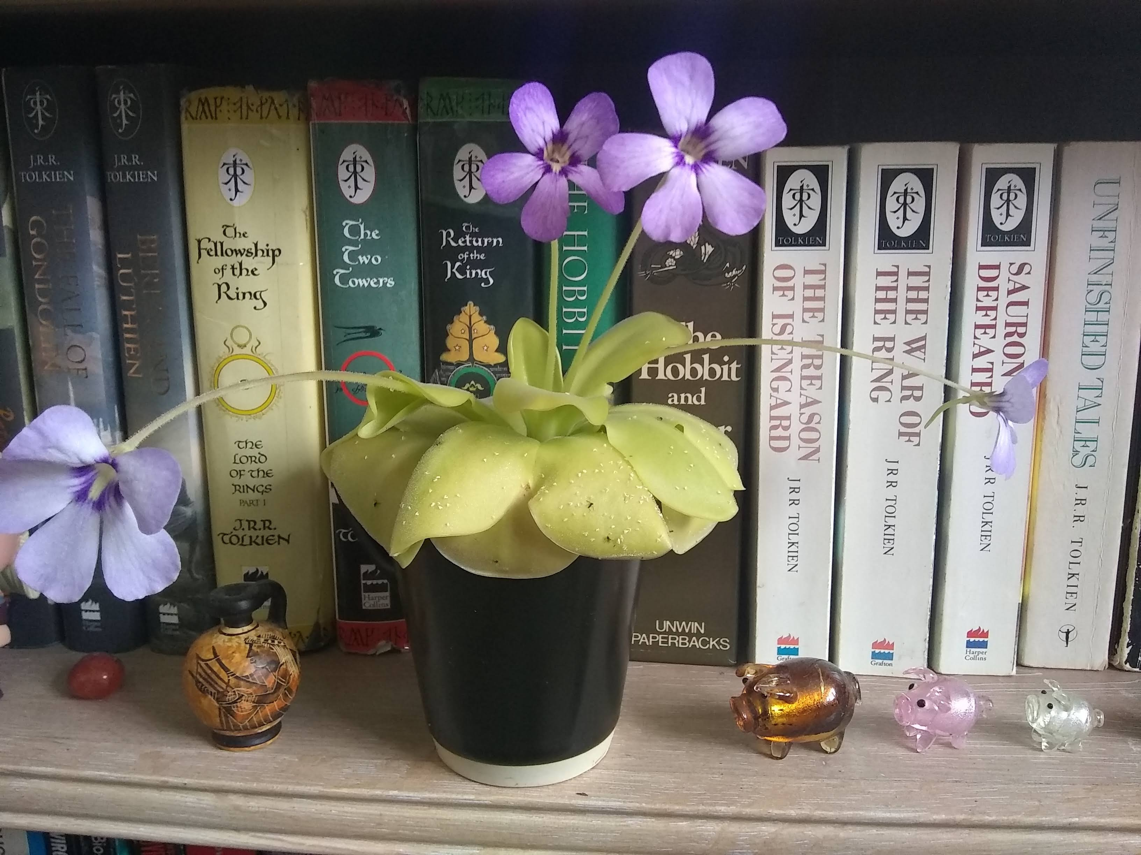
Thank you to…
baw888@student.bham.ac.uk
@squidtrees
Sarah Greene
Jason Hilton
Rob Mackenzie
Simon Dixon
Gael Denny
Kris Hart
Osamu Seki
Ian Boomer
Helen Whelton
Heiko Moossen
NERC NEIF

