Slide 1






Calibration of the physics-based ground motion
model of the 2019 M_{w}4.9 Le Teil earthquake (France)
Fanny Lehmann^{1,2}, F. Gatti², M. Bertin¹, D. Clouteau²
1 CEA/DAM/DIF, F-91297, Arpajon, France
2 Université Paris-Saclay, ENS Paris-Saclay, CentraleSupélec, CNRS, LMPS - Laboratoire de Mécanique Paris-Saclay, 91190 Gif-sur-Yvette, France

Slide 2
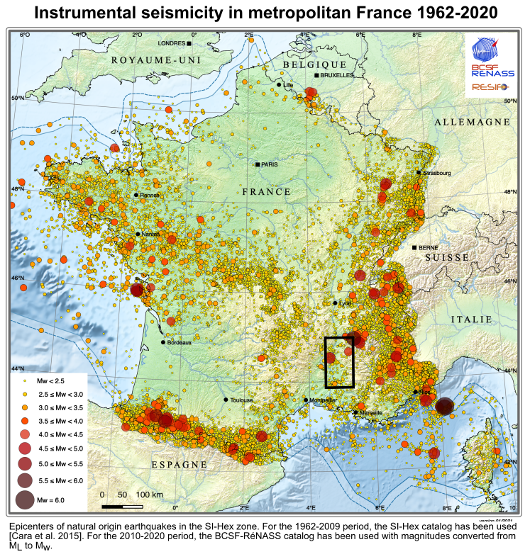
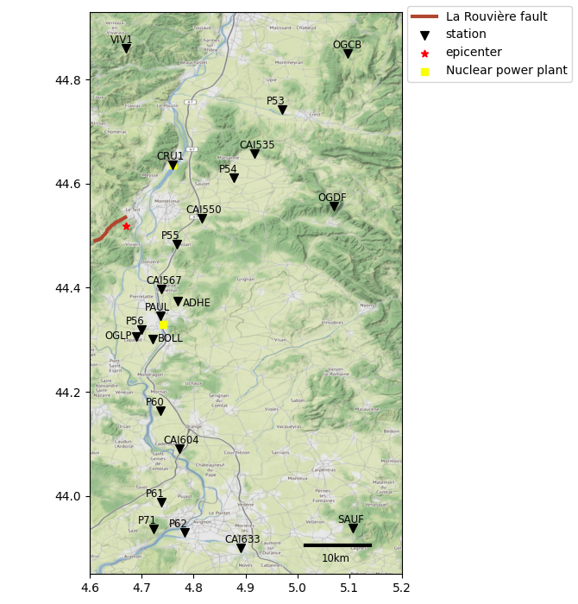
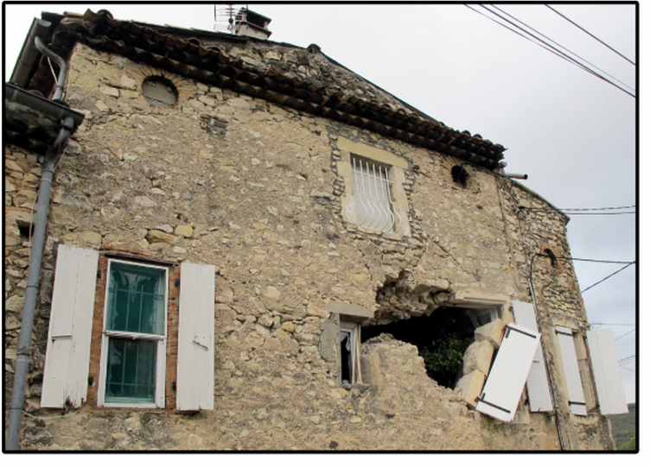
Regional context
[Schlupp et al. 2021]
Le Teil earthquake (M_{w} 4.9)
November 11, 2019
Recorded by 23 stations within 70km of epicentral distance
Epicenter: -1.3km depth
The lower Rhône Valley is ‘rather poorly seismic’. [Larroque 2021]
The Le Teil earthquake is the largest (M_{w}4.9) in metropolitan France since 1996.
Renewed interest for seismic hazard analysis in the region
What can be achieved with numerical simulation in a data sparsity context?
2
2

Slide 3
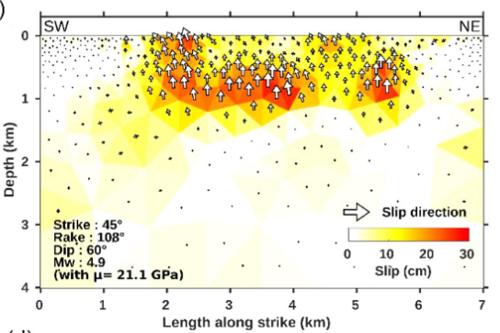
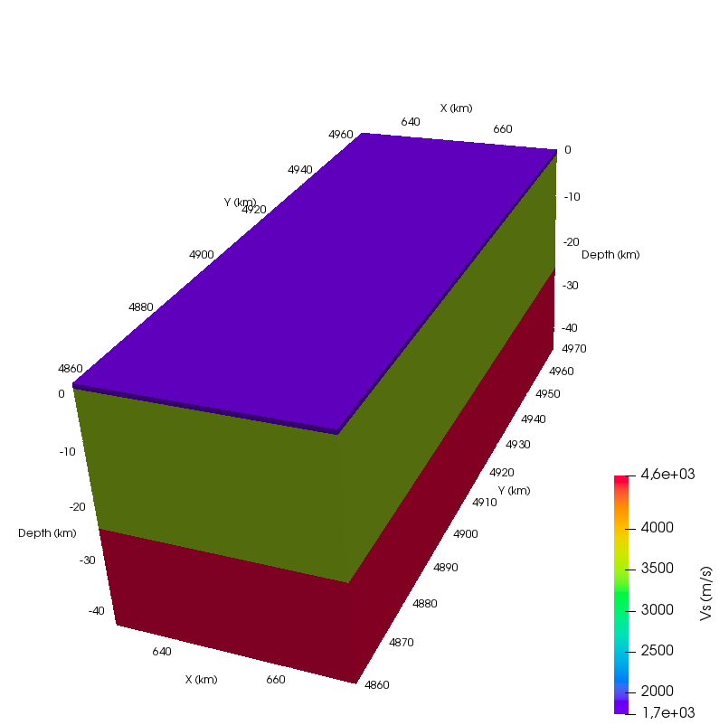
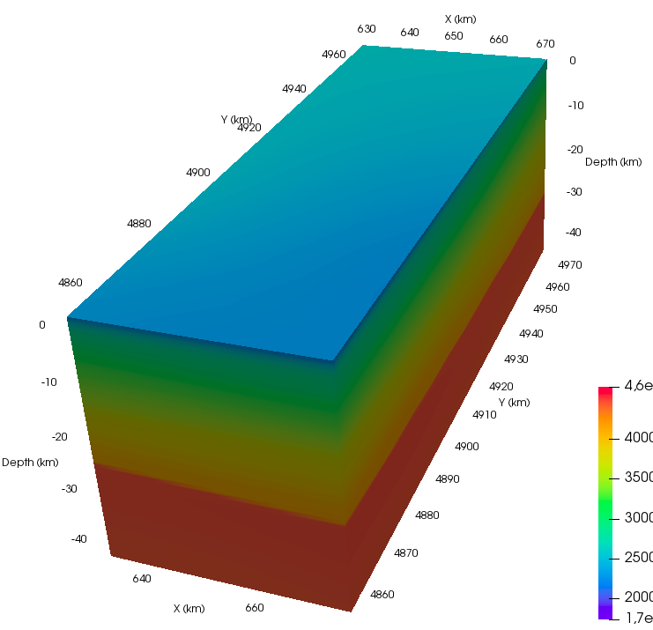
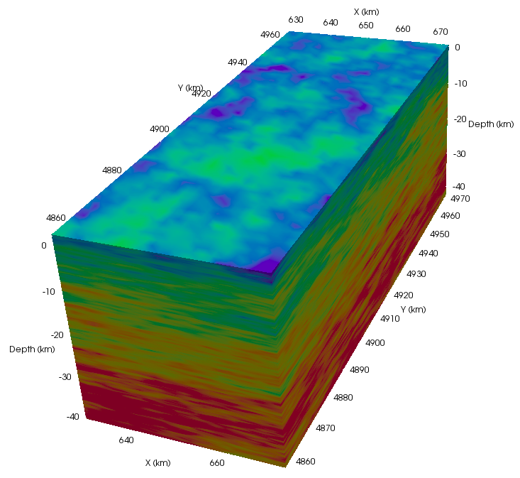
Ground motion model
Numerical propagation code
Source model
SEM3D [CEA, IPGP, Centrale Supélec] Spectral element method
Domain: 42 x 110 x 45km³
f_{max} = 5Hz
min. element size = 260m
6 million elements
~10⁹ dofs
a) Equivalent moment tensor [Delouis 2021]
b) Kinematic rupture model [Vallage 2021]
2,600h CPUs
for 60s of signal
Geophysical description
Addition of topography but sedimentary basin not included yet
a) National 3-layer
homogeneous model
(LDG [Duverger 2021])
b) National spatially-varying
model (EDF [Arroucau 2020])
c) Random fluctuations
(c_{x}= c_{y}= 10km, c_{z}= 1km, cv = 0.1)
42km
110km
45km
3
3
3

Slide 4
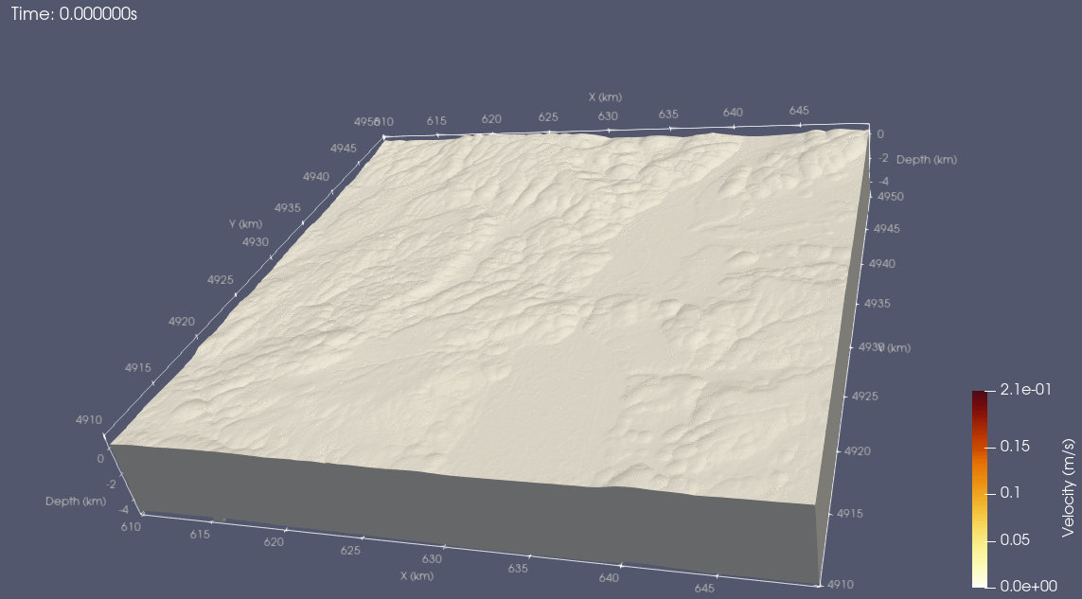
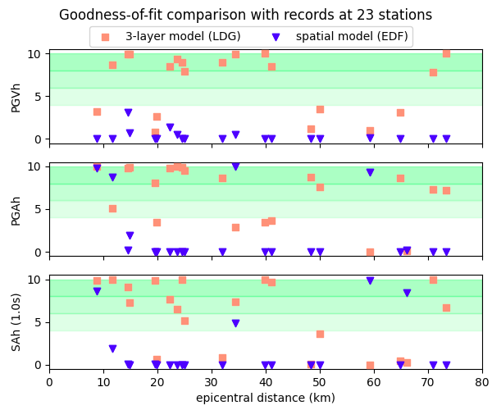
Results (1): Geophysical description
Comparison between numerical results and records
Mean horizontal component of PGV, PGA, Pseudo Spectral Acceleration at 1s.
Although simple, the models provide satisfying goodness-of-fit scores.
4
4
4

Slide 5
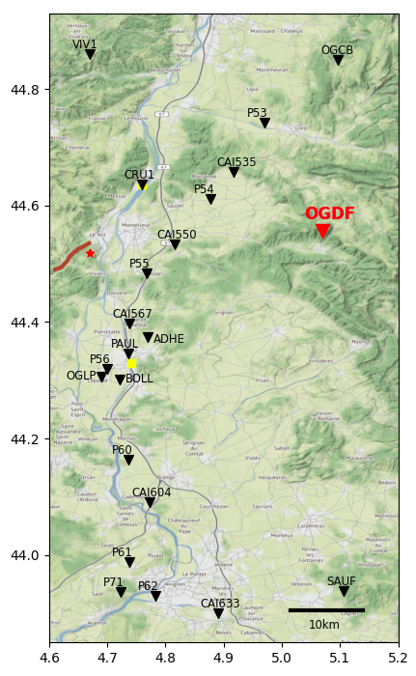
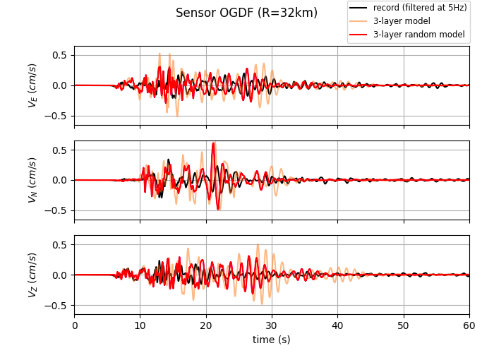
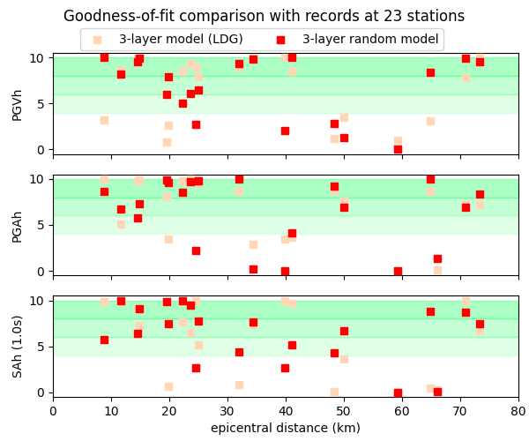
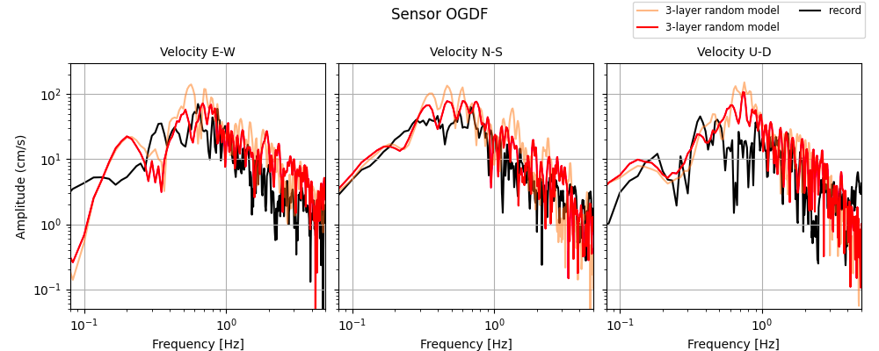
Results (2): Adding random fluctuations
Example: OGDF station (epicentral distance = 32km)
GOF scores in 23 stations
No consistant effect on horizontal Peak Ground Velocity (PGVh) and Acceleration (PGAh)
Mean improvement of 0.4 GOF point for horizontal pseudo-spectral acceleration (SAh 1s)
Smaller peaks and oscillations with heterogeneities
5
5
5

Slide 6
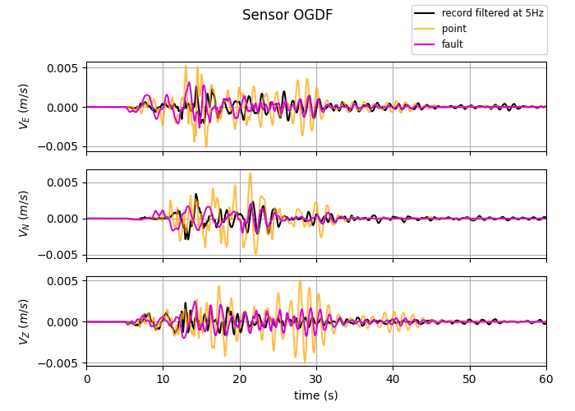
Conclusion and perspectives
Despite their geophysical simplicity, available models provide coherent results (wave arrival times, peak ground motion, pseudo-spectral acceleration).
Random fluctuations give more realistic ground motion.
Open question:
Why are the results obtained with a finite fault model so different from the equivalent point source?
Perspectives:
Improve the geophysical description by including the sedimentary basin
 fanny.lehmann@centralesupelec.fr
6
6
6

