Slide 1



Potential for future reduction of GHG and air pollution from implementing global circular municipal waste management systems.
Adriana Gómez-Sanabria, Gregor Kiesewetter, Zbigniew Klimont, Wolfgang Schoepp & Helmut Haberl
May 2022

Slide 2
COP26
“Waste sector overlooked…global leaders to recognize the crucial role that the waste and resources industry will play in supporting economy-wide decarbonization…” CIWM
Circular economy and climate
Switching to renewable energy is only half the story. It is vital but would only address 55% of global emissions. To reach net-zero, we also need to change the way we make and use products, materials, and food. Ellen MacArthur foundation
Global Methane Pledge
Voluntary actions to contribute to a collective effort to reduce global methane emissions at least 30 percent from 2020 levels by 2030, which could eliminate over 0.2˚C warming by 2050. This will require substantial mitigation in all three main human-driven sectors for methane emissions: fossils fuels, waste, and agriculture.
UNEA-5 Plastic resolution
Over 170 member countries of the United Nations Environment Assembly (UNEA-5) endorsed the End Plastic Pollution resolution, which could boost investment in recycling technologies and bioplastics production.
Notes:
Waste sector accounts for 3-5% global GHG. However, this estimates represents mostly emissions from CH4. The benefits of avoiding emissions in other sectors through recycling and recovery and waste prevention are not accounted for.
For example, by eliminating waste in buildings and construction, sharing buildings more, and by reusing and recycling construction materials, we can reduce the emissions from construction materials by 38% by 2050. Likewise, shifting to regenerative production practices in agriculture, eliminating food waste, and using better and upcycled ingredients in our food products and menus could halve food system emissions by 2050.
Achieving the Global Methane Pledge Targeted measures could avoid as much as 127 Mt (Fossil Fuels 64 Mt; Waste 31 Mt; Agriculture 32 Mt) of methane emissions globally by 2030,

Slide 3
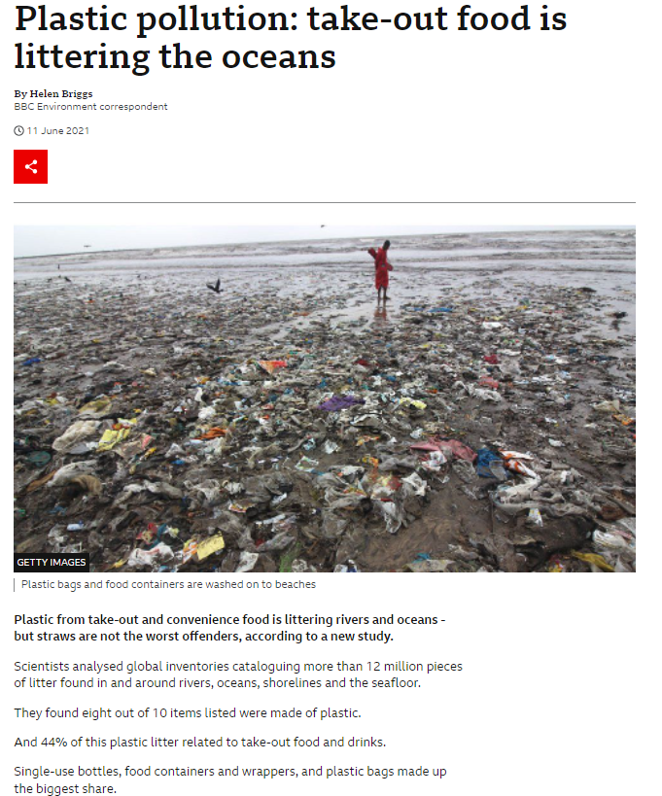
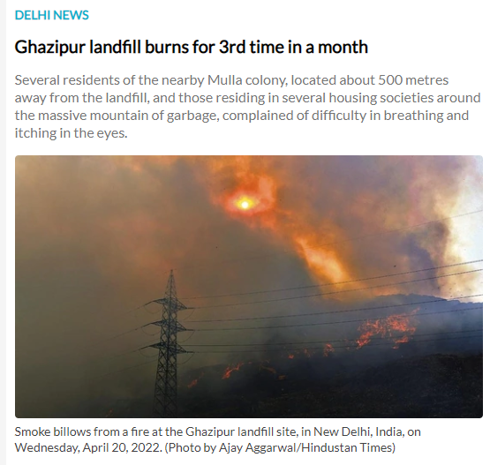
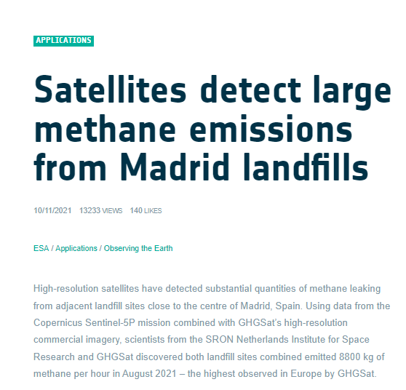
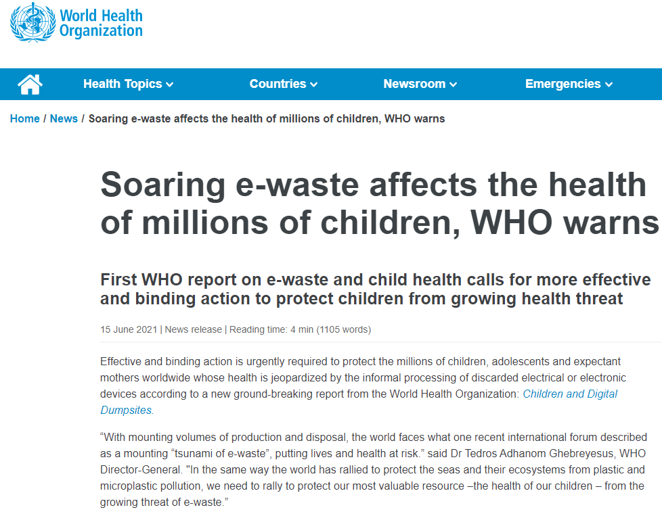
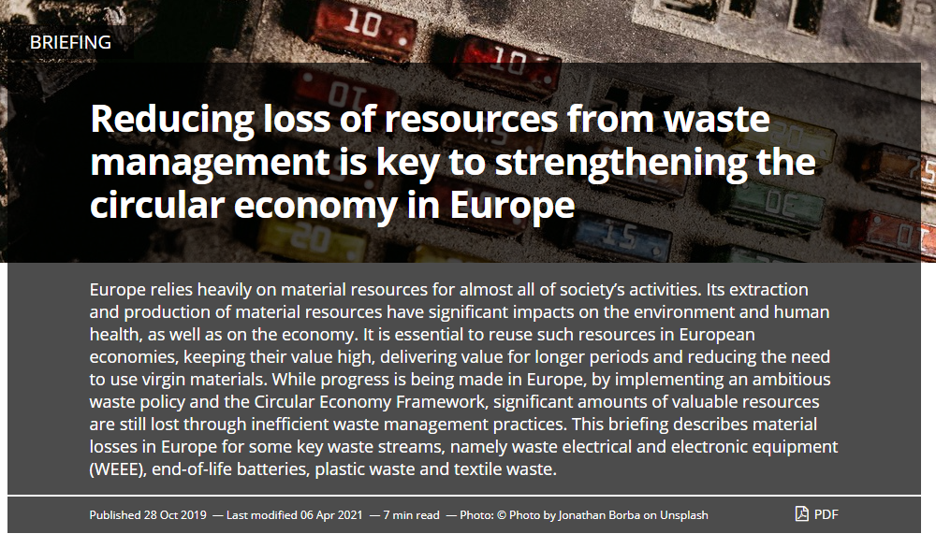

Slide 4
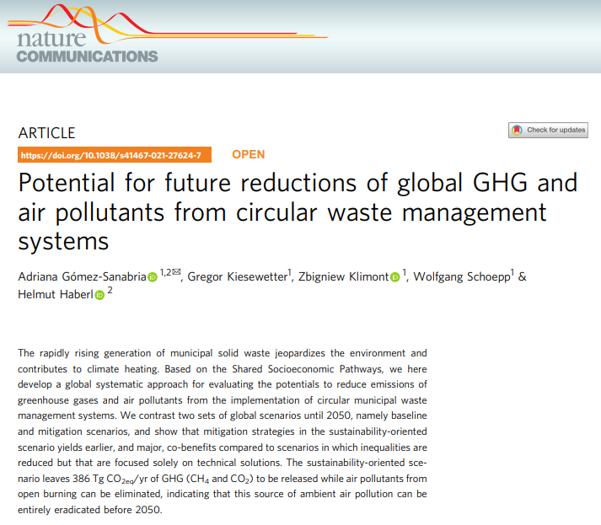
The objective
To evaluate the potentials to reduce emissions of greenhouse gases and air pollutants resulting from the implementation of circular municipal waste management systems.
The motivation
To improve the understanding of how different economic developments and societal choices could transform MSW management practices to address global climate, pollution, and sustainability issues.

Slide 5
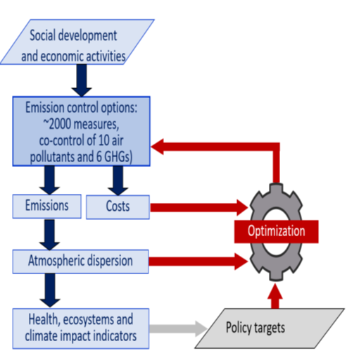
The method:
Greenhouse Gas and Air Pollution Interactions and Synergies -GAINS model
Maximum feasible technical reduction potential- MFR
Scenario
SSP1
SSP2
SSP3
SSP4
SSP5
Eclipse_V6
CLE
MFR
SDGs
Global circular MSW management systems which include:
Restrained landfilling of MSW
Increase material recycling rates and technological improvement.
SSP1 includes implementation of behavioral measures such as reduction of food and plastic waste generation
Overall objective across scenarios is to reach ~ 100% implementation in 2050. The difference is the phase-in of the technology
Notes:
The Shared Socioeconomic Pathways (SSPs) can be translated into emission baselines (CLE) and mitigation scenarios (MFR) for the MSW sector.

Slide 6
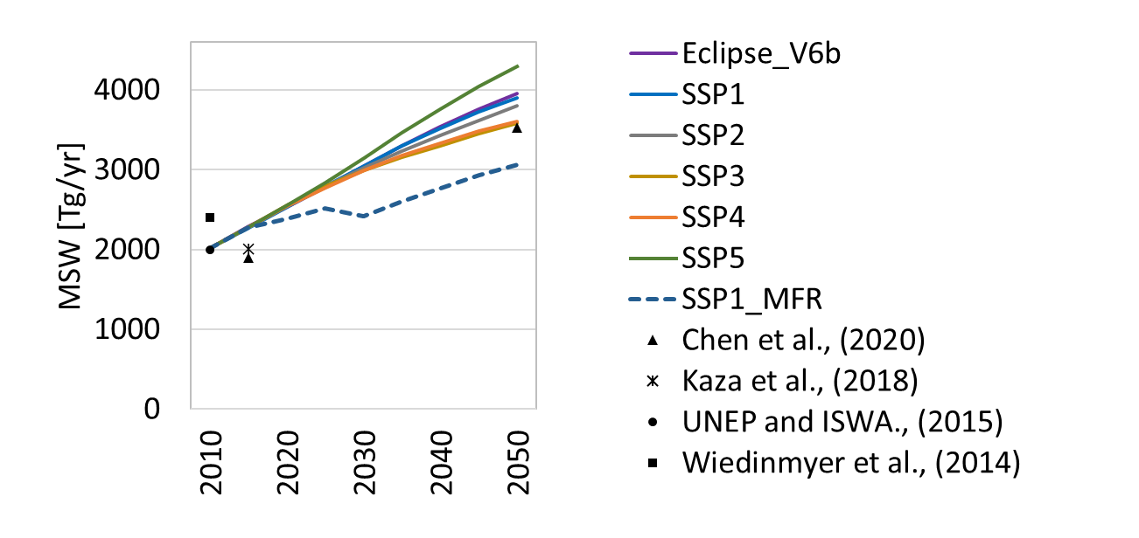
The results
Global MSW generation
-10%
-20%
Notes:
Our estimate for the global yearly MSW generation span from 2014 Tg/yr in 2010 to 2289 Tg/yr in 2015. Different socioeconomic assumptions underlying each of the SSPs lead to significant differences in the amounts of future MSW generation . Although the SSP1 represents a sustainability-oriented pathway, MSW quantities in the baseline are foreseen to reach 3901 Tg/yr in 2050, which is only 10% lower than the expected MSW amounts in the SSP5.

Slide 7
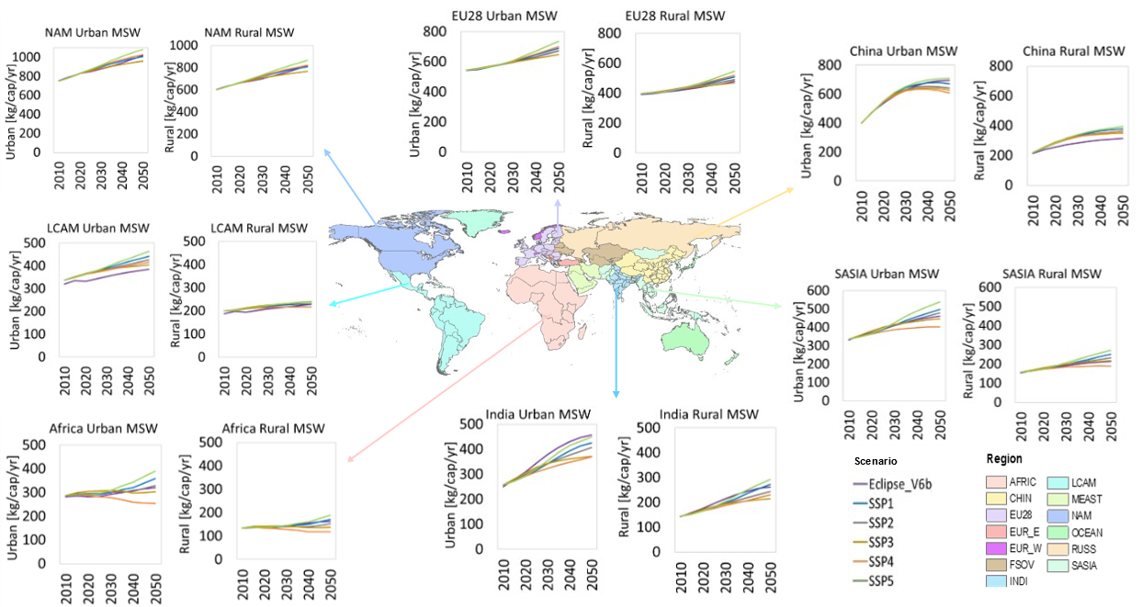
MSW generation per capita
Notes:
Our estimate for the global yearly MSW generation span from 2014 Tg/yr in 2010 to 2289 Tg/yr in 2015. Different socioeconomic assumptions underlying each of the SSPs lead to significant differences in the amounts of future MSW generation

Slide 8
MSW management in 2015
Unmanaged
Managed
Notes:
Around % of MSW is not properly managed at global level. The generally high collection rates of MSW in urban areas does not necessarily imply appropriate management. In SASIA, India, China, LCAM and Africa about 80% of the collected MSW is either dumped or openly burned. Furthermore, most of the MSW generated in rural areas is uncollected and thus ends up being illegally dumped, scattered, or openly burned resulting in several environmental impacts related to air pollution and greenhouse gas emissions. Our findings also indicates that in urban areas about 60% of the open burning occurs either on transfer stations or dumpsites i.e., in the collected fraction, while in rural areas is estimated that about 80% of the burning occurs in the uncollected fraction.

Slide 9
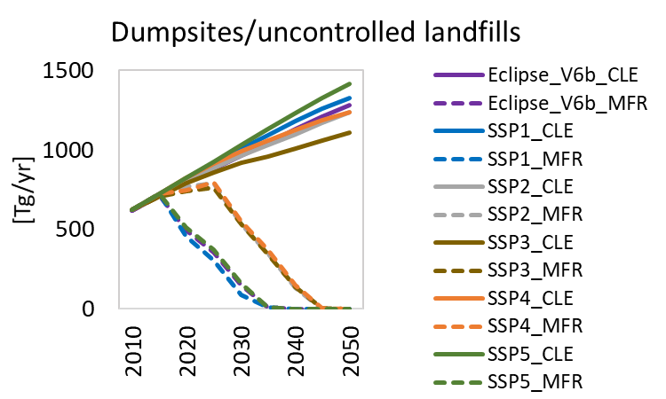
Emissions and abatement potentials - methane
47 Tg /yr of CH4 in 2050
26 Tg/yr of CH4 in 2050
42 Tg/yr of CH4 in 2050
Notes:
Our estimates indicate that current CH₄ emissions from MSW handling account for 8 % (28 Tg ) of the global CH₄ anthropogenic emissions estimated at 344 Tg/yr in 2015³¹. Under the current management strategies, baseline CH₄ emissions in 2050 are projected to be between 1.7 (SSP3_CLE) and 2 (SSP5_CLE) times higher than in 2015, increasing the contribution of MSW to 13% of the projected global CH₄ anthropogenic emissions estimated at 450 Tg/yr in 2050³¹. Based on the fact that the maximum technically abatement potential is about 205 Tg Ch4 in 2050 the reduction on emission from MSW play a significant role.

Slide 10
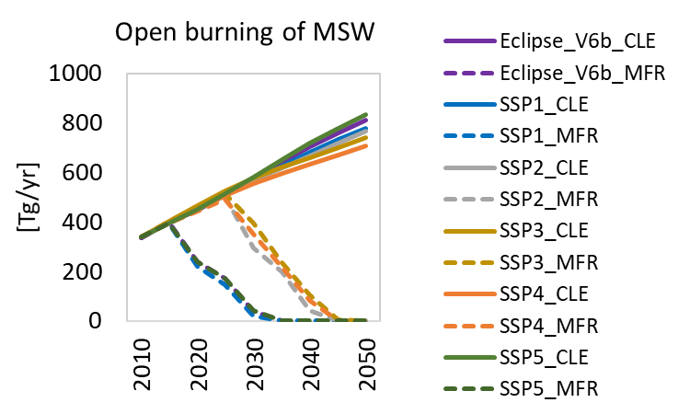
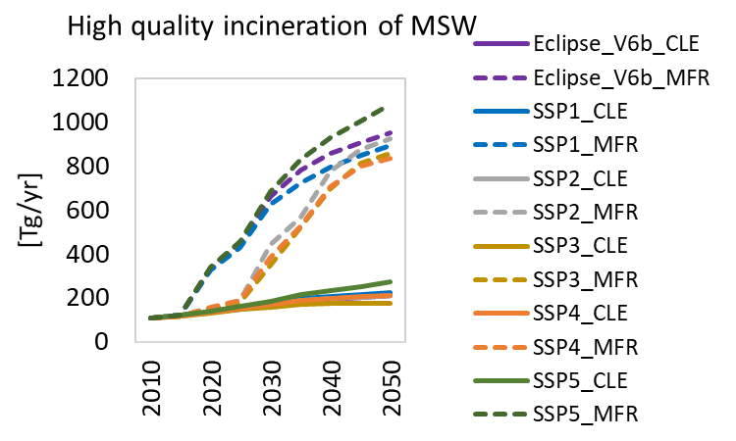
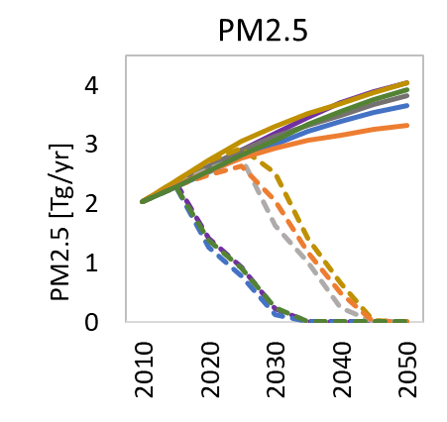
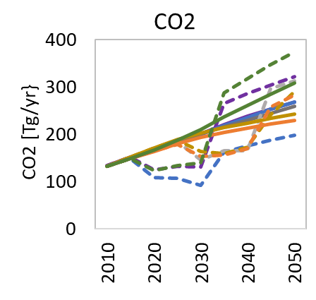
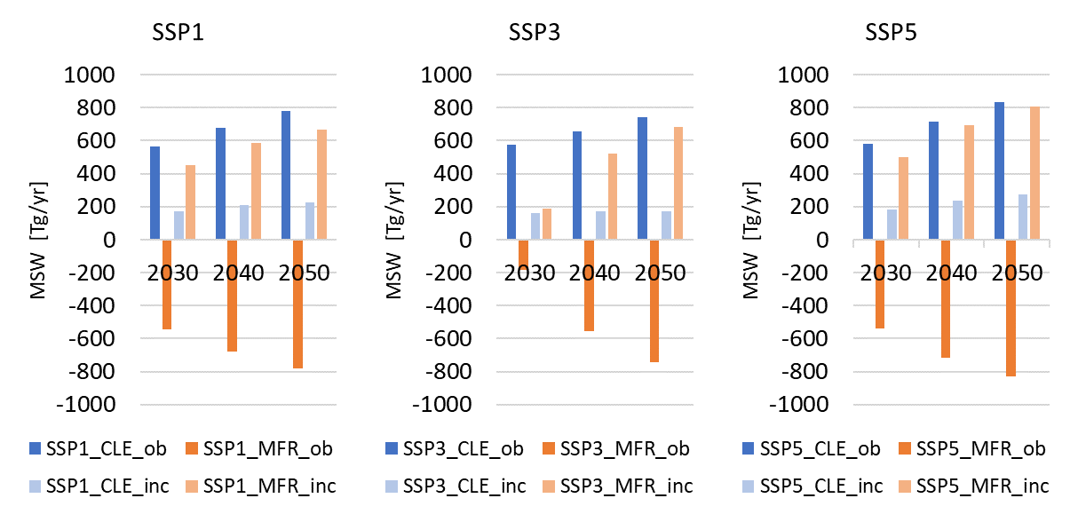
Emissions and abatement potentials - air pollutants
Notes:
In the baseline (CLE), in which current MSW management practices persist without further policy implementation, emissions to air would increase proportionately to the growth in MSW generation. The reduction of MSW being openly burned translates into the same reduction level of emissions of particulate matter and air pollutants. Currently, PM2.5 emissions account for 8% of the total global anthropogenic emissions and it is projected to increase its contribution to 17% under CLE by 2050

Slide 11
The highlights
The adoption of mitigation strategies in the sustainability-oriented scenario yields earlier, and major, co-benefits compared to scenarios in which inequalities are reduced but that are focused solely on technical solutions.
In 2050, the reduction of CH₄ emissions in the sustainability-oriented scenario play a significant role on the global anthropogenic CH₄ mitigation potential.
Particulate matter, and air pollutants from open burning of MSW can be virtually eliminated before 2050 in the sustainability-oriented scenario.
Important to act on various fronts, namely, consumer behavior, technological development, technology transfer and institutional coordination.
A solid system for the reporting of MSW couple with a transparent systematic follow-up of policy enforcement will help to reduce the uncertainty of the estimates as well as will provide clearer insights into the efforts needed by countries to meet their climate, air pollution and SDGs commitments.
Thanks for your attention ☺ !
gomezsa@iiasa.ac.at
Notes:
The benefits from reduction of MSW generation can be jeopardized by social and economic inequalities between and within regions which could restrain the adoption and implementation of measures to improve MSW management systems.

