Slide 1

Fertilizer type effect on nitrous oxide (N₂O) emissions in a Swedish long-term field experiment
Rong Lang¹, Muhammad Shahbaz², Katharina H. E. Meurer³, Gunnar Börjesson³, Thomas Kätterer¹
1 Swedish University of Agricultural Sciences, Department of Ecology
2 Lund University, Centre for Environmental and Climate Science
3 Swedish University of Agricultural Sciences, Department of Soil and Environment
Notes:
Den här dolda bilden kan du använda för att visa åhörarna din struktur och variera avsnitten efter de bilder du väljer att ta med.
För att visa den i din presentation högerklickar du på den och ta bort ”Dold bild”.

Slide 2
N₂O emission and mitigation in agriculture
Increasing N₂O emissions from using nitrogen fertilizers and manure in agriculture, mainly responsible for the growth of N₂O in the atmosphere (Tian et al., 2020)
Mitigation strategies in agriculture
- Optimize fertilization, e.g. 4R (right N application rate, formulation (fertilizer type), timing of application and placement) (Millar et al., 2014)
- Use nitrification inhibitors, e.g. dicyandiamide (DCD)
Notes:
“globally averaged surface mole fractions(1) for CO2, methane (CH4) and nitrous oxide (N2O) reached new highs in 2020, with CO2 at 413.2 ± 0.2 ppm(2), CH4 at 1889 ± 2 ppb(3) and N2O at 333.2 ± 0.1 ppb.” The number of stations used for the analyses was 139 for CO2, 138 for CH4 and 105 for N2O

Slide 3
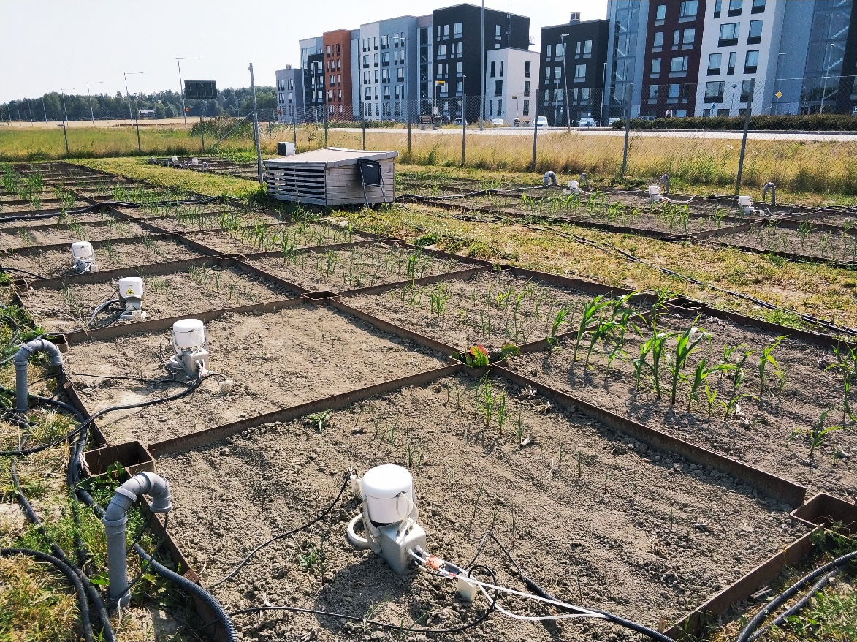
Ultuna long-term soil organic matter experiment
(Frame trial, 1956 ~ present)
Four selected treatments: control, N fertilizer Ca(NO₃)₂, (NH₄)₂SO₄, CaCN₂; three replicates
Eosense automated chambers, Picarro G5131-i analyzer
1 June ~ 15 Oct 2019, maize
Clay loam soil, mean air temperature 5.8 ℃, total precipitation 542 mm
Notes:
Move soil properties to results, add instrument info.
air temperature of 5.8 ◦C and an annual mean total precipitation of 542mm. The topsoil (0–20cm) is a clay loam with 36.5% clay, 41% silt (0.002–0.06mm)and22.5%sand (0.06–2mm)andhasbeen classified as a Typic Eutrochrept(USDAsoil taxonomy)or EutricCambisol
The original aims of the experiment were to investigate the long-term effect of mineral N fertilizers and different organic amendments on crop yields, soil organic matter changes and soil physical properties. The experiment consists of 15 treatments replicated in four blocks (Table 1).
Approximately similar amounts of C are added in 10 of the treatments biannually as different organic amendments, such as straw, green manure, farmyard manure, sawdust, peat and sewage sludge. Since three treatments receive inorganic N fertilizers only, six receive organic amendments only, four receive both and one receives neither nor, differences in crop yields are considerable and increasing over time.

Slide 4
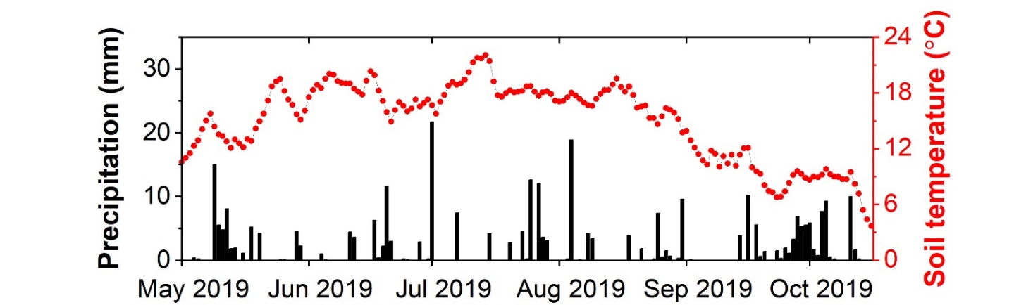

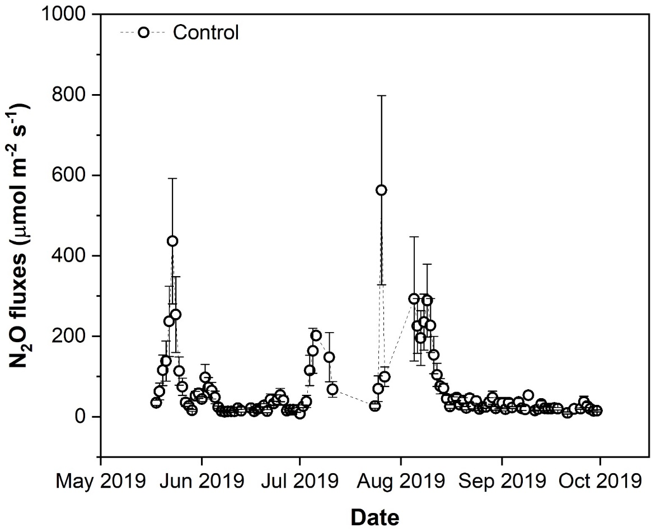
Dynamics of N₂O fluxes by treatment
sowing
harvest
Control: high fluxes after rain when temperature was high

Slide 5
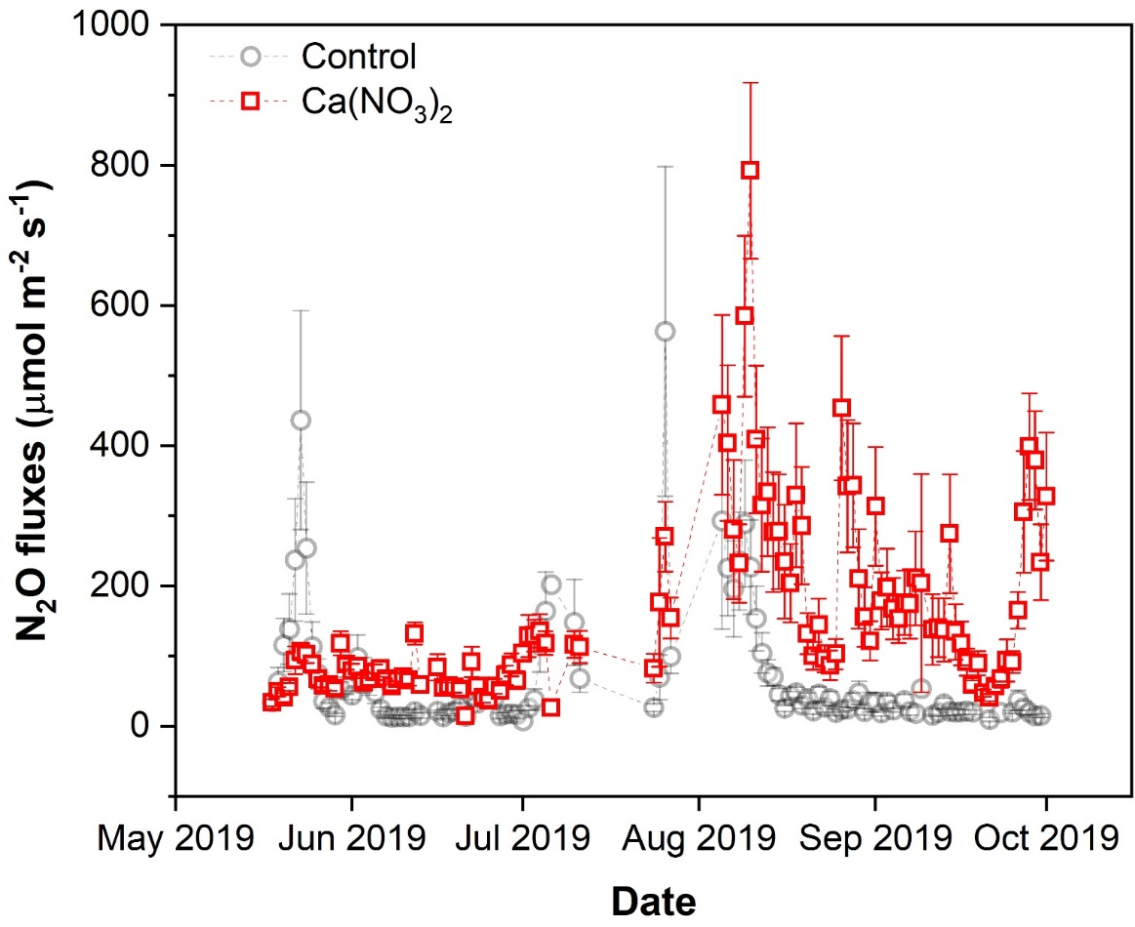
Dynamics of N₂O fluxes by treatment
sowing
harvest
Control: high fluxes after rain when temperature was high
Ca(NO₃)₂: high emissions in summer and autumn

Slide 6
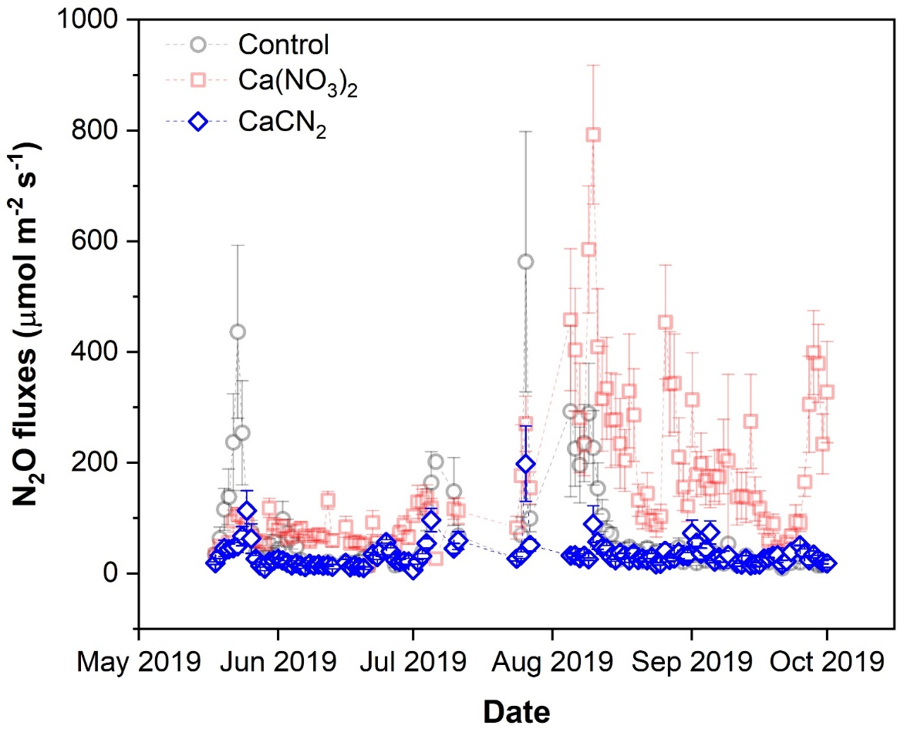
Dynamics of N₂O fluxes by treatment
sowing
harvest
Control: high fluxes after rain when temperature was high
Ca(NO₃)₂: high emissions in summer and autumn
CaCN₂: 29% of N₂O emitted by Ca(NO₃)₂

Slide 7
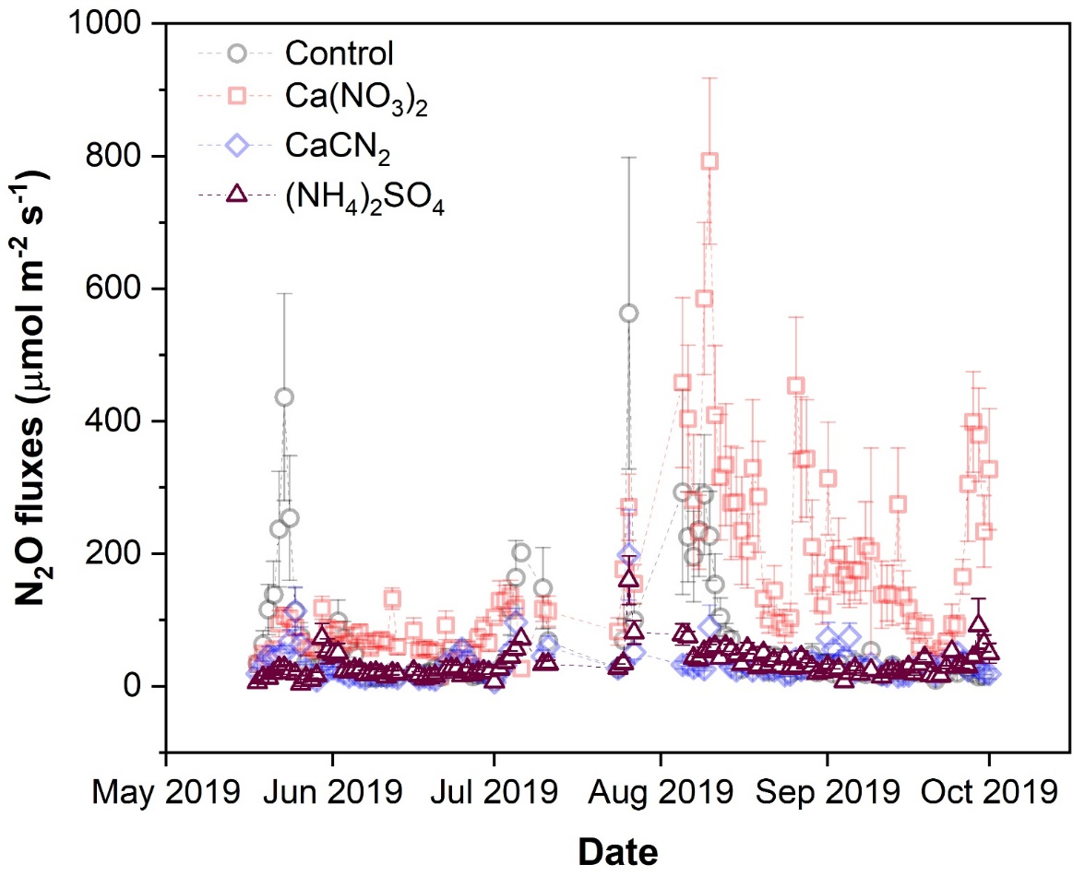
Dynamics of N₂O fluxes by treatment
sowing
harvest
Control: high fluxes after rain when temperature was high
Ca(NO₃)₂: high emissions in summer and autumn
CaCN₂: 29% of N₂O emitted by Ca(NO₃)₂
(NH₄)₂SO₄: low emissions due to low pH (4.1)

Slide 8
Long-term fertilization effect on soil properties
Soil properties in 2019 (mean ± standard error, n=3)
Treatment | Total C (%) | pH | Total N (%)
Control | 1.02±0.01ª | 6.37±0.07ª | 0.095±0.002ª
Ca(NO₃)₂ | 1.29±0.02_{b} | 6.60±0.06ª | 0.114±0.003^{b}
(NH₄)₂SO₄ | 1.10±0.01ª | 4.10±0.00^{b} | 0.123±0.001^{b}
CaCN₂ | 1.37±0.04^{b} | 7.20±0.06^{c} | 0.122±0.003^{b}

Slide 9
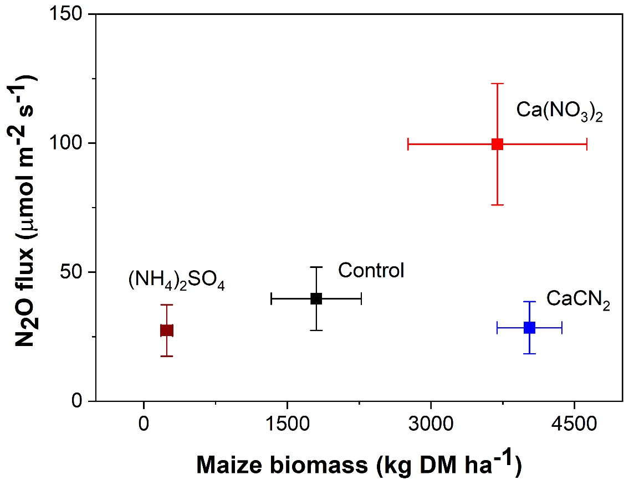
N₂O emissions vs yield
Ca(NO₃)₂: high yield, high N₂O emission
CaCN₂: high yield, low N₂O emission
Control & (NH₄)₂SO₄: low yield, low N₂O emission

Slide 10
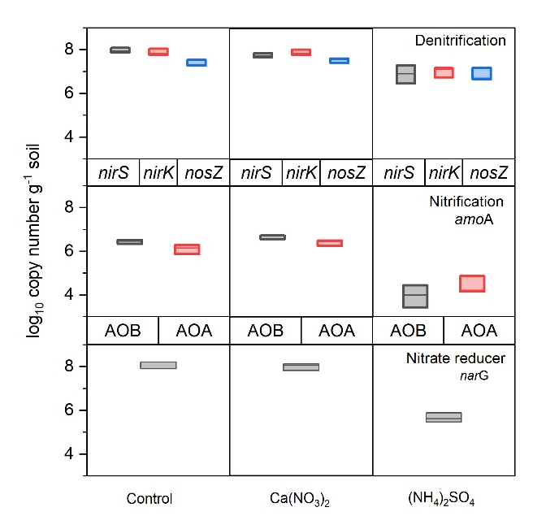
Nitrification & denitrification communities
Low pH at (NH₄)₂SO₄ affected the size of nitrification and denitrification communities (Hallin et al., 2009)
CaCN₂: inhibit both nitrification and denitrification (Hirono & Nonaka, 2014), dicyandiamide (DCD)
Data from Hallin et al (2009)
Notes:
Hallin et al (2009): ” The size of the functional guilds and the total bacterial community were greatly affected by the fertilization regimes, especially by the sewage sludge and ammonium sulfate treatments. The community size results were combined with previously published data on the composition of the corresponding communities, potential ammonia oxidation, denitrification, basal and substrate-induced respiration rates, in addition to crop yield for an integrated analysis. It was found that differences in size, rather than composition, correlated with differences in process rates for the denitrifier and ammonia-oxidizing archaeal and total bacterial communities, whereas neither differences in size nor composition was correlated with differences in process rates for the ammonia-oxidizing bacterial community. In contrast, the composition of nitrate-reducing, denitrifying and total bacterial communities co-varied with primary production and both were strongly linked to soil properties.”

Slide 11
Conclusion
Fertilizer type affected N₂O emissions due to effect on soil pH, size of N-cycling communities and substrates
Calcium cyanamide as nitrogen fertilizer has a great potential to reduce N₂O emissions from agricultural soils without compromising crop production.

Slide 12
Reference
Enwall, K., Nyberg, K., Bertilsson, S., Cederlund, H., Stenström, J., & Hallin, S. (2007). Long-term impact of fertilization on activity and composition of bacterial communities and metabolic guilds in agricultural soil. Soil Biology and Biochemistry, 39(1), 106-115.
Hallin, S., Jones, C. M., Schloter, M., & Philippot, L. (2009). Relationship between N-cycling communities and ecosystem functioning in a 50-year-old fertilization experiment. The ISME Journal, 3(5), 597-605.
Hirono, Y., & Nonaka, K. (2014). Effects of application of lime nitrogen and dicyandiamide on nitrous oxide emissions from green tea fields. Soil Science and Plant Nutrition, 60(2), 276-285.
Tian, H., Xu, R., Canadell, J. G., Thompson, R. L., Winiwarter, W., Suntharalingam, P., et al. (2020). A comprehensive quantification of global nitrous oxide sources and sinks. Nature, 586(7828), 248-256.
Millar, N., Doll, J. E. & Robertson, G. P. 2014. Management of nitrogen fertilizer to reduce nitrous oxide (N₂O) emissions from field crops, Climate Change and Agriculture Fact Sheet Series—MSU Extension Bulletin E3152.

