Slide 1

Hydro-pedotransfer functions: A roadmap for future development
Workshop Modelling of Crop Rotations Wednesday, 9 December 2020
On behalf of the International Soil Modelling Consortium Pedotransfer function Working group
Dr. rer. nat. Tobias KD Weber | University of Hohenheim | 0000-0002-3448-5208
Notes:
https://meetingorganizer.copernicus.org/EGU22/session/42142
Weber, T. K. D. and the ISMC Working Group: Pedotransfer functions: Hydro-pedotransfer functions: A roadmap for future development , EGU General Assembly 2022, Vienna, Austria, 23–27 May 2022, EGU22-757, https://doi.org/10.5194/egusphere-egu22-757

Slide 2


Slide 3
Introduction
What are hydro-pedotransfer functions?

Slide 4
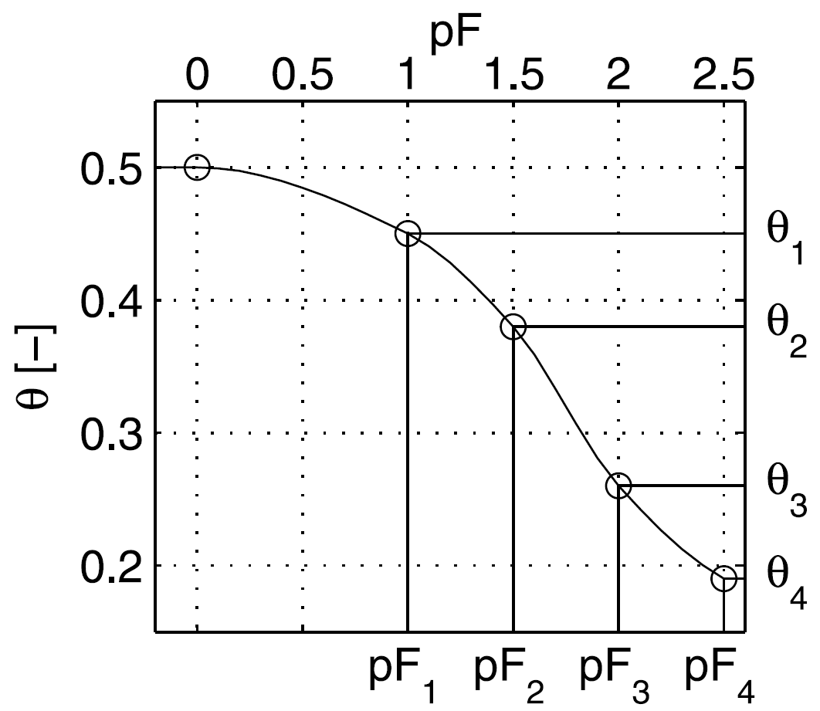
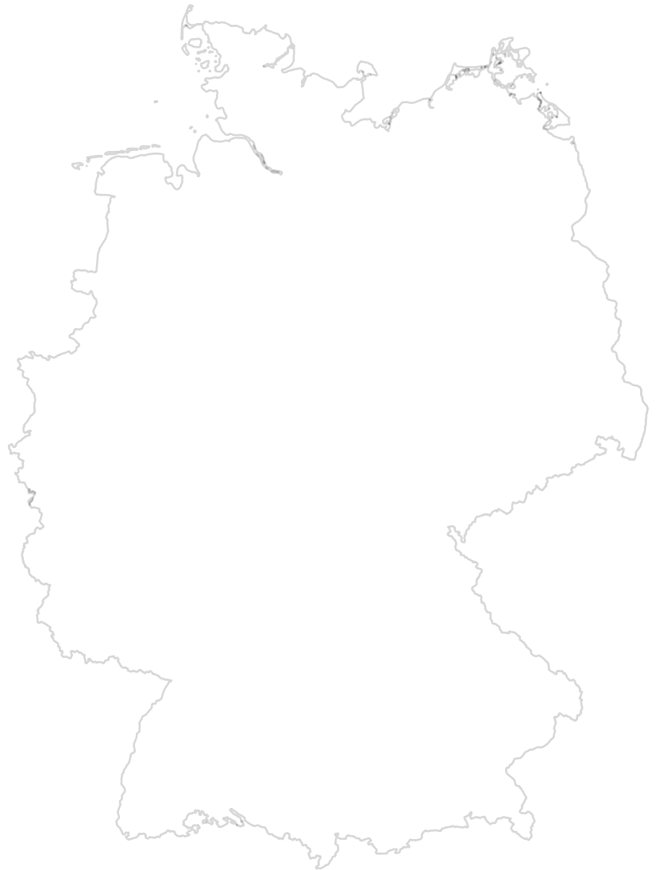
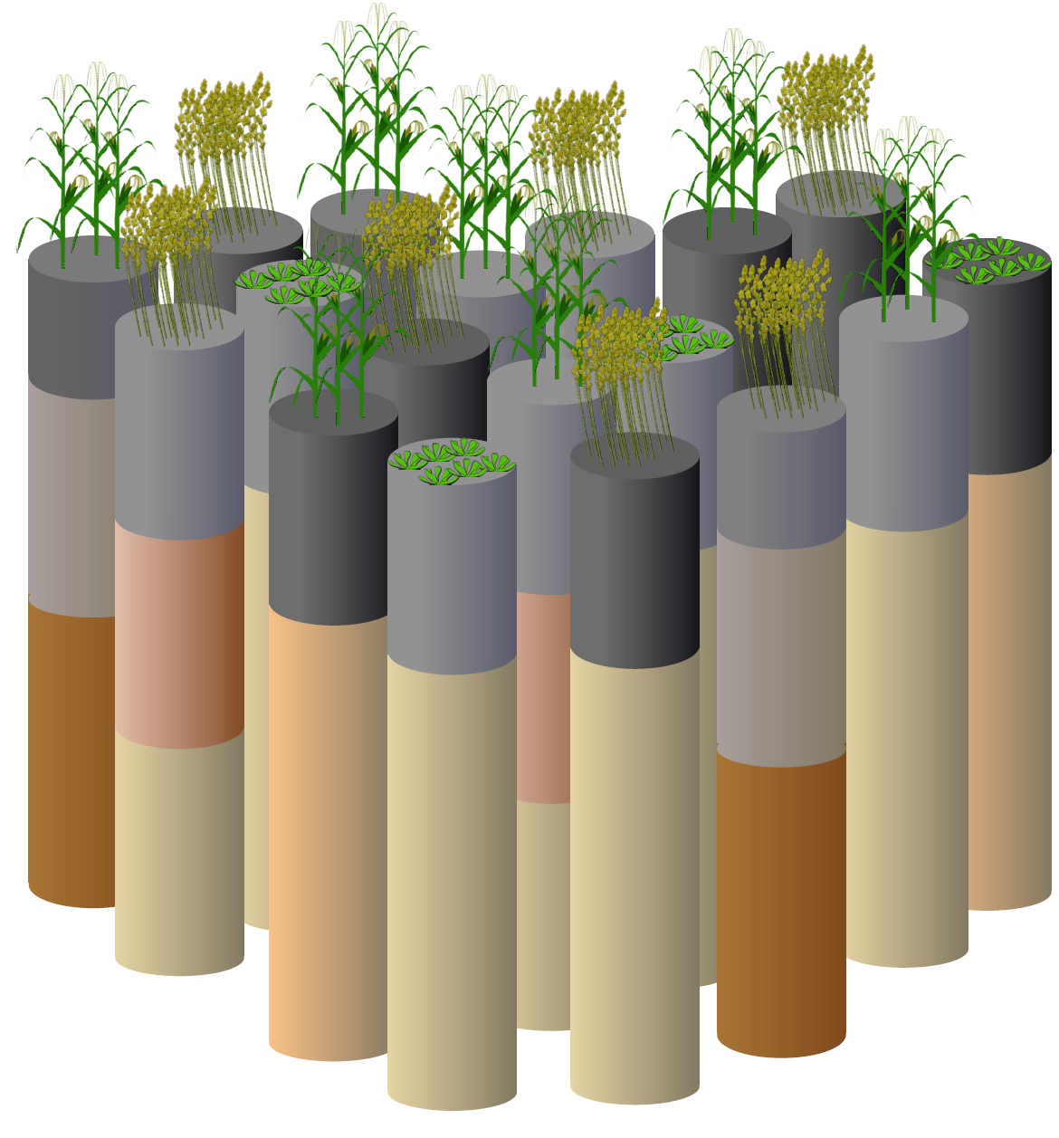
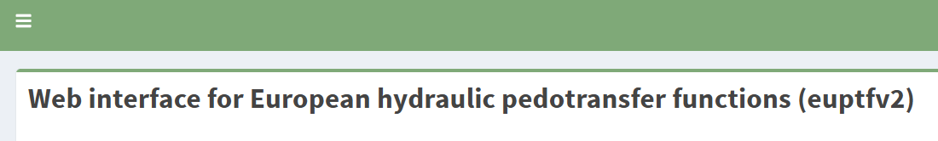


What are hydro-pedotransfer functions?
pF = log₁₀ [cm]
f(ssc, oc, bd, …)
Iden and Durner, 2007, WRR, mod
User friendliness!!
eg. Szabo et al. 2021, GMD
https://ptfinterface.rissac.hu/app_direct/ptf/
1
2

Slide 5
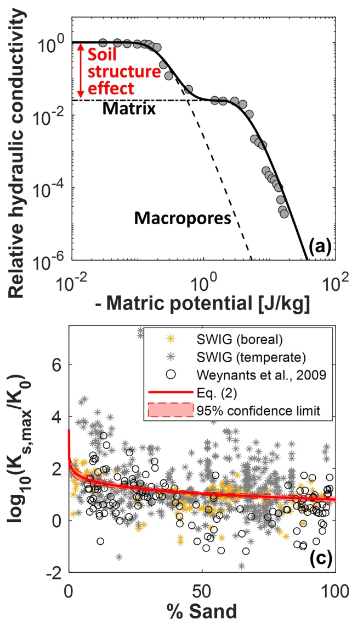
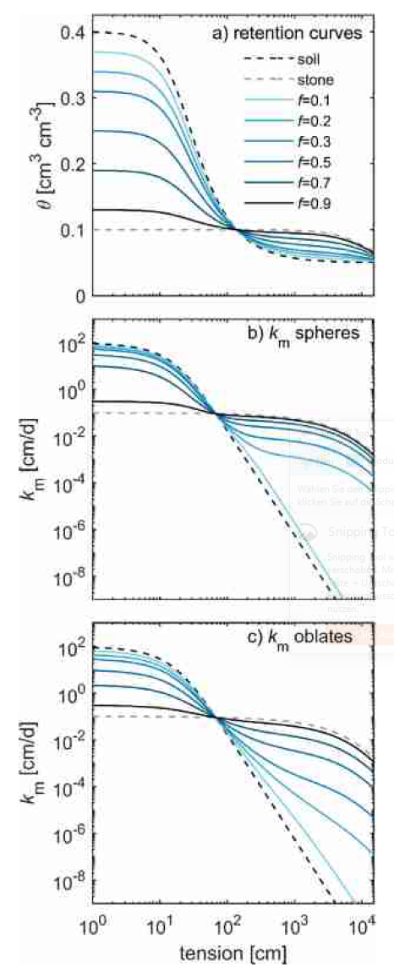
Example I: Is structure sufficiently captured?
post hoc modulation
post hoc modulation
Soil structure
Stoniness
Bonetti, Wei and Or. (2021) Communications Earth & Environment
Naseri et al. (2020) AWR
Notes:
https://meetingorganizer.copernicus.org/EGU22/session/42142
Weber, T. K. D. and the ISMC Working Group: Pedotransfer functions: Hydro-pedotransfer functions: A roadmap for future development , EGU General Assembly 2022, Vienna, Austria, 23–27 May 2022, EGU22-757, https://doi.org/10.5194/egusphere-egu22-757

Slide 6
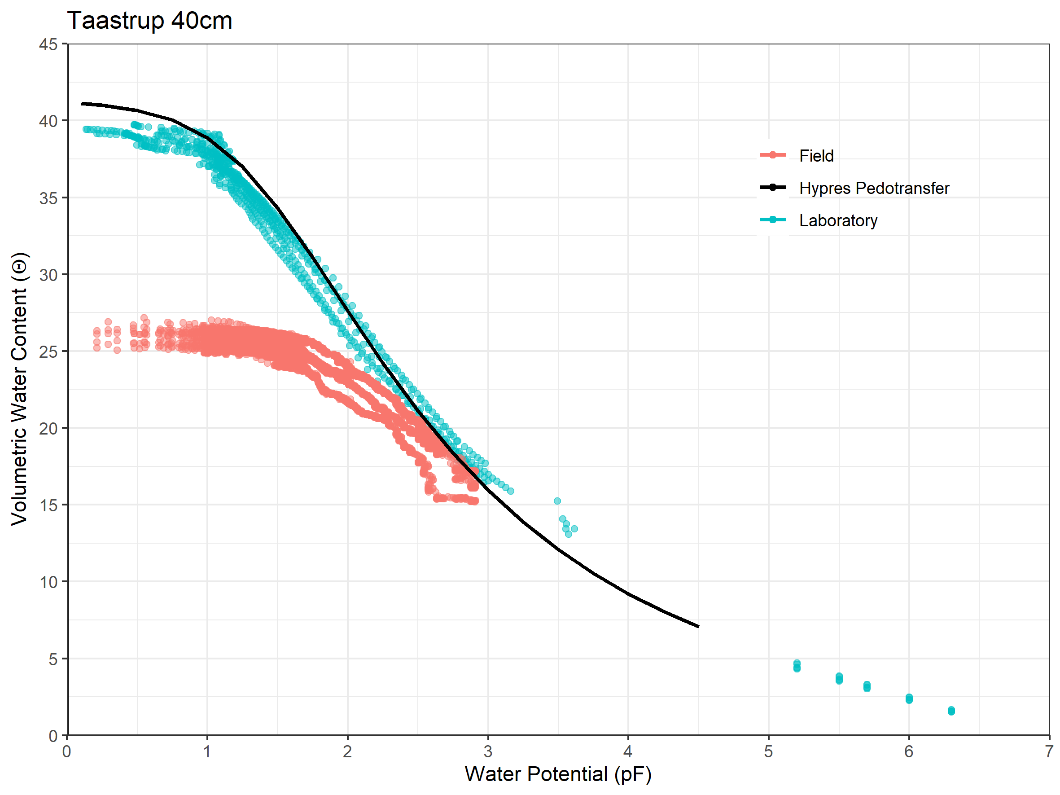
Example IV: Are laboratory measurements representative?
Example: Image and data provided by Dr. Simon Svane, KU, Denmark
Weber et al., 2022. Hydro-pedotransfer functions: A roadmap for future development, in prep.

Slide 7
Example II: Are currently predicted SHP models adequate?
Example III: What kind of data is usually used?
lab observation
Example: Image provided by E. Diamantopoulos, Uni Bayreuth, Germany Weber et al., 2022. Hydro-pedotransfer functions: A roadmap for future development, in prep.
Notes:
https://meetingorganizer.copernicus.org/EGU22/session/42142
Weber, T. K. D. and the ISMC Working Group: Pedotransfer functions: Hydro-pedotransfer functions: A roadmap for future development , EGU General Assembly 2022, Vienna, Austria, 23–27 May 2022, EGU22-757, https://doi.org/10.5194/egusphere-egu22-757

Slide 8
Some Slogans for Action
Access for and exchange between user groups has to be fascilitated by developpers.
hyPTFs are needed for all sorts of non-arable land environments.
hyPTFs have to be physically consistent (post hoc modulation helps).
Notes:
https://meetingorganizer.copernicus.org/EGU22/session/42142
Weber, T. K. D. and the ISMC Working Group: Pedotransfer functions: Hydro-pedotransfer functions: A roadmap for future development , EGU General Assembly 2022, Vienna, Austria, 23–27 May 2022, EGU22-757, https://doi.org/10.5194/egusphere-egu22-757

Slide 9








Time for questions
Special thanks to all co-authors:
Attila Nemes, Lutz Weihermüller, Sara Bonetti, Tobias Hohebrink, Conrad Jackisch, Brigitta Szabo, Michel Bechtold, Aurore Degré, Efstathios Diamantopoulos, Surya Gupta, Harry Vereecken,
Anne Verhoef, Michael Young, Yijian Zeng, Yonggen Zhang, John Koestel, Peter Lehmann, Daniel Hirmas, Toby Marthews, Simone Fatichi, Vilim Filipovic, Quirijn de Jong van Lie, Martine van der Ploeg, Holger Pagel, Simon Svane
"bwUniCluster 2 funded by the Ministry of Science, Research and the Arts Baden- Württemberg and the Universities of the State of Baden-Württemberg, Germany.”
“Agro-ecosystem model library Expert-N developed by the Helmholtz Centre Munich, now maintained by the Biogeophysics Department of the University of Hohenheim”

