Slide 1




Sea ice characterization from combined passive microwave and scatterometers observation and radiative transfer modelling.
Clément Soriot, Catherine Prigent, Ghislain Picard, Frédéric Frappart

Slide 2
Introduction
Passive microwave observations:
Are almost insensitive to clouds
Daily arctic basin coverage
Sensitive to multiple geophysical parameters
Can we get more information from passive microwave information about sea ice and its snow cover?
Can a sea ice or snow characterization be made from TB or σ⁰ with a radiative transfer model?

Slide 3
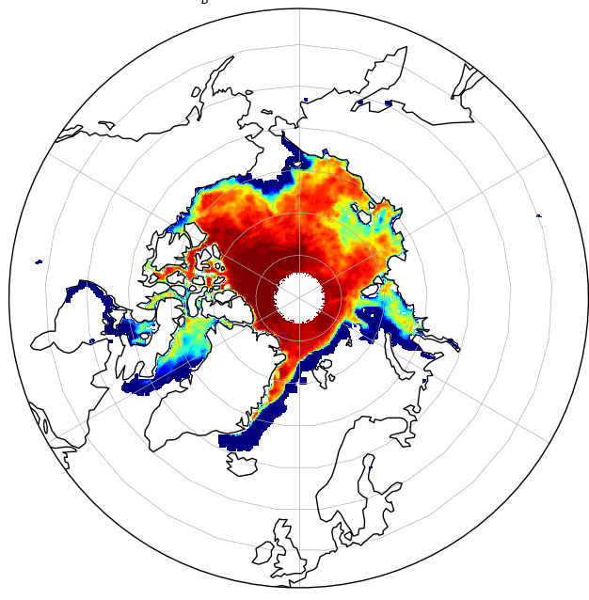
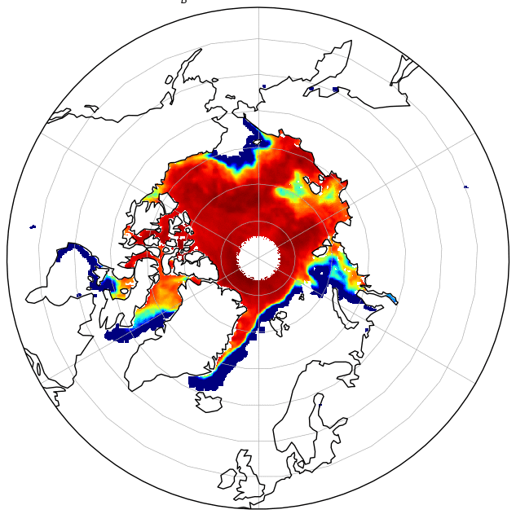
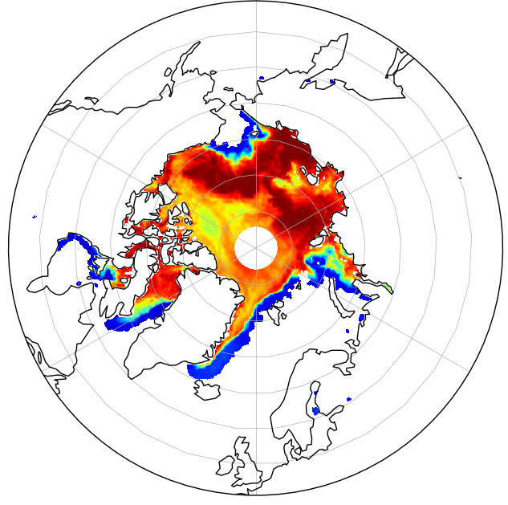
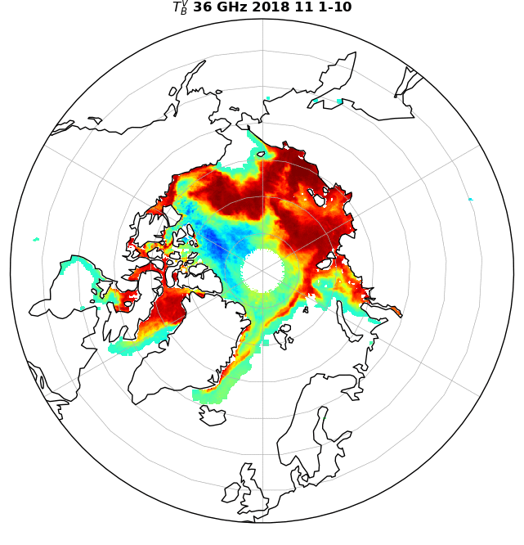
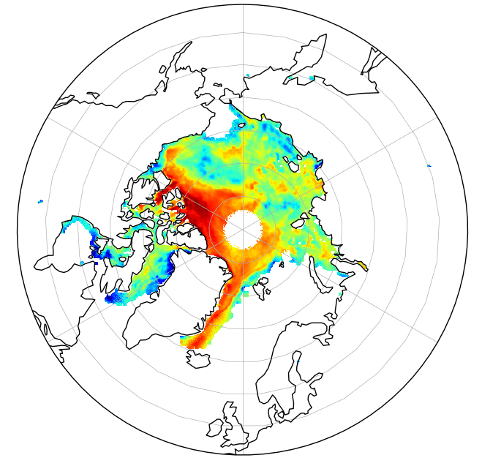
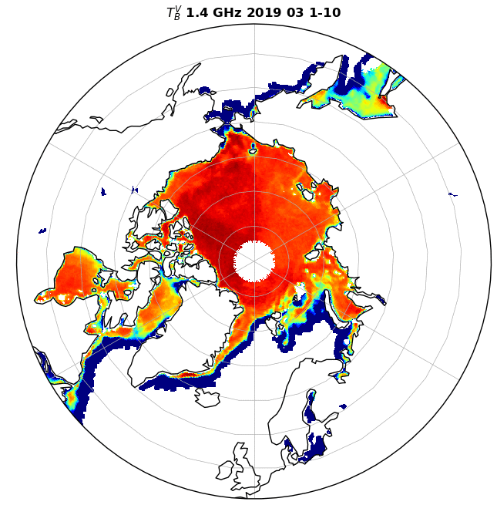
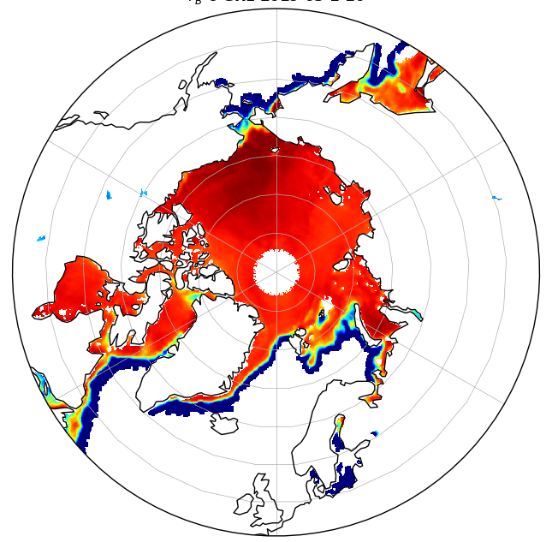
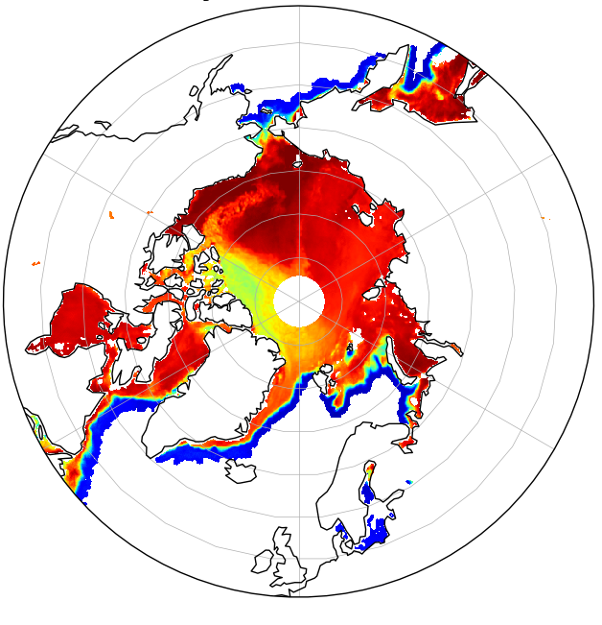
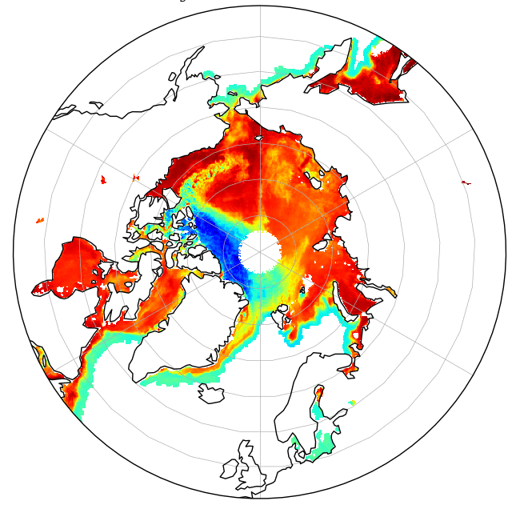
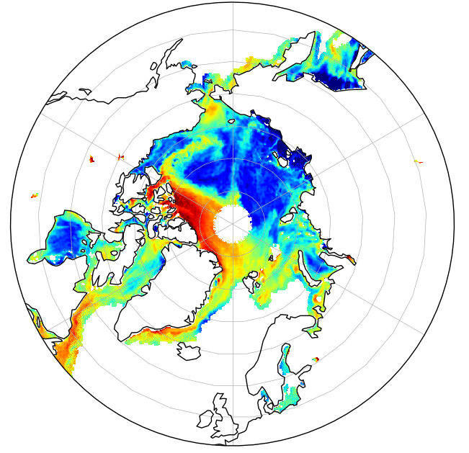
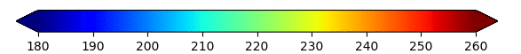
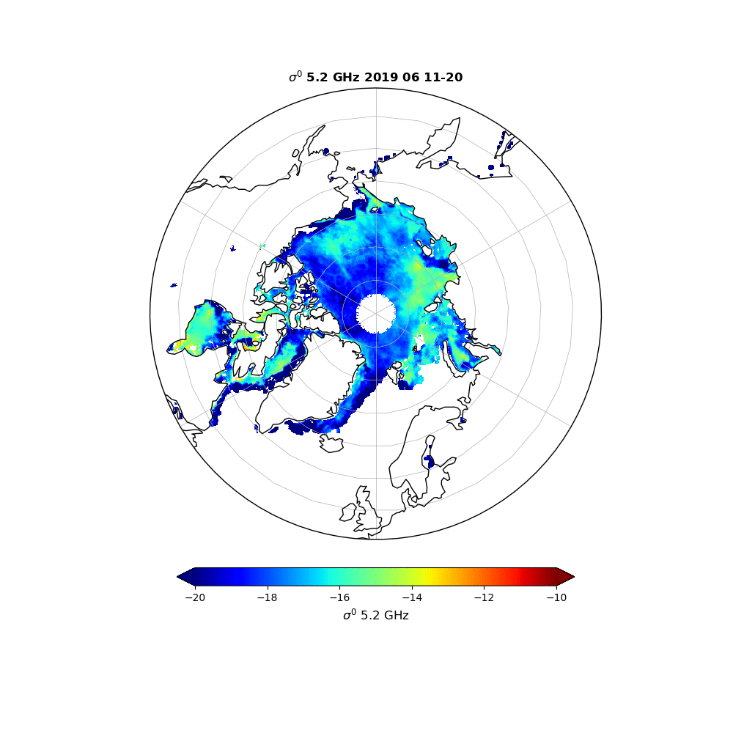
CIMR
SMAP AMSR2
T_{B}^{V} 1.4 GHz T_{B}^{V} 6 GHz T_{B}^{V} 18 GHz T_{B}^{V} 36 GHz
ASCAT
ASCAT
σ⁰ 5 GHz (at 40°)
1-10 March 1-10 November
T_{B} ^{V} (K)
σ⁰ (dB)
Notes:
Here is the data for CIMR, using SMAP and AMSR2 data, for a 10day period in November (top pannels) and in March (bottom pannels)
ASCAT images for the same period of times are shonw on the right.
Once the observations are ready, how to synthetize the information? How to merge the information to better assess and interpret their co-variability?

Slide 4
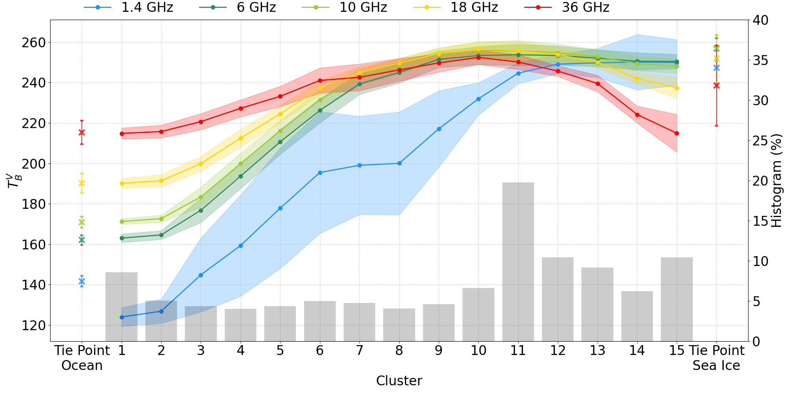
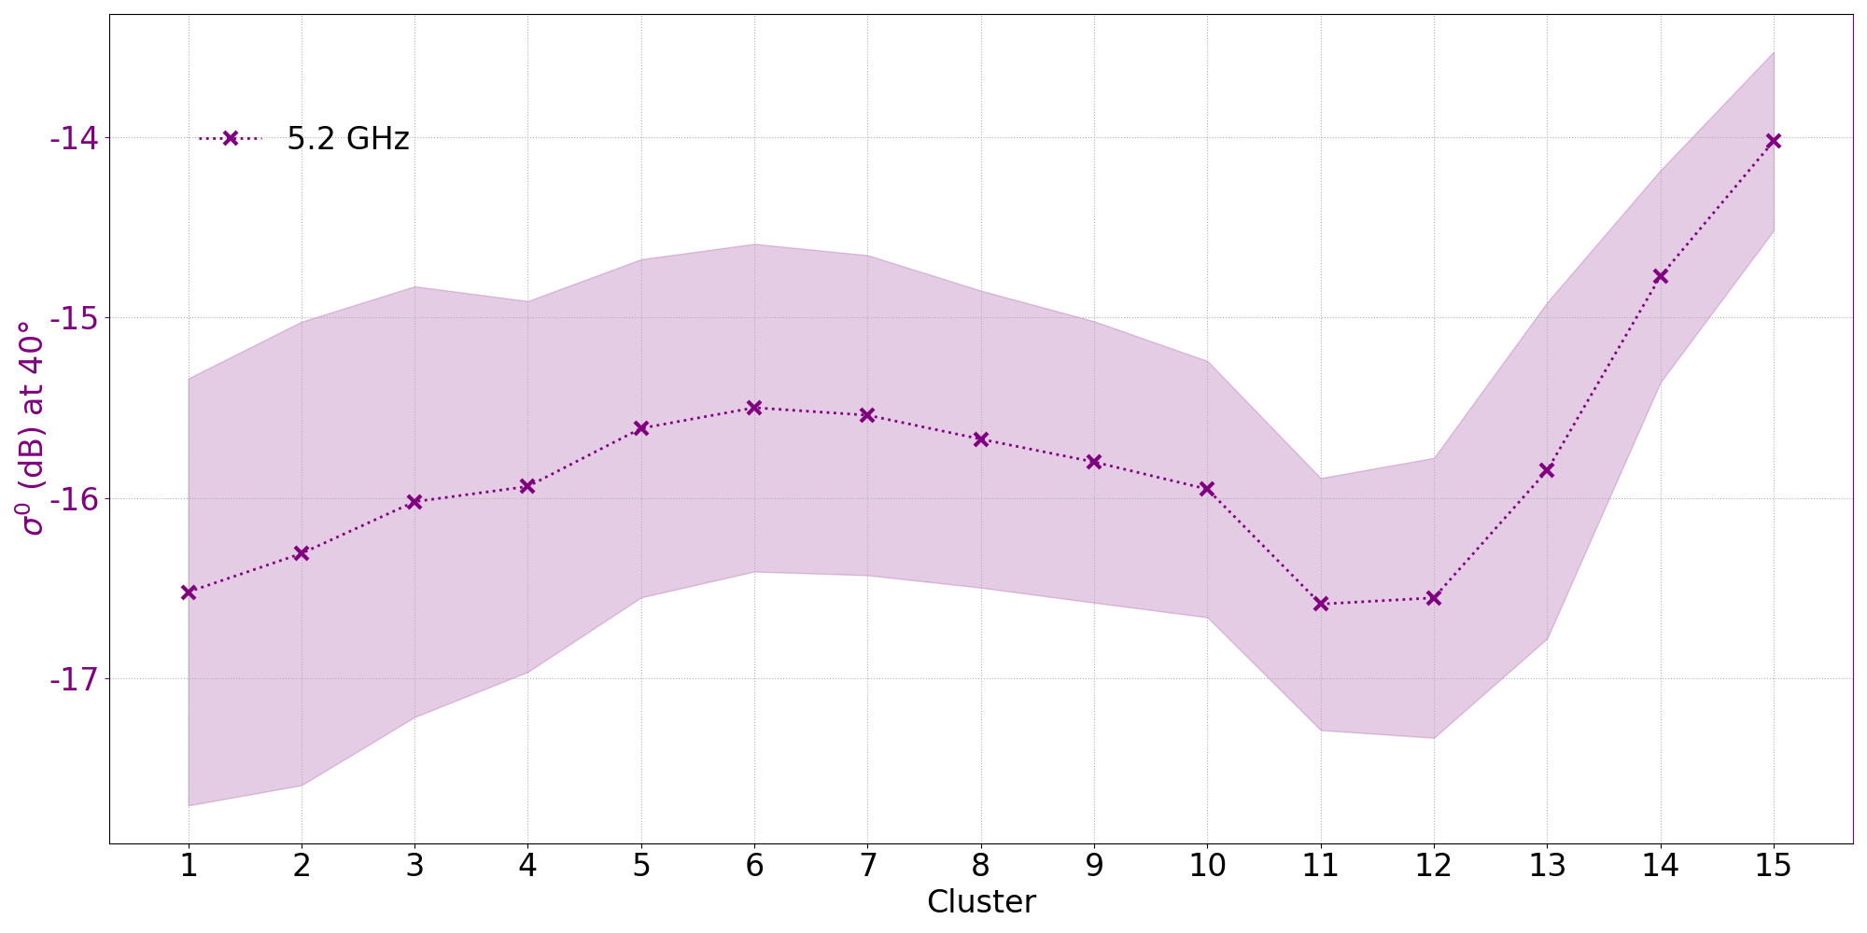
Results of the clustering
It makes it possible to analyze the co-variability of the observations, for different environmental conditions (i.e., for each cluster).
CIMR (SMAP + AMSR2) T_{B}^{V}
ASCAT σ⁰ (5 GHz)
Cluster
Cluster
Increasing SIT
Scattering
Sea Ice Concentration effects
Sea Ice Thickness effects
Scattering effects
Snow scattering or surface scattering?
Snow depth and/or ice type ?
Increasing SIC
SIC ~ 100%

Slide 5
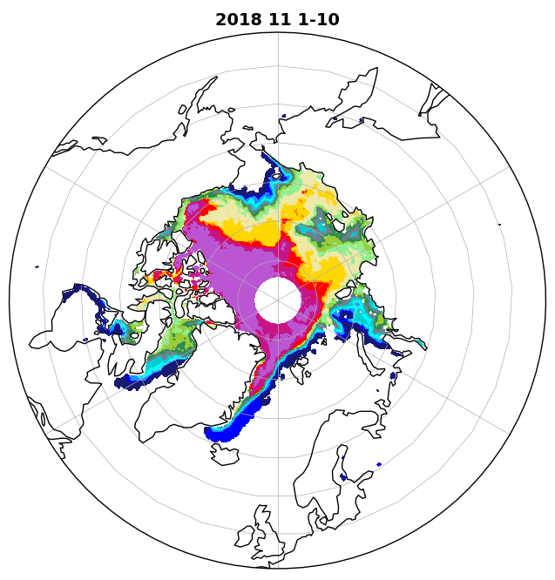
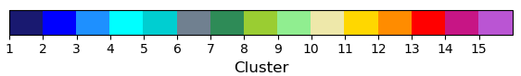
Results of the clustering
Increasing SIT
Scattering
Increasing SIC
SIC ~ 100%
Spatialy and temporaly consistent clustering results (despite the fact that no temporal or spatial information is provided to the clustering)
Notes:
Let’s take a look at the map resulting from the classification.
The legend on the right sum up what has been said before, about the cluster interpretation.
The clusters evolve very smoothly during the winter, in relationship with the geophysical properties of the sea ice, and its snow cover as a result of the synergy between the different observations.

Slide 6
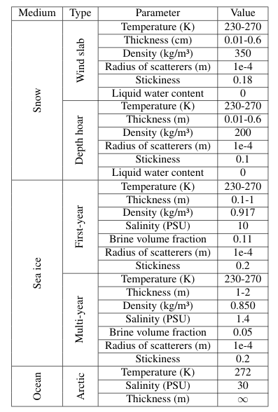
SMRT Snowpack - Sea Ice Diagram
Air
(1-f_{dh}) h_{snow}
Rounded Grain
Flat
interface
h_{snow} ∈ [1 ; 60 cm]
f_{dh} h_{snow}
Depth Hoar
Rough
interface
SIT ∈ [0.1 ; 2 m]
≈
Sea Ice
Ocean
Notes:
Here is a diagram of the sea ice and its snow pack we have simulated with SMRT.
We have a single sea ice layer with 2 layer of snow.
The first is windslab and the other is depth hoar.
Each geophysical parameter have been modified in the following range.

Slide 7
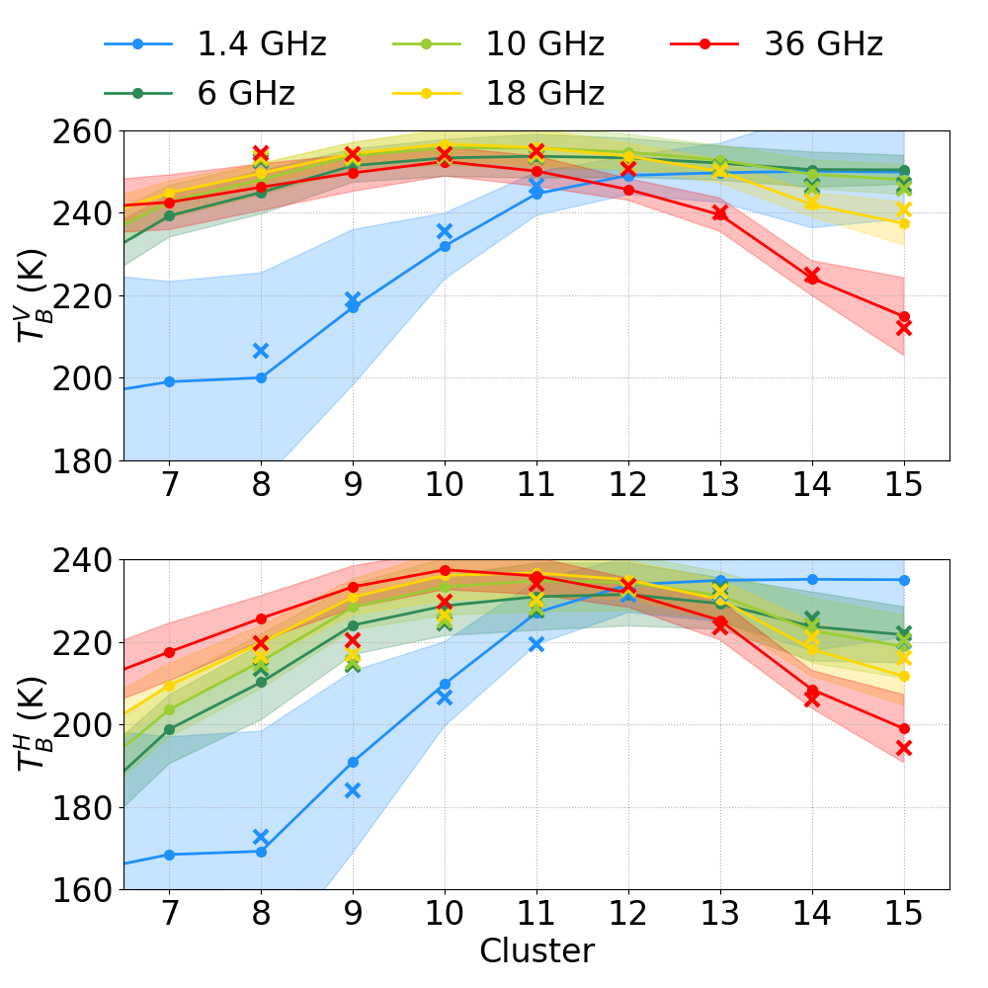
Evaluation of SMRT over Sea Ice
With SMRT, we are able to:
Simulate the effect of SIT
Explain the scattering signatures
Due to depth hoar (18-36 GHz)
Due to surface roughness (σ⁰)
Reproduce behaviors highlighted by the classification
For all the CIMR frequencies at V and H polarization

Slide 8
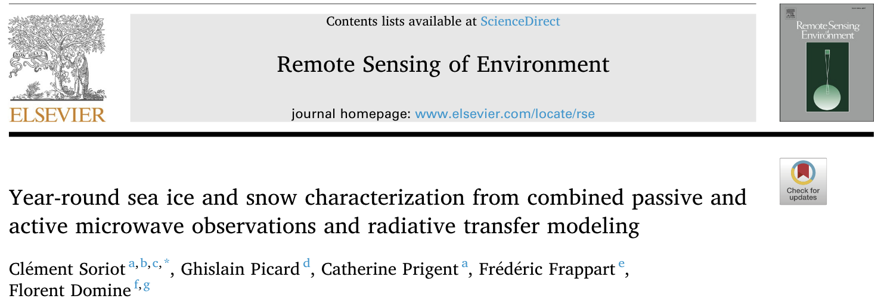
Take home message
There are synergies to be exploited between CIMR and ASCAT.
Passive microwave observation at CIMR frequencies can tell a lot about sea ice and its snow cover
Realistic simulations with consistent physical interpretations of the microwave signal have been obtained with SMRT
Snow microstructure has more impact on brightness temperature than snow depth
More information in Soriot et al. 2022

