Slide 1
A molecular simulation and laboratory characterization study of micropore and sorption sites impact on methane adsorption in kerogen
2022 EGU
Wei Li¹, Lee A. Stevens¹, Dingye Zheng², Colin E. Snape¹
1. University of Nottingham, Low Carbon Energy and Resources Technologies Group, Faculty of Engineering, Energy Technologies Building, Triumph Road, Nottingham NG7 2TU, UK.
2. State Key Laboratory of Petroleum Resources and Prospecting, China University of Petroleum (Beijing), Beijing, 102249, China.
2022. 05
Notes:
My name is wei Li, today’s presentation is about

Slide 2
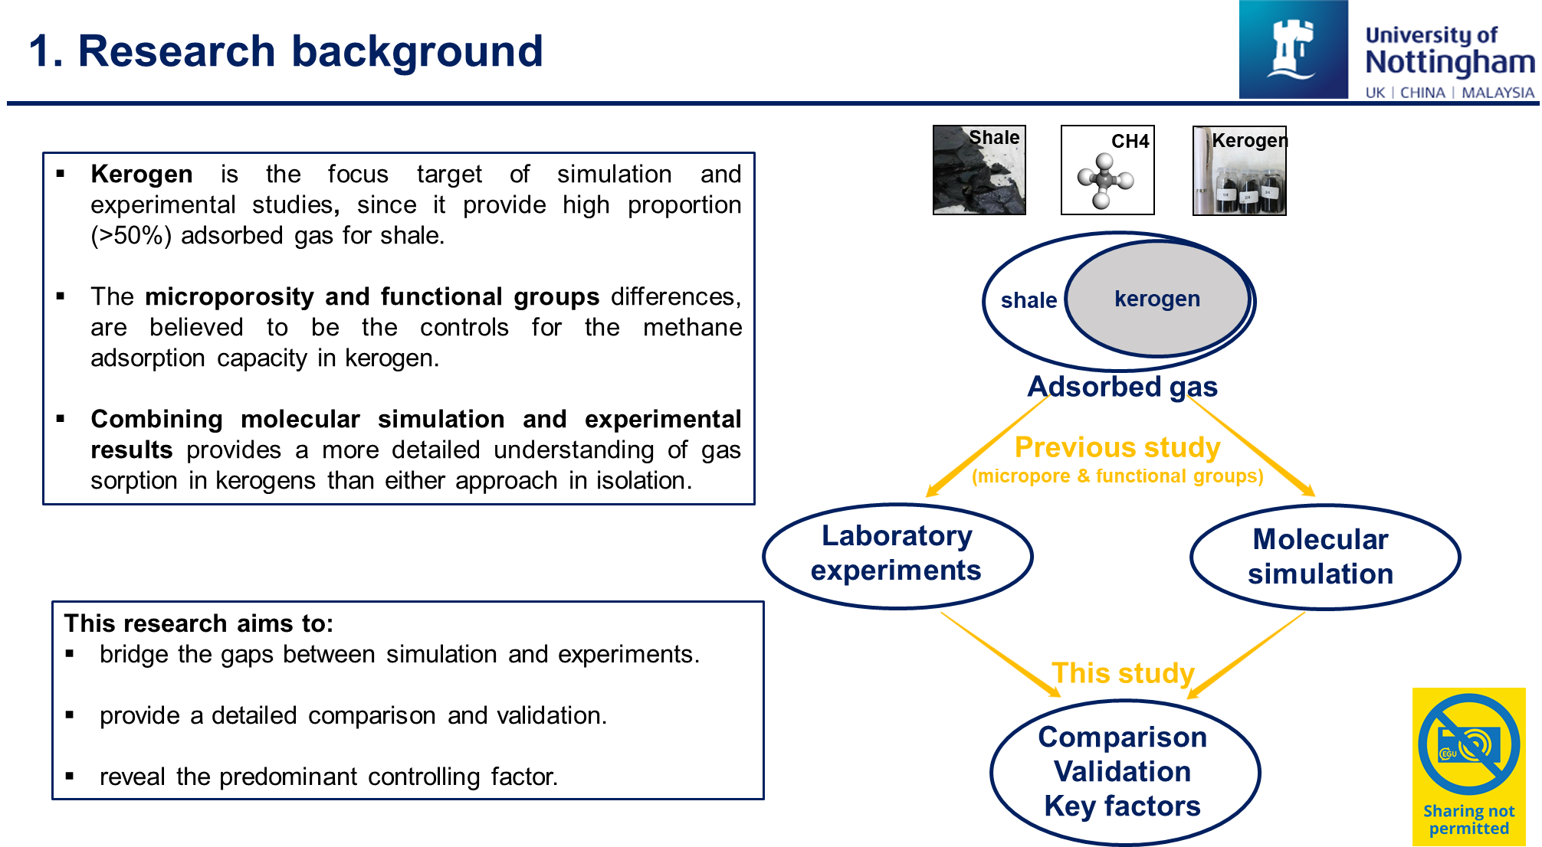
Notes:
The importance of kerogen making it become the main focus for both simulation and experimental studies about shale gas exploration and storage, since it can provide high proportion (>50%) adsorbed gas. The microporosity and functional groups differences, are believed to be the controls for the changes in methane adsorption capacity in kerogen with varying maturity. With Most simulation research are studied separately from experimental study.
Therefore, this research is going to bridge the gaps between simulation and experiments, by combining these two methods together. Demonstrating the difference between molecular simulation and experimental results, which is vital for supporting further simulations on gas exploration and storage. And, Understanding how thermal maturity controls methane adsorption and revealing the predominate controlling factors in kerogen is crucial for predicting shale gas resources.

Slide 3
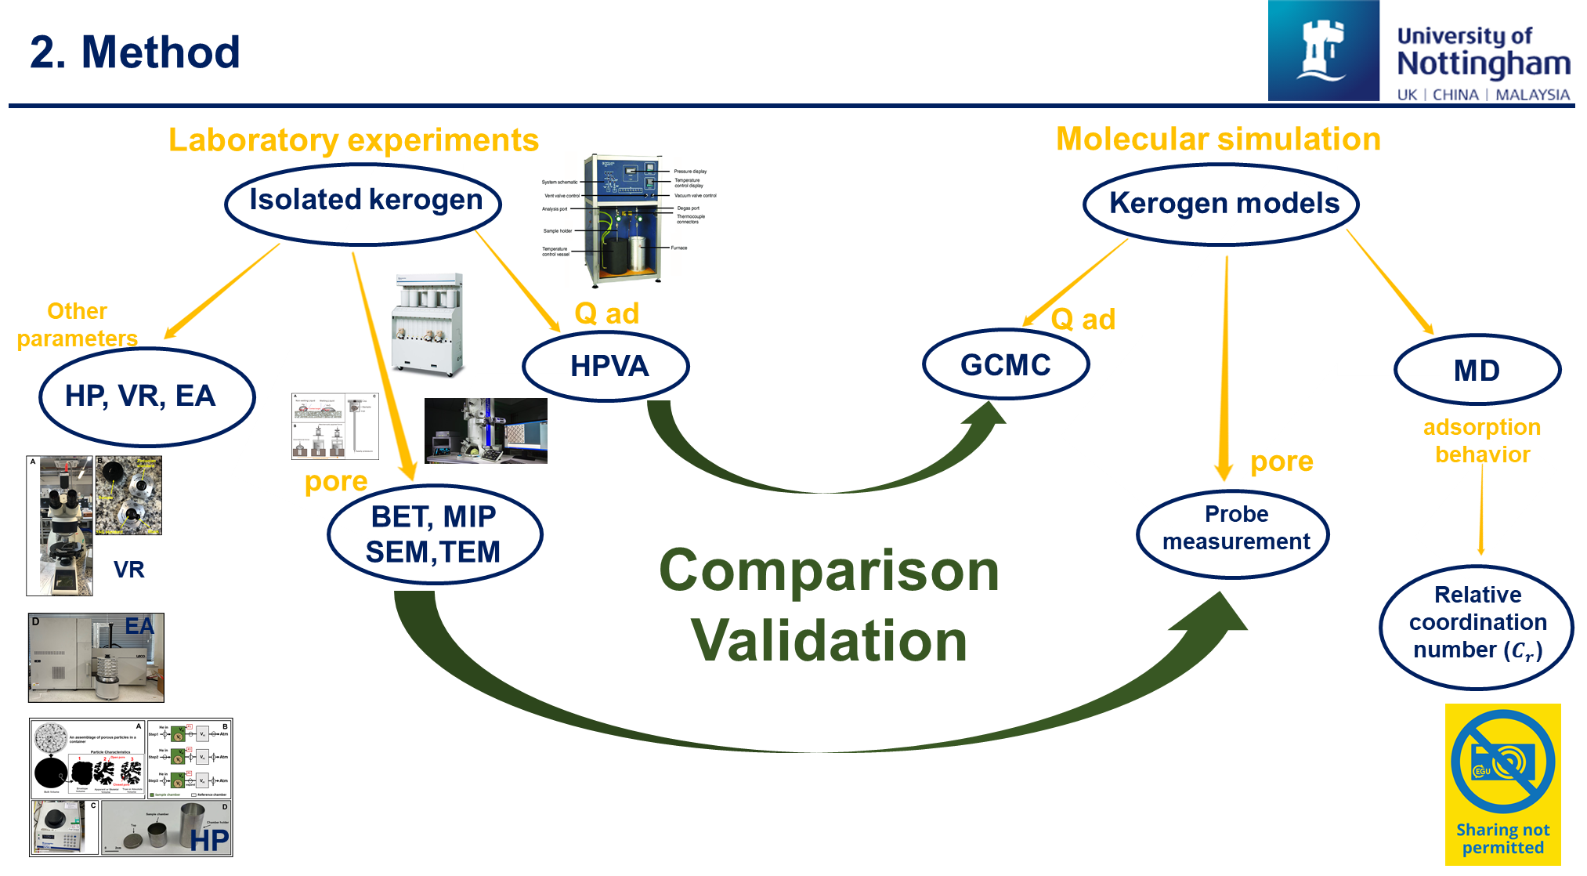
Notes:
The Type II isolated kerogens and simulated kerogen matrix and slit models are prepared for laboratory experiments and molecular simulation. Grand Canonical Monte Carlo (GCMC), probe measurement, and molecular dynamic (MD) simulations are applied to obtain simulation results, including the methane adsorption capacity, micropore texture, and adsorption behaviour. Laboratory experiments, high-pressure methane adsorption, low-pressure gas sorption, SEM and TEM, and other experiments are carried out on isolated kerogens for verifying and comparing with simulation results.

Slide 4
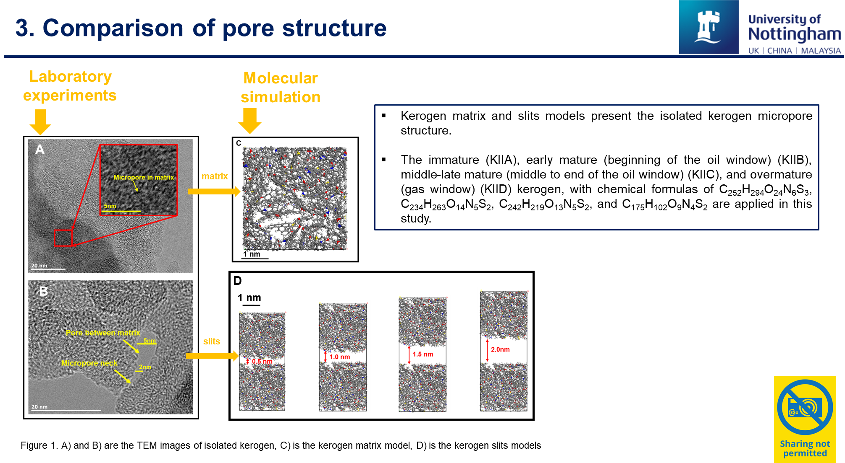
Notes:
Kerogen matrix and slits models with different size and maturity are constructed to present the micropore structure of real kerogen

Slide 5
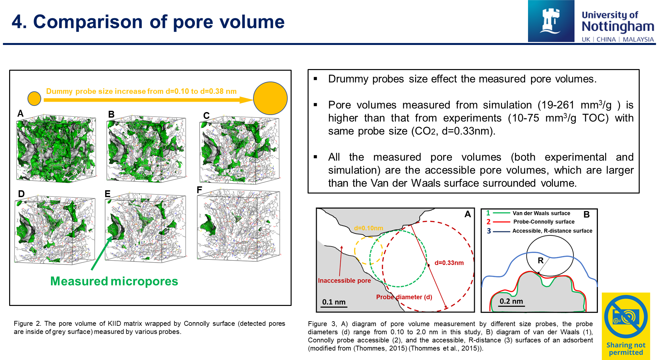
Notes:
The results indicates measured micropore volumes in simulation are effected by the probes size, and the results from simulation is higher than that from experiments, as all pores are accessible in simulation, including the dead pores and the blocked pores by narrow pore necks.

Slide 6
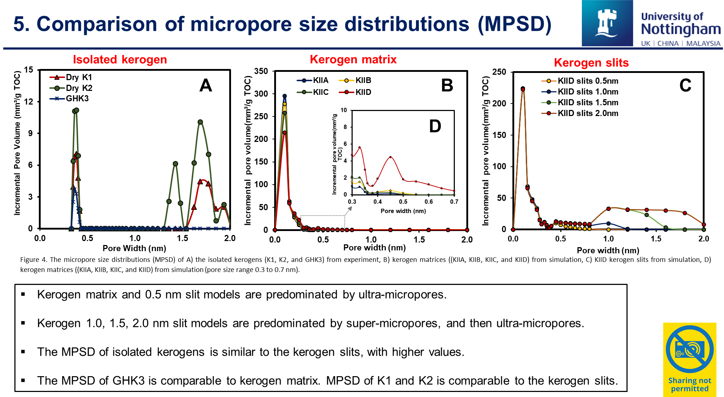
Notes:
The MPSD of kerogen are also comparad, where, kerogen matrix and 0.5nm slit models predominated by ultra-micropores like kerogen3, and the other slits models cover all the micropores range in isolated kerogen1 and 2, suggesting the kerogen models in the simulated are pretty good to represent the isolated kerogen considering the MPSD.

Slide 7
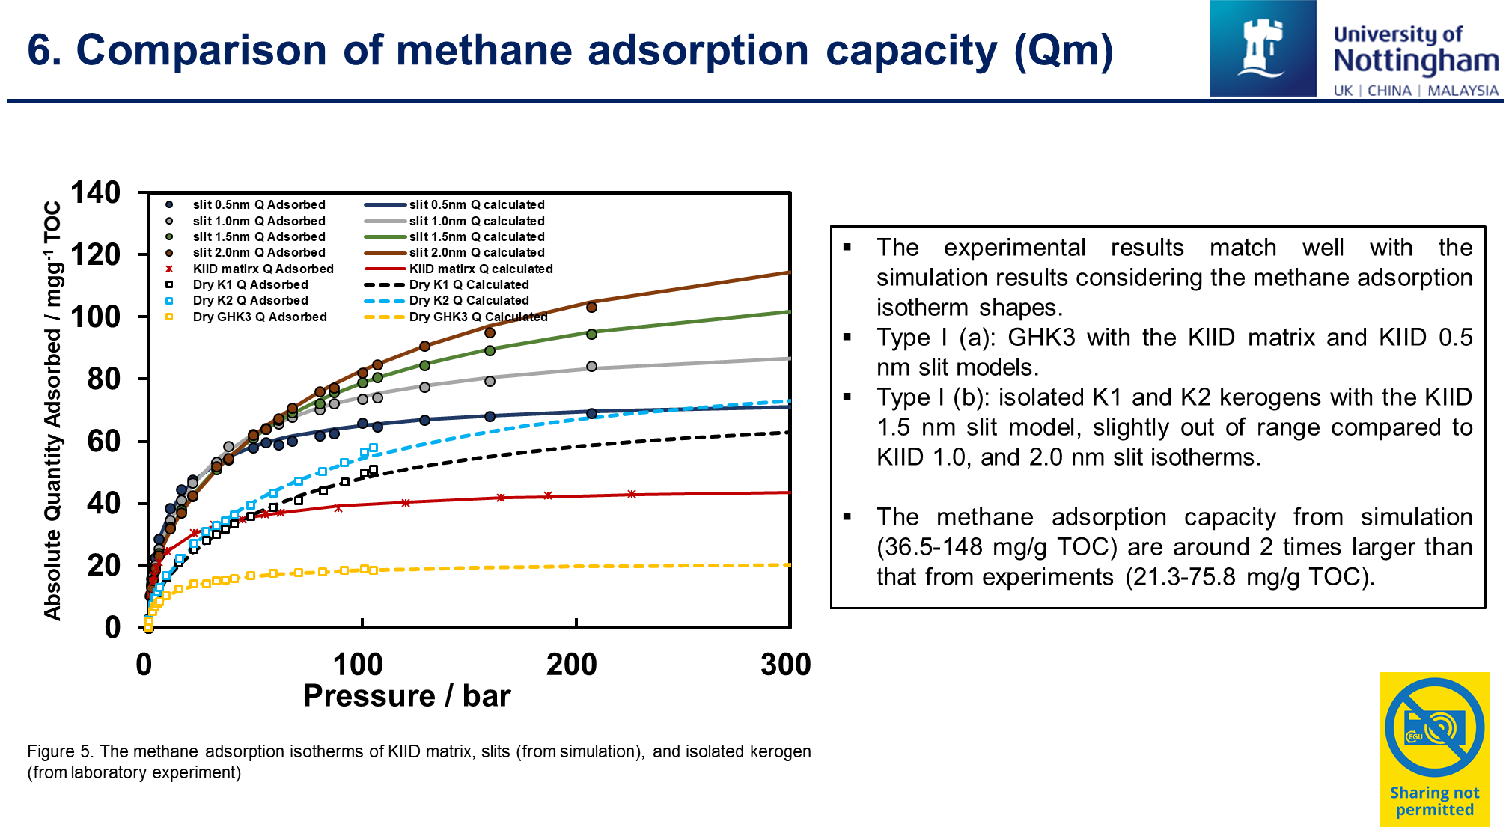
Notes:
The experimental results match well with the simulation results considering the methane adsorption isotherm shapes. Kerogen 3 matches well with the KIID matrix and KIID 0.5 nm slit models, reflecting Type I (a) isotherms, and kerogens 1 and 2 display Type I (b) isotherms, comparable with the larger slits models.
The average Qm from simulation is about 2 times larger than that for experiments, since GCMC simulations assuming all the pores are accessible.

Slide 8
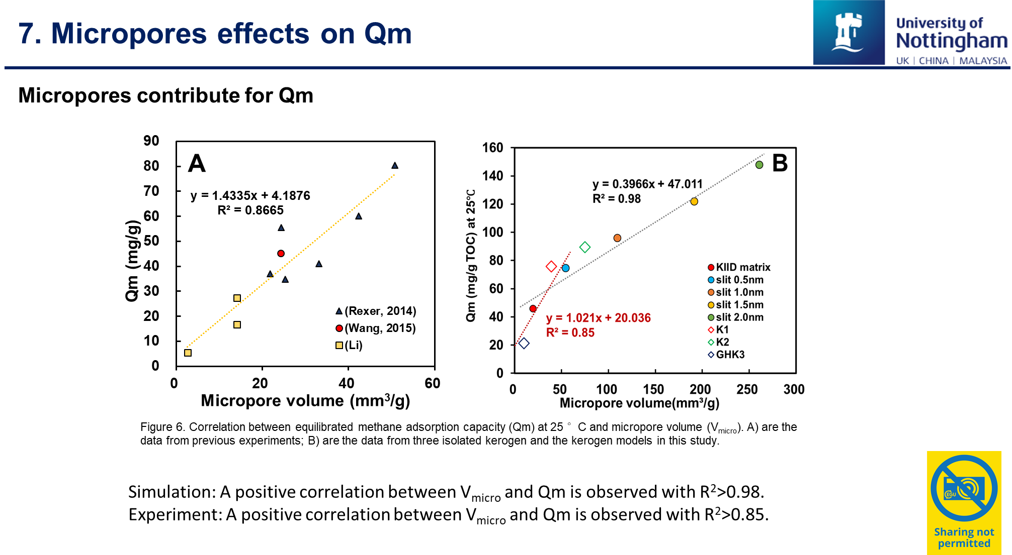
Notes:
Although microporosity and functional groups differences, are believed to be the controls for the changes in methane adsorption capacity, a positive correlation between Qm and micropore volume in kerogen was observed from recent experimental research and this simulation, suggesting the micro pore could be the key controlling.

Slide 9
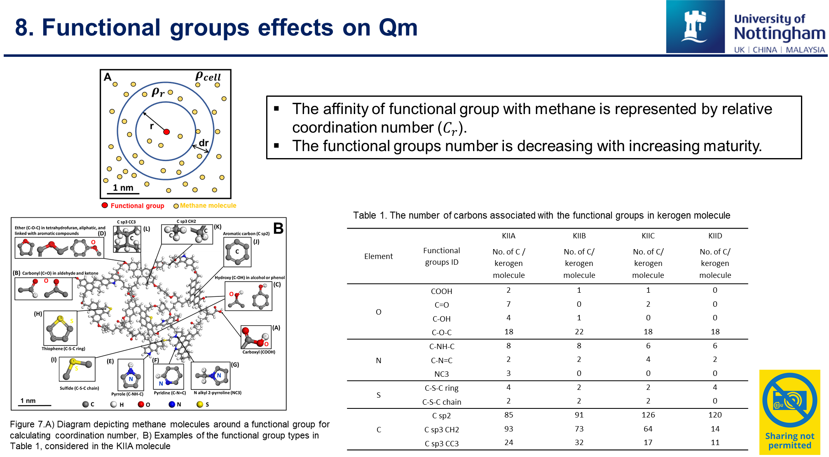
Notes:
Functional groups affinity with methane are represented by the relative coordination number. The functional groups number is decreasing with increasing maturity, which means the immature kerogen including all the functional groups.

Slide 10
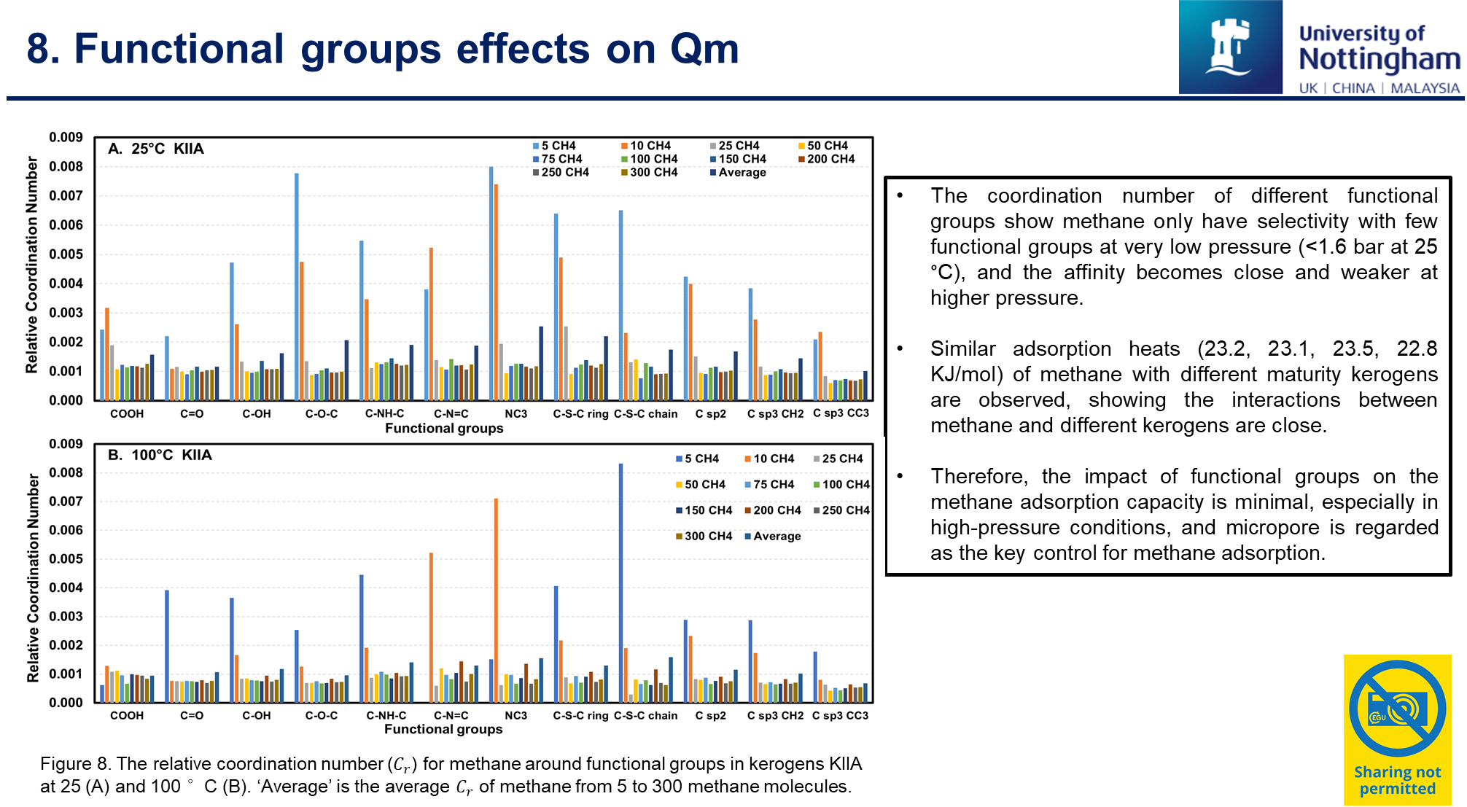
Notes:
The results indicates, The relative coordination number of different functional groups show methane only have selectivity with few functional groups at very low pressure (<1.6 bar at 25 °C), and the affinity becomes close and weaker at higher pressure. Moreover, similar adsorption heats of methane with different maturity kerogens are observed, showing the interactions between methane and different kerogens are close. Therefore, the impact of functional groups on the methane adsorption capacity is minimal, especially in high-pressure conditions, and micropore is regarded as the key control for methane adsorption.

Slide 11
Thank you
Email: Wei.li2@nottingham.ac.uk
Notes:
Thanks for your time. Please contact me if you have any questions, I would be very glad for further discussion.

