Slide 1
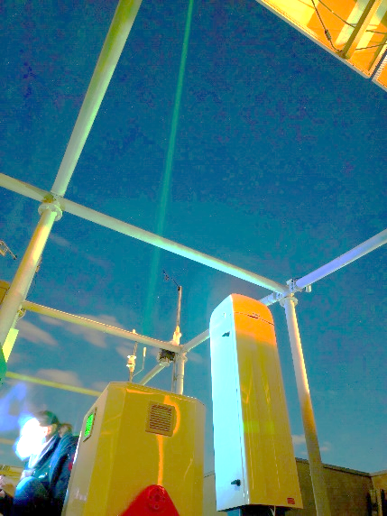
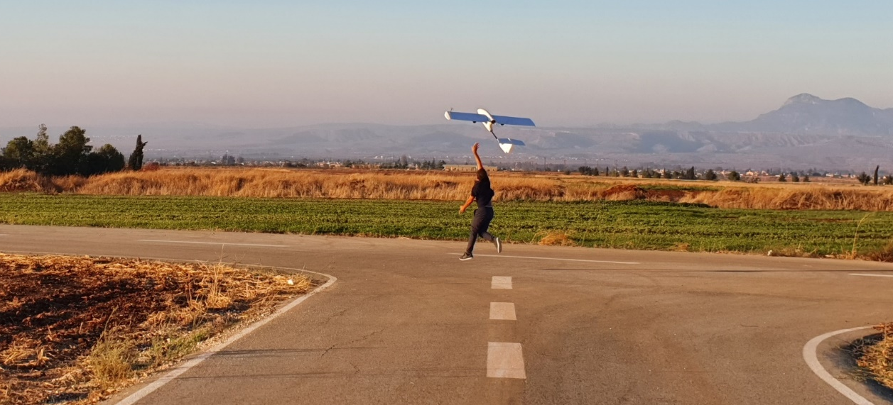
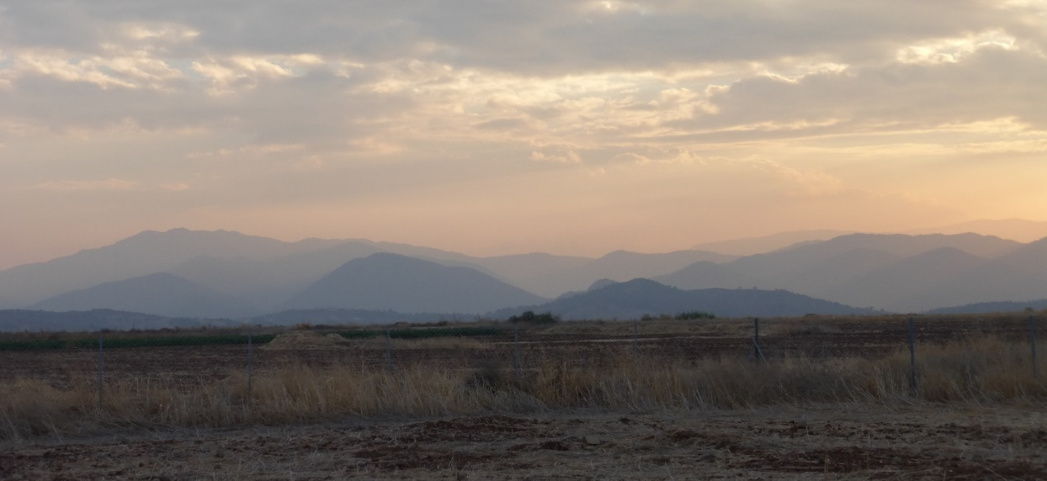


Characterizing dust aerosols with lidar and UAV based measurements (Cyprus Fall campaign 2021)
Papetta A., Kezoudi M., Marenco F., Keleshis C. , Mamouri E. R. , Nisantzi A. , Philippe Goloub and Sciare J.
EGU 2022, Vienna Austria

Slide 2
Contents
Motivation
Instrumentation
Overview
Preliminary Results
Outlook and Future work

Slide 3
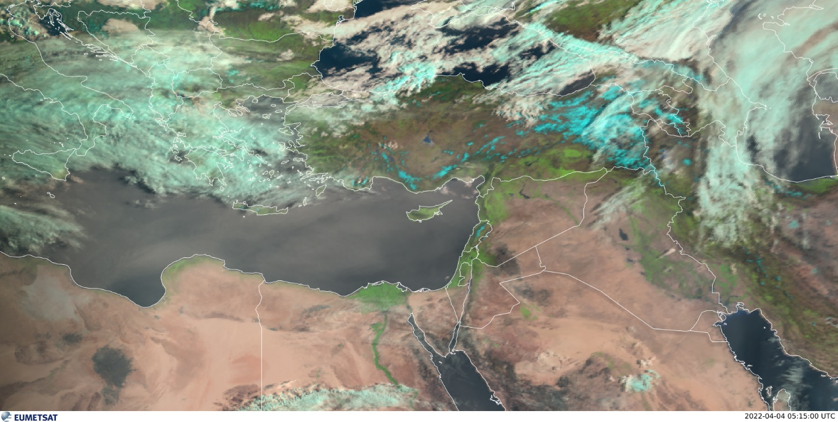
Motivation
Cyprus surrounded by the biggest deserts and often affected by dust storms.
Dust storms have became more frequent due to climate change: stronger winds and absence of vegetation.
In preparation for the ASKOS campaign funded by ESA and will take place in Cape Verde in June 2022
ARABIAN DESERT
SAHARA DESERT
Satellite image from EUMETSAT during a dust storm in April 2022. (AERONET measured AOD =0.485)

Slide 4
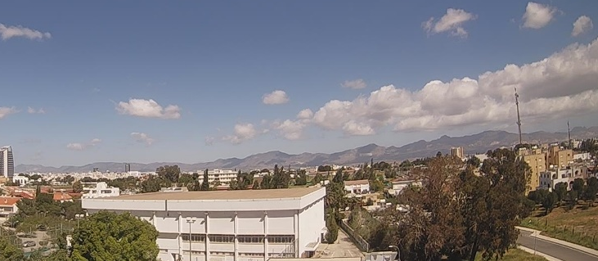
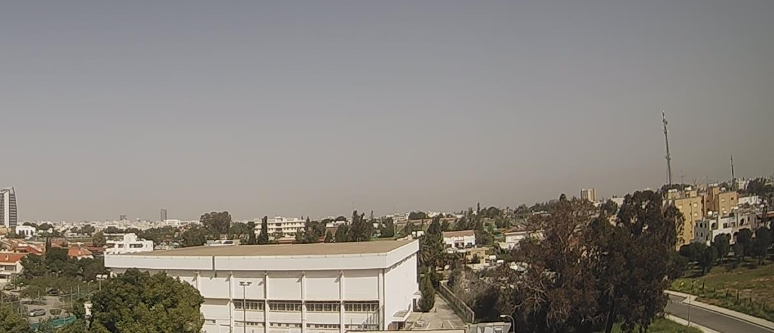
Picture Pentadaktylos clear day / Dusty day
12/04/2022 07:50 (UTC)
04/04/2022 07:50 (UTC)

Slide 5
Picture Pentadaktylos clear day / Dusty day
Pentadaktylos mountains
12/04/2022 07:50 (UTC)
04/04/2022 07:50 (UTC)

Slide 6
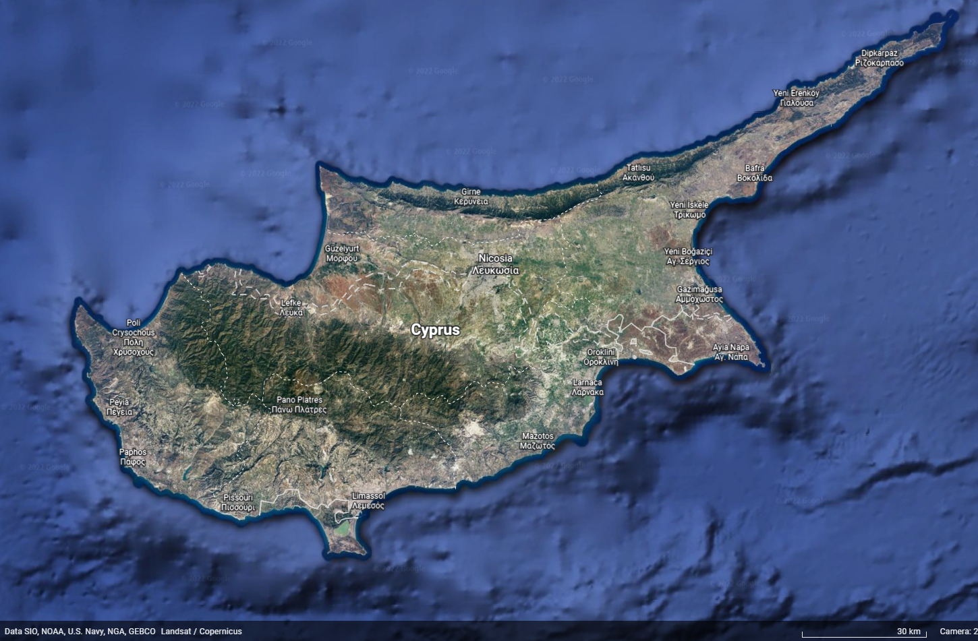



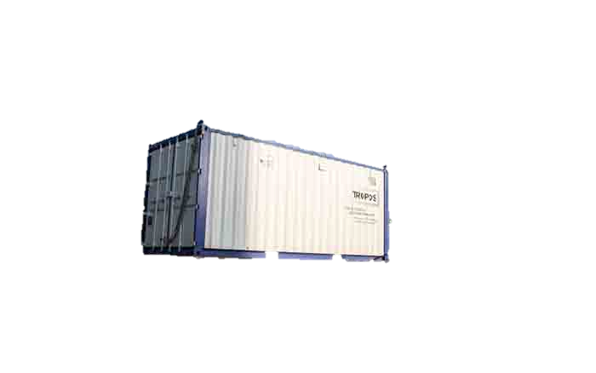
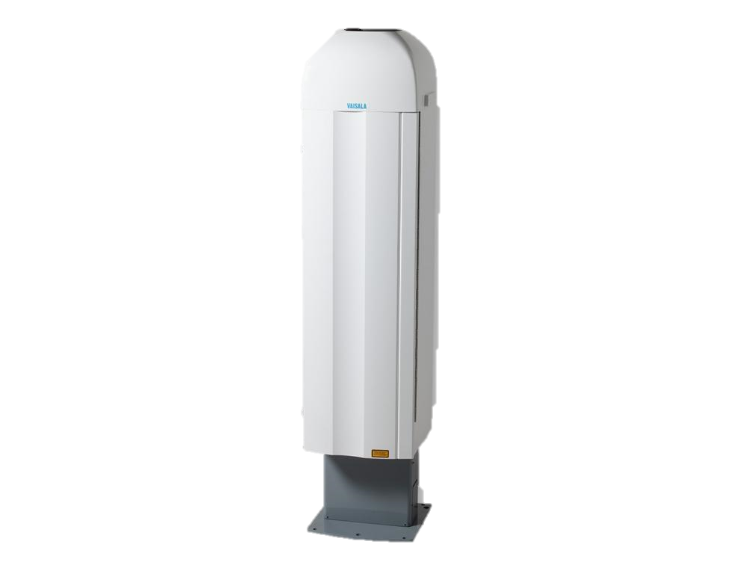

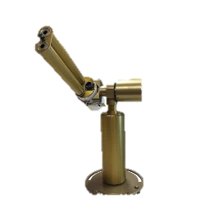
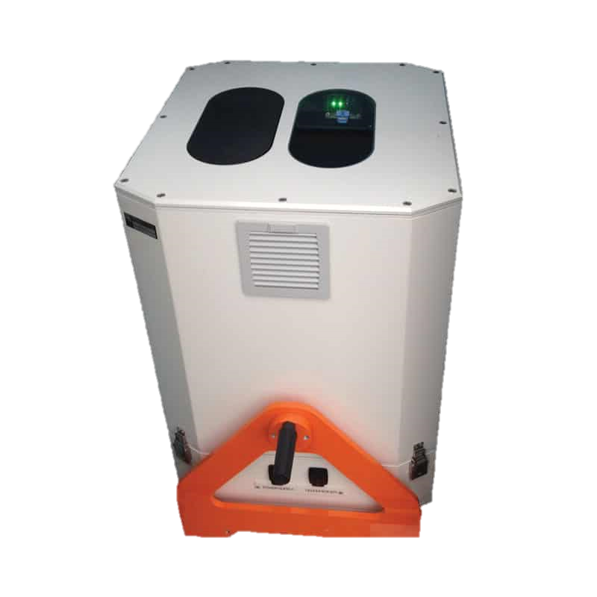

Instrumentation
CIMEL Sunphotometer (CYI: Nicosia / LOA/CYI: Agia Marina Xyliatou/ ECoE-TROPOS: Limassol)
VAISALA Ceilometer (CYI-Nicosia/ CYI-Agia Marina Xyliatou)
CIMEL CE376 (CYI): bi-wavelength elastic lidar
PollyXT (ECoE-TROPOS, Limassol): multi-wavelength Raman lidar
Optical particle counters (UCASS, POPS)
Sampling filters
Optical aerosol backscatter detector (COBALD)
Remote Sensing
UAV based in-situ

Slide 7
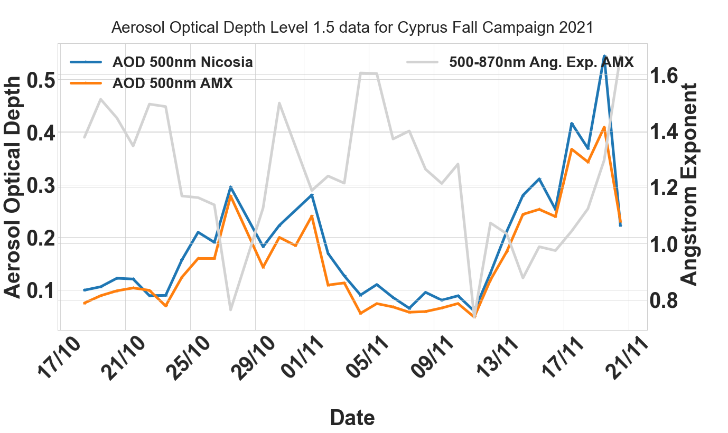
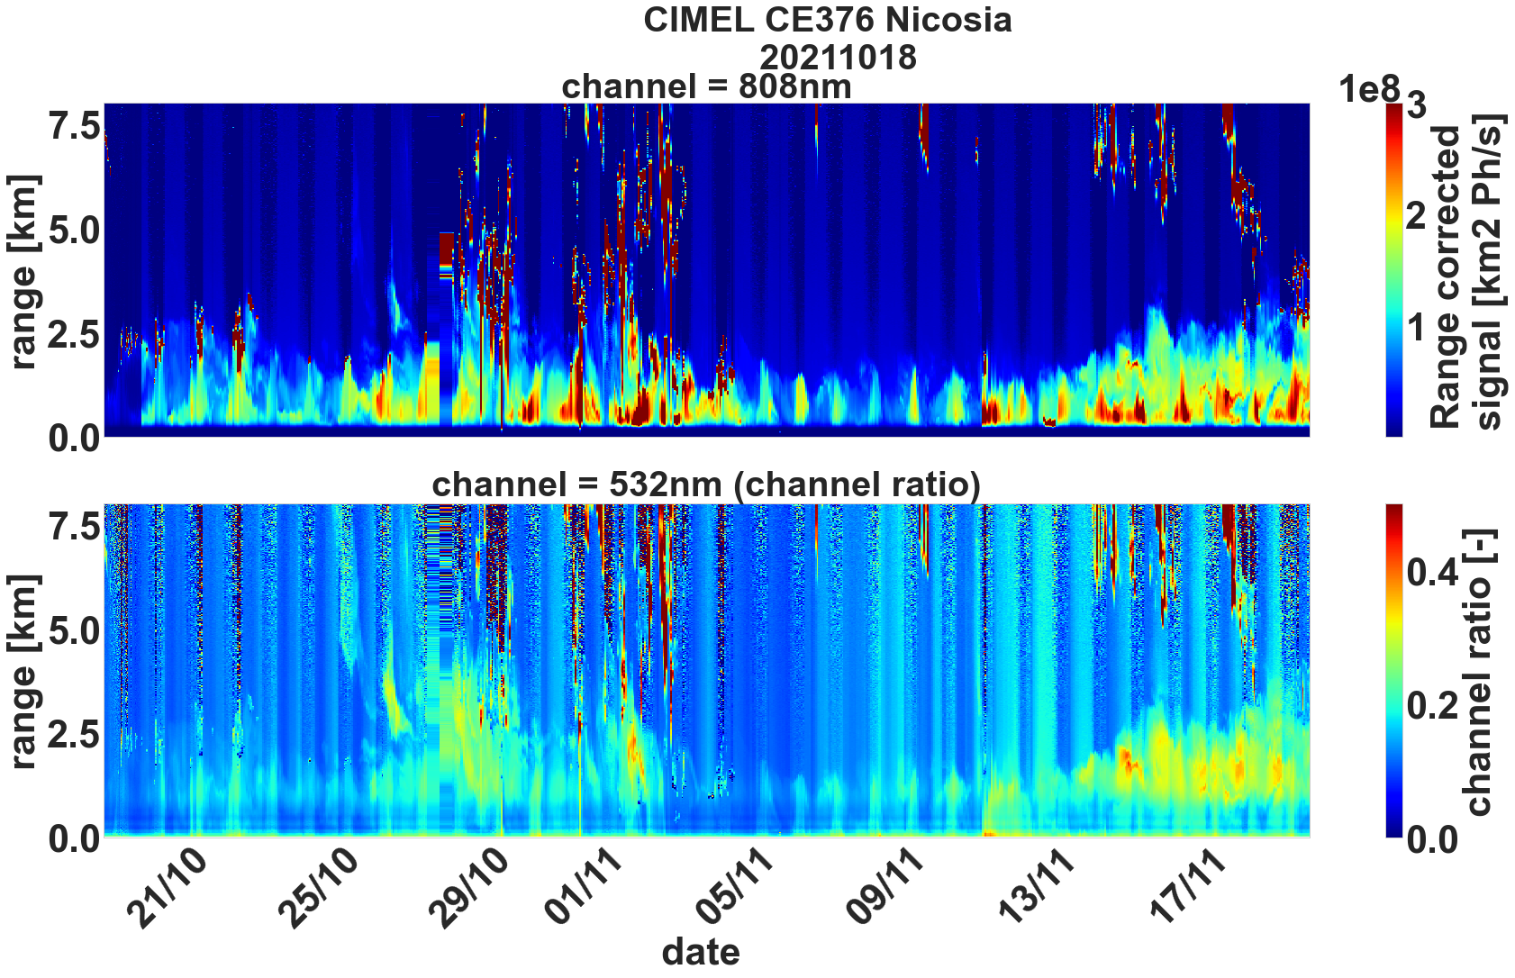
Overview
↑ AERONET data Nicosia and Agia Marina Xyliatou
←CIMEL lidar Nicosia

Slide 8
Overview
Dust event #1
Dust event #2
Dust event #1
Dust event #2
↑ AERONET data Nicosia and Agia Marina Xyliatou
←CIMEL lidar Nicosia

Slide 9

Overview
Dust event #1
Dust event #2
Dust event #1
Dust event #2
↑ AERONET data Nicosia and Agia Marina Xyliatou
←CIMEL lidar Nicosia
: UAV flights

Slide 10
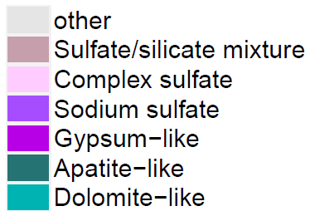
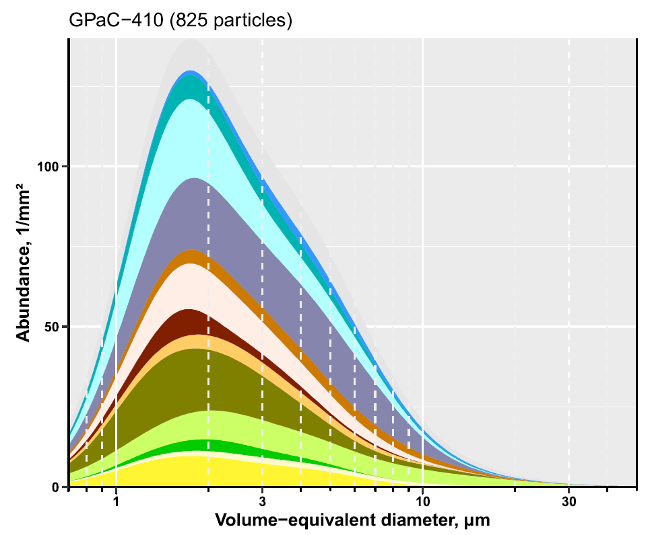
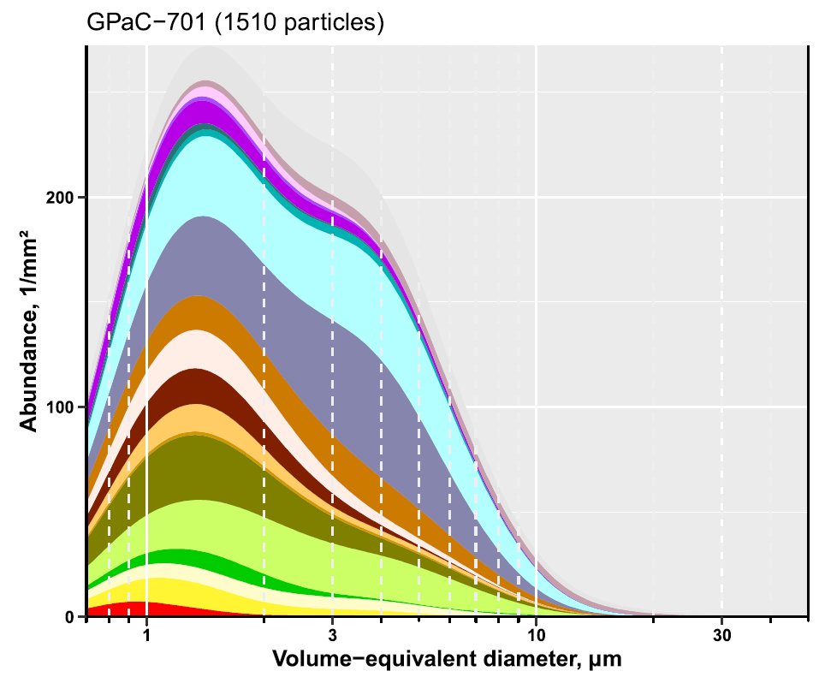
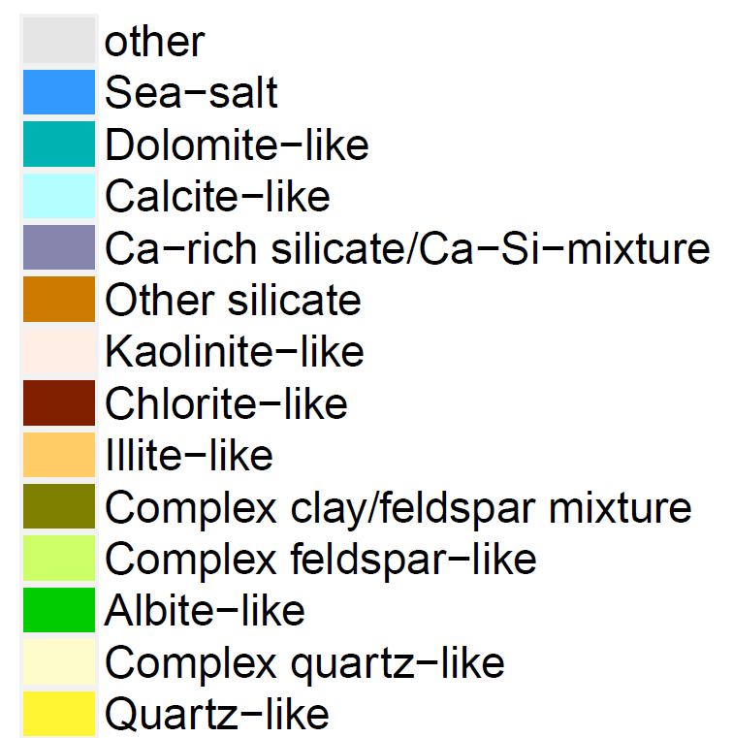

Dust origin
During the Fall Campaign 2021 we had two dust event outbreaks with the first one arriving mainly from the Sahara and the second from Middle East
Example from dust event #1 25/10-01/11
Example from dust event #2 13/11-18/11
28/10/2021
18/11/2021
Courtesy of Konrad Kandler

Slide 11
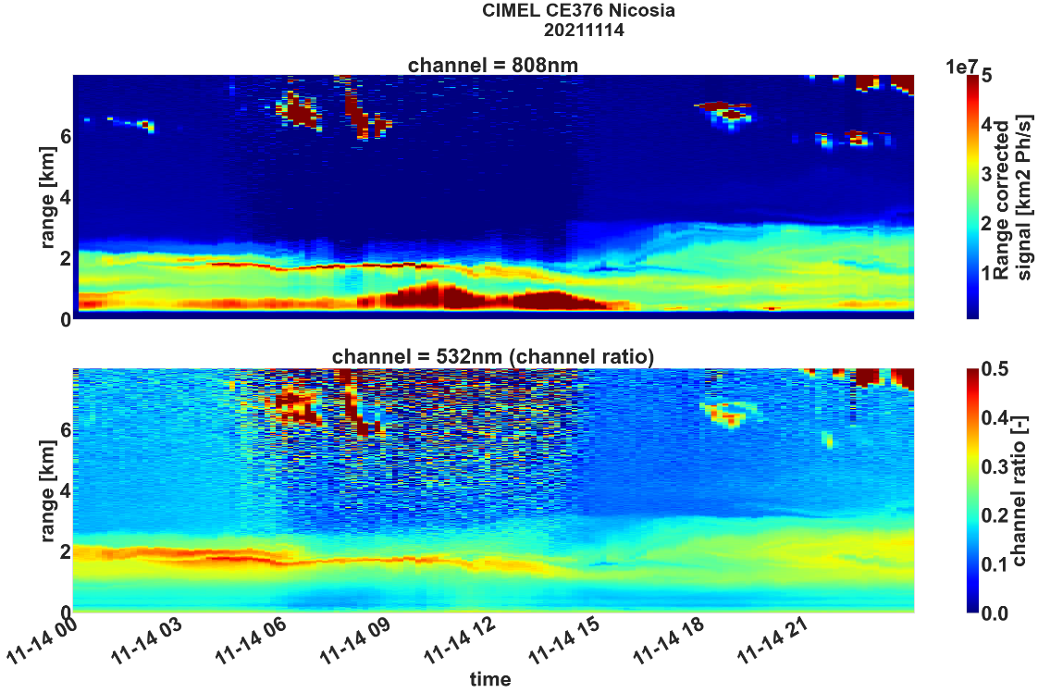
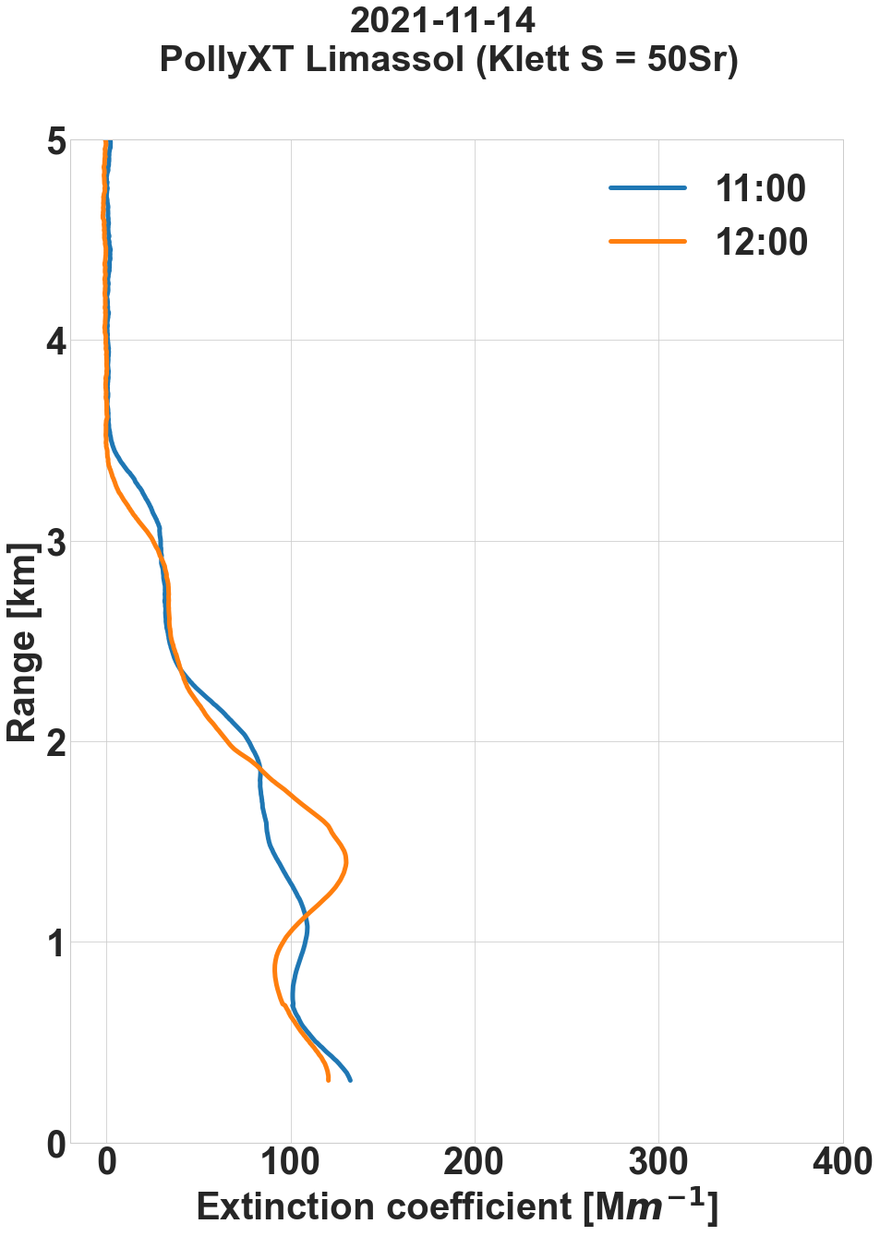
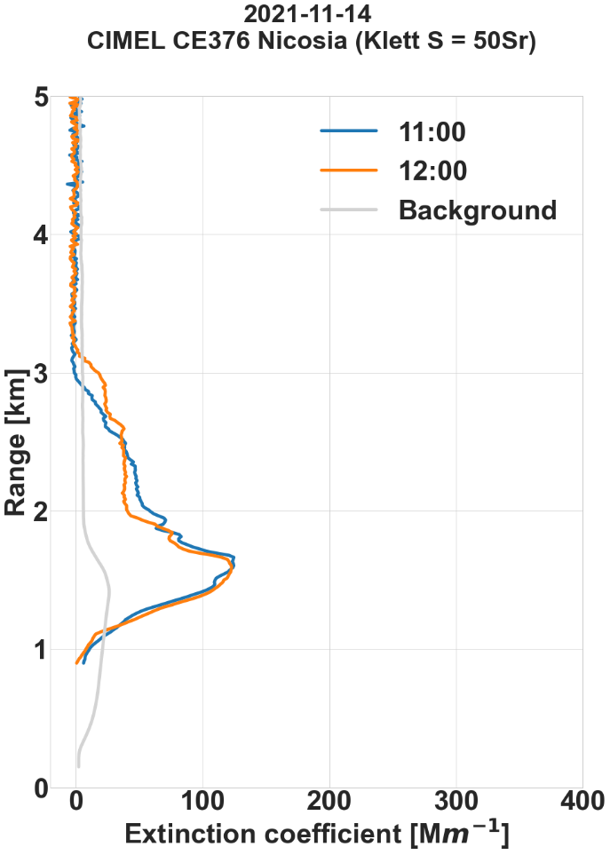
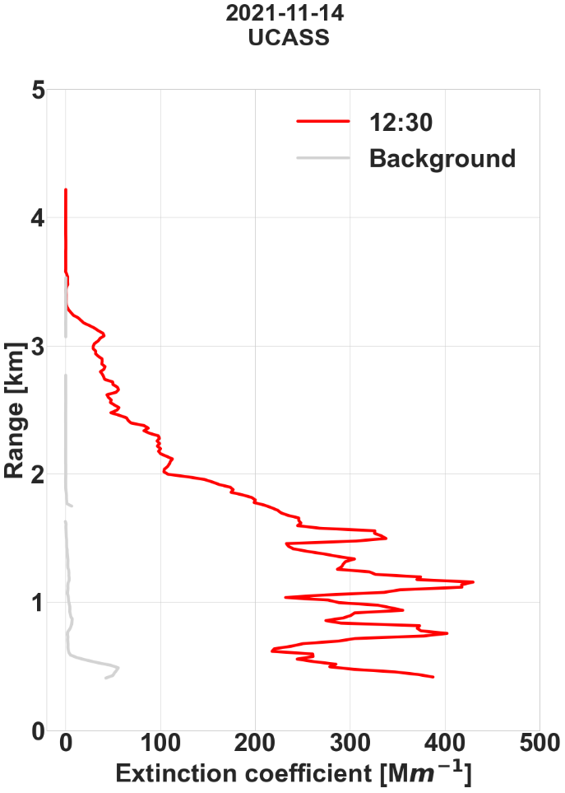



Preliminary results:14/11/2021
Case with AOD = 0.2
λ = 532 nm
λ = 532 nm
In agreement above ~1.5 km
Boundary layer height (Ceilometer Nicosia)
Boundary layer height (Ceilometer AMX)

Slide 12
Summary and further work
Summary
Synergy between remote sensing and in-situ gives a better picture on the aerosol characteristics.
In-situ to assess spatial variability of the layers
Remote-sensing fills temporal gaps between flights
Further work
Statistical analysis for extinction/backscatter products for Fall Campaign 2021
Create a full picture on the propagation of the the dust layers using all the observations on the island

Slide 13
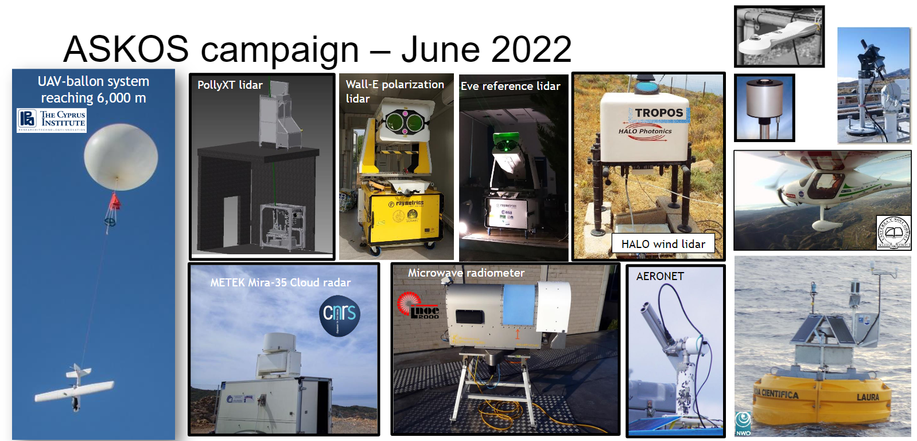
Thank you !
Correspondence: Alkistis Papetta a.papetta@cyi.ac.cy
Acknowledgements:
EMME-CARE: This project has received funding from the European Union’s Horizon 2020 research and innovation programme under grant agreement No. 856612 and the Cyprus Government
Coming up next:

