Slide 1


Methodology and Thwaites Glacier
What can high resolution surface observations tell us about the bed topography of
Pine Island Glacier, West Antarctica?
Helen Ockenden, Rob Bingham, Andrew Curtis, Dan Goldberg
University of Edinburgh
h.ockenden@sms.ed.ac.uk

Slide 2
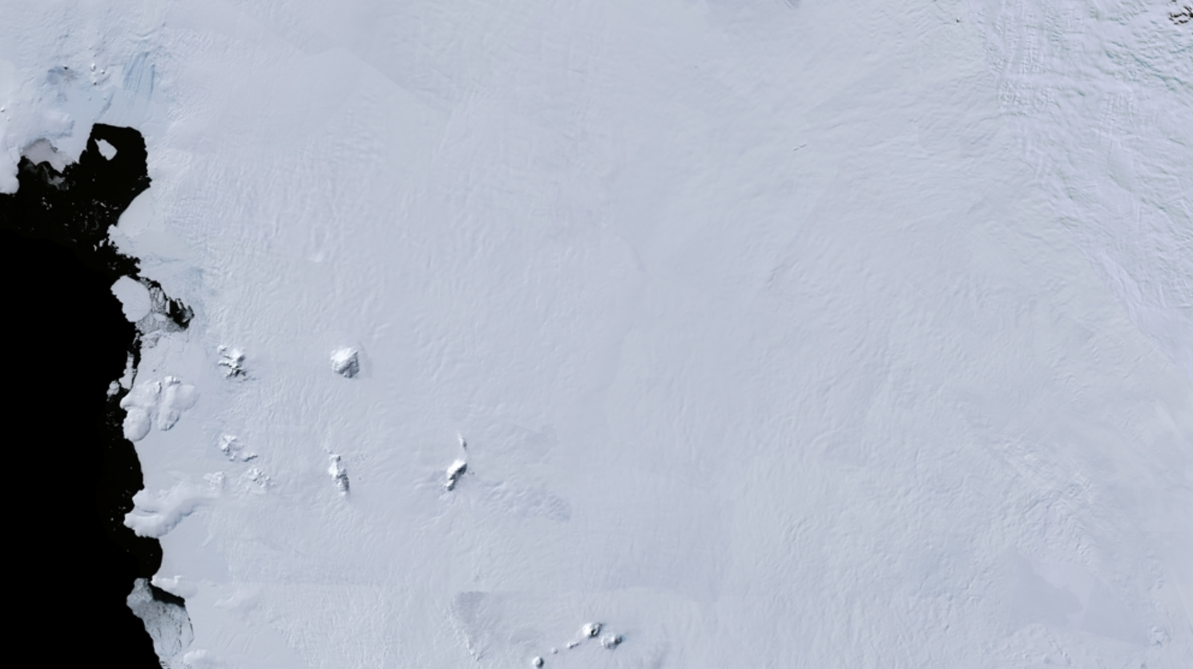
Bed topography is important for modelling sea level rise, but what if there are no direct observations of the bed?

Slide 3
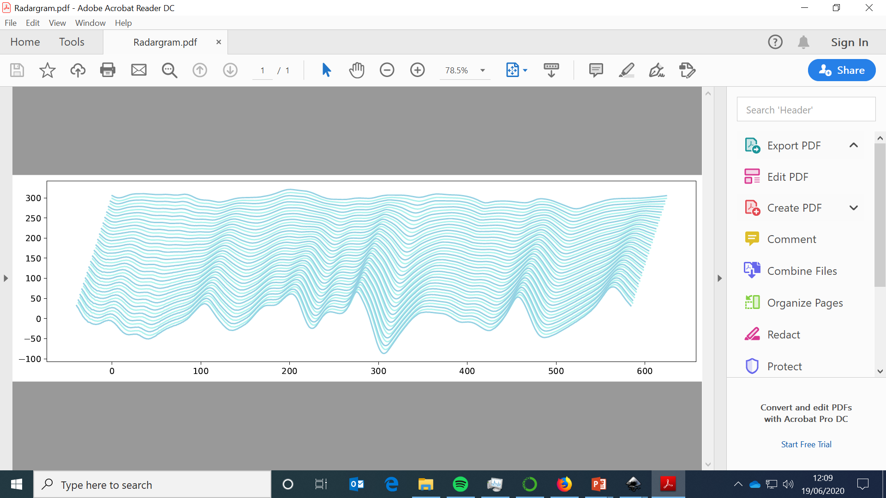
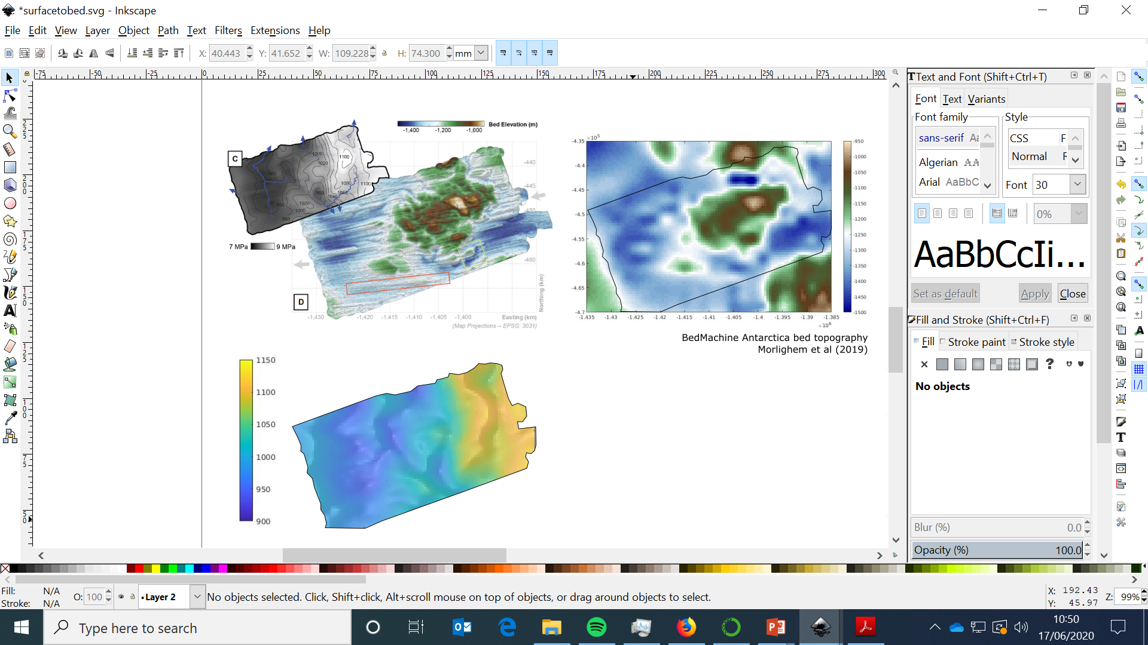
What can the surface tell us about the bed?
Ice Penetrating Radar
Bed
REMA Ice surface
Howat et al (2019)
Holshuh et al (2020)

Slide 4

Shallow-ice-stream transfer functions
Surface
Bed
Linear Perturbation theory
Gudmundsson (2003,2008)
Based on the Shallow-Ice-stream equations

Slide 5
Least squares inversion
Thorsteinsson et al. (2003)
Methodology and Thwaites Glacier
Surface
Bed
Linear Perturbation theory
Gudmundsson (2003,2008)
Based on the Shallow-Ice-stream equations

Slide 6
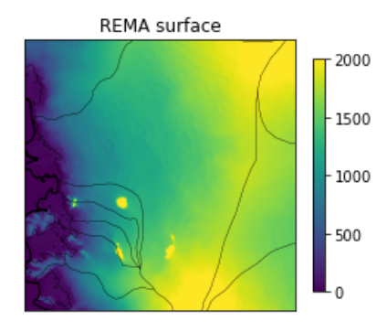
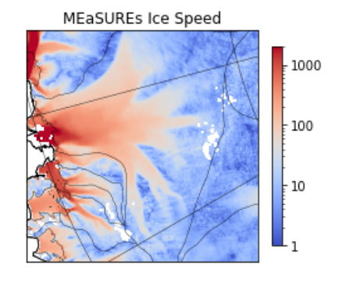
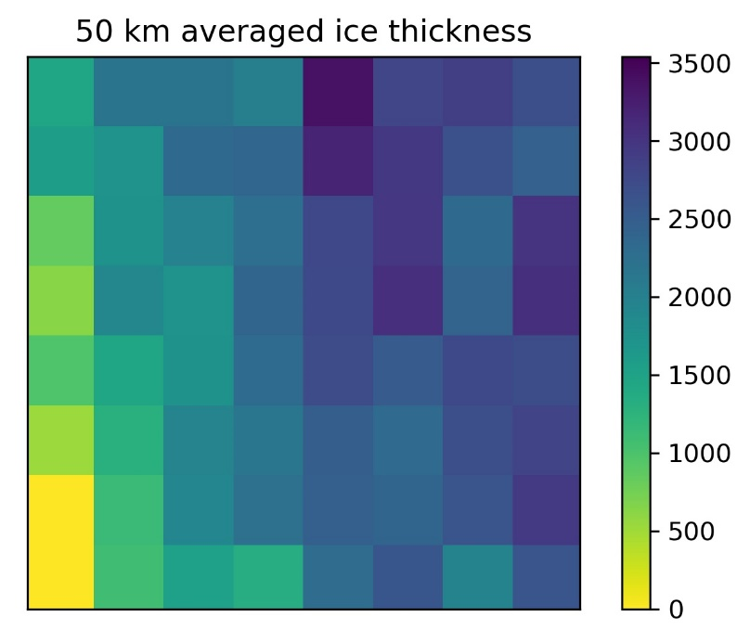
Surface data sources
REMA
(Howat et al. 2019)
ITSLIVE velocity
(Gardner et al. 2019)
50km averaged
ice thickness
(Morlighem et al. 2020)

Slide 7
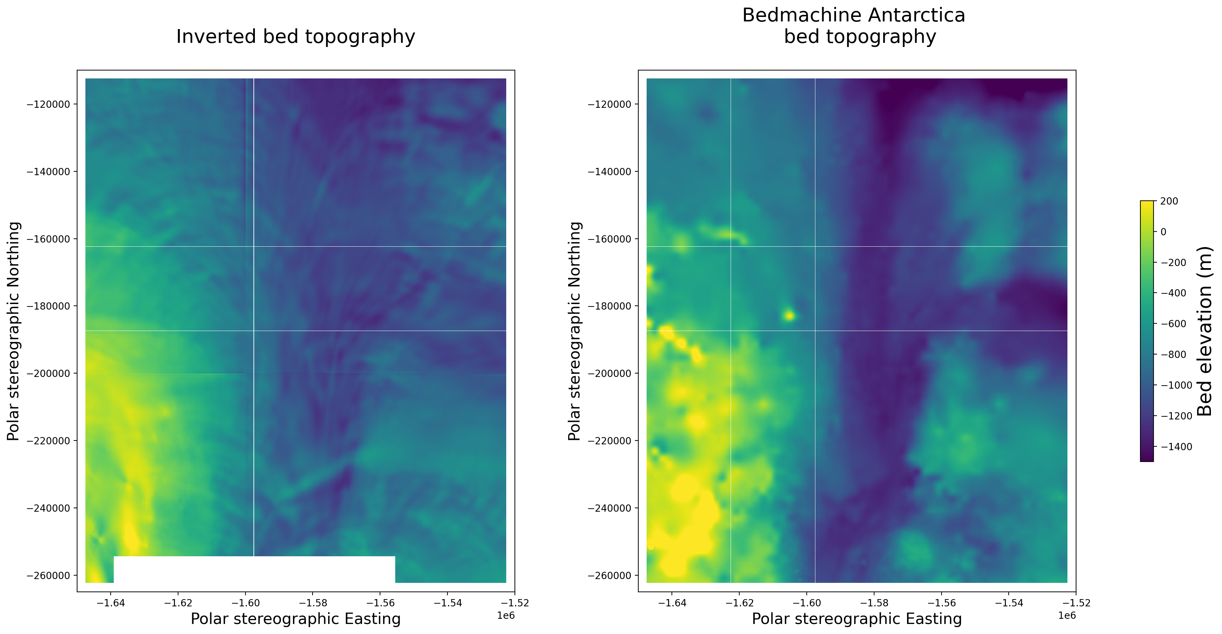
Pine Island Glacier bed topography

Slide 8
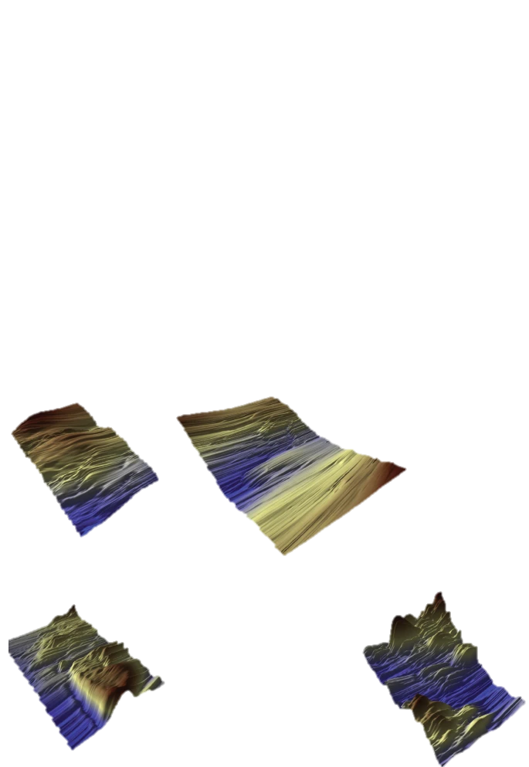
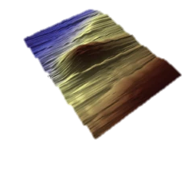
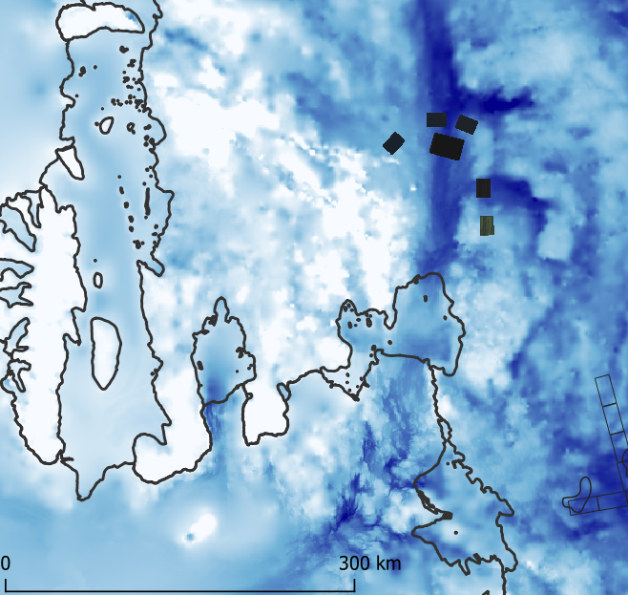
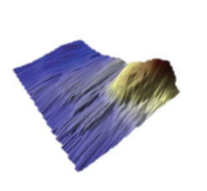
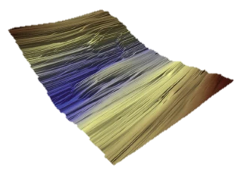
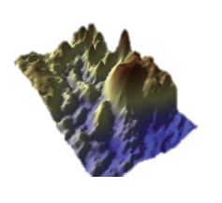
Comparison to radar surveys
B
C
Bedmachine Antarctica bed topography
A
B
C
E
A
D
D
E
F
G
F
G
Radar grids from Bingham et al. (2017)

Slide 9
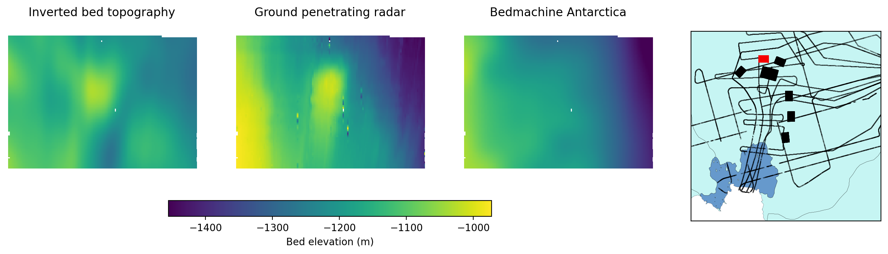
B
Comparison to radar surveys

Slide 10
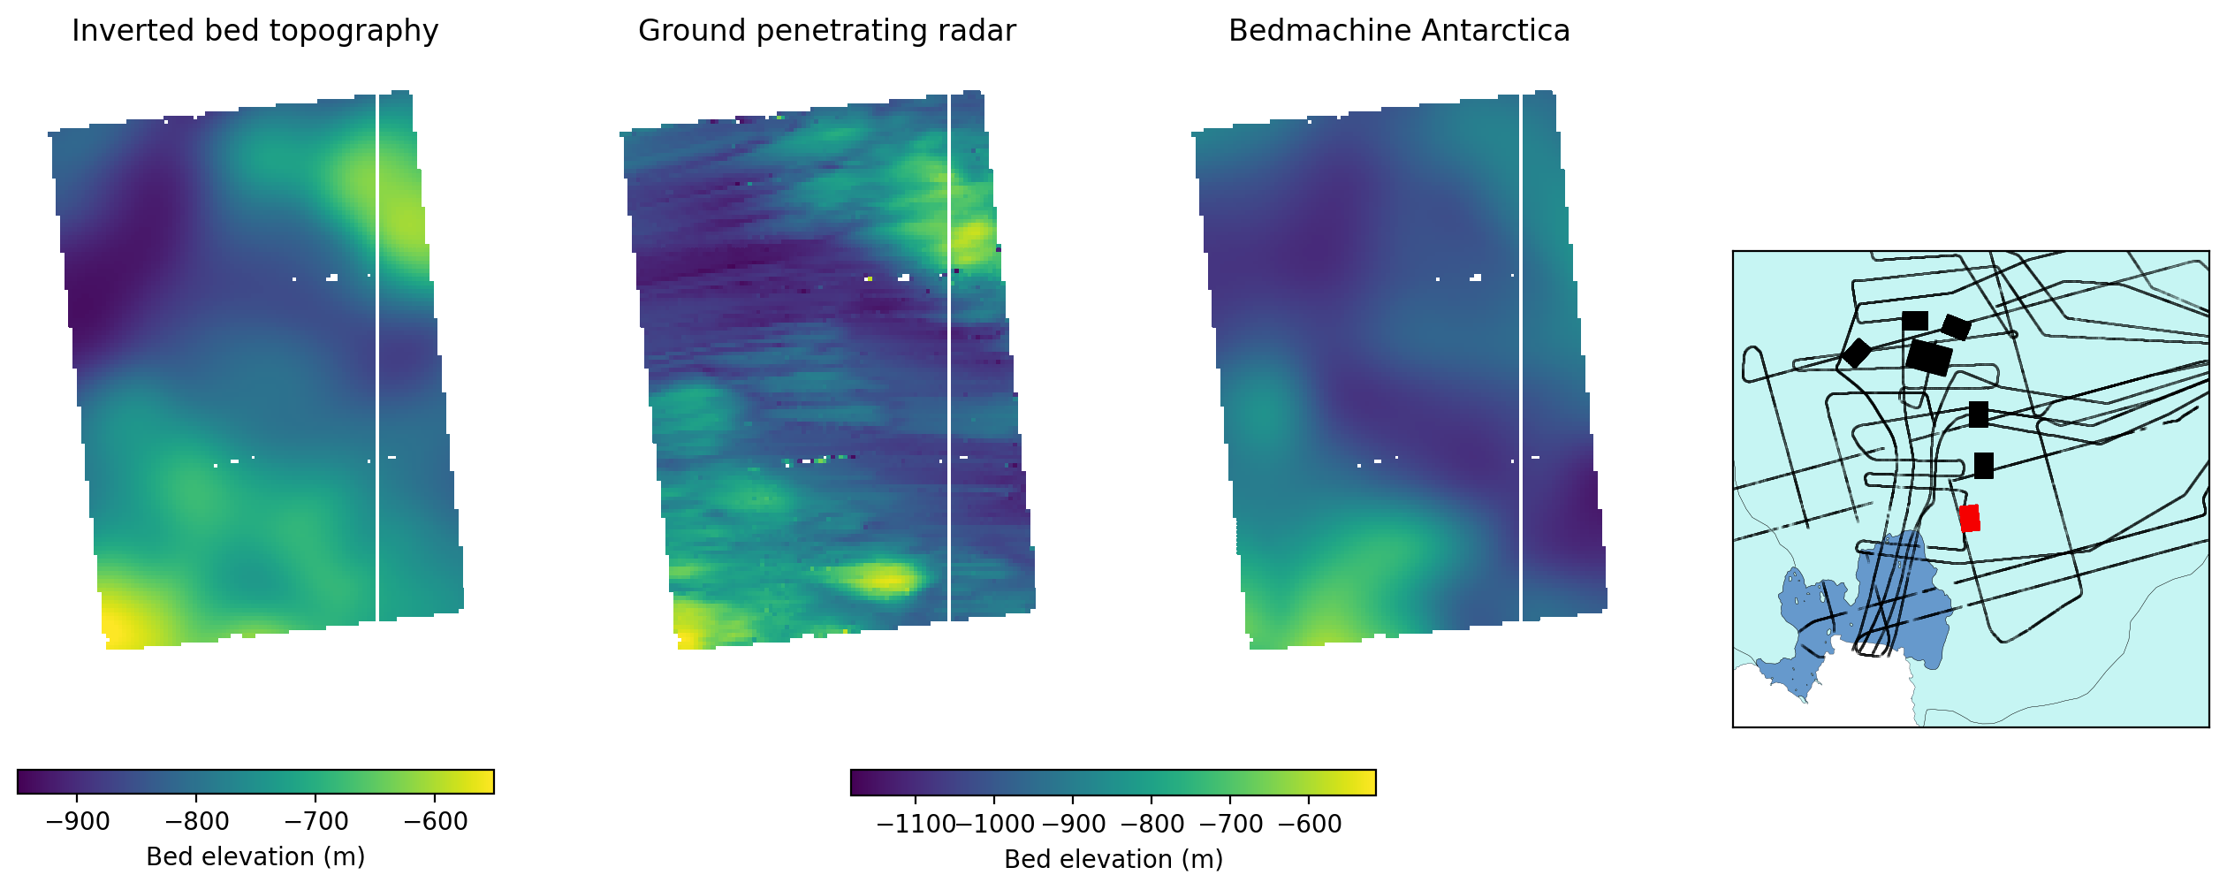
Comparison to radar surveys
G

Slide 11
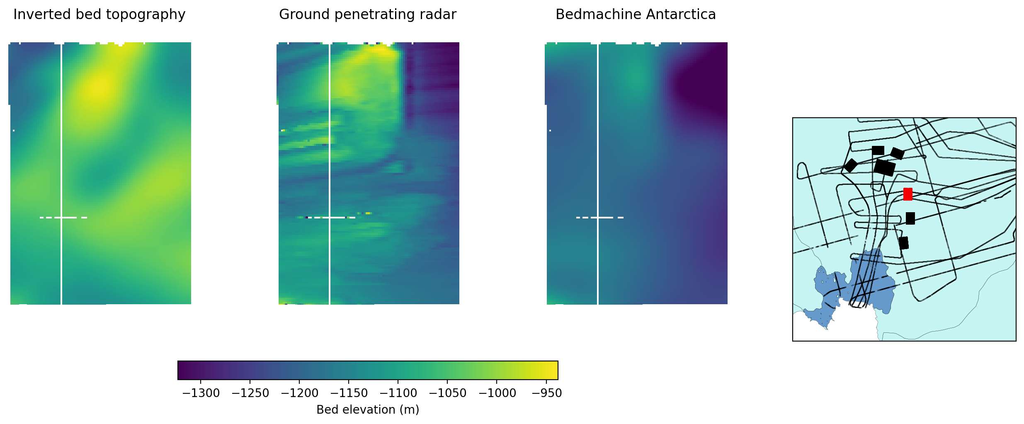
E
Comparison to radar surveys

Slide 12
Conclusions from Pine Island Glacier
NOT SO GOOD
Where the topography changes steeply
GOOD
At locating hills and troughs

Slide 13
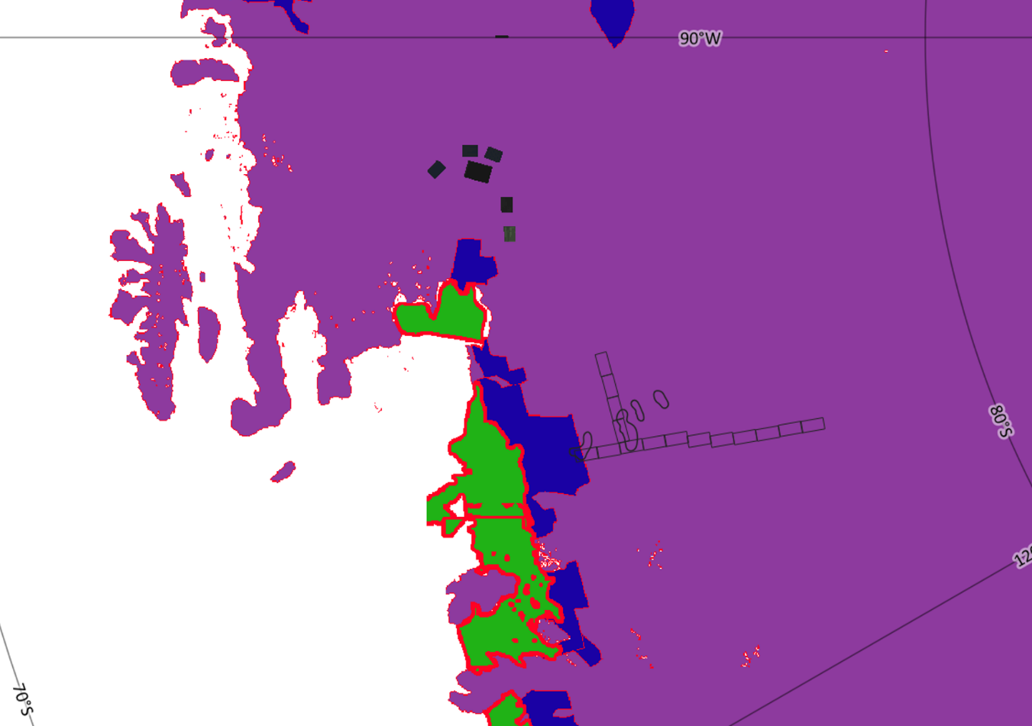
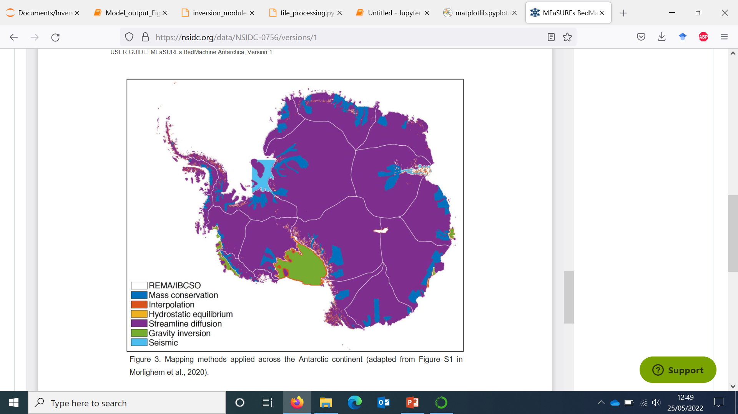
What do we see as the uses for this method?
1) Locate features which can not be identified using interpolation methods (such as streamline diffusion)
Bedmachine Antarctica methods
Morlighem et al. (2019)

Slide 14
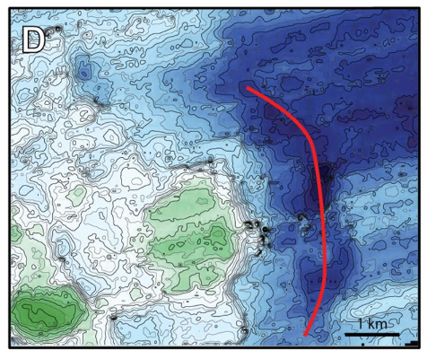
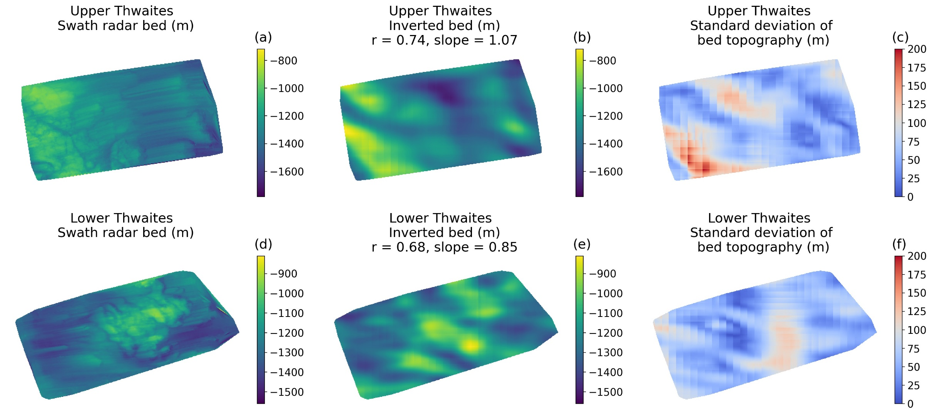
What do we see as the uses for this method?
2) Suggest locations for future radar surveys or hydrological work
Water flow paths
INVERSION BED
SWATH RADAR
Figure from Alley et al. (2021)

Slide 15
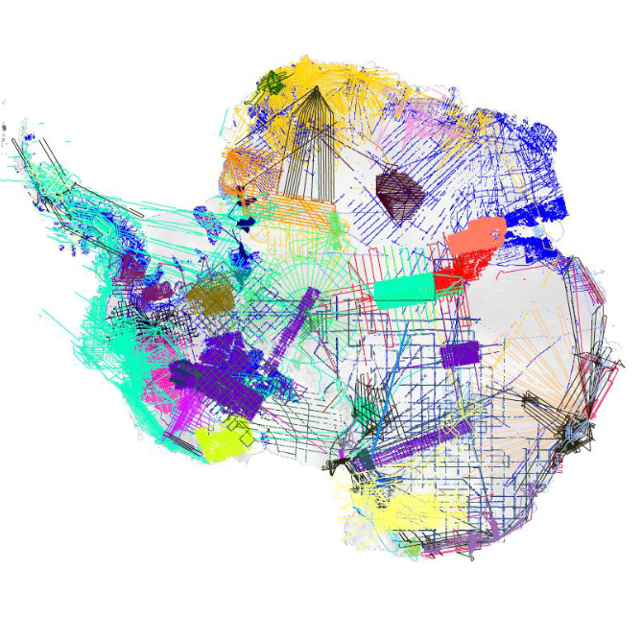
Any suggestions of where to study next?
BedMachine Antarctica radar data lines
Morlighem et al. (2019)
BedMachine Antarctica methods
Morlighem et al. (2019)

Slide 16
Methodology and Thwaites Glacier
What can high resolution surface observations tell us about the bed topography of
Pine Island Glacier, West Antarctica?
Helen Ockenden, Rob Bingham, Andrew Curtis, Dan Goldberg
University of Edinburgh
h.ockenden@sms.ed.ac.uk

