Slide 1









Biomarker evidence for bacterial oxidation of oil-derived hydrocarbons at seeps in the southern Gulf of Mexico
BG1.8 Hydrocarbon seepage – from past records to modern examples and models to evaluate the future
Nicola Krake¹, Daniel Birgel¹, Daniel Smrzka², Jennifer Zwicker³, Huiwen Huang⁴, Dong Feng^{5,6}, Gerhard Bohrmann⁷, and Jörn Peckmann¹
¹Institute for Geology, Center for Earth System Research and Sustainability, Universität Hamburg, 20146 Hamburg, Germany
²Institute for Geology, Universität Wien, 1090 Wien, Austria
³Institute for Mineralogy and Crystallography, Universität Wien, 1090 Wien, Austria
⁴Key Laboratory of Ocean and Marginal Sea Geology, South China Sea Institute of Oceanology, Innovation Academy of South China Sea Ecology and Environmental Engineering, Chinese Academy of Sciences, Guangzhou 510301, China
⁵Shanghai Engineering Research Center of Hadal Science and Technology, College of Marine Sciences, Shanghai Ocean University, Shanghai 201306, China
⁶Laboratory for Marine Mineral Resources, Qingdao National Laboratory for Marine Science and Technology, Qingdao 266061, China
7 MARUM – Center for Marine and Environmental Sciences and Department of Geosciences, University of Bremen, 28334 Bremen, Germany

Slide 2
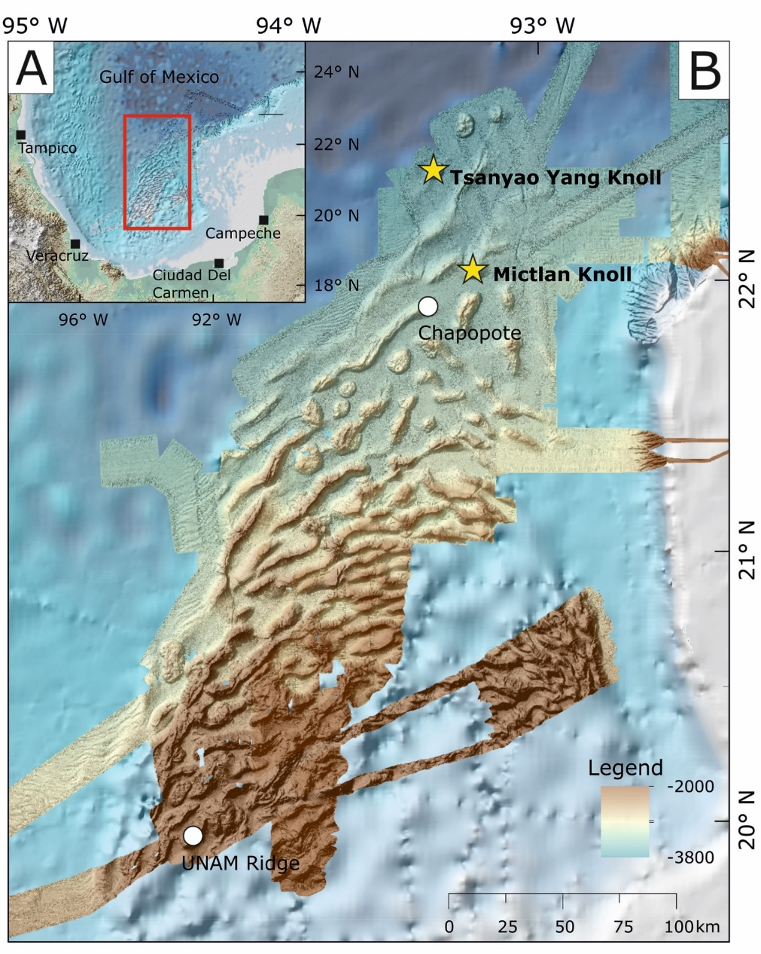
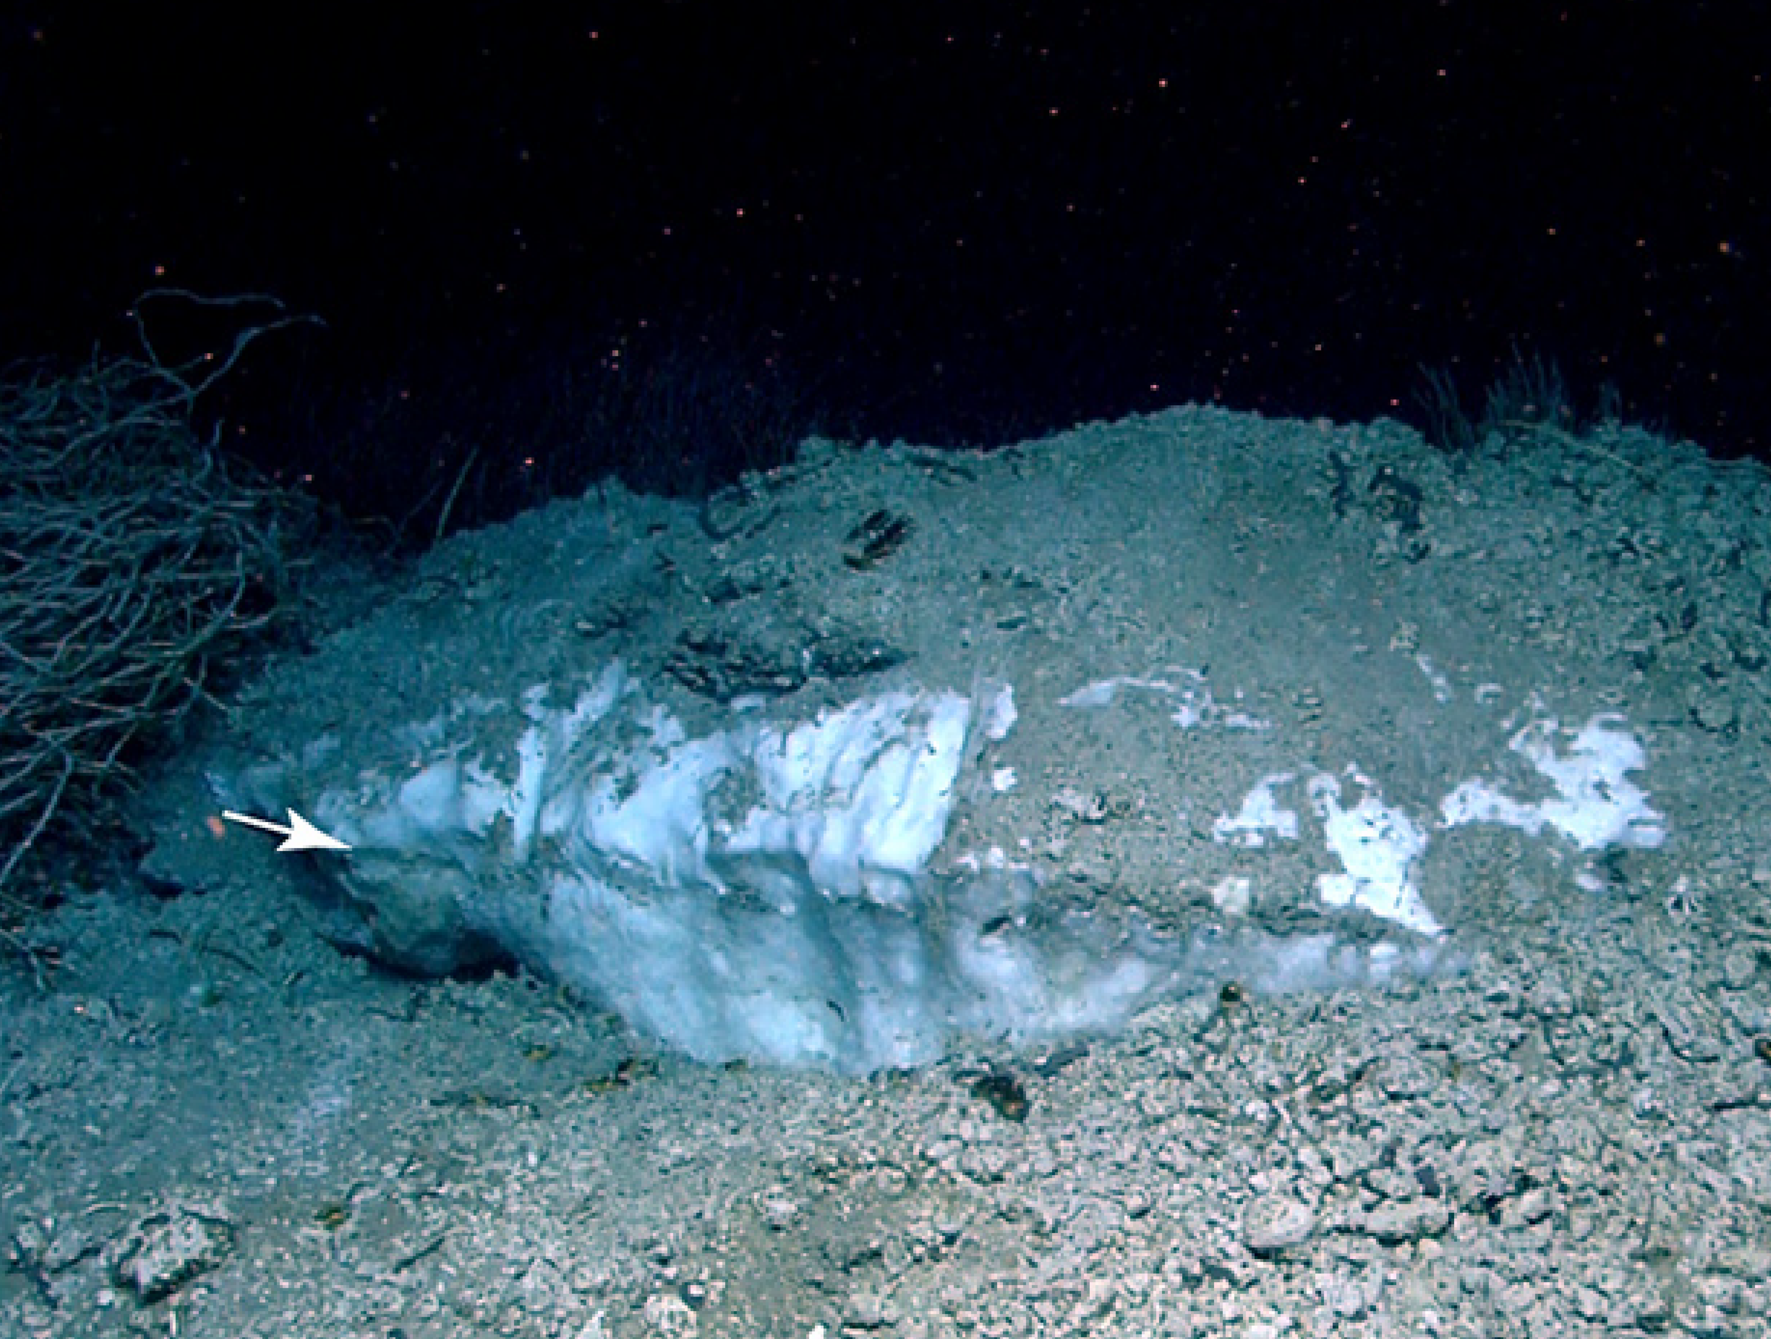
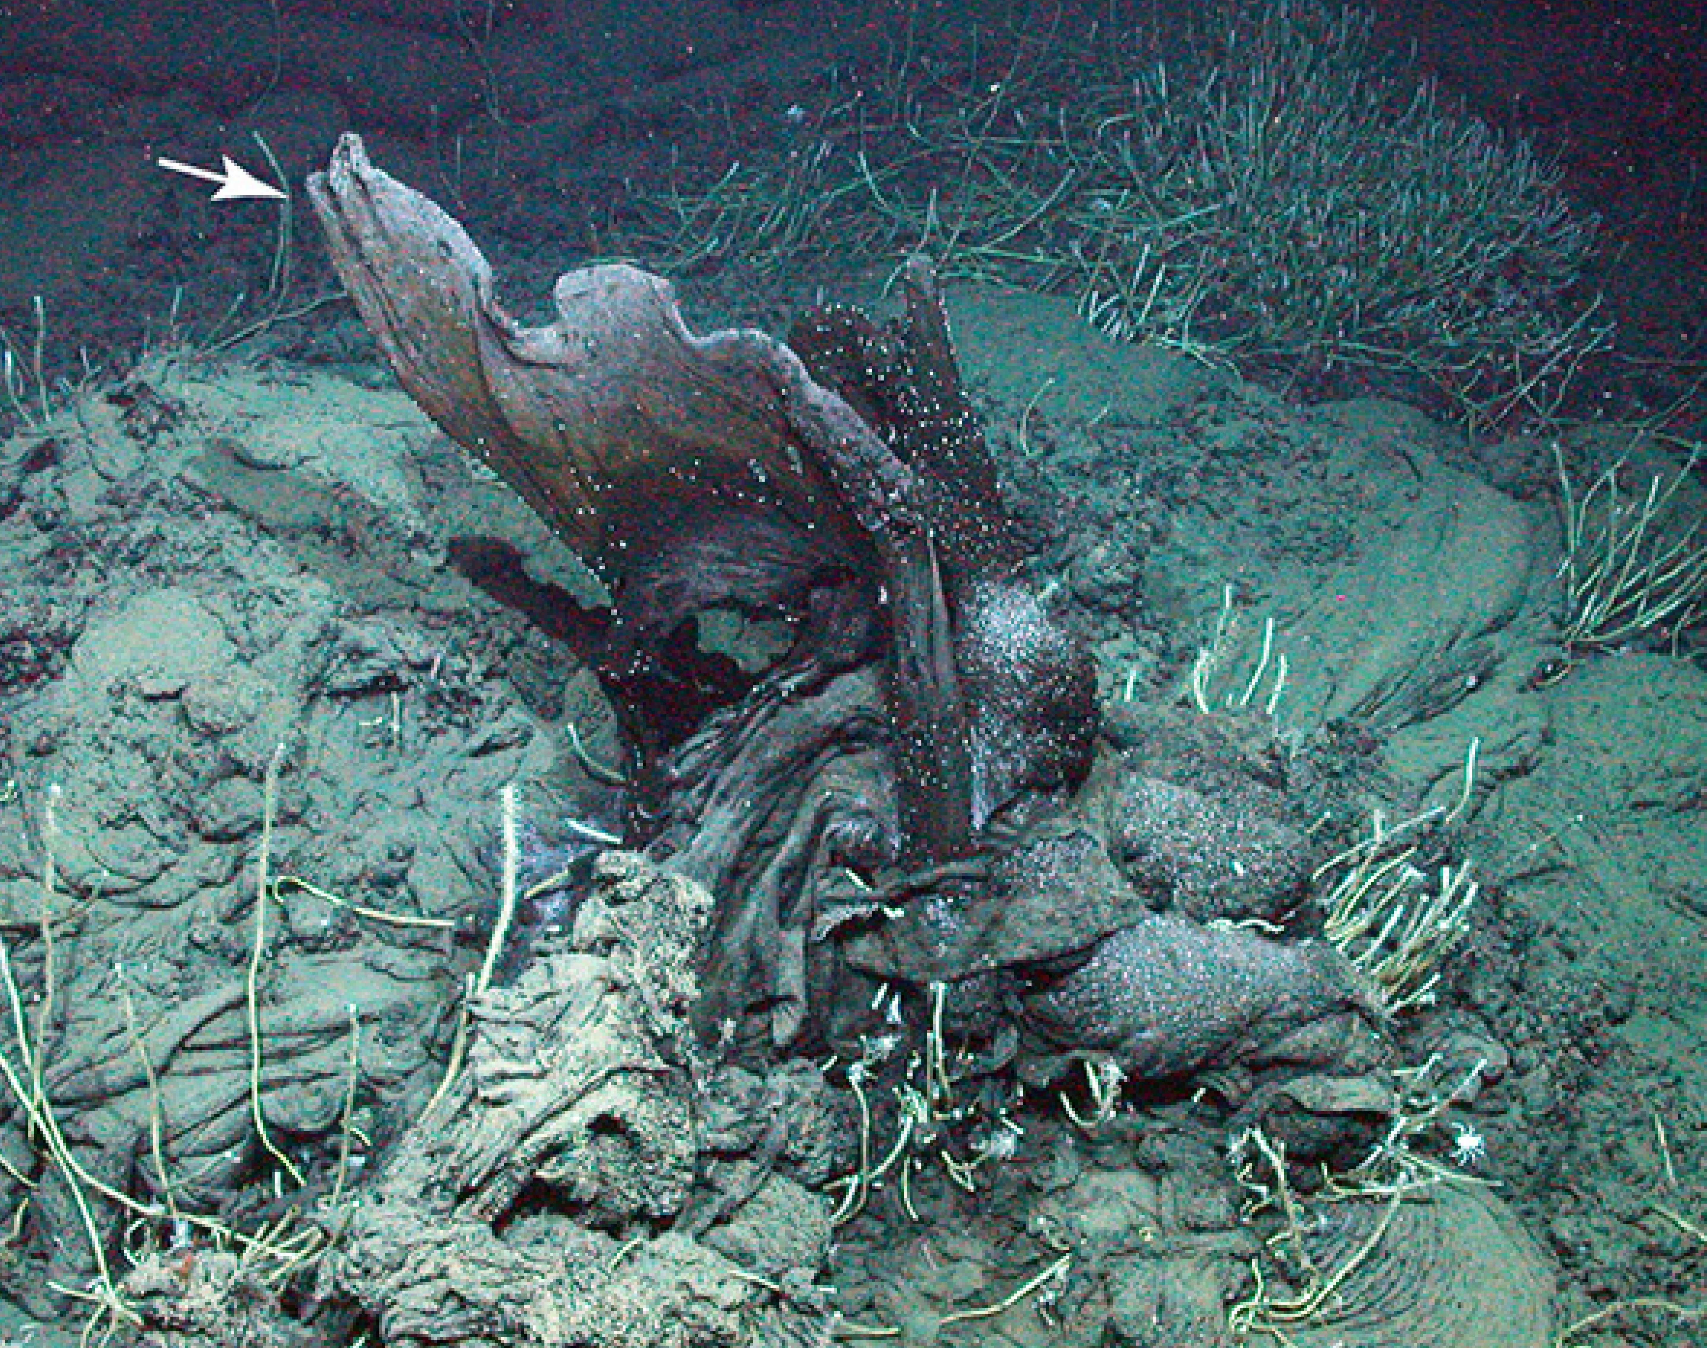
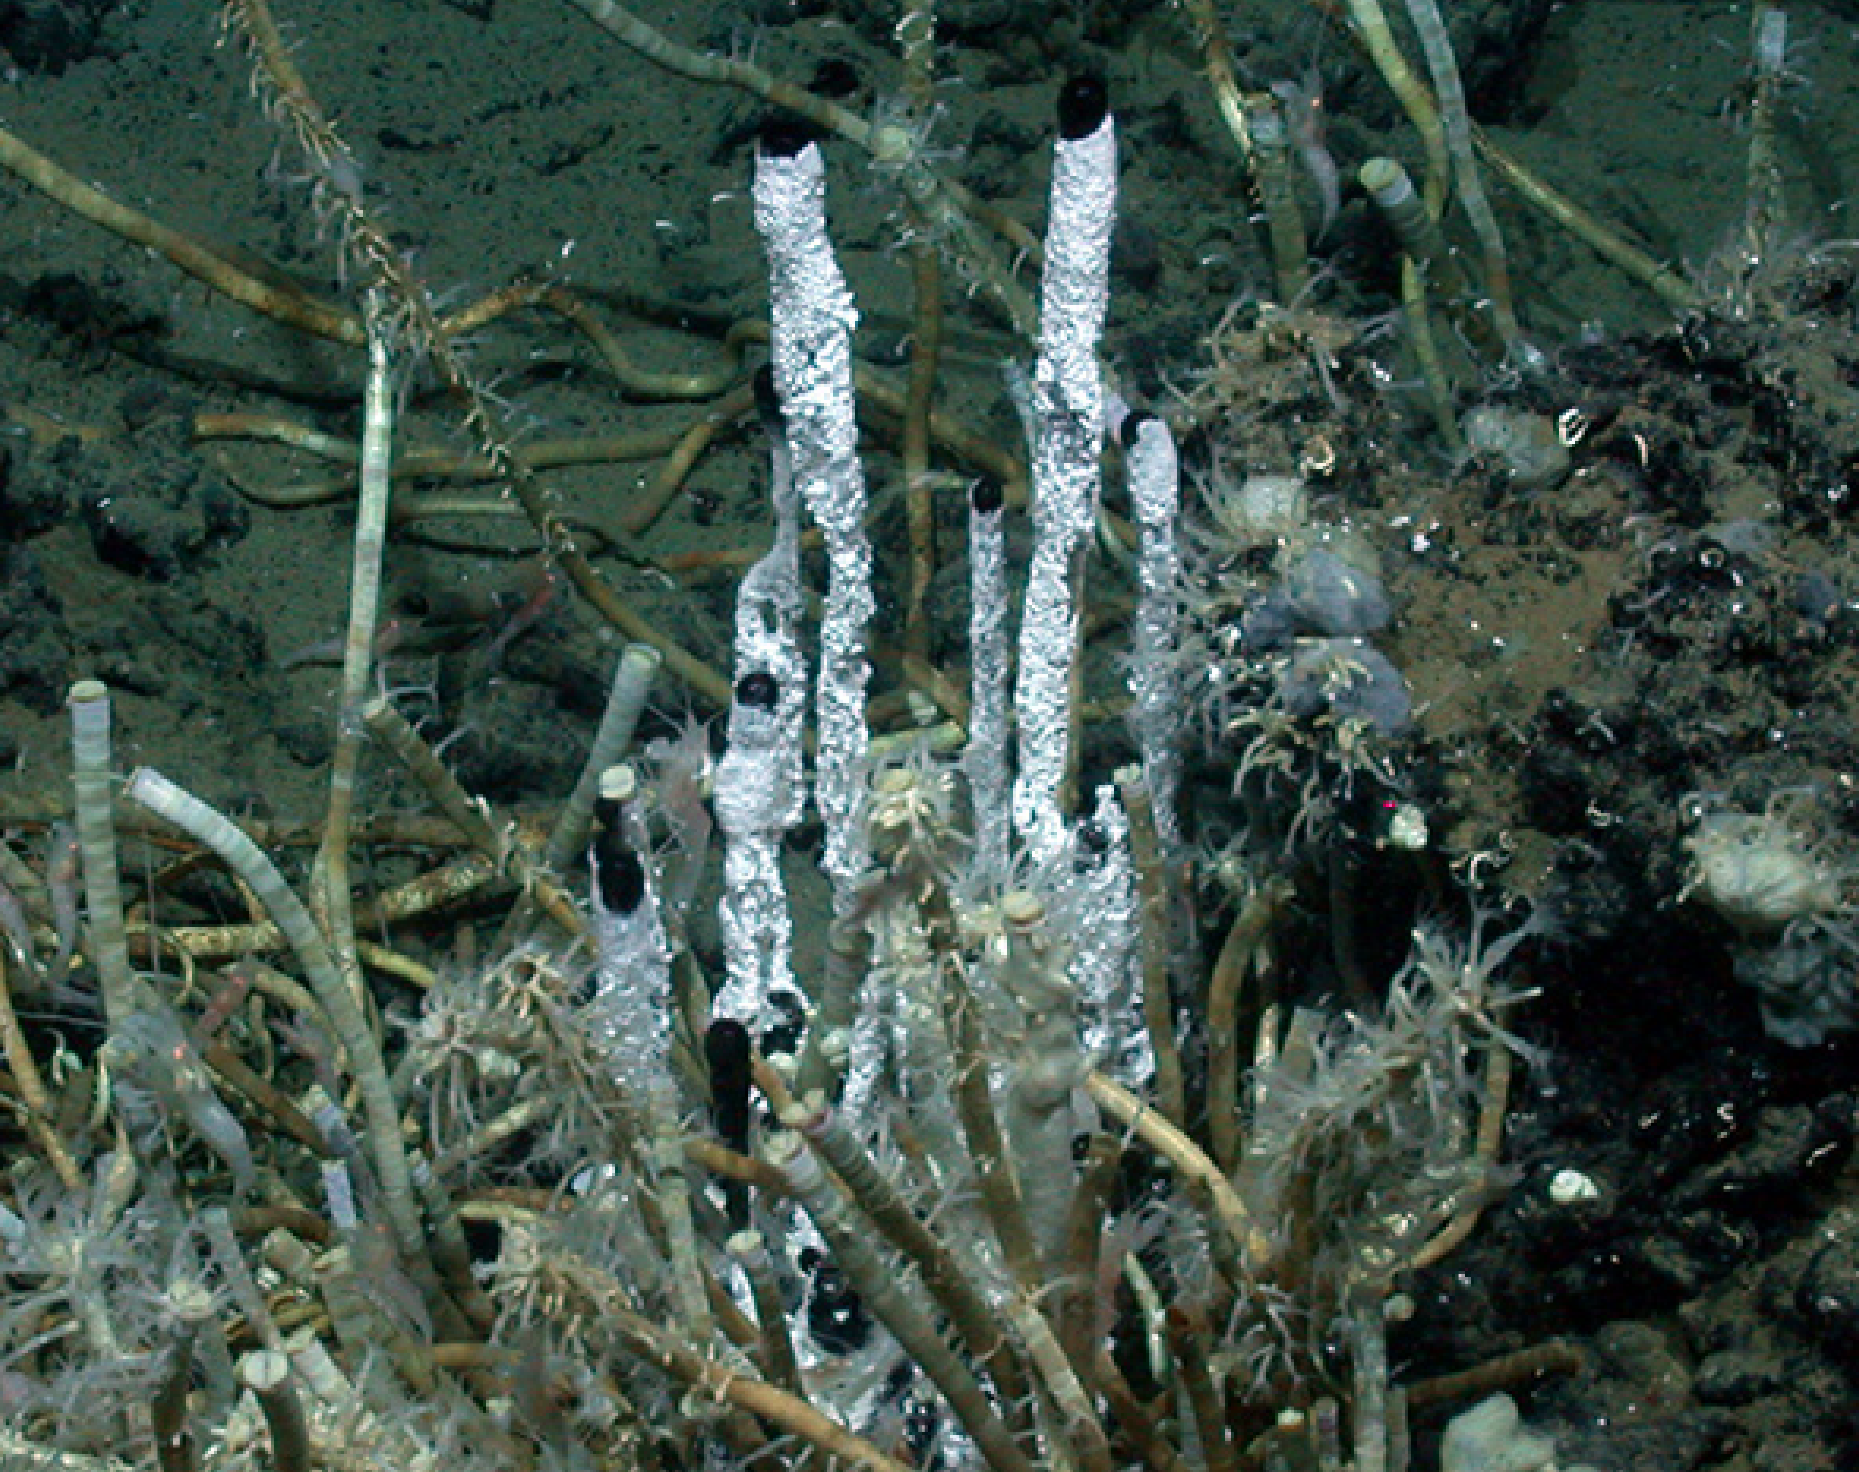
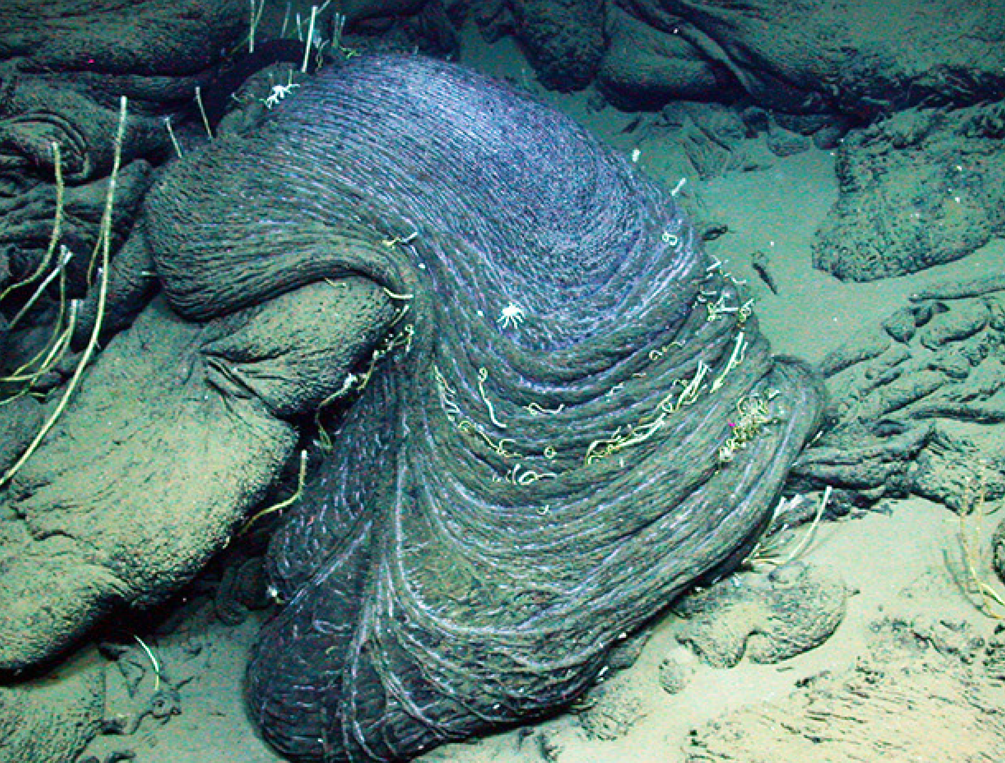
Sampling area – Oil seepage at the Campeche Knolls
(modified after Sahling et al., 2016; Smrzka et al.., 2019).
(after Sahling et al., 2016).

Slide 3
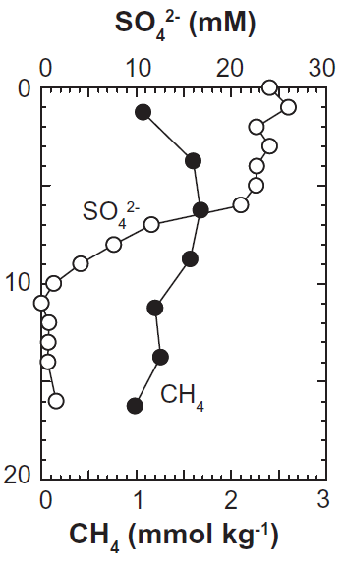

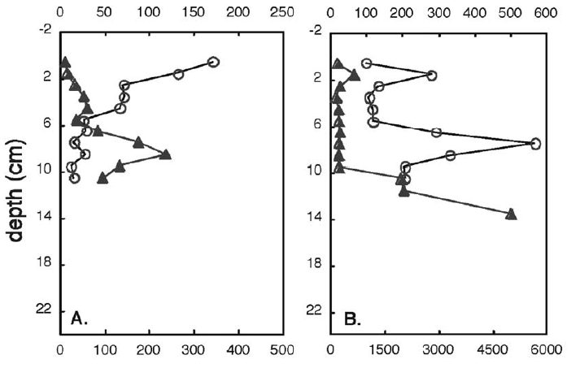
Sampling area – Oil seepage at the Campeche Knolls
(after Schubotz et al., 2011).
(modified after Sahling et al., 2016; Smrzka et al.., 2019).
(after Joye et al., 2016).

Slide 4
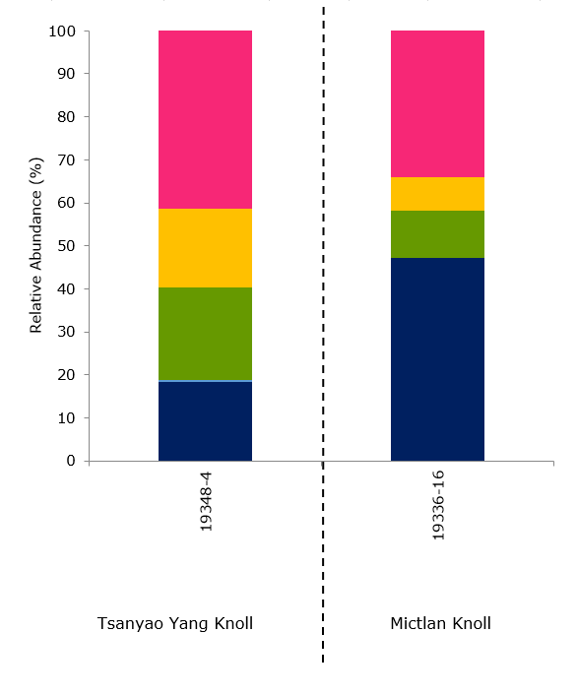
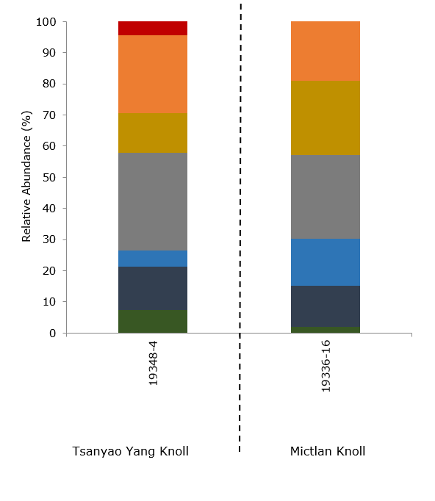
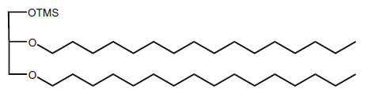
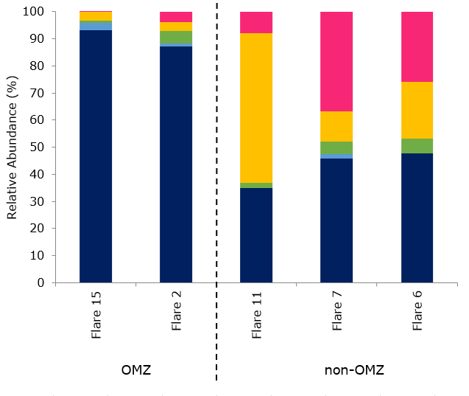
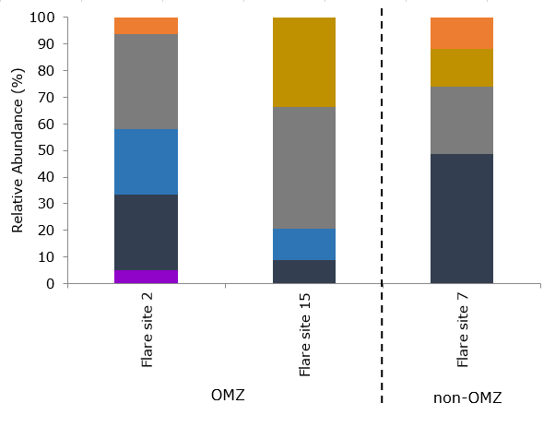
Lipid biomarker inventory
Oil seep setting
DAGE = dialkyl glycerol diether
Methane seep setting
(Krake et al., 2022).
(Krake et al., 2022).

Slide 5
Implications from carbon stable isotopes
(Krake et al., 2022, after Himmler et al., 2015 and Smrzka et al., 2019).
(Krake et al., 2022).

Slide 6
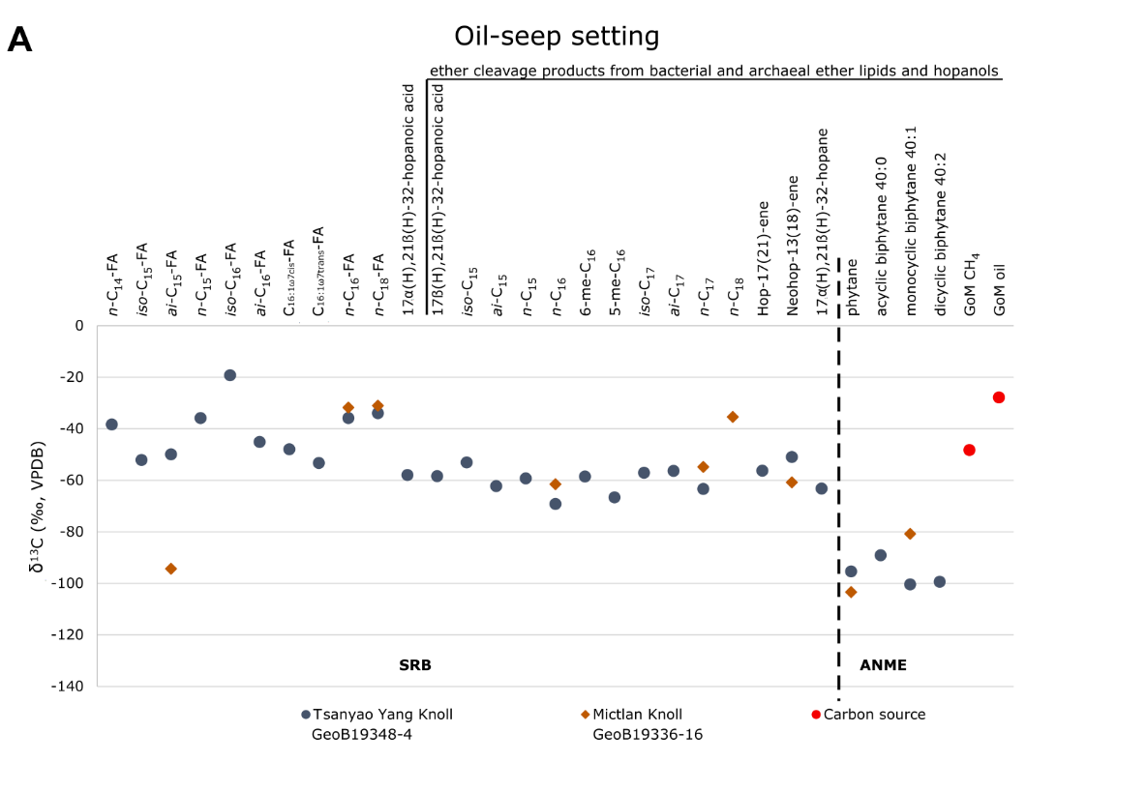
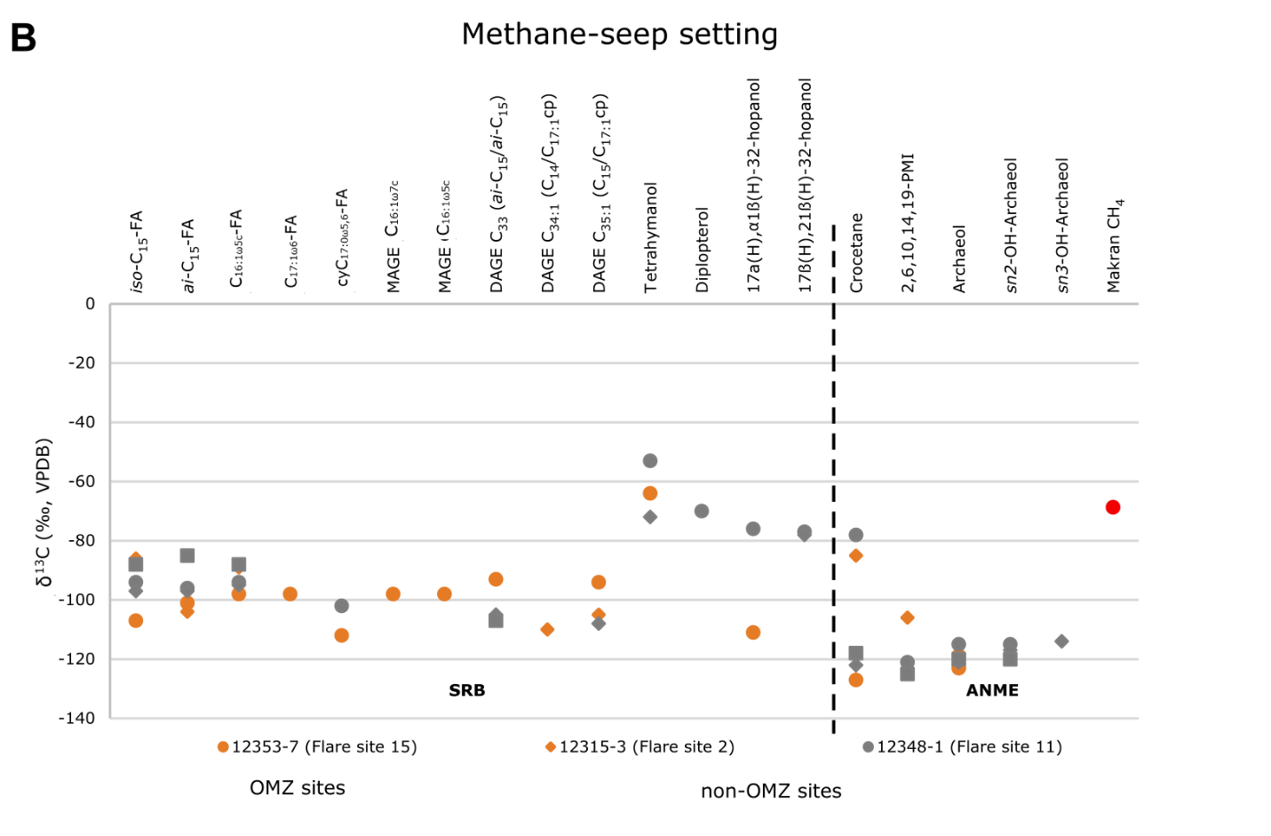
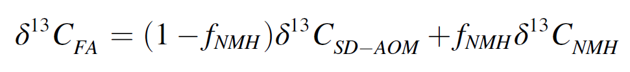
Implications from carbon stable isotopes
SRB
ANME
SRB
ANME
(Krake et al., 2022).
~ 73% of sulfate reduction is fueled by non-methane hydrocarbons (NMH)

Slide 7
Conclusion
Oil degradation contributes to carbonate authigenesis
Characterization of the microbial community and metabolic processes via biomarker inventory and carbon stable isotopes:
Overall higher amount of bacterial ether lipids
High diversity of DAGEs especially with longer alkyl chains
Heavier δ¹³C_{carb} and δ¹³C of bacterial biomarkers and different offset
Oil degradation fuels sulfate reduction

