Slide 1
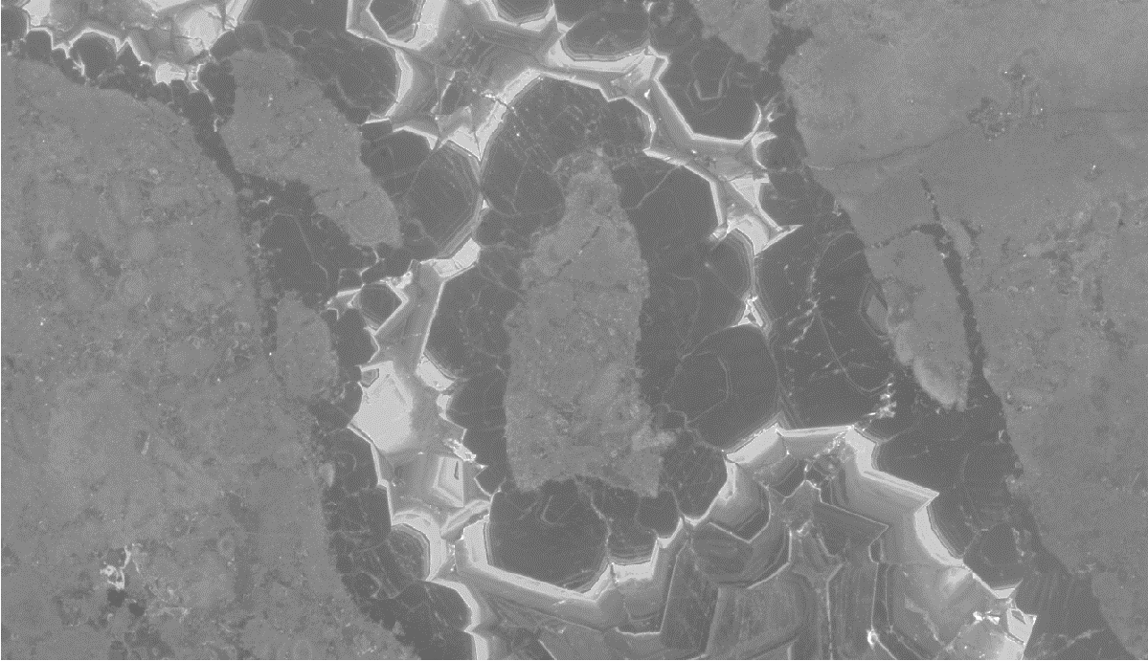



Effect of normal fault activity on carbonate reservoir diagenetic evolution
(Urgonian facies, SE France)
Irène Aubert ¹
P. Léonide, F. Fournier, H. Bitault, J. Lamarche, N. Godeau, P. Deschamps, R. Correa, L. Marié
25-05-2022
¹ Laboratoire des Complexes et leurs Réservoirs – IPRA, E2S-UPPA, TotalEnergies, CNRS, Université de Pau et des Pays de l’Adour, UMR5150 Pau, France

Slide 2
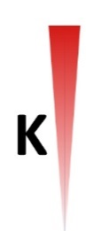
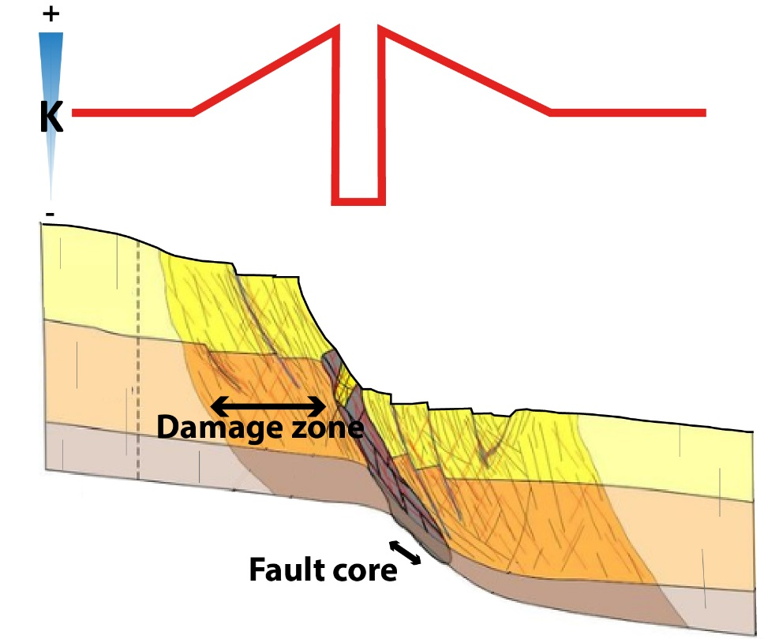
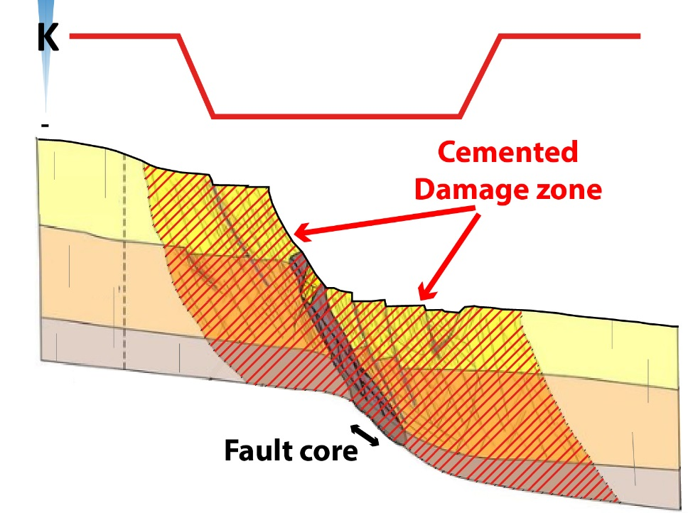
INTRODUCTION
BARRIER
DRAIN
Modified from Johannessen et al. (2017)
Modified from Johannessen et al. (2017)
What is the impact of burial vs. structural deformations in reservoir diagenetic modifications ?

Slide 3
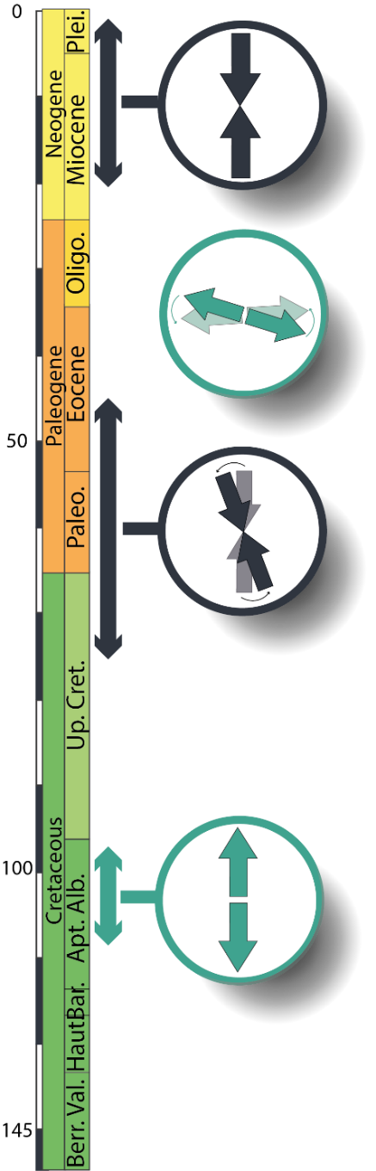
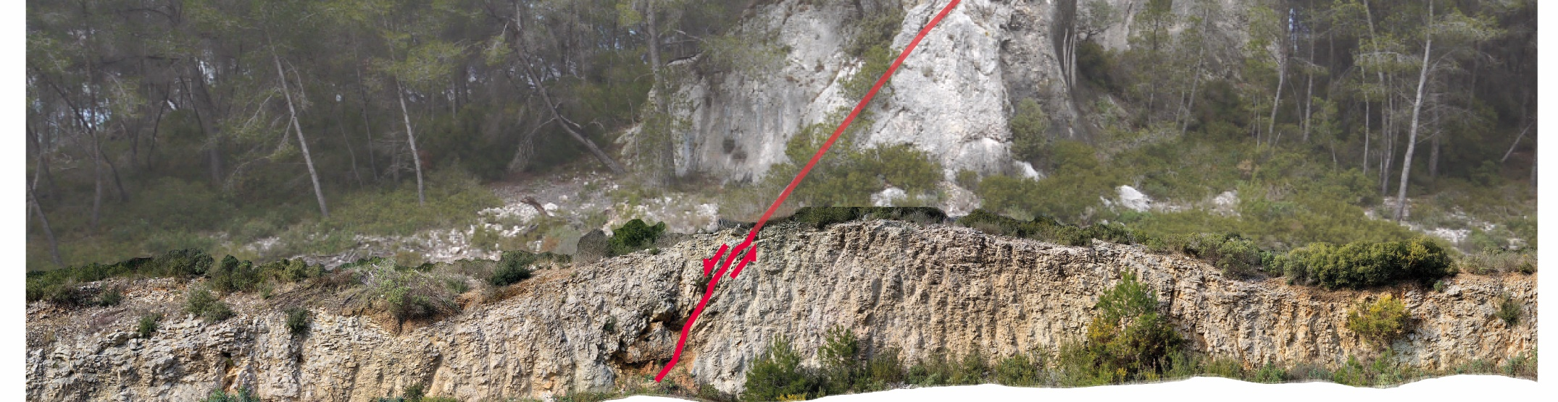
GEOLOGICAL SETTINGS
N145° - 80° NW
Liguro-provençal opening
Durancian uplift
1
Normal fault development
2
Normal fault reactivation

Slide 4
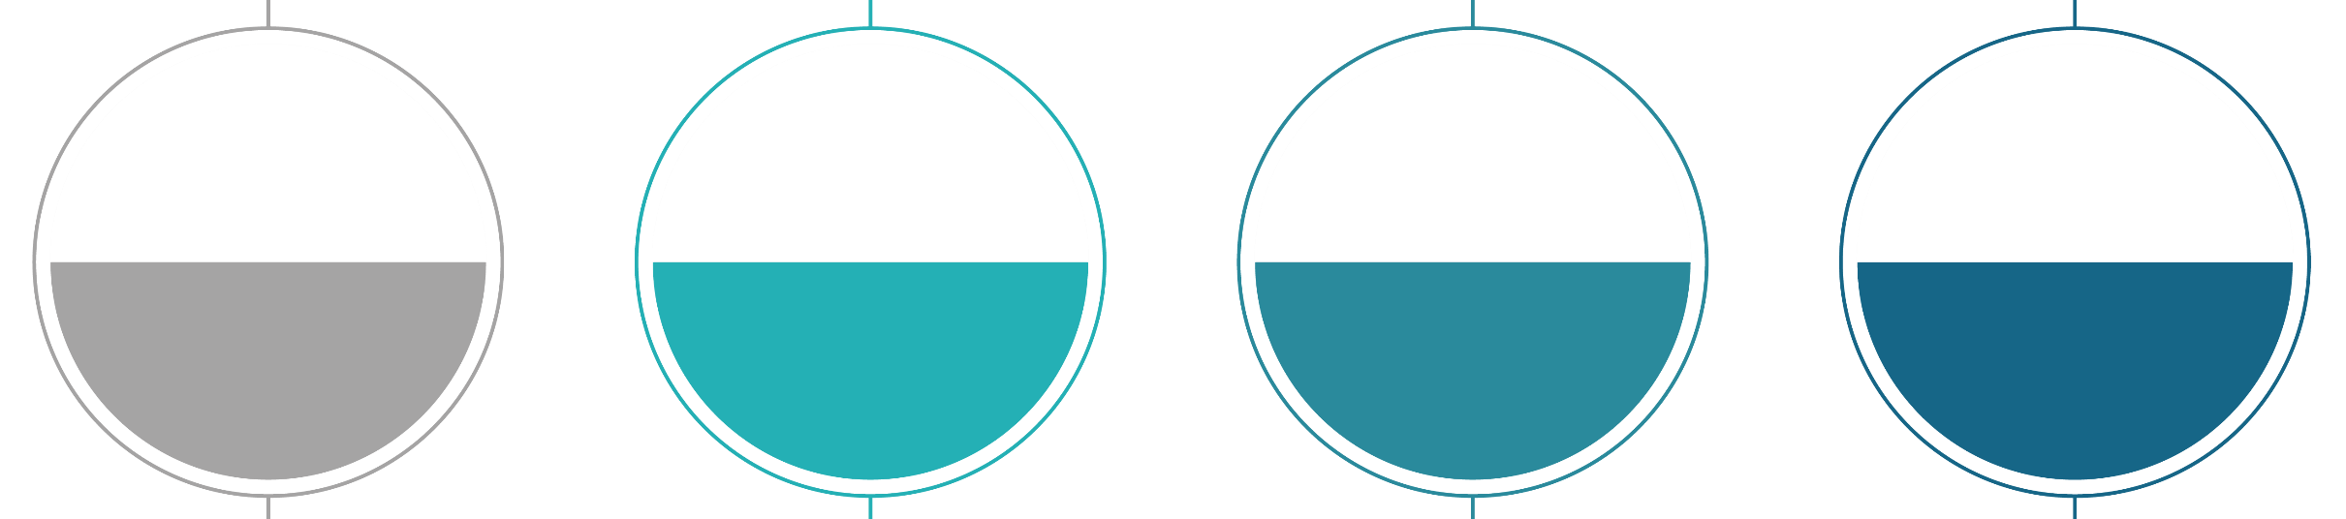
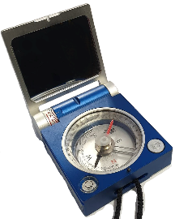
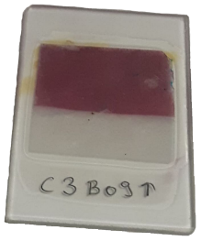
DIAGENTIC PHASES CARACTERISATION
Reservoir
properties
Diagenetic
analyses
Structural
Analyses
Geochemical
analyses

Slide 5
DIAGENTIC PHASES CARACTERISATION
Petrophysical
analyses
Diagenetic
analyses
Structural
Analyses
Geochemical
analyses

Slide 6
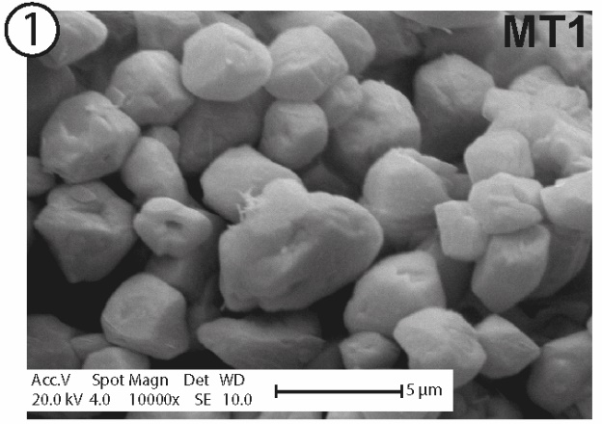
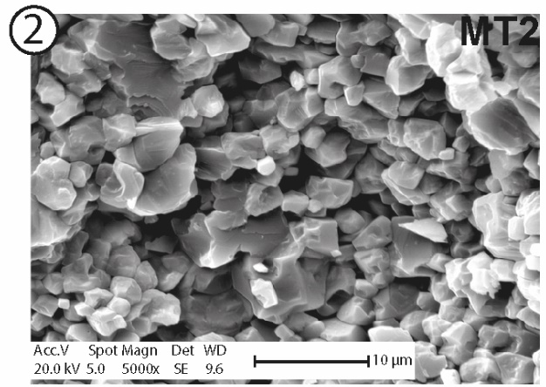
DIAGENTIC PHASES CARACTERISATION
Petrophysical
analyses
Diagenetic
analyses
Structural
Analyses
Geochemical
analyses

Slide 7
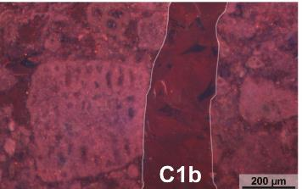
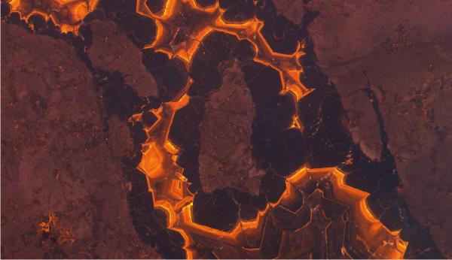
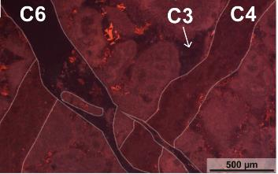
DIAGENTIC PHASES CARACTERISATION
Petrophysical
analyses
Diagenetic
analyses
8 cements
2 “key” diagenetic phases : C2 & C7
Structural
Analyses
Geochemical
analyses

Slide 8
DIAGENTIC PHASES CARACTERISATION
Clumped isotopes
Stable isotopes
Petrophysical
analyses
To define cement precipitations natures & ages
Diagenetic
analyses
Structural
Analyses
Geochemical
analyses
U/Pb

Slide 9
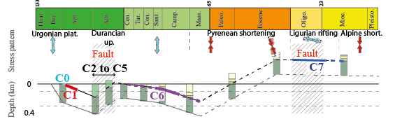
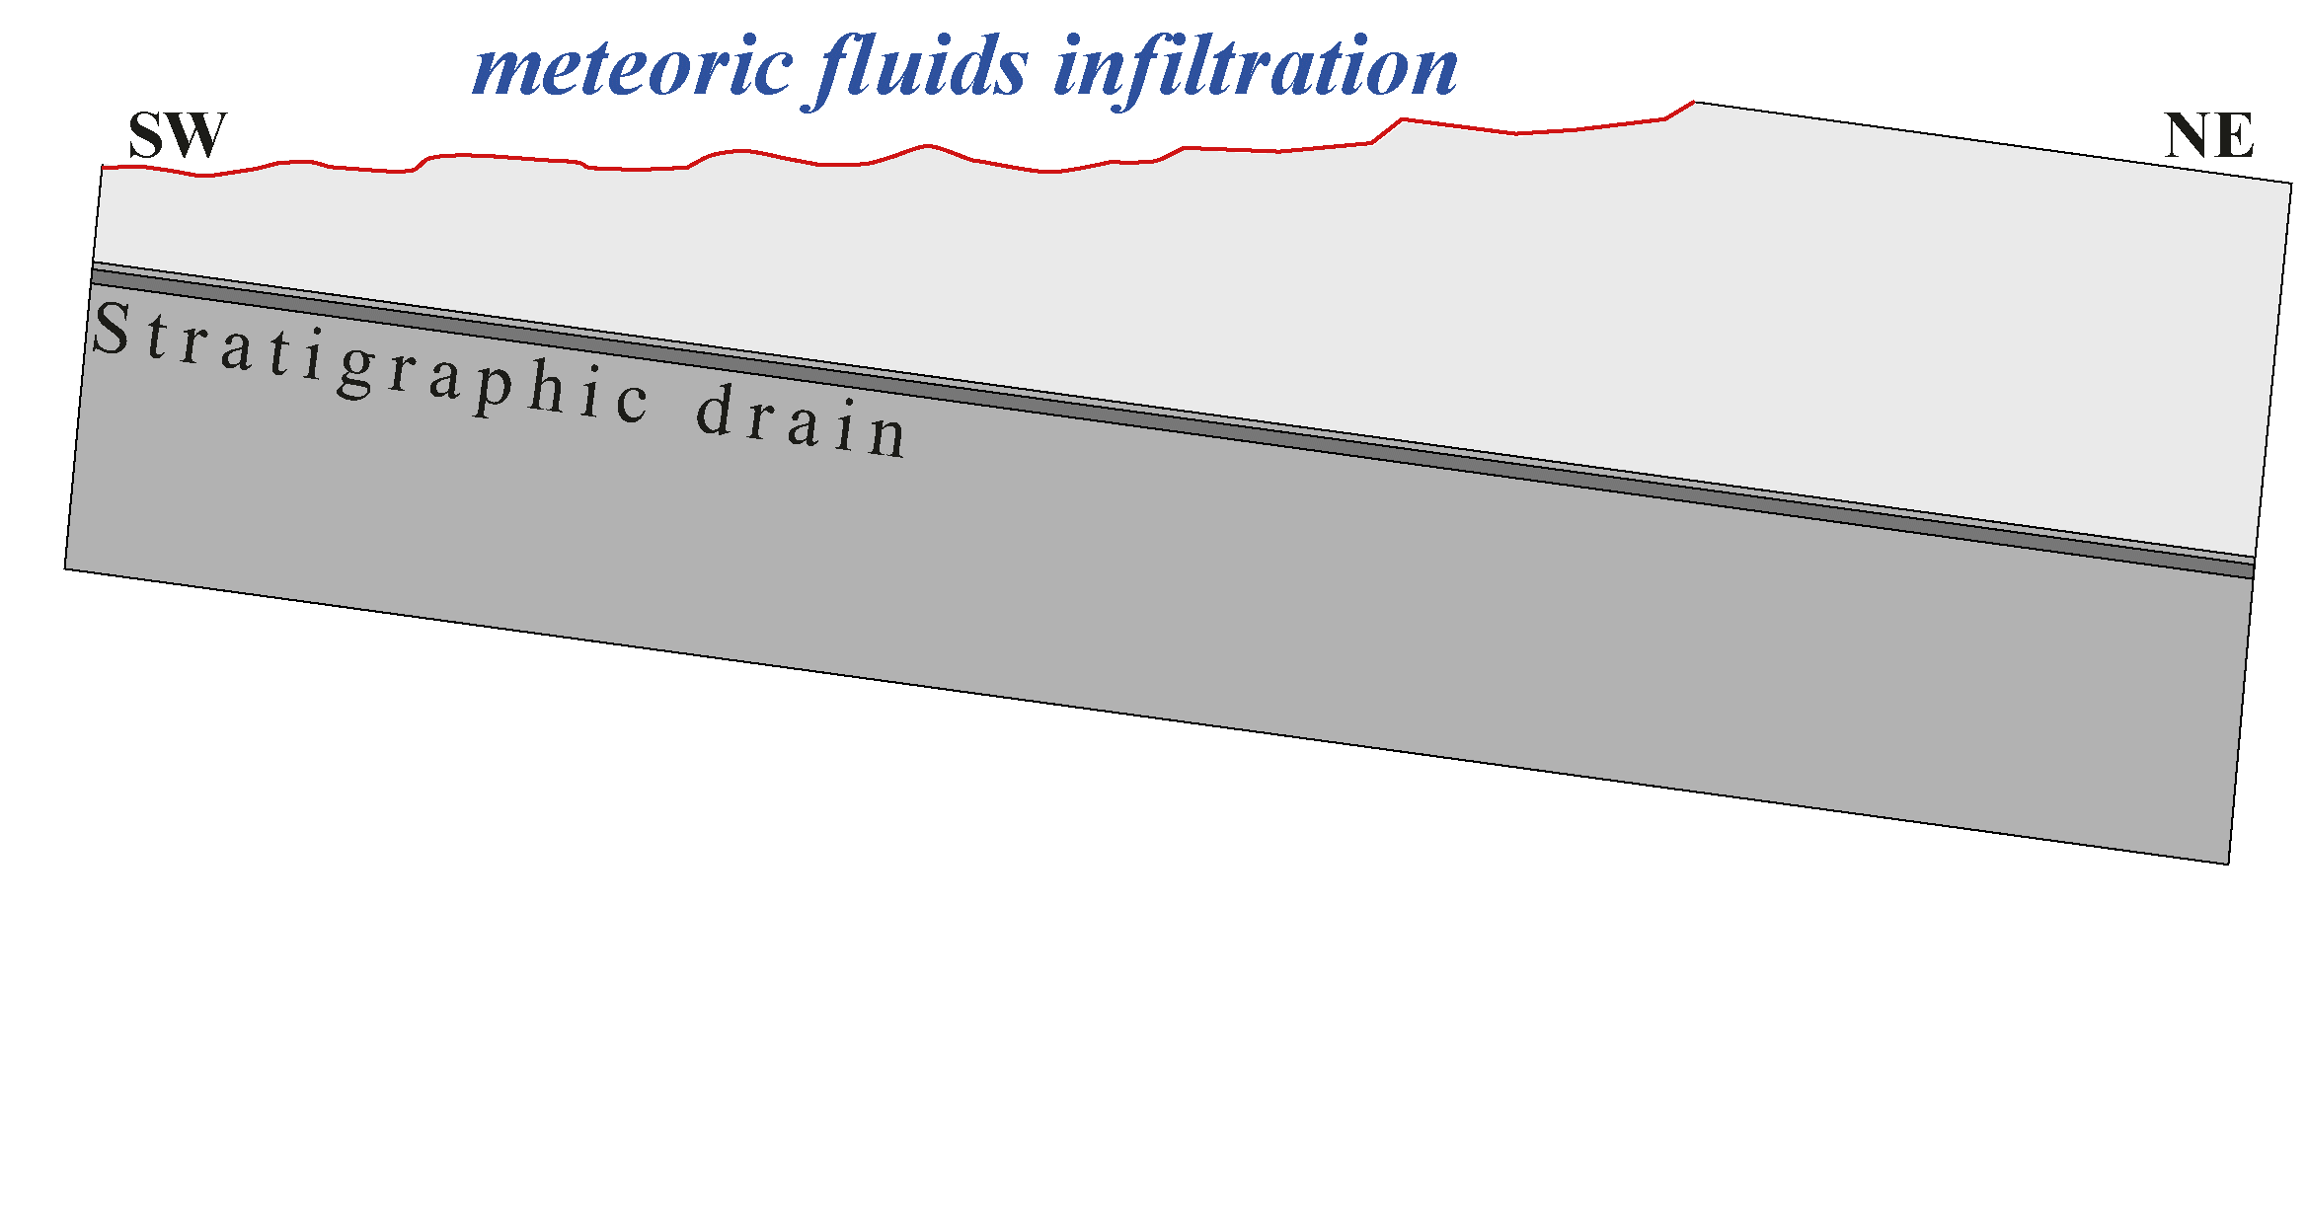
DIAGENTIC EVOLUTION
Cement C2
Meteoric fluids flows in a stratigraphic drain (UC)
Important dissolution in UC unit
Micrite first recrystallisation
Stable isotopes

Slide 10
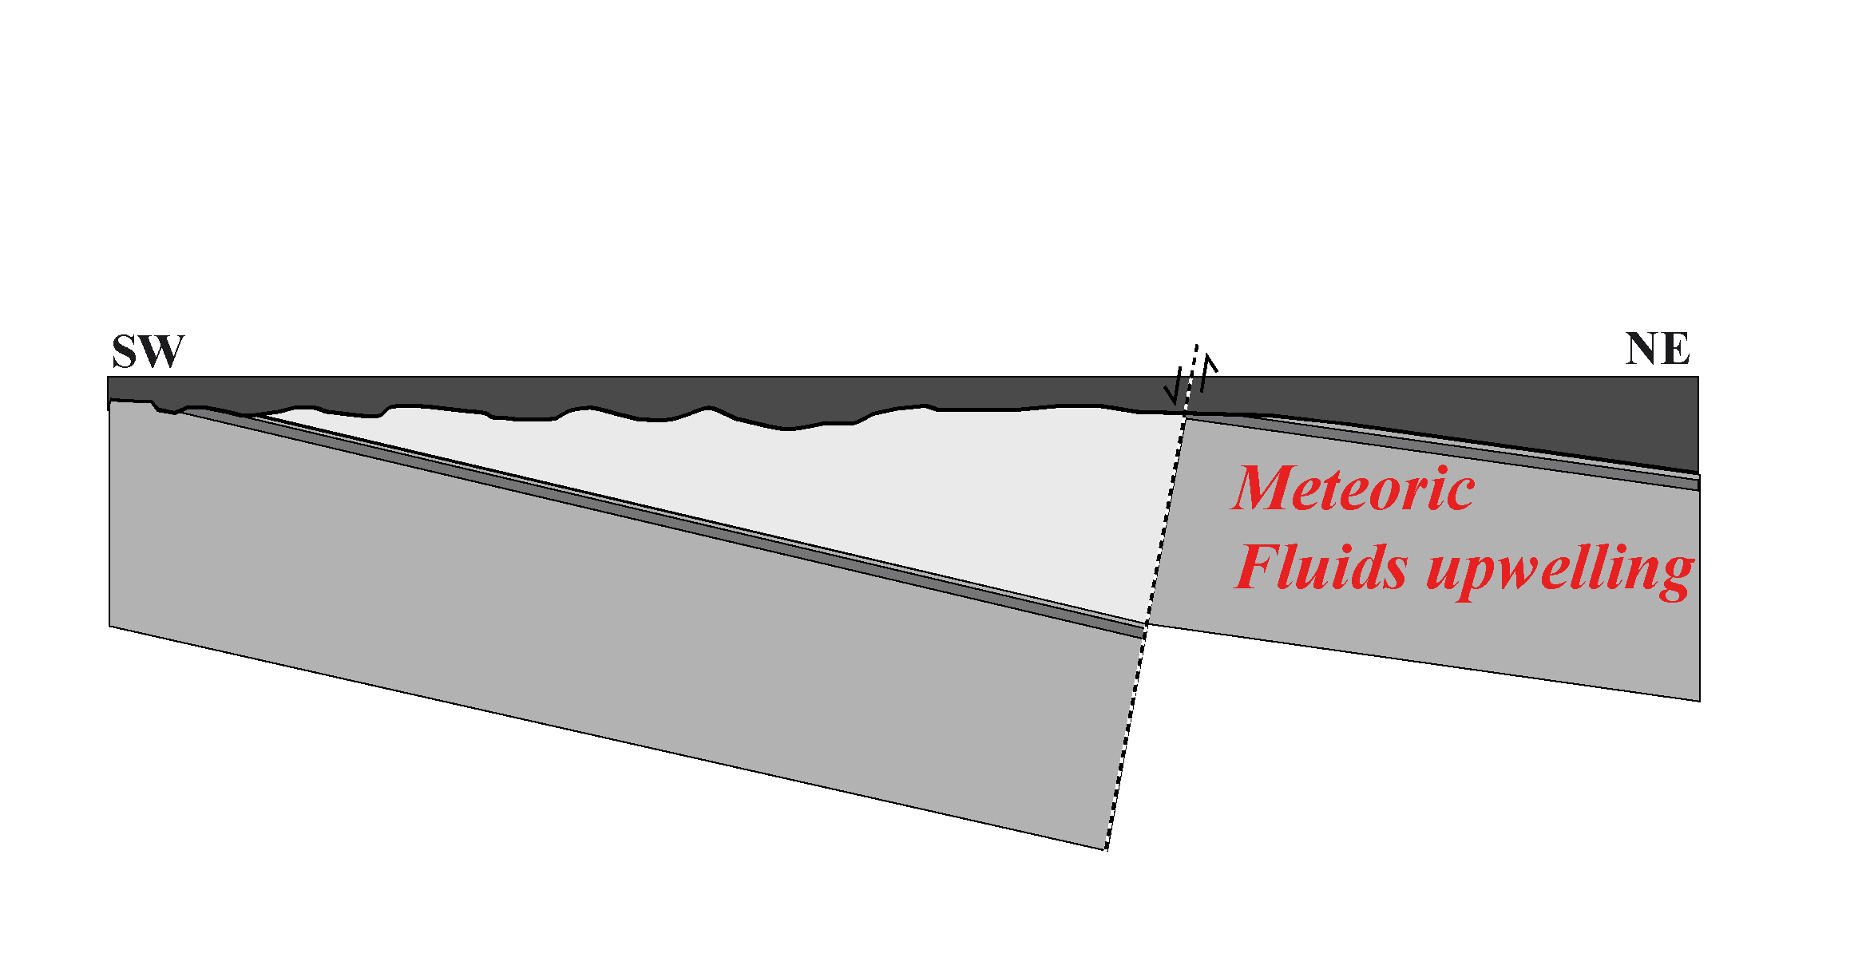
DIAGENTIC EVOLUTION
Cement C7
Rupelian (≈30Ma)
Seismic pumping of infiltrated meteoric water (≈400m)
Karst
Micrite recrystallisation (µФ) Cement C7
U-Pb
∆₄₇

Slide 11
CONCLUSIONS
The diagenetic events related tonormal fault zone activity are mainly restricted to fault zone
The fault zone related fluid flows impacted UC properties only during the fault Rupelian reactivation.
The presence of the fault zone can impact heterogeneously the reservoir properties over large distances
> 700m in the UC Unit

Slide 12
CONCLUSIONS
The normal fault zone related diagenetic events are mainly restricted to fault zone
Thank you for your attention !
The fault zone related fluid flows impacted UC properties only during the fault Rupelian reactivation.
The presence of the fault zone can impact heterogeneously the reservoir properties over large distances
If you have any further questions, you can contact me at :
irene.aubert@univ-pau.fr
> 700m in the UC Unit
12

