Slide 1







Soil greenhouse gas fluxes following conversion of tropical forests to
fertilizer-based sugarcane systems in northwestern Uganda
(Published in Agriculture, Ecosystems, and Environment)
Joseph Tamale^{1,5}, Oliver van Straaten², Roman Hüppi⁴,
Laban F. Turyagyenda⁵, Peter Fiener¹, and Sebastian Doetterl³
¹Institute of Geography, University of Augsburg, Augsburg 86159, Germany
²Northwest German Forest Research Institute, Grätzelstr. 2, 37079 Göttingen, Germany
³Soil Resources, Department of Environmental Systems Science, ETH, Zürich 8092, Switzerland
⁴Sustainable Agroecosystems, Department of Environmental Systems Science, ETH, Zürich 8092, Switzerland
⁵Ngetta Zonal Agricultural Research and Development Institute (NGEZARDI), P. O. Box 52, Lira, Uganda

Slide 2
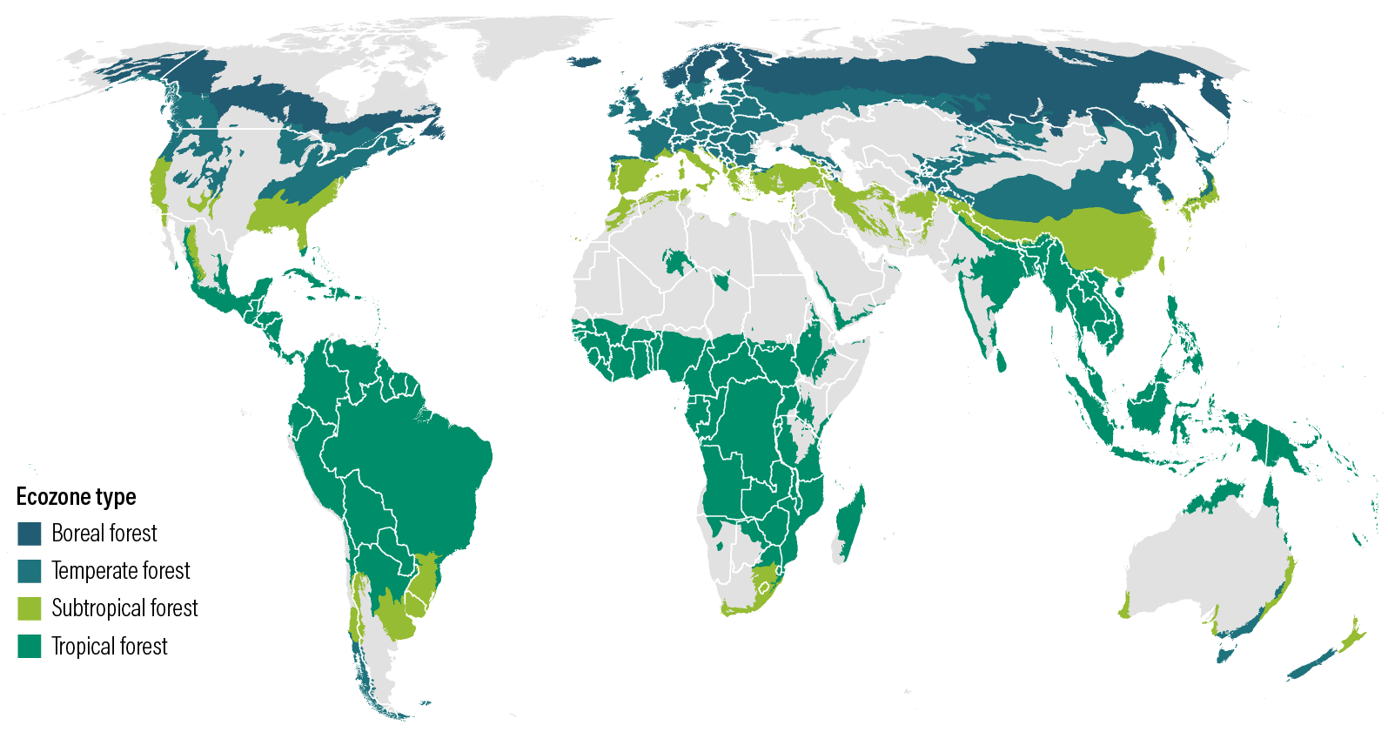
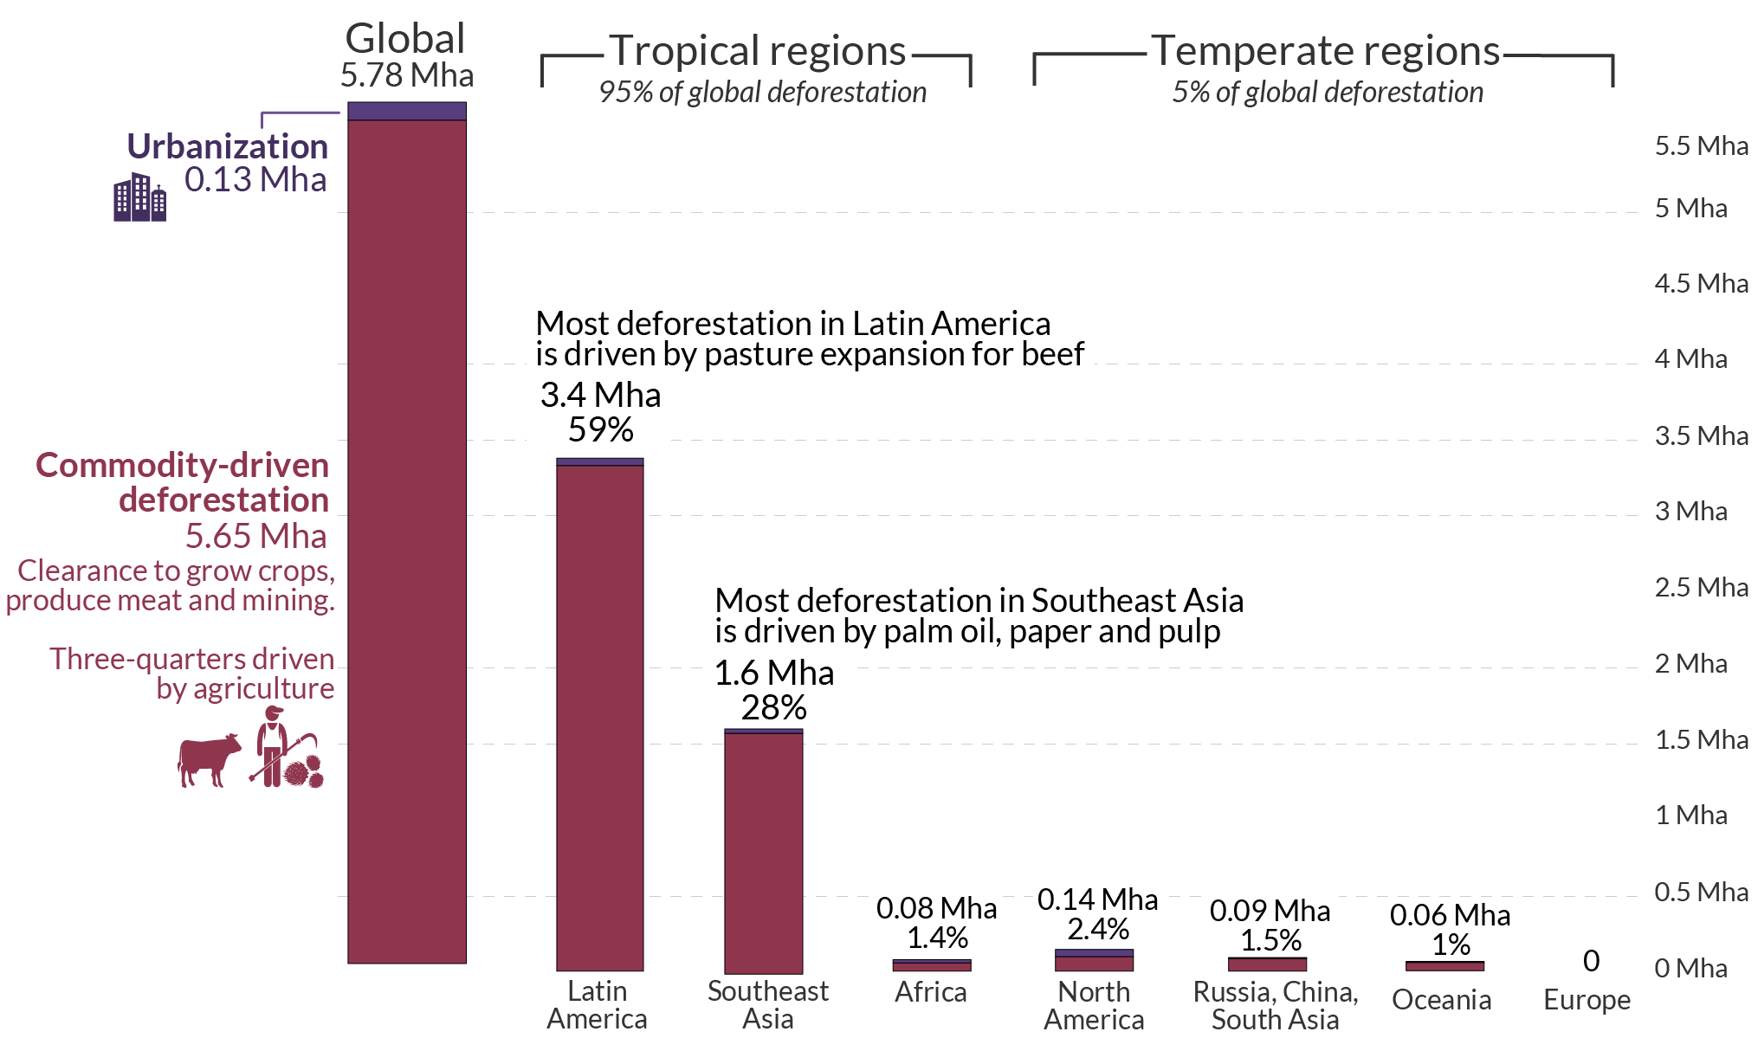
What do we know?
1/6
5.78 Mha of forest land lost annually globally
Tropical forests play an important role in C and N cycling^{1,2}
Large areal extent (~ 43% of global forest cover)
Large pools of C in vegetation and soils (30% of global SOC stocks)
Large N pools
Nearly all global deforestation occurs in the tropics⁴
Africa expected to be the next deforestation hotspot⁴
For instance, Uganda lost nearly 60% of its forest cover (1990-2015) to fertilizer based agriculture (sugarcane )⁵
Limited studies on deforestation and soil greenhouse gas fluxes
Large potential for C and N losses to the atmosphere³
¹Brown, 1996; ²Cusack et al., 1999; ³Curtis et al., 2018; ⁴Veldkamp et al., 2020; ⁵NEMA, 2017

Slide 3
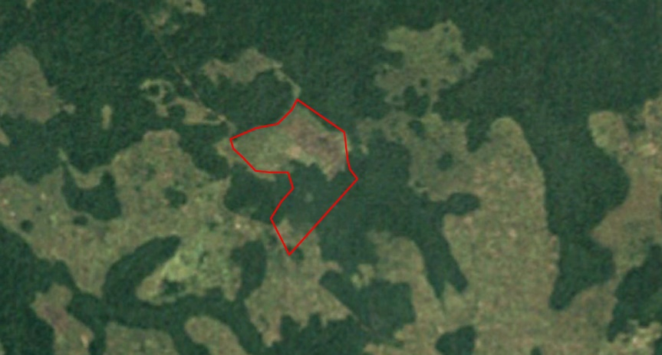
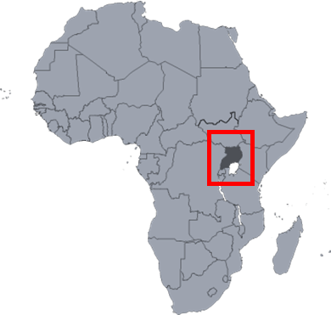
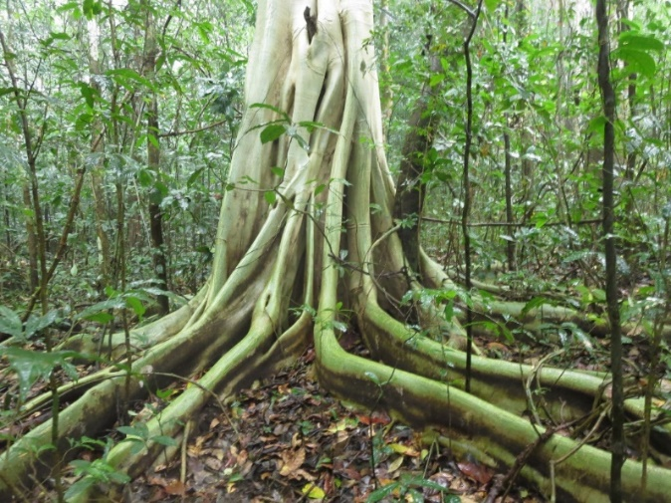
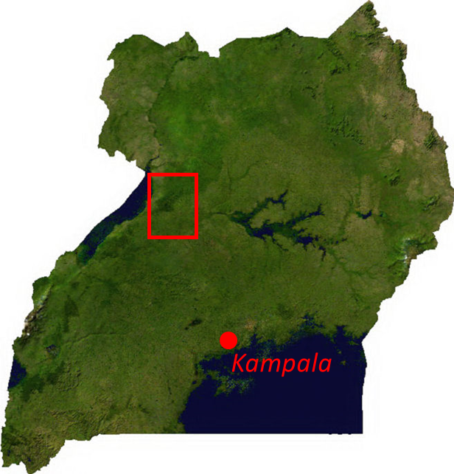
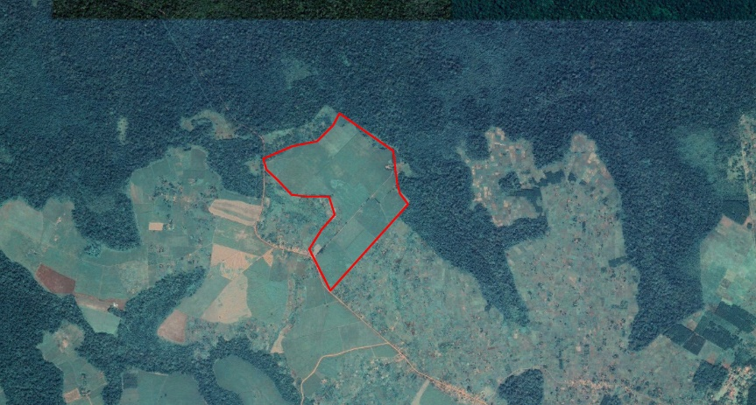
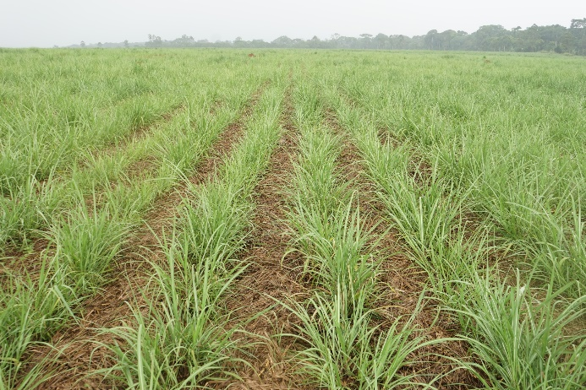
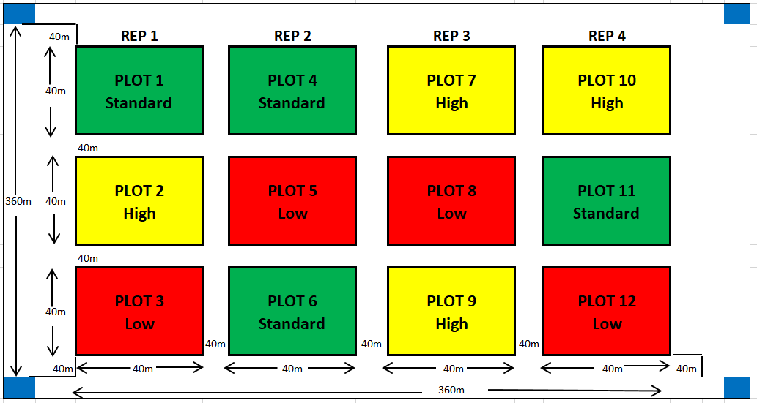
Study aim: Investigate soil greenhouse gas fluxes (CO₂, CH₄, and N₂O) from a reference forest and fertilized sugarcane plantations
2/6
Study area
Four control plots
1985
2020
Hypotheses:
Increased CO₂ emissions from the respective sugarcane CRD treatment plots compared to reference plots (low input > standard input > high input > forest).
Reduced CH₄ uptake in the respective sugarcane CRD treatment plots compared to the reference forest plots (high input < standard input < low input < forest).
Increased N₂O emissions from the respective sugarcane CRD treatment plots compared to the reference forest plots (high input > Standard input > low input > forest).
Measurements
Soil greenhouse gas fluxes
Auxiliary control measurements
Soil Temperature
Soil moisture
Soil mineral nitrogen
14 months
Carbon stocks in soils and vegetation

Slide 4
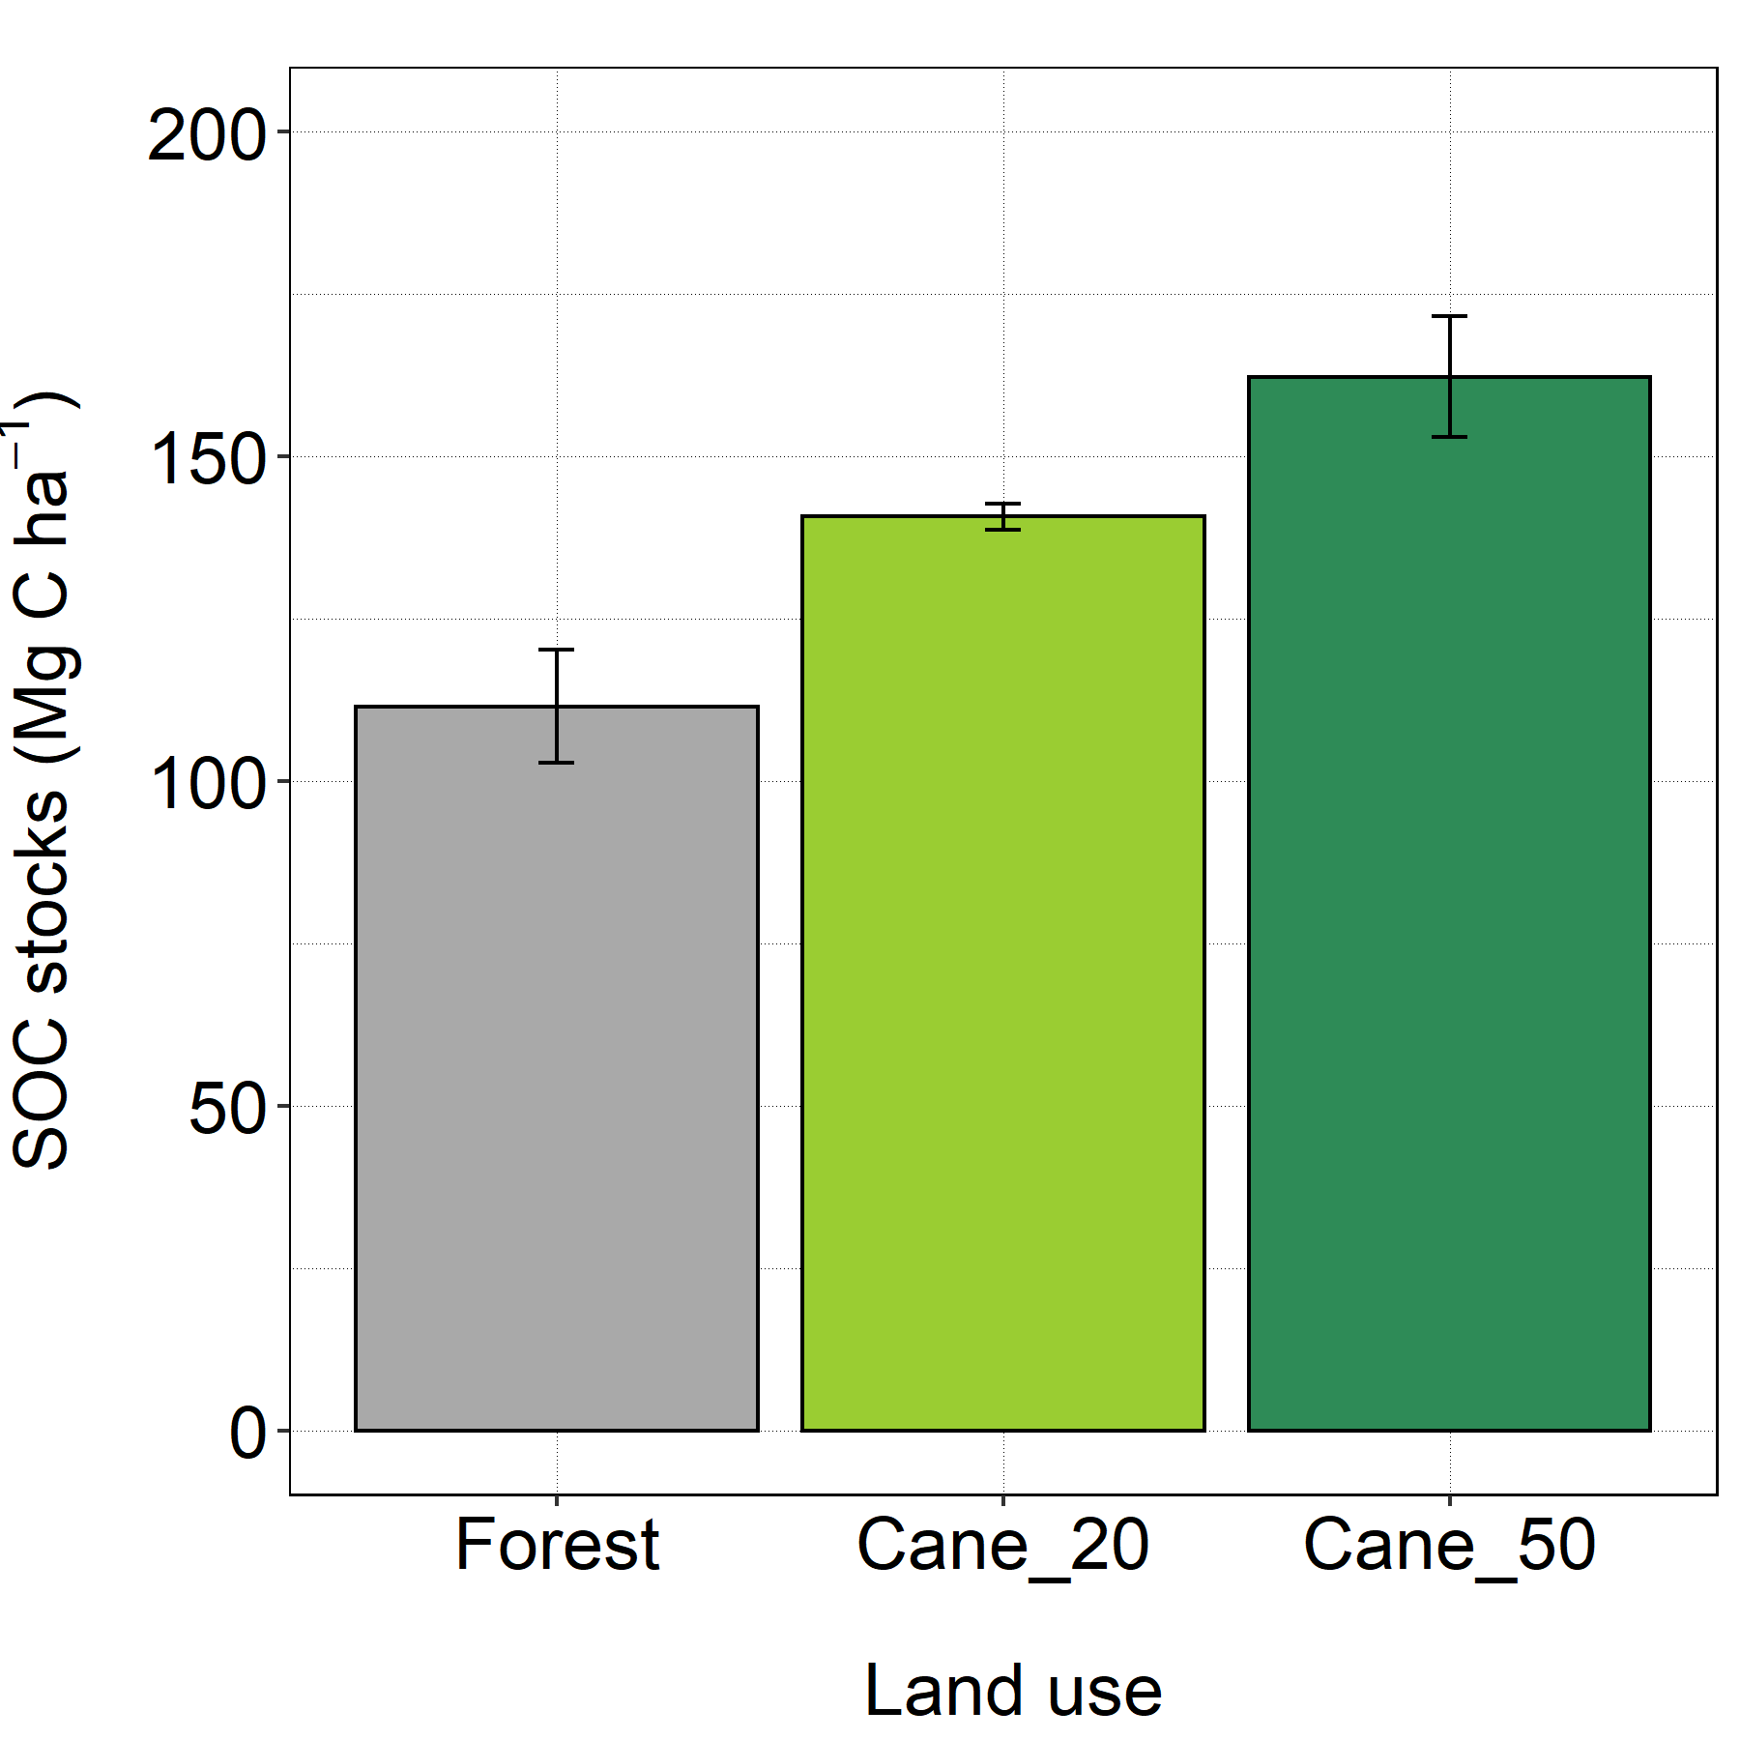
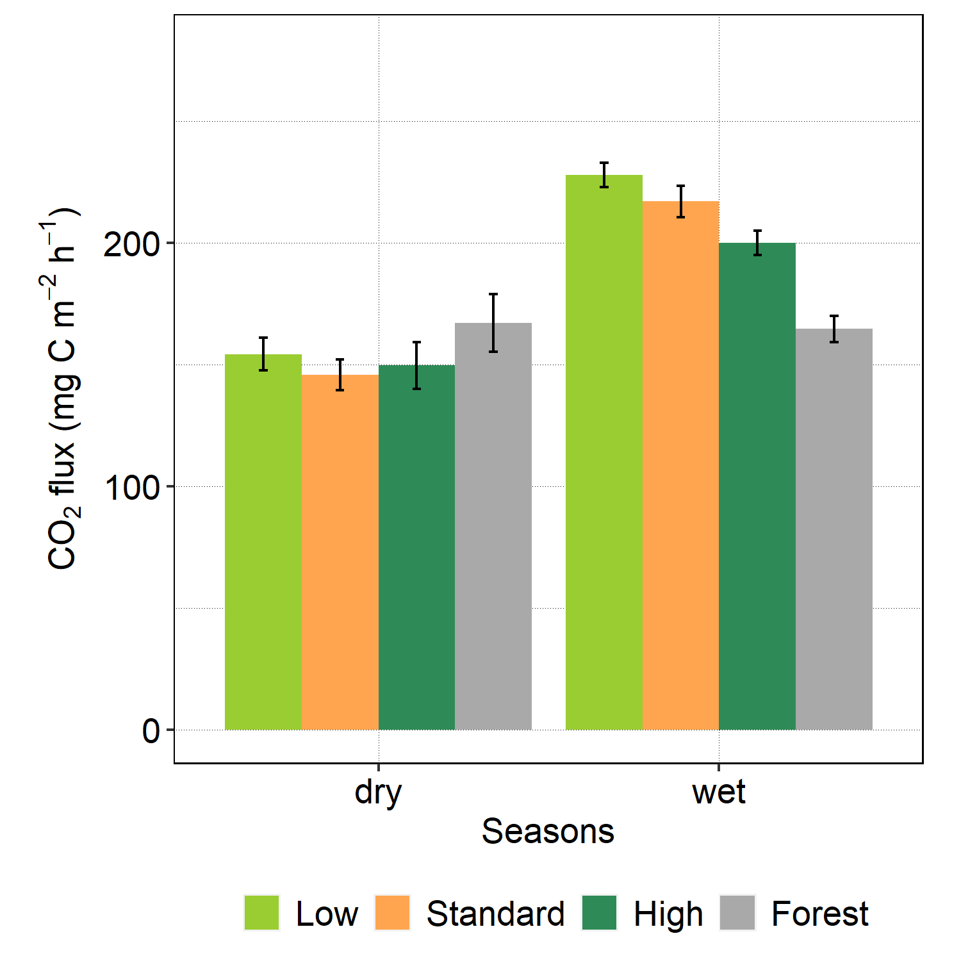
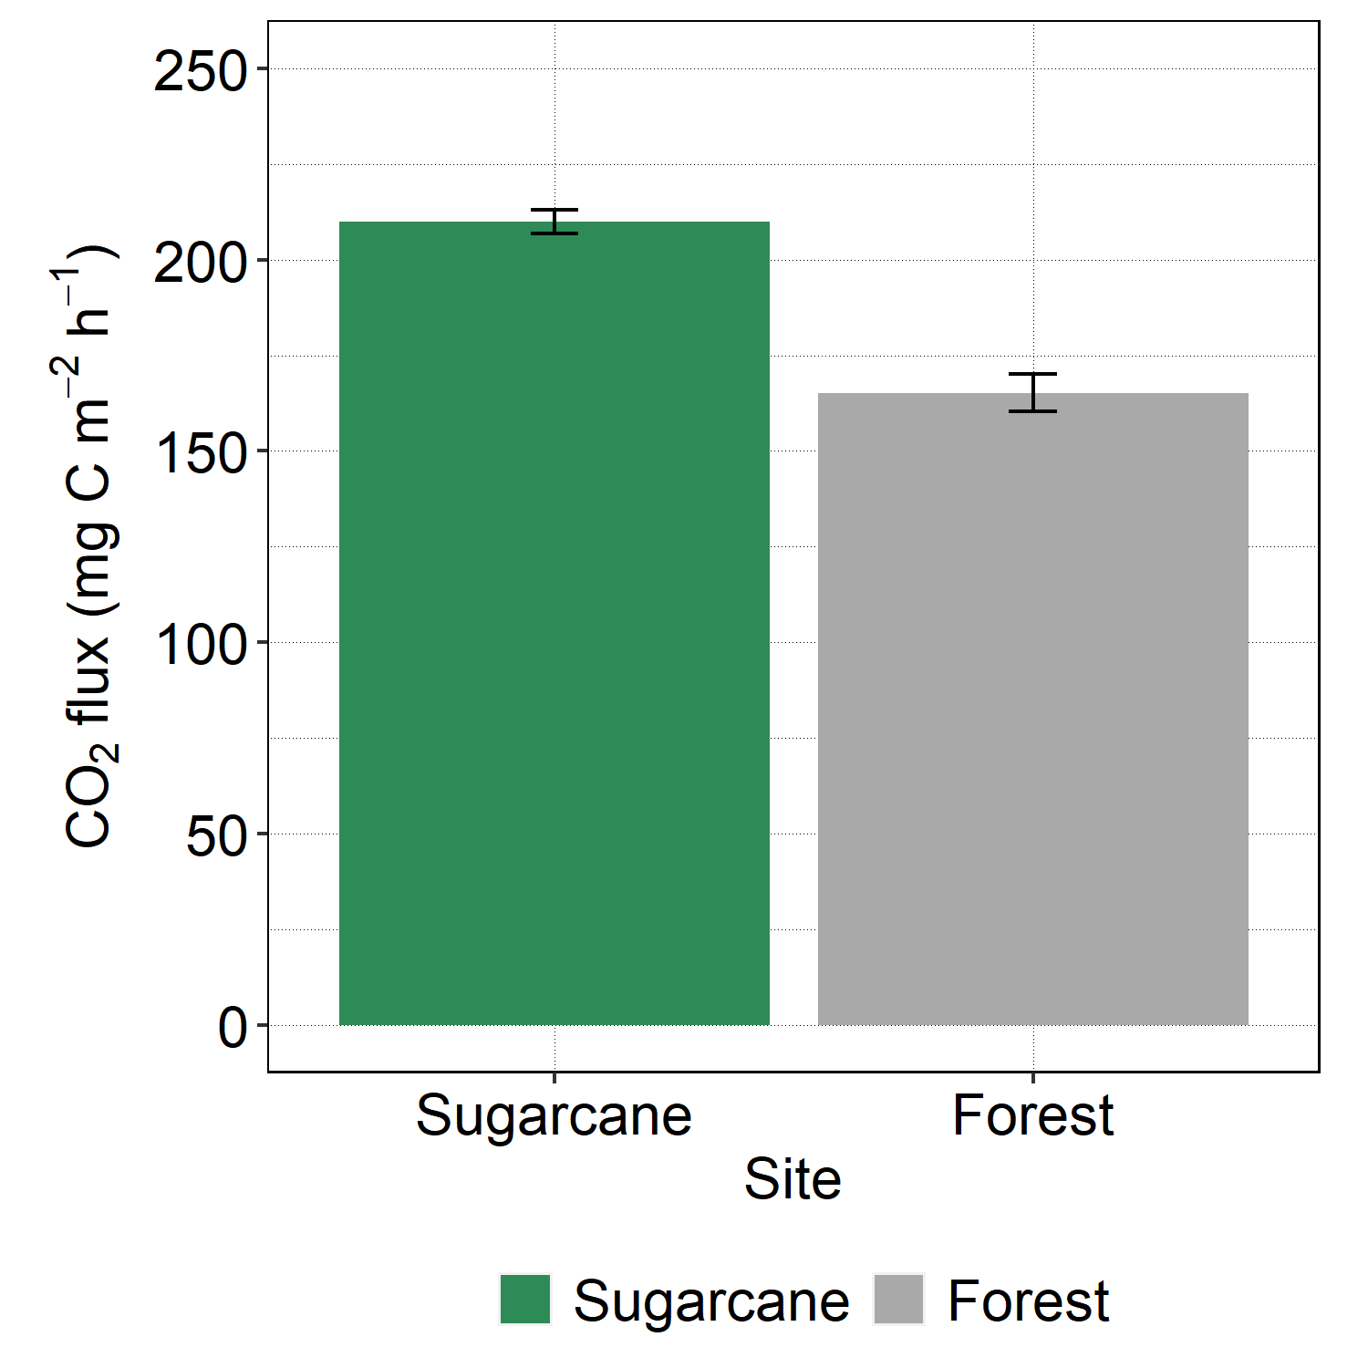
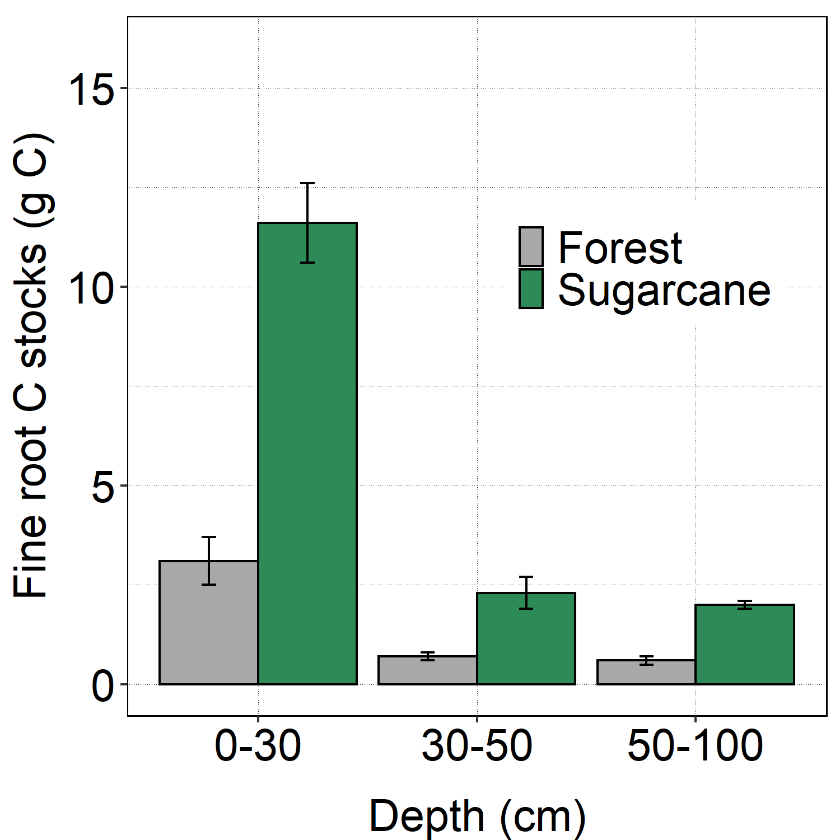
Key findings
3/6
***
H1: Increased CO₂ emissions from the respective sugarcane CRD treatment plots compared to reference plots (low input > standard input > high input > forest)
***
H1 partially rejected/ confirmed
***
***
NS
NS
***
***
***
Higher soil respiration under sugarcane than the forest

Slide 5
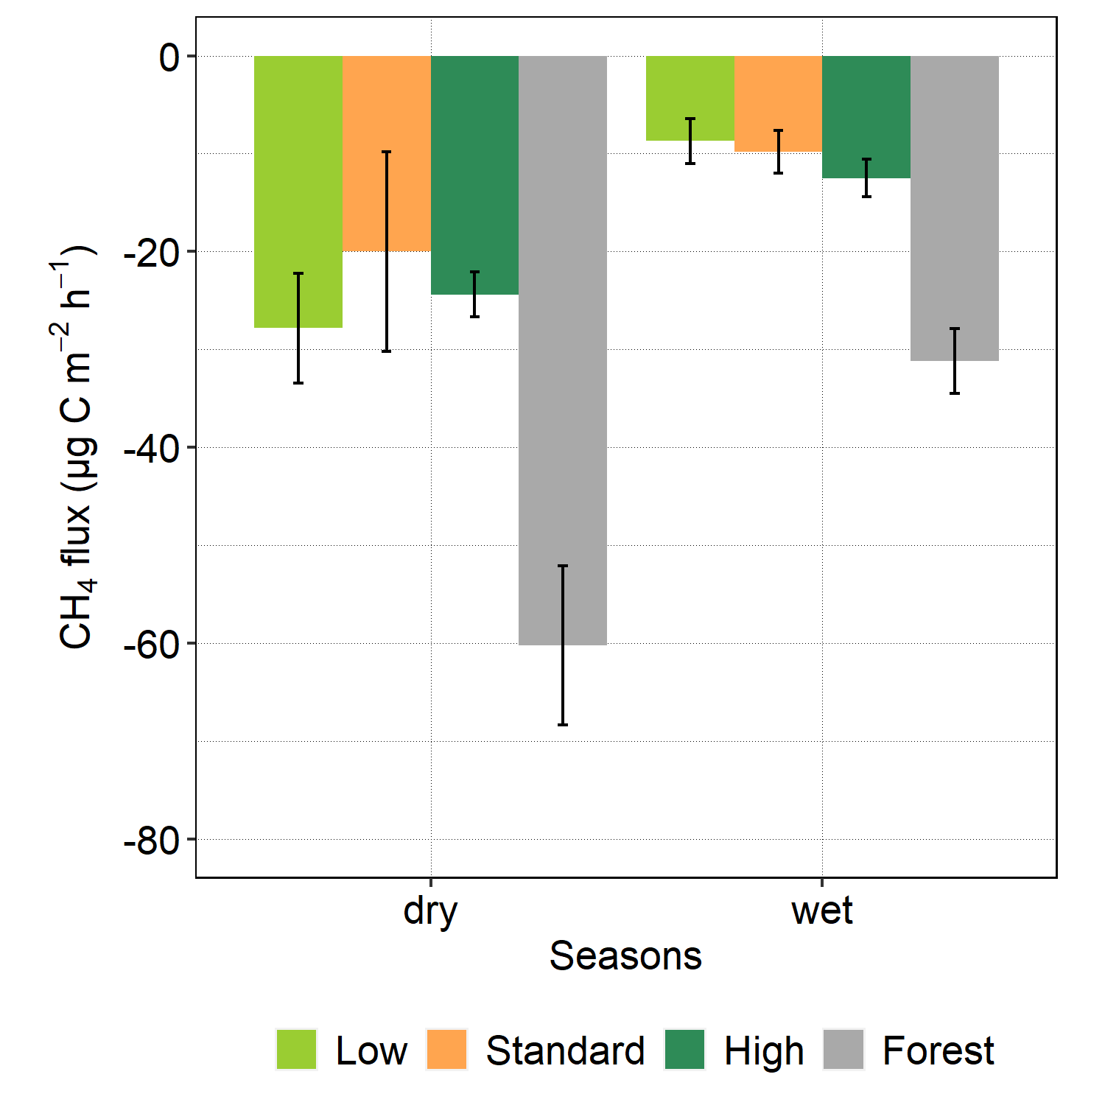
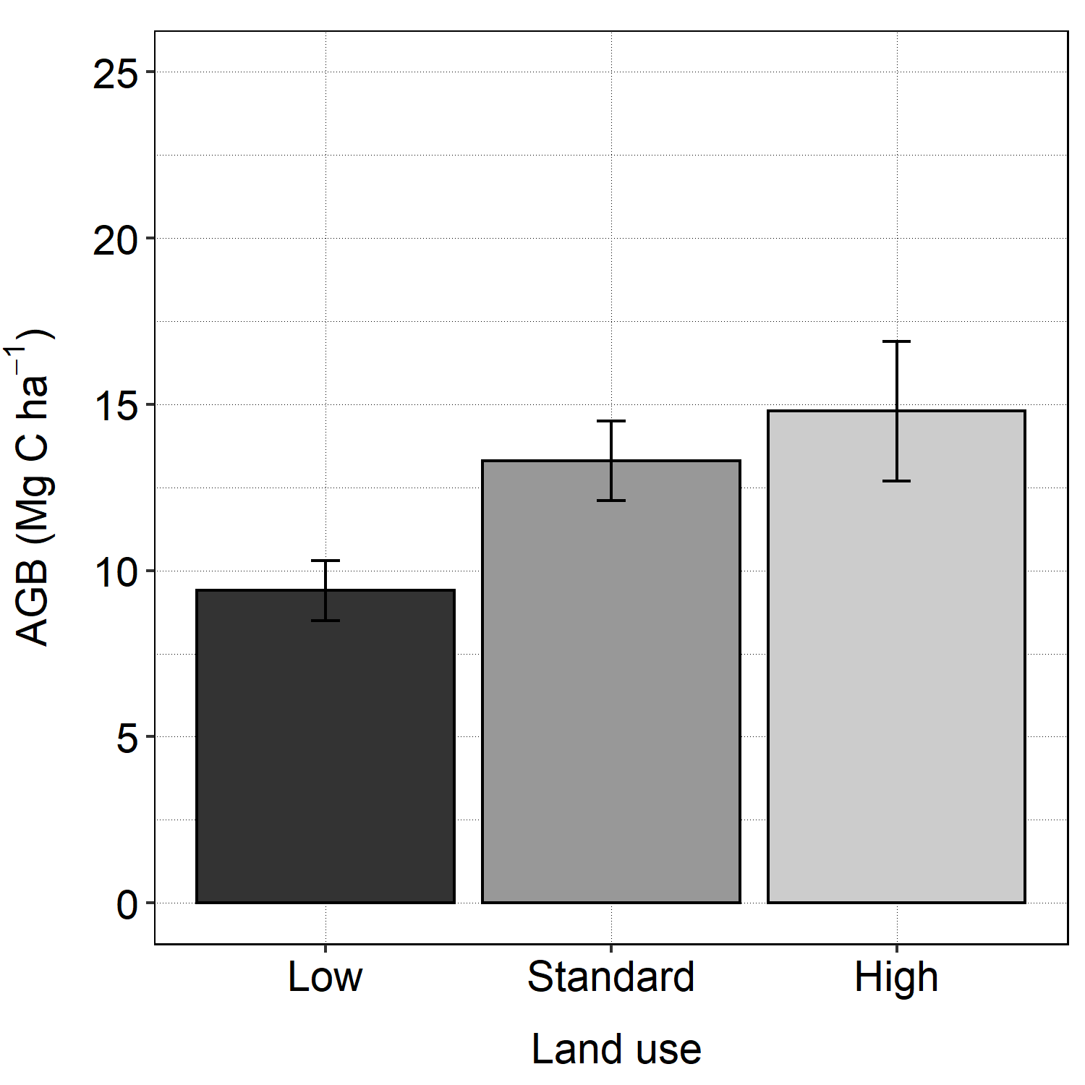
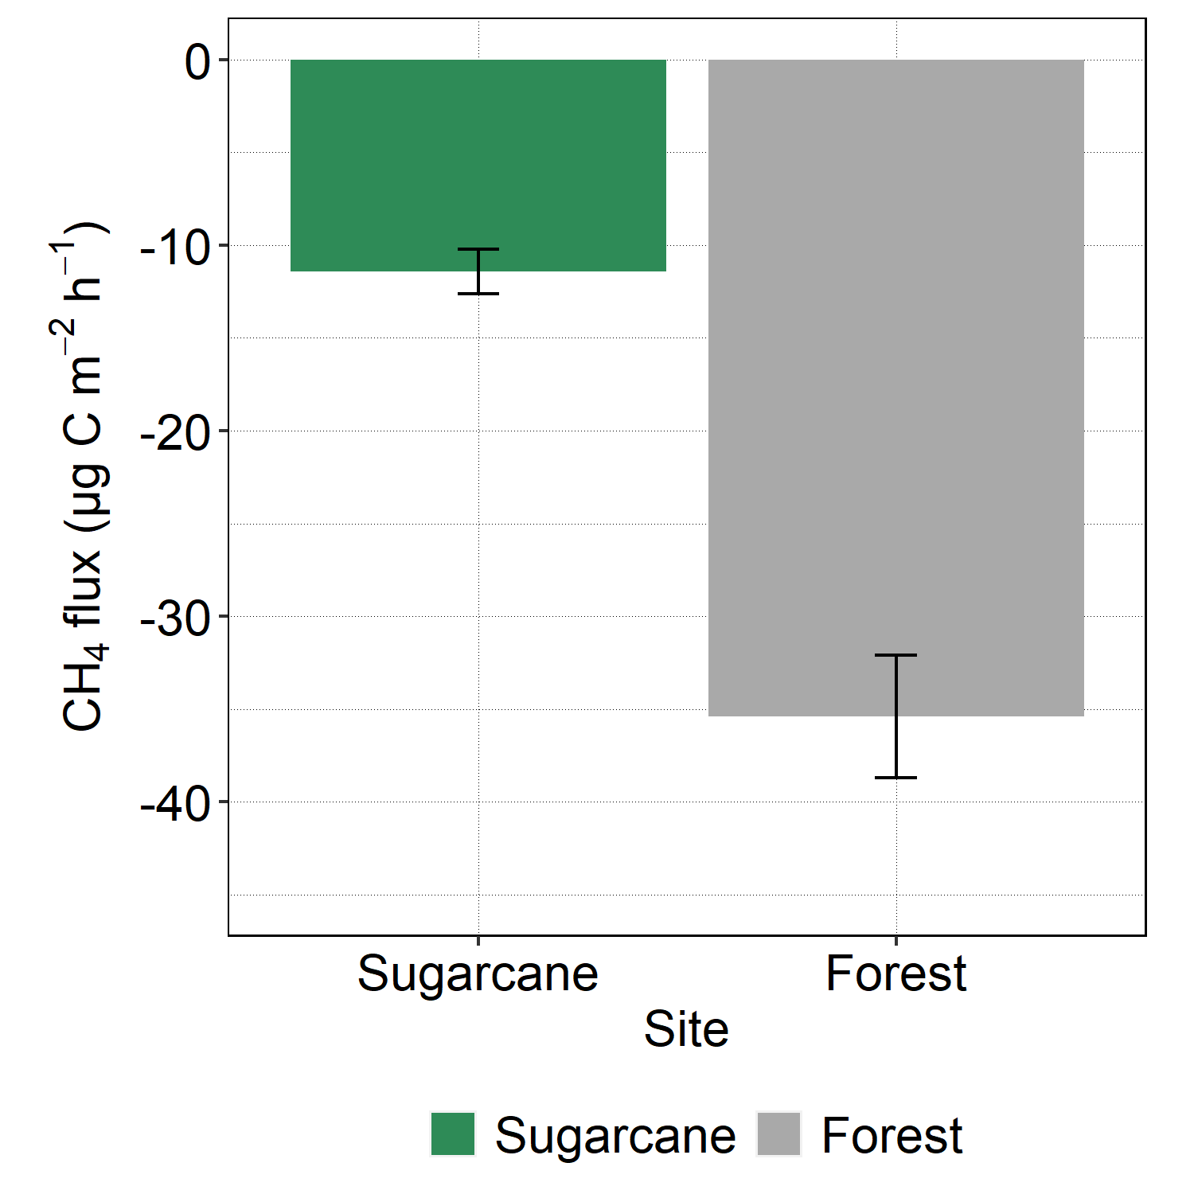
H2: Reduced CH₄ uptake in the respective sugarcane CRD treatment plots compared to the reference forest plots (high input < standard input < low input < forest).
4/6
H2 partially rejected/confirmed
Lower methane uptake under sugarcane compared to forest
***
NS
NS
NS
***
***
***
Alteration of the methanotrophic abundance upon conversion

Slide 6
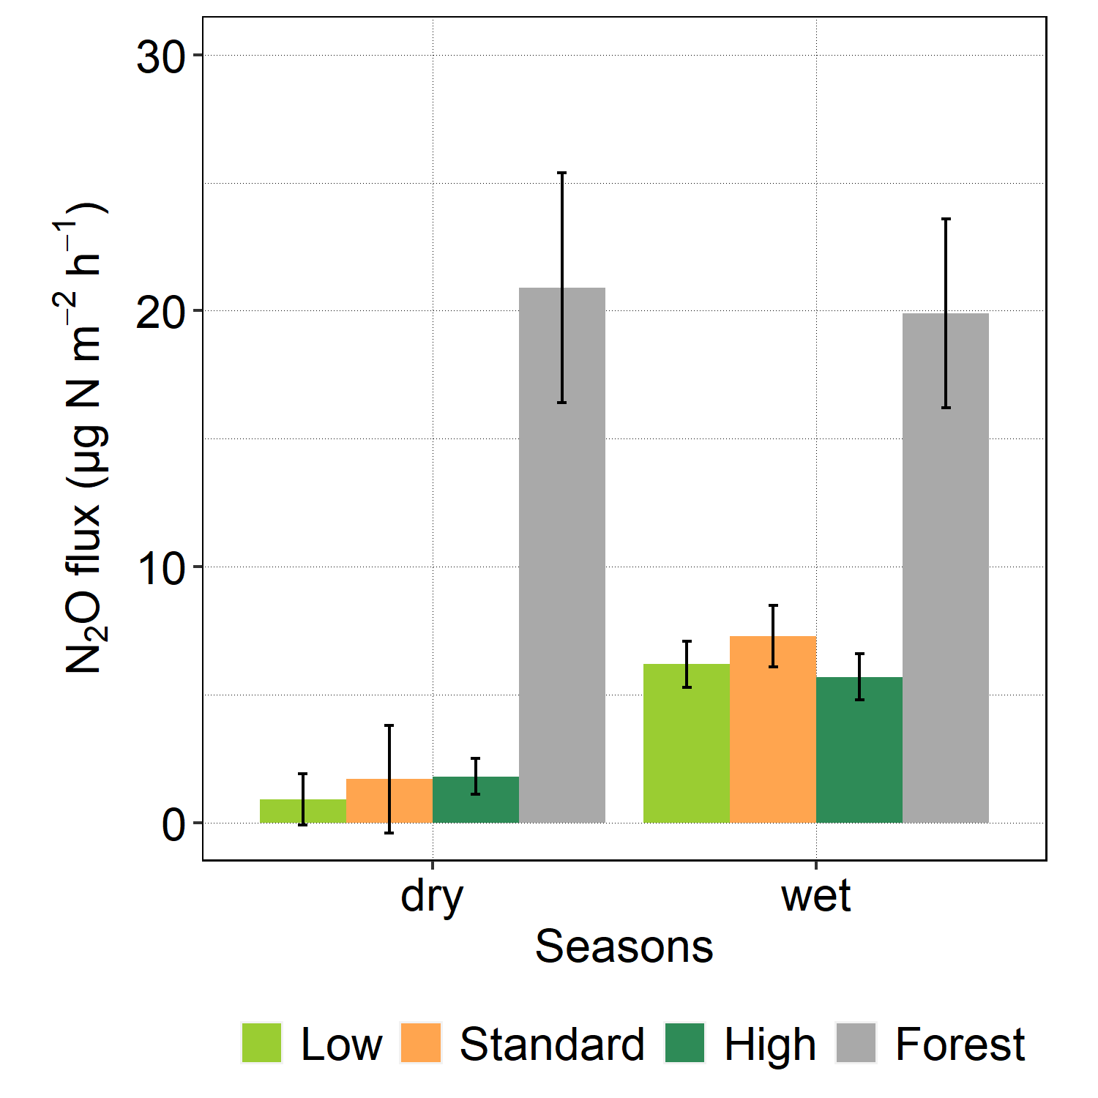
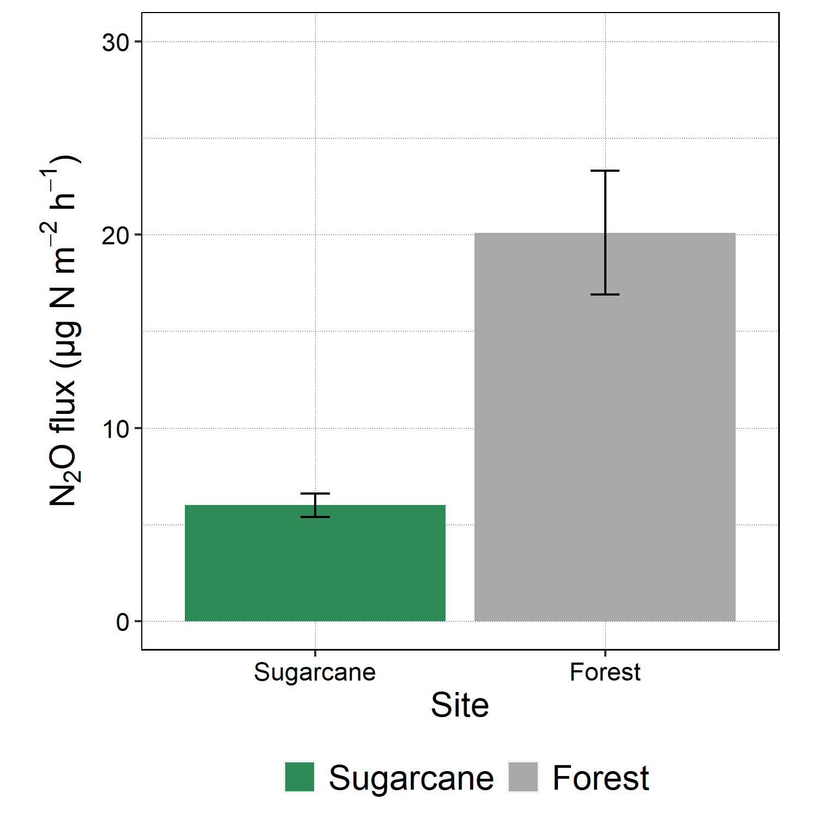
H3: Increased N₂O emissions from the respective sugarcane CRD treatment plots compared to the reference forest plots (high input > Standard input > low input > forest).
5/6
H3 falsified
Lower N₂O emissions under sugarcane compared to forest
***
***
***
***
NS
NS
NS
Plant N uptake
N leaching
Ammonia volatilization

Slide 7
Main Message from the study
6/6
Even with increased SOC sequestration and lower N₂O emissions under sugarcane compared to forest, the forest-sugarcane conversion resulted in a net annual C loss of 2.8 Mg CO₂-eq ha⁻¹ from soil to the atmosphere
Thank you for listening

