Slide 1
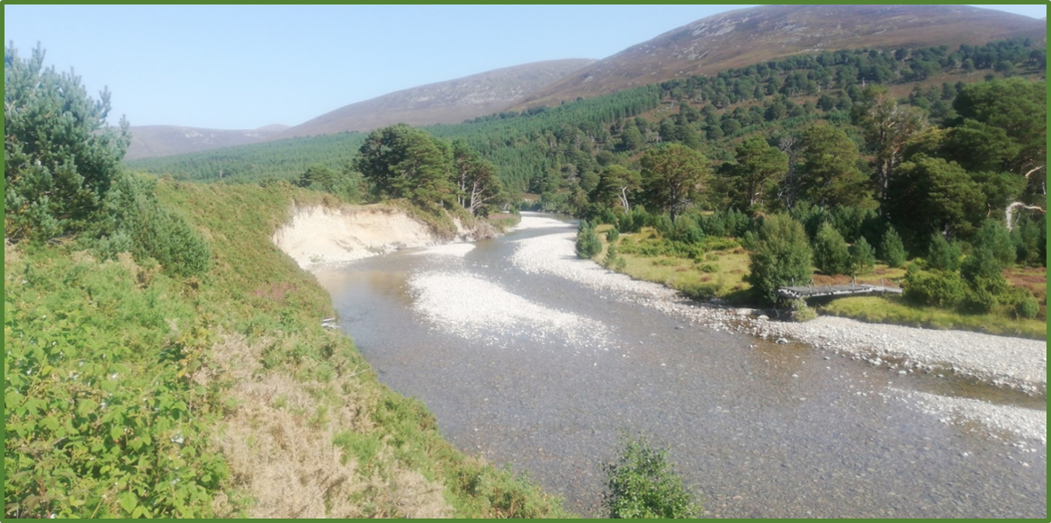









Isolating bedload transport using river induced seismic signals
1
Bronwyn Matthews
PhD student at the School of Geosciences, The University of Edinburgh
Bronwyn.Matthews@ed.ac.uk
${\text{Dr} \text{Mark} \text{Naylor}}^{\text{1}}$, ${\text{Prof}\text{. }\text{Hugh} \text{Sinclair}}^{\text{1}}$, ${\text{Dr} \text{Richard} \text{Williams}}^{\text{2}}$, ${\text{Dr} \text{Michael} \text{Dietze}}^{\text{3}}$, ${\text{Calum} \text{Cuthill}}^{\text{2}}$, ${\text{Dr} \text{Andrew} \text{Black}}^{\text{4}}$, ${\text{Matthew} \text{Gervais}}^{\text{1}}$, ${\text{Anna} \text{Smith}}^{\text{1}}$
OSPP
2
3
4

Slide 2
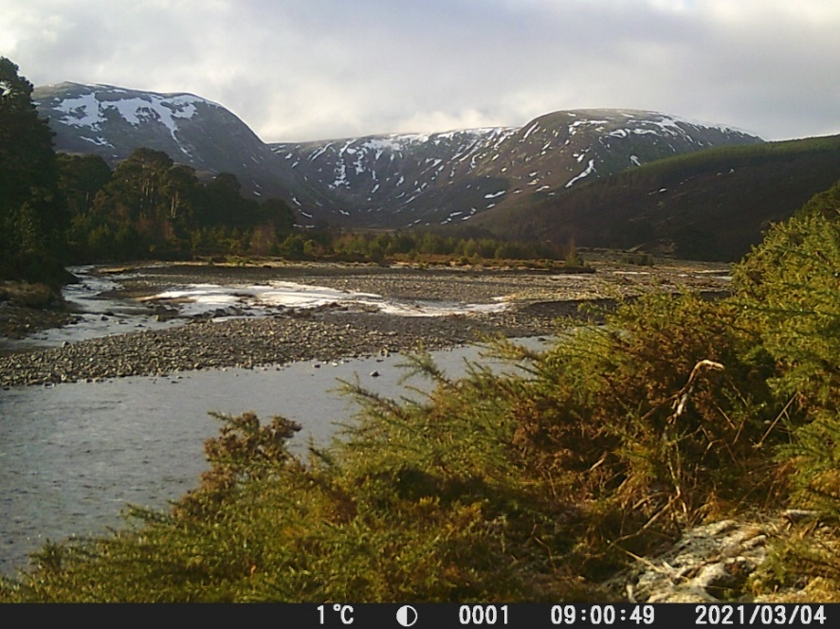
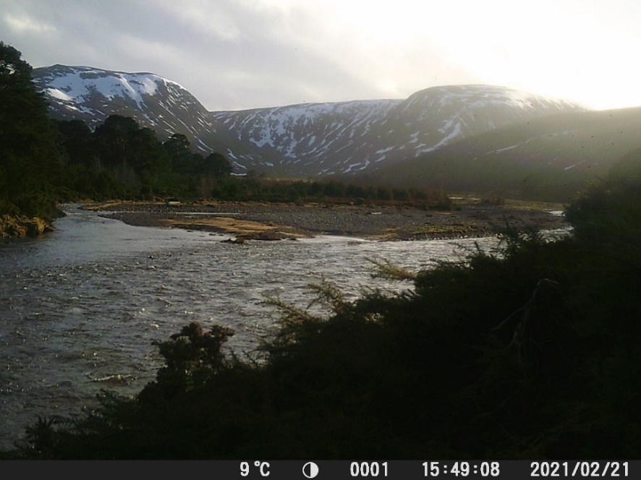
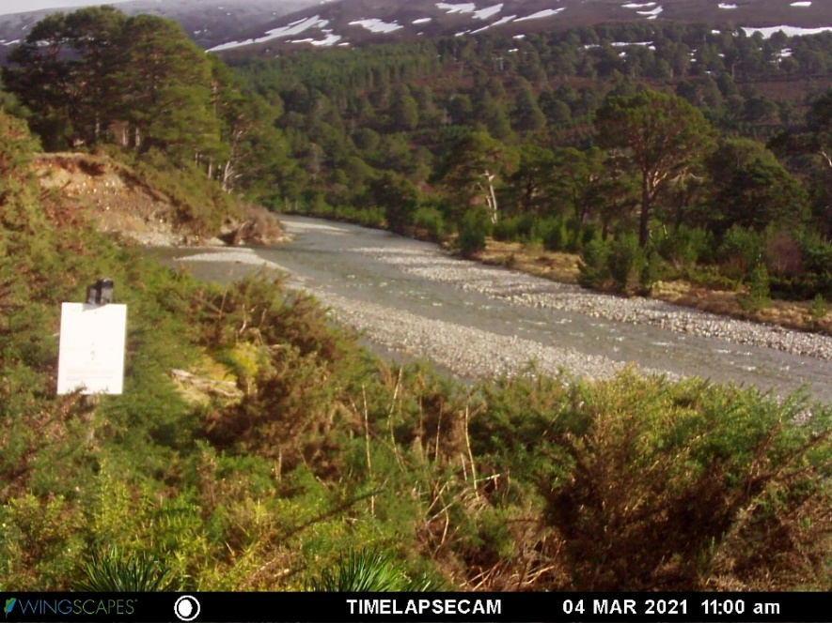
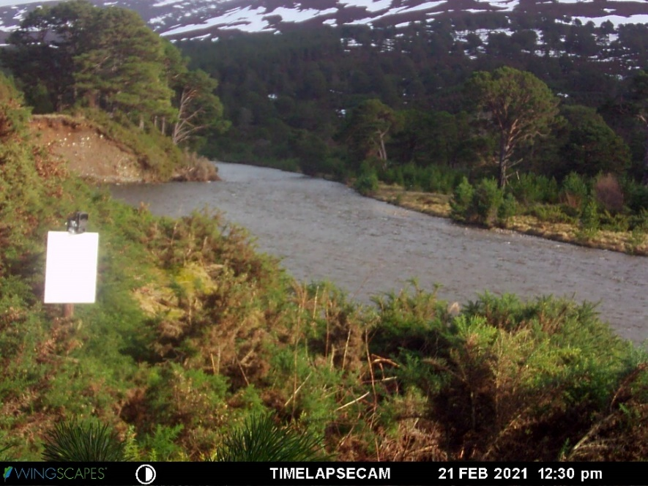
Time-lapse imagery at the River Feshie field site
Upstream
Downstream
Low flow
High flow

Slide 3

Hysteresis in seismic power vs stage or discharge = bedload transport?
Hysteresis has been fundamental to identifying bedload transport in previous studies
rising limb
falling limb
River-induced seismic noise
Bedload
seismic power (PSD)
=
+
seismic power (PSD)
Turbulence
water level
water level

Slide 4
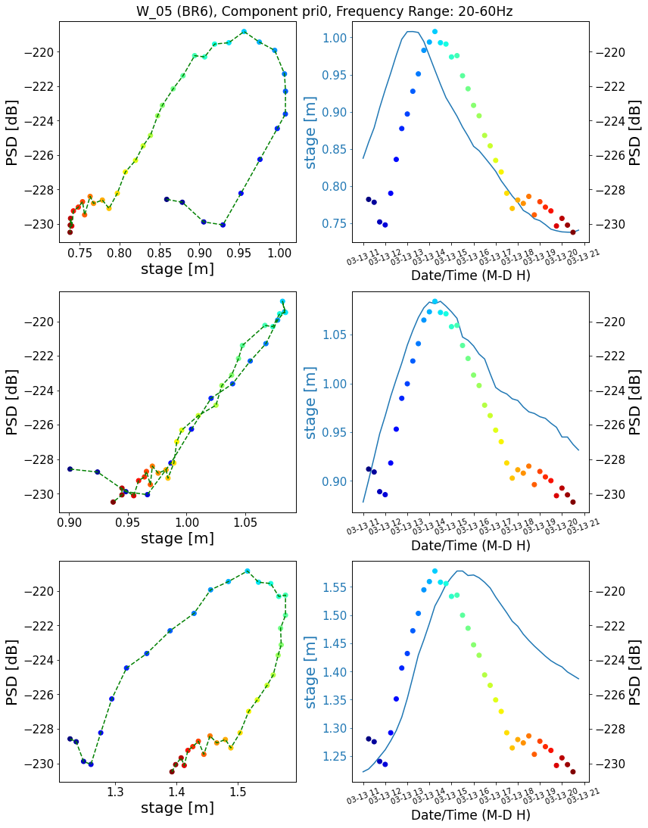
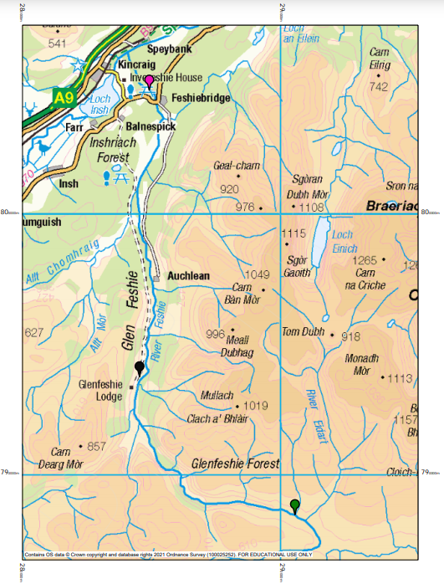

Hysteresis in seismic power vs stage or discharge = spatial offset between measurement sites?
Data from our study site at the River Feshie in Scotland in March 2022
Station W_07
Stage
Seismic power
Upstream
gauge
C
A
B
No hysteresis with collocated seismic and water level measurements
On-site
gauge
A
B
Downstream
gauge
C

Slide 5
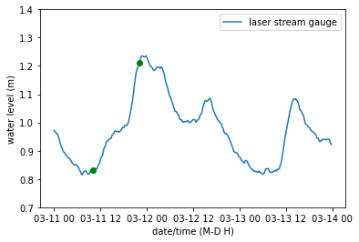

*Hover over the loudspeaker and click the play button*
Low Water Level
Turbulence
High Water Level
Bedload
Predicted water level for the onset of bedload motion
Hydroacoustic recordings from a low water level prior to the peak in the hydrograph, and from a high water level near the peak.
Can be used to identify when bedload transport was occurring to inform on the interpretation of geophone data.
Clear that bedload transport was occurring during this event despite the lack of hysteresis in the seismic power vs water level measurements.

