Slide 1
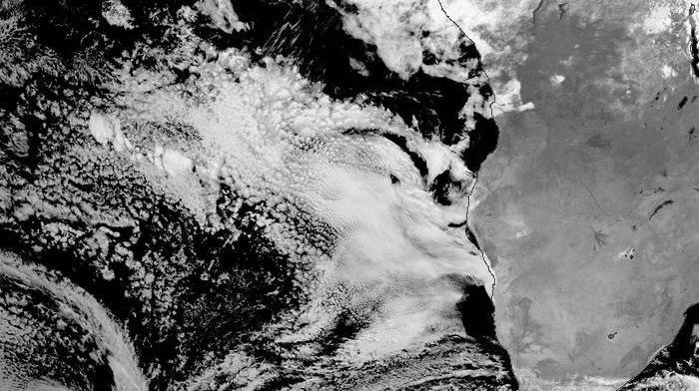










Observation of the direct effect
of aerosols in the South-East
Atlantic at high temporal resolution from MSG/SEVIRI
Fanny Peers, Jim Haywood, Richard Allan,
Pete Francis, Ben Johnson,
Gunnar Myhre, and Michael Schulz
EGU 2022, session AS3.17

Slide 2
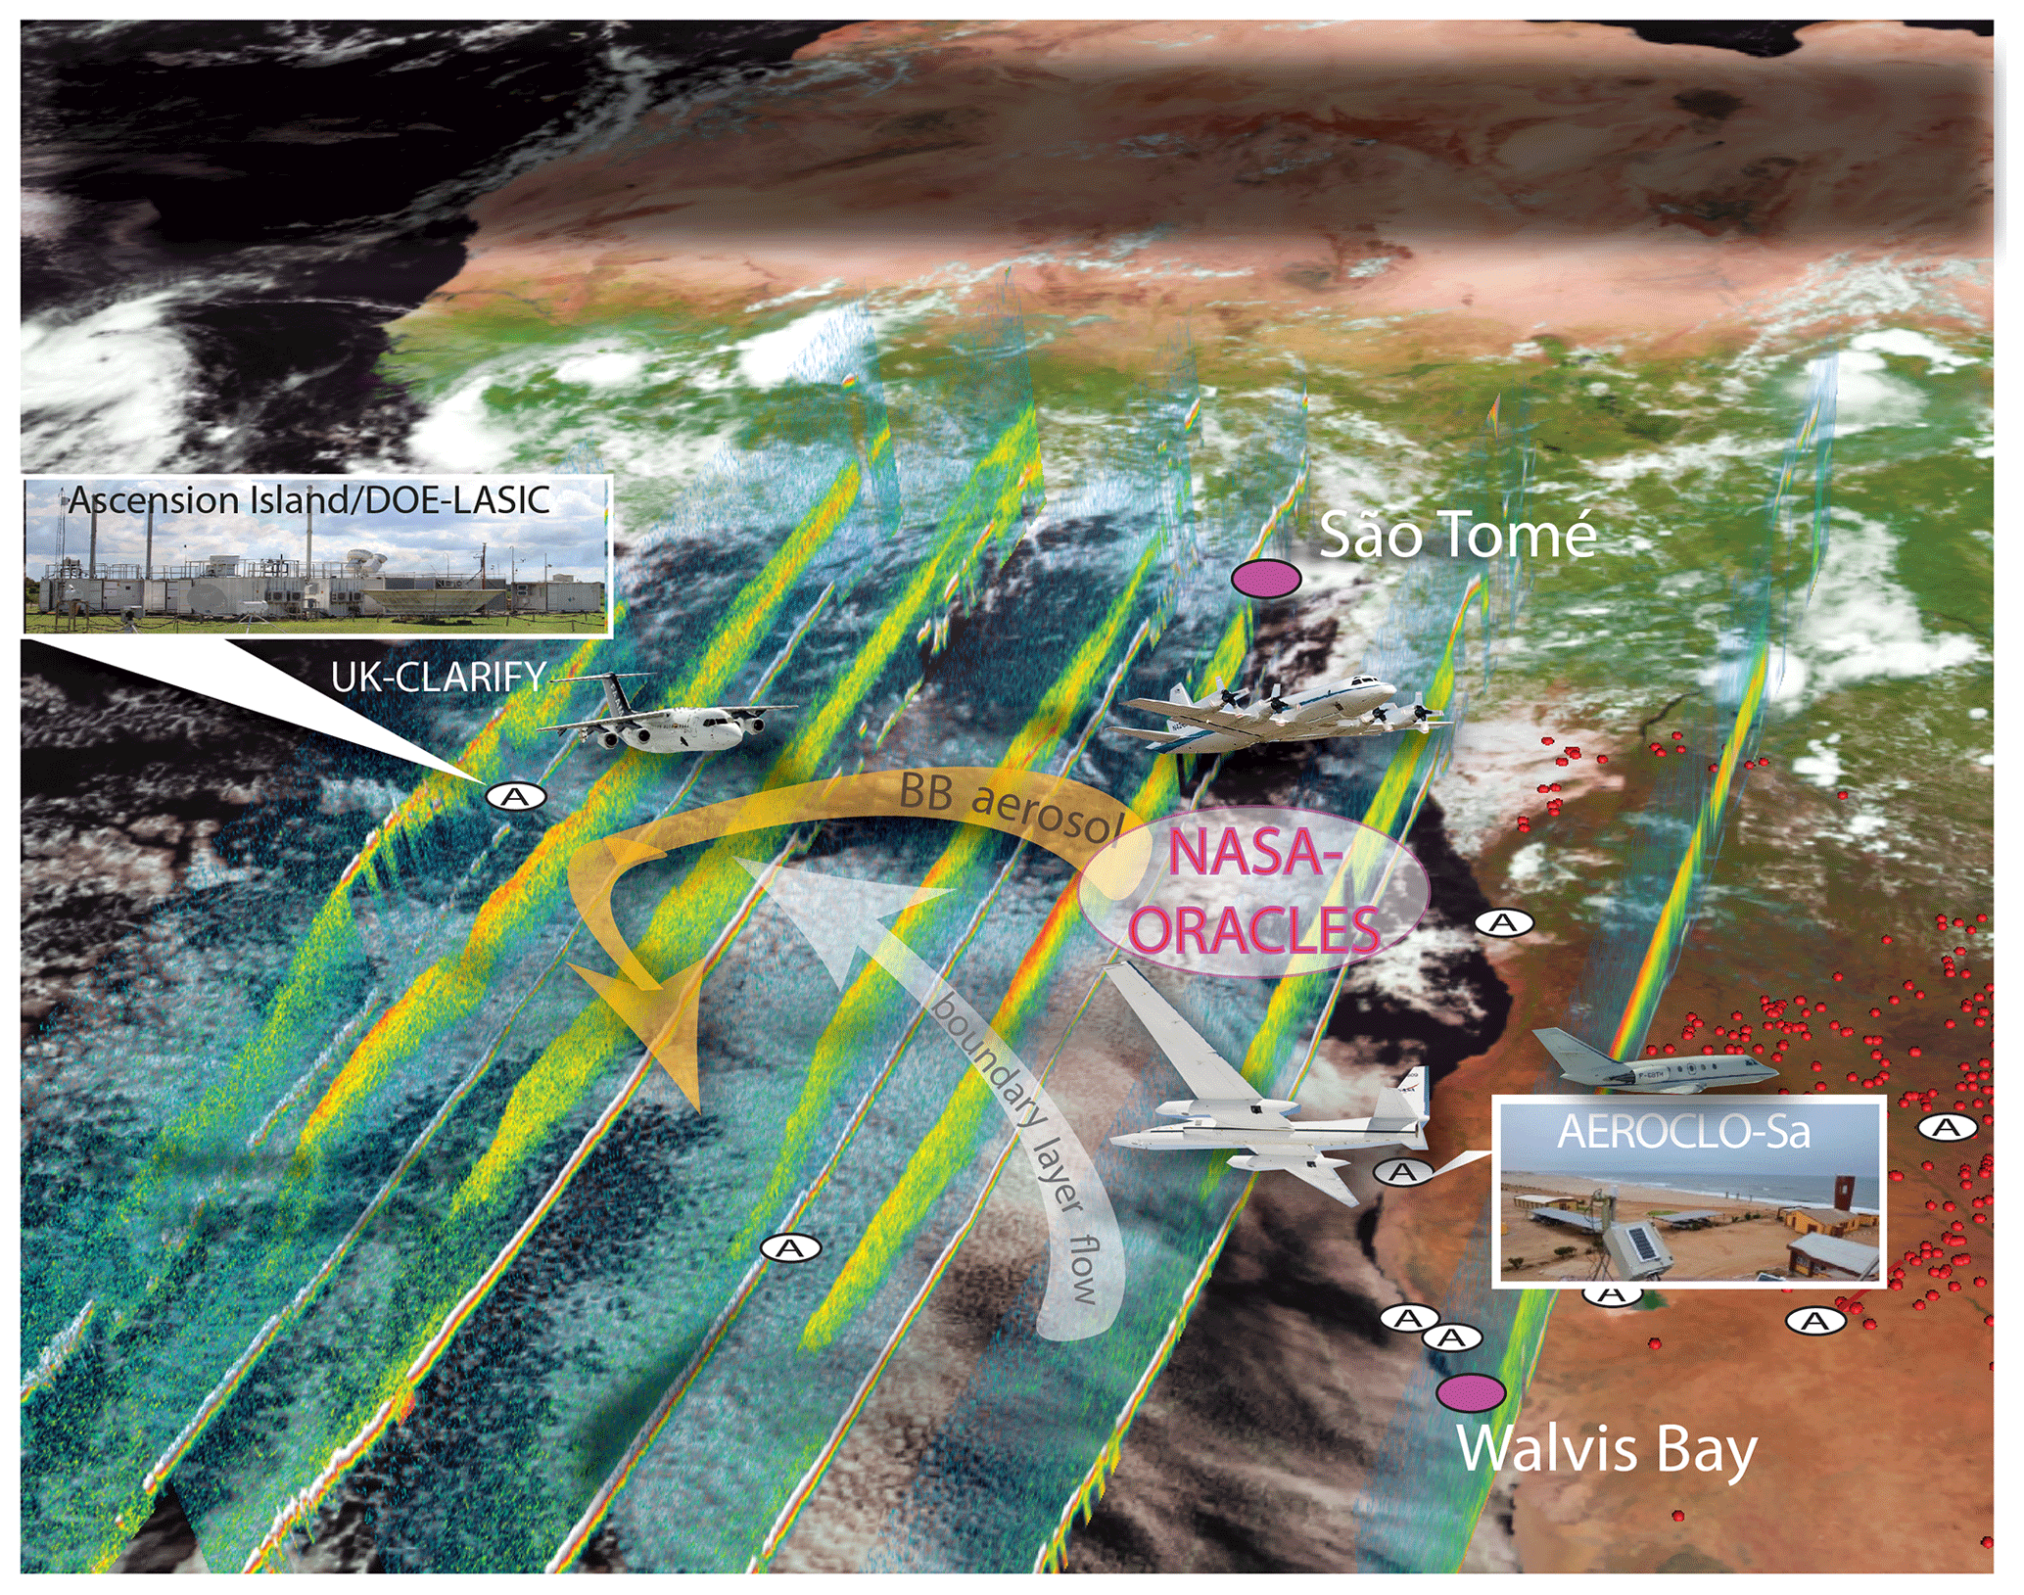

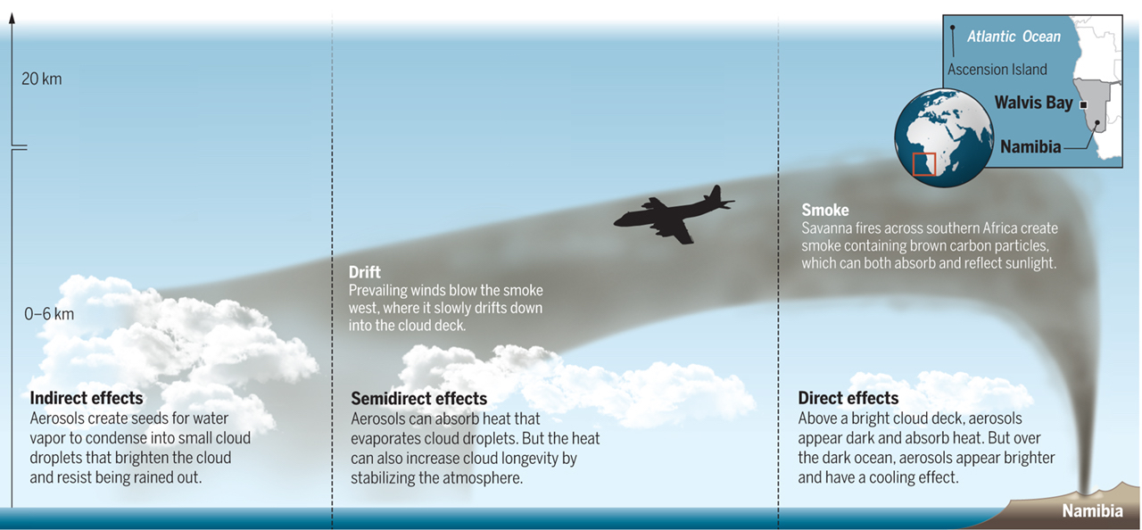
2016/2018: Coordinated international field campaigns in the SE Atlantic
Highly absorbing aerosols from African biomass burning
Transported in the free troposphere
Highly reflective stratocumulus deck
UK-CLARIFY
US - ORACLES
FR - AEROCLO
Aerosol-cloud interaction
Aerosol-radiation interaction:
Semi Direct Effect
Aerosol-radiation interaction:
Direct Effect
CLARIFY-2017: Aug-Sept 2017, Ascension Island, aircraft (Haywood et al., ACP,2 021)
ORACLES: Sept 2017, Aug 2017, Oct 2018, Sao Tomé, Walvis Bay, aircraft (Redemanm et al., ACP, 2021)
AEROCLO-sA: Aug-Sept 2017, Walvis Bay, aicraft/ground based (Formenti et al., AMS, 2019)
LASIC: 2016-2017, Ascension Island, ground based (Zuidema et al., OSTI.gov, 2015)

Slide 3
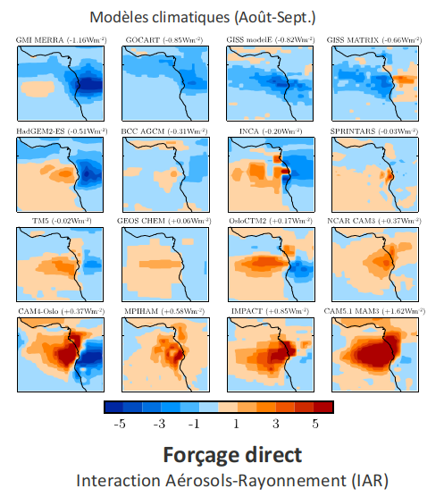
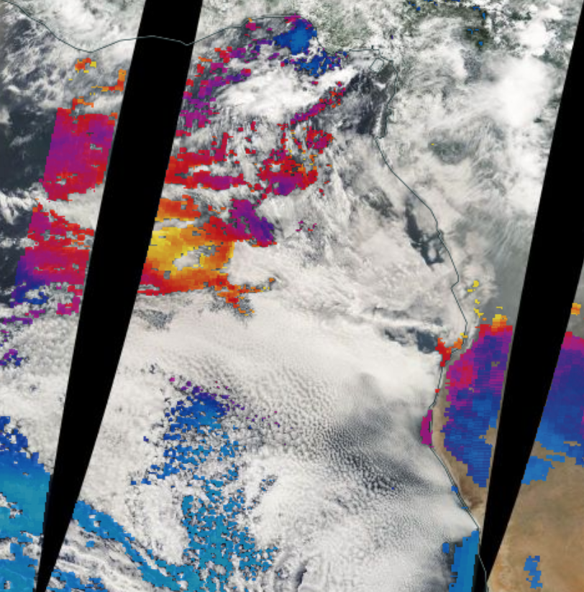
Uncertainty in the Direct Effect of aerosols in the SE Atlantic
CLIMATE MODELS
OBSERVATIONS
MODIS AOD
AEROCOM phase II GCMs
Operational retrievals of cloud and aerosol properties generally mutually exclusive
Reflectivity of clouds underestimated by satellite because of the aerosol absorption above clouds
New approaches for aerosol above
cloud observations limited to polar orbting satellites
Aircraft measurements
Satellite retrieval with aerosols
Standard satellite retrieval
Key params for DRE
Aerosol absorption
Cloud’s reflectivity
Diurnal evolution of cloud fraction
Aug/Sept All-sky DRE (W m⁻²)
Uncertainty on the sign of the aerosol forcing
Aerosol and cloud parameters poorly constrained in this region

Slide 4
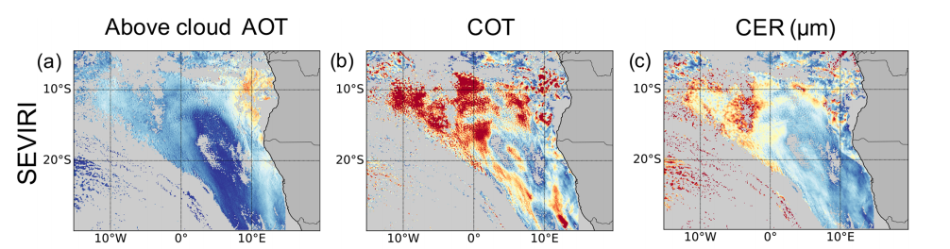
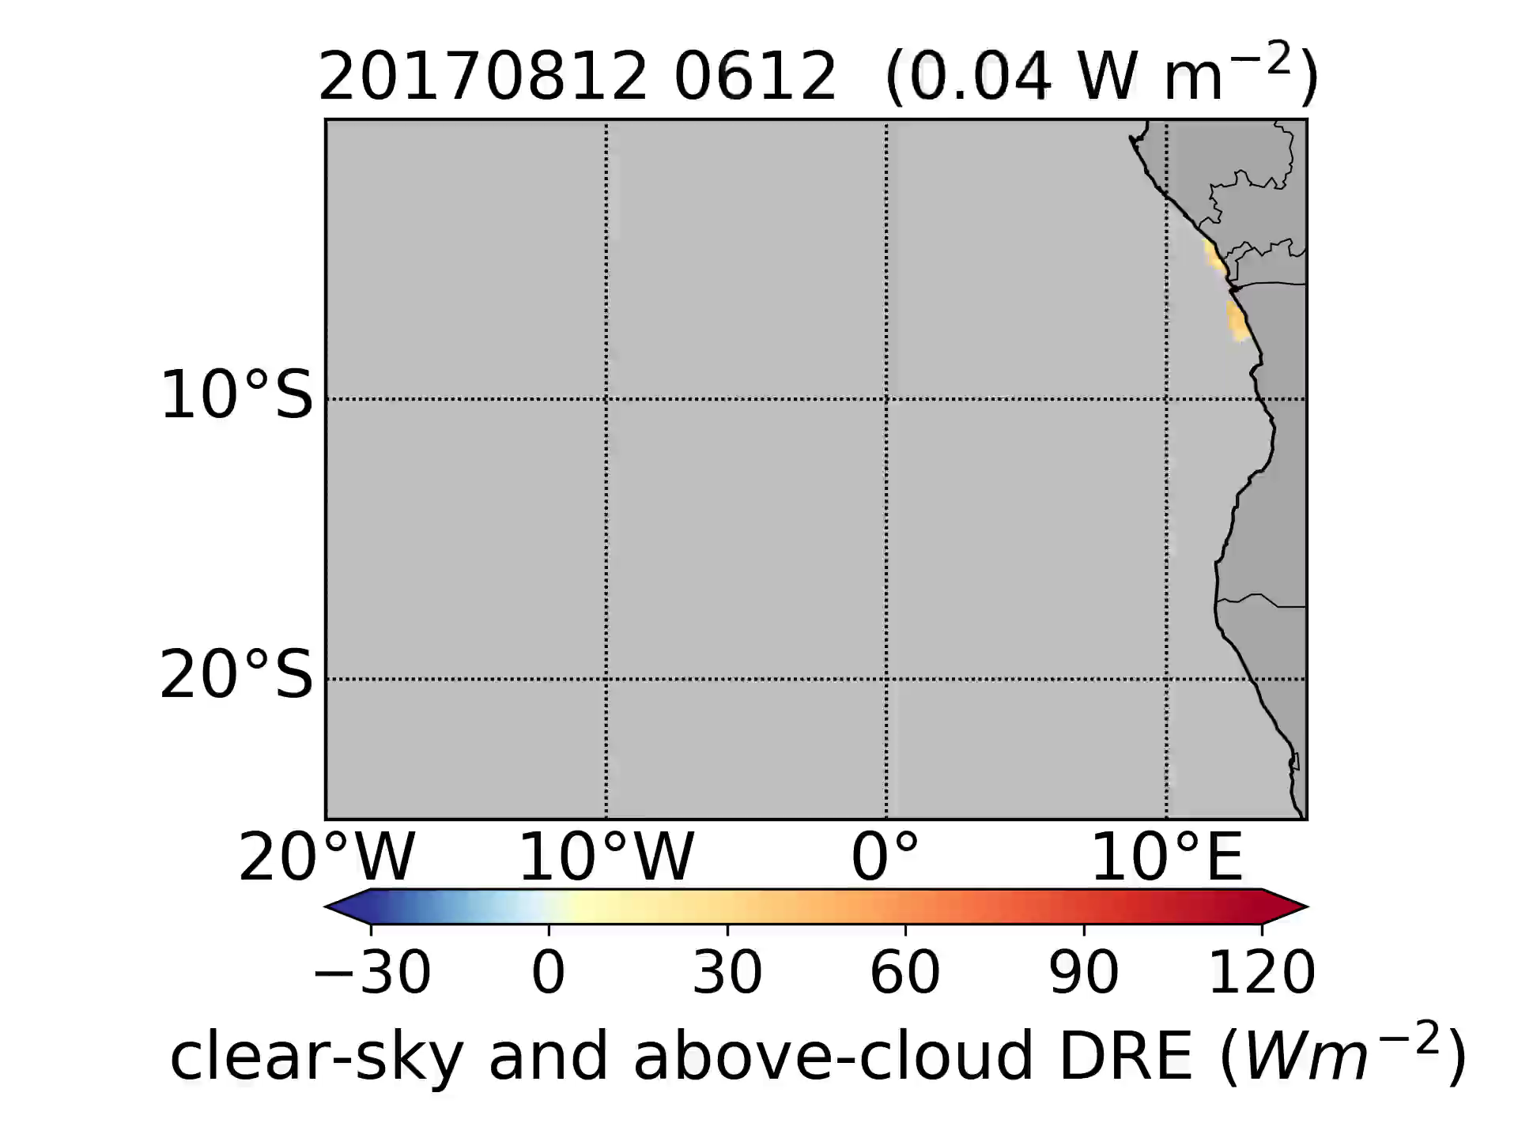
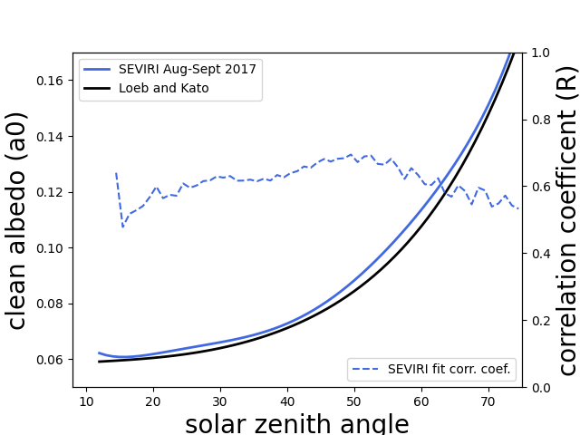
Observation of aerosols in clear-sky and above clouds at high temporal resolution
Aerosol microphysical properties based on aircraft measurements
Cloud properties corrected from the aerosol absorption
Results validated against in-situ measurements and compared with MODIS
Radiative
Transfer Code
Above-Clouds
Clear-Sky
All-sky DRE every 15 min
clear-sky AOT
MODIS Aqua and Terra
SEVIRI Flux (W m⁻²)
Loeb and Kato method (JoC, 2002)
Peers et al.
(ACP 2019, ACP 2021, in prep.)

Slide 5
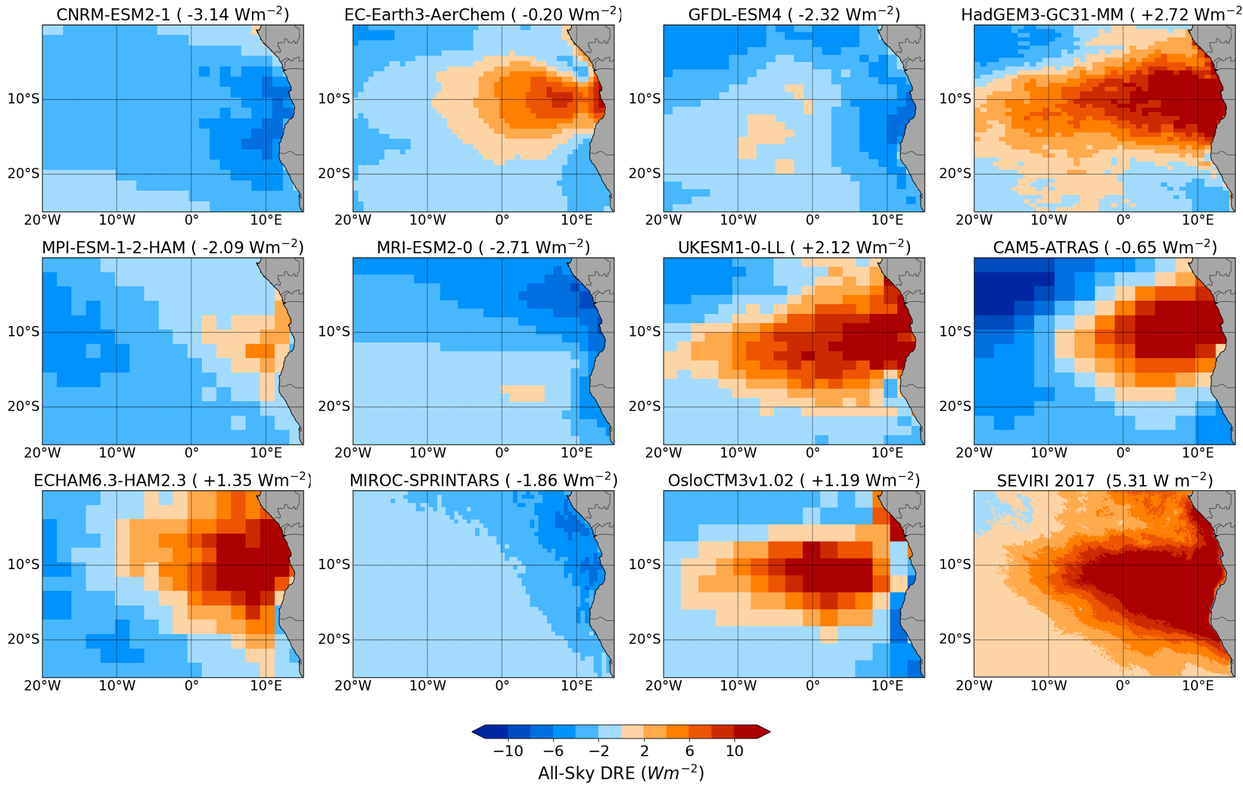
Direct Radiative Effect of aerosols : observations vs. GCM
CMIP-6
AEROCOM phase III
Aug-Sept 2017 All-Sky Direct Radiative Effect (W m⁻²)

Slide 6
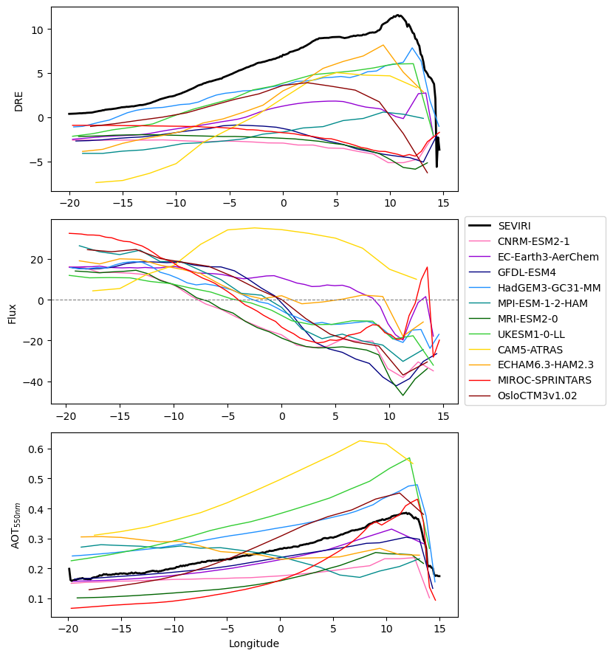
Direct Radiative Effect of aerosols : observations vs. GCM
CONCLUSIONS
Development of high temporal resolution satellite retrieval for aerosols in cloudy conditions based on (and validated against) state-of-the-art in-situ measurements
Combination of clear-sky and above-cloud observations at high temporal resolution can be directly compared with GCM outputs (ie. monthly mean, all-sky)
Observations show a large positive DRE in the South-East Atlantic
GCMs underestimate the DRE compared to observations
Models generally underestimate the cloud’s reflectivity close to the African coast
All-Sky DRE
ΔFlux (Model-SEVIRI)
AOT
Longitude

