Slide 1
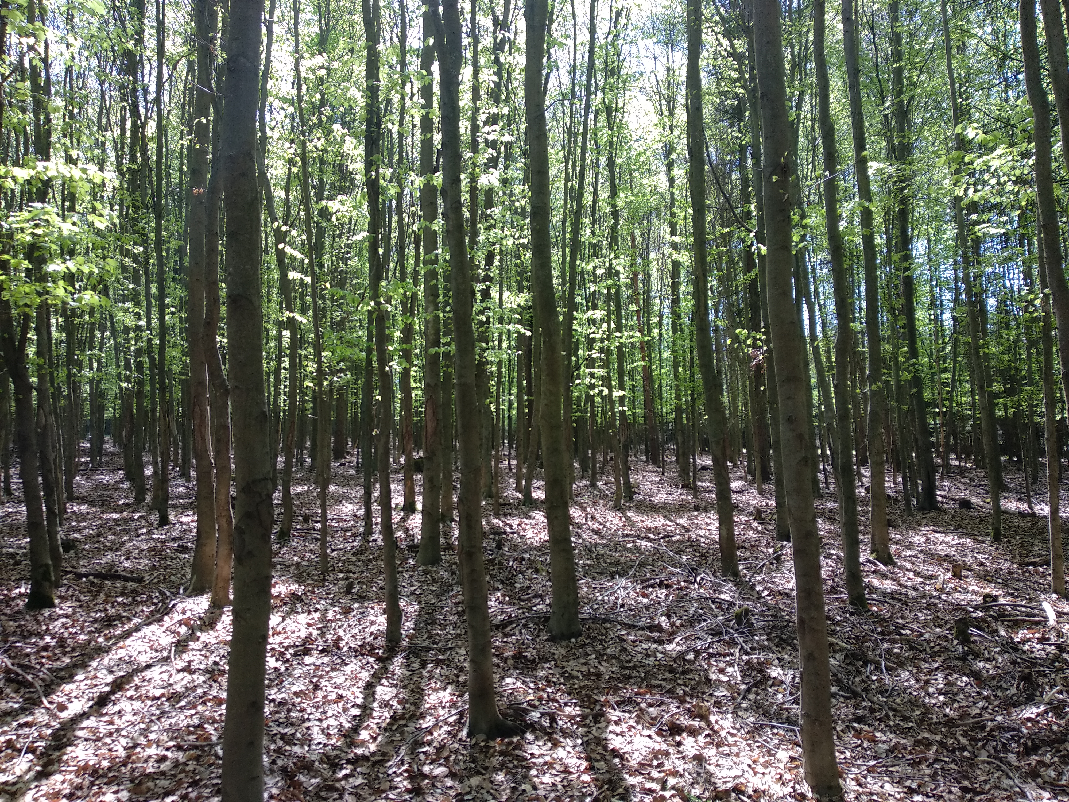


Effect of different tree species on soil moisture and temperature
Early-stage view of continuous forest soil regime monitoring.
Marta Kuželková et al.
2022

Slide 2
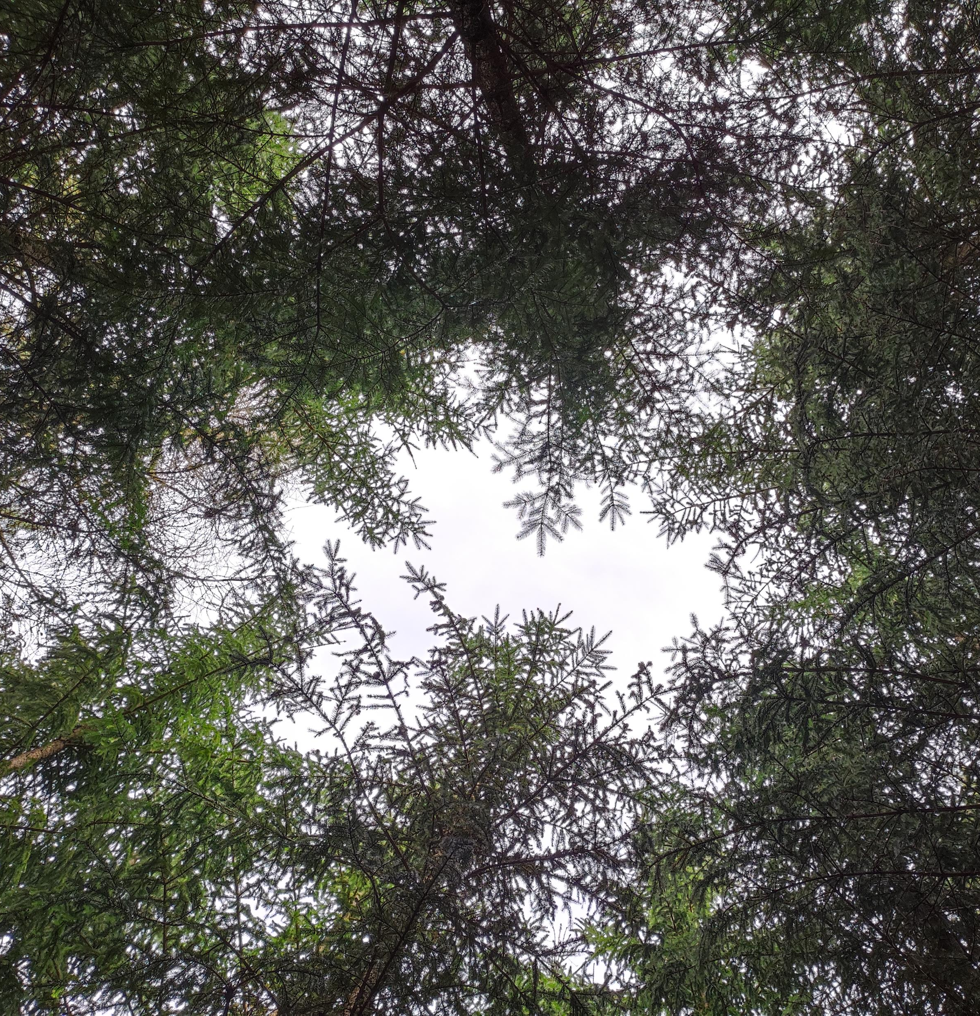
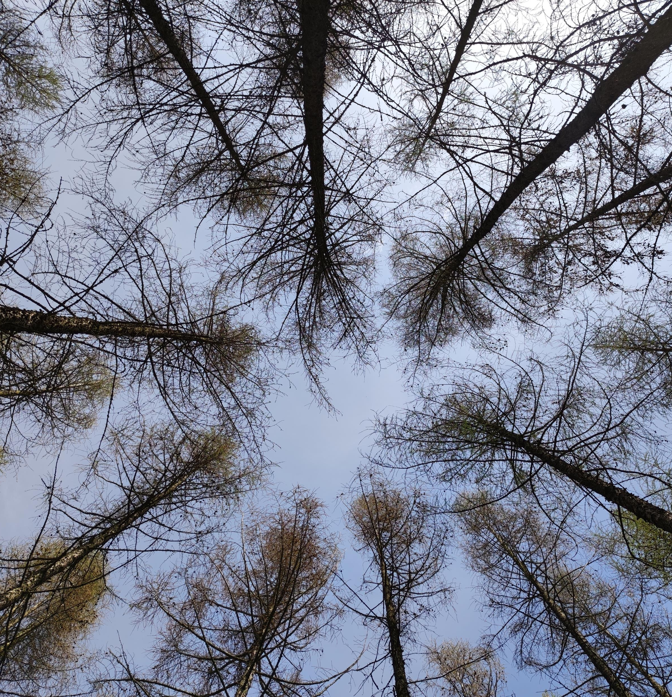
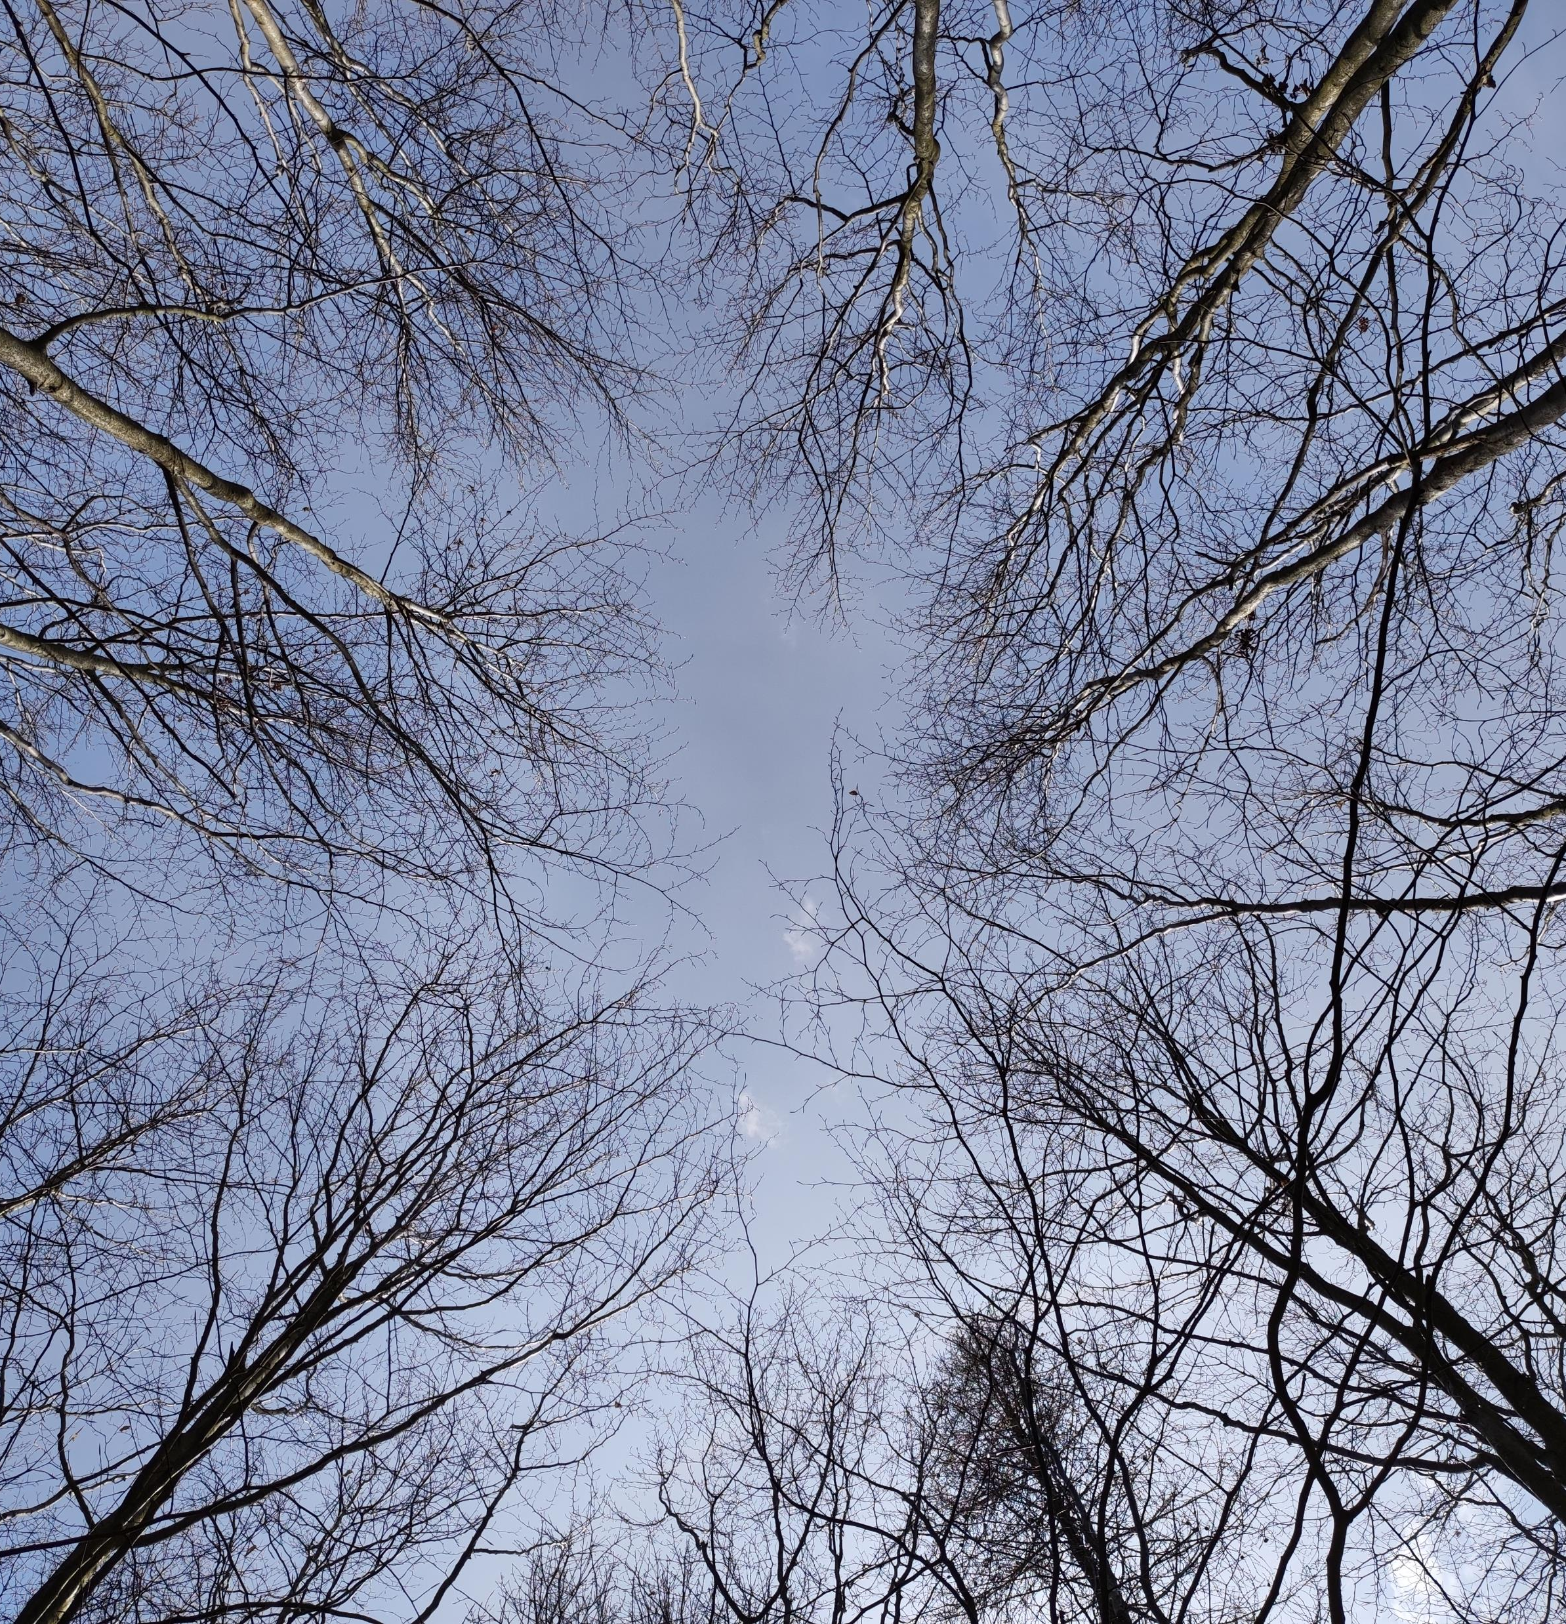
Spruce
Larch
Beech
2022-04-14

Slide 3
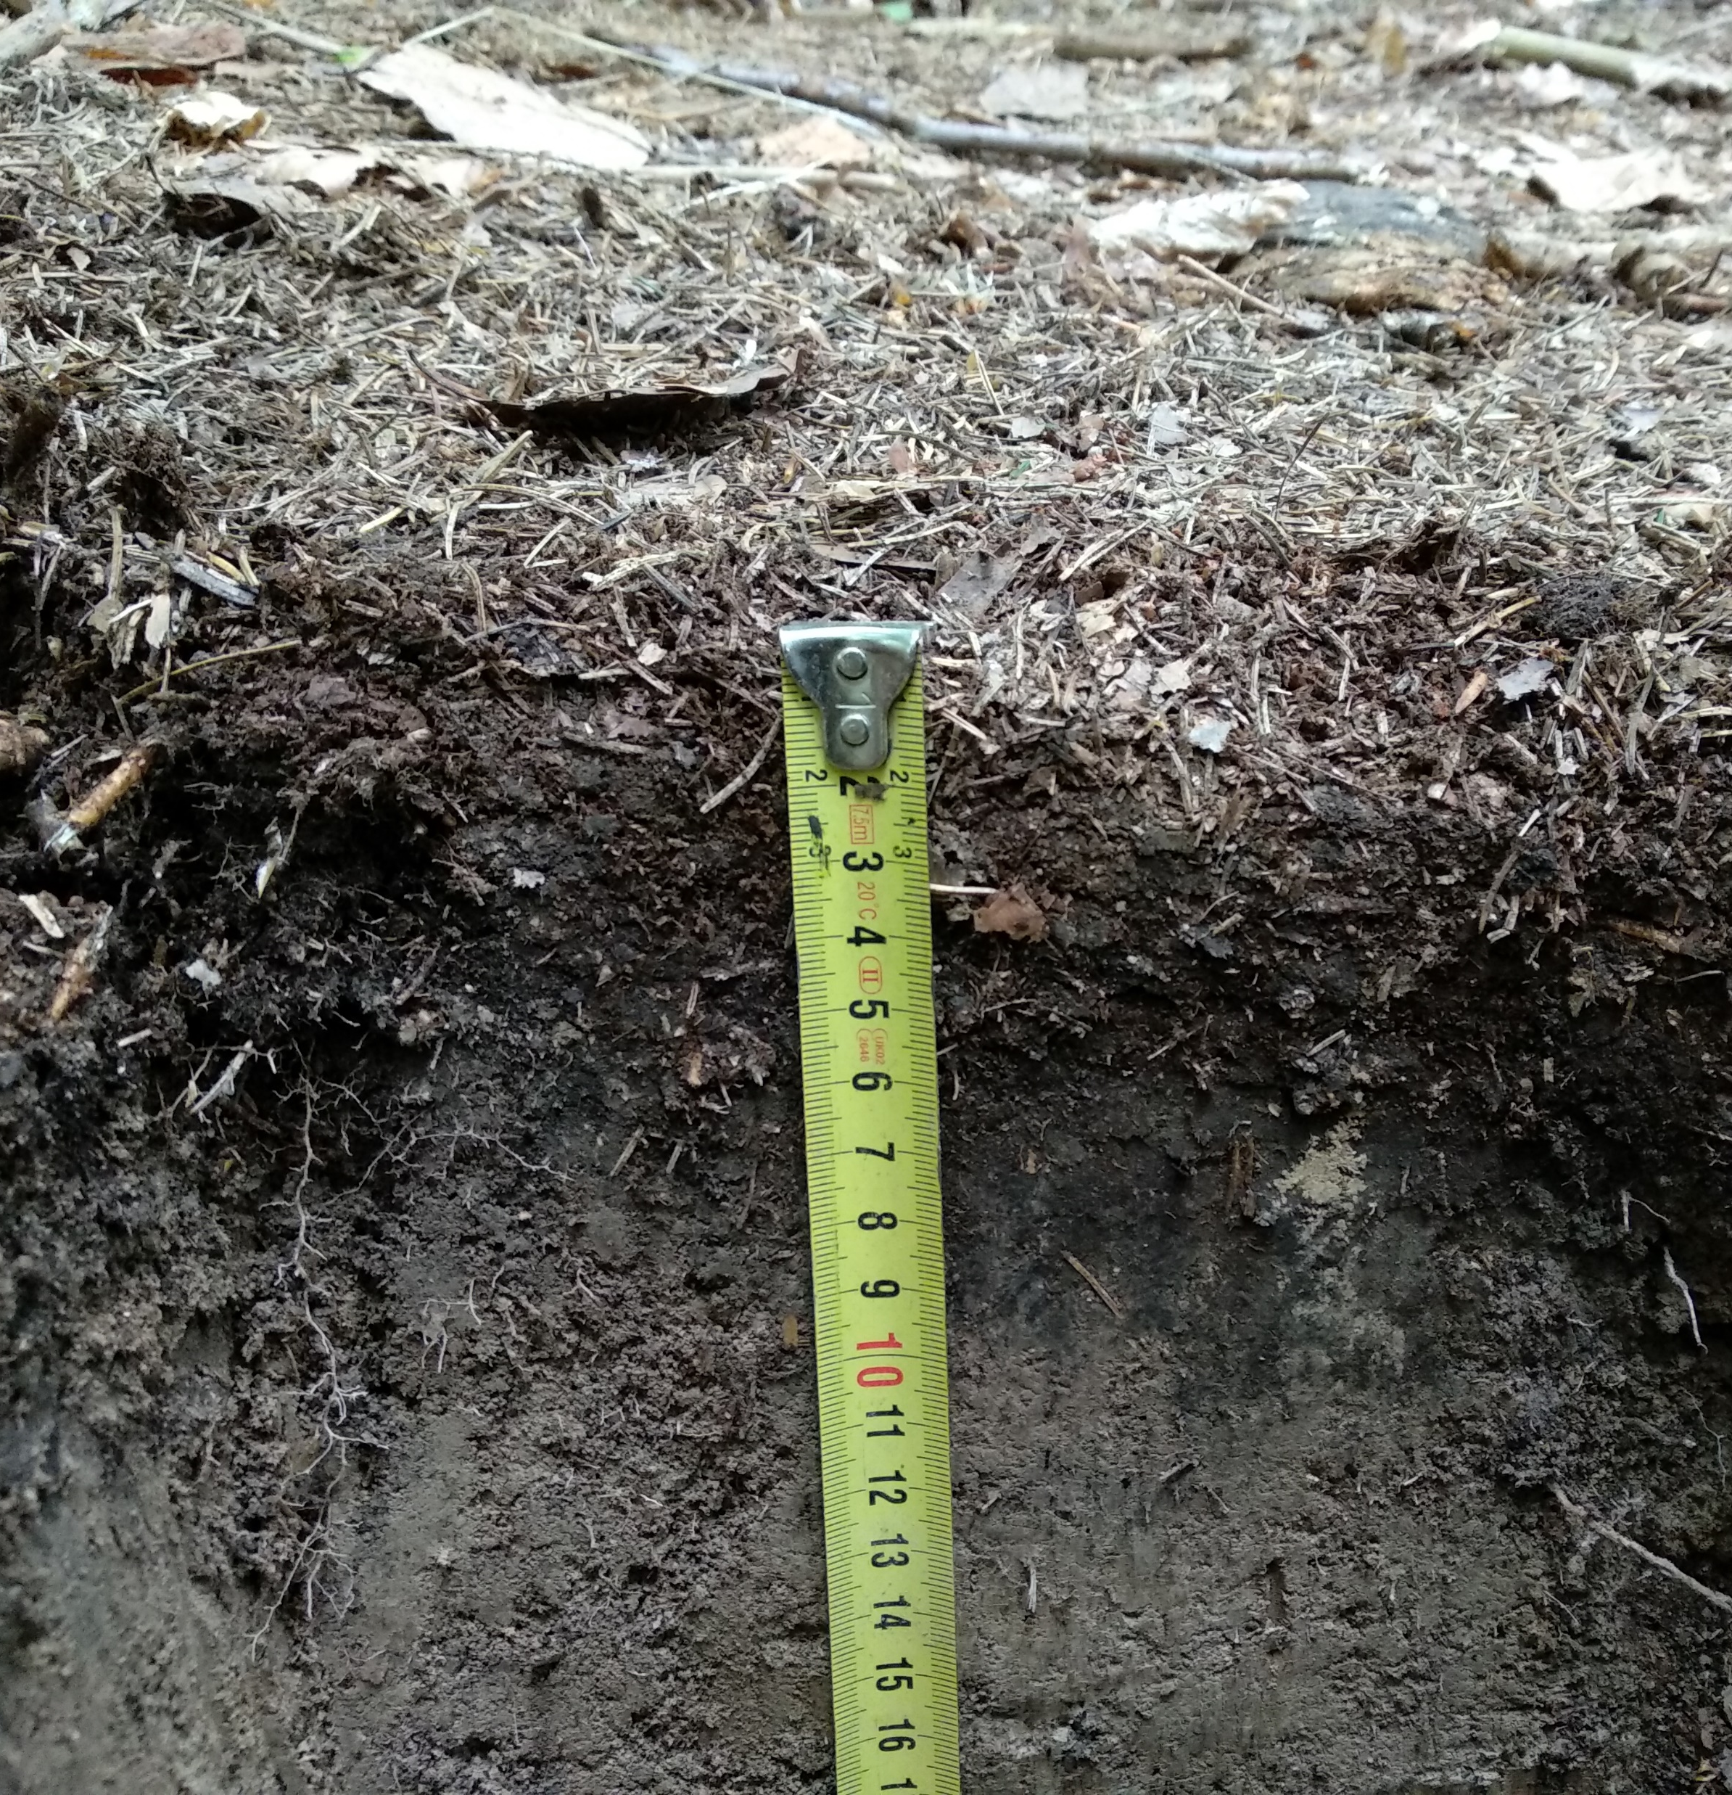
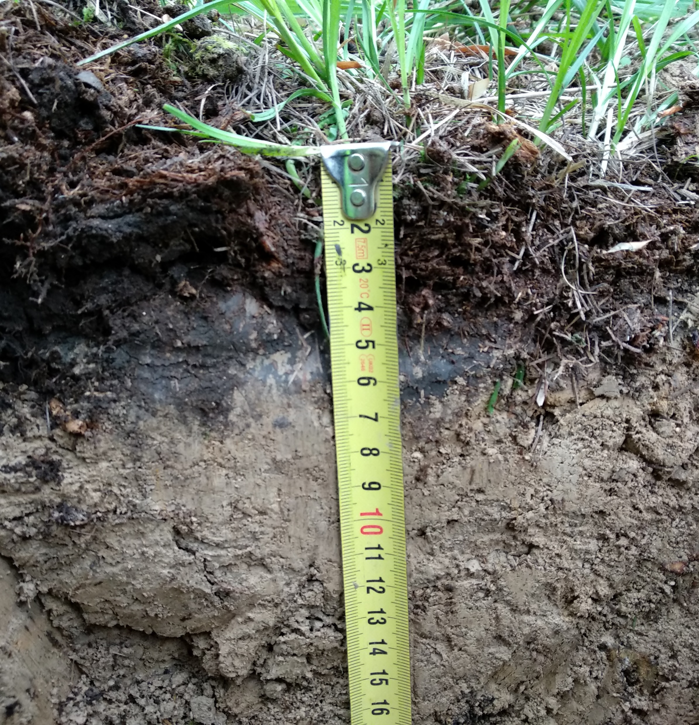
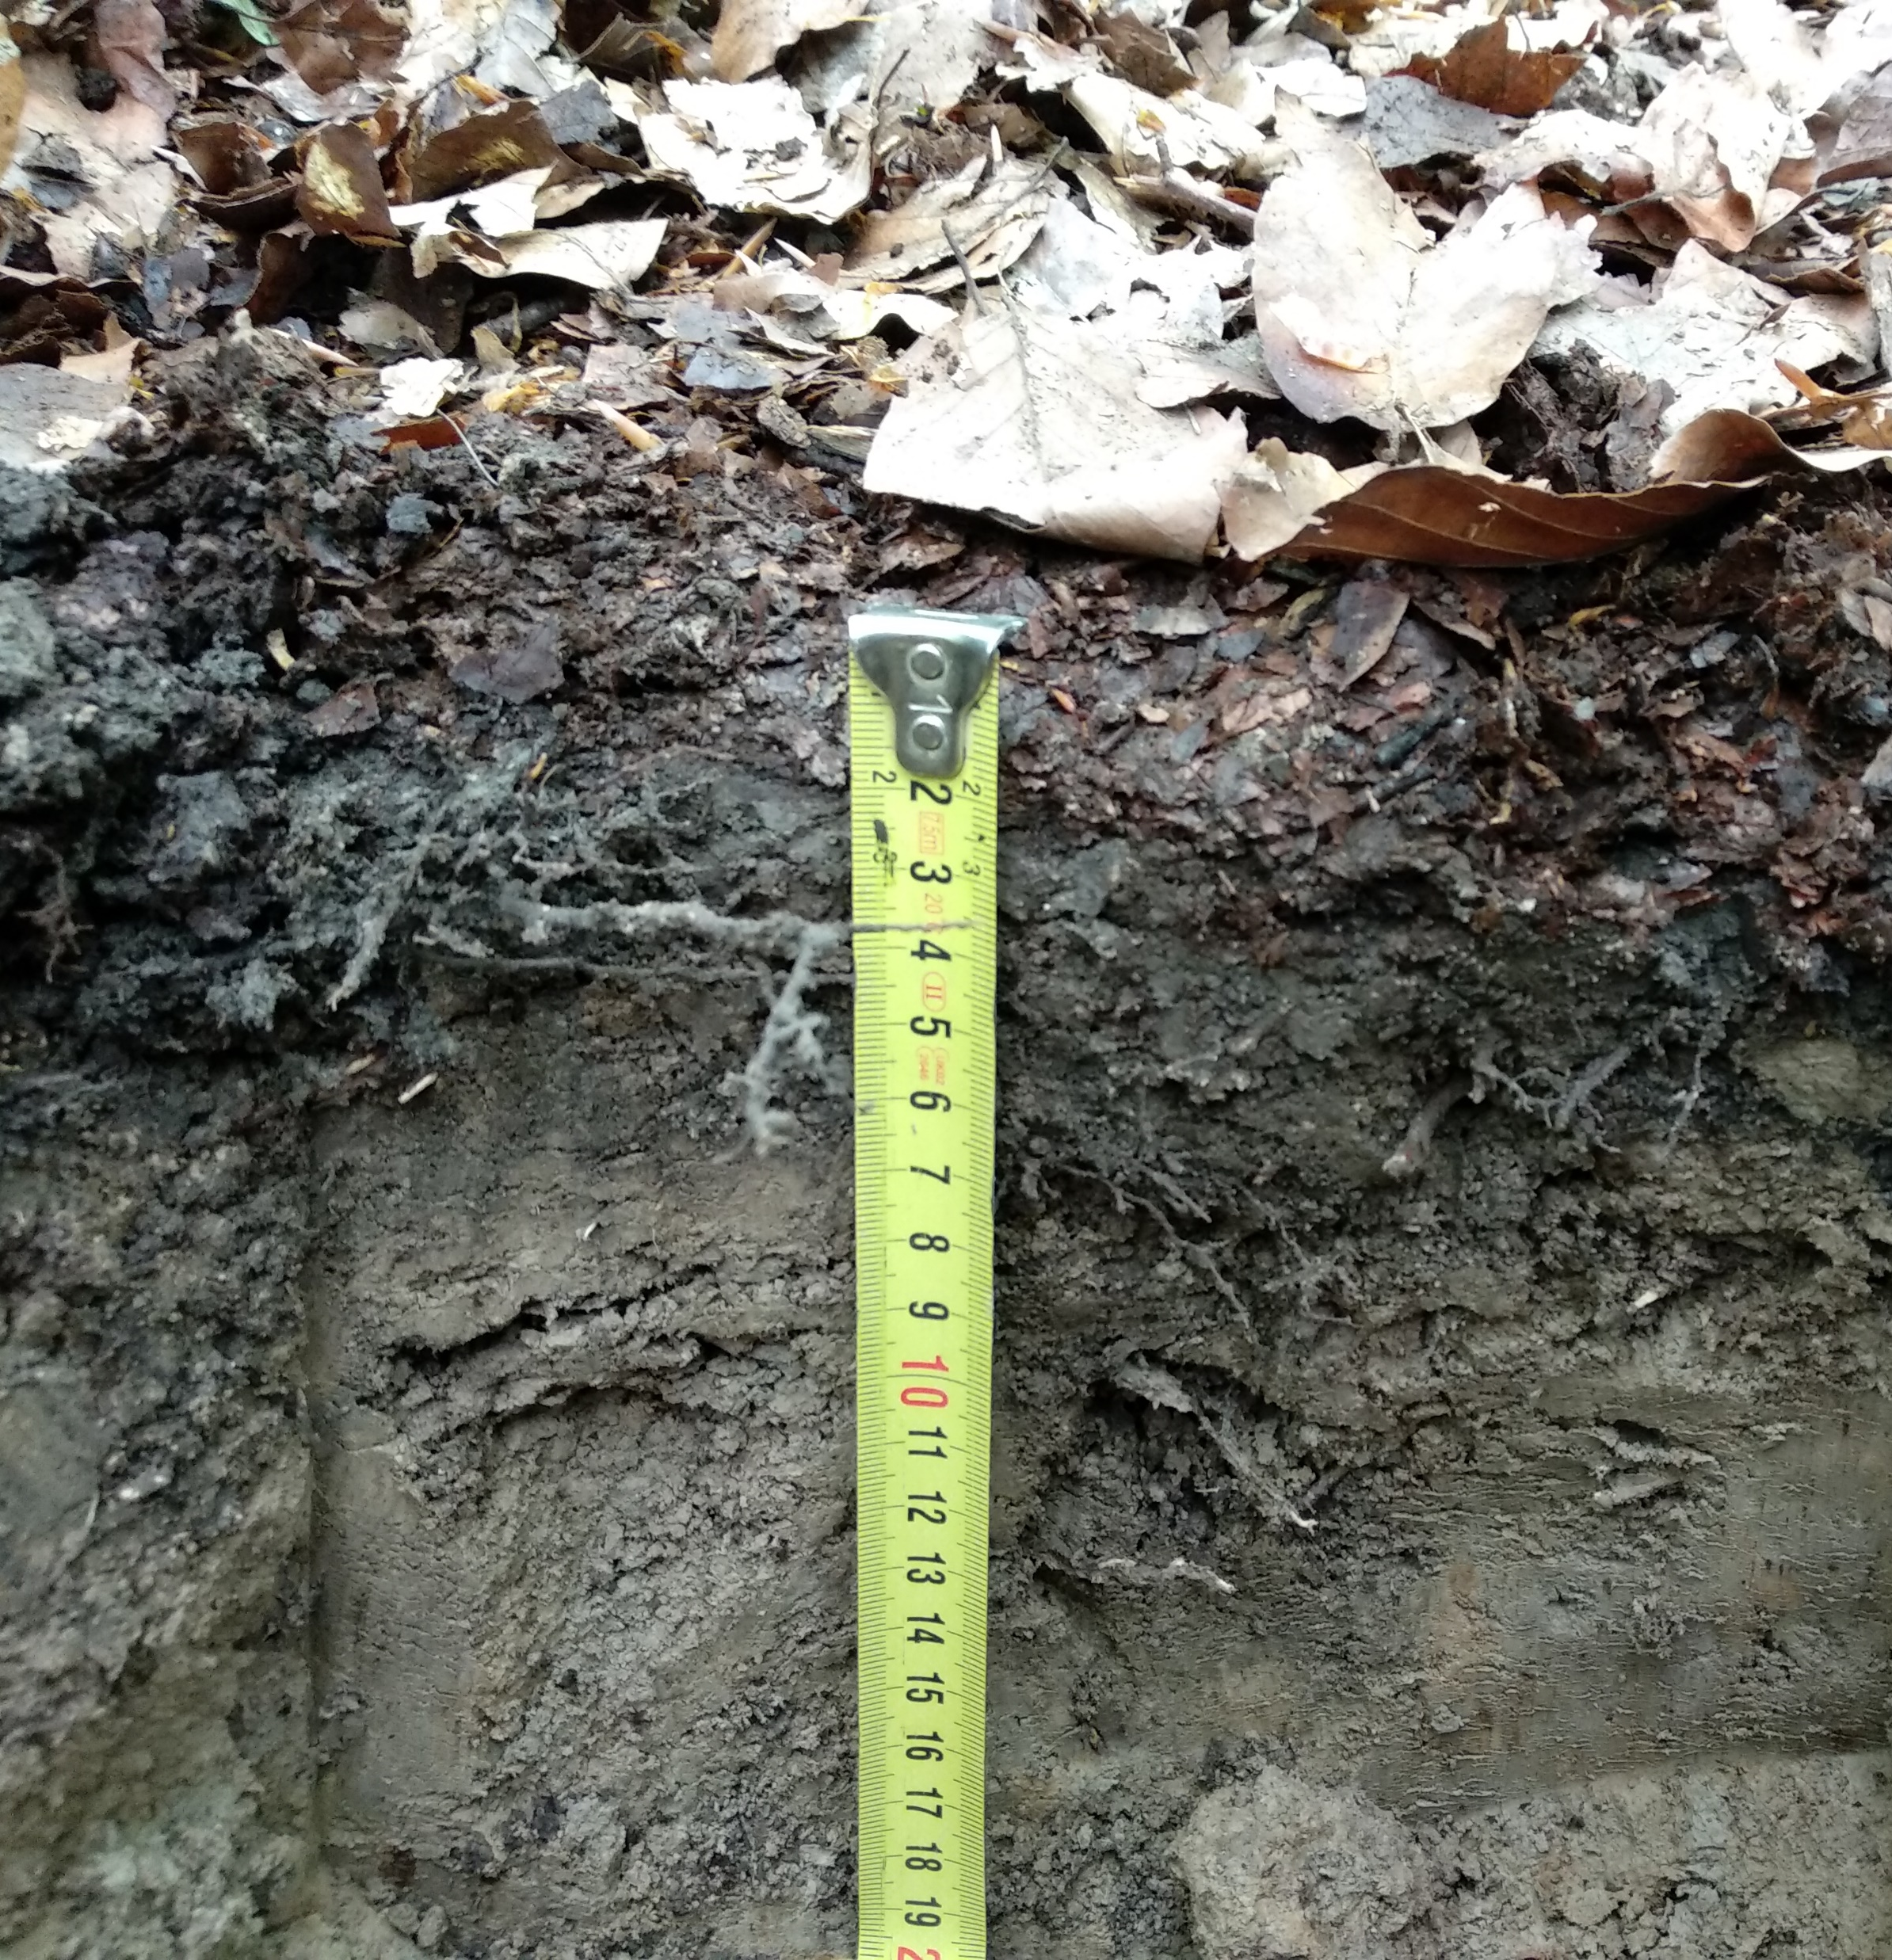
Spruce
Larch
Beech
2021-05-27

Slide 4
Research question:
Is there an influence of tree species on forest soil moisture and temperature?
Main aim:
To determine, if there are significant alternations in soil moisture and temperature regime caused by tree specific conditions.
What are the differences?

Slide 5
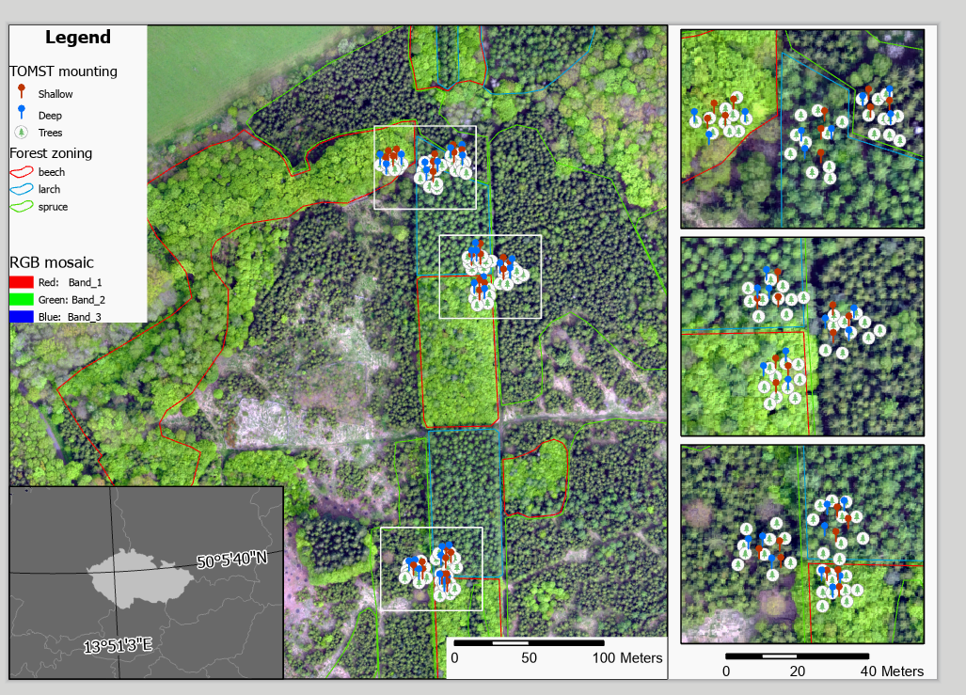
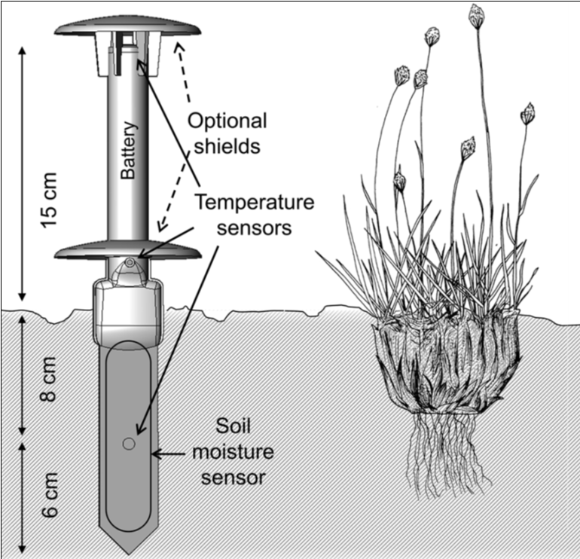
Wild et al., 2019
Map made by: Jan Komárek, 2022

Slide 6
Soil water content
Time

Slide 7
Surface temperature
Time

Slide 8
Take home message
Spruce, beech, and larch have significantly different effects on soil moisture and temperature regime.
Possible applications
Hydrological modeling
Forest management
Precise modeling of soil water according to tree species
Mitigation the negative effects of droughts by tree species replacement

Slide 9




Feel free to ask any questions.
Abstract
Photo gallery
This research is supported by IGA Faculty of Environmental Sciences CZU Prague n. 2021B0027, Czech University of Life sciences.
.

