Slide 1



Impact of local climate change on groundwater resources and surface water availability in headwater catchments
Muhammad Usman Munir & Sven Frei
Department of Hydrology
University of Bayreuth, Germany
Department of Hydrology

Slide 2
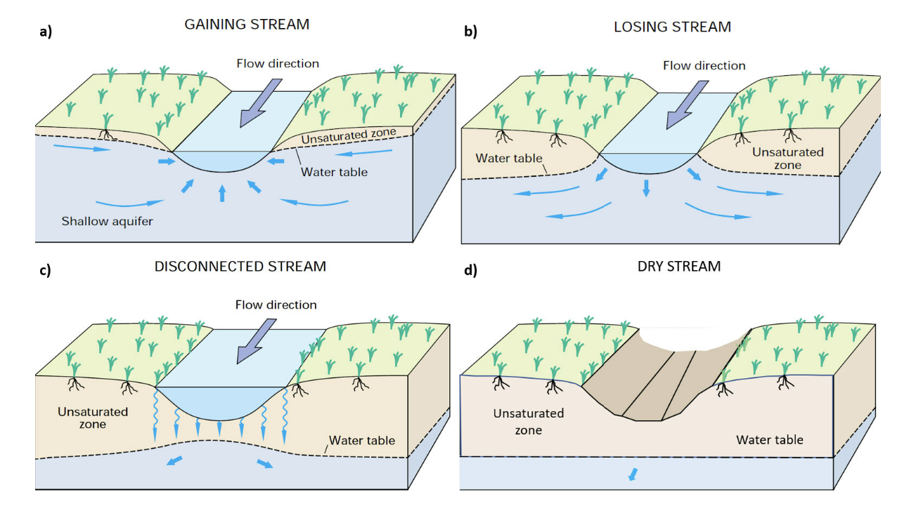
Surface Water and Groundwater Interaction
(a) connected gaining stream (b) losing- connected stream (c) disconnected stream (d) Dry stream bed
Winter et al. 1998
Notes:
The flow direction may reverse when the stage recedes. In addition, after floods the clogging layer is temporarily removed to facilitate connection between a river and groundwater system (Winter et al; 1998)

Slide 3
Overview
Surface/Groundwater interactions are important for water availability in rivers and streams and for ecosystems functioning
Factors that are influencing surface groundwater interactions
Groundwater contributions into rivers and streams are threatened by consequences of climate change
Headwater catchments are even more affected by consequences of climate change

Slide 4
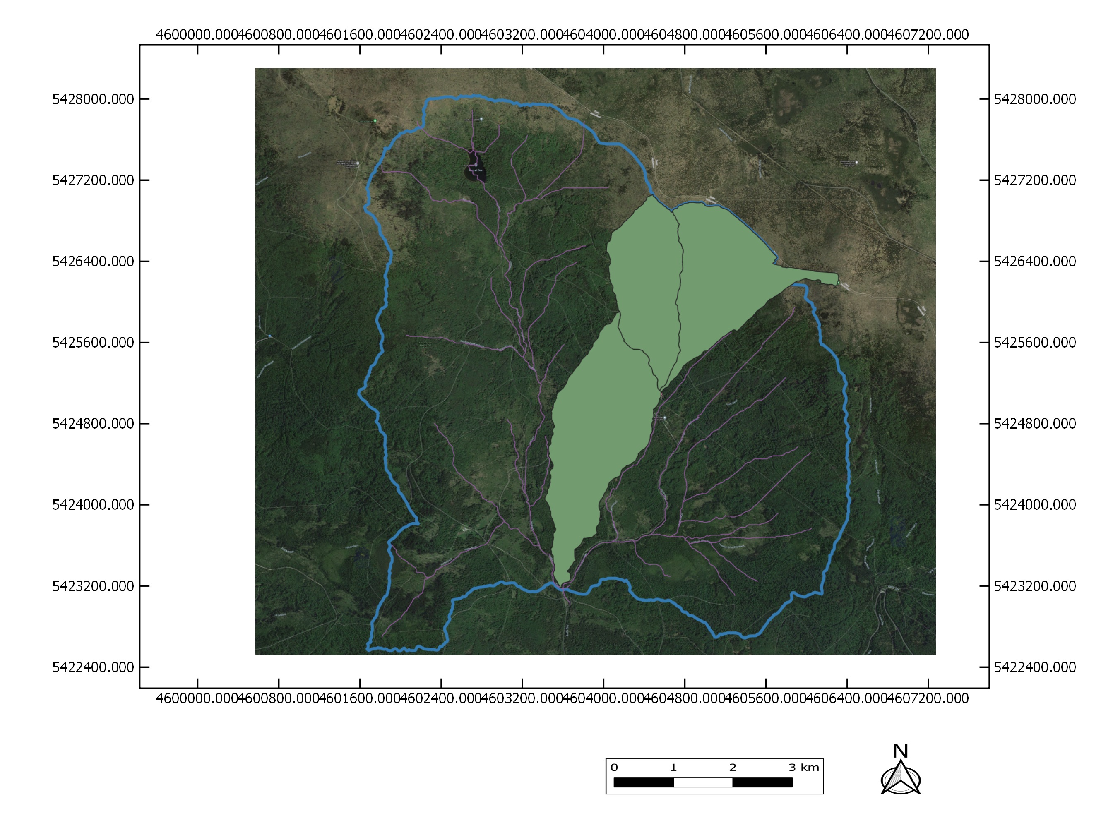
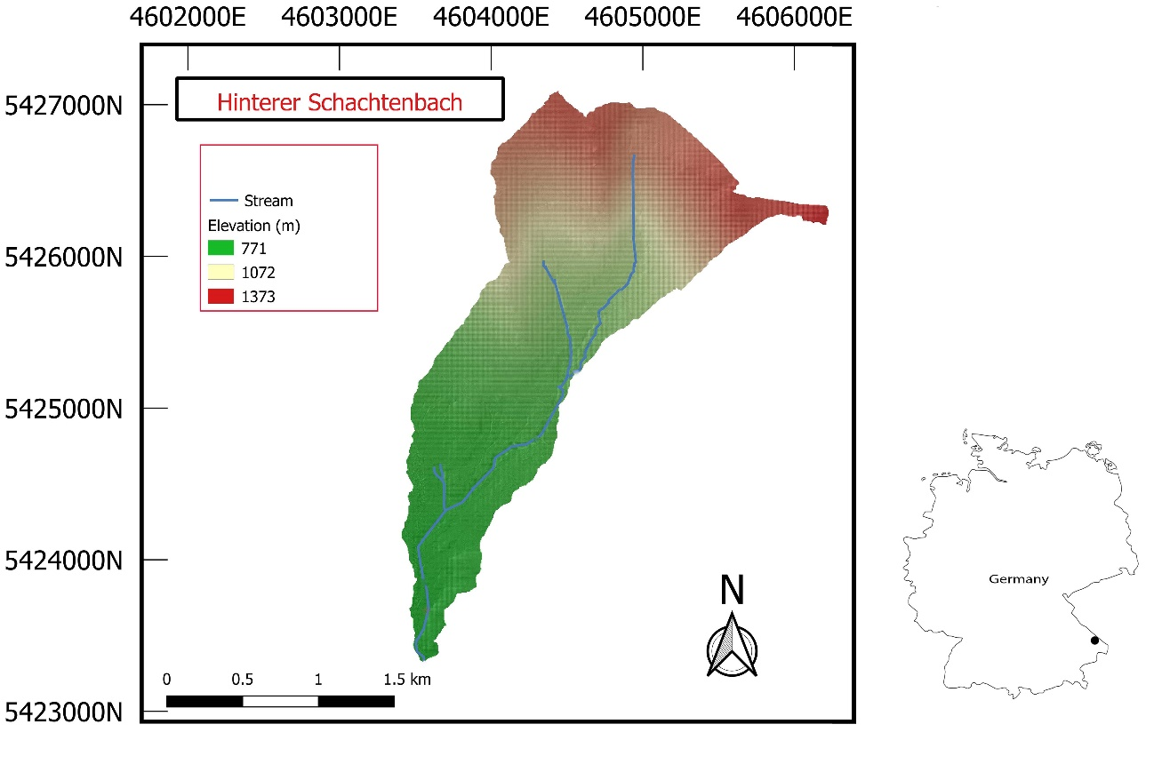
Study Area
Notes:
As the headwater catchment are more prone to the impact of climate change. So we choose a headwater catchment in Bavaria, Germany named Grosse Ohe catchment. This catchment having area 19.1 km2. Further there is a subcathment, hinterschatenbach which is located inside the main catchment.

Slide 5
Climate Model and Hydrological Modelling
HydroGeoSphere ( an integrated, process based, fully distributed model)
Calibration and Validation
Regional climate Model data
Euro-CORDEX and Re-Klies projects
RCPs (2.6, 4.5, and 8.5)

Slide 6
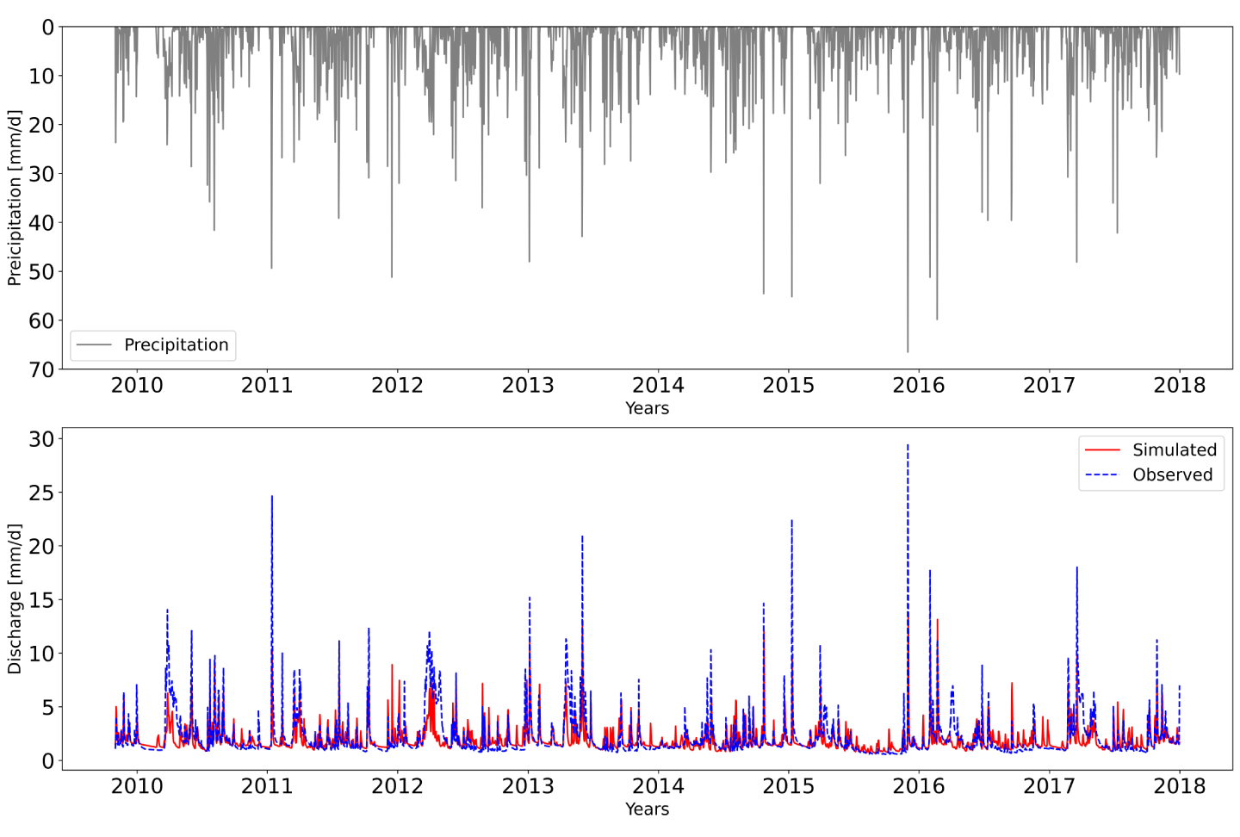
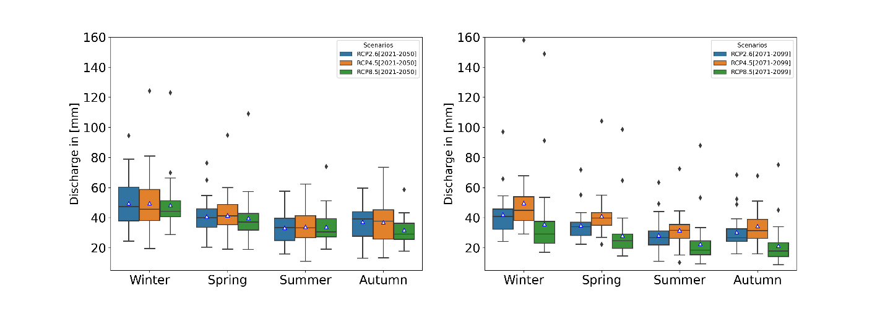
Results

Slide 7
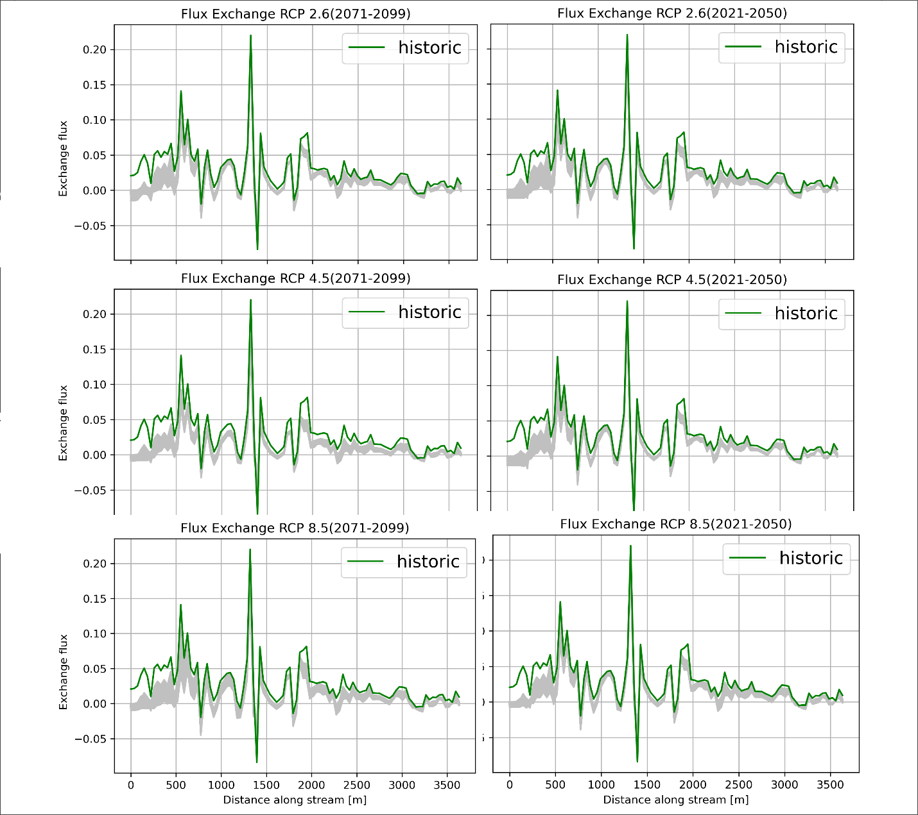
Exchange flux in streams
Up stream area is more affected
Both near future and far future are showing decline in flux exchange

Slide 8
Conclusions
Water availability is decreasing in summer with increasing evapotranspiration as showed by all scenarios. RCP 8.5 showed the maximum reduction.
Decreasing the contribution of groundwater to streams because of depleting groundwater level
Streams are drying in summer due to impact of climate change. This phenomena is more adverse in upstream area of this headwater catchment
Surface flow changes in summer becoming threat to the aquatic habitat.

Slide 9
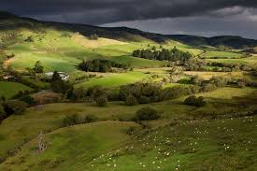
Thank You for your Attention

