Slide 1
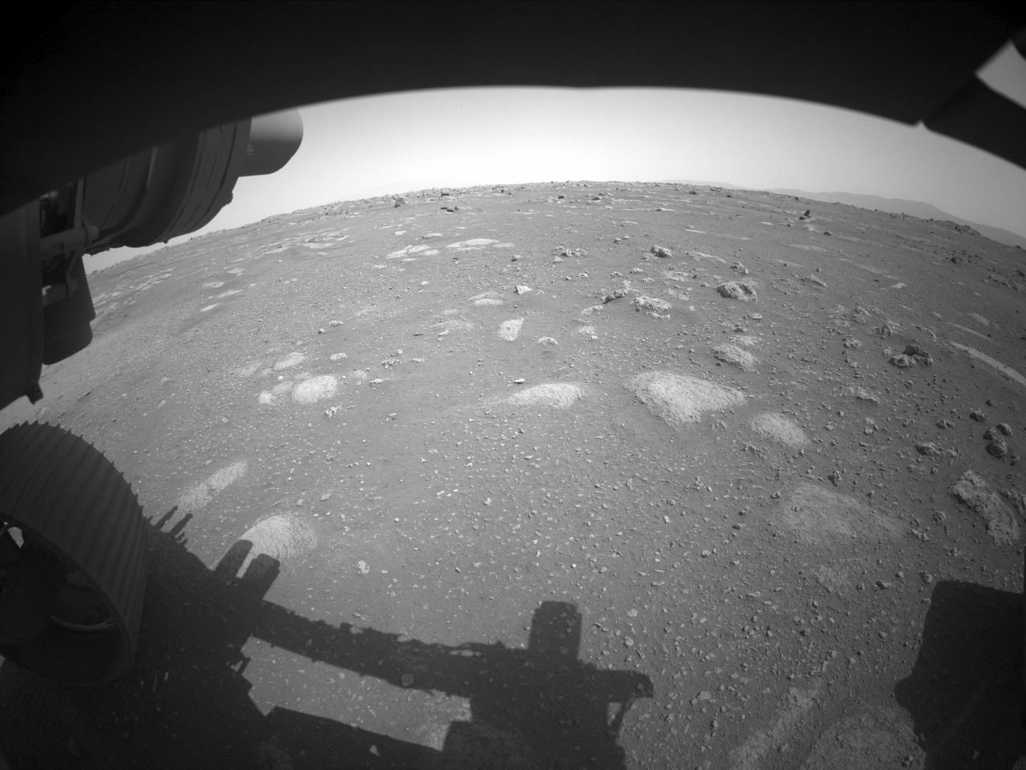


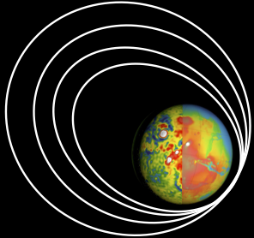

Estimation of the NASA Mars 2020 Perseverance rover’s path through Visual Odometry
Simone Andolfo¹, Flavio Petricca¹, Antonio Genova¹
¹ Department of Mechanical and Aerospace Engineering, Sapienza, University of Rome
SPRING

Slide 2
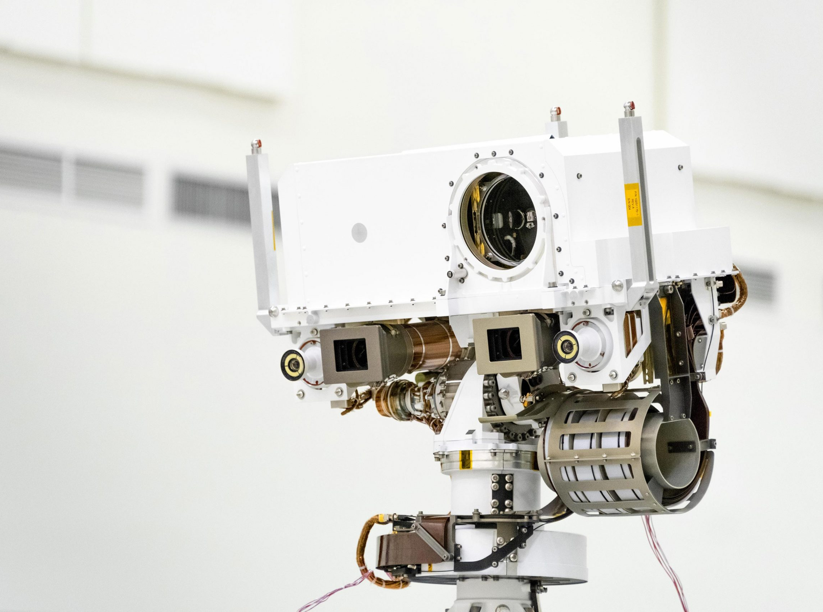
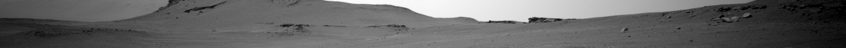
Outline
At the Space Robotic Investigation Group (SPRING), we are developing a GNC software to enable safe robotic operations on unprepared terrains.
To test and validate the localization system, we processed stereo images acquired by the NavCams of the NASA Mars 2020 Perseverance rover by using a 3D-to-3D Visual Odometry (VO) approach.
We present here the reconstructed Perseverance’s path on sols 65, 66 and 72.
Mars 2020 NavCams. The NavCams acquire 5120×3840 pixels images in full-scale mode. (Credit: NASA/JPL-Caltech)
Estimation of the NASA Mars 2020 Perseverance rover’s path through Visual Odometry

Slide 3
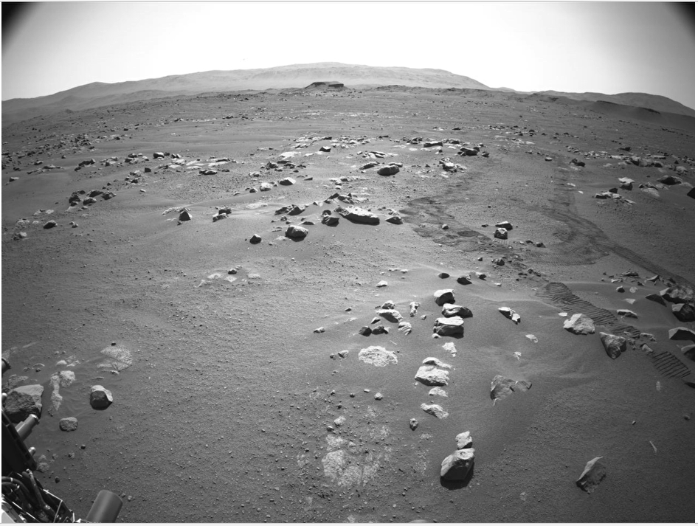
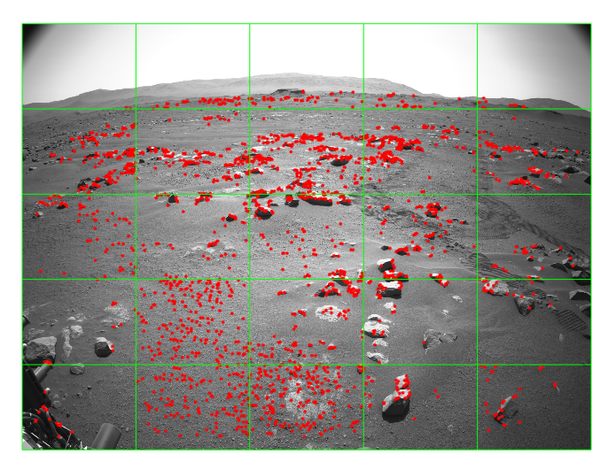
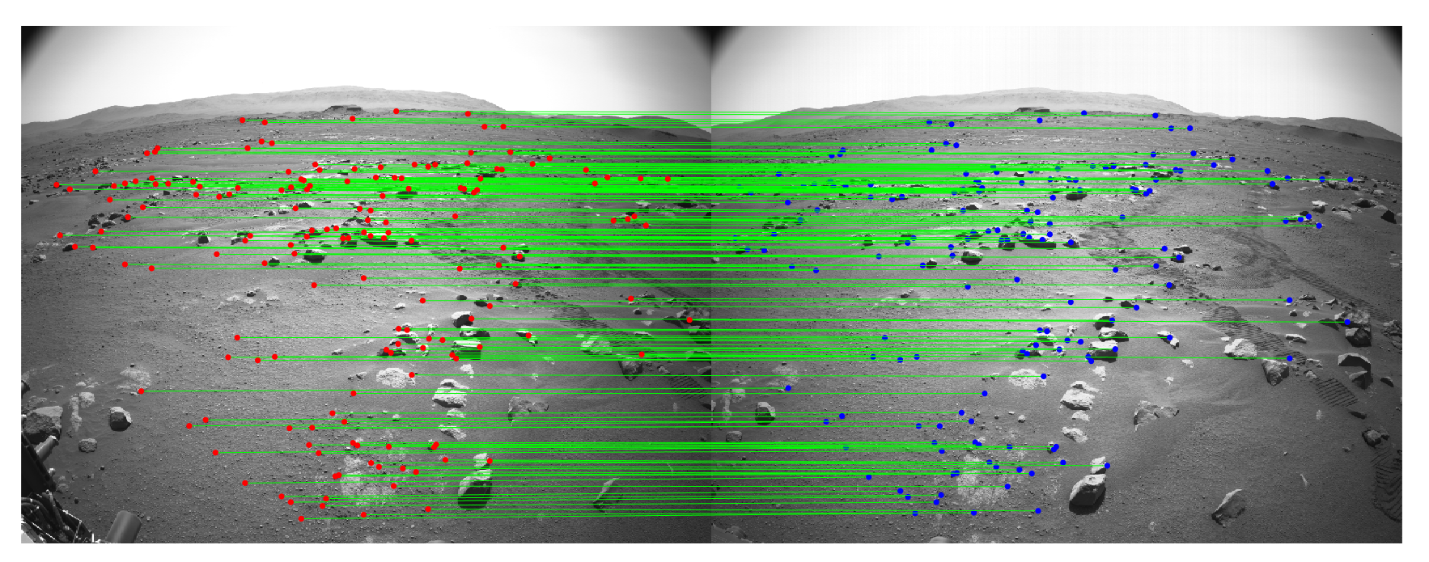
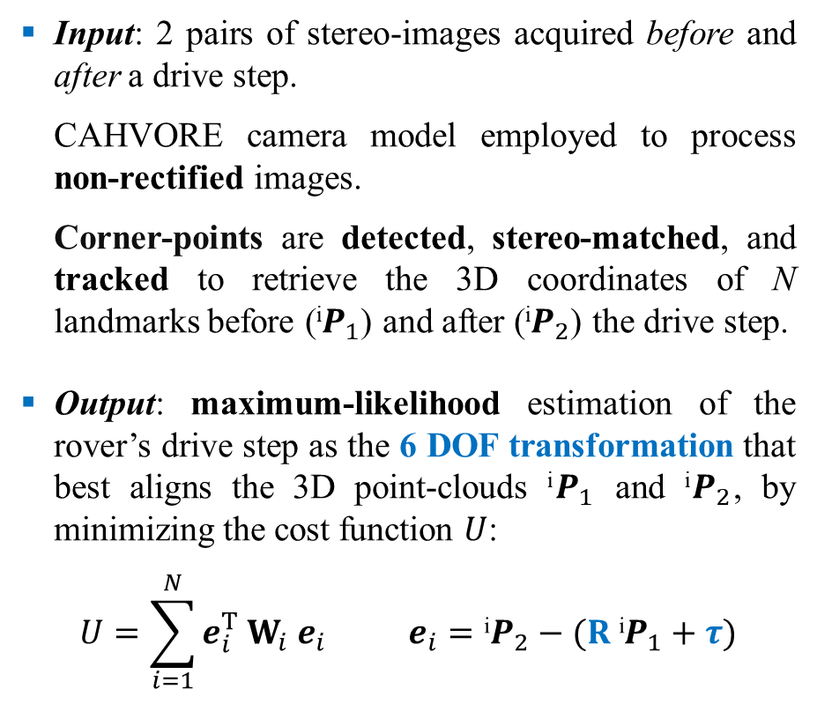
Methods
Input: 2 pairs of stereo-images acquired before and after a drive step.
CAHVORE camera model employed to process non-rectified images.
Corner-points are detected, stereo-matched, and tracked to retrieve the 3D coordinates of N landmarks before (^{i}$P_{1}$) and after (^{i}$P_{2}$) the drive step.
Output: maximum-likelihood estimation of the rover’s drive step as the 6 DOF transformation that best aligns the 3D point-clouds ^{i}$P_{1}$ and ^{i}$P_{2}$, by minimizing the cost function $U$:
$$U=\sum_{i=1}^{N}{e_{i}^{T} W_{i} e_{i}} e_{i}=\text{i}P_{2}−(R \text{i}P_{1}+τ)$$
Left NavCam images on sol 65.
Corner-points detection.
Stereo-matching of corner-points.
Estimation of the NASA Mars 2020 Perseverance rover’s path through Visual Odometry

Slide 4
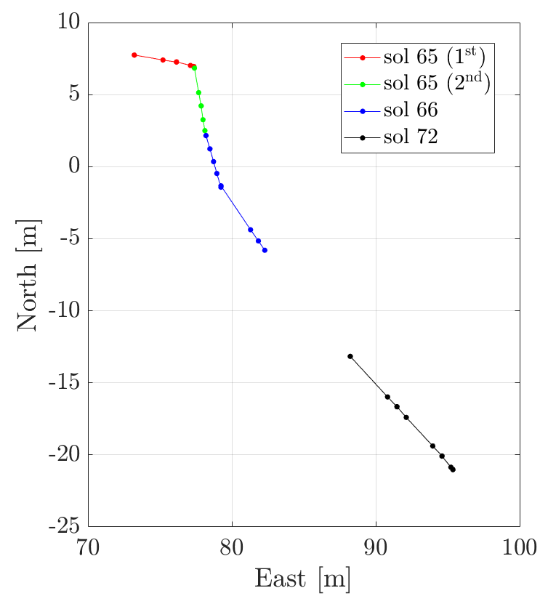
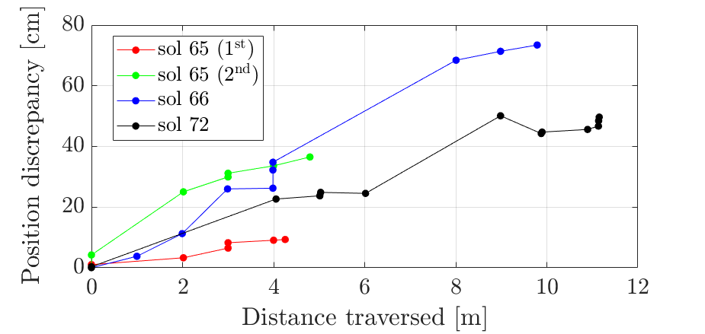
Results
>25 stereo pairs processed to reconstruct Perseverance’s trajectory across the Van Zyl overlook region (sols 65-72).
Pose differences computed between our VO-estimated path, and the telemetry-based path (from image metadata).
Estimated attitude in full agreement with the onboard IMU data (<0.1° difference).
Accumulation of position discrepancies.
Reconstructed Perseverance’s path by using our VO software. Coordinates are expressed in the local North-East-Nadir frame.
Estimation of the NASA Mars 2020 Perseverance rover’s path through Visual Odometry

Slide 5
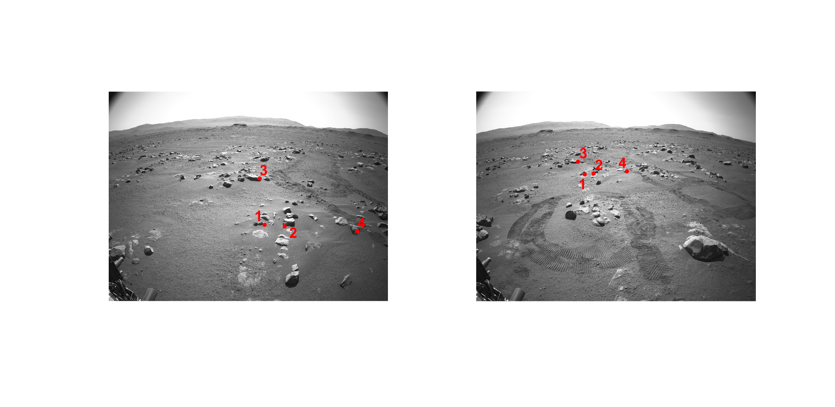
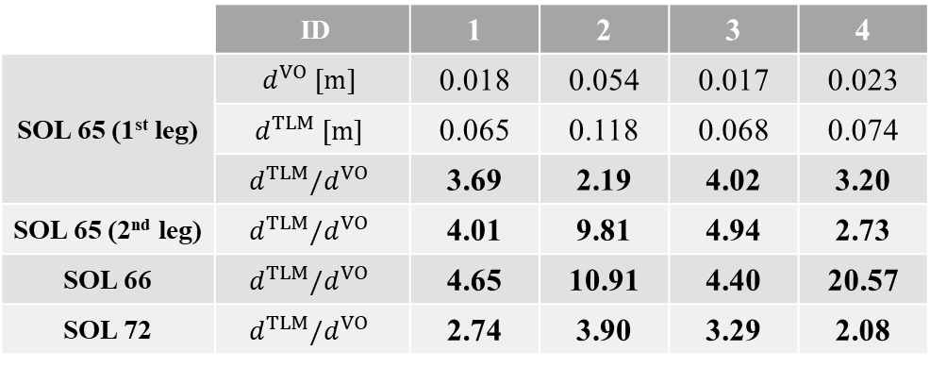
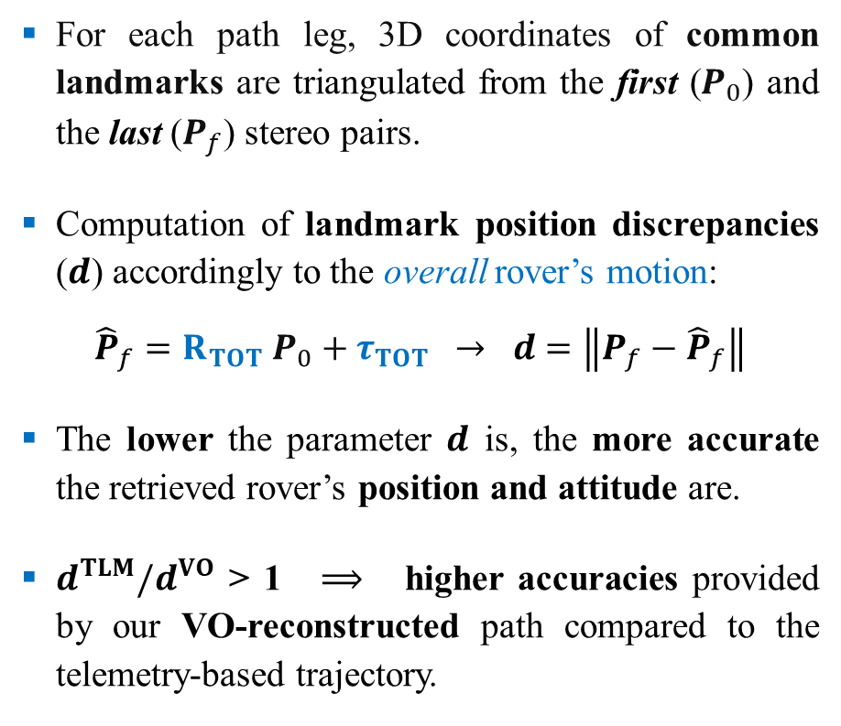
Accuracies of the VO-reconstructed path
For each path leg, 3D coordinates of common landmarks are triangulated from the first ($P_{0}$) and the last ($P_{f}$) stereo pairs.
Computation of landmark position discrepancies ($d$) accordingly to the overall rover’s motion:
$${\hat{P}}_{f}=R_{TOT} P_{0}+τ_{TOT} → d=\left\|P_{f}−{\hat{P}}_{f}\right\|$$
The lower the parameter $d$ is, the more accurate the retrieved rover’s position and attitude are.
$d^{TLM}/d^{VO}$ > 1 $⟹$ higher accuracies provided by our VO-reconstructed path compared to the telemetry-based trajectory.
a
b
First (a) and last (b) left images acquired along the 1st traverse on sol 65.
 | ID | 1 | 2 | 3 | 4
SOL 65 (1st leg) | $$d^{VO} [m]$$ | 0.018 | 0.054 | 0.017 | 0.023
 | $$d^{TLM} [m]$$ | 0.065 | 0.118 | 0.068 | 0.074
 | $$d^{TLM}/d^{VO}$$ | 3.69 | 2.19 | 4.02 | 3.20
SOL 65 (2nd leg) | $$d^{TLM}/d^{VO}$$ | 4.01 | 9.81 | 4.94 | 2.73
SOL 66 | $$d^{TLM}/d^{VO}$$ | 4.65 | 10.91 | 4.40 | 20.57
SOL 72 | $$d^{TLM}/d^{VO}$$ | 2.74 | 3.90 | 3.29 | 2.08
Estimation of the NASA Mars 2020 Perseverance rover’s path through Visual Odometry

Slide 6
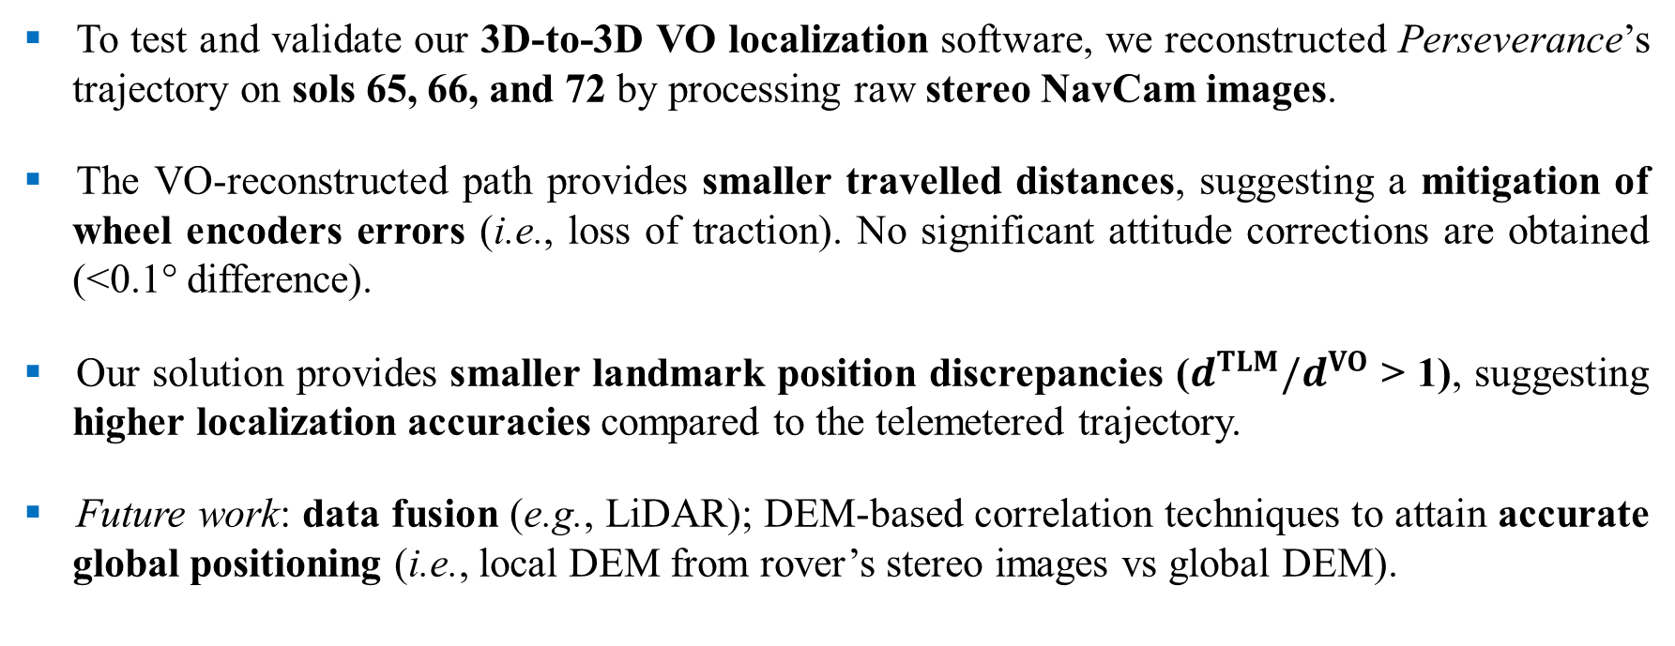
Summary
To test and validate our 3D-to-3D VO localization software, we reconstructed Perseverance’s trajectory on sols 65, 66, and 72 by processing raw stereo NavCam images.
The VO-reconstructed path provides smaller travelled distances, suggesting a mitigation of wheel encoders errors (i.e., loss of traction). No significant attitude corrections are obtained (<0.1° difference).
Our solution provides smaller landmark position discrepancies ($d^{TLM}/d^{VO}$ > 1), suggesting higher localization accuracies compared to the telemetered trajectory.
Future work: data fusion (e.g., LiDAR); DEM-based correlation techniques to attain accurate global positioning (i.e., local DEM from rover’s stereo images vs global DEM).
Estimation of the NASA Mars 2020 Perseverance rover’s path through Visual Odometry

Slide 7
Back-up slides

Slide 8
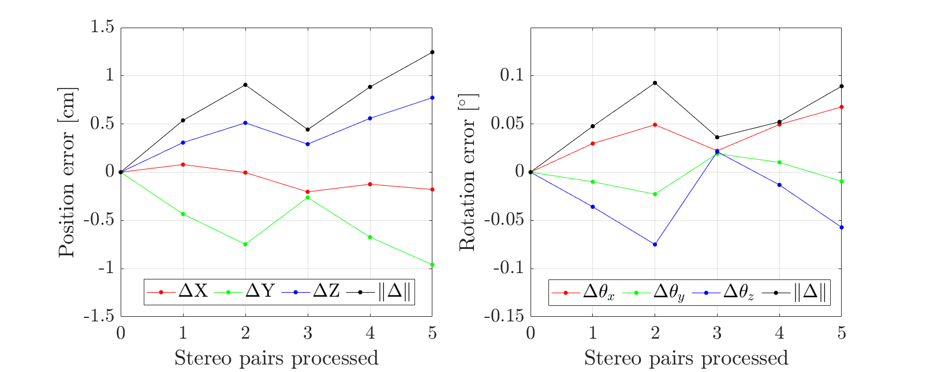
a
b
Attitude (a) and position (b) errors on sol 120. The set of stereo pairs were acquired by Perseverance by only changing the NavCams pointing direction.
Estimation of the NASA Mars 2020 Perseverance rover’s path through Visual Odometry

