Slide 1
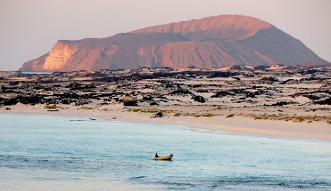
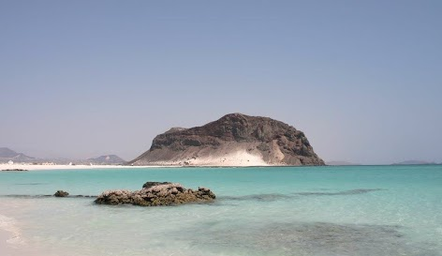

Late Holocene climate changes reconstructed from the southern margins of the Arabian Desert, Yemen
Shah Parth¹*, Ankit Yadav², Ilaria Mazzini³, James Russell⁴, Nicolas Waldmann¹
Dr. Moses Strauss Department of Marine Geosciences, Charney School of Marine Sciences, University of Haifa, 3498838 Haifa, Israel.
Department of Earth and Environmental Sciences, Indian Institute of Science Education and Research, Mohali, India.
Consiglio Nazionale delle Ricerche, IGAG, Area della Ricerca di Roma 1 - Montelibretti, Via Salaria km 29,300, 00015 Monterotondo (Rome), Italy.
Department of Earth, Environmental and Planetary Sciences, Brown University, Providence, RI, US.
Notes:
1
1
1

Slide 2
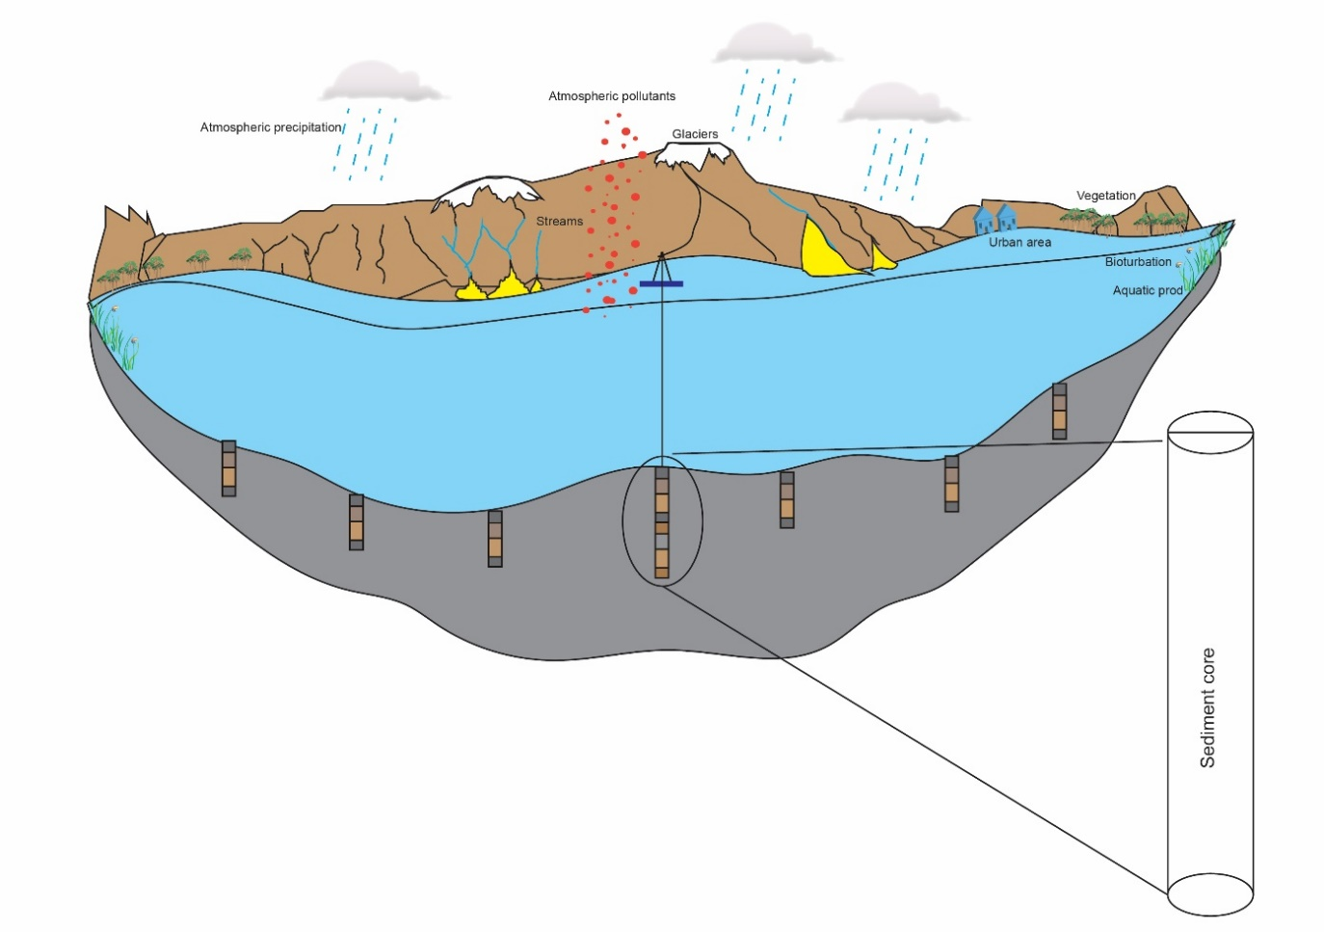
Introduction
Lakes can be.......
A natural laboratory.
An archive for geological processes.
An example for modeling the mechanisms influencing the environment, both at regional and global scales.
A lacustrine environment serves as a small-scale analogue for the marine realm.
An useful sentinel of paleo-climatic changes.
Long core
Short cores

Slide 3
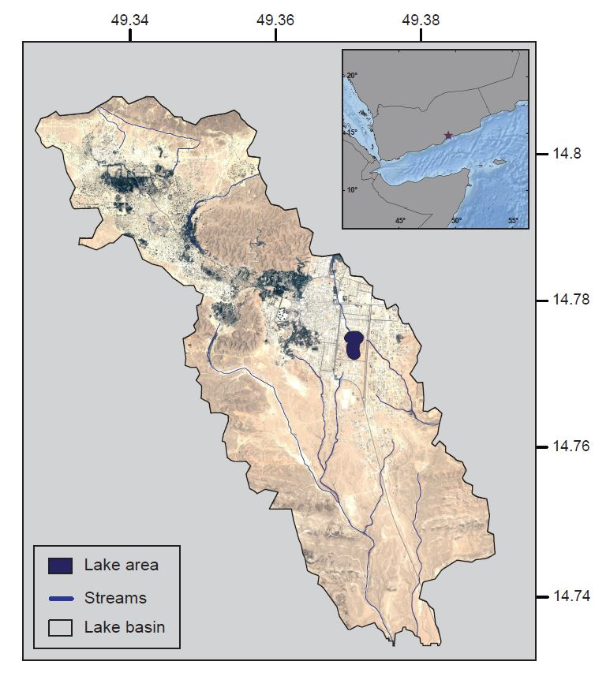
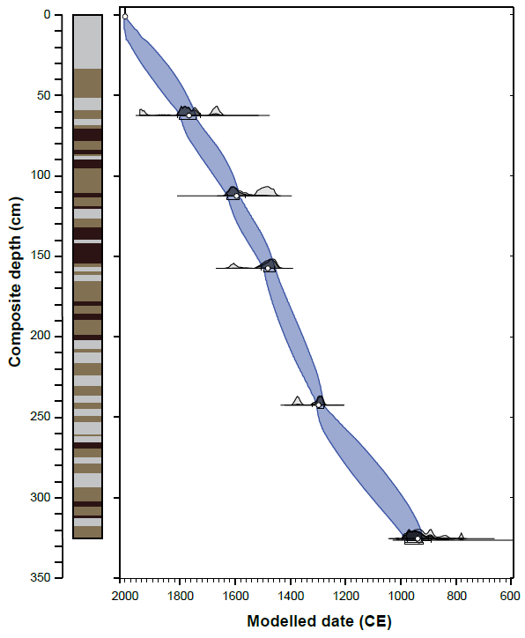
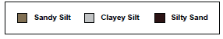
Introduction
Study Area & Chronology
Parth et al., 2022

Slide 4
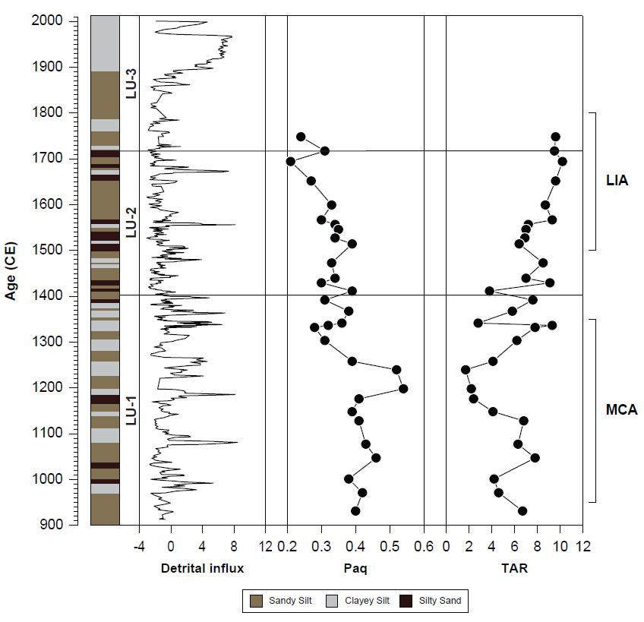


Results & Discussion
Biomarker Study
$$Paq=\frac{(C_{23}+C_{25})}{(C_{23}+C_{25}+C_{29}+C_{31})}$$
$$TAR=\frac{(C_{27}+C_{29}+C_{31})}{(C_{15}+C_{17}+C_{19})}$$
Parth et al., 2022

Slide 5
Results & Discussion
Ostracod Assemblages
Fabaeformiscandona sp.
Bradleytriebella lineata
Limnocythere sp.
Vestalenula sp.

Slide 6
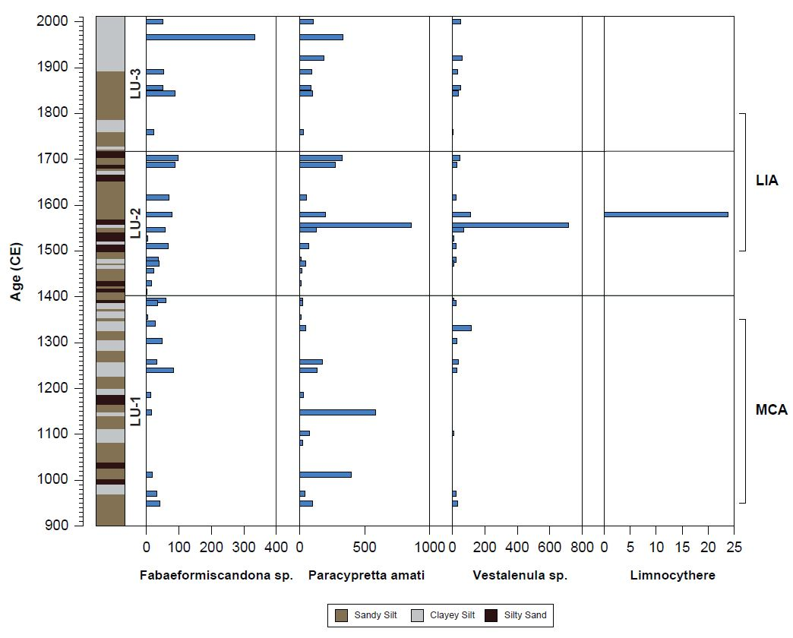
Results & Discussion
Ostracod Assemblages
Fabaeformiscandona sp.
Bradleytriebella lineata
Limnocythere sp.
Vestalenula sp.

Slide 7
Conclusions
The climate reconstruction based on n-alkanes indices (P_{aq}, TAR) suggests increased aquatic productivity (C₂₁-C₂₅) during the MCA, probably due to the increased input of nutrients to the lake and indicating increase in wetness.
Furthermore, ostracods assemblage data also revealed that the abundance of Bradleytriebella lineata (swimmer species) increased during the wet intervals, corroborating previous hypotheses.
The amalgamation of climate data from Ghayl ba Wazir provides important information on the mechanisms modulating the provision of humidity to the region both in the long and short terms.
Overall, this study will help us understand the role of the Intertropical Convergence Zone (ITCZ) vis-à-vis monsoonal dynamics in the region and help develop long-term strategies for the seasonal prediction in the region area.

Slide 8





Thank You

