Slide 1
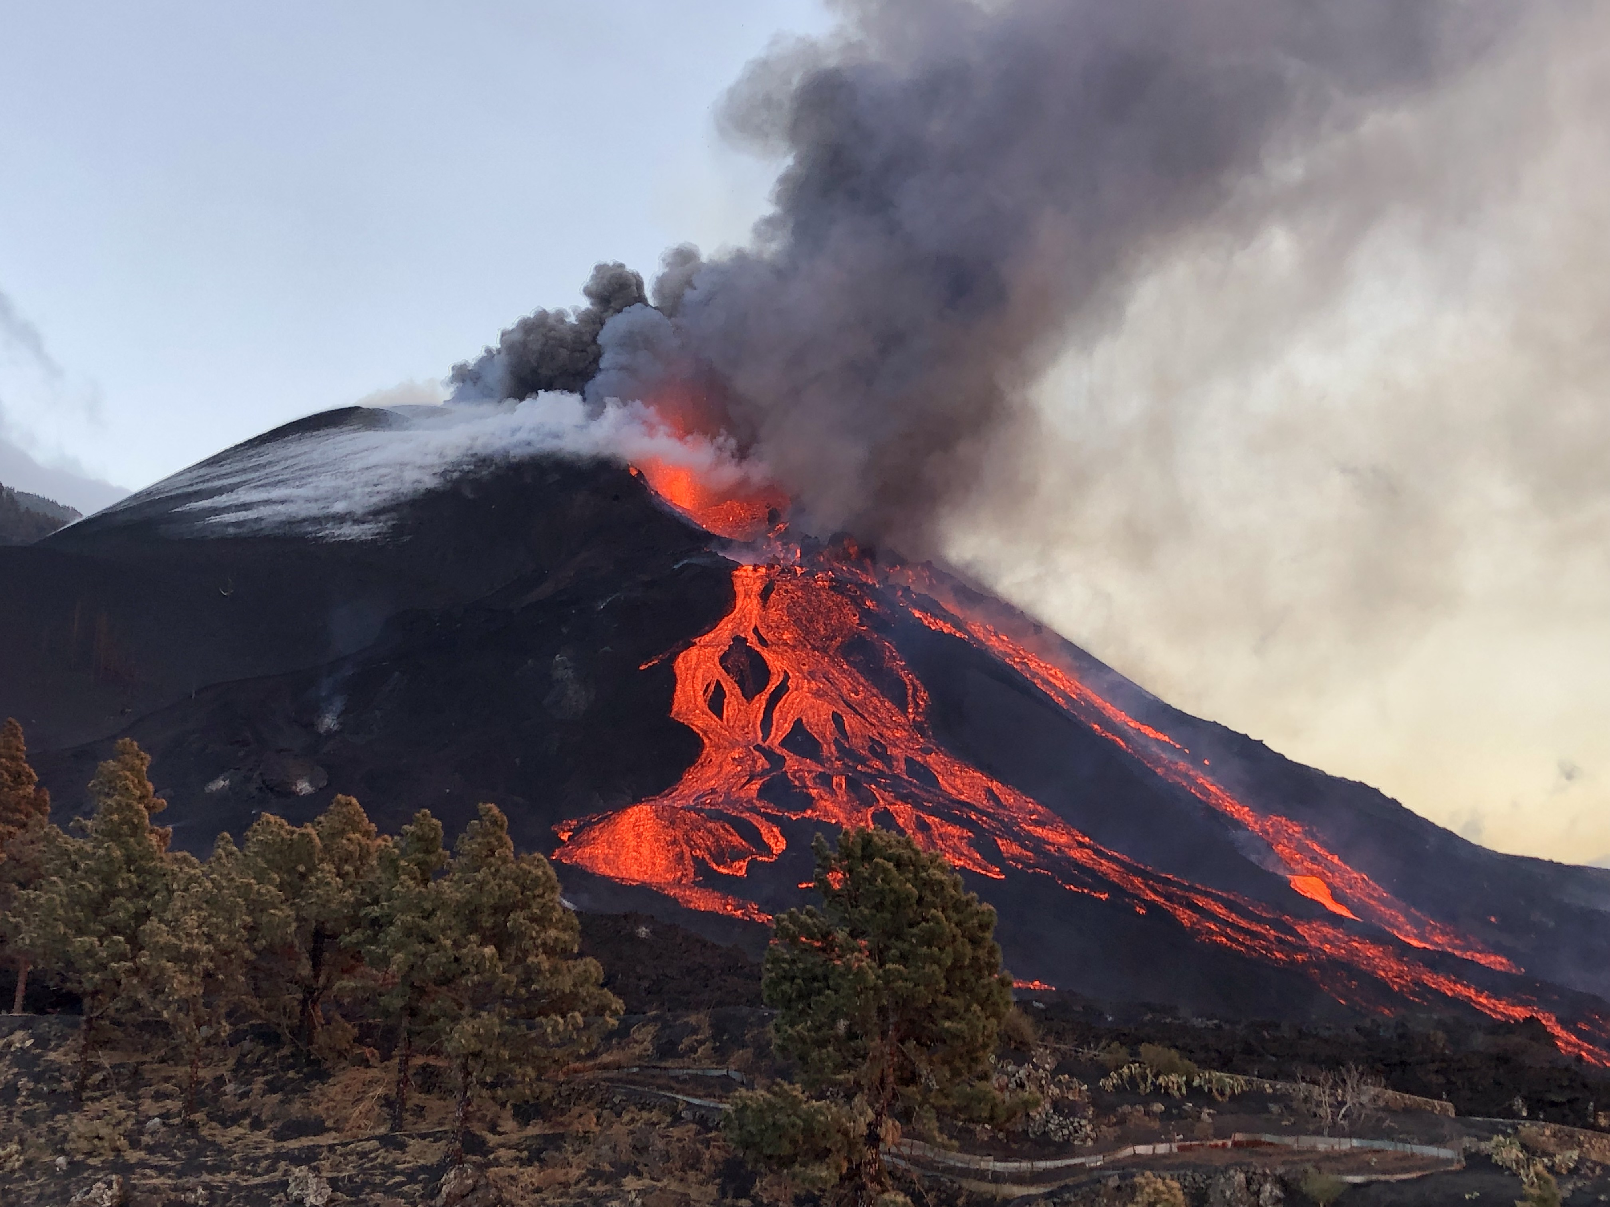





Gas hazard assessment at Puerto Naos and La Bombilla inhabited areas, Cumbre Vieja volcano, La Palma, Canary Islands
Pedro A. Hernández (1,2), Eleazar Padrón (1,2), Gladys V. Melián (1,2), Nemesio M. Pérez (1,2), Germán Padilla (1,2), María Asensio-Ramos (1), Daniel Di Nardo (1), José Barrancos (1,2), José Pacheco (3), Maud Smit (4)
Instituto Volcanológico de Canarias (INVOLCAN), 38320 La Laguna, Tenerife, Canary Islands, Spain
(2) Instituto Tecnológico y de Energías Renovables (ITER), 38600 Granadilla de Abona, Tenerife, Canary Islands, Spain
(3) Instituto de Investigação em Vulcanologia e Avaliação de Riscos (IVAR), 9500-321 Ponta DelgadaAzores, Portugal
(4) Earth Science Department, University of Iceland, 102 Reykjavík, Iceland
Session: GMPV9.2

Slide 2
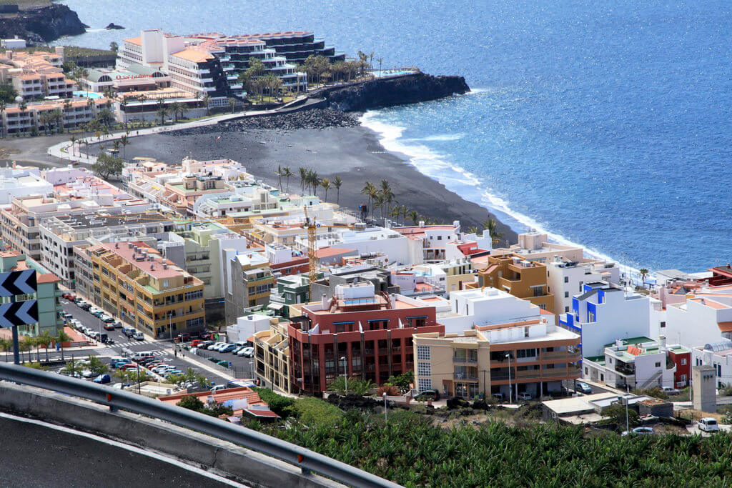
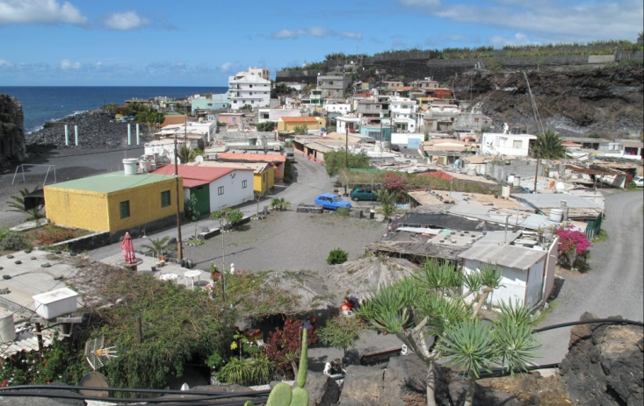
INTRODUCTION
METHODOLOGY
OBJECTIVE
CONCLUSIONS
RESULTS
To investigate the hazards associated to the carbon dioxide (CO₂) emissions in the neighborhoods of Puerto Naos and La Bombilla, Los Llanos de Aridane, La Palma.
Puerto Naos
La Bombilla

Slide 3
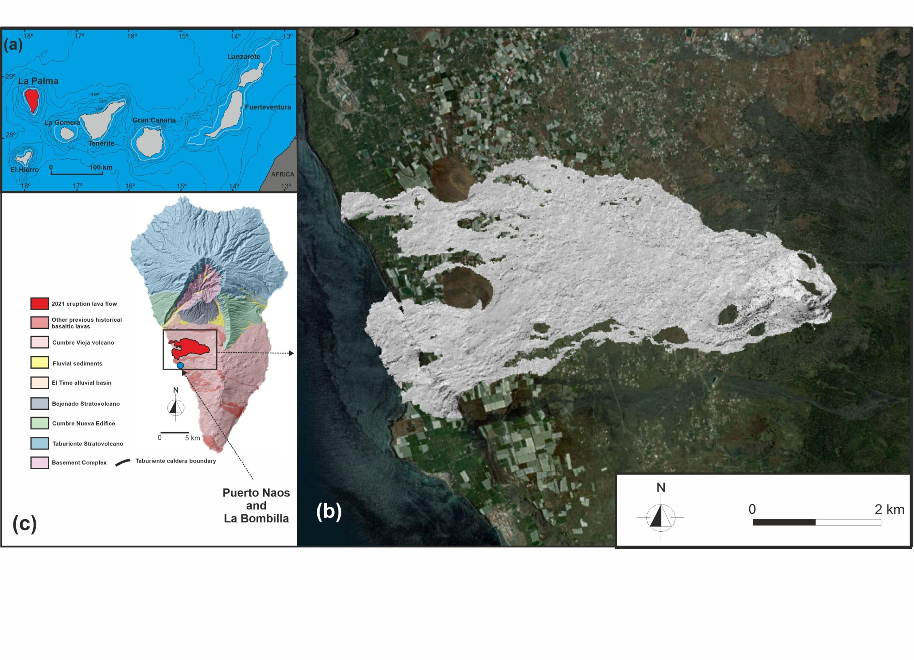
INTRODUCTION
METHODOLOGY
OBJECTIVES
CONCLUSIONS
CONCLUSIONS
RESULTS

Slide 4
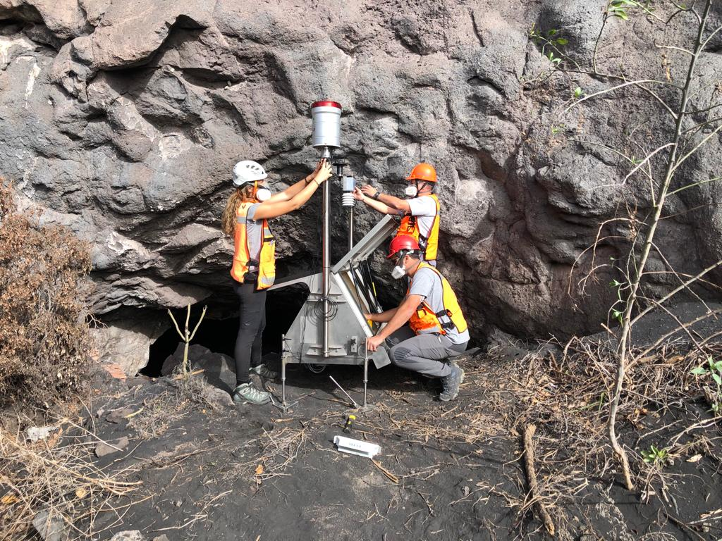
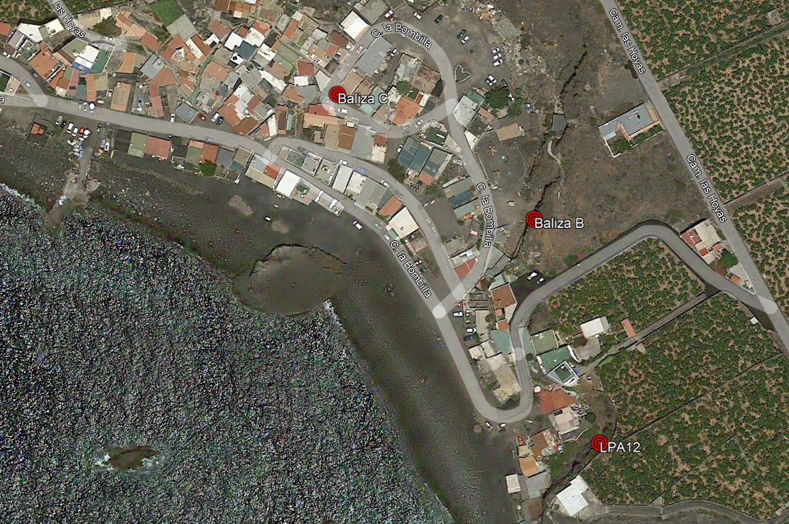
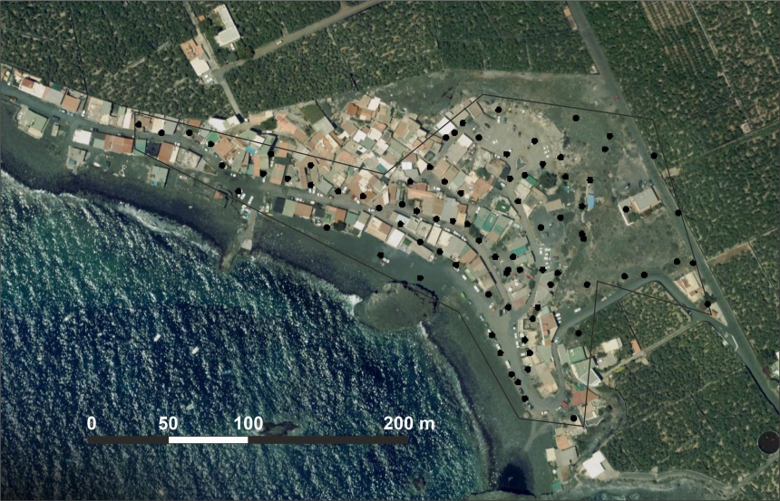
INTRODUCTION
METHODOLOGY
OBJECTIVES
CONCLUSIONS
RESULTS
La Bombilla
Soil CO₂ degassing surveys
Weekly
84 observation sites
Continuous soil CO₂ efflux monitoring
1 station
Continous outdoor air CO₂ monitoring
2 stations

Slide 5
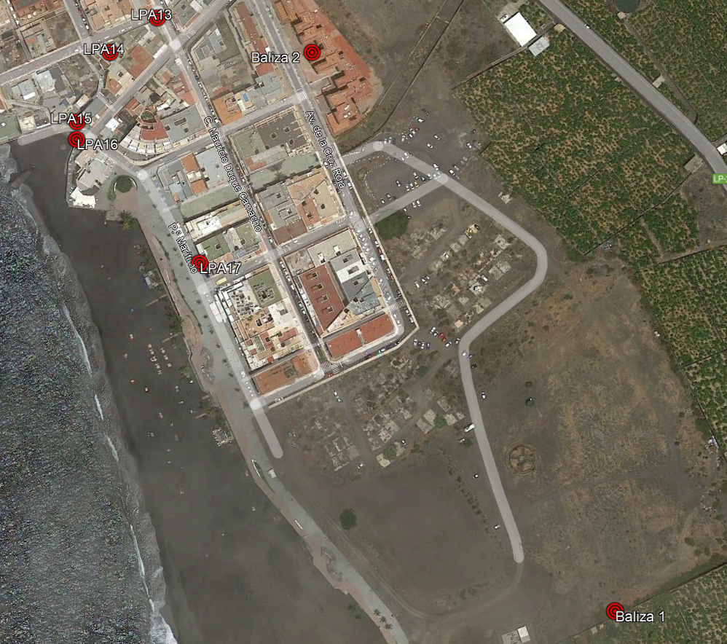
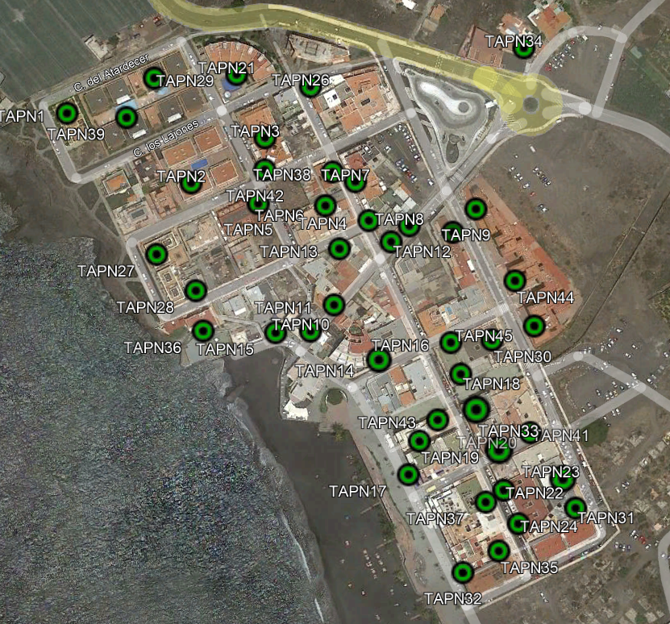
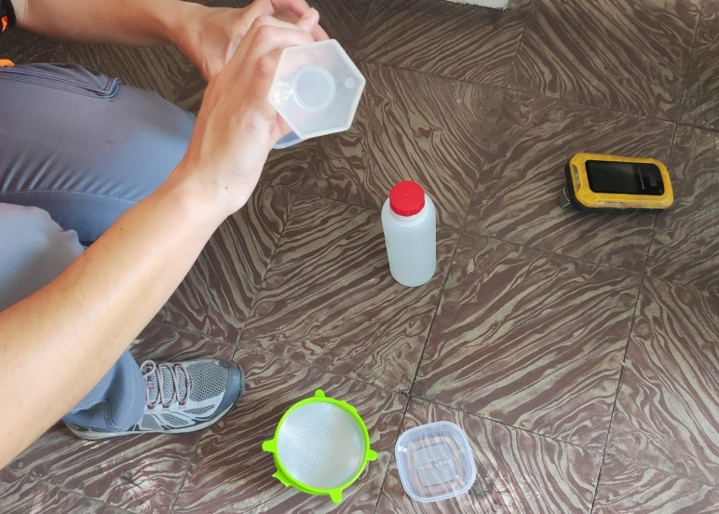
INTRODUCTION
METHODOLOGY
OBJECTIVES
CONCLUSIONS
RESULTS
Puerto Naos
Continous outdoor air CO₂ monitoring
3 stations
Continous indoor air CO₂ monitoring
4 stations
Indoor alkaline traps network
Weekly
39 observation sites

Slide 6
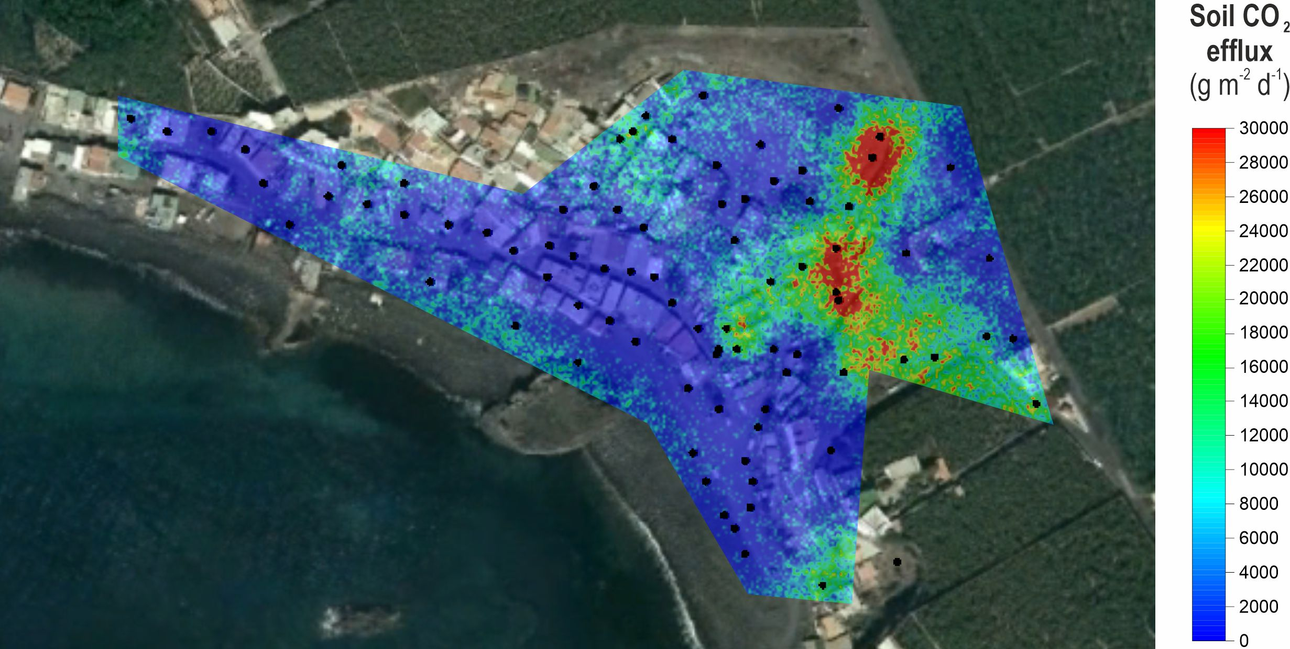
INTRODUCTION
METHODOLOGY
OBJECTIVES
CONCLUSIONS
RESULTS
Diffuse CO₂ emission - La Bombilla
February 2-3, 2022
84 measuring sites
170 ± 48 td⁻¹

Slide 7
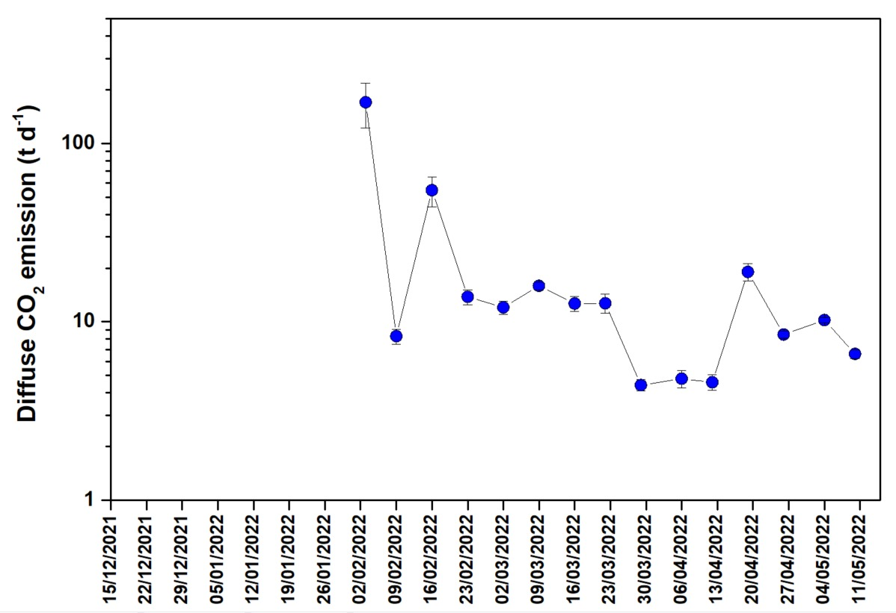
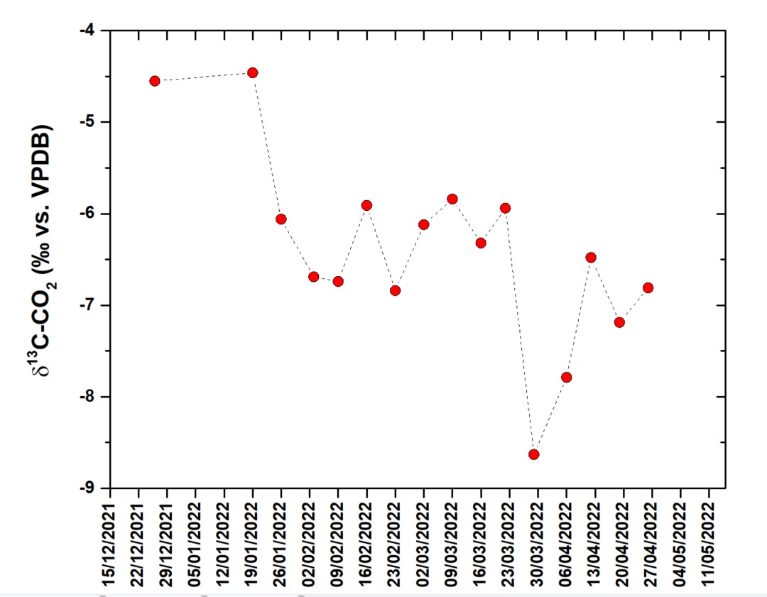
INTRODUCTION
METHODOLOGY
OBJECTIVES
CONCLUSIONS
RESULTS
Temporal variations · Diffuse CO₂ emission
La Bombilla
Diffuse CO₂ emission
Soil δ¹³C-CO₂

Slide 8
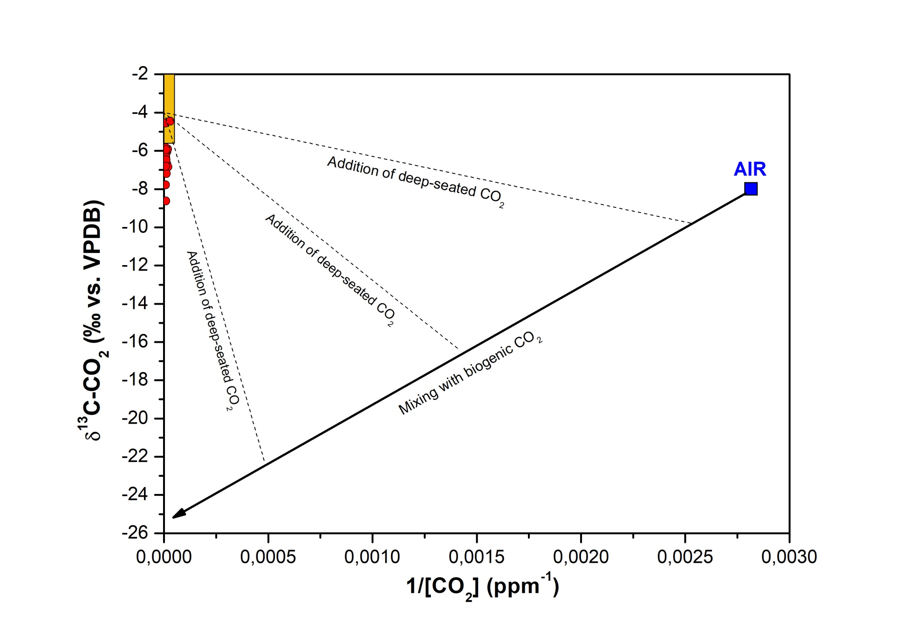
INTRODUCTION
METHODOLOGY
OBJECTIVES
CONCLUSIONS
RESULTS
Origin of the anomalous CO₂ degassing · La Bombilla
Volcanic-hydrotermal

Slide 9
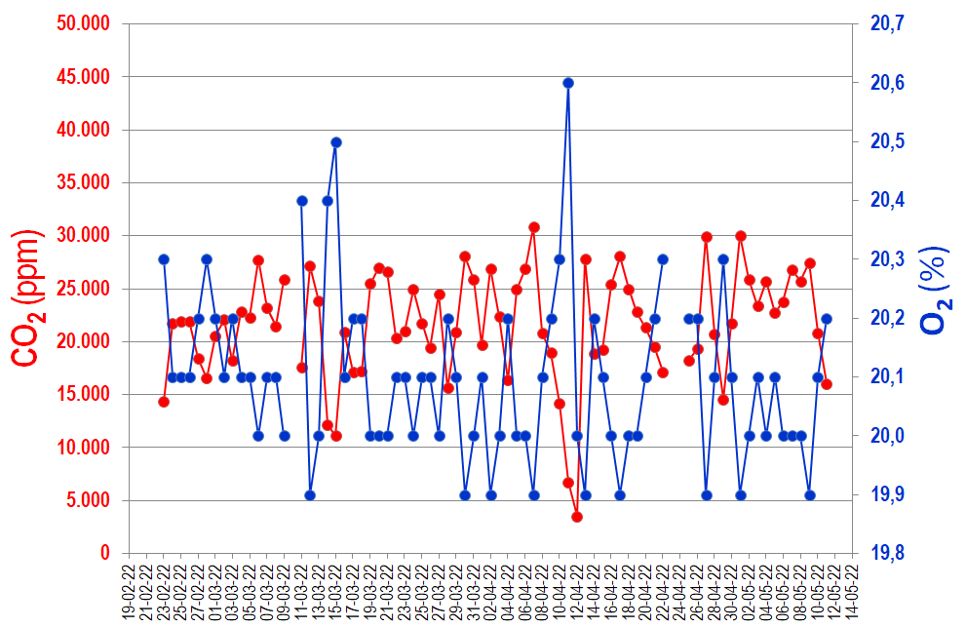
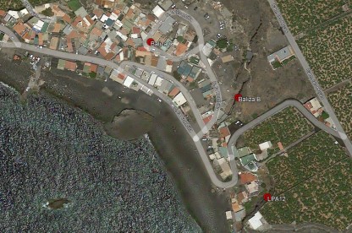
INTRODUCTION
METHODOLOGY
OBJECTIVES
CONCLUSIONS
RESULTS
Continuous outdoor air CO₂ monitoring · La Bombilla · Station B (30 cm)

Slide 10
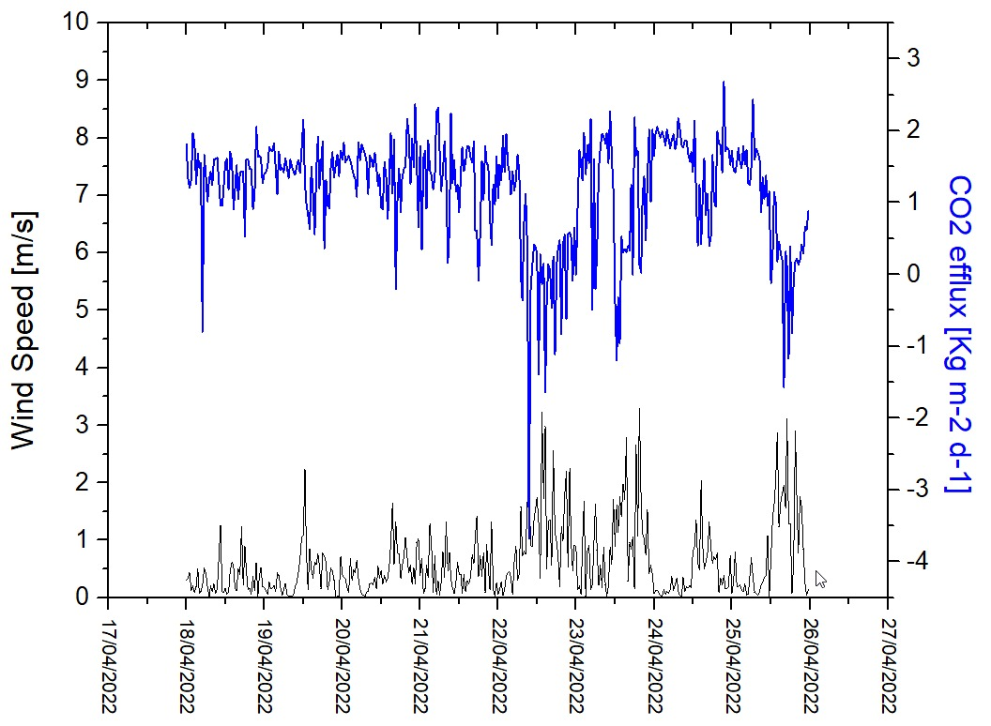
INTRODUCTION
METHODOLOGY
OBJECTIVES
CONCLUSIONS
RESULTS
Soil CO₂ efflux monitoring · La Bombilla · LPA12 (30 cm)

Slide 11
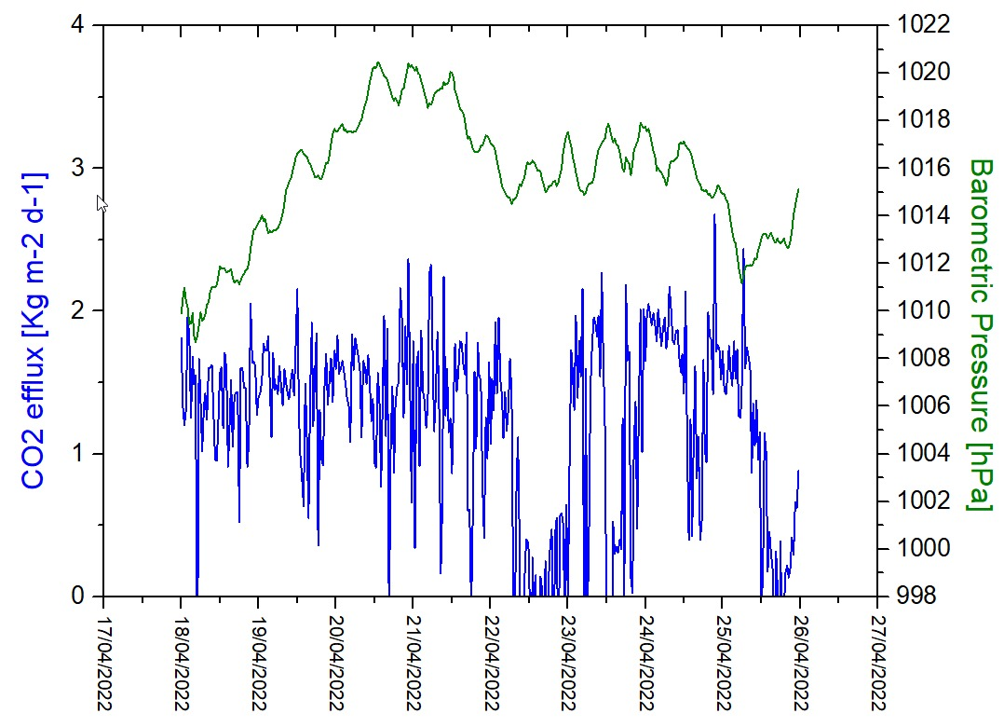
INTRODUCTION
METHODOLOGY
OBJECTIVES
CONCLUSIONS
RESULTS
Soil CO₂ efflux monitoring · La Bombilla · LPA12 (30 cm)

Slide 12
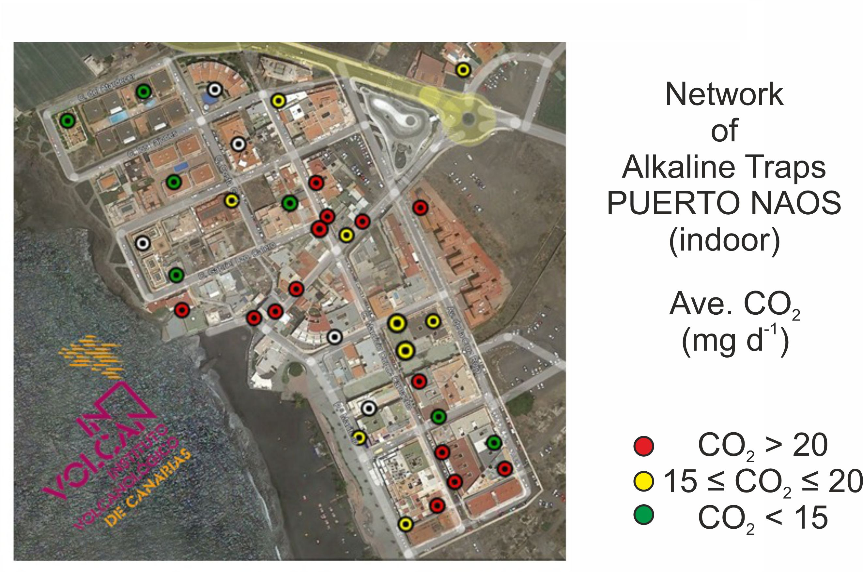
INTRODUCTION
METHODOLOGY
OBJECTIVES
CONCLUSIONS
RESULTS

Slide 13
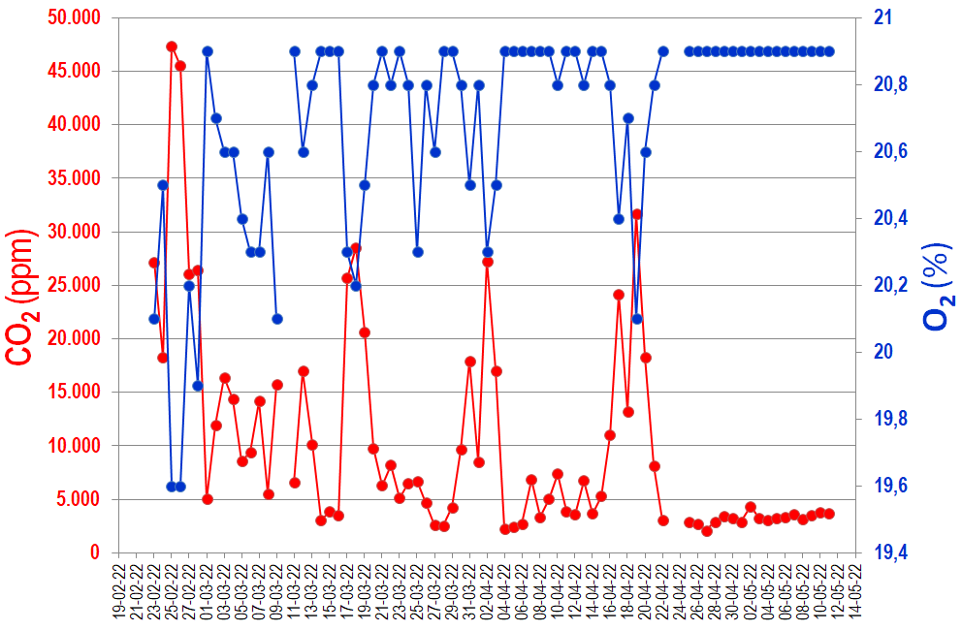
INTRODUCTION
METHODOLOGY
OBJECTIVES
CONCLUSIONS
RESULTS
Continuous outdoor air CO₂ monitoring · Puerto Naos · Station 2 (30 cm)

Slide 14
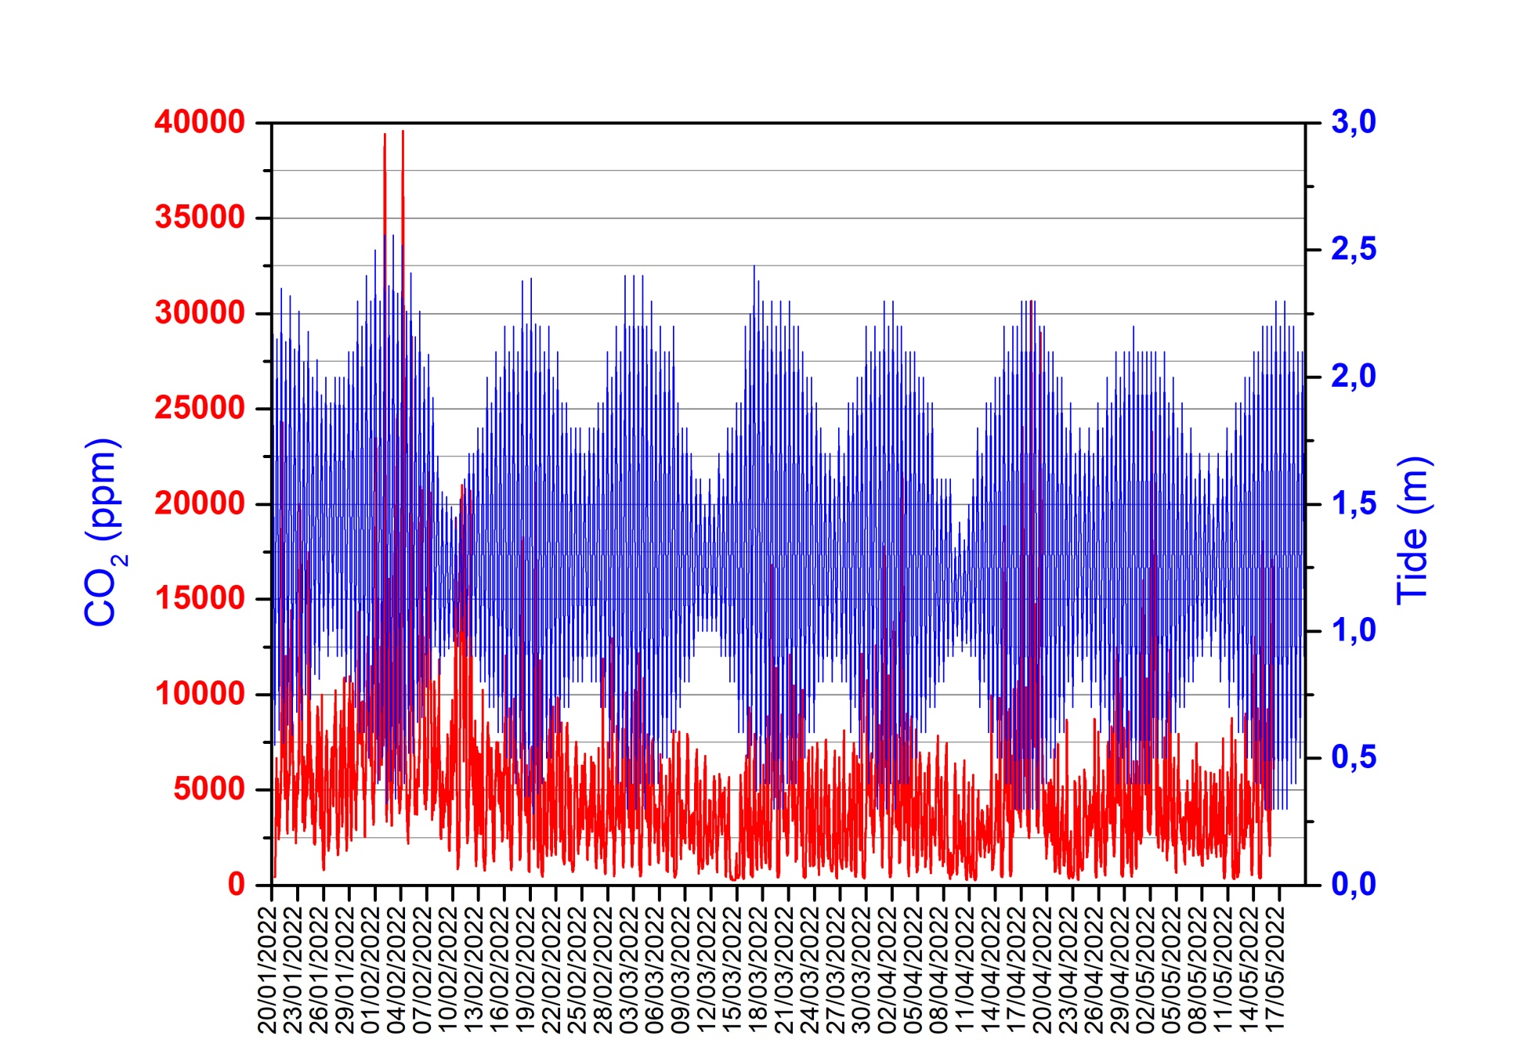
INTRODUCTION
METHODOLOGY
OBJECTIVES
CONCLUSIONS
RESULTS
Continuous outdoor air CO₂ monitoring · Puerto Naos · LPA17 (150 cm)

Slide 15
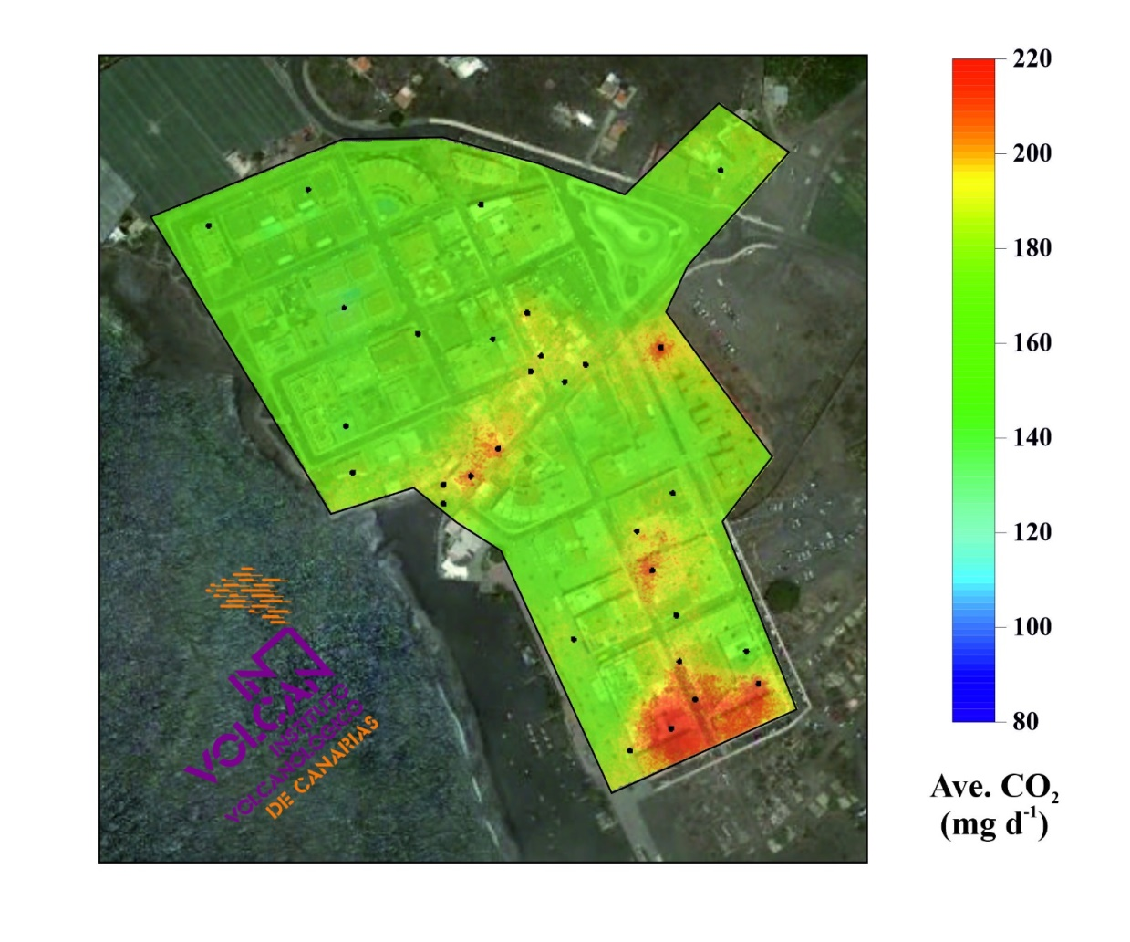
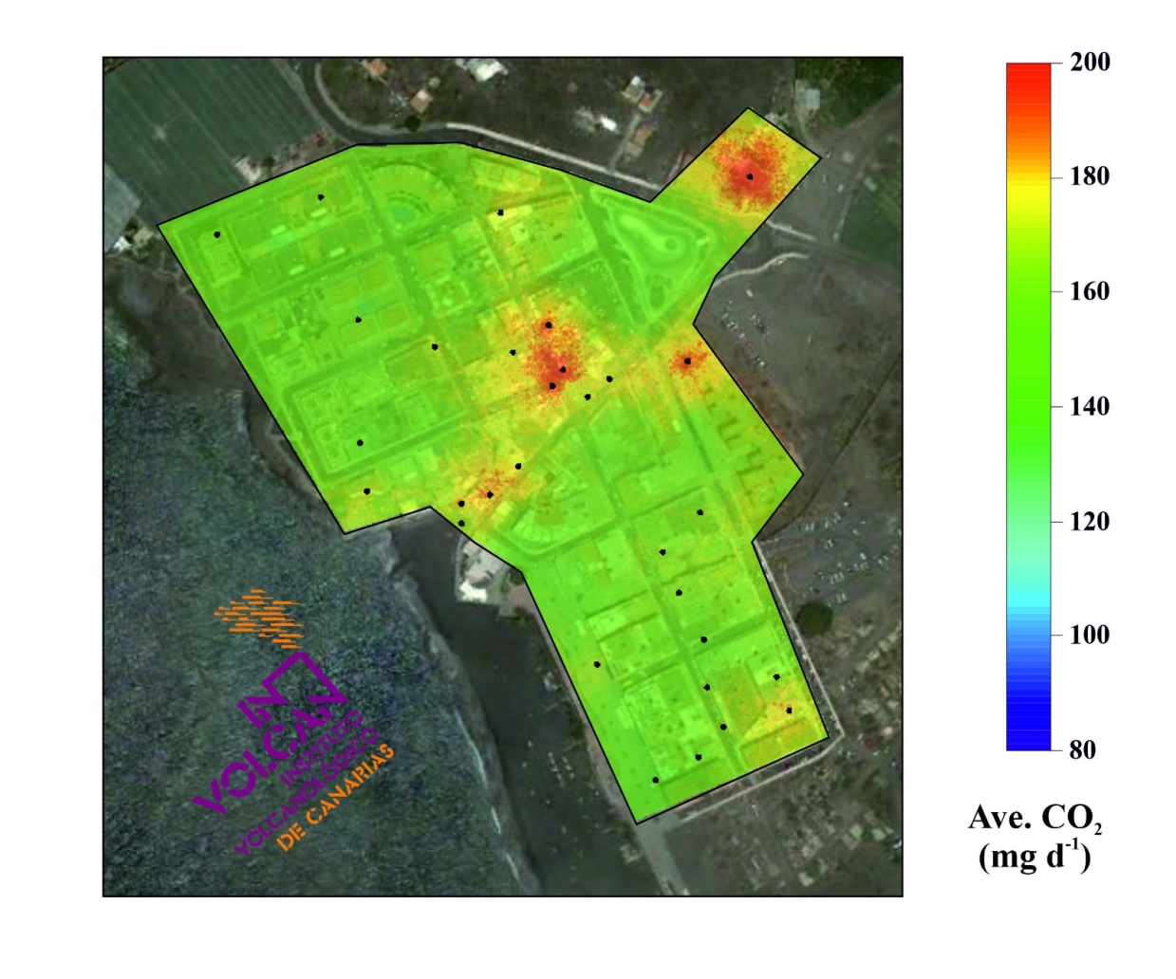
INTRODUCTION
METHODOLOGY
OBJECTIVES
CONCLUSIONS
RESULTS
Alkaline traps for indoor air CO₂ · Puerto Naos
May 3 – 10, 2022
May 10 – 17, 2022

Slide 16
INTRODUCTION
METHODOLOGY
OBJECTIVES
CONCLUSIONS
RESULTS
Puerto Naos and La Bombilla inhabited areas are affected by intense volcanic-hydrothermal CO₂ emissions.
Diffuse CO₂ emission rates estimated from La Bombilla soil gas surveys since February 2022 show a decreasing trend with time, with the maximum value (170±48 td⁻¹) registered in the first survey on March 3, 2022.
Isotopic values of soil δ¹³C-CO₂ from La Bombilla indicate a mixing of biogenic CO₂ with deep-seated CO₂, showing a decreasing to lighter soil δ¹³C-CO₂ values with time.
Time series of soil CO₂ efflux from LPA12 geochemical station at La Bombilla showed relatively high values up to 3 kg m⁻² d⁻¹, being mainly controlled by wind speed.
The installation of different type of CO₂ monitoring stations (outdoor and indoor) as well as alkaline traps in numerous buildings (first floors) of Puerto Naos has allowed us to evaluate the levels of CO₂ emissions and to define those areas that show the greatest CO₂ emissions of this gas in order to investigate the hazards associated. The analysis of the time series of the LPG17 station has revealed that the external factor that most controls anomalous CO₂ emissions is the tide.
At present, lethal CO₂ concentrations occur at some places, and we cannot exclude that the zone exposed to gas hazard might be enlarged by further geochemical studies.

Slide 17




Acknowledgements
Projects VOLRISKMAC (MAC/3.5b/124) and VOLRISKMAC II (MAC2/3.5b/328), financed by the Program INTERREG V A Spain-Portugal MAC 2014-2020 of the European Commission
Project Cumbre Vieja Emergencia financed by the Ministerio de Ciencia e Innovación, Spanish Government
Project TFassistance financed by the Cabildo Insular de Tenerife

Slide 18
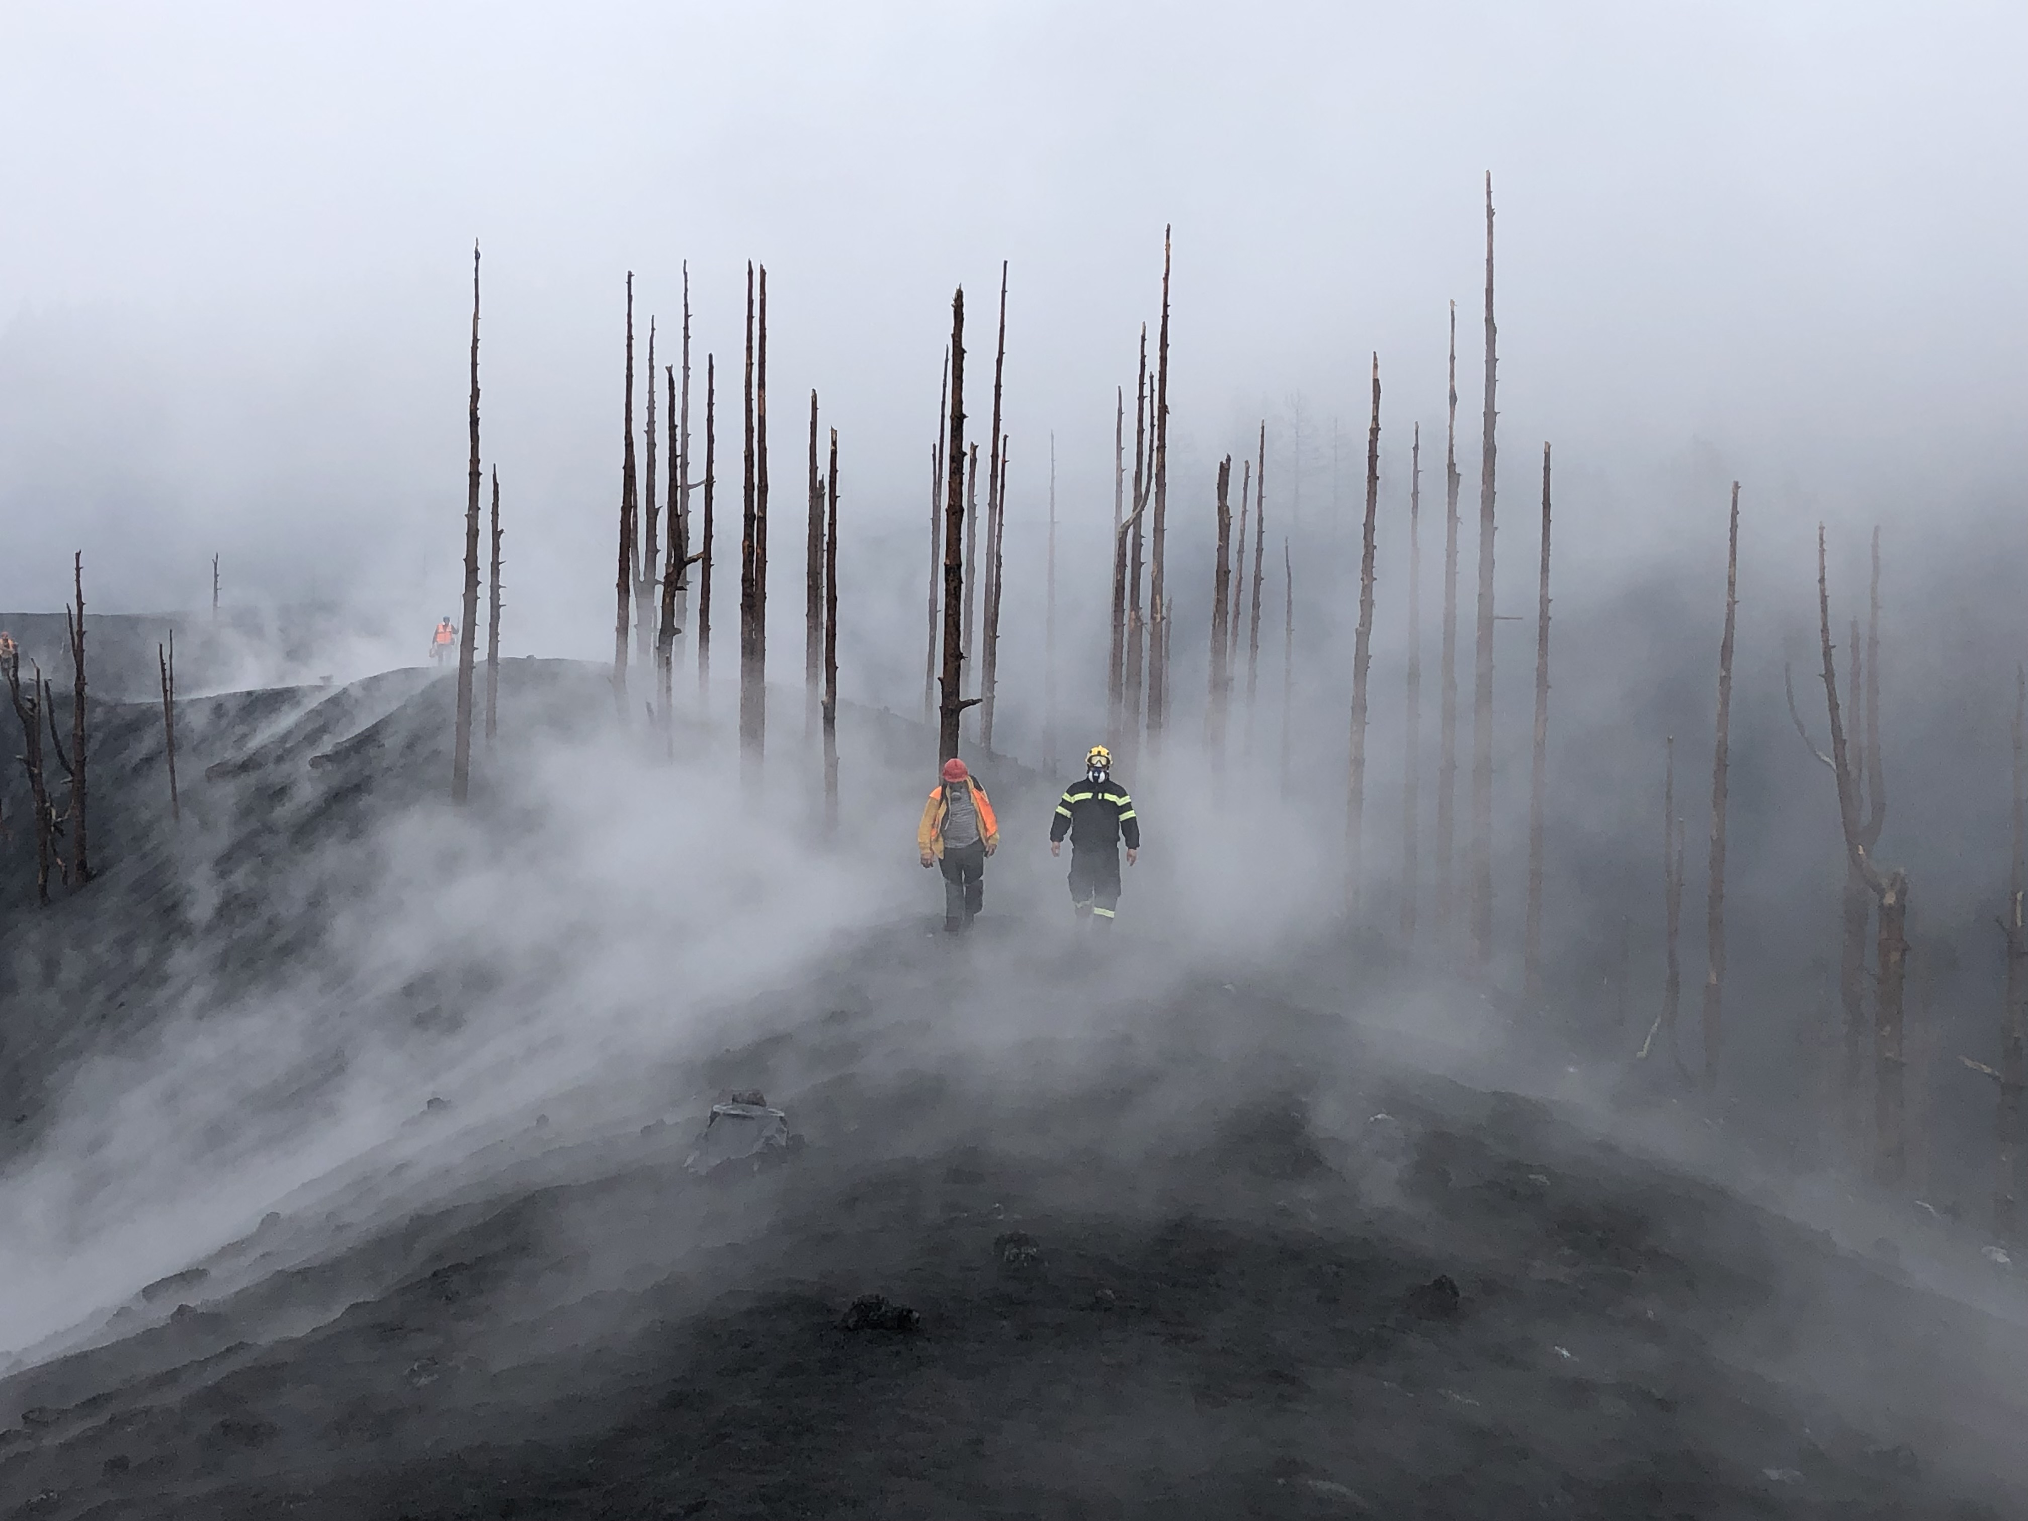
THANK YOU FOR YOUR ATTENTION!

