Slide 1
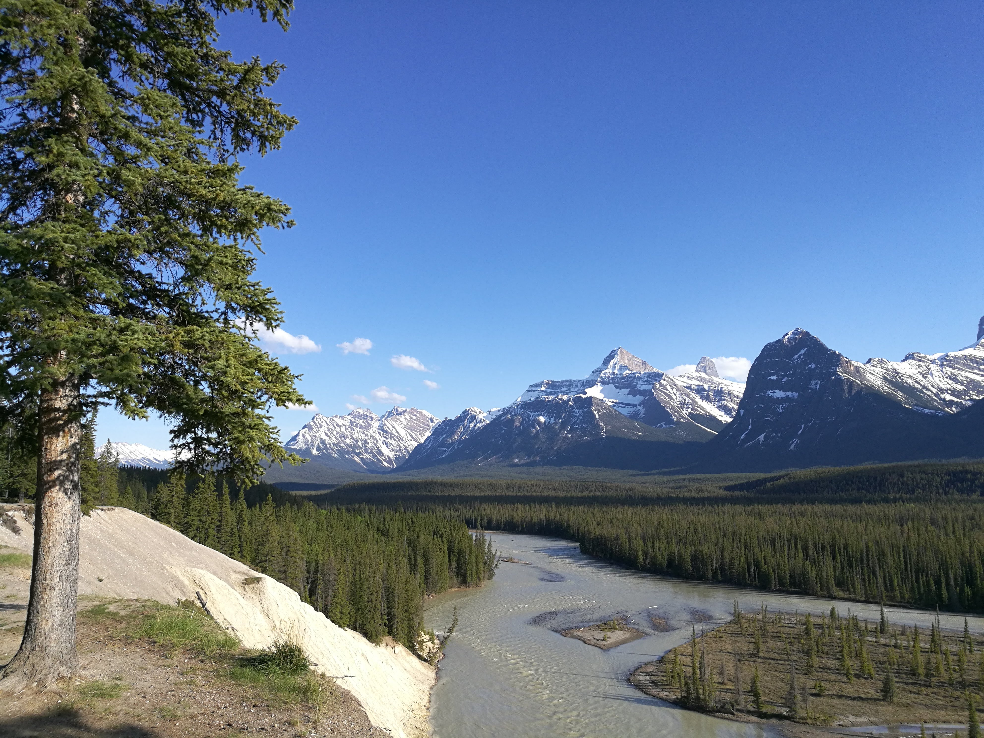

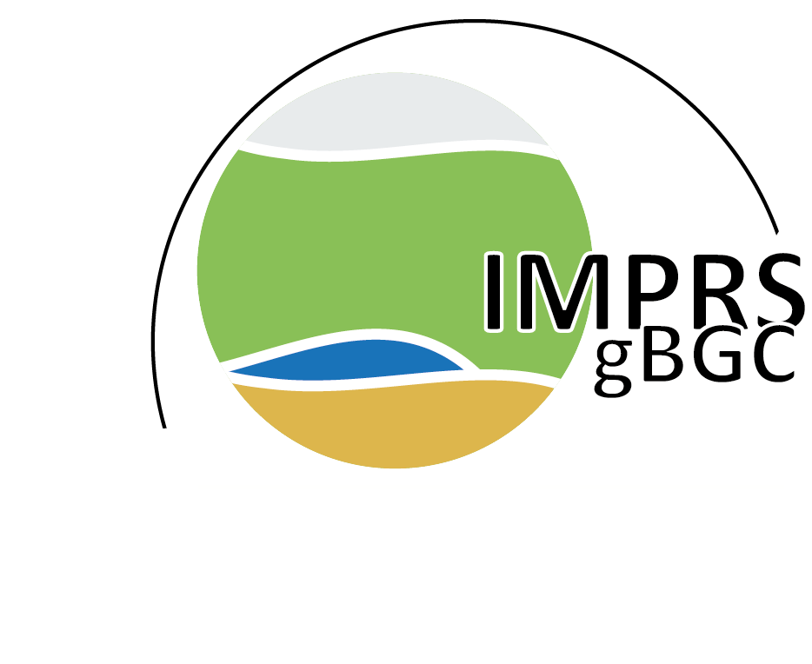

Implications of river storage for integrating GRACE TWS observations
into a global hydrological model
Tina Trautmann ▲▼
Sujan Koirala▲
Andreas Güntner■▼
Hyungjun Kim○
Martin Jung▲
▲Max-Planck-Institute for Biogeochemistry, Jena, Germany
→ International Max Planck Research School for Biogeochemical Cycles, Jena, Germany
▼Potsdam University, Potsdam, Germany
■German Research Center for Geoscience, Potsdam, Germany
○Korea Advanced Institute of Science and Technology, Daejeon, South Korea

Slide 2

GRACE observes the vertically integrated TWS – but what’s the impact of river water storage when it’s used for model calibration?
GRACE TWS
TWS mod
Hydrological Model
OR
Model Calibration
Simulations
GRACE TWS
TWS mod
Routing
with 3 different
flow velocities
with 3 different
flow velocities
What’s the effect on model calibration?
What’s the effect on model simulation?
looking at calibration results
when using different TWS estimates
comparing simulated TWS with & without
river storage against GRACE TWS

Slide 3
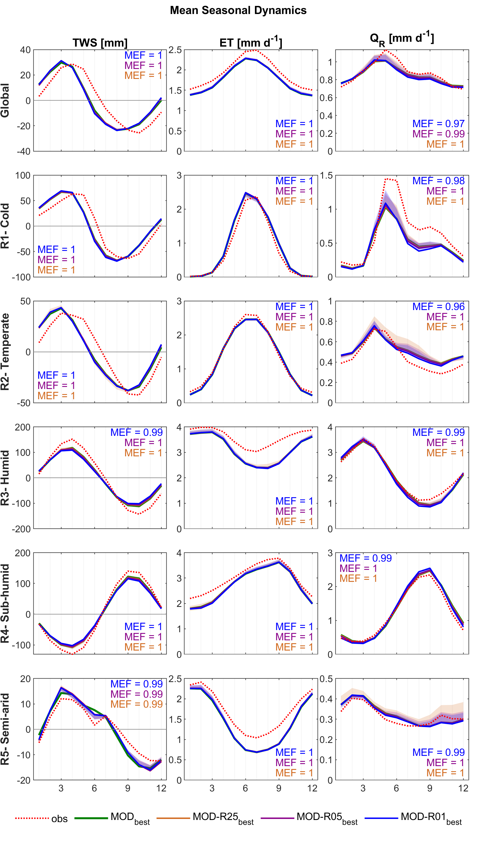
Removing river storage from GRACE TWS has no systematic impact on large-scale model calibration and resulting simulations.
(MEF = Nash-Sutcliff Efficiency with MOD_{best})

Slide 4
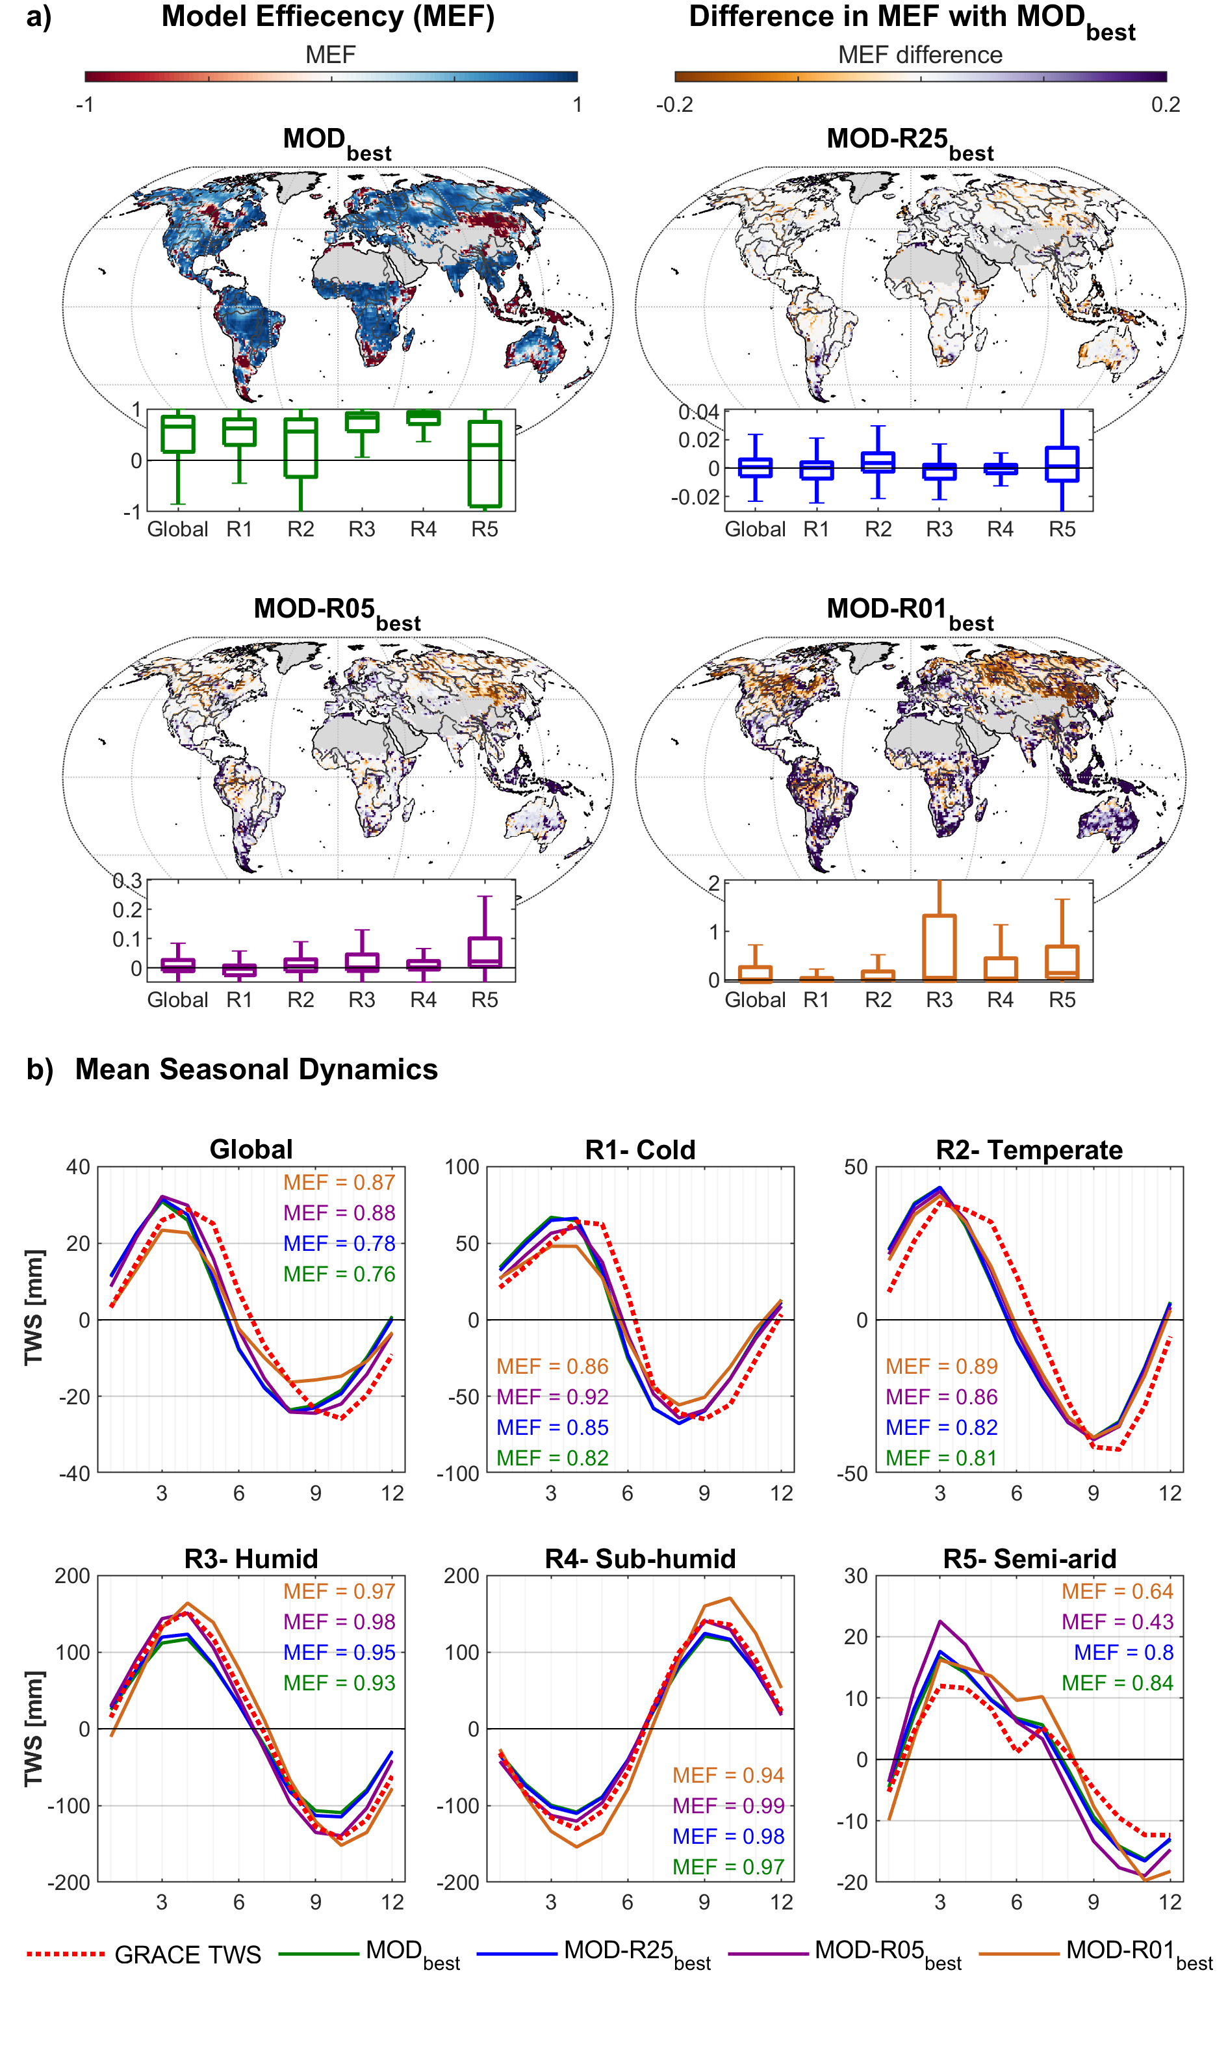
Considering simulated river storage is regionally advantageous when evaluating model simulations against GRACE TWS.
with routing
without routing
(MEF = Nash-Sutcliff Efficiency)

Slide 5
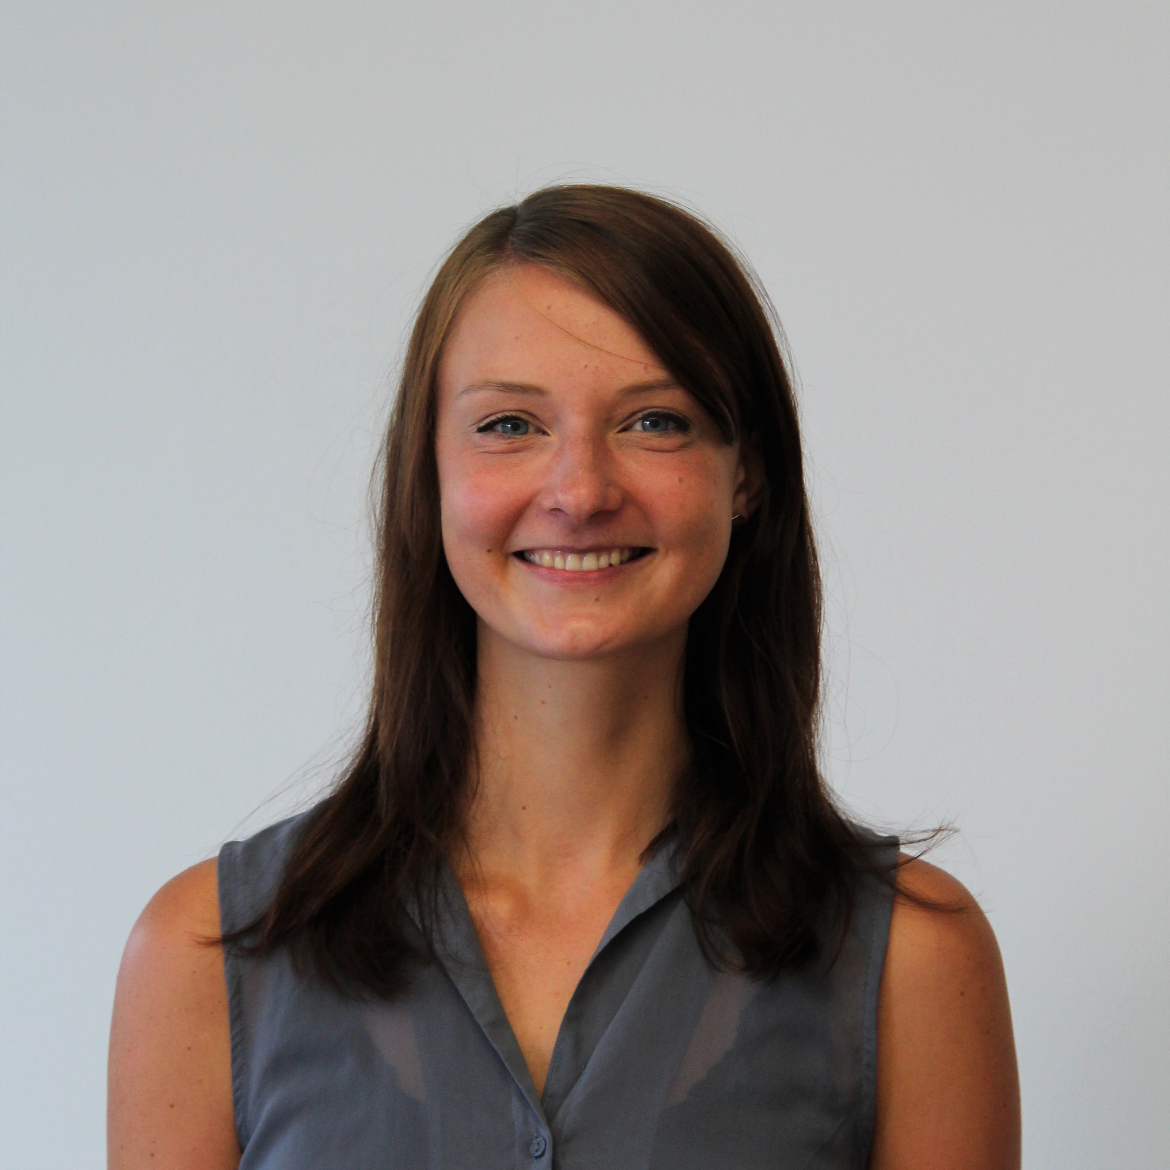


Contact
Tina Trautmann ▲▼
Max-Planck Institute for Biogeochemistry, Jena
mail: ttraut@bgc-jena.mpg.de
What’s the effect on model calibration?
river storage included in GRACE TWS has no large impact on large-scale model calibration
What’s the effect on model simulation?
river routing & river storage should be considered for model evaluation
Co-Authors
Sujan Koirala▲
Andreas Güntner■▼
Hyungjun Kim○
Martin Jung▲
▲Max-Planck-Institute for Biogeochemistry, Jena, Germany
→ International Max Planck Research School for Biogeochemical Cycles, Jena, Germany
▼Potsdam University, Potsdam, Germany
■German Research Center for Geoscience, Potsdam, Germany
○Korea Advanced Institute of Science and Technology, Daejeon, South Korea

