Slide 1

Global sensitivity analyses to characterize the risk of earth fissures in subsiding basins
Yueting Li

Slide 2
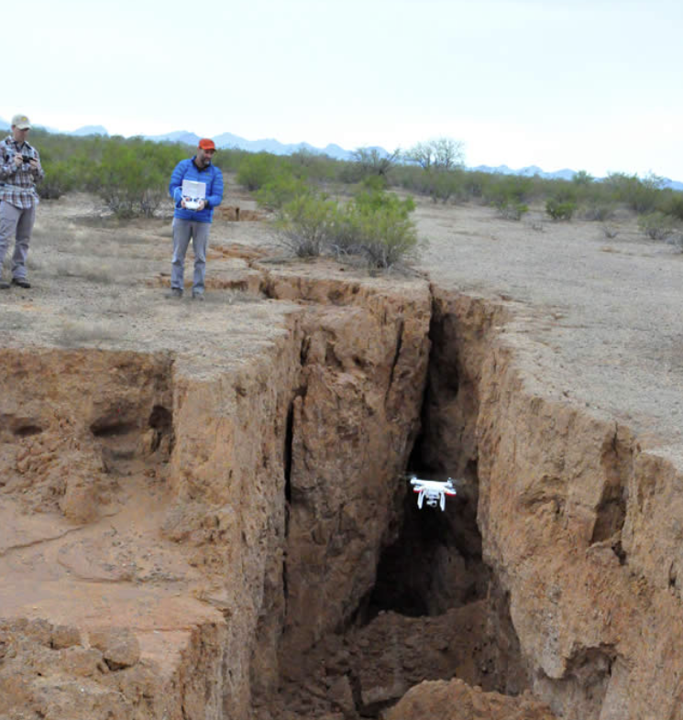
Introduction
Damages:
Loss and injuries to human and livestock;
Damages to the building and infrastructures;
Provide the path for contaminants to the depth;
Retard property development and reduce property values …
Objective:
Investigation to the mechanism of pumping-induced earth fissure by cooperating numerical simulation and sensitivity analysis.
Earth fissure in Arizona https://new.azwater.gov/news/articles/2017-25-01
Notes:
So first of all, what is the earth fissure. Well, earth fissure is the rupture at land surface which can be formed by natural events like earthquake. However, in this context I am refering to earth fissure that is the byproduct of land subsidence as result of excessive groundwater pumping. As I list here, this geo-hazard can cause a brunch of problems on society and ecology. Therefore, our work aims to investigate the mechanism of earth fissure by cooperating numerical simulation and sensitivity analysis.

Slide 3
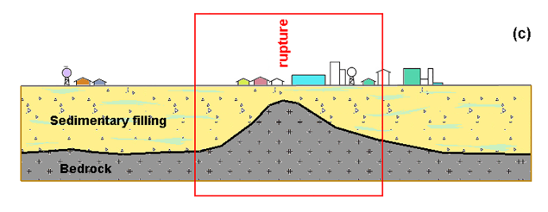
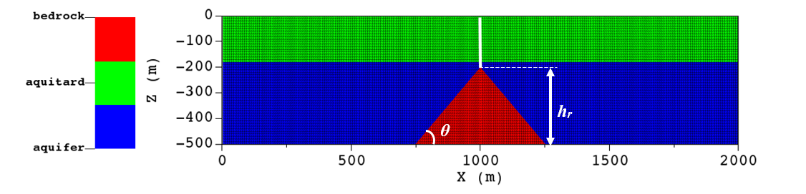
Model Setup
Frigo et al, 2019
GEPS3D, a numerical simulator, integrates the FEs and IEs in the same grid to describe the continuous and discontinuous mechanics respectively.
conceptualized
Notes:
To this end, we first developed a conceptual model based on the field cases reported in Arizona and Yangzi delta. The common characteristic in these area is the compressible sediment layers are obstructed by a convex bedrock. So our conceptual model includes two-layered aquifer system and a triangular prism bedrock. Besides we inserted a pair of interfaces above the bedrock ridge to represent earth fissure. Then several numerical trials are conducted by a simulator called GEPS3D which allows us to solve the discontinuous mechanism in finite element grid.

Slide 4
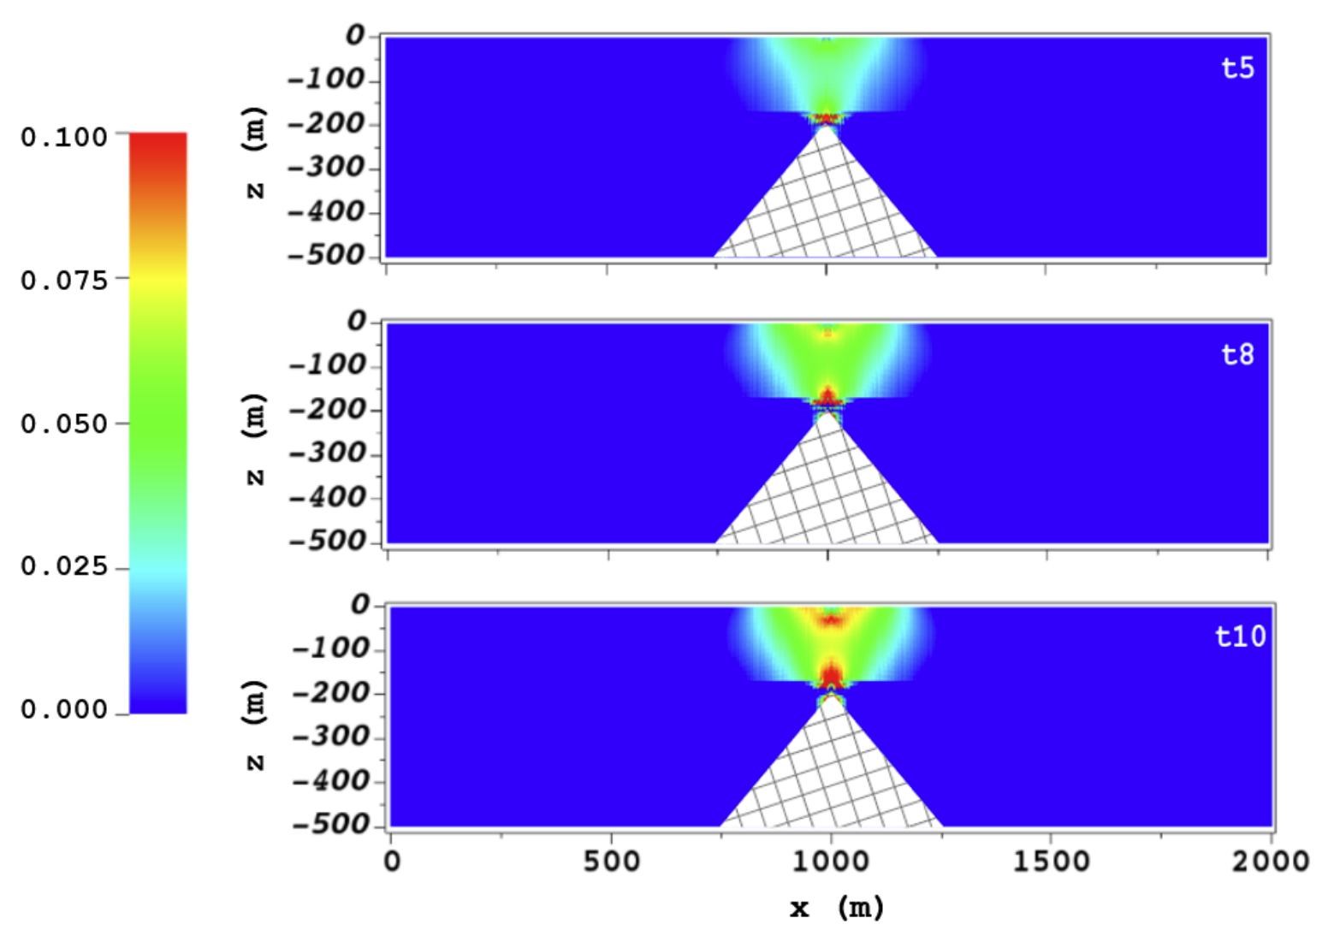
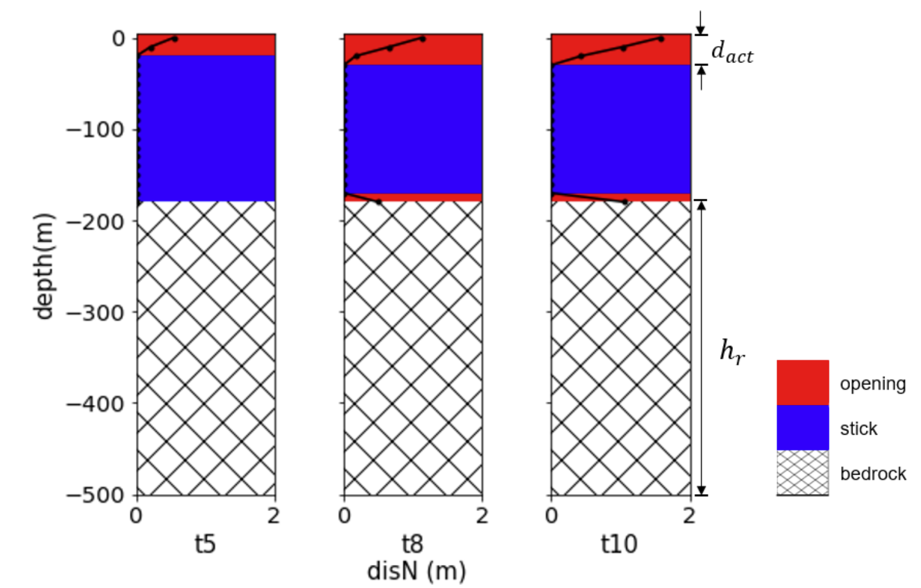

Numerical Trial
$$\frac{σ_{xx}}{∆p}$$
Horizontal tension of continuum medium
during 10-year pore pressure depletion
Horizontal displacement of interfaces
The behaviors of earth fissure depend on stress field.
Notes:
Moving on this slide, the numerical simulations suggest the differential subsidence causes the tension accumulation above the bedrock tip after long term pore pressure depletion. At the same time, the interfaces have experienced such high tension that a rip occurs between them and enlarges as the tensile stress keeps increasing. The main point I want to make here is the behaviors of earth fissure are governed by stress field.

Slide 5
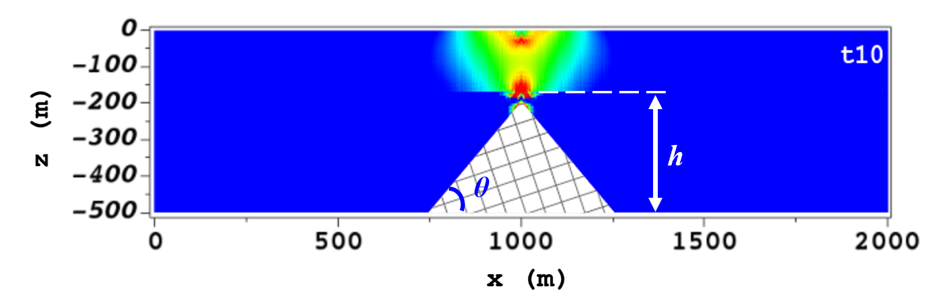
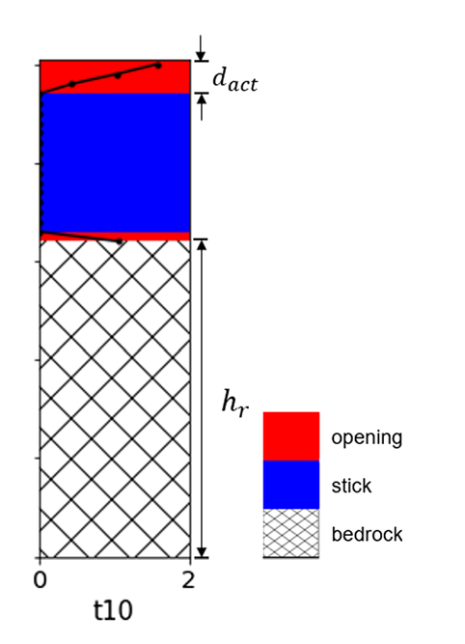

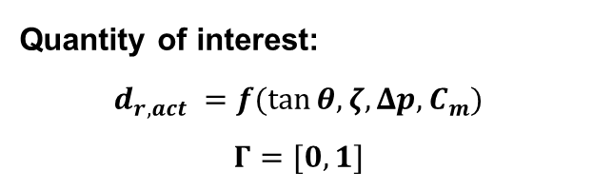
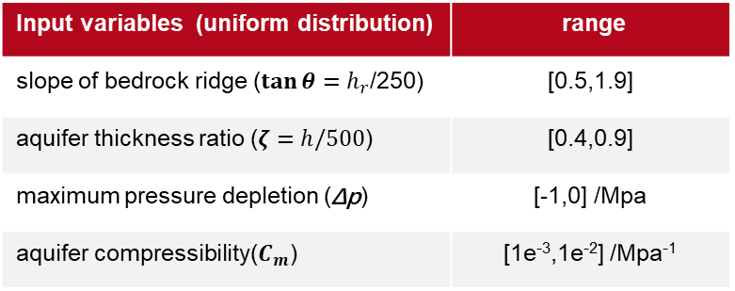
Sensitivity Analysis
$$d_{r,act}=\frac{d_{act}}{500−hr}$$
Horizontal tension of continuum medium
after 10-year pore pressure depletion
Input variables (uniform distribution) | range
slope of bedrock ridge ($\tan{θ}=h_{r}$/250) | [0.5,1.9]
aquifer thickness ratio ($ζ=h/500$) | [0.4,0.9]
maximum pressure depletion (Δp) | [-1,0] /Mpa
aquifer compressibility($C_{m}$) | [1e⁻³,1e⁻²] /Mpa⁻¹
Quantity of interest:
$$d_{r,act} =f(\tan{θ, ζ, Δp, C_{m})}$$
$$Γ=[0,1]$$
Notes:
On the other hand, we found stress field is affected by four parameters including bedrock slope, aquifer thickness, pore pressure variation and aquifer compressibility. So now the problem turns to addressing how these variables influence on earth fissure behaviors. For this purpose, we assumed these four avaribles are uniform distributions and the corresponding ranges are commonly cited in the literature. Furthermore, we introduced the ratio of activated depth to sediment thickness to quantify the degree of earth fissure.

Slide 6
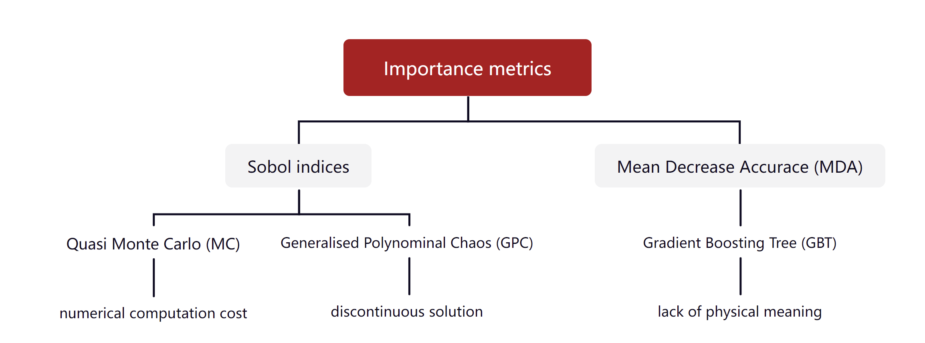
Stochastic Methods
drawbacks
Notes:
In this work, three different methods are employed to carry out SA of which Sobol method and GPC provide sobol indices whereas GBT gives MDA as the indicator of importance.

Slide 7
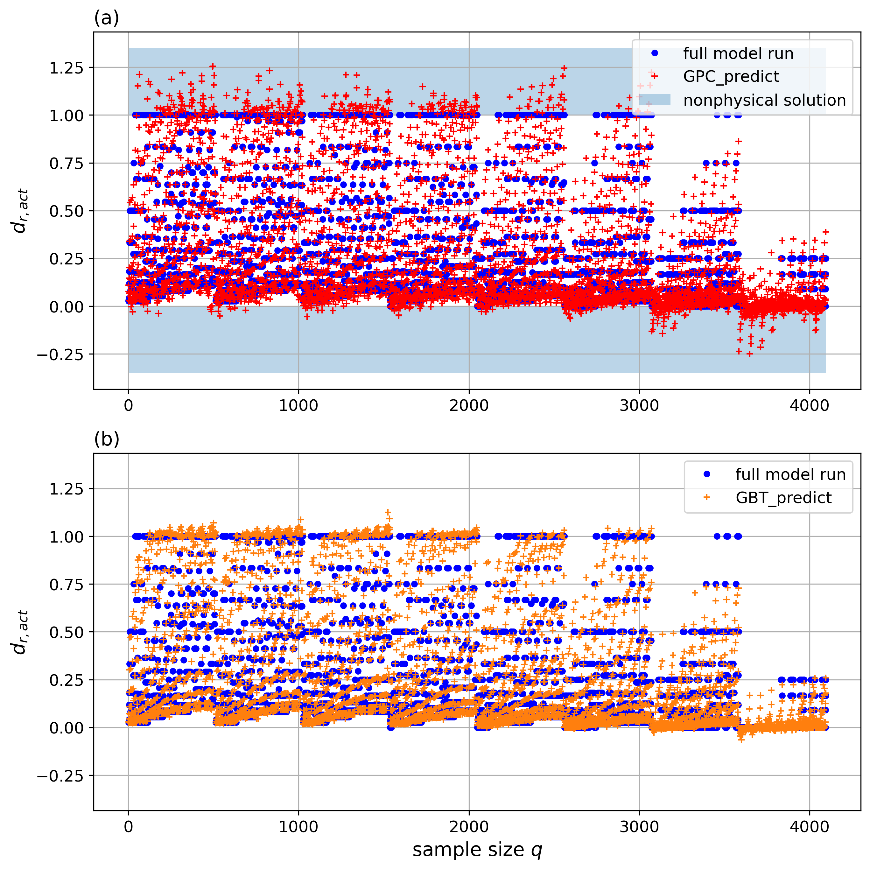
Prediction Performance
Coefficient of determination: $R_{GPC}^{2}$ = 0.79 $R_{GBT}^{2}$ = 0.96
Both surrogate models are able to approximate the forward model solutions
Notes:
Since GPC and GBT are the surrogate models, we had to access their prediction performance. The test results show both two surrogate models are able to approximate forward model solution. Even though GPC gives more non-physical solutions at these extreme cases.

Slide 8
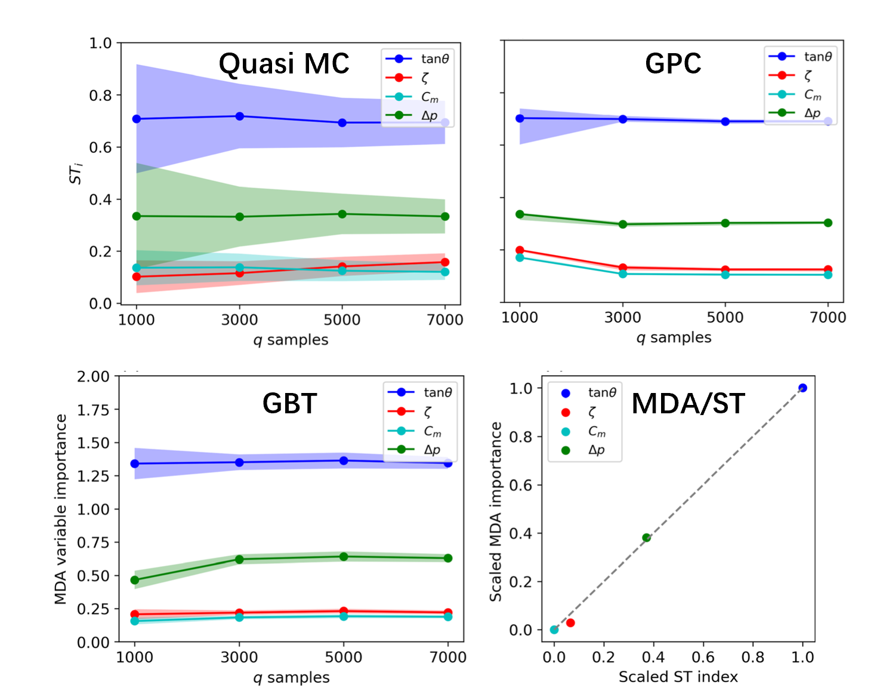
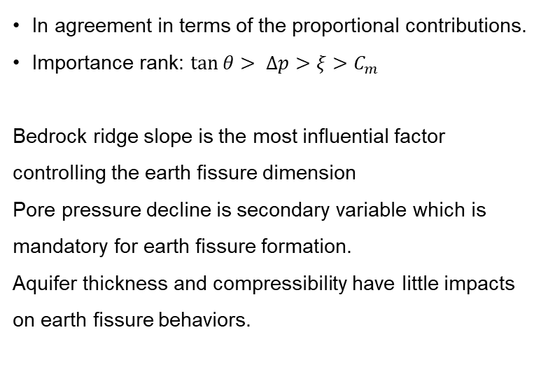
Importance Metrics
In agreement in terms of the proportional contributions.
Importance rank: $\tan{θ> ∆p>ξ>C_{m}}$
Bedrock ridge slope is the most influential factor controlling the earth fissure dimension
Pore pressure decline is secondary variable which is mandatory for earth fissure formation.
Aquifer thickness and compressibility have little impacts on earth fissure behaviors.
Shaded area presents 95% confidence intervals
Notes:
And lastly, we will finish by looking at the sensitivity results. If check these subplots one by one, it’s clear that the values computed by each method are pretty much in agreement in terms of proportional contributions. In general, all three methods suggest bedrock slope is the most influential factor to earth fissure dimension. Followed by pore pressure depletion which is mandatory for earth fissure formation. By contrast, the impacts of aquifer thickness and compressibility are quite low.

