Slide 1
Linking litter decomposition characterized by the Tea Bag Index to soil microbial characteristics under long term manure and crop rotation management
Yuting Fuª, Marcos Paradelo^{b}, Sabine Ravnskovª, Lis W. de Jongeª, Emmanuel Arthurª
ªDepartment of Agroecology, Faculty of Technical Sciences, Aarhus University, Denmark
^{b}Natural Resources Institute, University of Greenwich, Kent, United Kingdom

Slide 2
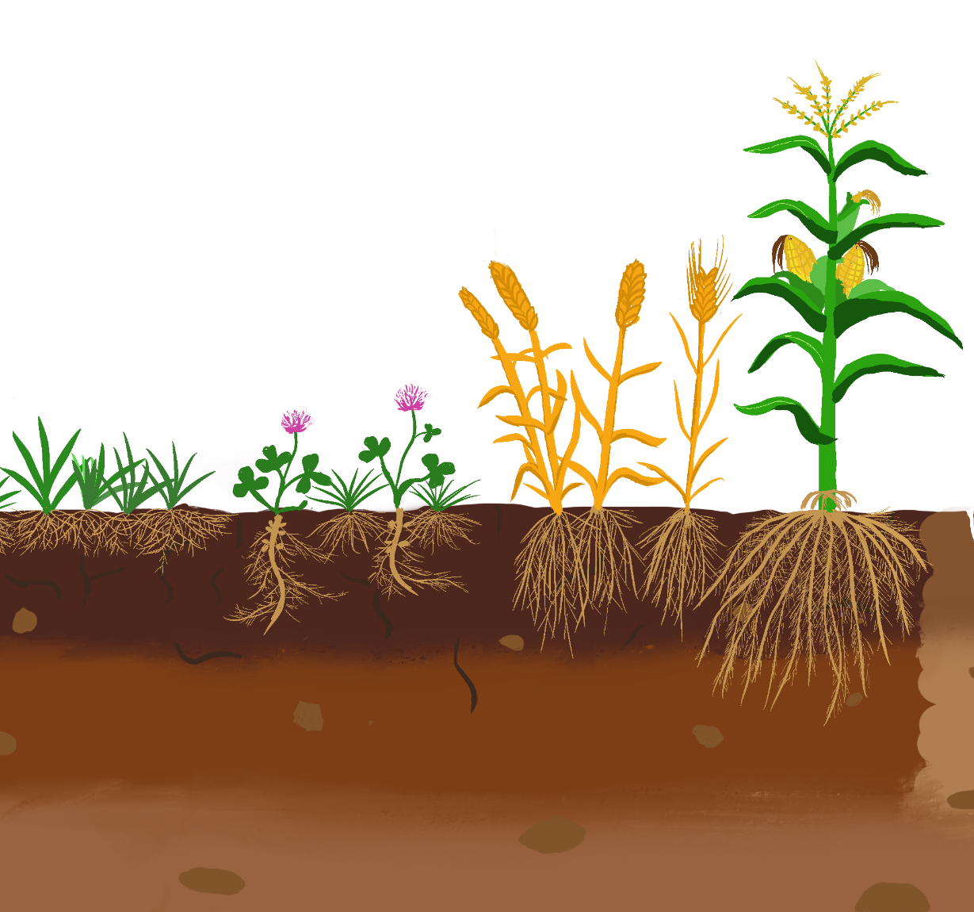
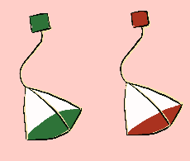
objectives
manure
Two research questions:
How do manure and crop types affect plant litter decomposition and microbial characteristics?
How are microbial characteristics correlated to plant litter decomposition?
Topsoil
Grass/clover – arable rotation
Arable rotation

Slide 3
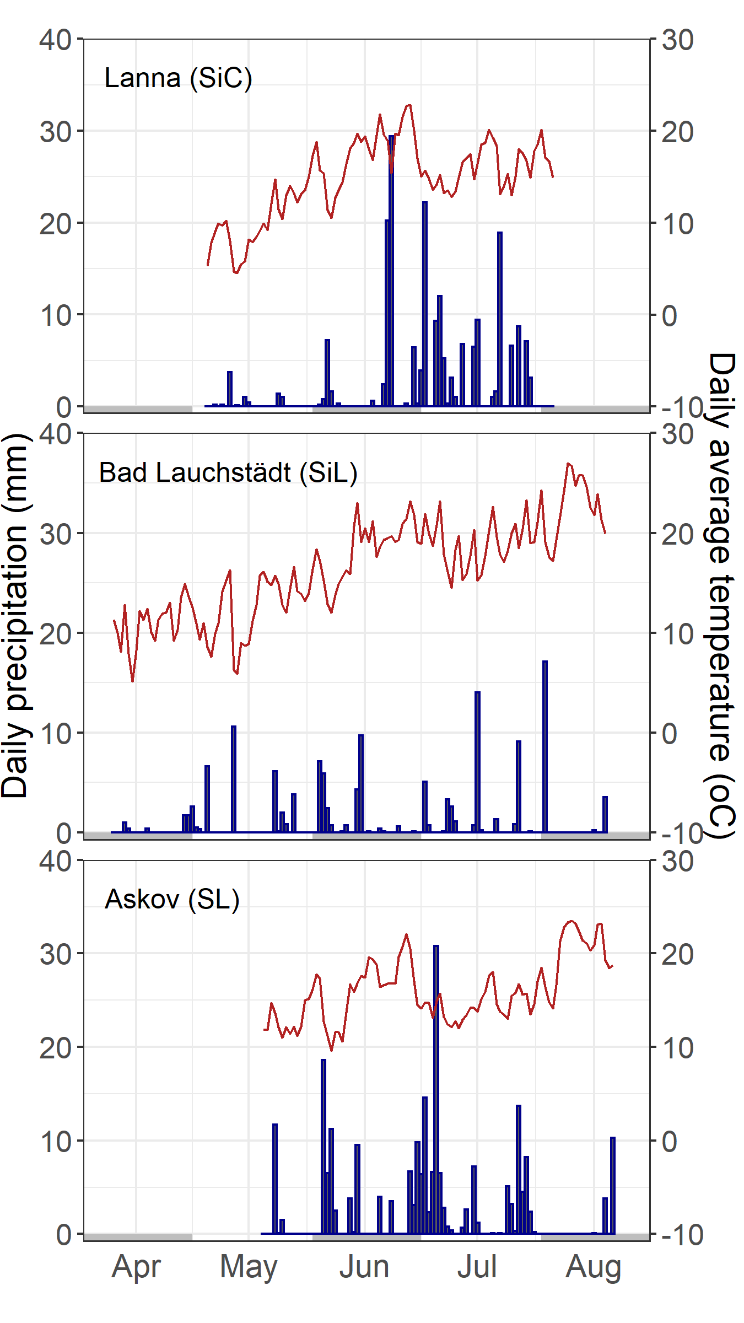
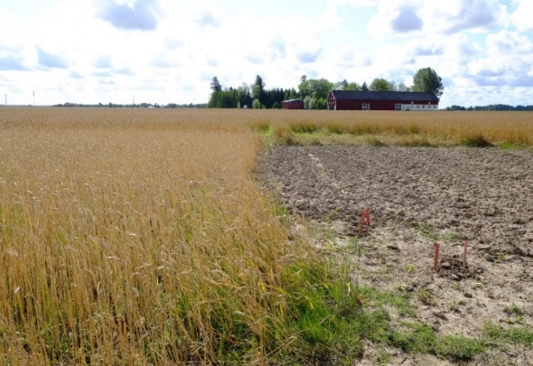


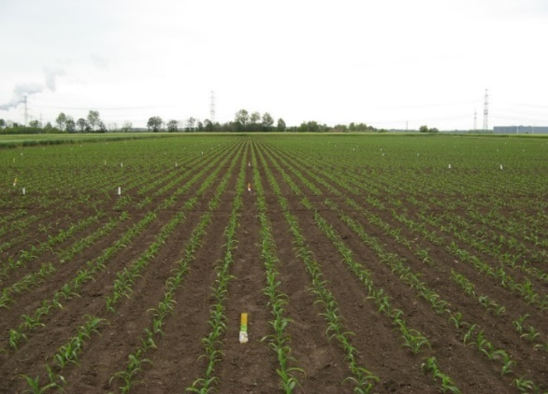
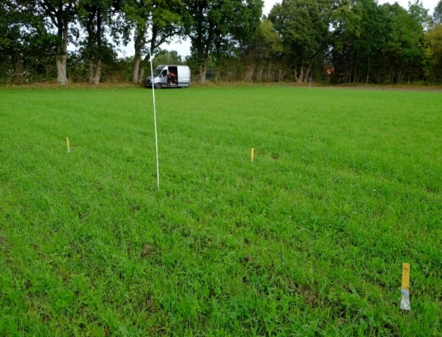
Lanna, SE, 25 years
Silty clay – Clayey
Unfertilized (UNF), 38t farmyard manure
Wheat
Silty loam – Silty
UNF, 30t farmyard manure
Barley, maize
Sandy loam – Sandy
UNF, 37.5t cattle slurry
Wheat, maize, barley, grass/clover
Bad Lauchstädt, DE, 119 years
*
Picture: Ines Merbach
Askov, DK, 127 years
*DWD – Deutscher Wetterdienst

Slide 4
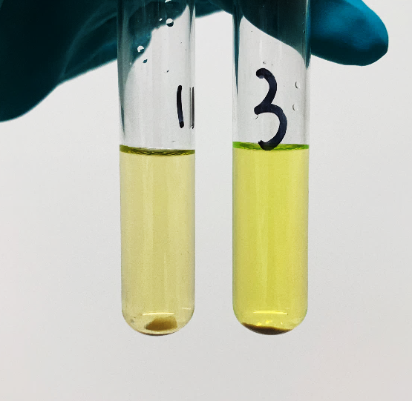
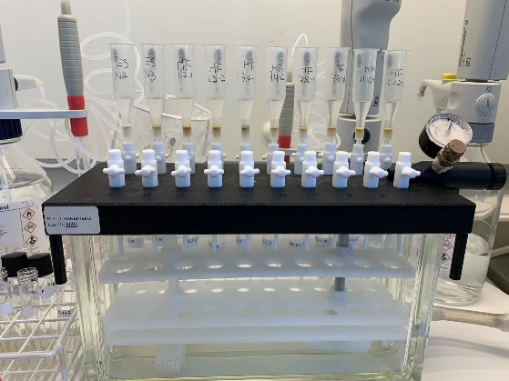


Lab analysis
Enzyme activity
Fluorescein diacetate hydrolysis
Biomarkers
Phospholipid fatty acids (PLFA) and neutral lipid fatty acids for arbuscular mycorrihzal fungi (AMF)
DNA sequencing
16S rRNA and ITS

Slide 5

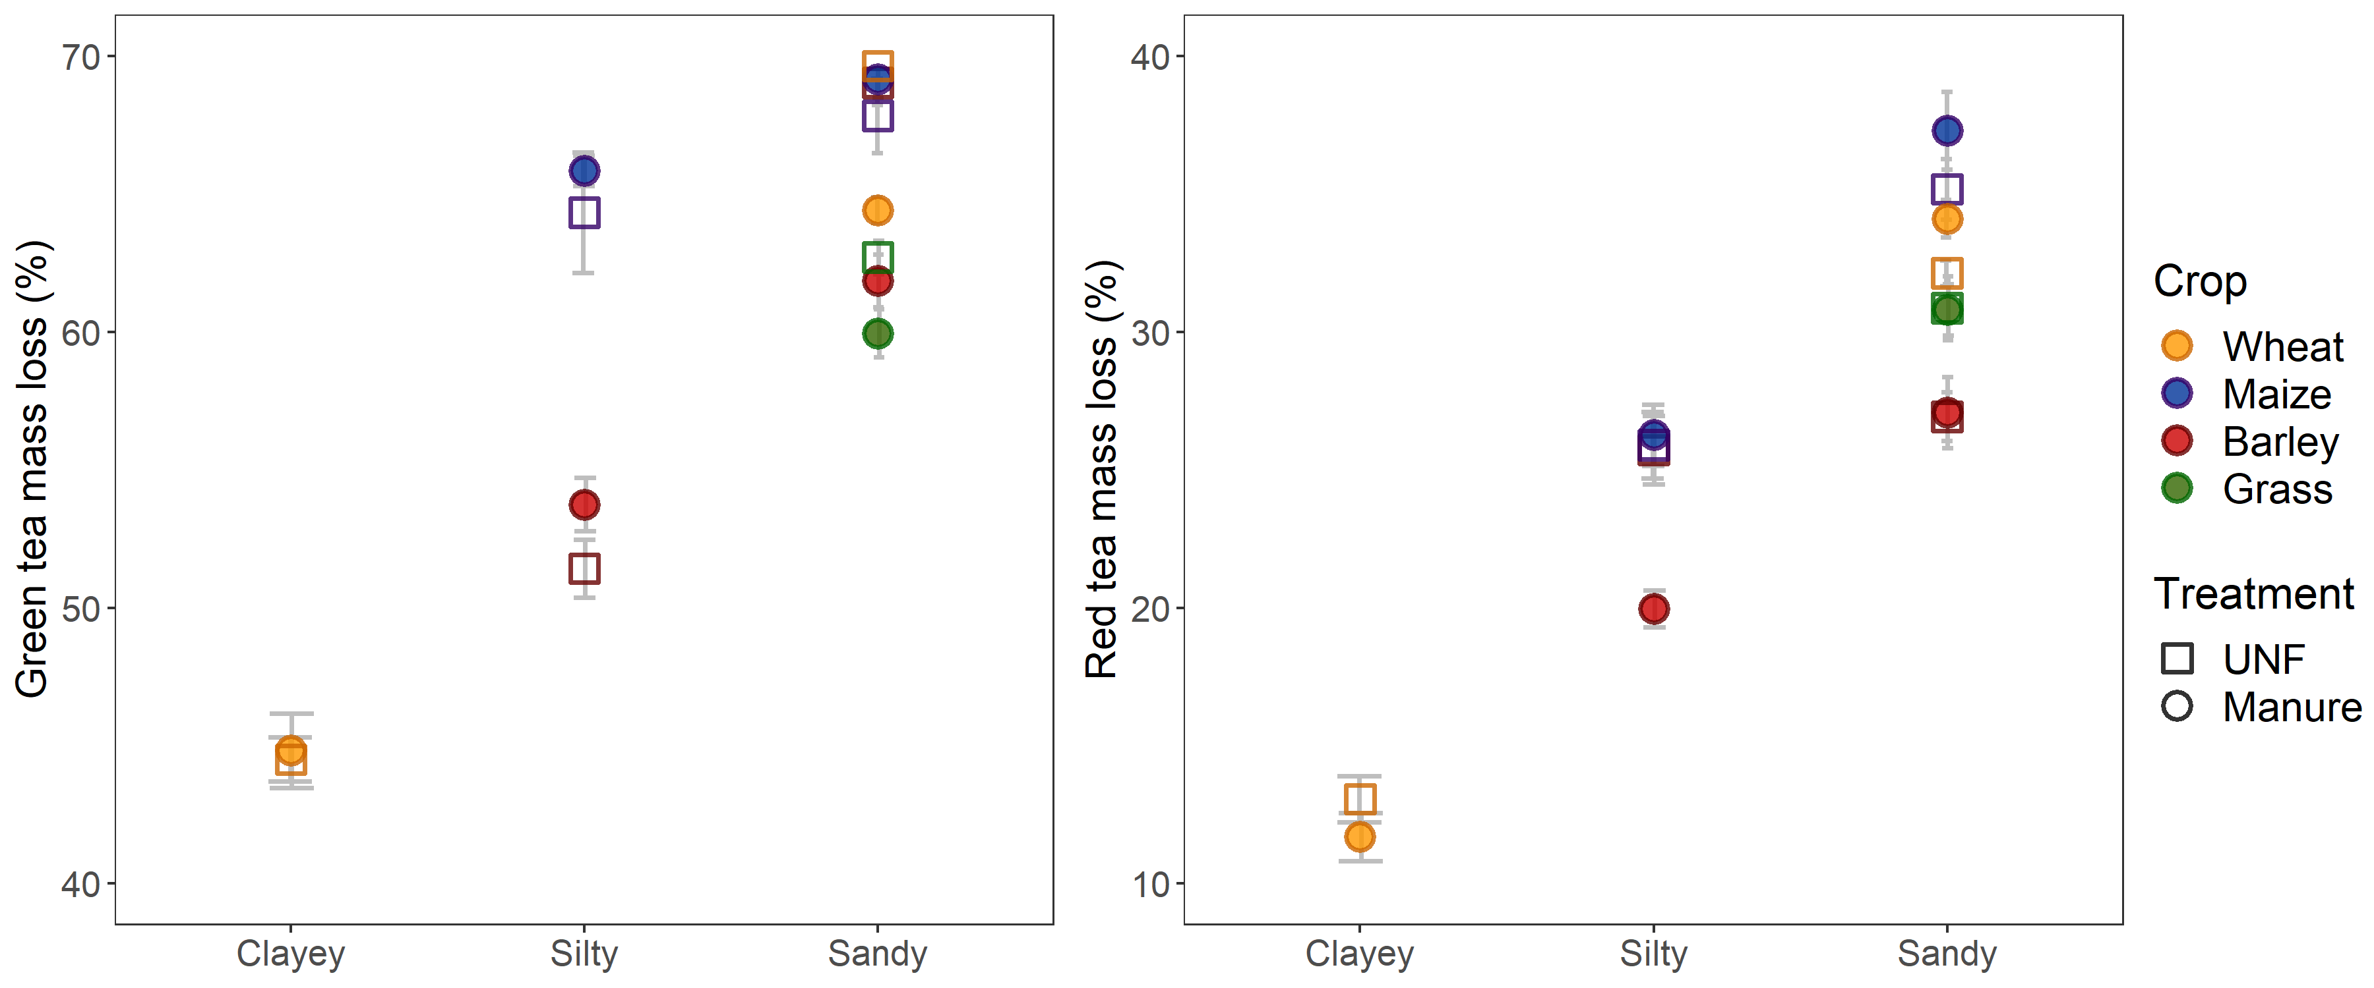
litter decomposition varied with tea type, crop type and soil type
Effect of manure on plant litter decomposition varied with litter type and crop type.

Slide 6
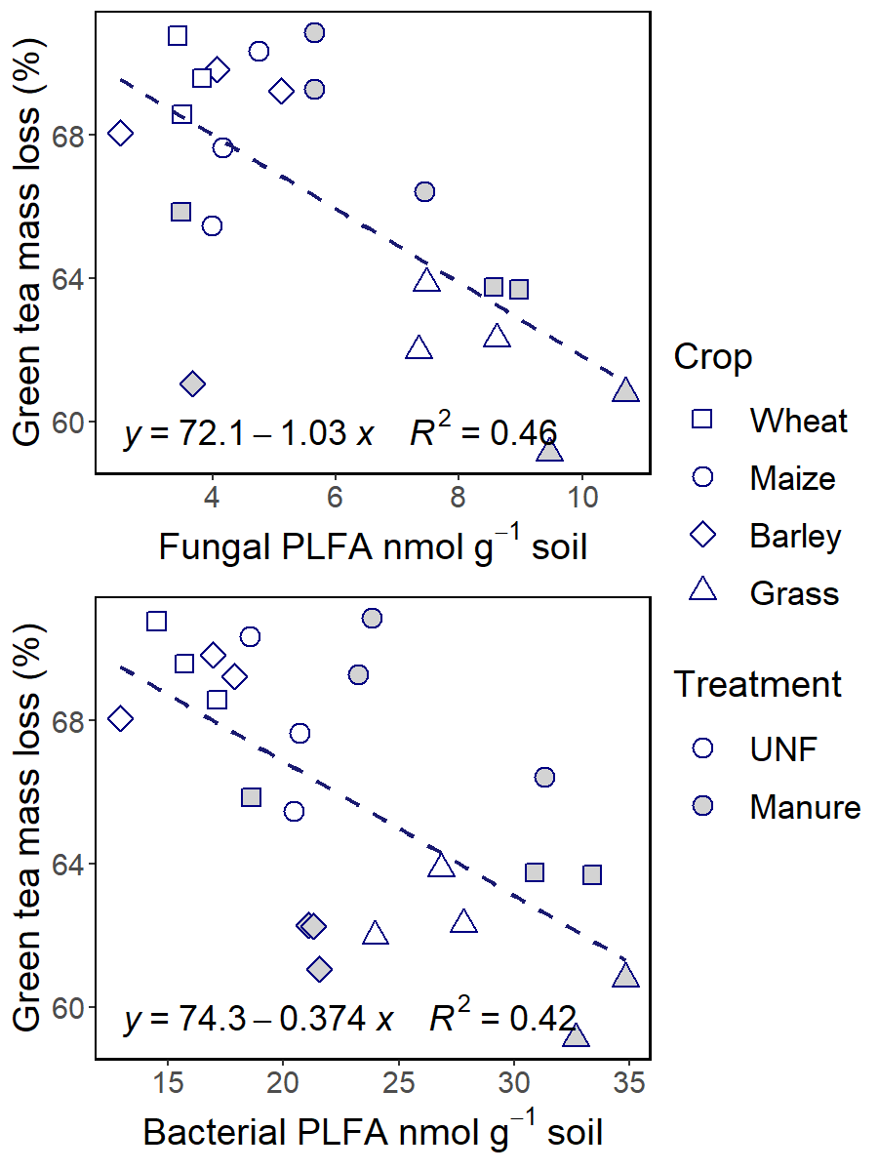
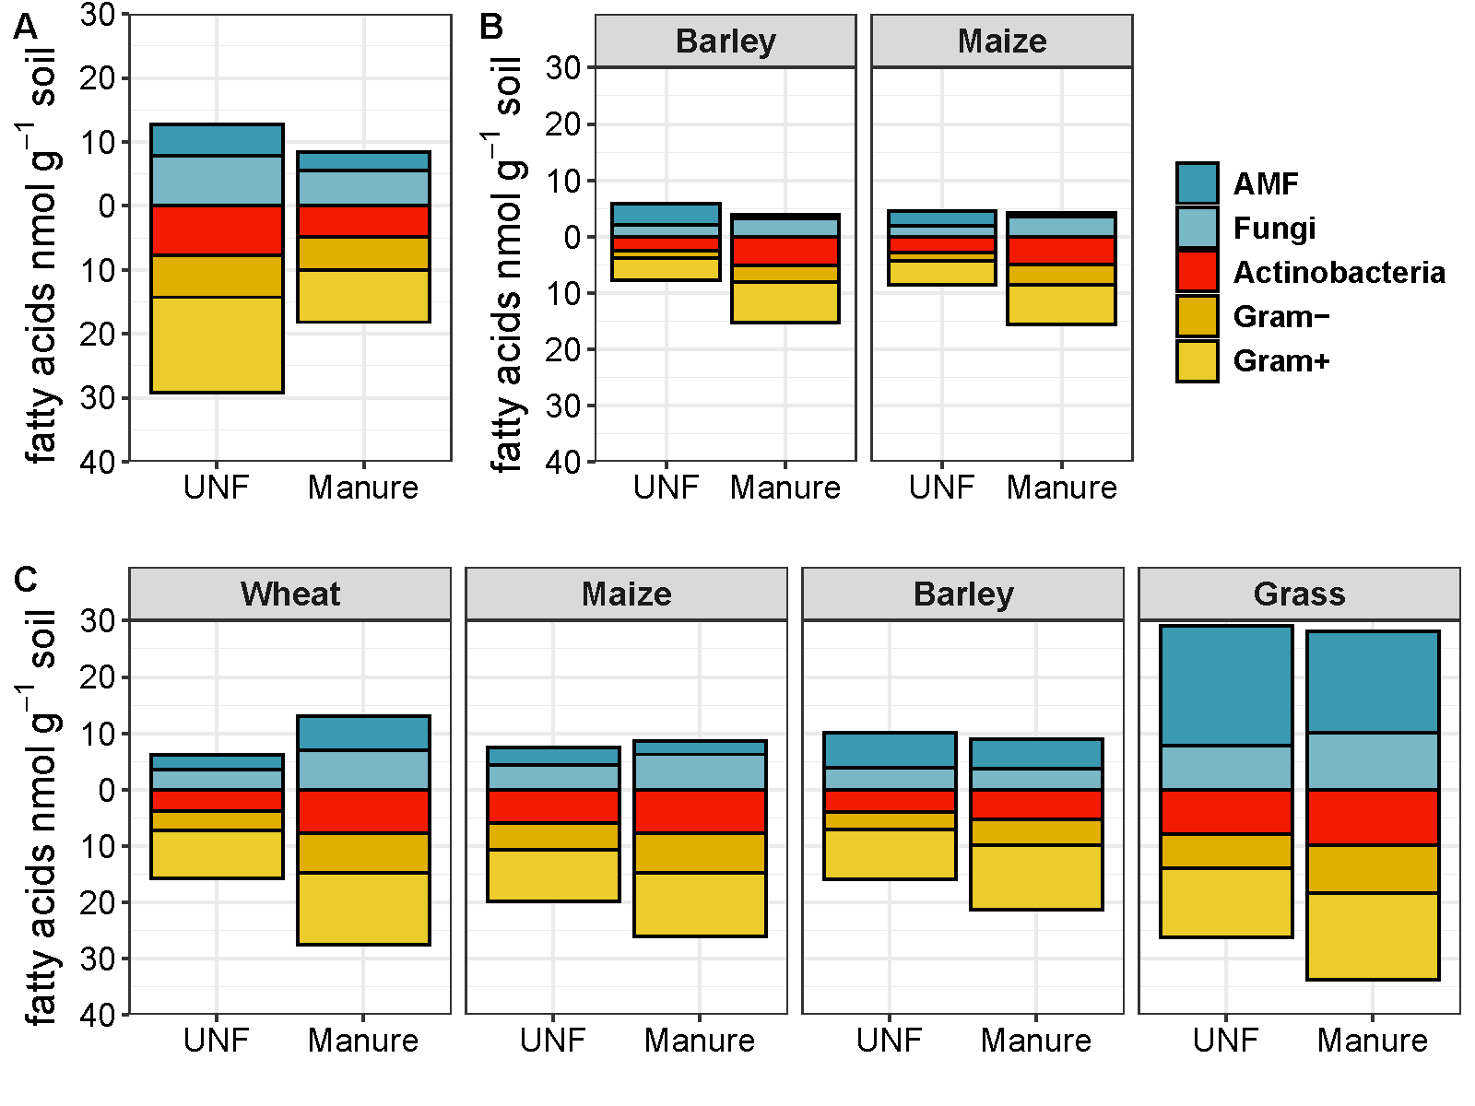
Manure increased fungal and bacterial PLFA in silty and sandy soils
Clayey Silty
Sandy
Notes:
The grass had the highest AMF.
No correlation between fungal:bacteria ratio and tea mass loss

Slide 7
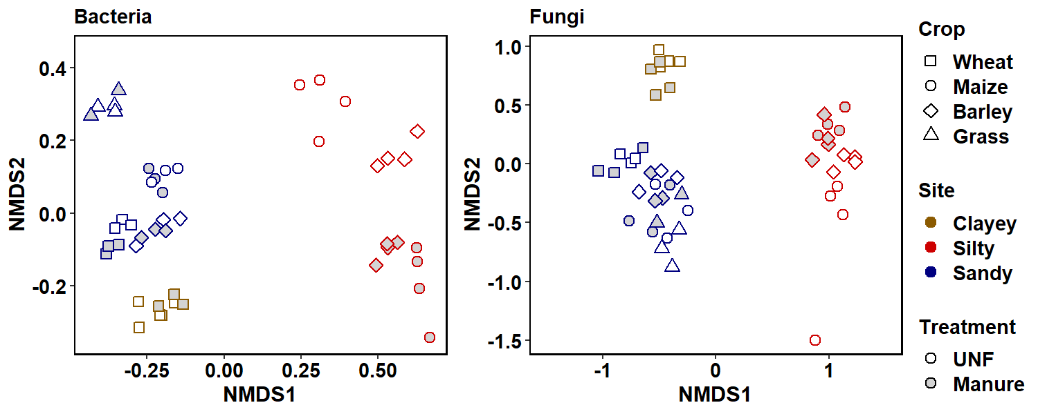
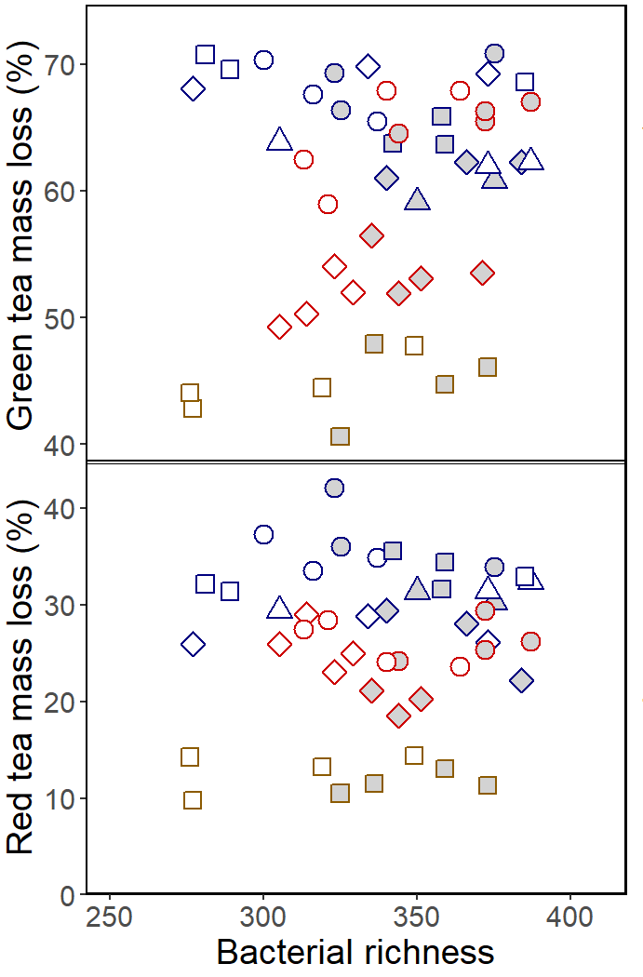
Manure and crop type impacted bacterial composition, not Fungal
Soil type has impact on microbial composition.
No clear correlations between tea mass loss and bacterial and fungal richness.

Slide 8
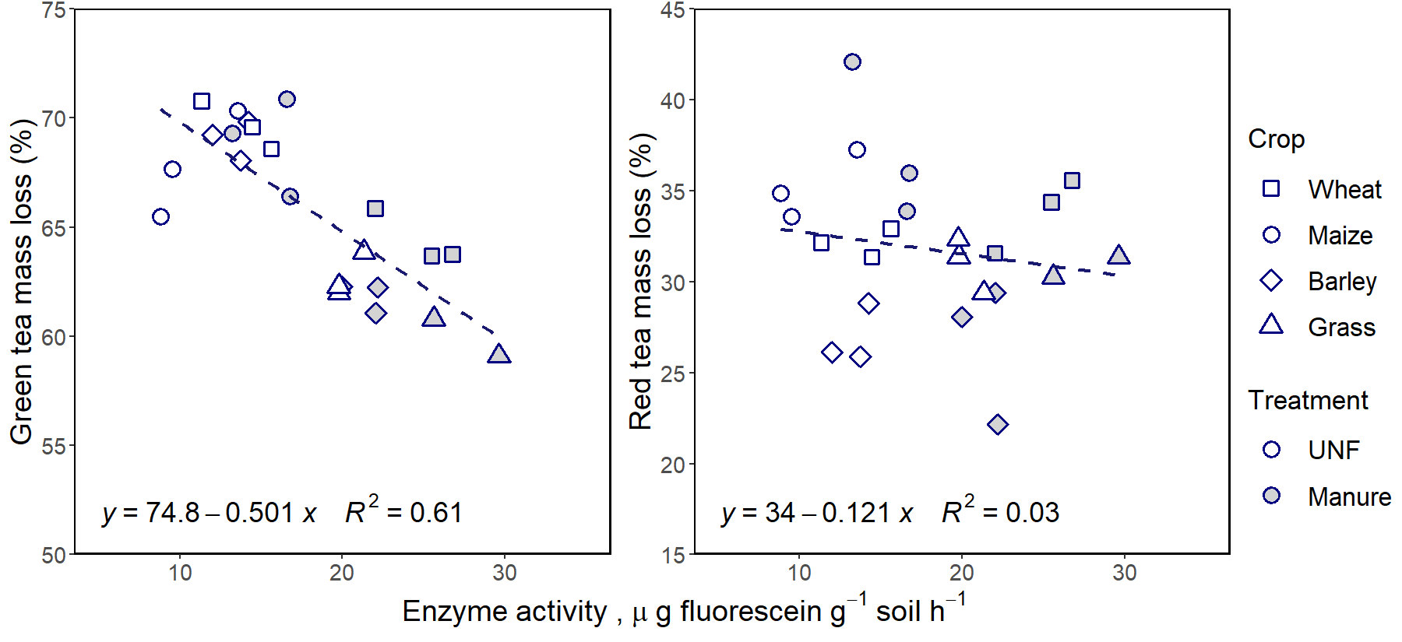
High enzyme activity could lead to lower green tea mass loss, but not for red tea in sandy soil

Slide 9
summary
How do manure and crop types affect plant litter decomposition and microbial characteristics?
Manure effect on litter decomposition depends on litter type, soil type and crop type.
Manure increased bacterial and fungal PLFA for sandy and silty soils; decreased it for the clayey soil. The change in AMF varied with crop type and soil type.
How are microbial characteristics correlated with plant litter decomposition?
No general correlation between tea mass loss and microbial richness and fungal:bacterial ratio.
In the sandy soil, high enzyme activity, high fungal and bacterial PLFA could lead to lower mass loss of more labile litter.

Slide 10
Acknowledgement
Lanna station (SLU)
Sofia Delin
Bad Lauchstädt station (UFZ)
Ines Merbach, Thomas Reitz and the staff
Askov station (AU)
Bent Christensen, Pia Andersen, Henning Thomsen
AU Flakkebjerg (AU)
Bente Laursen
Thank you for your attention!
yuting.fu@agro.au.dk

