Slide 1
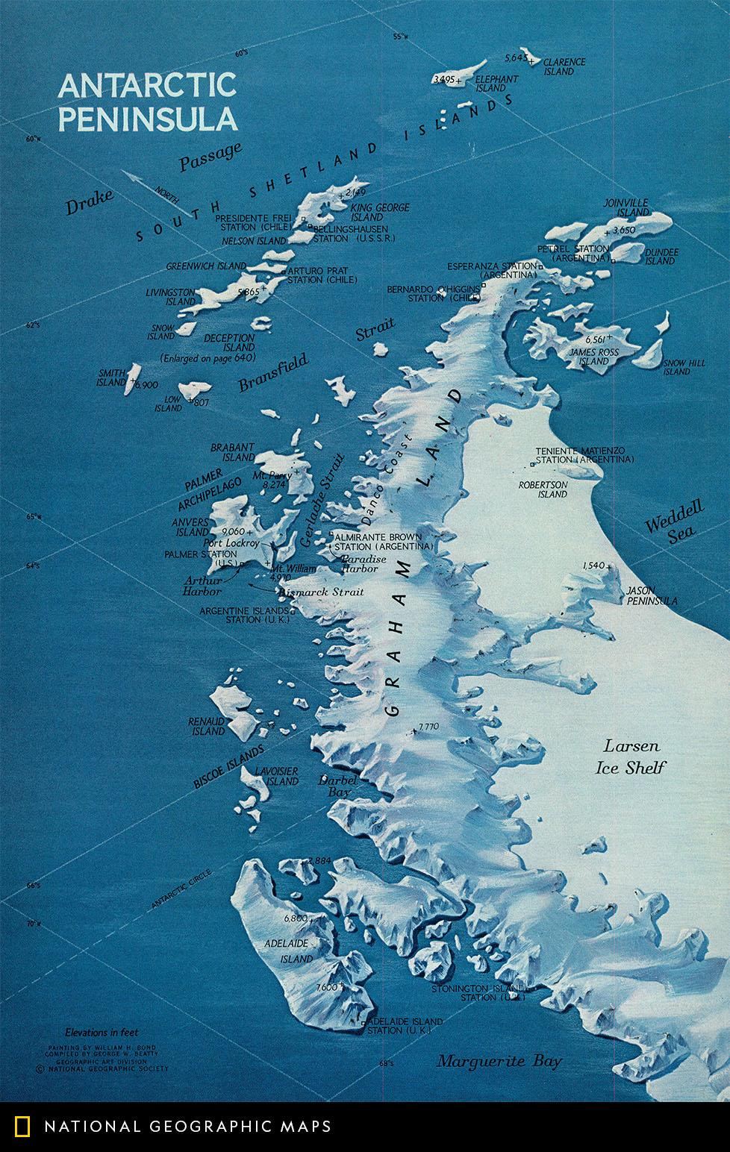





Interannual variability of winds in Antarctic MLT
From meteor radar observations and WACCM-X
Phoebe E Noble^{1,2}, C J Wright¹, N J Hindley¹, C Cullens³, S England⁴,
N Pedatella⁵, N J Mitchell^{1,2} & T Moffat-Griffin²
¹Centre for Space, Atmospheric and Oceanic Sciences, Department of Electronic Engineering, University of Bath, Bath, UK
²Atmosphere, Ice and Climate Team, British Antarctic Survey, Cambridge, UK
³Laboratory for Atmospheric and Space Physics, University of Colorado, Boulder, CO, USA
⁴Virginia Polytechnic Institute and State University, Blacksburg, VA, USA
⁵High Altitude Observatory, National Center for Atmospheric Research, Boulder, CO, USA
Rothera
Notes:
27
63
Conversation
NatGeoMaps
@NatGeoMaps
Map of the Day: Painted by William H. Bond, this map details Antarctica's panhandle, the 800-mile-long Antarctic Peninsula, in November 1971.

Slide 2
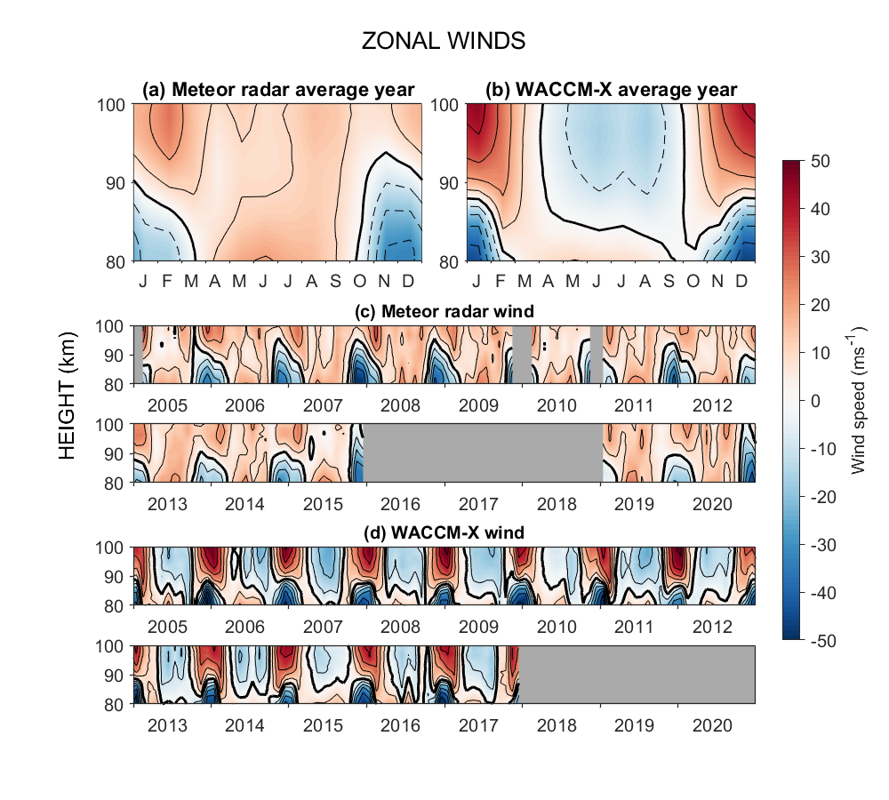
The meteor radar at Rothera measures winds at 80-100km altitude
WACCM-X version 2.1 extended runs (specified dynamics version)
Average year of zonal winds from 2005-2020
We find large biases between meteor radar observations and WACCM-X
Zonal winds

Slide 3
The meteor radar at Rothera measures winds at 80-100km altitude
WACCM-X version 2.1 extended runs (specified dynamics version)
Average year of zonal winds from 2005-2020
We find large biases between meteor radar observations and WACCM-X
Zonal winds
We propose that the bias here is due to the lack of secondary gravity wave modelling in GCMs
In Antarctic winter at heights of 85-100km, WACCM predicts westwards winds, whilst the radar observations show eastwards winds

Slide 4
Time series of monthly winds from 2005-2020
We can see the biases between the model and observations occurring every year
Interannual variability in both meteor radar observed winds and WACCM-X simulated winds
Cullens et al (2016) found evidence to suggest that the 11-year solar cycle influences the winds in the MLT
Zonal wind – radar observations
Zonal wind – WACCM-X model
Zonal wind – WACCM-X model
Notes:
Data availability – datagaps
Difference between MR/WACCM (zonal wind only – no time for meridional).
Also there is interannual variability

Slide 5
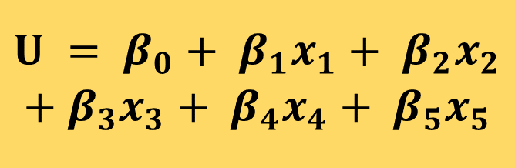
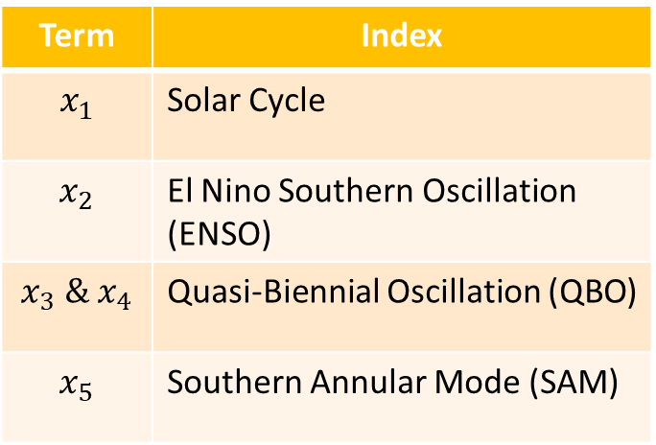
Multilinear Regression
$$U = β_{0}+ β_{1}x_{1}+ β_{2}x_{2}$$
$$+ β_{3}x_{3}+ β_{4}x_{4}+ β_{5}x_{5}$$
Term | Index
$$x_{1}$$ | Solar Cycle
$$x_{2}$$ | El Nino Southern Oscillation (ENSO)
$x_{3} \&$ $x_{4}$ | Quasi-Biennial Oscillation (QBO)
$$x_{5}$$ | Southern Annular Mode (SAM)

Slide 6
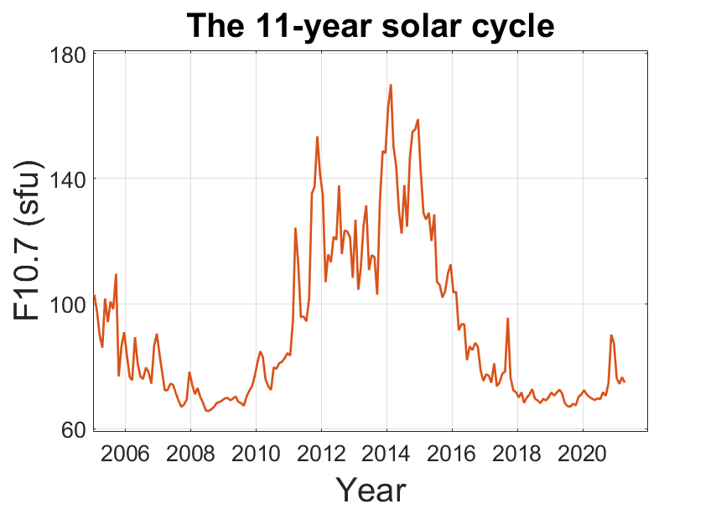
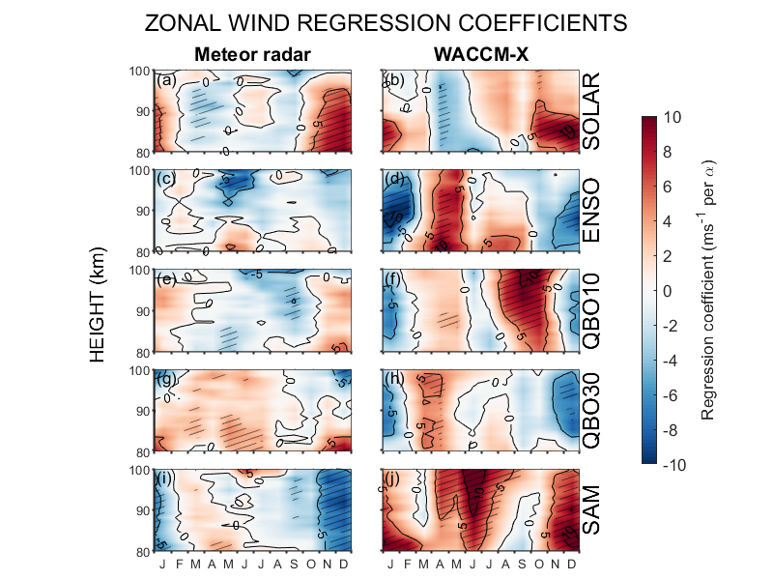
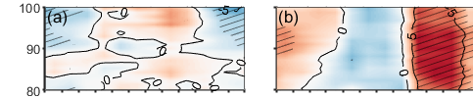
Multilinear Regression
The 11-year solar cycle
$$U = β_{0}+ β_{1}x_{1}+ β_{2}x_{2}$$
$$+ β_{3}x_{3}+ β_{4}x_{4}+ β_{5}x_{5}$$
Zonal
Term | Index
$$x_{1}$$ | Solar Cycle
$$x_{2}$$ | El Nino Southern Oscillation (ENSO)
$x_{3} \&$ $x_{4}$ | Quasi-Biennial Oscillation (QBO)
$$x_{5}$$ | Southern Annular Mode (SAM)
ms⁻¹ per 70 sfu
Meridional
= statistically significant at the 90% level

Slide 7
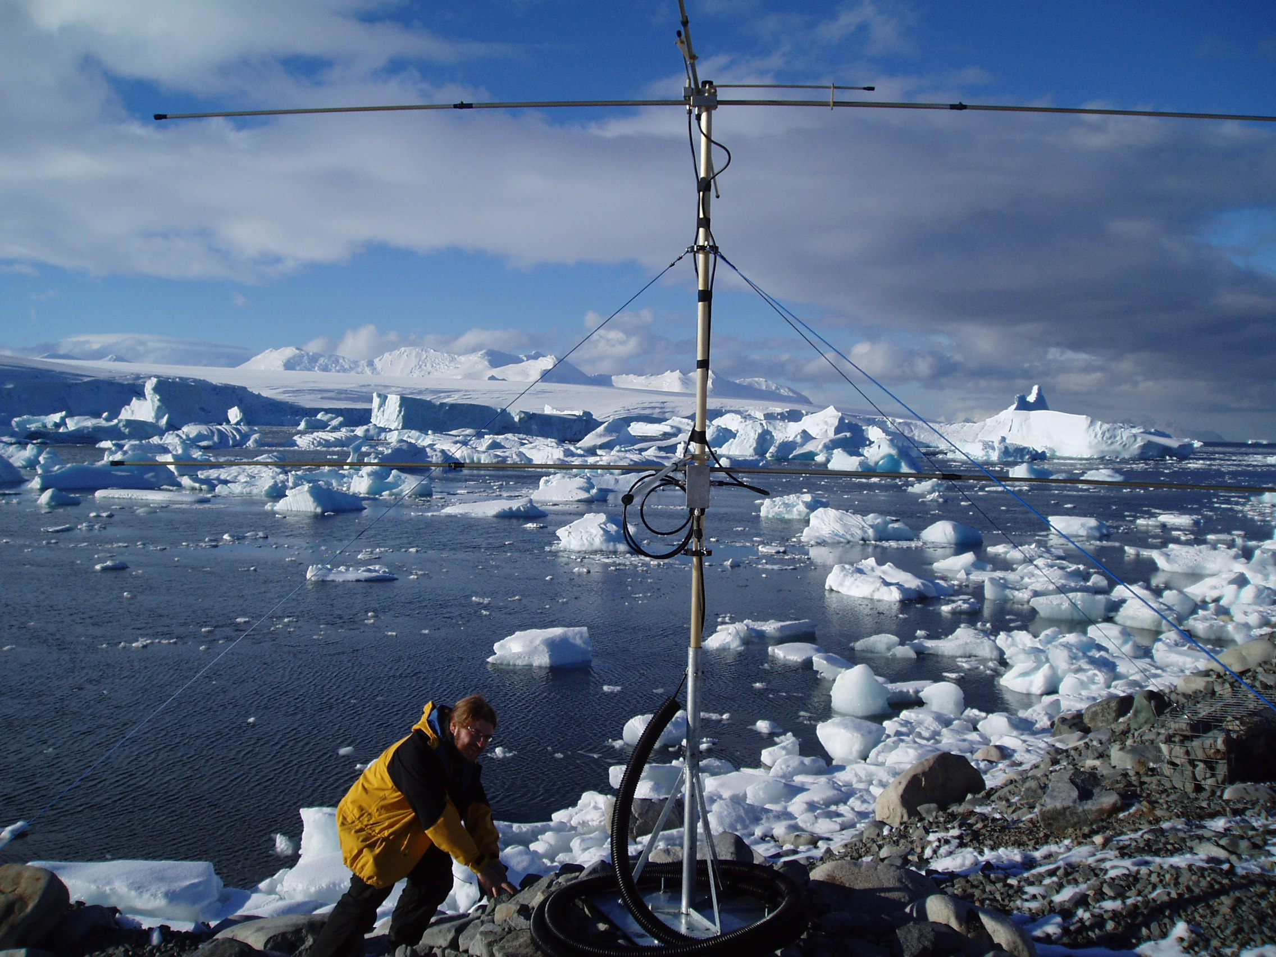
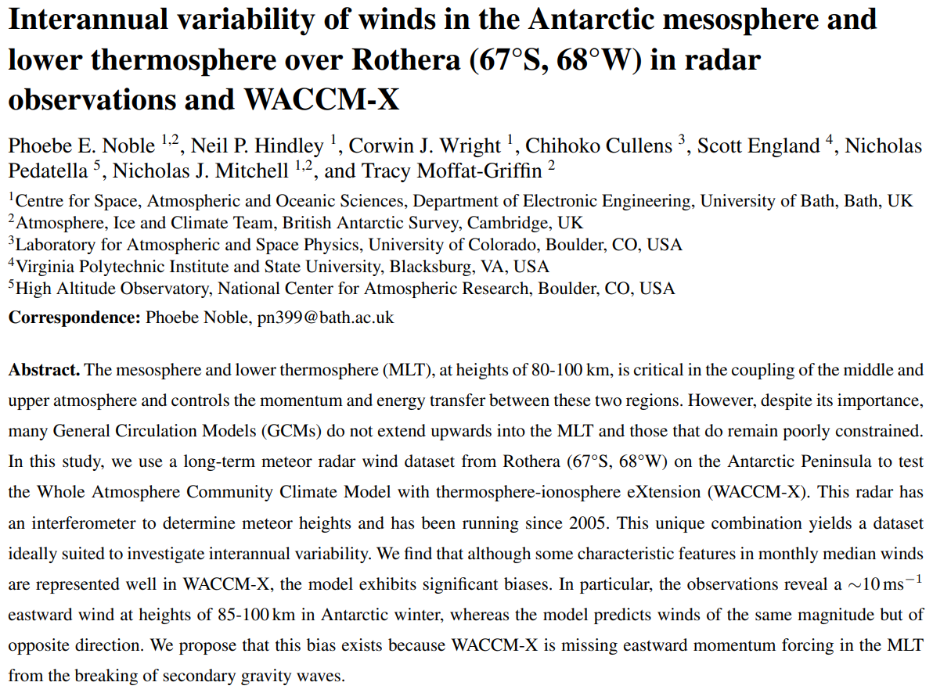

Summary
We compared
  Data from the meteor radar at Rothera
  WACCM-X 2.1
Used a multilinear regression method to explore drivers of interannual variability.
Key results:
  1) Large biases between modelled and observed winds
  2) Zonal wind in both observations and models correlates with the solar cycle (but meridional results do not agree!)

