Slide 1

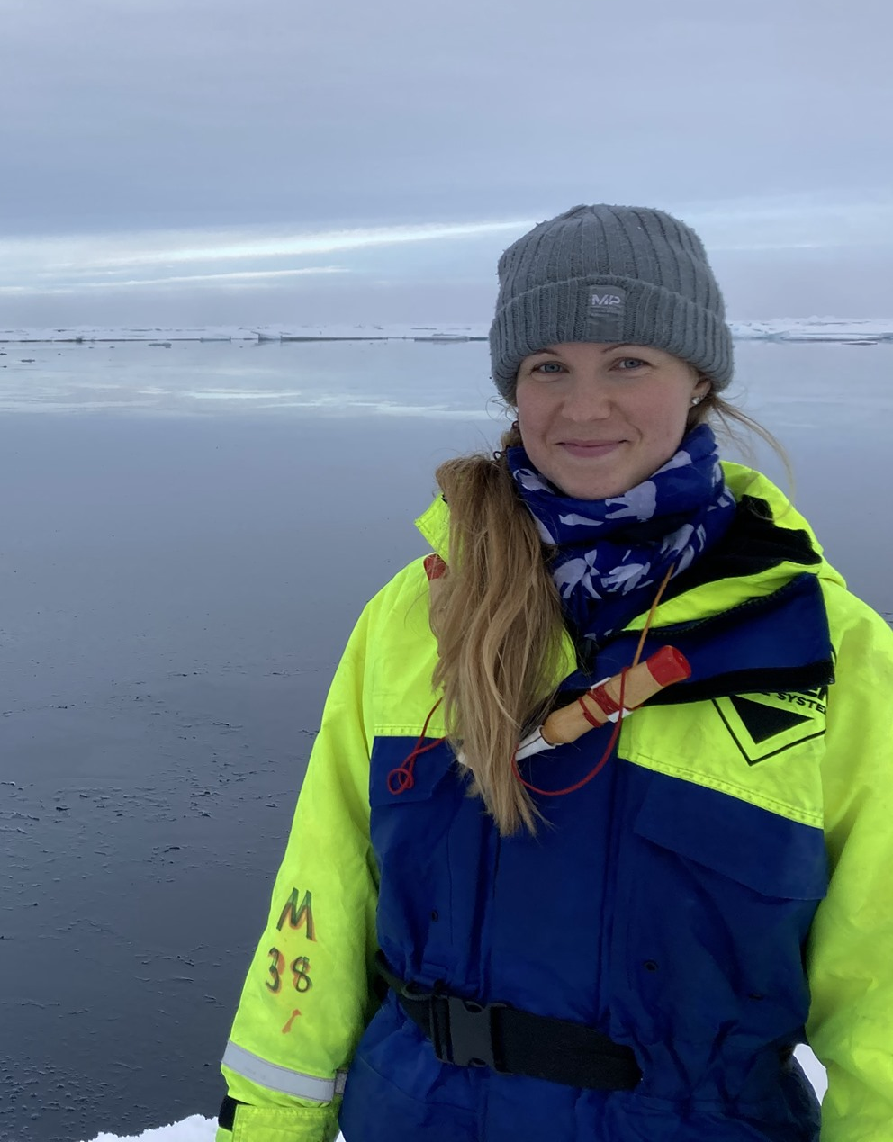
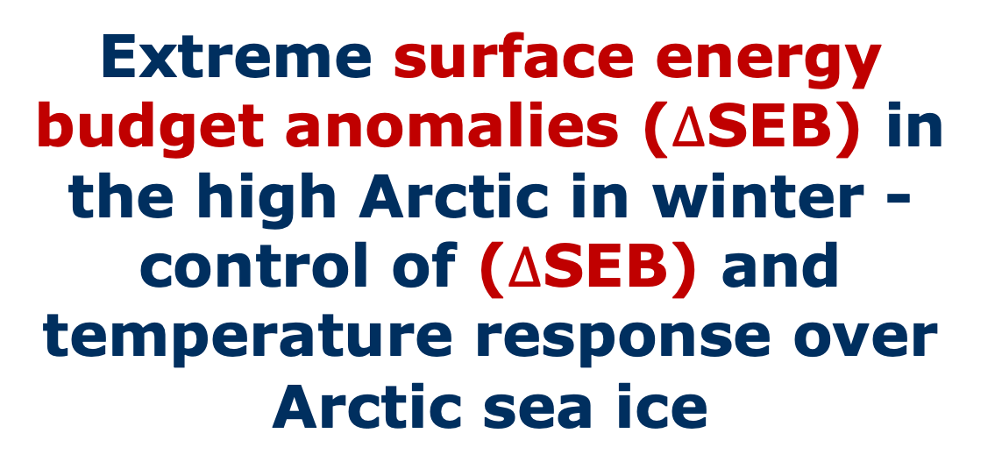
Extreme surface energy budget anomalies ($∆$SEB) in the high Arctic in winter - control of ($∆$SEB) and temperature response over Arctic sea ice
Extended material
In review Journal of Climate
Sonja Murto^{1,2}, Lukas Papritz³, Gabriele Messori^{2,4}, Heini Wernli³, Rodrigo Caballero^{1,2}, Gunilla Svensson^{1,2}
¹ Department of Meteorology, Stockholm University, Stockholm, Sweden
² Bolin Centre for Climate Research, Stockholm University, Stockholm, Sweden
³ Institute for Atmospheric and Climate Science, ETH Zürich, Zürich, Switzerland
⁴ Department of Earth Sciences and Centre of Natural Hazards and Disaster Science, Uppsala University, Uppsala, Sweden
sonja.murto@misu.su.se

Slide 2


Motivation – wintertime Arctic extremes
Woods et al. 2013
Boisvert et al. 2016
Zheng et al. 2022
Park et al. 2015
Woods &
Caballero 2016
Woods &
Caballero 2016
Lee et al. 2017
Notes:
SEB = energy flow within the Earth system, influenced by moist intrusions. Driver of surface processes

Slide 3
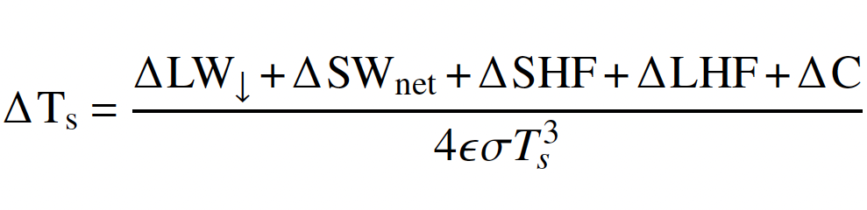
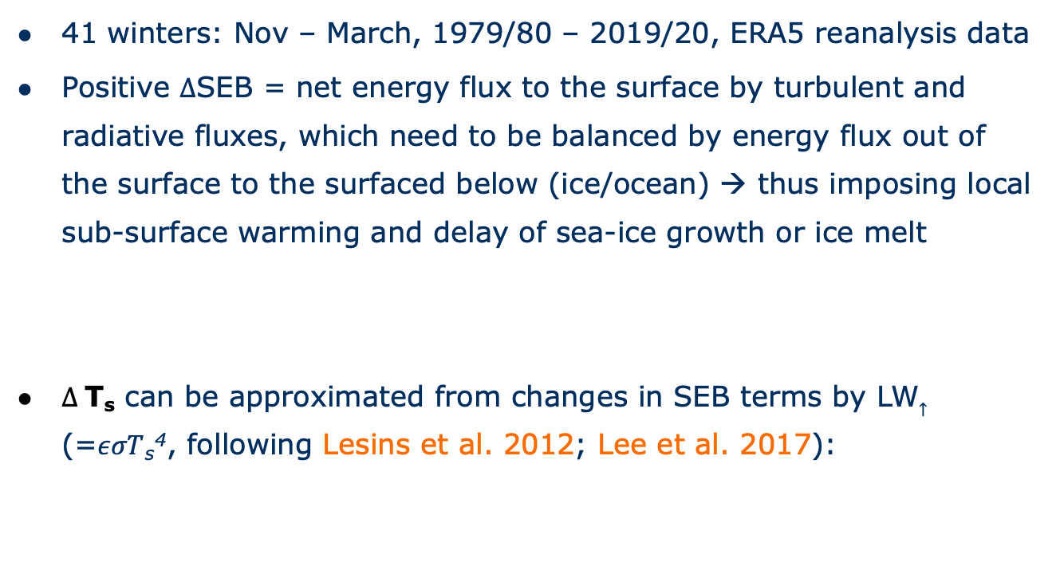

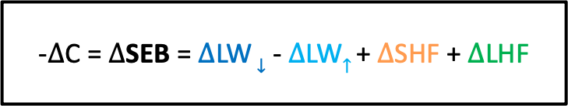
Wintertime Arctic extremes events defined by positive SEB anomalies ($∆$SEB) over sea-ice
41 winters: Nov – March, 1979/80 – 2019/20, ERA5 reanalysis data
Positive $∆$SEB = net energy flux to the surface by turbulent and radiative fluxes, which need to be balanced by energy flux out of the surface to the surfaced below (ice/ocean) → thus imposing local sub-surface warming and delay of sea-ice growth or ice melt
$∆$T_{s} can be approximated from changes in SEB terms by LW$↑$ (=$εσT$_{s}⁴, following Lesins et al. 2012; Lee et al. 2017):
-$∆$C = $∆$SEB = $∆$LW $↓$ - $∆$LW$↑$ + $∆$SHF + $∆$LHF

Slide 4
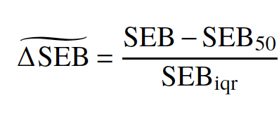

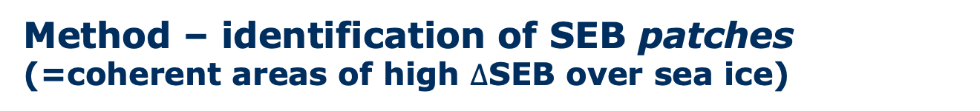

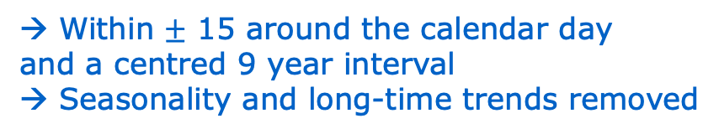

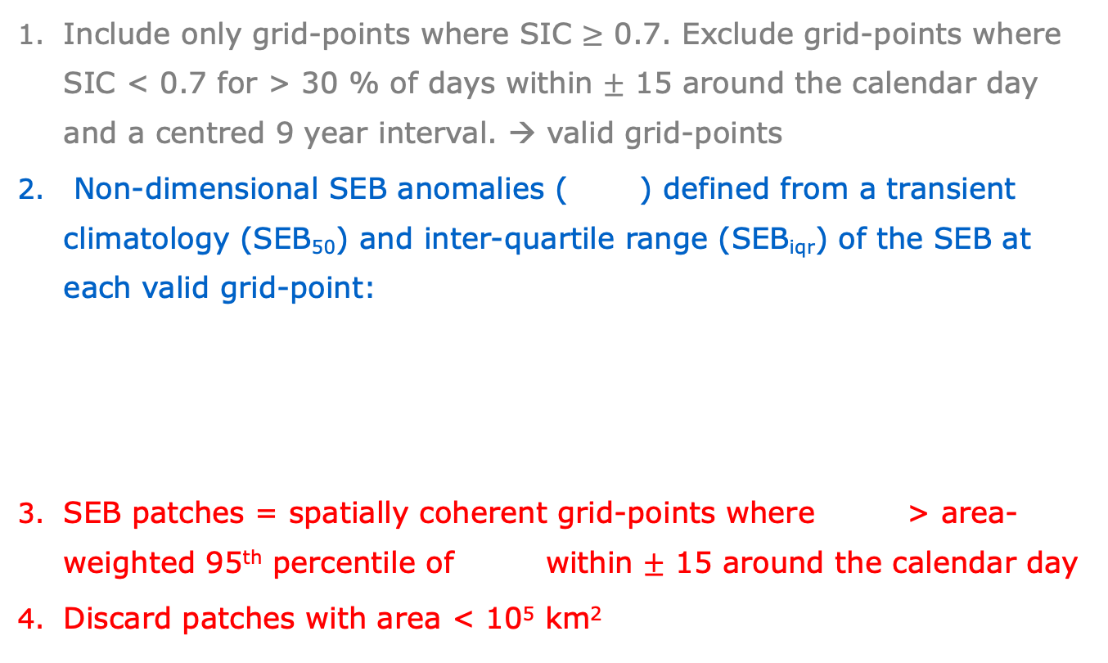
Method – identification of SEB patches (=coherent areas of high $∆$SEB over sea ice)
Include only grid-points where SIC $≥$ 0.7. Exclude grid-points where SIC < 0.7 for > 30 % of days within $±$ 15 around the calendar day and a centred 9 year interval. → valid grid-points
Non-dimensional SEB anomalies ( ) defined from a transient climatology (SEB₅₀) and inter-quartile range (SEB_{iqr}) of the SEB at each valid grid-point:
SEB patches = spatially coherent grid-points where > area-weighted 95th percentile of within $±$ 15 around the calendar day
Discard patches with area < 10⁵ km²
Sea ice
$∆$SEB
SEB anomalies
Within $±$ 15 around the calendar day
and a centred 9 year interval
→ Seasonality and long-time trends removed
$∆$SEB
$∆$SEB
SEB patches
Notes:
Transient climatology

Slide 5
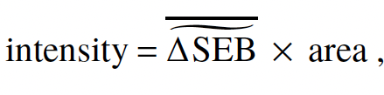
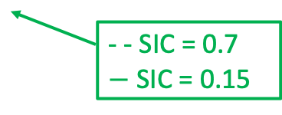

Method – definition of life-cycle events (LCEs) (=temporally connected SEB patches)
Amplitude $×$ Affected area
Individual patches (forward and backward in timeare temporally connected to multi-day LCEs:
1. centroid of the patch at t+1 within 2 equivalent radii from patch at t, AND
2. the centroid trajectories are within 1500 km 2 days prior to arrival at the patches
10d Centroid of backward trajectories started at 200 hPa AGL from the patch
Sectors of air mass origin:
Pacific, Atlantic, Canada, Siberia
Location 2 days prior to arrival in the peak event determines the origin of the LCE
t
t+1
Peak event = SEB patch with largest intensity
ONSET – PEAK – DECAY
142 LCEs
- - SIC = 0.7
$−$ SIC = 0.15

Slide 6
LCEs associated with vertically deep moist and warm air intrusions
~ 3.5 LCEs per winter season (0 – 8 LCEs)
Duration ~ 5 days (2 – 12 days)
Atlantic LCEs in Nov & Dec (higher North-Atlantic cyclone activity), Pacific LCEs in Feb & March (more blocks over Alaska)
→ Entire tropospheric column anomalously (~10K) warm
142 LCEs
at PEAK
Atlantic
Pacific
More cyclones in Greenland-Iceland & Central Arctic
More blocks in Northern Eurasia
More cyclones (blocks) in western (eastern) North Pacific

Slide 7
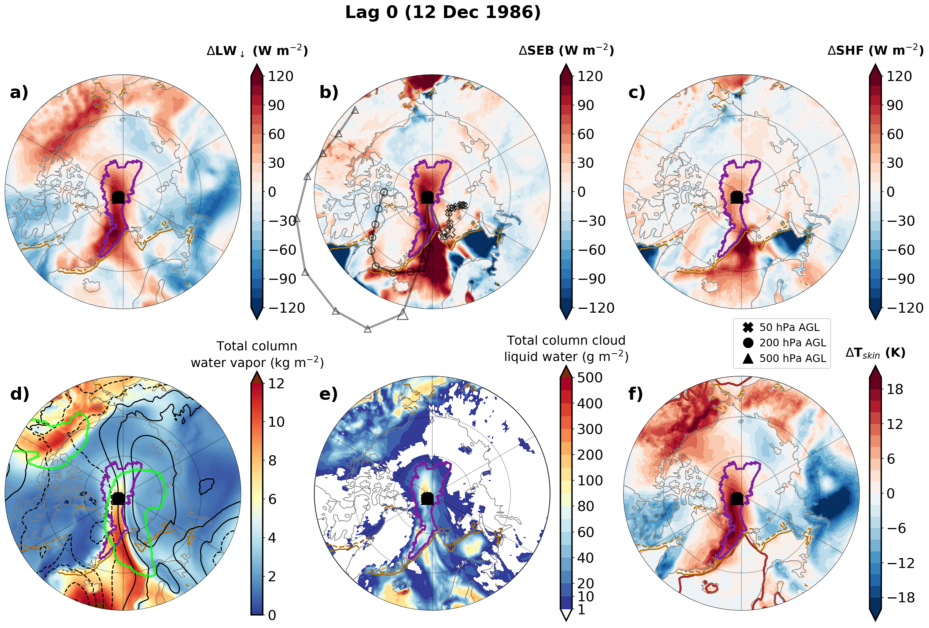

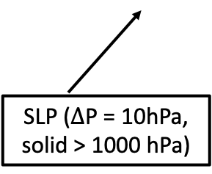




Case study – Atlantic event LCE 44 (5days) at peak
$∆$LW$↓$
$∆$SEB
$∆$SHF
10d Backward trajectories from the peak event
SEB patch
Column water vapor
Cloud liquid water
$∆$T_{s}
SLP ($∆$P = 10hPa, solid > 1000 hPa)
blocking
Animation $±$10 days around the peak event

Slide 8
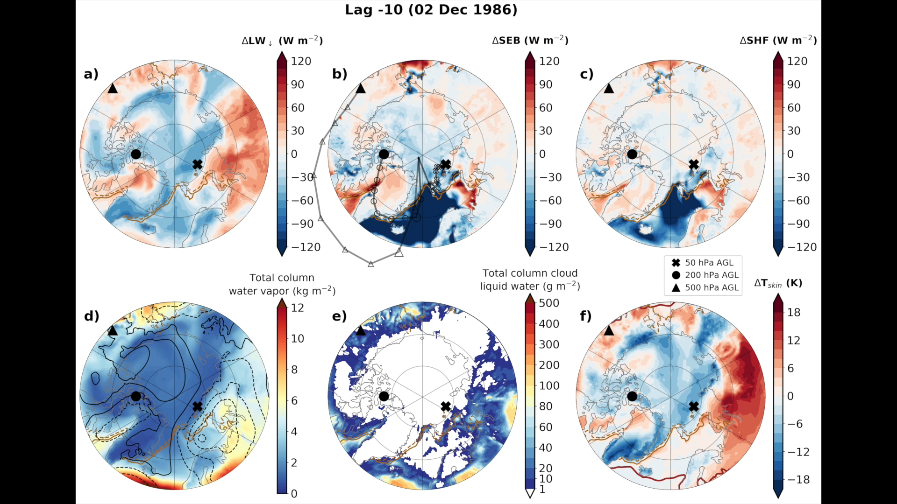


LCE 44 (peak 12 December 1986) - animation -
$∆$SEB
terms
Moisture, clouds
$∆$T_{s}

Slide 9
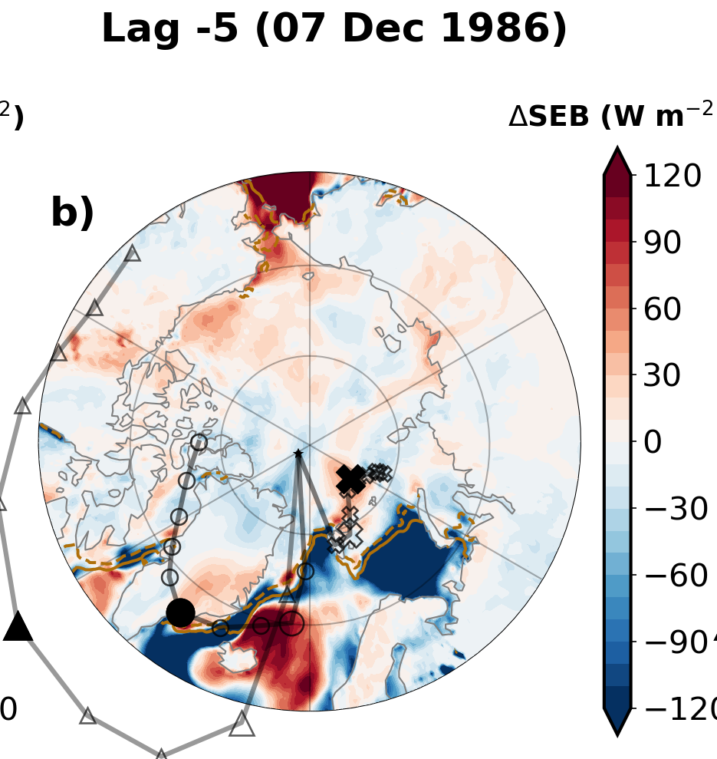
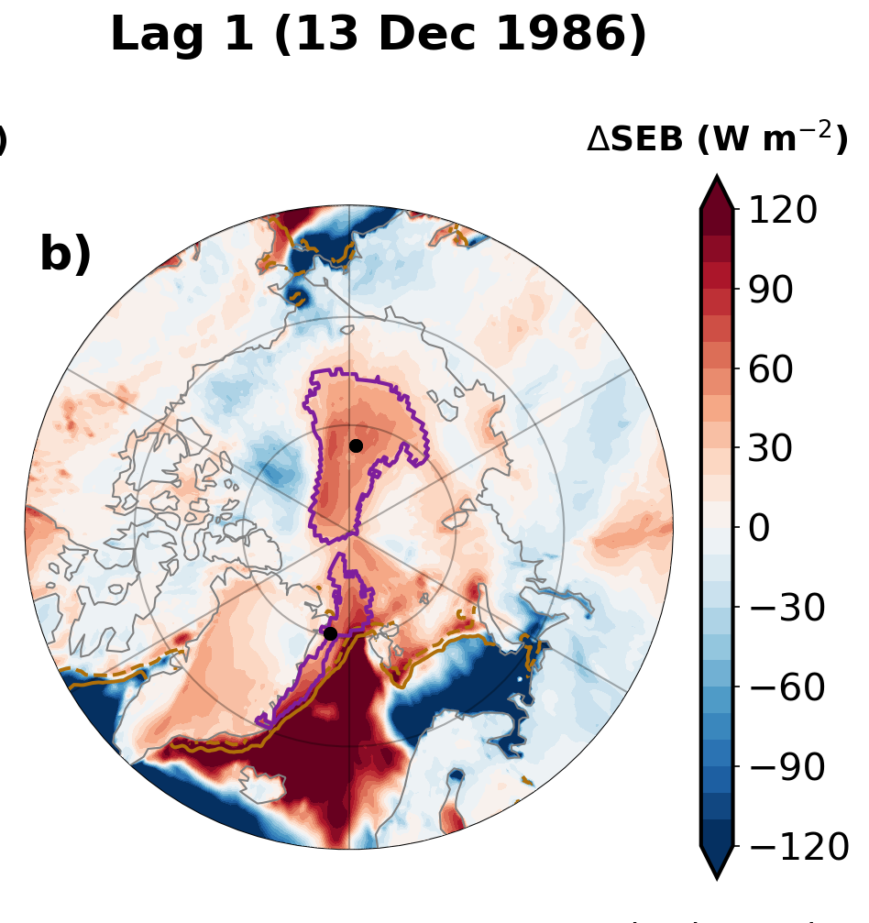
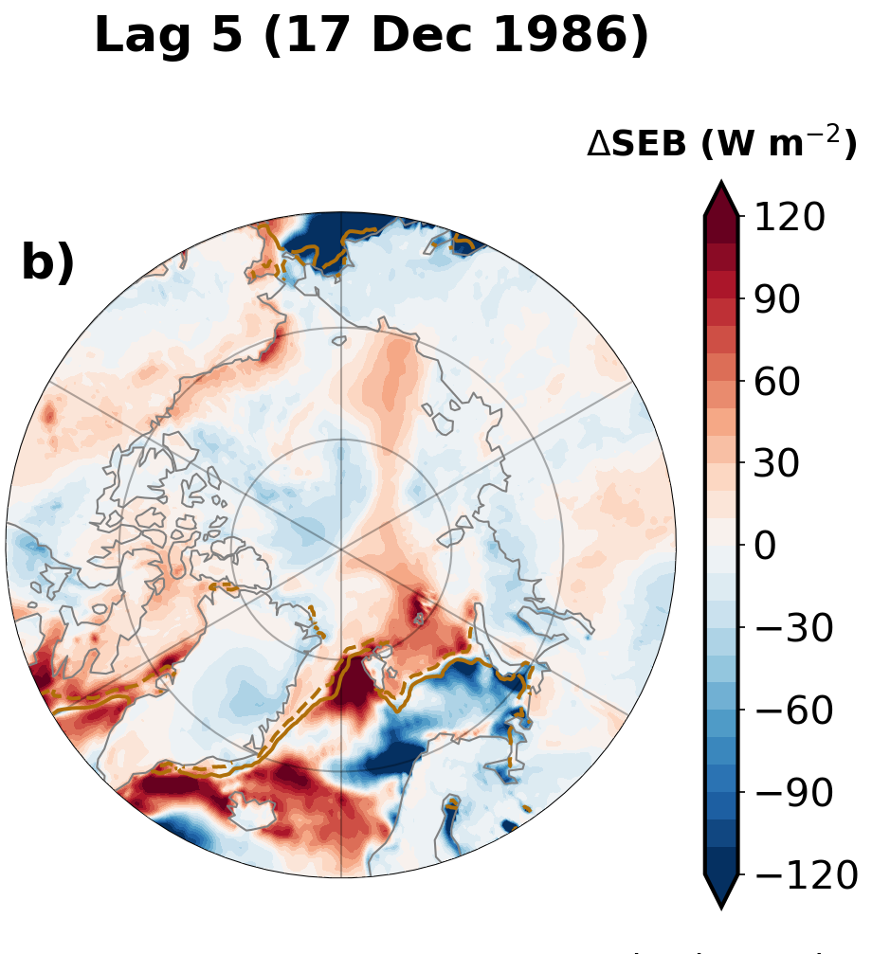
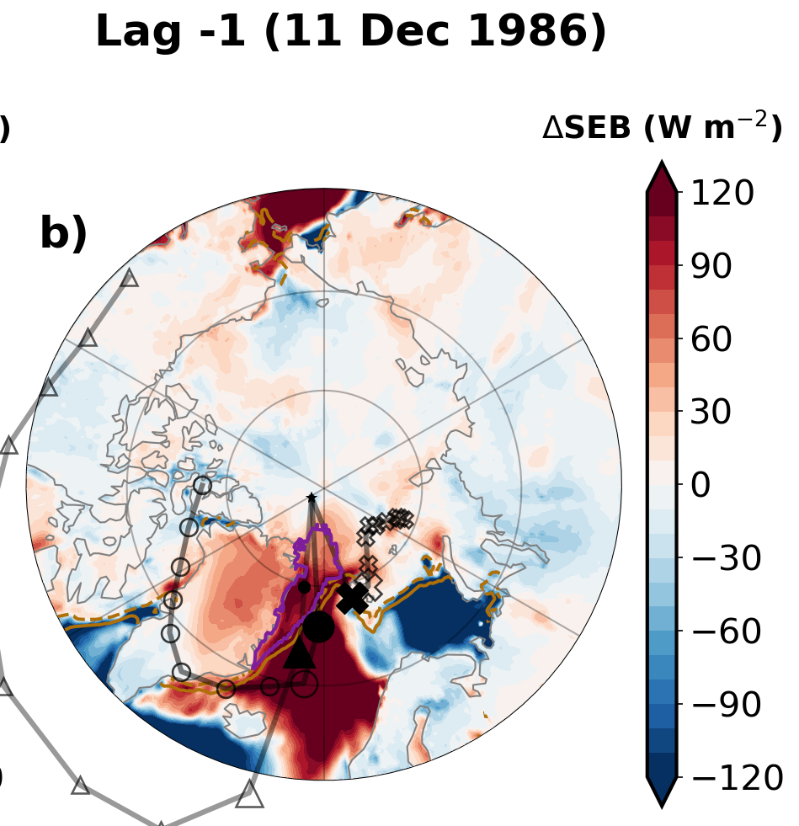



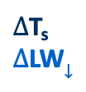
Case study – Atlantic event LCE 44
before
Spatially-averaged terms
$∆$SEB
$∆$SEB
$∆$SHF
$∆$T_{s}
after
$∆$T_{s}
$∆$LW$↓$
ONSET – PEAK – DECAY
largest intensity

Slide 10
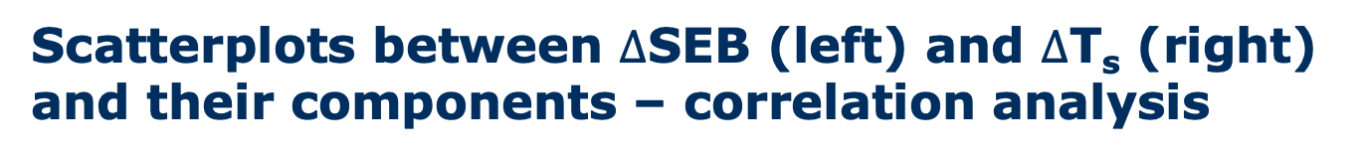
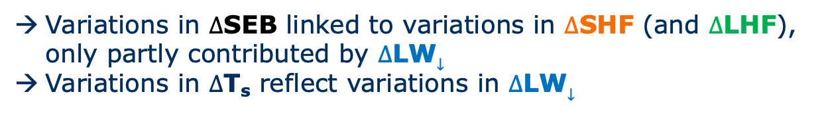
Scatterplots between $∆$SEB (left) and $∆$T_{s} (right) and their components – correlation analysis
Variations in $∆$SEB linked to variations in $∆$SHF (and $∆$LHF), only partly contributed by $∆$LW$↓$
Variations in $∆$T_{s} reflect variations in $∆$LW$↓$

Slide 11

Patches with anomalously low / high $∆$SEB - 10th and 90th percentile of daily $∆$SEB for all LCEs -

Slide 12




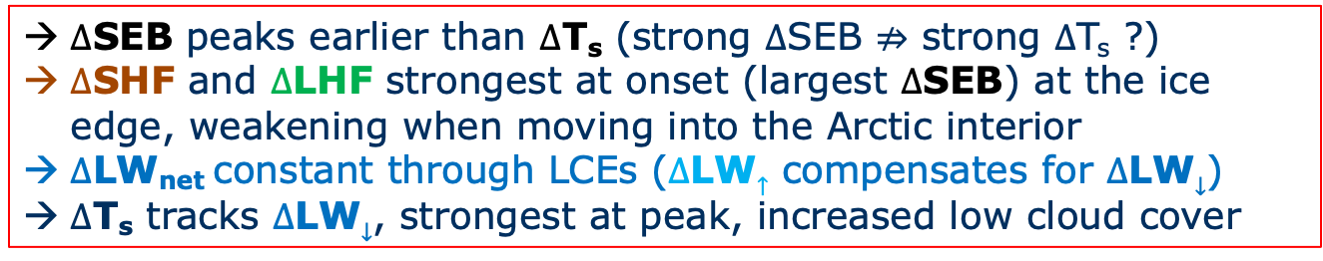
Time evolution & LCE pathways - composite over Atlantic and Pacific LCEs -
Low cloud cover
Low cloud cover
$∆$SEB
$∆$T_{s}
$∆$SEB
$∆$T_{s}
$∆$SEB peaks earlier than $∆$T_{s} (strong $∆$SEB $⇏$ strong $∆$T_{s} ?)
$∆$SHF and $∆$LHF strongest at onset (largest $∆$SEB) at the ice edge, weakening when moving into the Arctic interior
$∆\text{LW}$_{net} constant through LCEs ($∆$LW$↑$ compensates for $∆$LW$↓$)
$∆$T_{s} tracks $∆$LW$↓$, strongest at peak, increased low cloud cover

Slide 13


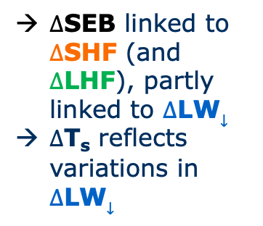
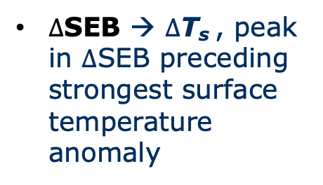
Summary
Extreme positive SEB
anomaly life-cycle events
in high Arctic in winter
Majority of LCEs associated with inflow from Atlantic or Pacific sectors
$∆$SEB linked to $∆$SHF (and $∆$LHF), partly linked to $∆$LW$↓$
$∆$T_{s} reflects variations in $∆$LW$↓$
?
$∆$SEB
$∆$T_{s}
$∆$SEB → $∆$T_{s} , peak in $∆$SEB preceding strongest surface temperature anomaly

Slide 14
References
Boisvert, L. N., A. A. Petty, and J. C. Stroeve, 2016: The impact of the extreme winter 2015/16 Arctic cyclone on the Barents–Kara Seas. Mon. Weather Rev., 144, 4279–4287, https://doi.org/10.1175/MWR-D-16-0234.1
Lee, S., T. Gong, S. B. Feldstein, J. A. Screen, and I. Simmonds, 2017: Revisiting the cause of the 1989–2009 Arctic surface warming using the surface energy budget: Downward infrared radiation dominates the surface fluxes. Geophys. Res. Lett., 44 (20), 10–654, https://doi.org/10.1002/2017GL075375
Lesins, G., T. J. Duck, and J. R. Drummond, 2012: Surface energy balance framework for Arctic amplification of climate change. J. Climate, 25 (23), 8277–8288, https://doi.org/10.1175/JCLI-D-11-00711.1
Park, H.-S., S. Lee, S.-W. Son, S. B. Feldstein, and Y. Kosaka, 2015: The impact of poleward moisture and sensible heat flux on Arctic winter sea ice variability. J. Climate, 28 (13), 5030–5040, https://doi.org/10.1175/JCLI-D-15-0074.1
Woods, C., and R. Caballero, 2016: The role of moist intrusions in winter Arctic warming and sea ice decline. J. Climate, 29 (12), 4473–4485, https://doi.org/10.1175/JCLI-D-15-0773.1
Woods, C., R. Caballero, and G. Svensson, 2013: Large-scale circulation associated with moisture intrusions into the Arctic during winter. Geophys. Res. Lett., 40 (17), 4717–4721, https://doi.org/10.1002/grl.50912
Zheng, C., M. Ting, Y. Wu, N. Kurtz, C. Orbe, P. Alexander, R. Seager, and M. Tedesco, 2022: Turbulent Heat Flux, Downward Longwave Radiation and Large-Scale Atmospheric Circulation Associated with Wintertime Barents-Kara Sea Extreme Sea Ice Loss Events. J. Climate, 1–55, https://doi.org/10.1175/JCLI-D-21-0387.1

