Slide 1




Attributing the spatial patterns of hydrological change to the
effects of climate and land use change by distributed modelling
Jana Bernsteinová and Jakub Langhammer
23.5.2022

Slide 2
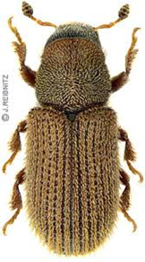
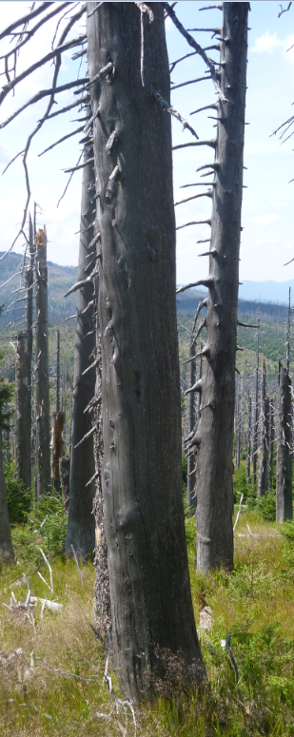
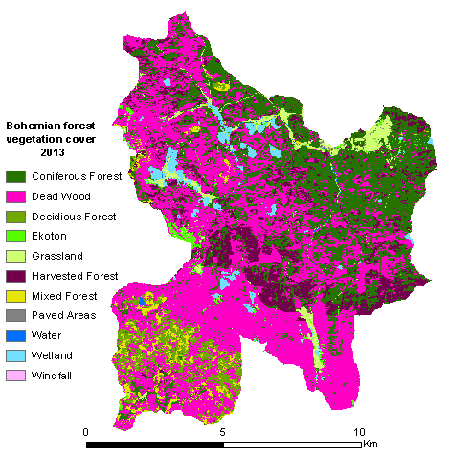
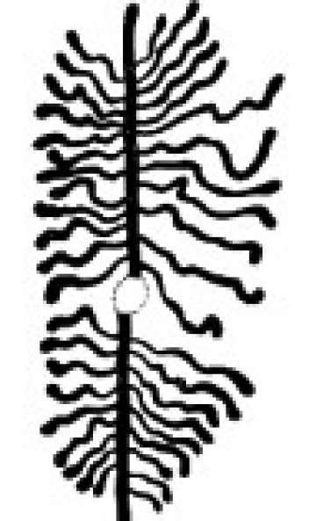
Motivation
2 catchment (Grosse OHE – DE, Vydra – CZ)
Bark beetle (Ips Typographus) disturbance
  Different runoff conditions:
  Different reaction on impact:
 | Grosse Ohe | Vydra
Elevation | 999 | 1134
Slope (%) | 20 | 10
Forestation (%) | 91 | 63
Dead Wood (%) | 58 | 54
Waterlogged soils | 25 | 46
Runoff (mm/yr) | 1009 | 1227
Φ (-) (R/P) | 0.6 | 0.8
Change of Φ (%) | + 8.3 | +2-3

Slide 3
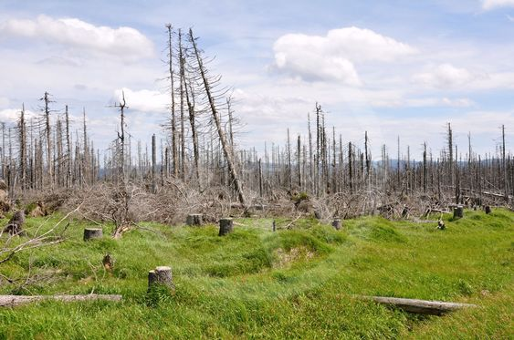
How does a catchment react on land use change?
Scenario Modelling
Is there any evidence of climatic and/or geographical factors?

Slide 4
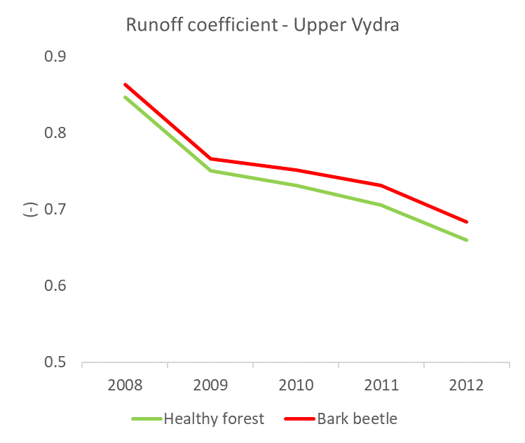
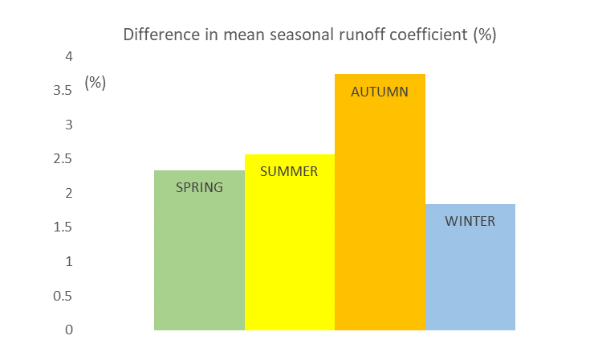
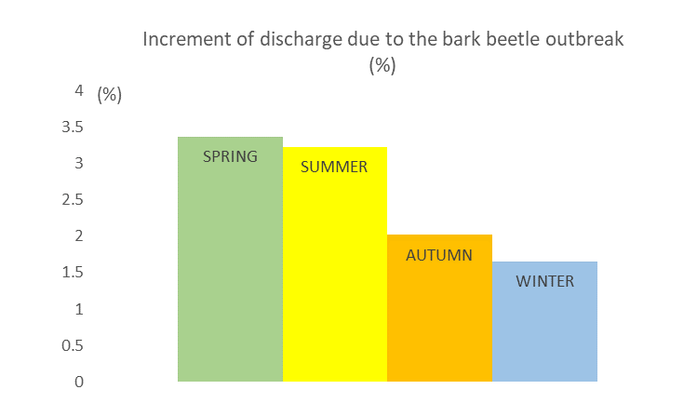
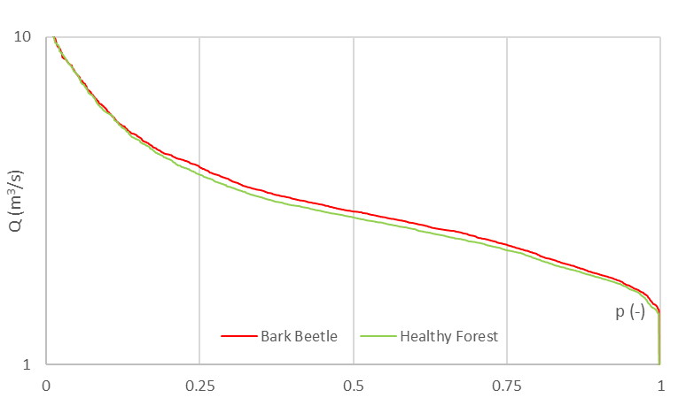
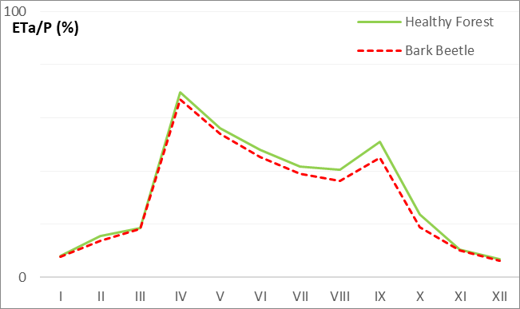
Lesson Learned
Knowledge base for model parametrization
MIKE SHE integrated, distributed and physically based model
Transfer to other studysites
Consistent metodology
Common and publicly avaliable data sources
Notes:
More effect on runoff oefficient is seen in the dryier period (2011-2012) and in summer half year
In absolute values of discharge, there is obvious increment of spring and summer values. Nevertheless the changes are small (around 3%)

Slide 5
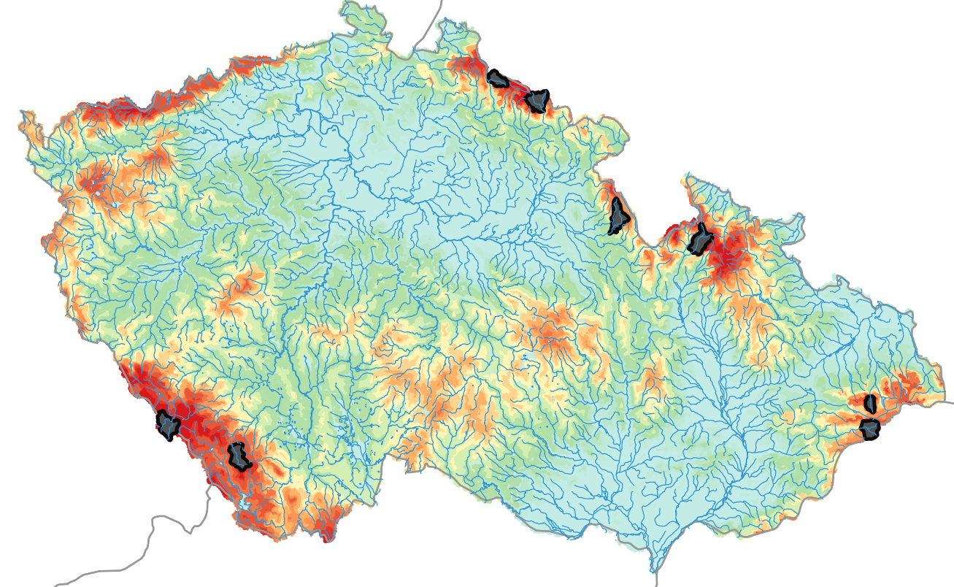
Study sites

Slide 6
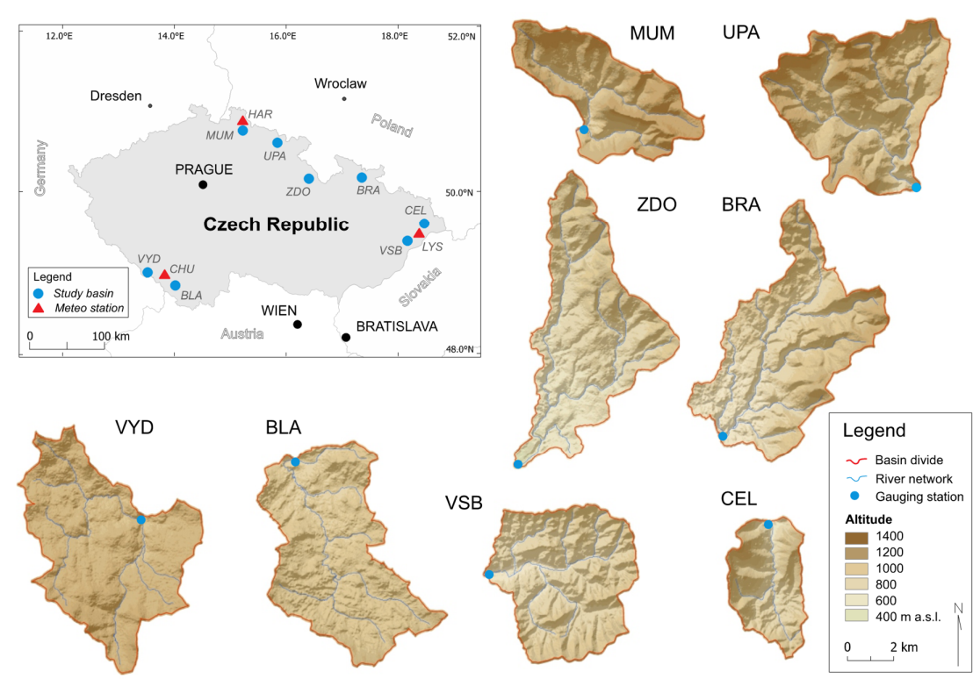
Study sites

Slide 7
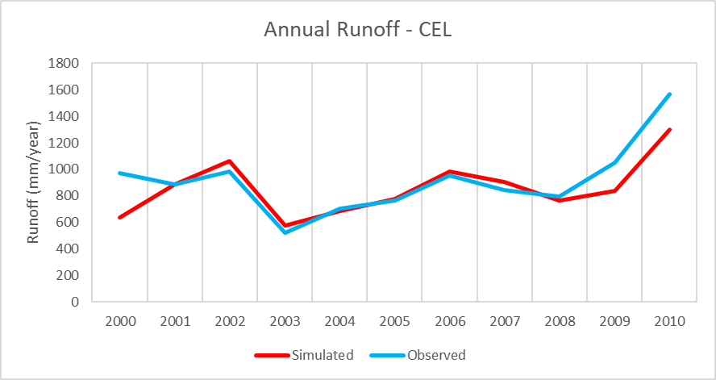
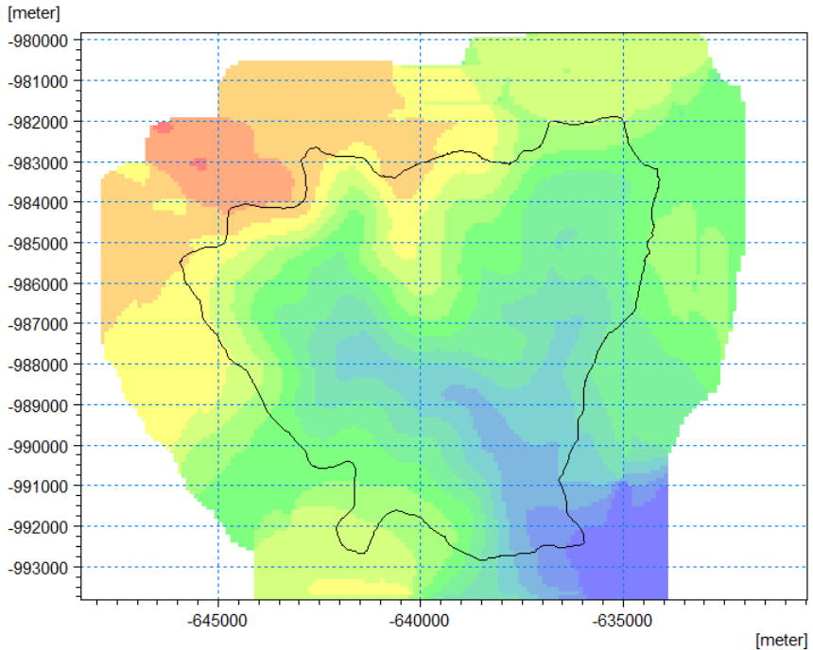

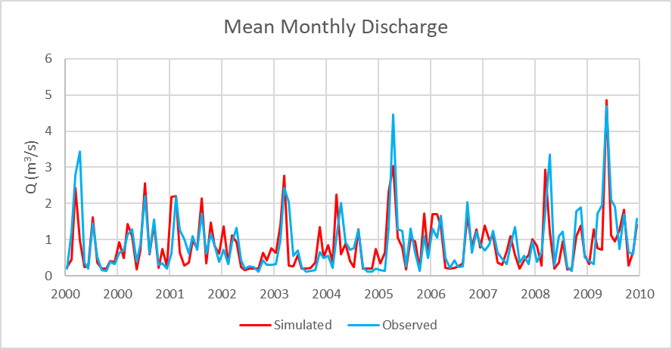
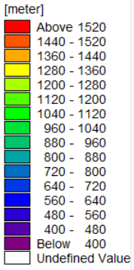
Model setup and verification
Approach = Water balance
Resolution = 100m
Static data (Elevation, Soils, Saturated Zone, River topography.)
Dynamic data – LAI (MODIS), Climate (P, T, PET)
Time step = 1 day
Notes:
Calibration
Measures:
Annual Runoff
Mean Monthly Discharge
Objective Function
NSE
RMSE
Correlation coefficient

Slide 8
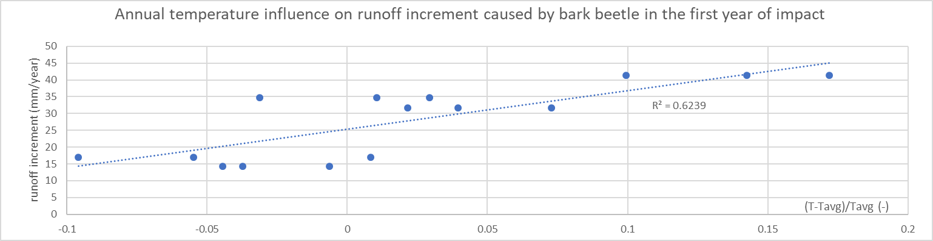
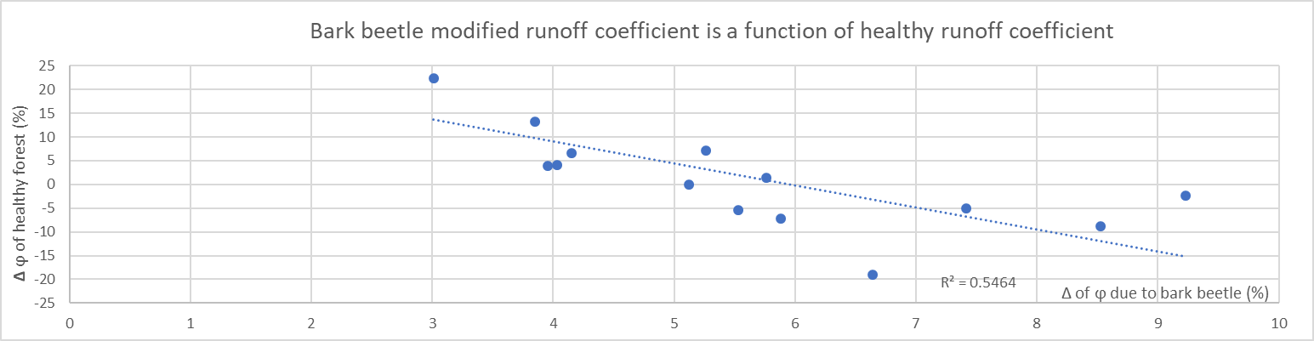
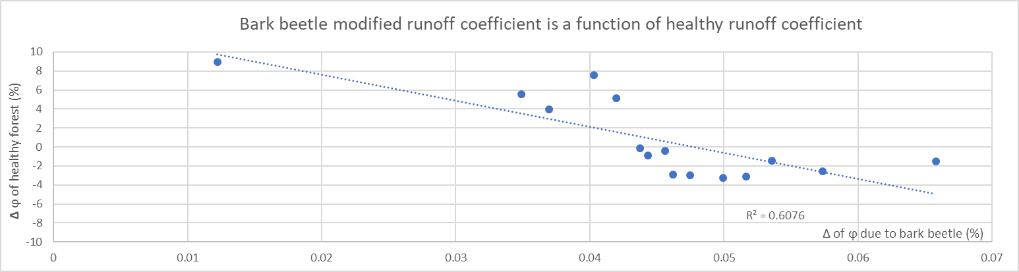
Results – Climate conditions
First year
Temperature
PET
Runoff increment
Second year
First 5 years means
Φ of healthy forest
Impact on Φ

Slide 9
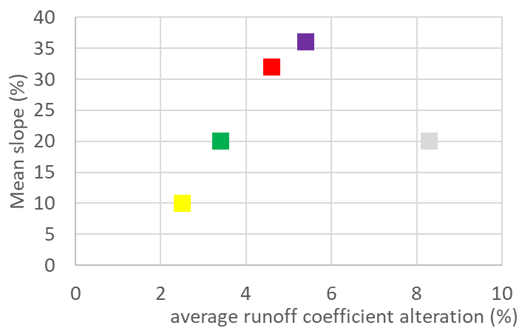
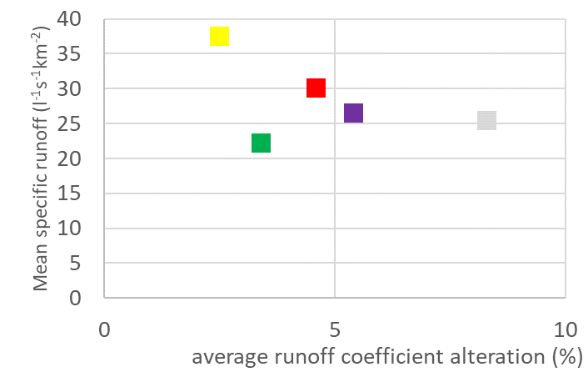
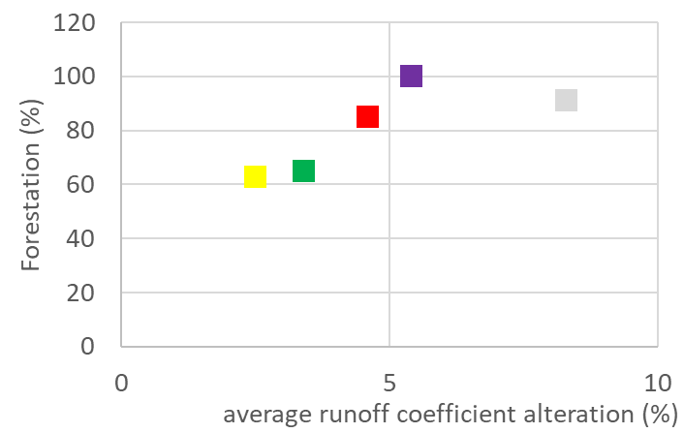
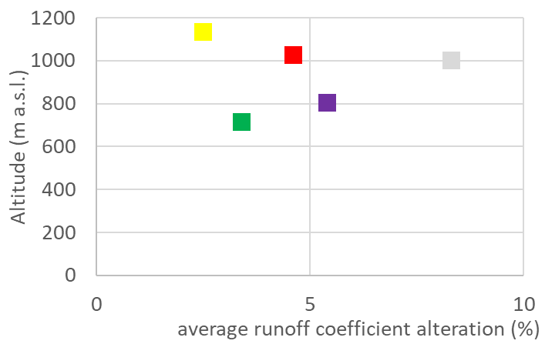
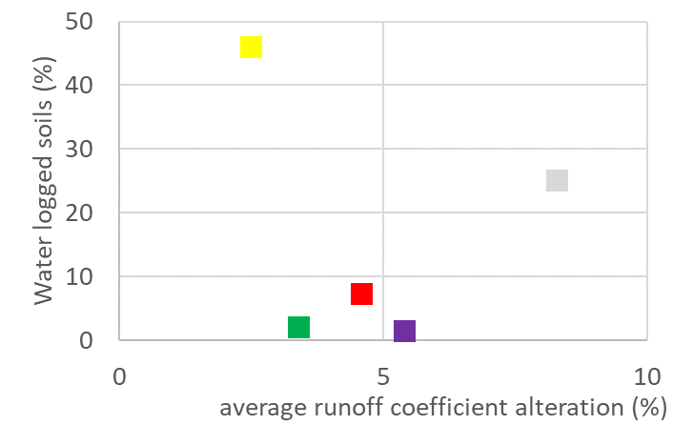
Results - Geography
Grosse Ohe
Notes:
Horní grafy poukazují na přítonost vztahu
Dolní grafy naopak vztah nepředpokládají

Slide 10
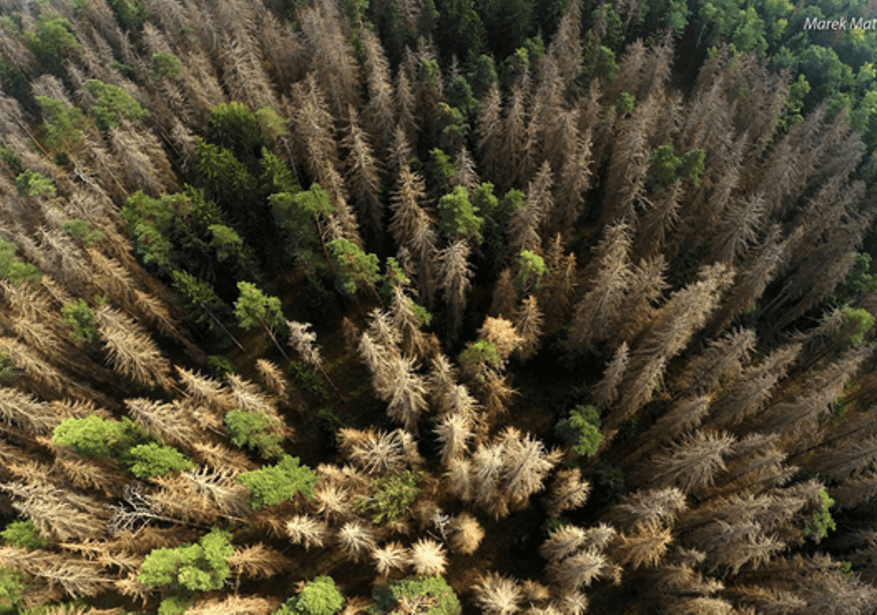
Main Findings
Lesson learned = Beetle outbreak in Bohemian forest
Bark beetle outbreak increase runoff coefficient
Test of different spaital-temporal characteristics of the impact
The intensity of hydrological response on comparable impact differs with geographical and climatic conditions
Change of runoff coefficient is driven by annual temperature in the first year but by runoff coefficient of healthy forest in 2-5 years

Slide 11
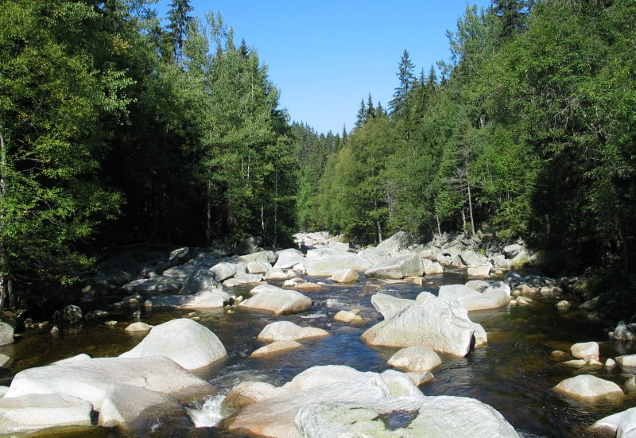
Further steps
Extend Model Results Database
Include experinmental catchments with detailed observations
Prolong Time frame – upcoming 20 years
Include climate change effect
Test multiparametric relations

Slide 12
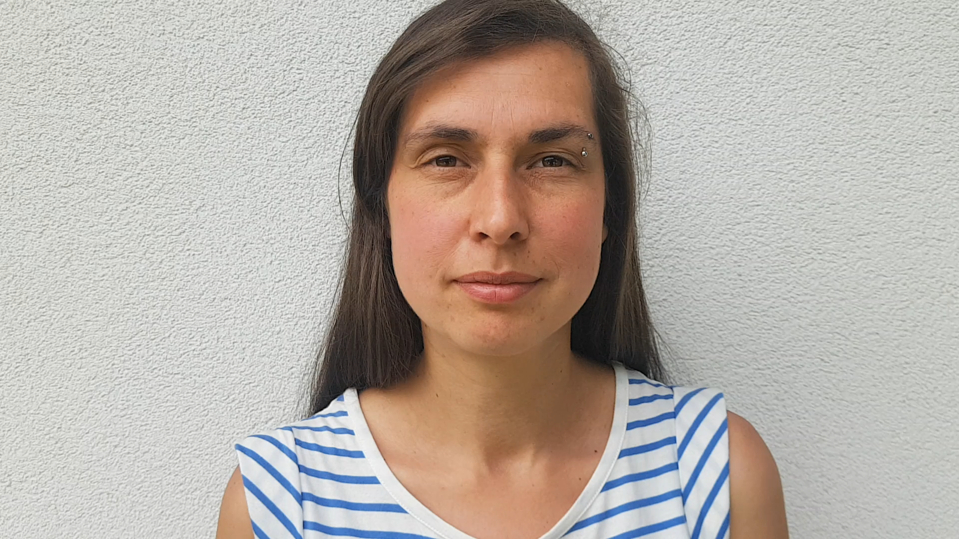
Thank you for your attention
References:
Bernsteinová, J., et al., 2015. Changes in runoff in two neighbouring catchments in the Bohemian Forest related to climate and land cover changes. Journal of Hydrology and Hydromechanics 63(4): 342-352.
Langhammer, J. and Bernsteinová, J, 2020. Which Aspects of Hydrological Regime in Mid-Latitude Montane Basins Are Affected by Climate Change?. Water 2279(12): 1-22 .
Acknowledgement:
The research was funded by the Czech Science Foundation project 19-05011S “Spatial and temporal dynamics of hydrometeorological extremes in montane areas”.

