Slide 1



Charophyte biostratigraphy of the Lower Cretaceous (Wealden) Cuchia section, Basque-Cantabrian Chain, North Spain: Interest for regional stratigraphic correlation
Khaled Trabelsi 1,2, Anna Tamara Mai 3 , Benjamin Sames 1,4, Jens O. Herrle 3 , and Frank Wiese 5
1University of Vienna, Geology, Vienna, Austria (trabkhalfss@yahoo.fr)
2Université de Sfax, Faculté des Sciences de Sfax, CP 3038, Sfax, Tunisie
3 Institut of Geosciences, Goethe-University Frankfurt, Altenhöferallee 1, 60438 Frankfurt am Main, Germany
4 Sam Noble Museum, University of Oklahoma, 2401 Chautauqua Ave, Norman, OK 73072, USA
5Courant Research Centre Geobiology, Georg-August-University Gottingen, Goldschmidtstrasse 3, 37077 Göttingen, Germany.

Slide 2
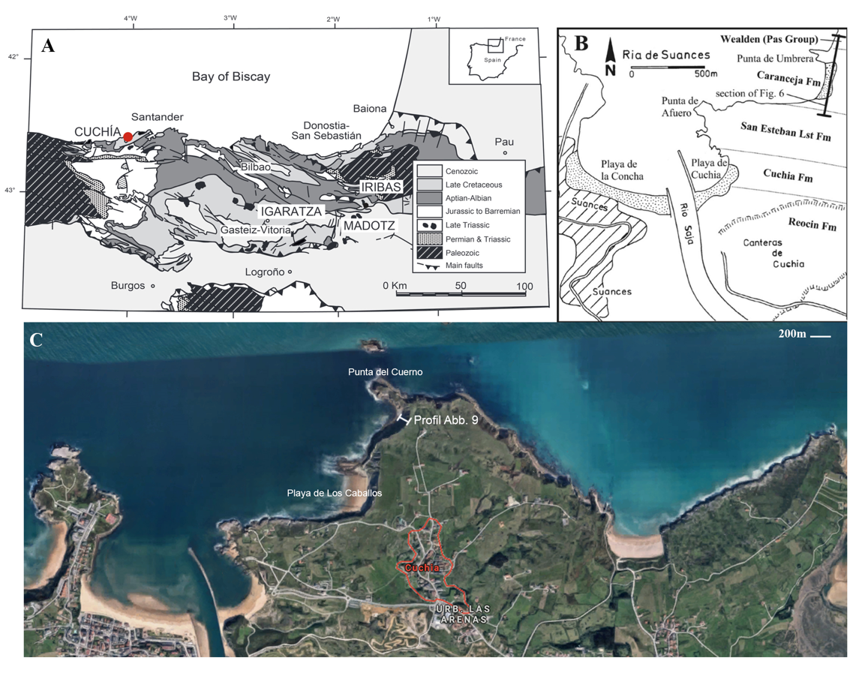
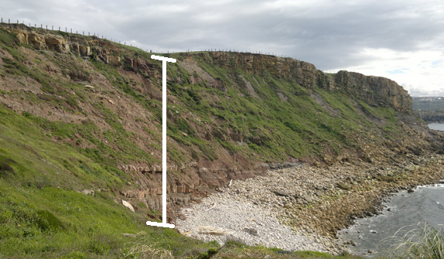
Study area – Geographical and Geological setting
A García-Mondéjar et al., 2015; B Wilmsen, 2005; C Mai, unpubl. (google.maps)

Slide 3
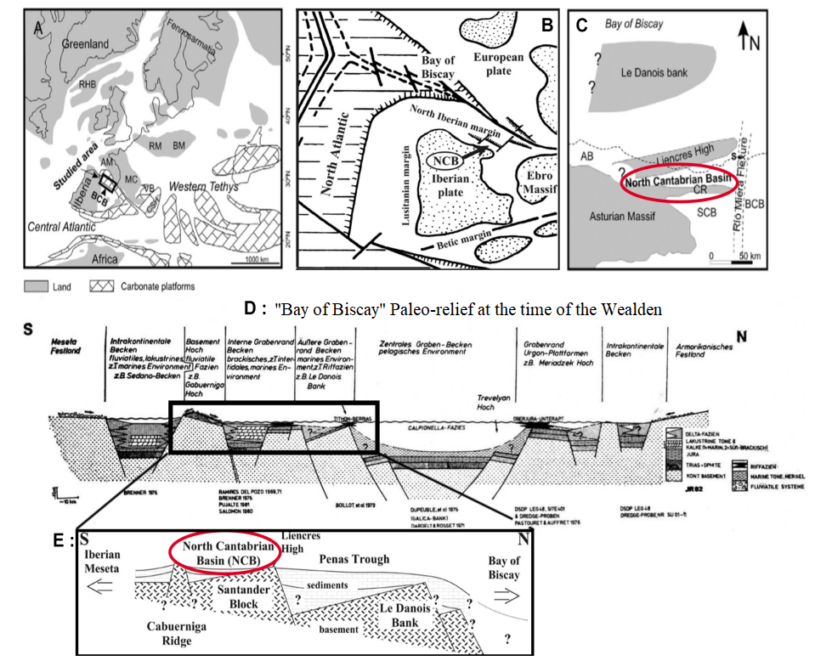
Study area – Geographical and Geological setting
(A) Najarro et al., 2011.
(B) Wilmsen, 2005.
(C) Najarro et al., 2011.
(D) Reitner und Wiedmann, 1982.
(E) Wilmsen, 2005.

Slide 4
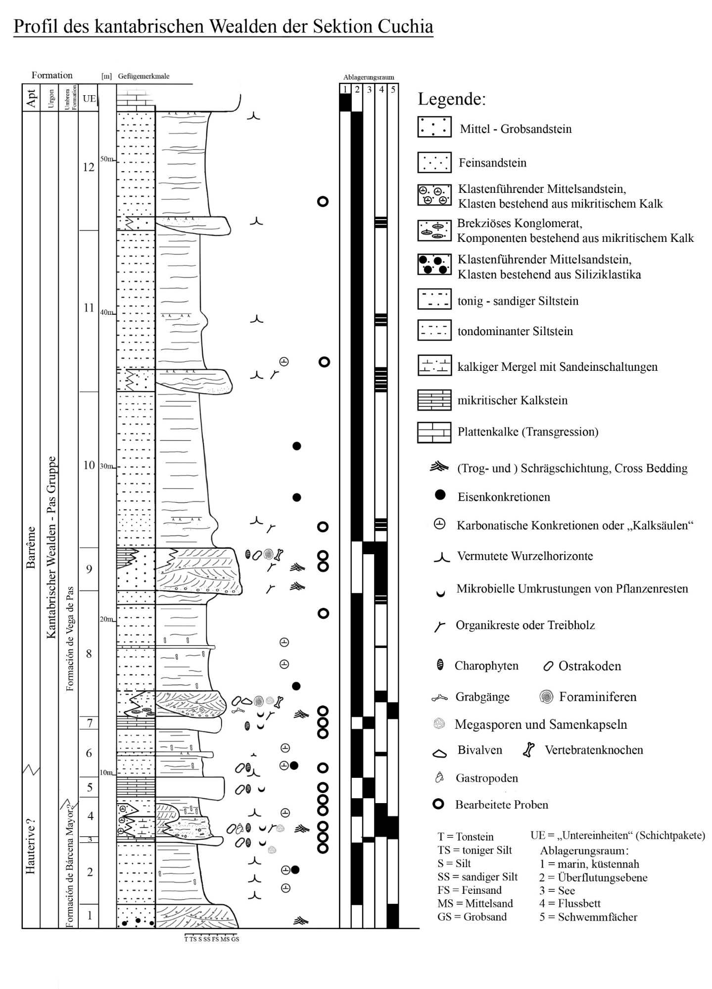
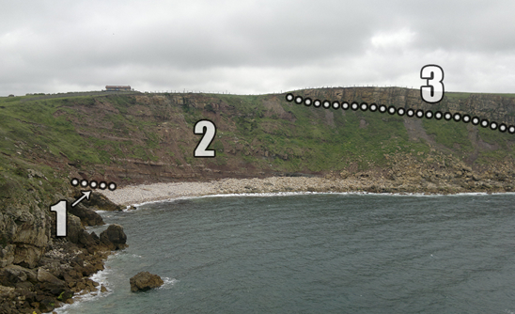
Lithostratigraphy of the studied Cuchia section
Study area – Geographical and Geological setting

Slide 5
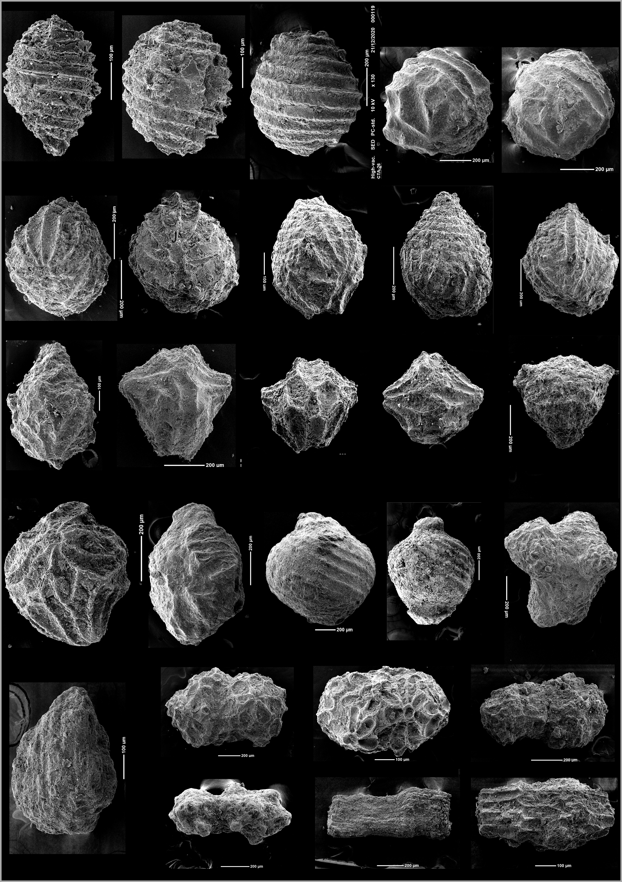
Charopyhte Palaeontology: Taxonomic identification

Slide 6
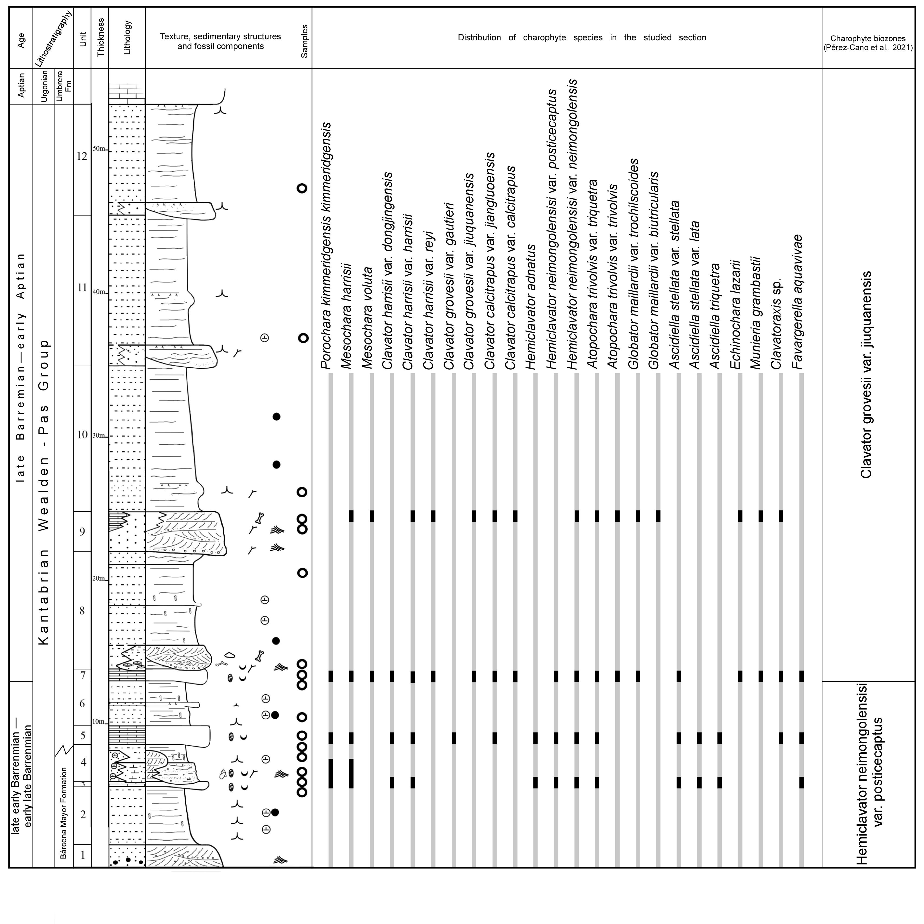
Charopyhte Biostratigraphy - Biozonation

Slide 7
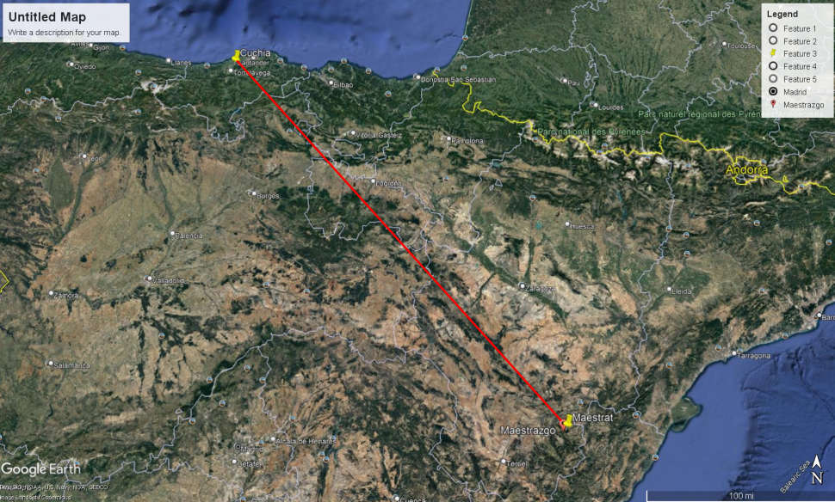
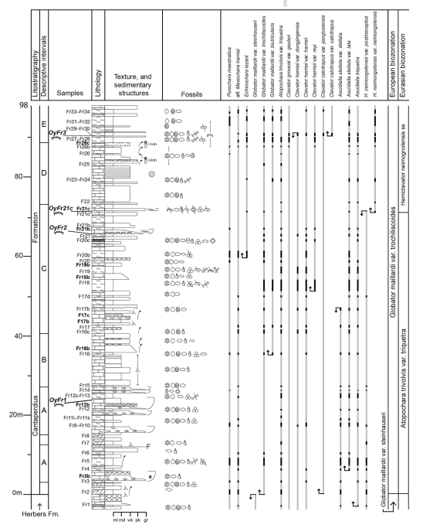
Regional Stratigraphic Correlation
Perez-Cano et al., 2021)
Present work

Slide 8
C o n c l u s i o n s
This is the first exhaustive and detailed taxonomic study of the charophyte flora from the Spanish Wealden
A charophyte biozonation has been established for the Wealden strata at the Cuchia section, Basque-Cantabrian Chain, North Spain, which allow a direct dating and therefore giving new insights on the chronostratigraphy of this continental Barremian event from this area.
Hence, a N-SE regional stratigraphic correlation of the continental Barremian event between the Cuchia basin (Basque-Cantabrian Chain) and Maestrat Basin (Iberian Chain, Spain) become possible, reflecting a tecton-sedimentary control on the spatial distribution of the charophyte-bearing facies from shallow marine depositional setting southeast to a marginal marinal to exclusively continental depositional setting northward of Spain.

