Slide 1

EFFECT OF DISCHARGE RATIO ON Flow and passive scalar transport in an open-channel confluence with a wider downstream channel
TIAN Jin, PEDRO X. Ramos & TOM De Mulder
Hydraulics Laboratory, Dep. Civil Engineering, Ghent University, Ghent, Belgium
Notes:
Good afternoon, everyone, my name is Tian Jin and I am doing Ph.D. research at Ghent University in Belgium.
My research is on open-channel confluences.

Slide 2

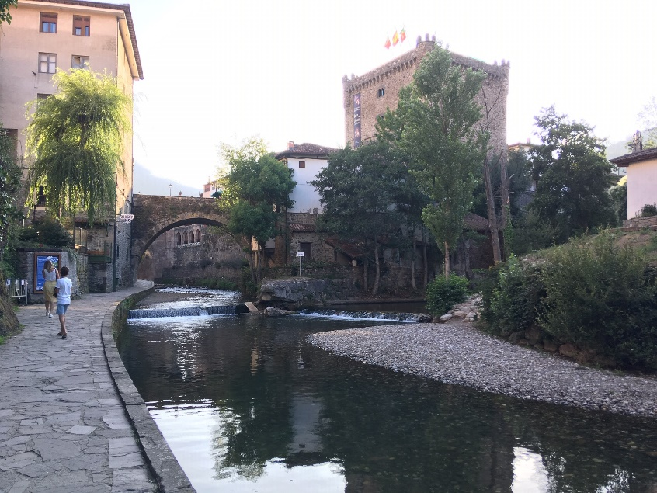
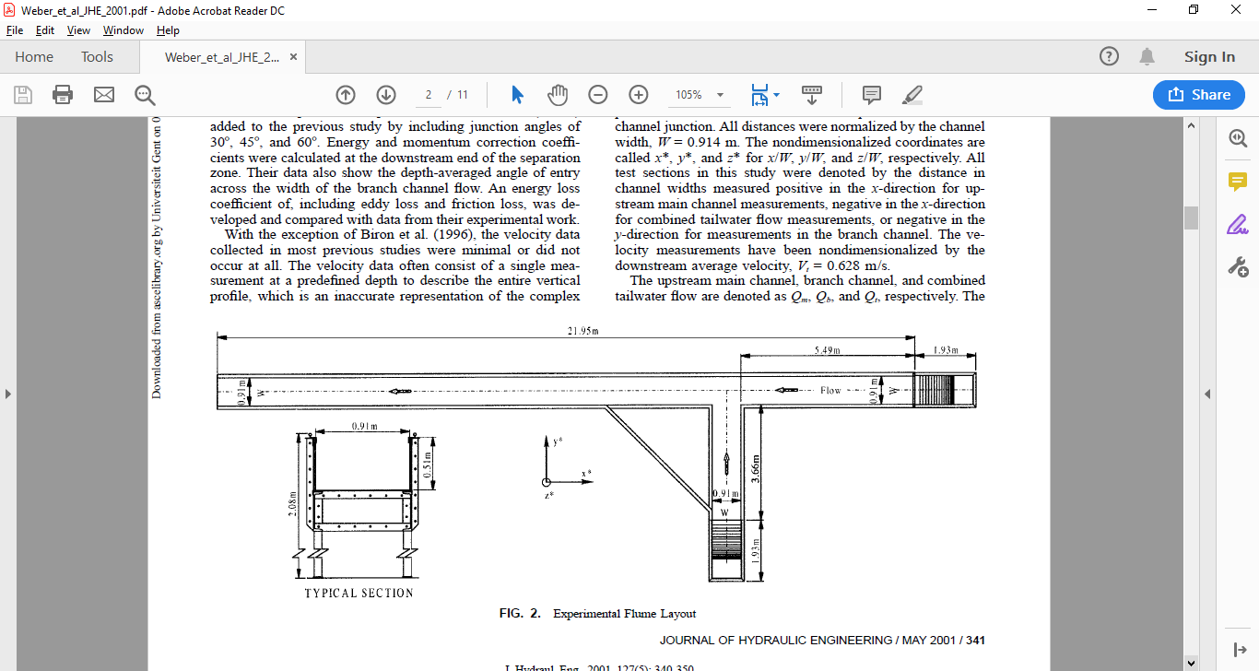
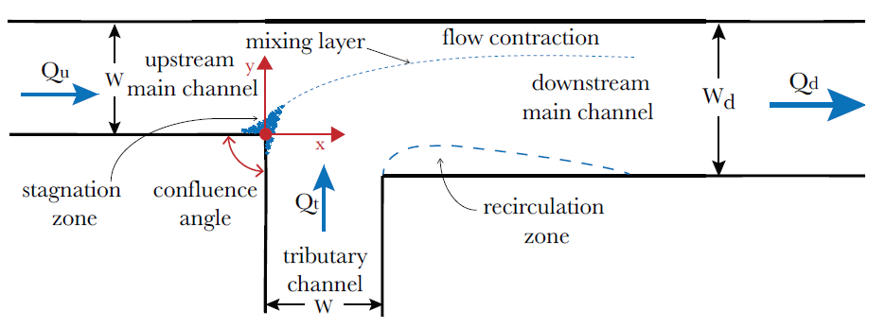
Confluences
(courtesy: Stefan Gottermann)
(courtesy: Patrik Peeters)
Studies in schematized geometries:
University of Iowa (Weber et al., JHE, 2001)
Concordant channel widths
Hohai University (Tang et al., EFM, 2018)
Discordant channel widths
W / W_{d} = 3 / 4
Notes:
I try to acquire knowledge on flow and mixing in confluences, based on numerical modelling. I study confluences with a schematized planform geometry, in particular T-shaped ones, which are also popular in lab experiments.
Interesting lab experiments have been carried out in the University of Iowa, in a flume in which the branches have an equal width.
More recently, lab experiments have been undertaken at Hohai University, in a flume where the post-confluence channel is wider than the upstream branches. These experiments will be used to validate the numerical simulations. Note that the x-y coordinate system has its origin at the upstream junction corner.

Slide 3
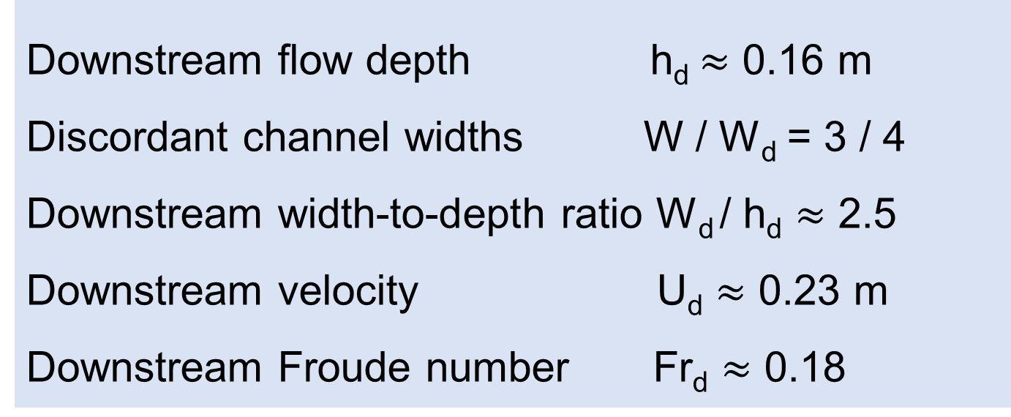
Hydraulic conditionS
Different discharge ratios
CASE 1 Qt:Qu=2:3
“Case 1” and “Case 2” of Tang et al. (EFM, 2018)
with fixed flat sand beds (d₅₀=0.9mm, d₉₀=2.5mm)
Main channel-dominant inflow
Downstream flow depth h_{d}$≈$ 0.16 m
Discordant channel widths W / W_{d} = 3 / 4
Downstream width-to-depth ratio W_{d} / h_{d} $≈$ 2.5
Downstream velocity U_{d} $≈$ 0.23 m
Downstream Froude number Fr_{d} $≈$ 0.18
Qu=9L/s
Qt=6L/s
CASE 2 Qt:Qu=3:2
Tributary-dominant inflow
Qu=6L/s
Qt=9L/s
Notes:
Two cases are studied, which only differ in terms of discharge ratio of the incoming flows. “Case1” is with a main channel-dominant inflow, while “Case 2” has a tributary-dominant inflow.

Slide 4
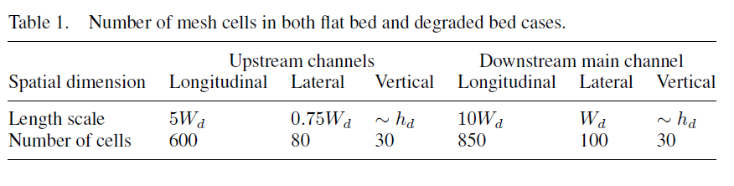
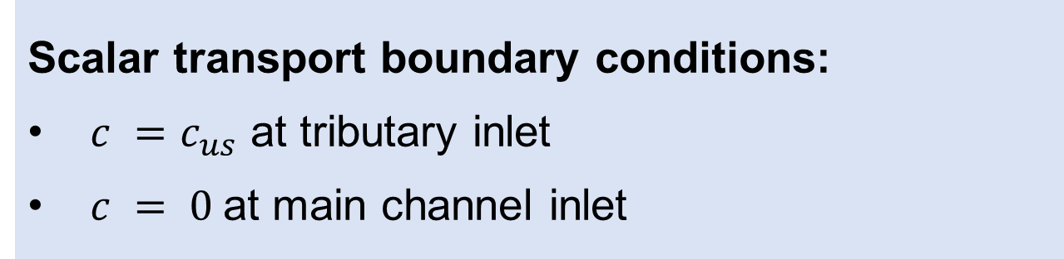
Numerical methodology
Large Eddy Simulations (LES):
Flow and passive scalar transport: Standard Smagorinski SGS model
Scalar transport boundary conditions:
$c =$ $c_{us}$ at tributary inlet
$c = 0$at main channel inlet
Flow boundary conditions:
Curved rigid-lid (Ramos et al., JHI, 2019)
Wall functions (smooth sidewalls, rough bed)
Precursor simulations (periodic channels at inlets)
OpenFOAM:
Finite Volume Method
2nd order accurate schemes in space and time
PISO algorithm
Fine mesh !
Notes:
The numerical model is based on Large Eddy Simulations with OpenFOAM software.
We adopt a curved rigid-lid as a free surface treatment and at the sidewalls and bed, we use wall functions. The computational meshes have a fine resolution.

Slide 5
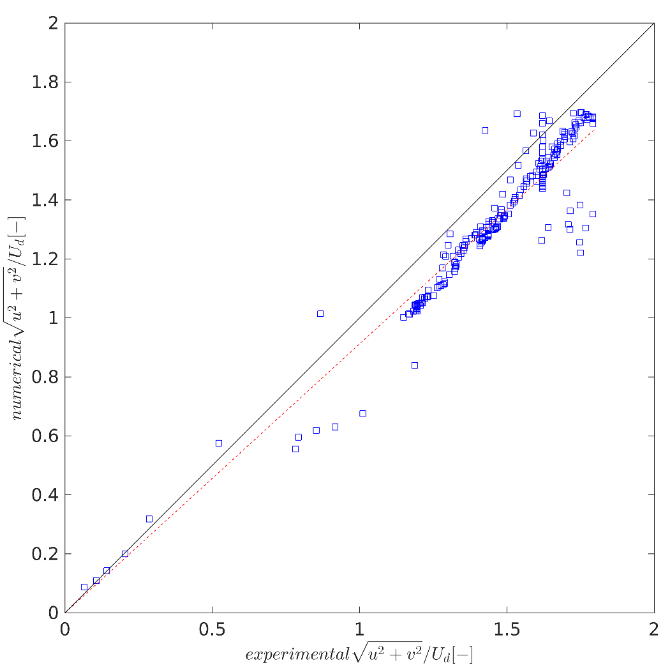
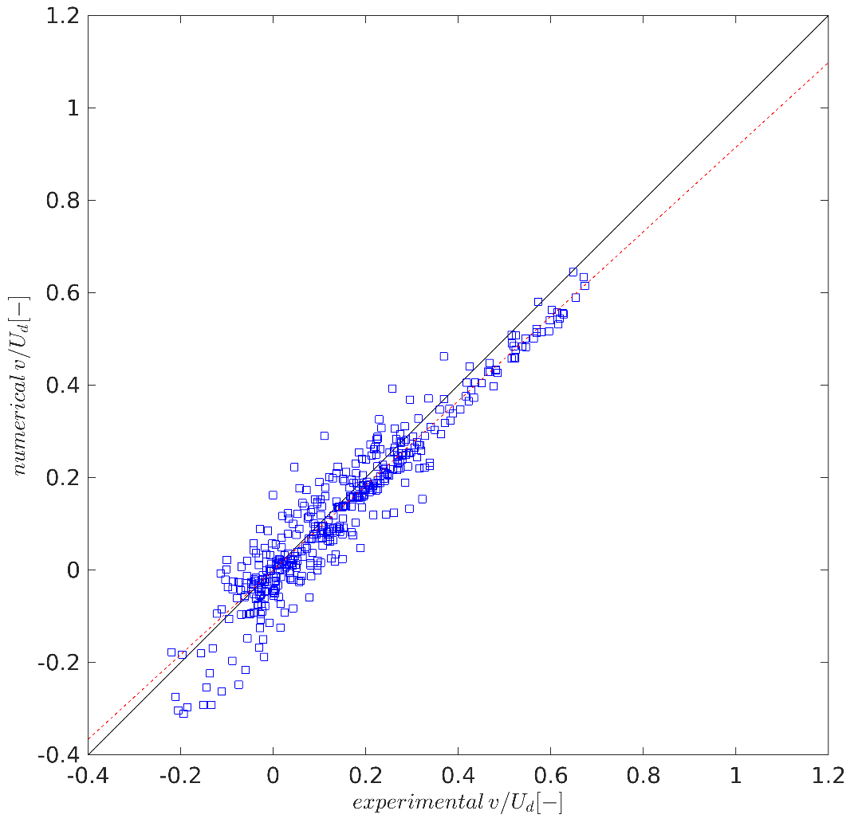
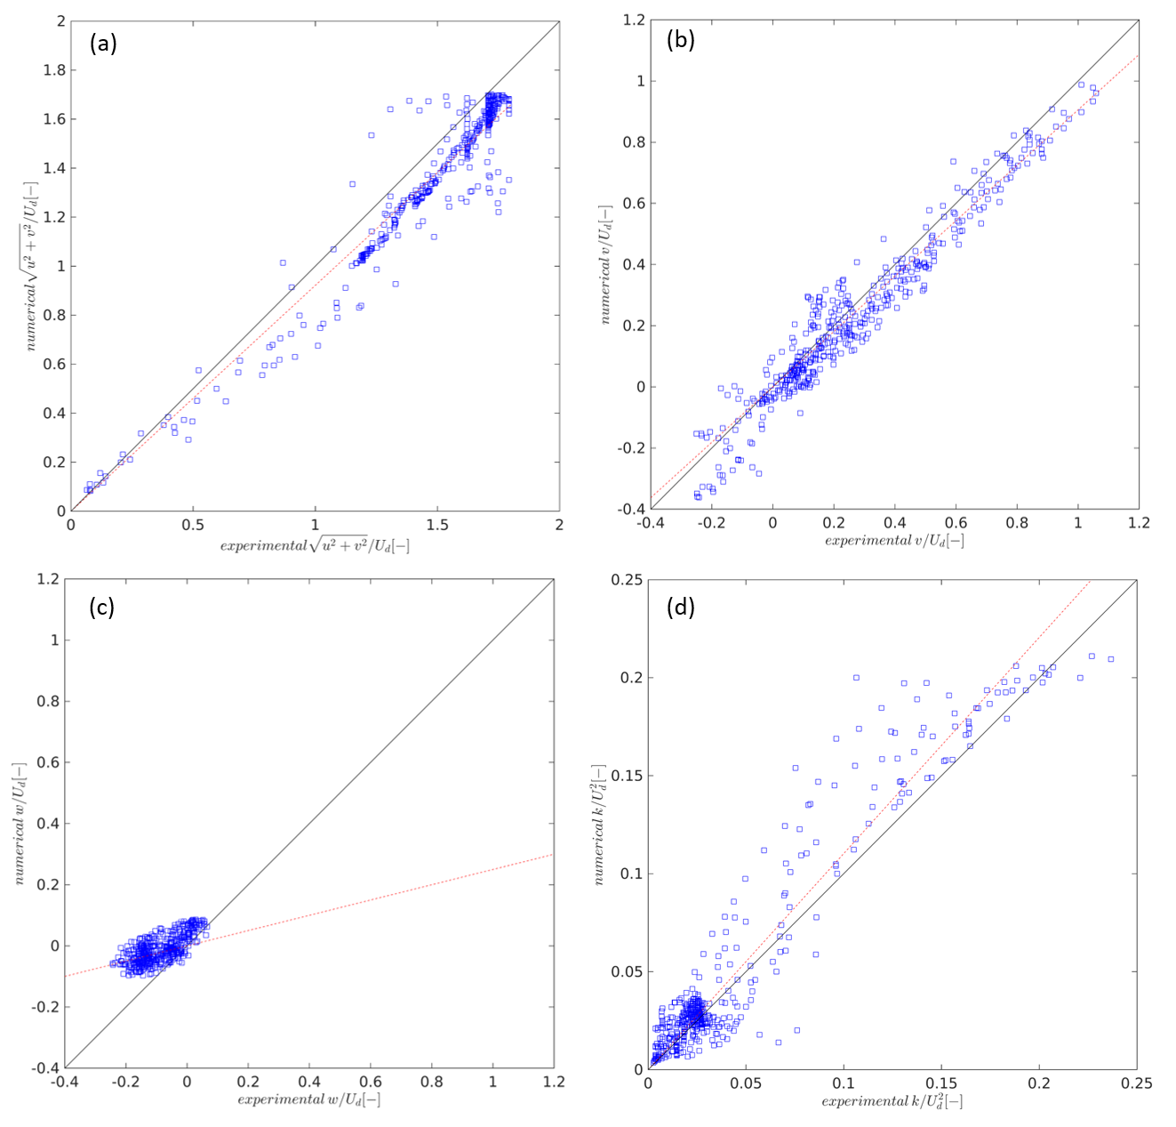
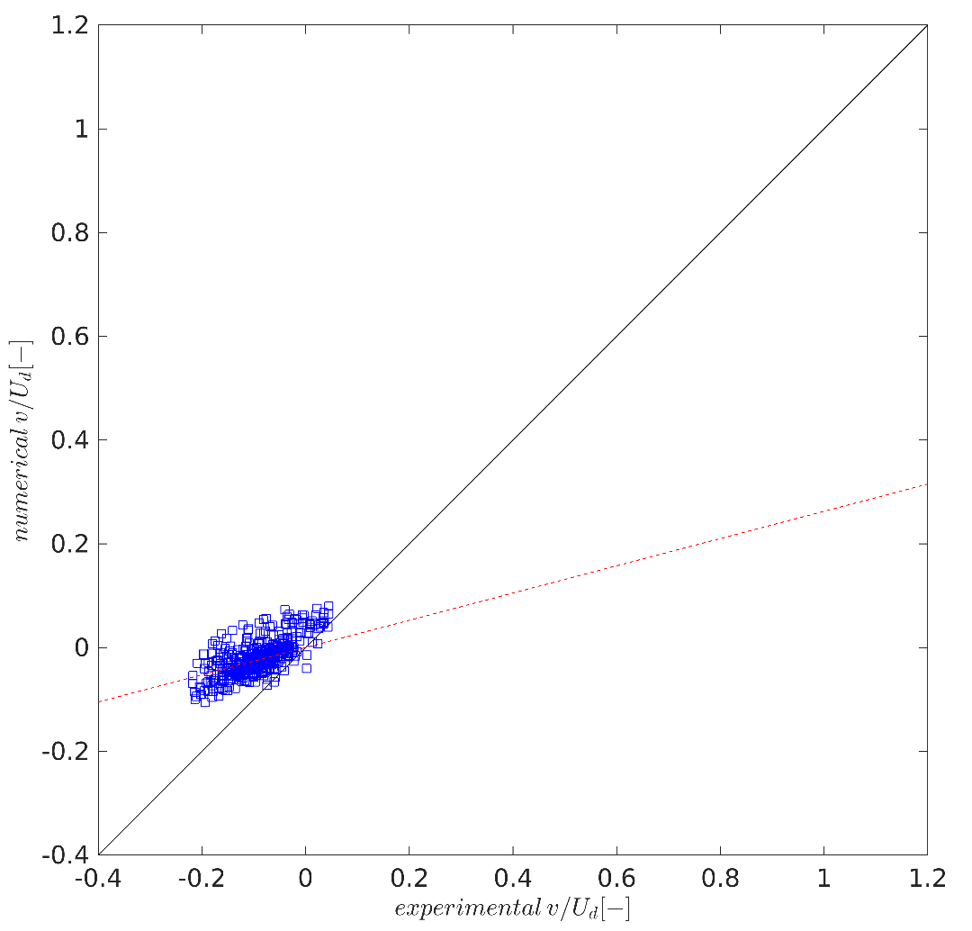
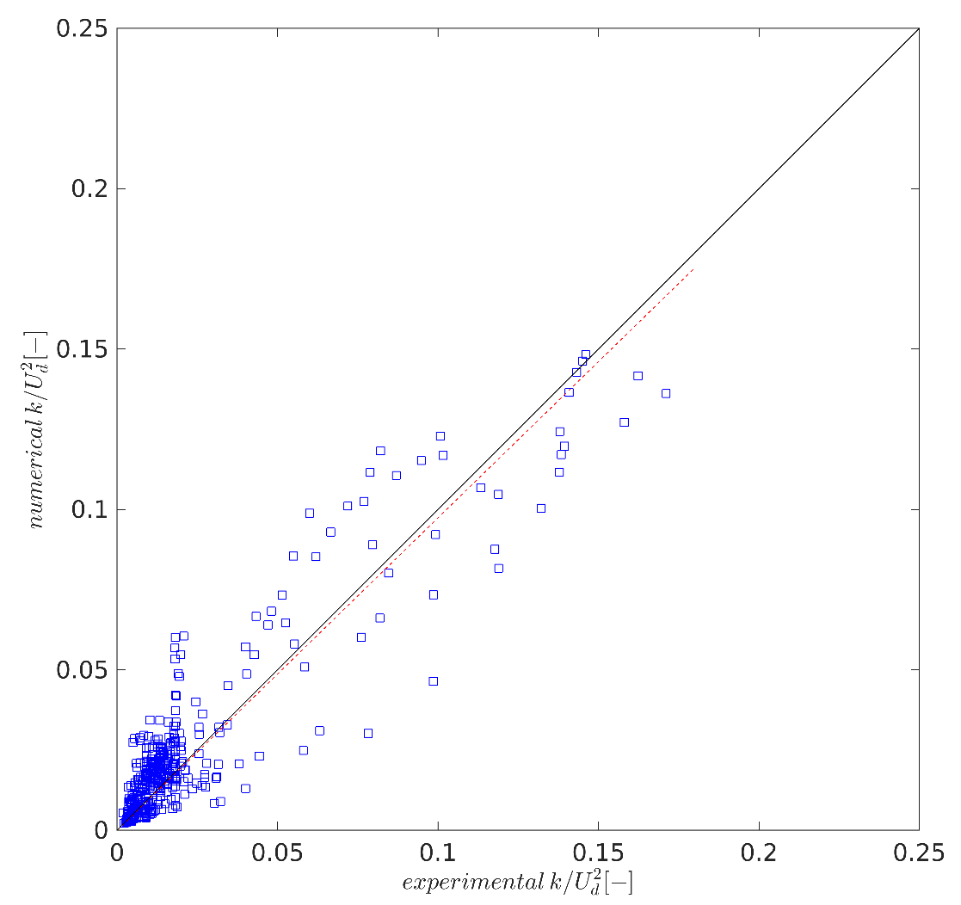
Validation OF simulations
CASE 1 (main channel-dominant inflow)
CASE 2 (tributary-dominant inflow)
(a)
Horizontal velocity
(b)
Lateral velocity
Horizontal velocity
Lateral velocity
numerical
experimental
(c)
Vertical velocity
(d)
TKE
Vertical velocity
TKE
Notes:
To validate the numerical model predictions, use can be made of the experimental data given in Qiu (2015). For both cases the agreement is fair for the horizontal velocity magnitude, the lateral velocity and the turbulent kinetic energy. For the vertical velocity component, which is quite small in absolute value, the agreement is, like usual in the literature, less good. Yet, for around 80% of the points in the scatter plot, the numerical model predicts the correct sign.

Slide 6
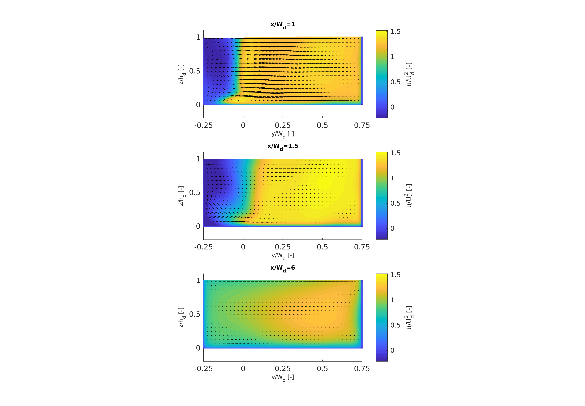
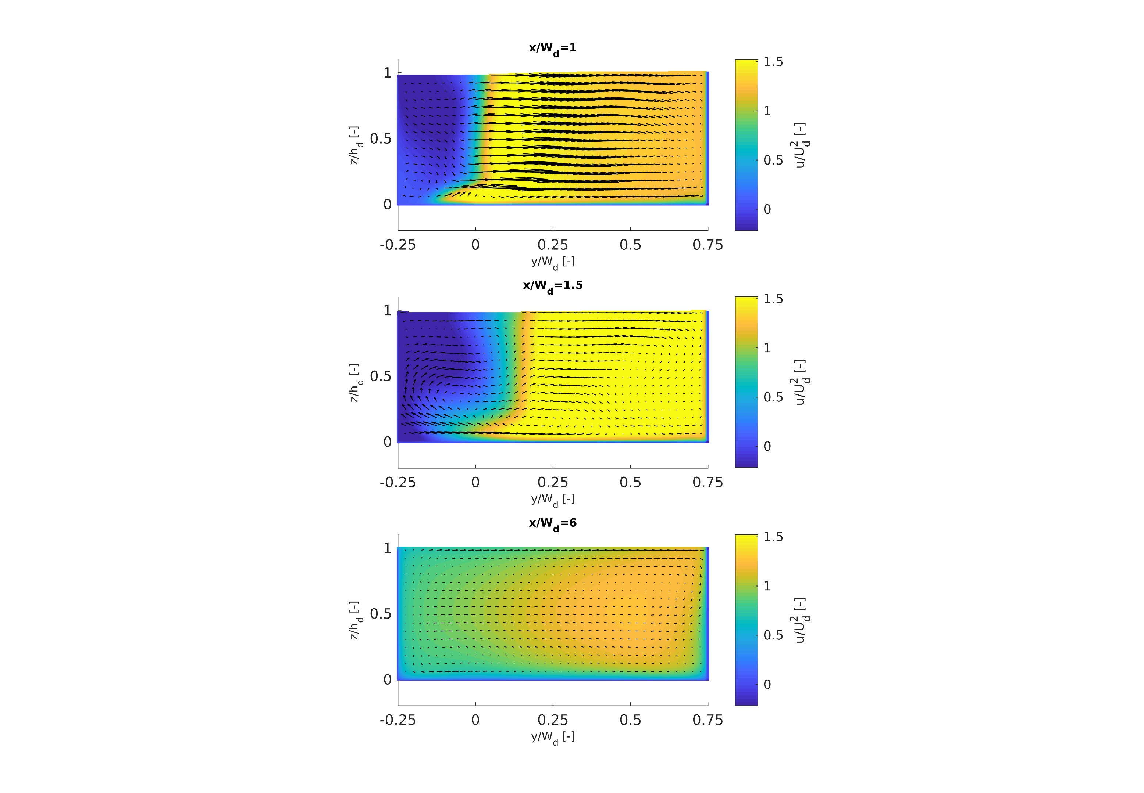
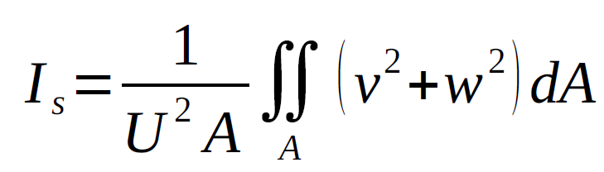
Time-averaged velocity
Cross-sections in downstream channel at different x/W_{d} positions
vectors = in-plane components (v, w) ; colors = streamwise component (u/U_{d})
Case 1
Case 2
x/W_{d} = 1
Case2 (tributary dominant case):
bigger lateral velocities
bigger reverse flow zone
larger intensities of secondary flow
x/W_{d} = 1.5
x/W_{d} = 6
Notes:
On this slide, cross-sections are shown at three different locations in the downstream main channel.
The left panels correspond to the main-channel dominant case and the right ones to the tributary-dominant one.
Each panel shows in color the streamwise velocity component and with vectors the in-plane velocity components.
In the cross-sections at x/W_{d} equal to 1 and 1.5, it follows that for the tributary-dominant case, the lateral velocity vectors are bigger and the reverse flow zone (in blue) is larger. This leads to a larger degree of contraction of the merging flows and larger streamwise velocities.
When calculating a so-called indicator for the intensity of secondary flow, based on the lateral and vertical velocity components in a cross-section, it turns out that the indicator is higher in the tributary-dominant case, throughout the simulated part of the downstream channel.

Slide 7
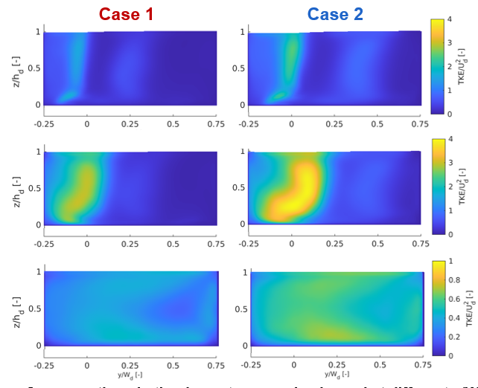
Turbulent kinetic energy
Cross-sections in the downstream main channel at different x/W_{d} positions
color = TKE/U_{d}²
x/W_{d} = 1
Case2 (tributary dominant):
higher TKE
separation zone shear layer and mixing layer more to outer bank
x/W_{d} = 1.5
x/W_{d} = 6
Notes:
On this slide, similar cross-sections are shown as in the previous slide, but this time the panels depict the turbulent kinetic energy.
The highest values of TKE show up in the separation zone shear layer, but also the combined flow shear layer is showing local extrema of TKE, though less clearly. In the lee of the separation zone, the TKE distribution gradually becomes wider. For the tributary-dominant case, the turbulence intensities are relatively higher and the aforementioned shear layers are closer to the outer bank.

Slide 8
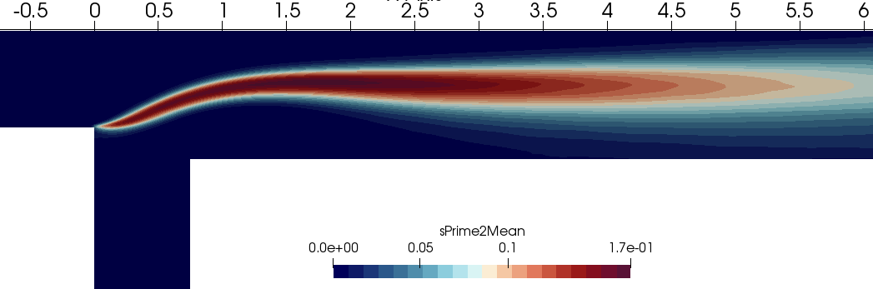
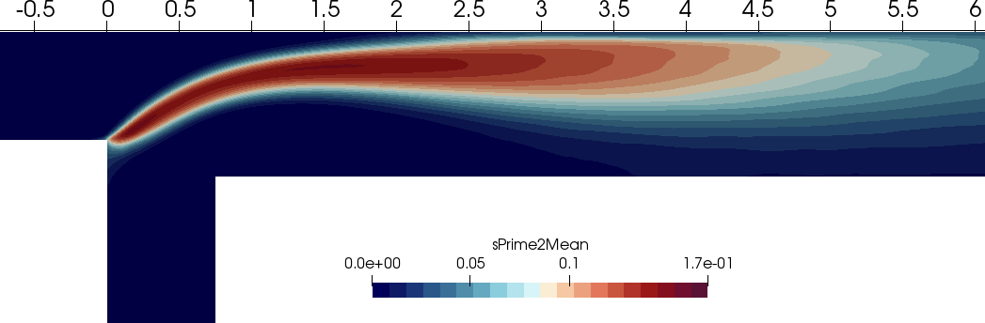
Mixing of passive scalar
Horizontal sections at z/h_{d}=0.5 of $\overline{c′²}$
(dimensionless) variance of turbulent fluctuations of passive scalar concentration
Case 1
(main channel-dominant)
Case 2 (tributary-dominant)
mixing layer is thicker
and closer to outer bank
Notes:
This slide visualizes the mixing interface between the merging flows by means of the variance of the turbulent fluctuations of the passive scalar concentrations. The two figures show the distribution of cprime2mean at mid-depth.
It seems that the mixing layer is thicker in the tributary-dominant case and is located closer to the outer bank.

Slide 9
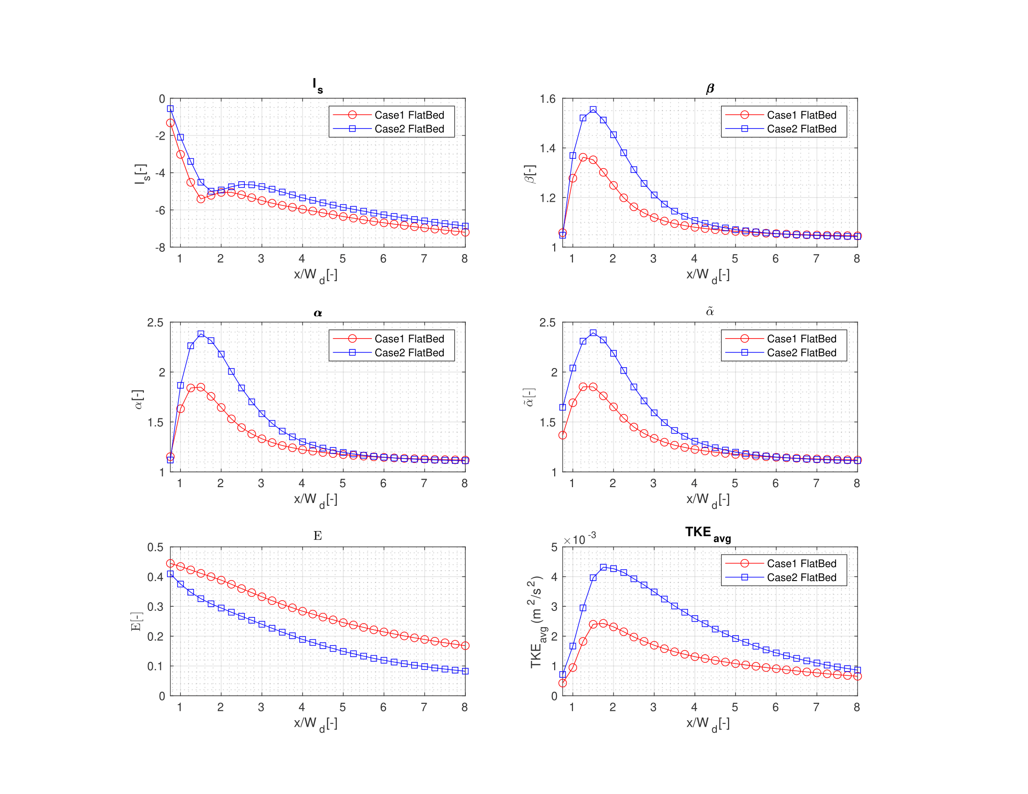
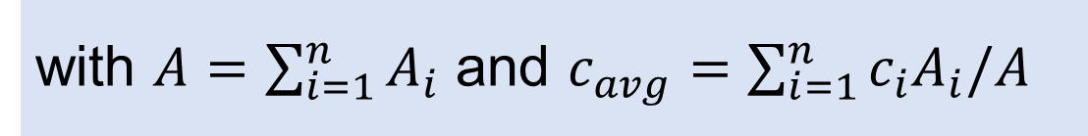
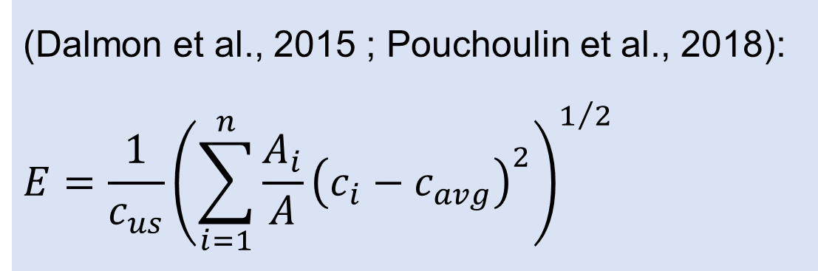
Mixing of passive scalar
Evolution of non-uniformity of mixing parameter E along downstream main channel
(Dalmon et al., 2015 ; Pouchoulin et al., 2018):
$$E=\frac{1}{c_{us}}{\left(\sum_{i=1}^{n}{\frac{A_{i}}{A}{\left(c_{i}−c_{avg}\right)}^{2}}\right)}^{1/2}$$
with $A=\sum_{i=1}^{n}{A_{i}}$ and $c_{avg}=\sum_{i=1}^{n}{{c_{i}A}_{i}/A}$
Case2 (tributary dominant case) : lowest E, hence higher degree of mixing.
Notes:
To quantify the non-uniformity of mixing downstream of the confluence, a dimensionless parameter E is adopted in the present work. This parameter is calculated from the time-averaged concentrations.
When flows are completed mixed, the E parameter would assume a zero value. However, the length of the downstream main channel in the present work is not long enough to attain complete mixing.
The figure shows the evolution of E along the downstream main channel. The tributary-dominant case has a higher degree of mixing in the whole downstream channel.

Slide 10
Discussion and cONCLUSIONS
Case 2 (tributary-dominant case):
Separation zone shear layer and mixing interface move to outer bank, due to larger lateral velocities in Confluence Hydrodynamics Zone.
Intensities of turbulence and secondary flow enhanced, leading to higher degree of mixing.
Present LES results confirm RANS results of Tang et al. (2018).
Present work: flat bed cases.
Further research: do conclusions still hold for degraded bed cases ?
Notes:
Based on the results shown on the previous slides, we can interpret these observations as follows.
In the tributary-dominant case, the shear layer and the mixing interface move to the outer bank, due to the larger lateral velocities in the Confluence Hydrodynamics Zone. Moreover, the intensities of turbulence and secondary flow are enhanced, leading to a higher degree of mixing, as compared to the case with a dominance of the incoming flow from the main channel.
Finally, it is worth pointing out that the present work has focused on the flat bed case. Further research is needed to find out whether the present conclusions also hold in degraded bed cases.

Slide 11
Thank you
for your attention
Tian Jin
Hydraulics Laboratory, Dep. Civil Engineering, Ghent University
Tian.Jin@UGent.be
Acknowledgements:
HPC infrastructure of Ghent University
doctoral research grant of China Scholarship Council (CSC)
co-funding by Special Research Fund (BOF) of Ghent University
Notes:
Thank you for your kind attention.

