Slide 1
COUPLING SORPTION AND BIODEGRADATION OF EMERGING ORGANIC COMPOUNDS TO GEOCHEMICAL MODELING
A. Canelles; P. Rodríguez-Escales;
X. Sanchez-Vila
Grup d’Hidrologia Subterrània (GHS)
Universitat Politècnica de Catalunya-BarcelonaTech
Barcelona, Spain

Slide 2





INTRODUCTION
Understanding Emerging Organic Compounds removal in subsurface is complex…
SORPTION
BIODEGRADATION
EOC_{w}
First order degradation
EOC_{w}
$$\frac{∂[EO{C]}_{w}}{∂t}=−k[EOC]$$
TP₁
EOC
SOIL
TP₂
$$EOC_{w}+SOIL ↔EOC_{s}−SOIL$$
$$K_{d}=\frac{[EO{C]}_{s}^{∗}}{[EO{C]}_{w}^{∗}}$$
TP_{n}
1

Slide 3


INTRODUCTION
Understanding Emerging Organic Compounds removal in subsurface is complex…
SORPTION
BIODEGRADATION
EOC_{w}
First order degradation
EOC_{w}
But… it is not as simple…
Equilibrium is not always reached and geochemistry plays an importal role…
In SORPTION conditioning pH and ionic interactions
In BIODEGRADATION conditioning REDOX potential
$$\frac{∂[EO{C]}_{w}}{∂t}=−k[EOC]$$
TP₁
EOC
SOIL
TP₂
$$EOC_{w}+SOIL ↔EOC_{s}−SOIL$$
$$K_{d}=\frac{[EO{C]}_{s}^{∗}}{[EO{C]}_{w}^{∗}}$$
TP_{n}
1

Slide 4
MOTIVATION
The goal of this work is to develop a numerical model that couples sorption and biodegradation processes for a mixture of EOCs to the global geochemistry of a soil-water system.
2

Slide 5
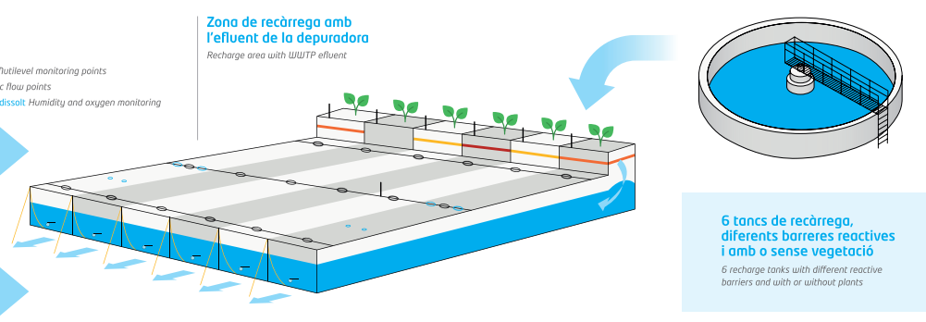
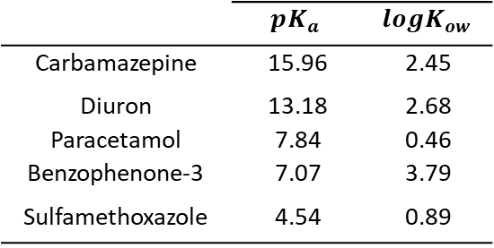
EXPERIMENTS
The experiments were based on the experimental Soil Aquifer Treatment of Palamós and reproduced three reactive barriers
Reactive barriers
Pilot recharge system
Valhondo et al. 2020 (Chemosphere)
3 column experiments
100 % sand
90 % sand
10 % compost
50 % sand
50 % compost
 | $$pK_{a}$$ | $$logK_{ow}$$
Carbamazepine | 15.96 | 2.45
Diuron | 13.18 | 2.68
Paracetamol | 7.84 | 0.46
Benzophenone-3 | 7.07 | 3.79
Sulfamethoxazole | 4.54 | 0.89
Waste Water
Pollutants
3
Modrzyński et al. 2021, WR

Slide 6
CONCEPTUAL MODEL
Canelles et al. 2021 (STOTEN)
1. FLOW TRANSPORT MODEL
2. GEOCHEMICAL MODEL
3. EOC’s FATE MODEL
Canelles et al. 2022 (submitted)
4

Slide 7





CONCEPTUAL MODEL
Canelles et al. 2022 (submitted)
1. FLOW TRANSPORT MODEL
2. GEOCHEMICAL MODEL
3. EOC’s FATE MODEL
PROCESS 1: SORPTION
PROCESS 2: BIODEGRADATION
MODEL 1A: Equilibrium sorption
MODEL 2A: First order degradation model decoupled from geochemistry
$$K_{d}=\frac{C_{i,s}}{C_{i, aq}}$$
$$\frac{dC_{i,aq}}{dt}=−k_{i}C_{i,aq}$$
MODEL 1B: Kinetic sorption/desorption
MODEL 2B: Biodegradation coupled to geochemical conditions
$$\frac{dC_{i, aq }}{dt}={−k}_{m}\left(C_{i,aq}−\frac{C_{i,soil}}{{k^{′}}_{d}}\right)$$
$$\frac{dC_{i,aq}}{dt}=−k_{i}C_{i,aq}F_{i}$$
These are the rates of the geochemical proce
$F_{i}=\frac{r_{m}}{r_{m}+q_{i}, m}$
5

Slide 8
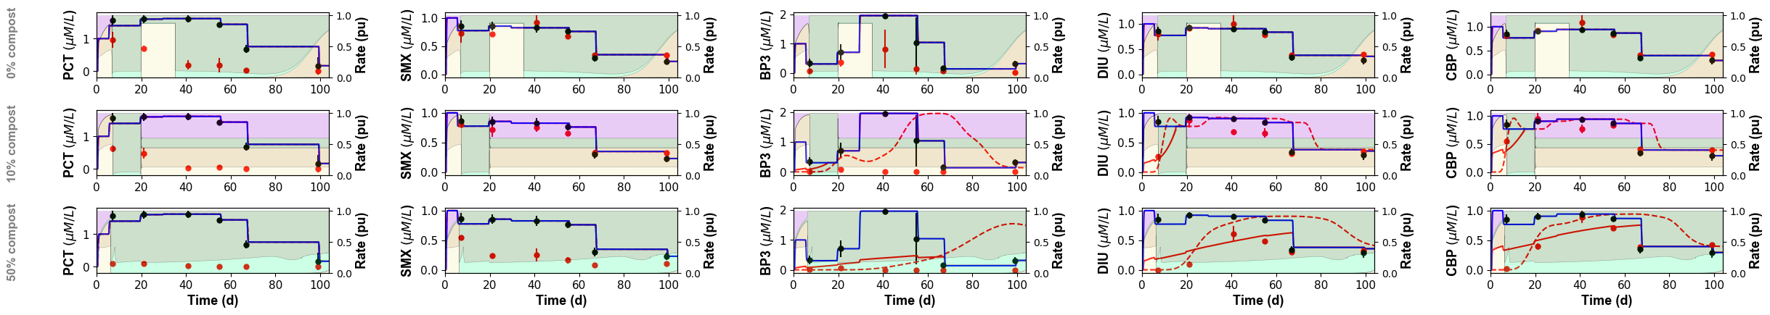
RESULTS
Modeling results
SORPTION
PARACETAMOL
SULFAMETHOXAZOLE
BENZOPHENONE-3
DIURON
CARBAMAZEPINE
100% SAND
10% COMPOST
50% COMPOST
Conservative transport model
Equilibrium sorption model
Kinetic sortion/desorption model
Inflow concentrations
Outflow concentrations
ONLY SORPTION
Being kinetic sorption the best option
Diuron
Carbamazepine
6
Canelles et al., Submitted to Water Research

Slide 9
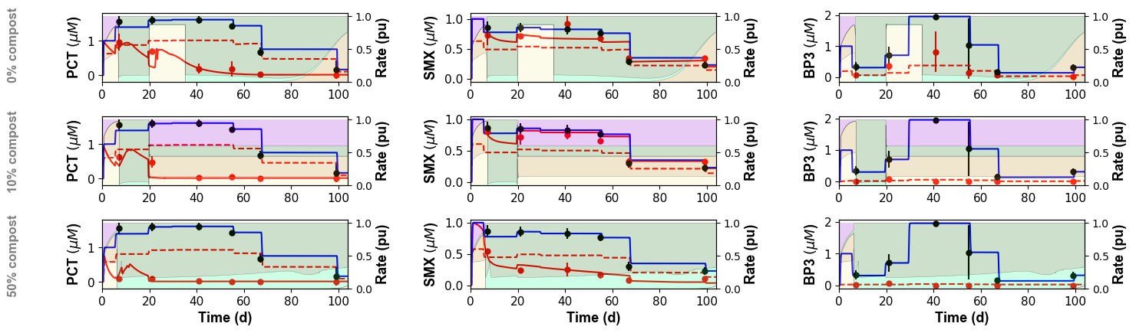
RESULTS
Modeling results
SORPTION + BIODEGRADATION
PARACETAMOL
SULFAMETHOXAZOLE
BENZOPHENONE-3
Conservative transport model
First order degradation model
Degradation model coupled to geochemistry
Inflow concentrations
Outflow concentrations
Aerobic conditions
Denitrification
ONLY BIODEGRADATION
Being first order coupled to geochemistry the best option
Paracetamol
Sulfamethoxazole
7
Canelles et al., Submitted to Water Research

Slide 10
COUPLING SORPTION AND BIODEGRADATION OF EMERGING ORGANIC COMPOUNDS TO GEOCHEMICAL MODELING
A. Canelles; P. Rodríguez-Escales;
X. Sanchez-Vila
paula.rodriguez.escales@upc.edu
Grup d’Hidrologia Subterrània (GHS)
Universitat Politècnica de Catalunya-BarcelonaTech

